Slide 1
COMFORT LIFE
THE MODEN FURNITURE SHOP

Slide 2
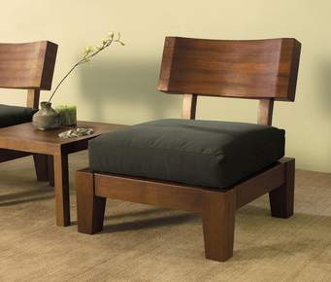
INTRODUCTION
The Old fashioned ways of buying furnitures was bit difficult and unsafe.
The new trend is online which provides flexibility and choices .

Slide 3
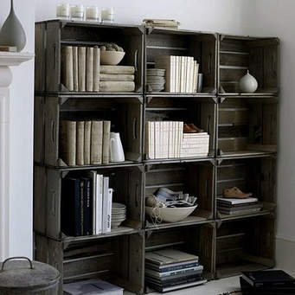
Problem Statement
The people are facing major problems in selecting the furnitures.
This app helps the consumers a wide variety of choices in selecting thier needs.

Slide 4
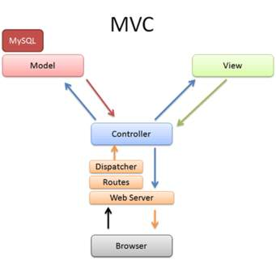
Architecture
Model View &Control method is used here.

Slide 5
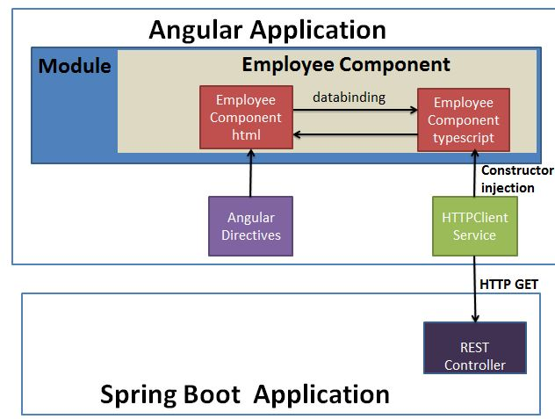

Slide 6
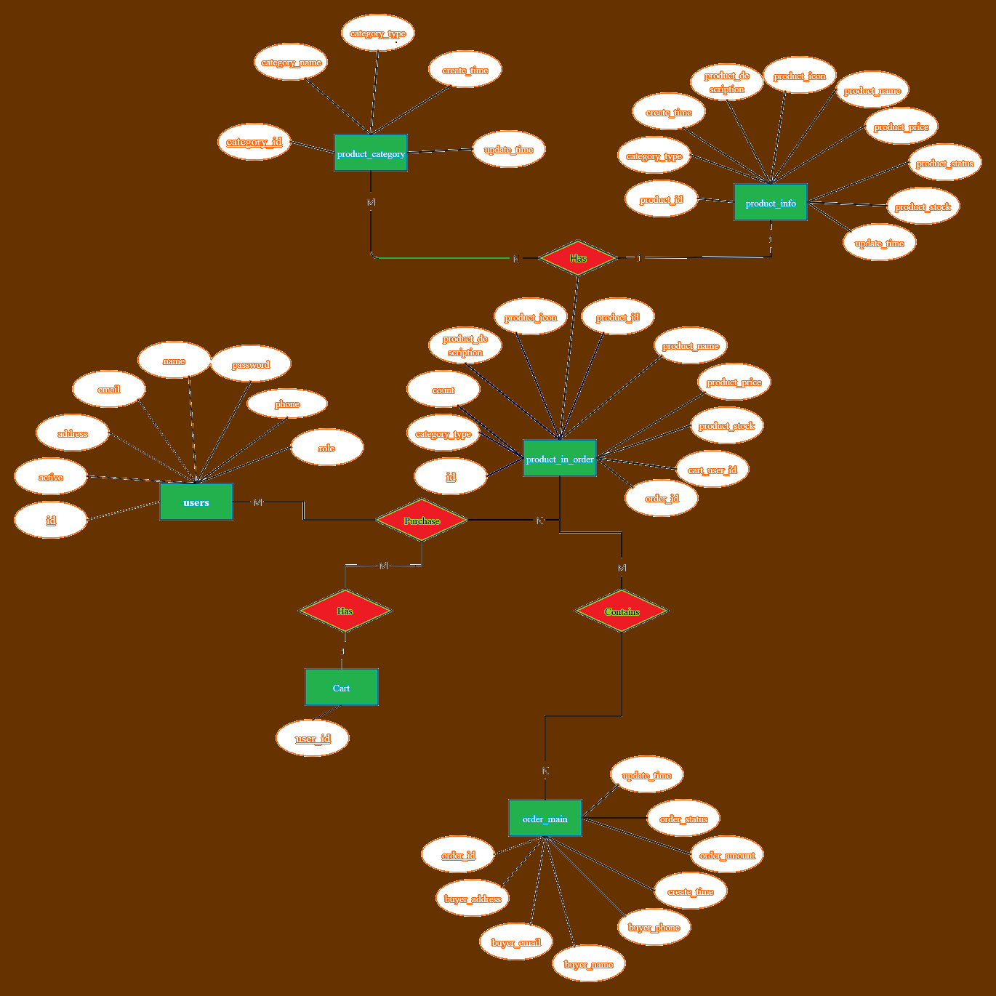
ER diagram

Slide 7
Tools Used
The Major Tools used in this project is:
Eclipse
Sublime Text
Nodejs
MySql

Slide 8
Work flow of the applications

Slide 9
CONCLUSION
THANK YOU UPASANA MAM

