Slide 1
MARKET

Slide 2
What is Market?
A market is a place where buyers and sellers can gather to facilitate the exchange of goods and services.
The market may be physical like a retail outlet, where people meet face-to-face, or virtual like an online market, where there is no direct physical contact between buyers and sellers.

Slide 3
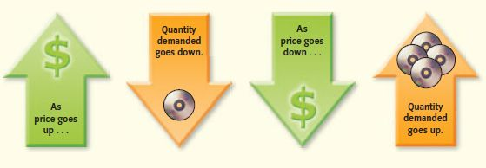
What is Demand?
Quantities of a particular good or service consumers are willing and able to buy at different possible prices.
Consumers buy more of a good when its price decreases and less when its price increases.

Slide 4
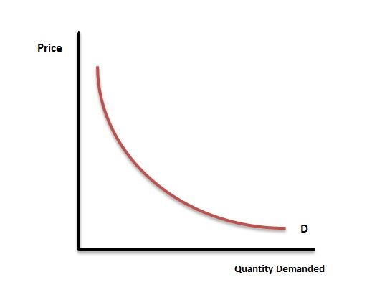
The Demand Curve

Slide 5
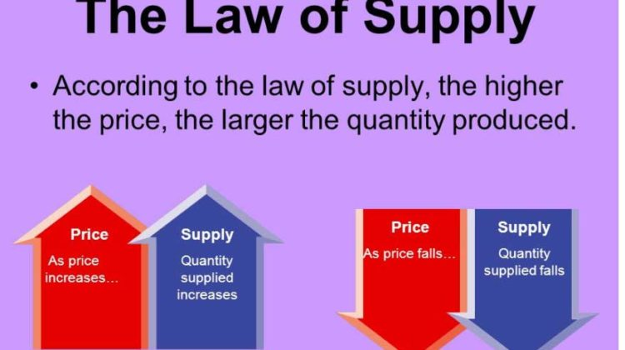
What is Supply?
Supply is an economic term that refers to the amount of a given product or service that suppliers are willing to offer to consumers at a given price level at a given period.
When the price of a product is low, the supply is low. When the price of a product is high, the supply is high.

Slide 6
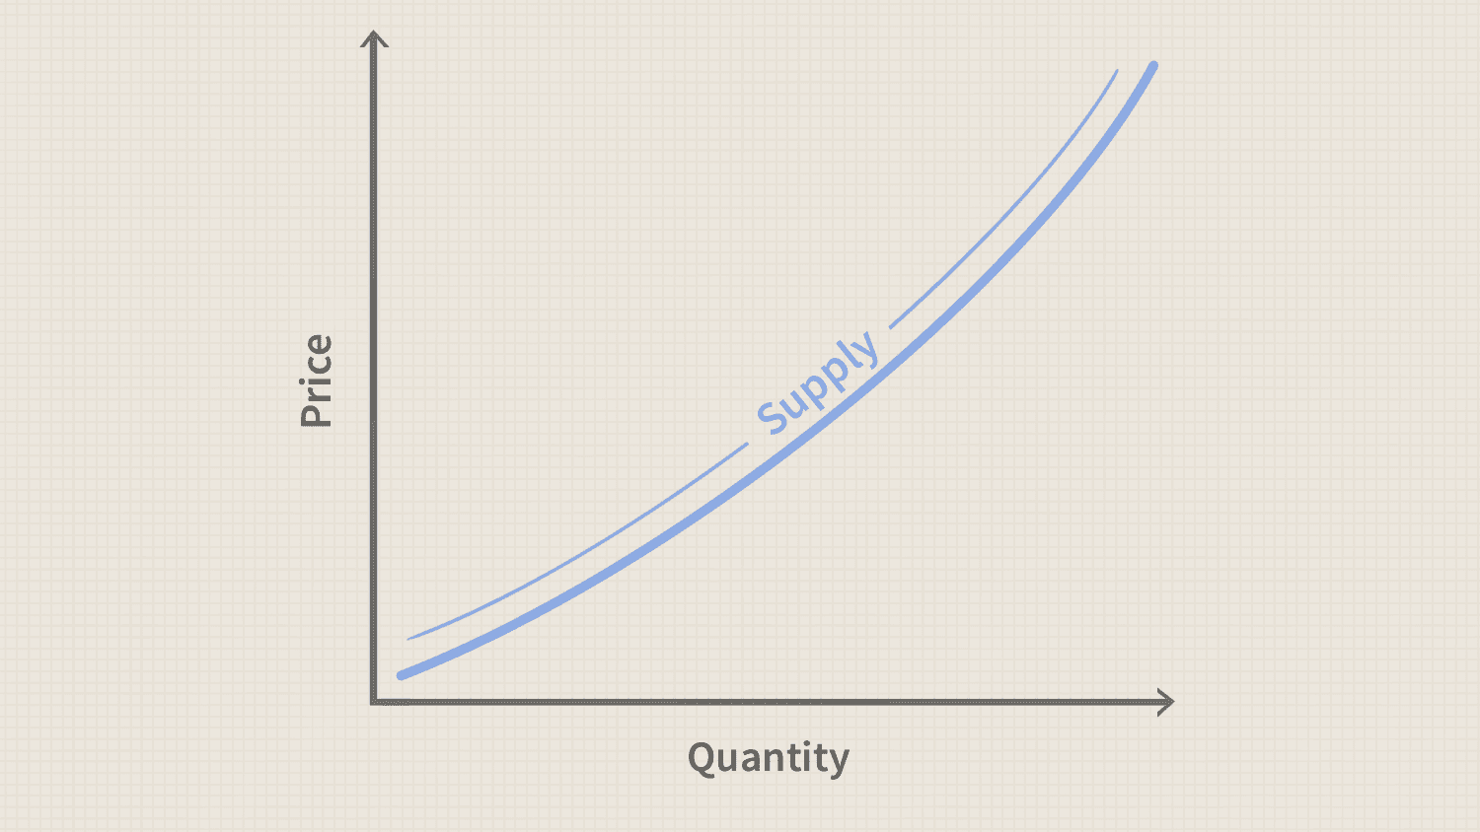
The Supply Curve

Slide 7
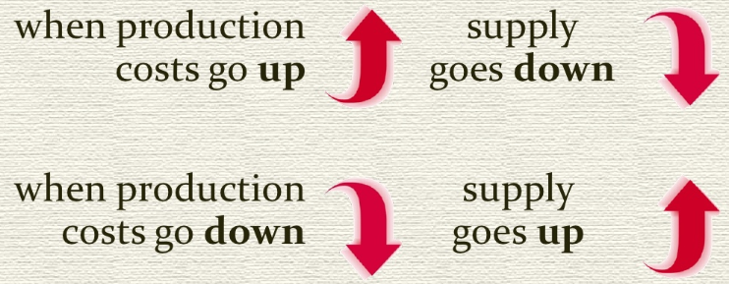
Factors of Supply
Cost of inputs
Change in the number of sellers in the market
More sellers in the market increase supply
Fewer sellers in the market decrease supply

Slide 8
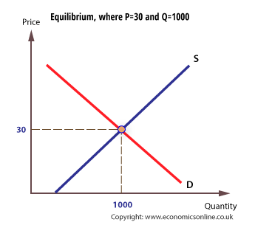
Market Equilibrium
Market equilibrium is a market state where the supply in the market is equal to the demand in the market.

