Slide 1

AI Tutor & Student Support System
An AI-powered learning and interview preparation system designed for personalised education at scale

Slide 2
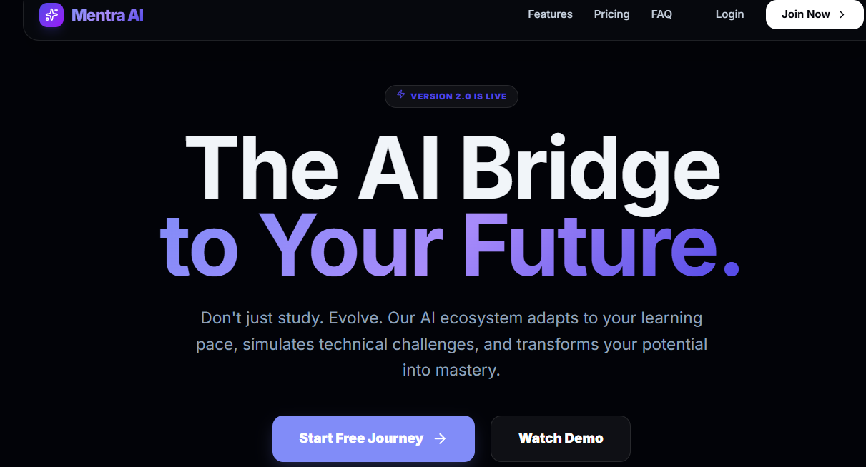

Why AI in Education?
The Challenge
The Opportunity
Traditional education systems deliver the same content to every student, regardless of their pace, strengths, or gaps. There is no real-time feedback, no personalised evaluation, and no structured preparation for real-world interviews.
AI can diagnose individual weaknesses instantly
Automated evaluation removes subjectivity and delay
Personalised paths accelerate genuine learning
Interview simulation builds real-world confidence
Students graduate without knowing where they truly stand — academically or professionally.

Slide 3
Project Objectives
Smart Quiz Generation
AI-Based Evaluation
Weakness Detection
Dynamically generate subject-specific MCQs and open-ended questions tailored to the student's level.
Automatically score and analyse student responses using rule-based logic combined with large language models.
Identify topic-level gaps from quiz performance and highlight areas requiring focused revision.
Interview Preparation
Performance Analytics
Simulate role-based technical interviews with real-time AI feedback and a consolidated performance summary.
Track progress across subjects and roles with rich visual dashboards and trend charts.

Slide 4
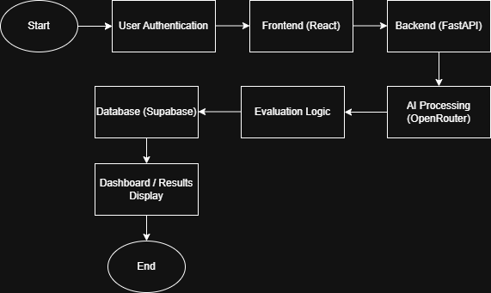
System Architecture Overview
Key Technologies
React
FastAPI
Interactive frontend UI with minimal setup
High-performance Python backend REST API
OpenRouter
Supabase
AI model access via DeepSeek LLM
Scalable PostgreSQL cloud database

Slide 5
Core Features at a Glance
Quiz Mode
Interview Mode
Dashboard Analytics
Subject-wise MCQ + open-ended AI-evaluated quizzes
Role-based technical interview simulation with AI coaching
Visual breakdown of performance by subject and role
AI Evaluation
Weakness Detection
Hybrid rule-based and LLM scoring with structured feedback
Pinpoint topic-level gaps and deliver targeted recommendations

Slide 6
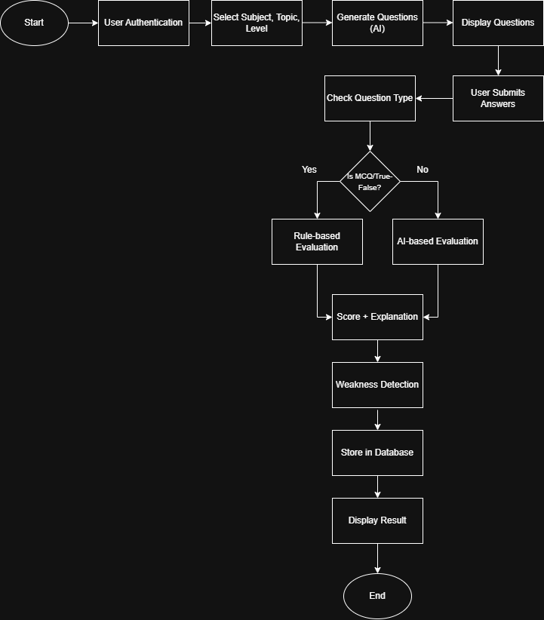
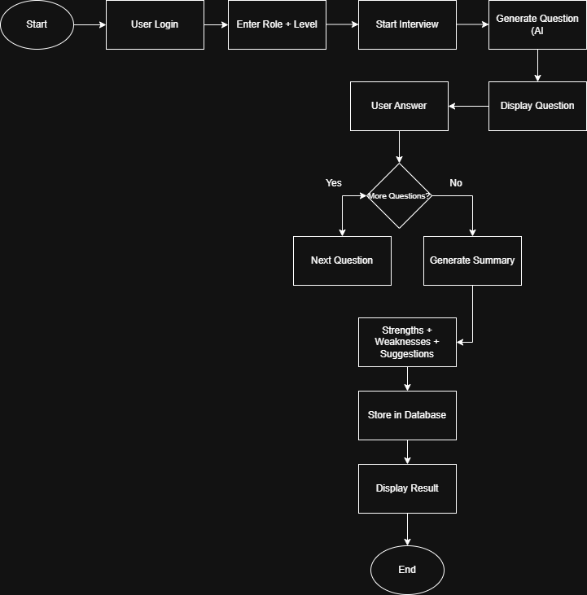
Quiz Mode & Interview Mode Flow
Quiz Mode
Interview Mode

Slide 7
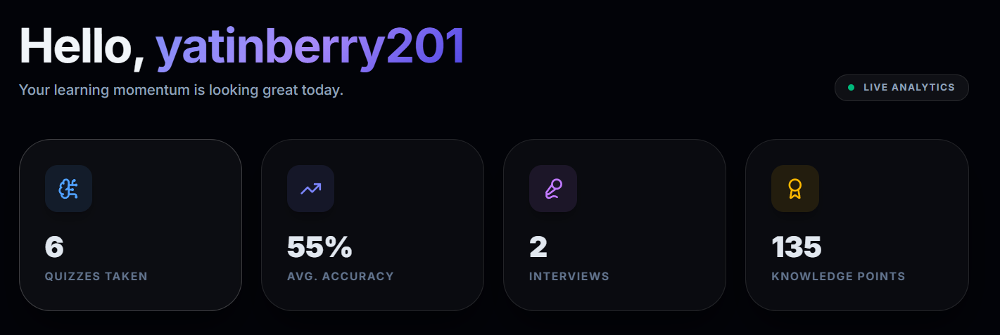
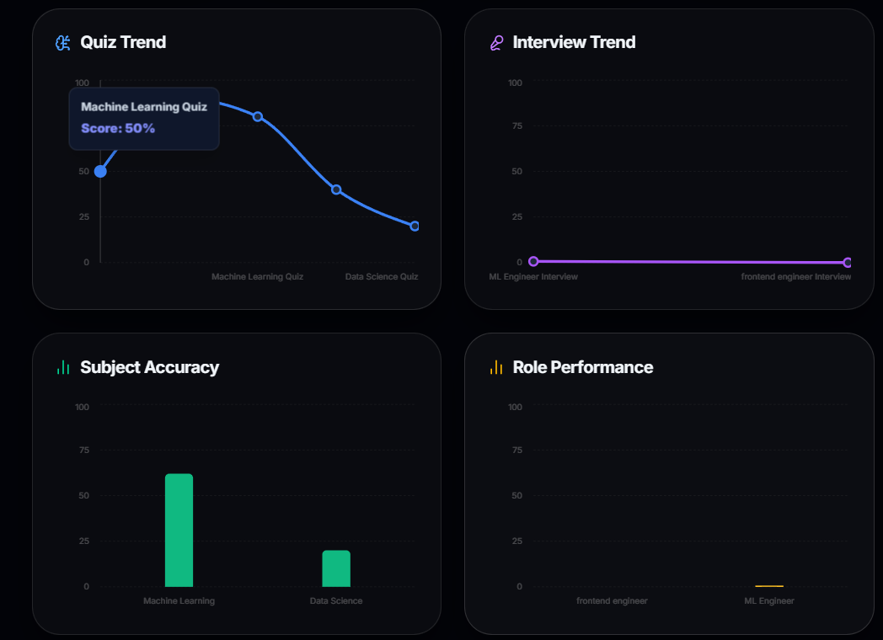
Performance Dashboard
Subject-Wise Stats
Role -Wise Stats
View scores, accuracy rates, and weakness flags broken down by topic for every quiz attempted
Track interview performance across different job roles — compare confidence levels and scores over time
Charts & Analytics
Interactive bar charts, trend lines, and radar graphs give students a clear picture of their growth trajectory

Slide 8

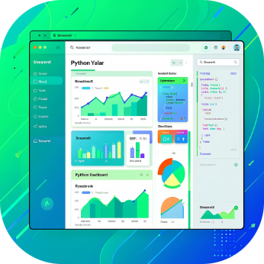


Technologies Used
Python & FastAPI
React
OpenRouter + DeepSeek
Supabase
Core backend language with FastAPI for building fast, asynchronous REST APIs with automatic documentation
Rapid, interactive frontend for data-driven applications — no JavaScript required, pure Python UI
Open-source Firebase alternative offering a managed PostgreSQL database with real-time capabilities and REST APIs
Unified AI API gateway providing access to DeepSeek LLM for question generation and intelligent evaluation

Slide 9
Advantages, Limitations & Future Scope
✅ Personalised Learning
✅ Instant AI Feedback
✅ Interview Readiness
Role-specific simulation bridges the gap between academic knowledge and job-market expectations
Every student receives questions and feedback tailored to their unique performance profile
No waiting — evaluation and coaching are delivered immediately after each response
🚀 Future Scope
User Authentication
Secure login system with individual progress
tracking across sessions
Voice-Based Interviews
⚠️ Model Accuracy
⚠️ API Dependency
Speech-to-text integration enabling fully spoken
interview simulations
Evaluation quality is bounded by the underlying LLM's capabilities and prompt sensitivity
System availability depends on third-party AI API uptime and rate limits
Adaptive Difficulty
Dynamic question difficulty that automatically
adjusts based on real-time student performance

Slide 10
Conclusion
This project bridges the gap between learning and evaluation by combining AI-powered quiz generation, intelligent assessment, and interview simulation. It provides a complete ecosystem for practice, feedback, and improvement, demonstrating how modern AI tools can revolutionize education and skill development.

Slide 11
Thank You!

