Slide 1
STRINGS
UNIT-4

Slide 2
Collection of characters- string
SINGLE CHARACTER –’ ‘
A group characters is called a STRING- “ “
A string of constants is actually a 1 D array of characters terminated by a ‘\0’ string- NULL string
ASCII VALUE- saves
int a[3]= {1,34,67}; a[0] a[1]a[2]
Eg- char name[]={‘A’, ‘B’, ’H’, ’I’, ’N’, ’A’, ’V’, ‘\0’};
or
EG- char name =“ABHINAV”; // no need for null string
A | B | H | I | N | A | V | \0

Slide 3
Each charc will occupy 1 byte of memory
ASCII value of NULL= 0
All the characters will be stored in a contiguous memory location.
Eg= char name[10]={‘A’, ‘B’, ’H’, ’I’, ’N’, ’A’, ’V’, ‘\0’};
END OF THE STRING END OF THE CHARACTER ARRAY
Length of an array= when the length of the string is calculated then the spaces are also counted in the string
char name =“ABHINAV KAPOOR”; LENGTH= 13+1=14
A | B | H | I | N | A | V | \0 | \0 | \0

Slide 4
Eg #include<string.h>
#include<conio.h>
#include<stdio.h>
void main()
{
char name[]= “ABHINAV”;
int i=0;
clrscr();
while(i<=6)
{
printf(“%c”,name[i]);
i++;
}
}

Slide 5
Eg #include<string.h>
#include<conio.h>
#include<stdio.h>
void main()
{
char name[]= “ABHINAV”;
int i=0;
clrscr();
while(name[i] !=‘\0’)
{
printf(“%c”,name[i]);
i++;
}
}

Slide 6
Eg #include<string.h>
#include<conio.h>
#include<stdio.h>
void main()
{
char name[]= “ABHINAV”;
clrscr();
printf(“%s”,name);
}

Slide 7
Eg #include<string.h>
#include<conio.h>
#include<stdio.h>
void main()
{
char name[]= “ABHINAV”;
int i=0;
char *ptr;
clrscr();
ptr=&name; // base address
while(*ptr !=‘\0’) // *(&name[1])
{
printf(“%c”,*ptr); //*(&name[1]) - ‘A’ B
ptr++;
}
}

Slide 8
Drawback of scanf()
Cannot read a multiword string
Does not considers a blank space
It discards the string or strings after a blank space.
To overcome this problem 2 string functions can be used- gets() and puts()
Since scanf() cannot read multiword string printf() also cannot display a multiword string read by scanf()
Name= Aakanksha
Printf(”%s”,name)

Slide 9
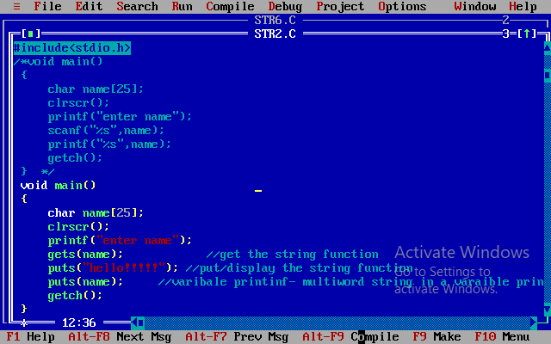

Slide 10
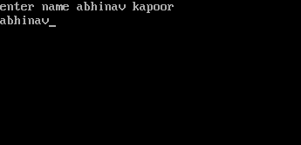

Slide 11
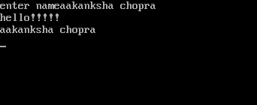

Slide 12
Different between reading and writing function
Reading() | Writing()
scanf() | printf()
gets() | puts()
getch() | -
getche()- e stands for echo | -
getchar() | putchar()

Slide 13
getch() vs getche()
Getch()- alternative of getchar(), unlike getchar(), getch() waits for a keypress after which it returns immediately.
getche()- similar to getch(), but getche() echos the character on the screen. It returns character read from the keyboard.

Slide 14
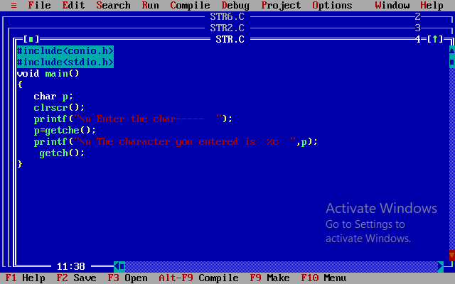

Slide 15
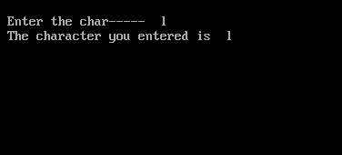

Slide 16
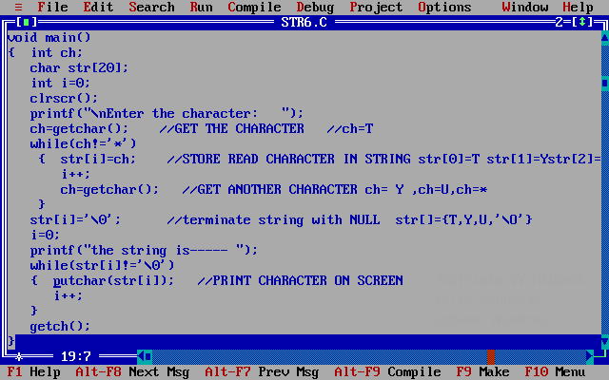
putchar() vs getchar()

Slide 17
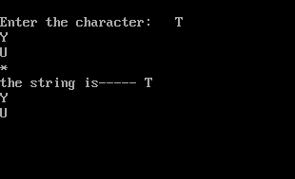

Slide 18
STRING
MANIPULATION
FUNCTIONS

Slide 19
strcat()- concatenates two strings
SYNTAX: char *strcat(char *str1, const char *str2);
void main()
{ char str1[50]=“PROGRAMMING ”;
char str2[]=“IN C”;
strcat(str1,str2);// append str2 at the end of str1
printf(“\n str1 : %s”,str1);
}
OUTPUT
str1 : PROGRAMMING IN C

Slide 20
strncat()- concatenates two strings upto ‘n’ no. of characters
void main()
{ char str1[50]=“PROGRAMMING”;
char str2[]=“ IN C”;
strncat(str1,str2,3);// append str2 at the end of str1
printf(“\n str1 : %s”,str1);
printf(“\n str2 : %s”,str2);
}
OUTPUT str1 : PROGRAMMING IN
str2 : IN C
SYNTAX:
char *strncat(char *str1, const char *str2, int n);

Slide 21
strchr()- searches for first occurrence of a character
void main()
{ char str1[50]=“PROGRAMMING IN C”;
char *pos;
pos=strchr(str1, ‘N’);
if(pos)
printf(“\n character found at position : %d”,pos);
else
printf(“the character is not found”);
}
OUTPUT
SYNTAX:
char *strchr(const char *str1, char c);

Slide 22
strcmp()- compare 2 strings
void main()
{ char str1[50]= “Jerry”;
char str2[]=“Ferry”
int i,j,k;
i=strcmp(str1,”Jerry”); //returns 0
j=strcmp(str2,”Aerry”); //70-65=5
k=strcmp(str1,”JerryBoy”); //0-66 =-66// SPACE 0-32=-32
printf(“%d %d %d”,i,j,k);
} OUTPUT i= 0 j=5 k=-66
SYNTAX:
int *strcmp(const char *str1, const char str2);

Slide 23
strncmp()- compare 2 strings upto ‘n’ no of characters
void main()
{ char str1[50]= “Jerry”;
char str2[]=“Ferry”
int i,j;
i=strncmp(str1,”JerRy”,3); // returns 0
j=strncmp(str2,”Aerry”,1); // F-A= 5
printf(“%d %d ”,i,j);
} OUTPUT i= 0 j=5
SYNTAX:
int *strncmp(const char *str1, const char *str2, int n);

Slide 24
strcpy()-copy two strings
SYNTAX:
char *strcpy( char *str1, const char *str2);
void main()
{ char str1[15], str2[15]=“Hello”,str3[15]=“pls wake up”;
strcpy(str1,str2); //HELLO
strcpy(str2,str3); //pls wake up
printf(“%s ”,str1); //HELLO
printf(“%s ”,str2); //plz wake up
printf(“%s ”,str3); //plz wake up
} OUTPUT-

Slide 25
strlen()-returns the length of the string which includes spaces.
void main()
{ char str1[15]=“Bombay”;
int len1, len2;
len1=strlen(str1);
len2=strlen(“Tom & Jerry”);
printf(“length of str1=%d”,len1); //6
printf(“length of Tom & Jerry=%d”,len2); //11
}
OUTPUT-
SYNTAX:
int *strlen(const char *str);

Slide 26
strstr()-this function helps find first occurrence of string str2 in the string str1
void main()
{ char str1[]=“PROGRAMMING IN C”;
char str2[]=“ING”;
char *ptr;
ptr=strstr(str1,str2); “ING”
if(ptr)
printf(“\n Substring found”);
else
printf(“\n substring not found”);
}
OUTPUT-
SYNTAX:
char *strstr(const char *str1, const char *str2);

Slide 27
strrev()-reverse a string
void main()
{ char str1[]=“HAPPY”;
strrev(str1);
printf(“\n %s”,str1);
}
OUTPUT- YPPAH
SYNTAX:
char *strrev(char *str1);

Slide 28
Array of strings
Write a Program to read and print the names of n employees
#include<conio.h>
#include<stdio.h>
void main()
{ char name[5][10];
int i,x;
clrscr();
printf(“Enter the number of employees”);
scanf(“%d”,&x);

Slide 29
Cont…..
for(i=0;i<x;i++)
{ printf(“\n Enter %d number of employees name”,i+1);
fflush(stdin);
gets(name[i]);
}
printf(“\n Name of employees are--------”);
for(i=0;i<x;i++)
{ puts(name[i]);
}
getch();
}

Slide 30
Array of pointers to string
char *name[size];

Slide 31
Ques. Write a Program to sort the names of employees in ascending order. Give the names at run time
#include<conio.h>
#include<stdio.h>
void main()
{
char name[5][10], t[10];
int i,j,k;
clrscr();
printf(“Enter the number of employees”);
scanf(“%d”,&k);
for(i=0;i<k;i++)
{
printf(“\n Enter %d number of employees name”,i+1);
fflush(stdin);
gets(name[i]);
}

Slide 32
cont..
for(i=0;i<k;i++)
{ for(j=0;j<k-i-1;j++)
{ if(strcmp(name[j],name[j+1]>0)
{
strcpy(t,name[j]);
strcpy(name[j],name[j+1]);
strcpy(name[j+1],t);
}
}
}
printf(“\n Employees name is sorted order are--------“);
for(i=0;i<k;i++)
{
puts(name[i]);
}
getch();
}

