Slide 1
ARRAYS
Collection of different value in one variable – same datatype

Slide 2
AN ARRAY IS A COLLECTION OF SIMILAR KINDS OF DATA
Homogeneous in nature. A name given to a group of similar datatypes/quantities
Datatype var_name[size/dimension]; int f[7]; f[0] …. To f[6]
int c[7]; [7*2=14 bytes]== c[0] to c[6]--------- 1010 1012 1014
Array variable= subscripted variable
Index position – subscript value C
1. array is a collection of similar data types- it will be having all ints, all floats, all chars, etc.
Eg- float f[3]={1, ‘h’, 3.5}---not valid, f[0] to f[2]
2. all ints and floats are called array but all char collection is called string
int x[5] – array
float v[8]- array
char f[4]- string---array –similar type

Slide 3
All the elements of array should be of same type
First element always starts from a position 0 and ends on n-1
An array must be declared first i.e its type & dimension must be declared first. J=9; float j= 9.0;
Eg-- x[0]=6------------wrong
int x[5];
No matter how big array is it is always stored in contiguous/continuous memory location
int c[100]; //200 byte------ c[0]=250; c[99]=34;

Slide 4
Array initialization(1D)
We can store values at run time or compile time
int num[6]= {2,4,12,5,45,5};
int n[]= {2,4,12,5,45,5};// initialized array in the same line, so you can skip the size of array.
float press[]={12.4,6.879,4.3};// floating array (4*3=12 bytes )
int arr[6]; //size
arr[0]=1;
arr[1]=2;
arr[2]=12;…….
5. auto int arr[6];
printf(“%d %d”,arr[2],arr[4]);====GV
Datatype var_name[size]= {value1, value2, vl3, vl4,……};
1 | 2 | 12 | 4 | 6 | 60

Slide 5
Void main()
{
int m;
static int i[6];
for(m=0;m<=5;m++) //m==1,2
printf(“%d”,i[m]);} //i[0], i[1] ,i[2]
i[0] | i[1] | i[2] | i[3] | i[4] | i[5]
0 | 0 | 0 | 0 | 0 | 0

Slide 6
ARRAY OUT OF BOUNDS- Bounds checking- unpredictable output
Void main()
{
int num[40]; // num[0]- num[39] correct num[40]----wrong
for(i=0;i<=100;i++) // 0-100 ---101 times
{
num[i]=i; // num[0]=0, num[39]=39
printf(“%d”,num[i]); //0,1,….39
}
}

Slide 7
Length of an array
Length= upperbound-lowerbound+1
int a[5]; 0 to 4
UB= 4 a[4]
LB =0 a[0]
length == 4-0+1= 5

Slide 8
10 -------------<10 0 to 9
10 ----- 11 12 14 - array out of bound// GV//unpredicatable
marks[0] | marks[1] | marks[2] | marks[3] | marks[4] | marks[5] | marks[6] | marks[7] | marks[8] | marks[9]
70 | 80 | 66 | 23 | 50

Slide 9
Practice questions-
Q1. WAP to find mean/avg of n numbers using arrays
Q2. WAP to print the position of the smallest of n numbers using arrays
Q3. WAP to find largest of n numbers using arrays
Q4. WAP to enter age of n workers and calculate their average age
Q5. WAP to enter n number of digits. Form a number using these digits….. N=3, 5,6,7 567 765 {5,6,7} {7,6,5}
Q6. WAP to find whether the array of integers contain duplicate number or not.

Slide 10
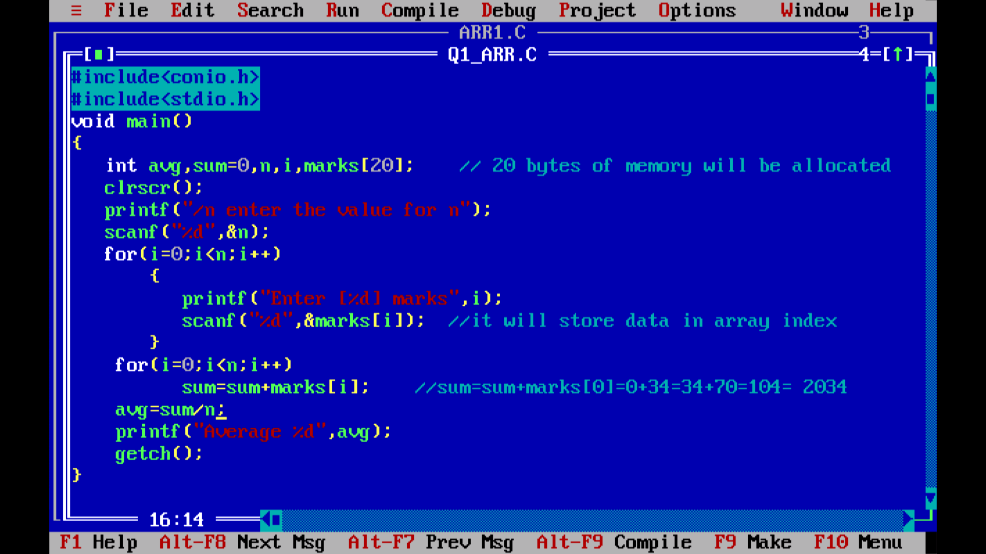
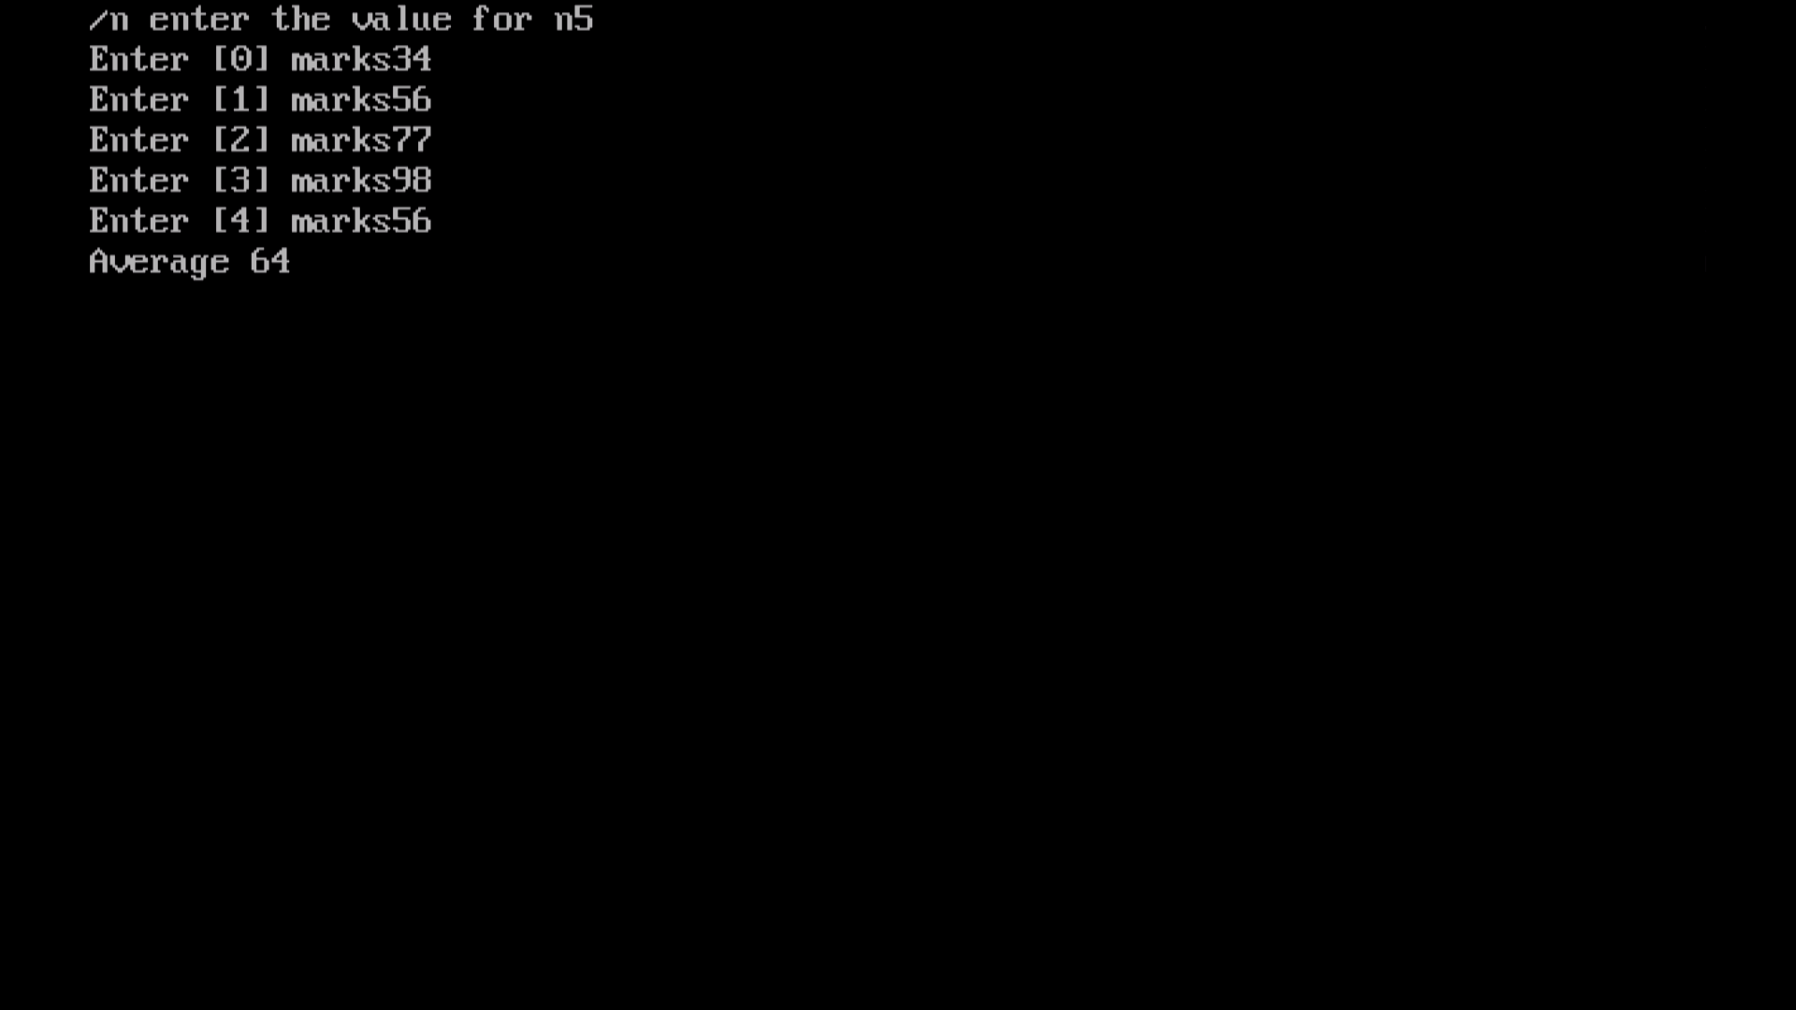

Slide 11
Passing array elements to a function
Array elements can be passed to function by calling the function value, or by reference. In call by value we pass values of array elements to the function, but in call be reference we pass address of the array elements to the function

Slide 12
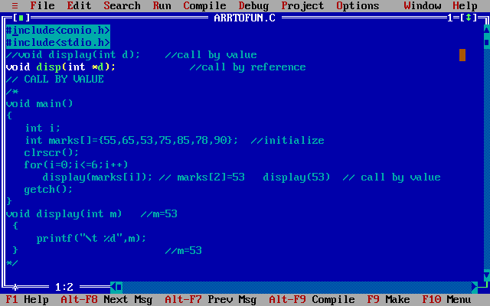
Call by value

Slide 13
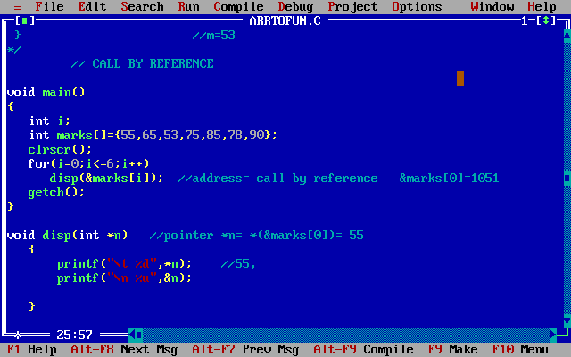
Call by reference

Slide 14
i++ i=0 =1
Adress++ int address 2 bytes float pointer 4 +
Int J= 1038
arr[0] Address=1034 | arr[1] | arr[2] | arr[3] | arr[4]
1 | 2 | 3 | 4 | 5

Slide 15
Address of a given variable
%u- address reading
int m=10
printf(“value at -%d”,m); //value of m- 10
printf(“address of m is =%u”,m); // address of m is=11908
int *n;
n=&m;
Printf(“%d”, n); //11908
Printf(“%d”,*n); //10 *(&m) =10
Printf(“%u”,&n);// 34345
Printf(“%u”,&m); //11908
Printf(“%u”,n); =11908
M=10
Address= 11908
N=&m
N=11908
Address of n= 34345

Slide 16
Passing an entire array to a function
1. passing individual elements to a function –CALL BY VALUE
2. passing address of individual elements to a function- CALL by reference.
3. passing an entire array to function call
Int r[7] 14 bytes = {,,,,,,,} arr
Or
Int r[0] – BASE ADDRESS/starting address
1012, 6= no . Of elements / last address
1022

Slide 17
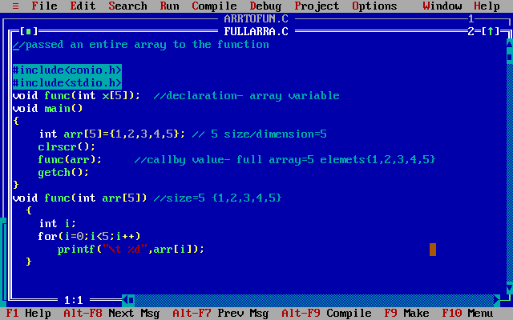

Slide 18
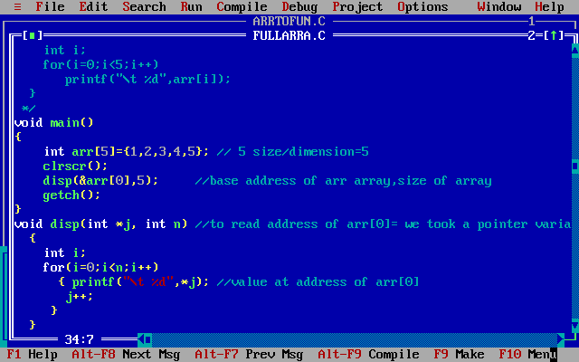
OR

Slide 19
Similar concept
arr[i], *arr , *(arr+i) , *(i+arr) , i[arr]
SAME OUTPUT
arr[i]= base address
*arr= base address
*(arr+i)= base address
*(i+arr)= base address
i[arr]= base address

Slide 20
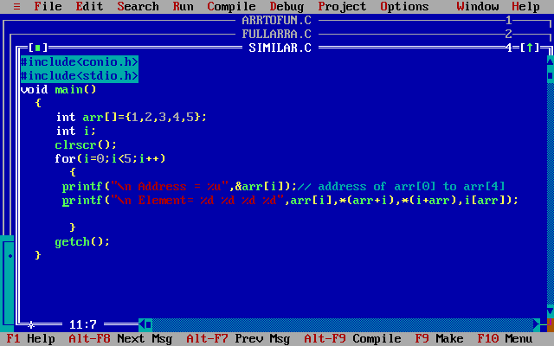

Slide 21
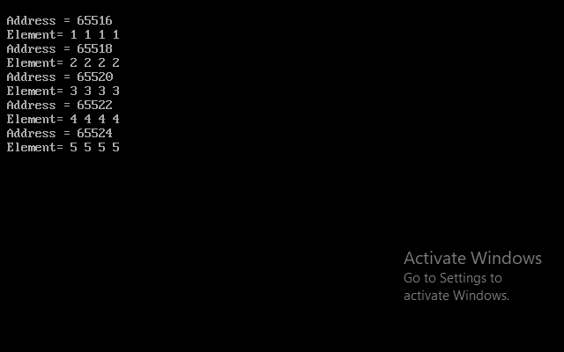
output

Slide 22
2D array- 2 Dimensional array
Matrix= Rows and columns [row_size] and [col_size]
It will have 2 subscripted values , one will be for row, second will be for column.
Datatype arr_name[row_size][col_size];
[2][2]- 2 rows and 2 columns== 4 values
2*2=4
1D- single , 1 subscripted value S[0]
Datatype arr_name[size]= {, , , , , ,};

Slide 23
While initializing 2D array it is necessary to mention the column dimension, whereas the row dimension can be skipped or it is optional-
Eg1 – int a[2][3]= {12,42,23,45,56,78};
a[0][0] a[0][1] a[0][2]
a[1][0] a[1][1] a[1][2]
int a[][3]= {12,42,23,45,56,78};
Eg 2. – int a[2][]= {12,42,23,45,56,78};(WRONG)
int a[][]= {12,42,23,45,56,78}; (WRONG)
INT A[25] TOTAL=50 BYTES (10 ELEMTS= 10*2) 20 BYTES == 30 BYTES ==== ‘\O’ null value
12 | 42 | 23
45 | 56 | 78
12 a[0][0] | 42 a[0][1] | 23 | 45 | 56 | 78
12 |  | 42 |  | 23 | \0
78 |  | \0 | \0 | \0 | \0

Slide 24
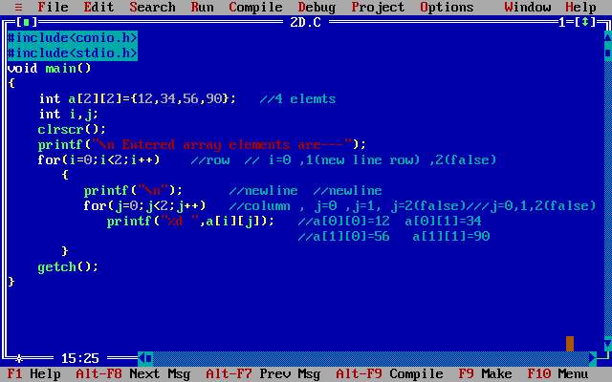
INITIALIZING 2D MATRIX

Slide 25
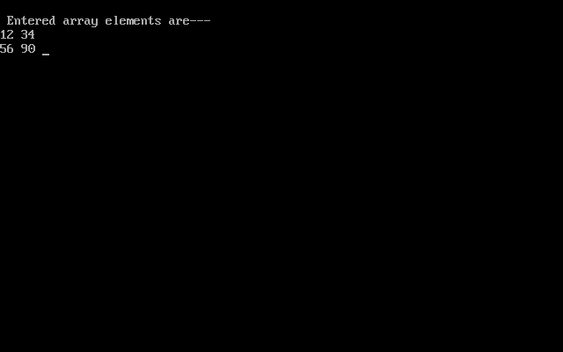
OUTPUT

Slide 26
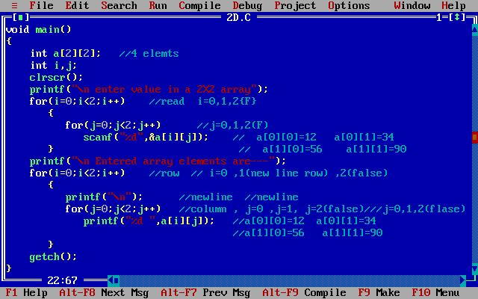
INPUTING VALUES IN A 2D ARRAY

Slide 27
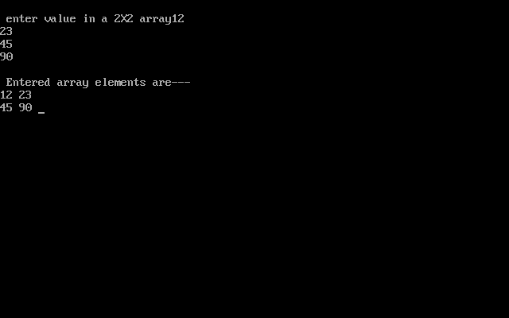
OUTPUT

Slide 28
PRACTICE QUESTIONS OF 2 D MATRIX
Q7. WAP to calculate sum of two mXn matrix. And store the sum in third mXn matrix.
C[m][n]= A[m][n] + B[m][n]
Q8. WAP to show multiplication of two mXn matrix. And store the multiply in third mXn matrix.
C[m][n]= A[m][n] * B[m][n]
Q9. WAP to transpose a 3X3 matrix.

Slide 29
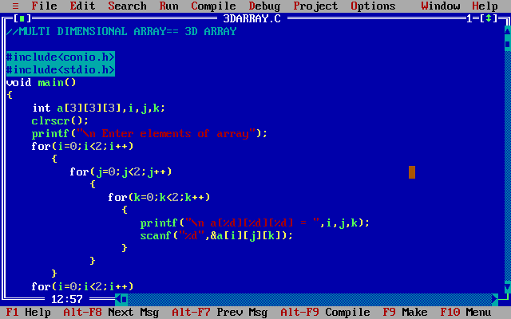
Multi-Dimensional Array- 3D

Slide 30
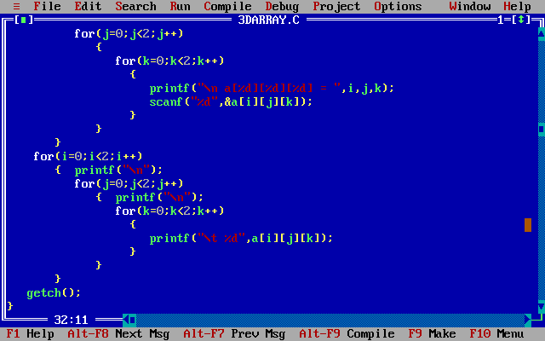

Slide 31
