Slide 1
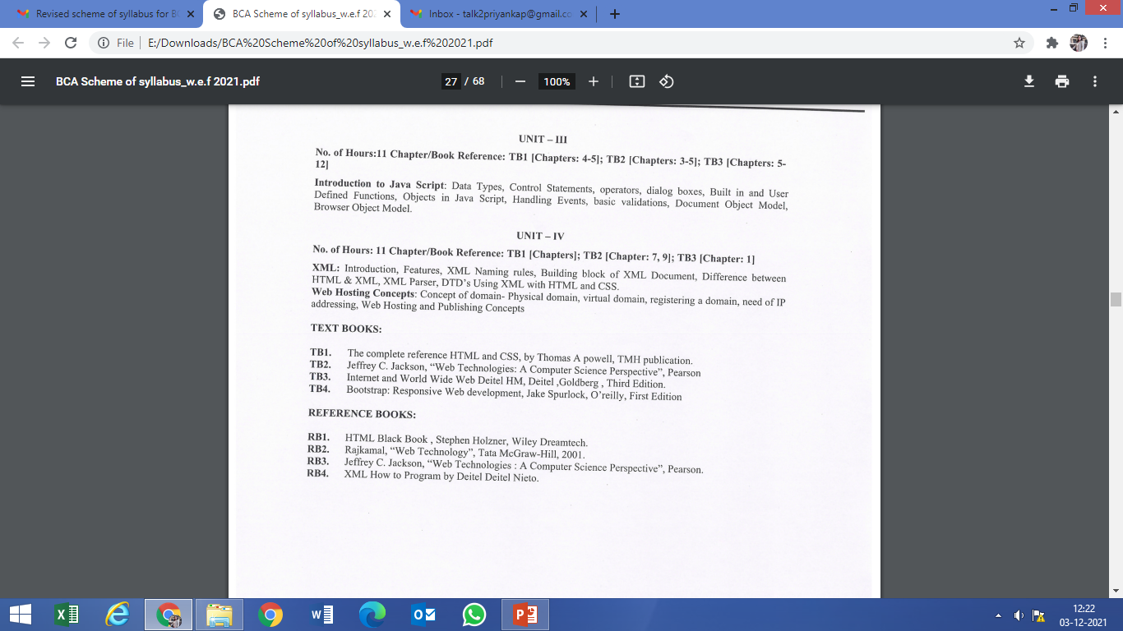
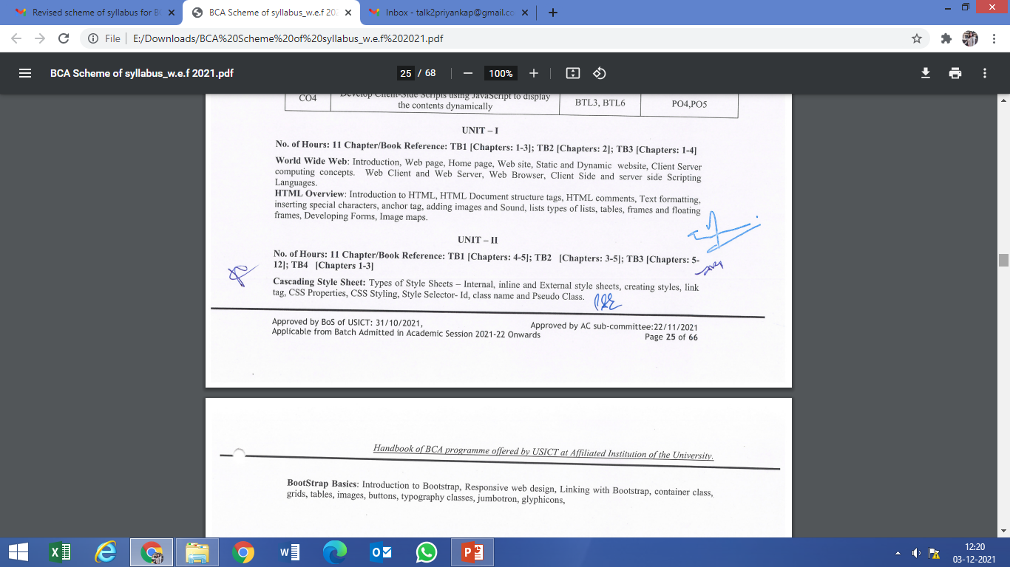
BCA 107- Web Technologies

Slide 2
Web : Basics
The Web is an Internet-based distributed information system.
Anyone with a computer connected to the Internet can easily retrieve information by giving a Web address or by simply clicking a mouse button.
The Web is a great way to disseminate information and making it available 24/7. Information can also be collected from Web users and customers through online forms.
Maintainers and administrators can control and update Web content from anywhere on the Web. All these make the Web a powerful tool for mass communication, e-business and e-commerce.

Slide 3
Web service companies offer free Web space and tools to generate simple personal or even business Web pages.
But, well-designed and professionally implemented websites are much more involved. Even then, expertly produced websites are still much more cost-effective than other means of mass communication.
For business and commerce, the cost of a website is negligible when compared to building and operating a brick-and-mortar office or store.
Once in-place, a website is a store that never closes and that is very attractive. People take great pains in building an office or store to project the right image and to serve the needs of customers.

Slide 4
Major Components of Web
Networks—The local-area and wide-area networks connecting computers world-wide forming the Internet.
• Clients—Web browsers that enable end-users to access the Web.
• Servers—Constantly running programs that serve up information to the Web.
• Documents—Web pages, mostly coded in HTML, that supply information on the Web.
• Protocols—The Hyper Text Transfer Protocol HTTP that Web clients and servers use to talk to one another and the TCP/IP (Transmission Control Protocol) on which HTTP depends.
A basic understanding of these components and how they work together lays a good foundation for Web Design and Programming.

Slide 5
Networking
A computer network is a high-speed communications medium connecting many, possibly dissimilar, computers or hosts. A network is a combination of computer and telecommunication hardware and software.
The purpose is to provide fast and reliable information exchange among the hosts and between processes, or executing programs, on different hosts. The Web is one of the most widely used Internet services. Others include: e-mail, file transfer, audio/video streaming, and login to remote hosts, just to name a few. The Web also provides convenient ways to tap into these other Internet services.

Slide 6
Networking Protocols
In order for programs and computers from different vendors, under different operating systems, to communicate on a network, a detailed set of rules and conventions must be established for all parties to follow. Such rules are known as networking protocols.
Protocols govern such details as
• address format of hosts and processes
• data format
• manner of data transmission
• sequencing and addressing of messages
• initiating and terminating connections
• establishing remote services
• accessing remote services
• network security

Slide 7
Thus, in order for a process on one host to communicate with another process on a different host, both processes must follow the same protocol. A protocol is usually viewed as having logical layers that come between the process and the networking hardware. The corresponding layers on different hosts perform complementary tasks to make the connection between the communicating processes.
Among common networking protocols, the Internet Protocol (IP) suite1 is the most widely used. IP is the basic protocol for the Internet which is, by far, the most predominant worldwide network. The Web is a service that uses HTTP (the Hyper Text Transfer Protocol), which is based on Internet protocols.

Slide 8
The Internet
Internet is a global network that connects IP networks. The linking of computer networks is called internetworking, hence the name Internet. Internet links all kinds of organizations around the world–universities, government offices, corporations, libraries, supercomputer centers, research labs, and even individual homes. The number of connections on the Internet is large and growing rapidly.
The Internet is a global network of billions of computers and other electronic devices. With the Internet, it's possible to access almost any information, communicate with anyone else in the world, and do much more.

Slide 9
Evolution of Internet
The Internet evolved from the ARPANET2 , a US Defence Advanced Research Projects Agency (DARPA) sponsored network that developed the IP as well as the higher-level TCP (Transmission Control Protocol) and UDP (User Datagram Protocol) networking protocols. The architecture and protocol were designed to support a reliable and flexible network that can endure war-time attacks.
The transition of ARPANET to Internet took place in the late 1980s as NSFNET, the US National Science Foundation’s network of universities and supercomputing centres, helped create an explosive number of IP-based local and regional networks and connections. The NSFNET remains an important component of Internet. The Internet is so dominant now that it has virtually eliminated all historical rivals such as Bitnet and Decnet.

Slide 10
The Internet Corporation for Assigned Names and Numbers (ICANN, www.icann.org) is a non-profit organization responsible for IP address space allocation, protocol parameter assignment, domain name system management, and root server system management functions.
One of the best features of the Internet is the ability to communicate almost instantly with anyone in the world. Email is one of the oldest and most universal ways to communicate and share information on the Internet, and billions of people use it. Social media allows people to connect in a variety of ways and build communities online.
There are many other things you can do on the Internet. There are thousands of ways to keep up with news or shop for anything online. You can pay your bills, manage your bank accounts, meet new people, watch TV, or learn new skills. You can learn or do almost anything online

Slide 11
Network Addresses
An address to a host computer is like a phone number to a telephone. Every host on the Internet has a unique network address that identifies the host for communication purposes. The addressing scheme is an important part of a network and its protocol. For the Internet, each host has a unique IP address represented by 4 bytes in a 32-bit quantity.
For example, monkey, a host at Kent State, has the IP address 131.123.35.92 (Figure 1.1). This dot notation (or quad notation) gives the decimal value (0 to 255) of each byte3 . The IP address is similar to a telephone number in another way: the leading digits are like area codes and the trailing digits are like local numbers.

Slide 12
Because of their numerical nature, the dot notation is easy on machines but hard on users. Therefore, each host also has a unique domain-based name composed of words, rather like a postal address.
With the domain names, the entire Internet host name space is recursively divided into disjoint domains.
edu, the top-level domain (TLD) for educational institutions. Other TLDs include org (non-profit organizations), gov (government offices), mil (military installations), com (commercial outfits), net (network service providers), uk, (United Kingdom), cn (China), etc.
The ICANN accredits domain name registrars who register domain names for clients so they stay unique. All network applications accept a host address given either as a domain name or an IP address. In fact, a domain name is first translated to a numerical IP address before being used.

Slide 13
Web Page
Web Page is a document available on world wide web. Web Pages are stored on web server and can be viewed using a web browser.
A web page can contain huge information including text, graphics, audio, video and hyper links. These hyper links are the link to other web pages.
Collection of linked web pages on a web server is known as website. There is unique Uniform Resource Locator (URL) is associated with each web page.

Slide 14
Web Site
Website is a collection of related web pages that may contain text, images, audio and video. The first page of a website is called home page. Each website has specific internet address (URL) that you need to enter in your browser to access a website.
Website is hosted on one or more servers and can be accessed by visiting its homepage using a computer network. A website is managed by its owner that can be an individual, company or an organization.
A website can be of two types:
Static Website
Dynamic Website

Slide 15
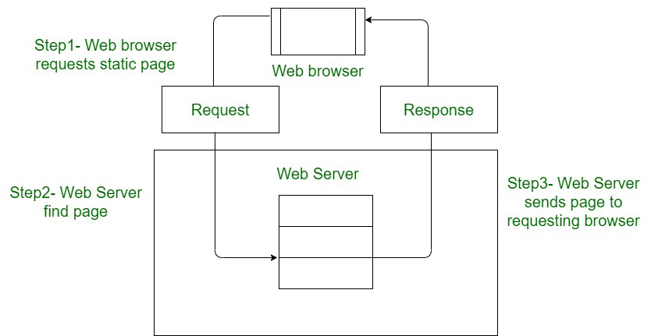
Static Website
In Static Websites, Web pages are returned by the server which are prebuilt source code files built using simple languages such as HTML, CSS, or JavaScript. There is no processing of content on the server (according to the user) in Static Websites. Web pages are returned by the server with no change therefore, static Websites are fast. There is no interaction with databases. Also, they are less costly as the host does not need to support server-side processing with different languages.
Static does not mean that it will not respond to user actions, These Websites are called static because these cannot be manipulated on the server or interact with databases (which is the case in Dynamic Websites).

Slide 16
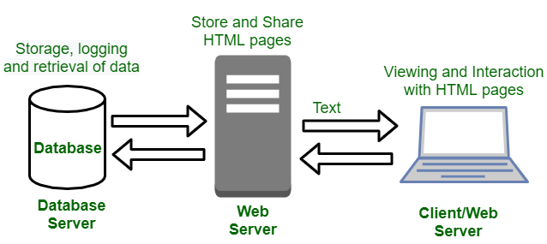
Dynamic Website
In Dynamic Websites, Web pages are returned by the server which are processed during runtime means they are not prebuilt web pages but they are built during runtime according to the user’s demand with the help of server-side scripting languages such as PHP, Node.js, ASP.NET and many more supported by the server. So, they are slower than static websites but updates and interaction with databases are possible.
Dynamic Websites are used over Static Websites as updates can be done very easily as compared to static websites (Where altering in every page is required) but in Dynamic Websites, it is possible to do a common change once and it will reflect in all the web pages

Slide 17
Static Website Vs Dynamic Website
Static Website | Dynamic Website
Prebuilt content is same every time the page is loaded. | Content is generated quickly and changes regularly.
It uses the HTML code for developing a website. | It uses the server side languages such as PHP,SERVLET, JSP, and ASP.NET etc. for developing a website.
It sends exactly the same response for every request. | It may generate different HTML for each of the request.
The content is only changed when someone publishes and updates the file (sends it to the web server). | The page contains "server-side" code which allows the server to generate the unique content when the page is loaded.
Flexibility is the main advantage of static website. | Content Management System (CMS) is the main advantage of dynamic website.

Slide 18
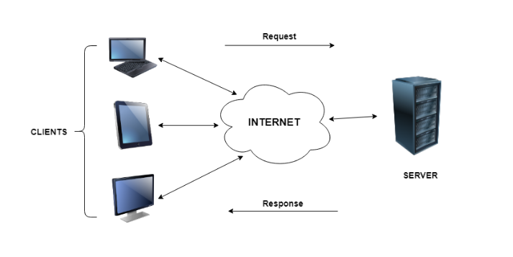
Client Server Computing
In client server computing, the clients requests a resource and the server provides that resource. A server may serve multiple clients at the same time while a client is in contact with only one server. Both the client and server usually communicate via a computer network but sometimes they may reside in the same system.

Slide 19
Client Vs Server
Based on | Client | Server
Basic functionality | Client relies on the services of server, and generates requests for various services. | Server authorizes the client's requests and facilitates them with the requested services.
Configuration | The configuration of client systems is simple. Their tasks are limited to generating requests. It has a basic hardware configuration. | The configuration of the server is more complex and sophisticated. Server has advanced hardware configuration.
Efficiency | The efficiency of client is limited. | The performance of server is high, and they are highly efficient.
Tasks | The common tasks for client are simple and mostly include requesting services. | The complex tasks like fulfilling client requests, storing and processing large datasets, data analysis are common for server.
Switch off | The client systems can be switch off without any fear. | Switching off servers may be disastrous for client systems that continuously request the services.
Login Support | There can be single user logins. | Server support multiple user login and request processing simultaneously.
Examples | Examples of clients are smartphones, desktops, laptops, etc. | Examples of servers are web servers, file servers, database servers, etc.

Slide 20
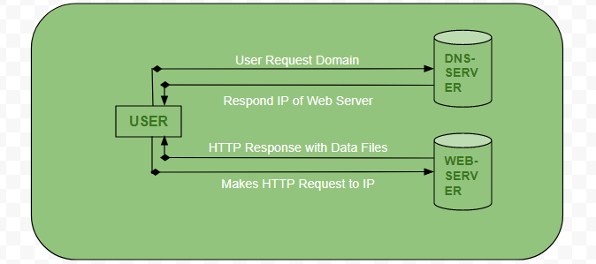
How the browser interacts with the servers ?
User enters the URL(Uniform Resource Locator) of the website or file. The Browser then requests the DNS(DOMAIN NAME SYSTEM) Server.
DNS Server lookup for the address of the WEB Server.
DNS Server responds with the IP address of the WEB Server.
Browser sends over an HTTP/HTTPS request to WEB Server’s IP (provided by DNS server).
Server sends over the necessary files of the website.
Browser then renders the files and the website is displayed. This rendering is done with the help of DOM (Document Object Model) interpreter, CSS interpreter and JS Engine collectively known as the JIT or (Just in Time) Compilers.

Slide 21
Characteristics of Client Server Computing
The salient points for client server computing are as follows:
The client server computing works with a system of request and response. The client sends a request to the server and the server responds with the desired information.
The client and server should follow a common communication protocol so they can easily interact with each other. All the communication protocols are available at the application layer.
A server can only accommodate a limited number of client requests at a time. So it uses a system based to priority to respond to the requests.
Denial of Service attacks hinder servers ability to respond to authentic client requests by inundating it with false requests.
An example of a client server computing system is a web server. It returns the web pages to the clients that requested them

Slide 22
Advantages of Client Server Computing
The different advantages of client server computing are −
All the required data is concentrated in a single place i.e. the server. So it is easy to protect the data and provide authorisation and authentication.
The server need not be located physically close to the clients. Yet the data can be accessed efficiently.
It is easy to replace, upgrade or relocate the nodes in the client server model because all the nodes are independent and request data only from the server.
All the nodes i.e. clients and server may not be build on similar platforms yet they can easily facilitate the transfer of data.

Slide 23
Disadvantages of Client Server Computing
The different disadvantages of client server computing are −
If all the clients simultaneously request data from the server, it may get overloaded. This may lead to congestion in the network.
If the server fails for any reason, then none of the requests of the clients can be fulfilled. This leads of failure of the client server network.
The cost of setting and maintaining a client server model are quite high.
Clients are prone to viruses, Trojans and worms if present in the Server or uploaded into the Server.
Server are prone to Denial of Service (DOS) attacks.
Data packets may be spoofed or modified during transmission.
Phishing or capturing login credentials or other useful information of the user are common and MITM(Man in the Middle) attacks are common.

Slide 24
Web Servers and Web Client
A web client is an application that communicates with a web server, using Hypertext Transfer Protocol (HTTP). The basic objective of the web server is to store, process and deliver web pages to the users. Web browser is an example of a web client.
Web servers speak the HTTP protocol, so they are often called HTTP servers. These HTTP servers store the Internet’s data and provide the data when it is requested by HTTP clients.

Slide 25
Web Browser
Web Browser: The web browser is an example of application software that is developed to retrieve and view the information from web pages or HTML files present on the web servers. The first web browser was invented by Sir Tim Berners-Lee in 1990 and the very first graphical web browser was developed in 1993 which is named the mosaic. After that, various web browsers were developed. Some of them are navigator which is developed by Netscape communication, Microsoft’s internet explorer, Google Chrome, Mozilla Firefox, Opera and Apple safari.
The main characteristics of Web Browser are:
It consists of Graphical User Interface.
It contains the search box where the user can type the address or URL.
Page style can be static or dynamic. It depends upon the interactivity and the formatting.
TCP/IP and HTTP protocols are used by the web browsers.

Slide 26
Web Server Vs Web Browser
Web Server | Web Browser
Web Browser is an Application program that displays a World wide web document. It usually uses the internet service to access the document. | Web server is a program or the computer that provide services to other programs called client.
The Web browser requests the server for the web documents and services. | The Web server accepts, approve and respond to the request made by the web browser for a web document or services.
The web browser act as an interface between the server and the client and displays a web document to the client. | The web server is a software or a system which maintain the web applications, generate response and accept clients data.
The web browser sends an HTTP request and gets an HTTP response. | The web server gets HTTP requests and send HTTP responses.
Doesn’t exist any processing model for the web browser. | There exist three types of processing models for web server i.e Process-based, Thread based and Hybrid.
Web browser stores the cookies for different websites. | Web servers provide an area to store and organize the pages of the website.
The web browser is installed on the client computer. | The web server can be a remote machine placed at the other side of your network or even on the other end of the globe, or it is your very own personal computer at home.

Slide 27
Client Side Scripting
Web browsers execute client side scripting. It is use when browsers has all code. Source code used to transfer from web server to user’s computer over internet and run directly on browsers. It is also used for validations and functionality for user events.
It allows for more interactivity. It usually performs several actions without going to user. It cannot be basically used to connect to databases on web server. These scripts cannot access file system that resides at web browser. Pages are altered on basis of users choice. It can also used to create “cookies” that store data on user’s computer.
Different Client-Side Uses are:
Makes interactive web pages
Make stuff work dynamically
Interact with temporary storage
Works as an interface between user and server
Sends requests to the server
Retrieval of data from Server
Interact with local storage
Provides remote access for client-server program

Slide 28
Client-side Languages Example
There are many client-side scripting languages too.
JavaScript
VBScript
HTML (Structure)
CSS (Designing)
AJAX
jQuery etc.

Slide 29
Server side scripting
Web servers are used to execute server side scripting. They are basically used to create dynamic pages. It can also access the file system residing at web server. Server-side environment that runs on a scripting language is a web-server.
Scripts can be written in any of a number of server-side scripting language available. It is used to retrieve and generate content for dynamic pages. It is used to require to download plugins. In this load times are generally faster than client-side scripting. When you need to store and retrieve information a database will be used to contain data. It can use huge resources of server. It reduces client-side computation overhead. Server sends pages to request of user/client.

Slide 30
Server Side Uses
It processes the user input
Displays the requested pages
Structure of web applications
Interaction with servers/storages
Interaction with databases
Querying the database
Encoding of data into HTML
Operations over databases like delete, update.

Slide 31
Server Side Scripting Languages
PHP
ASP.NET (C# OR Visual Basic)
C++
Java and JSP
Python
Ruby on Rails

Slide 32
Client side Vs Server Side Scripting
Client side scripting | Server side scripting
Source code is visible to user. | Source code is not visible to user because it’s output of server side is a HTML page.
It usually depends on browser and it’s version. | In this any server side technology can be use and it does not depend on client.
It runs on user’s computer. | It runs on web server.
There are many advantages link with this like faster. response times, a more interactive application. | The primary advantage is it’s ability to highly customize, response requirements, access rights based on user.
It does not provide security for data. | It provides more security for data.
It is a technique use in web development in which scripts runs on clients browser. | It is a technique that uses scripts on web server to produce a response that is customized for each clients request.
HTML, CSS and javascript are used. | PHP, Python, Java, Ruby are used.

