Slide 1
HTML
Hyper Text Markup Language

Slide 2
Introduction
HTML stands for Hyper Text Markup Language, which is the most widely used language on Web to develop web pages. HTML was created by Berners-Lee in late 1991 but "HTML 2.0" was the first standard HTML specification which was published in 1995. HTML 4.01 was a major version of HTML and it was published in late 1999. Though HTML 4.01 version is widely used but currently we are having HTML-5 version which is an extension to HTML 4.01, and this version was published in 2012.

Slide 3
Some of the key advantages of learning HTML:
Create Web site - You can create a website or customize an existing web template if you know HTML well.
Become a web designer - If you want to start a career as a professional web designer, HTML and CSS designing is a must skill.
Understand web - If you want to optimize your website, to boost its speed and performance, it is good to know HTML to yield best results.
Learn other languages - Once you understands the basic of HTML then other related technologies like javascript, php, or angular are become easier to understand.

Slide 4
Applications of HTML
Web pages development - HTML is used to create pages which are rendered over the web. Almost every page of web is having html tags in it to render its details in browser.
Internet Navigation - HTML provides tags which are used to navigate from one page to another and is heavily used in internet navigation.
Responsive UI - HTML pages now-a-days works well on all platform, mobile, tabs, desktop or laptops owing to responsive design strategy.
Offline support HTML pages once loaded can be made available offline on the machine without any need of internet.
Game development- HTML5 has native support for rich experience and is now useful in gaming development arena as well.

Slide 5
Timeline of HTML
1991- Tim Berners-Lee invents HTML 1.0
1993- HTML 1.0 is released. Not many developers are creating websites at this time.
1995- HTML 2.0 is published. This contains the features of HTML 1.0 plus new features. This remained the standard markup language for designing and creating websites until 1997.
1997- HTML 3.0 was invented. Here, Dave Raggett introduced a fresh draft on HTML, which improved new features of HTML and gave more powerful characteristics for webmasters in designing websites. Unfortunately, the powerful features slowed down the browser in applying further improvements.
1999- The widely-used HTML 4.0 comes out. It is very successful.
2014- HTML 5.0 is released and used worldwide. It is said to be the extended version of HTML 4.01 which was published in 2012.

Slide 6
HTML Text Editors
An HTML file is a text file, so to create an HTML file we can use any text editors.
Text editors are the programs which allow editing in a written text, hence to create a web page we need to write our code in some text editor.
There are various types of text editors available which you can directly download, but for a beginner, the best text editor is Notepad (Windows) or TextEdit (Mac).
After learning the basics, you can easily use other professional text editors which are, Notepad++, Sublime Text, Vim, etc.

Slide 7
Steps for Creating HTML File
Notepad is a simple text editor and suitable for beginners to learn HTML. It is available in all versions of Windows, from where you easily access it
Step 1: Open Notepad (Windows)
Step 2: Write code in HTML.
Step 3: Save the HTML file with .htm or .html extension.
Step 4: Open the HTML page in your web browser.

Slide 8
Building Blocks of HTML
An HTML document consist of its basic building blocks which are:
Tags: An HTML tag surrounds the content and apply meaning to it. It is written between < and > brackets.
Attribute: An attribute in HTML provides extra information about the element, and it is applied within the start tag. An HTML attribute contains two fields: name & value.
Syntax
<tag name attribute_name= " attr_value"> content </ tag name>

Slide 9
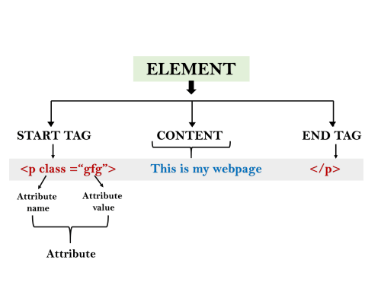
HTML Elements
Elements: An HTML element is an individual component of an HTML file. In an HTML file, everything written within tags are termed as HTML elements.
An HTML file is made of elements. These elements are responsible for creating web pages and define content in that webpage. An element in HTML usually consist of a start tag <tag name>, close tag </tag name> and content inserted between them. Technically, an element is a collection of start tag, attributes, end tag, content between them.

Slide 10
An attribute is used to define the characteristics of an HTML element and is placed inside the element's opening tag. All attributes are made up of two parts − a name and a value
The name is the property you want to set. For example, the paragraph <p> element in the example carries an attribute whose name is align, which you can use to indicate the alignment of paragraph on the page.
The value is what you want the value of the property to be set and always put within quotations. The below example shows three possible values of align attribute: left, center and right.
Attribute names and attribute values are case-insensitive. However, the World Wide Web Consortium (W3C) recommends lowercase attributes/attribute values in their HTML 4 recommendation.

Slide 11
HTML Attribute
HTML attributes are special words which provide additional information about the elements or attributes are the modifier of the HTML element.
Each element or tag can have attributes, which defines the behaviour of that element.
Attributes should always be applied with start tag.
The Attribute should always be applied with its name and value pair.
The Attributes name and values are case sensitive, and it is recommended by W3C that it should be written in Lowercase only.
You can add multiple attributes in one HTML element, but need to give space between two attributes.
Syntax
<element attribute_name="value">content</element>

Slide 12
HTML Tags
HTML tags are like keywords which defines that how web browser will format and display the content. With the help of tags, a web browser can distinguish between an HTML content and a simple content. HTML tags contain three main parts: opening tag, content and closing tag. But some HTML tags are unclosed tags.
An HTML file must have some essential tags so that web browser can differentiate between a simple text and HTML text. You can use as many tags you want as per your code requirement.
All HTML tags must enclosed within < > these brackets.
Every tag in HTML perform different tasks.
If you have used an open tag <tag>, then you must use a close tag </tag> (except some tags
Container Tags/Paired tags: That have both opening and closing tags. e.g <HTML>,<HEAD> etc.
Empty Tags/ Void/Unpaired tags: That have opening tag, but no closing tag e.g. <BR> , <HR> etc.
Syntax
<tag> content </tag>

Slide 13
Basic HTML File
The <!DOCTYPE html> declaration defines that this document is an HTML5 document
The <html> element is the root element of an HTML page
The <head> element contains meta information about the HTML page
The <title> element specifies a title for the HTML page (which is shown in the browser's title bar or in the page's tab)
The <body> element defines the document's body, and is a container for all the visible contents, such as headings, paragraphs, images, hyperlinks, tables, lists, etc.
The <h1> element defines a large heading
The <p> element defines a paragraph
<!DOCTYPE html> <html> <head> <title>Page Title</title> </head> <body> <h1>My First Heading</h1> <p>My first paragraph.</p> </body> </html>

Slide 14
HTML Headings
Search engines use the headings to index the structure and content of your web pages.
Users often skim a page by its headings. It is important to use headings to show the document structure.
<h1> headings should be used for main headings, followed by <h2> headings, then the less important <h3>, and so on.
Note: Use HTML headings for headings only. Don't use headings to make text BIG or bold.
Note: Bigger Heading
Each HTML Heading has a default size . However , we can specify the size of any heading with the style attribute, using the CSS font size property
Example
<h1 style =“ font –size : 60px ;” > Heading 1 </h1>

Slide 15
HTML Paragraph
HTML paragraph or HTML p tag is used to define a paragraph in a webpage. It is a notable point that a browser itself add an empty line before and after a paragraph. An HTML <p> tag indicates starting of new paragraph.
Note: If you put a lot of spaces inside the HTML p tag, browser removes extra spaces and extra line while displaying the page. The browser counts number of spaces and lines as a single one.
An HTML <br> tag is used for line break and it can be used with paragraph elements. Following is the example to show how to use <br> with <p> element.
An HTML <hr> tag is used to apply a horizontal line between two statements or two paragraphs. Following is the example which is showing use of <hr> tag with paragraph.

Slide 16
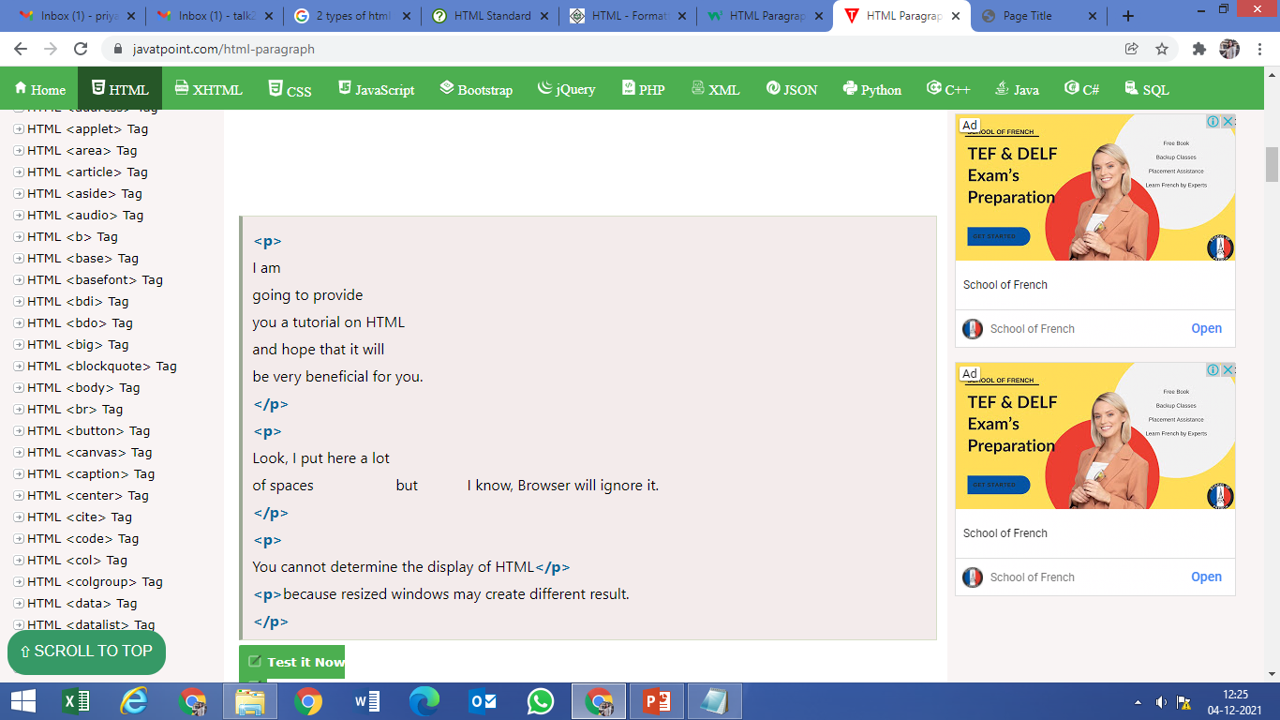
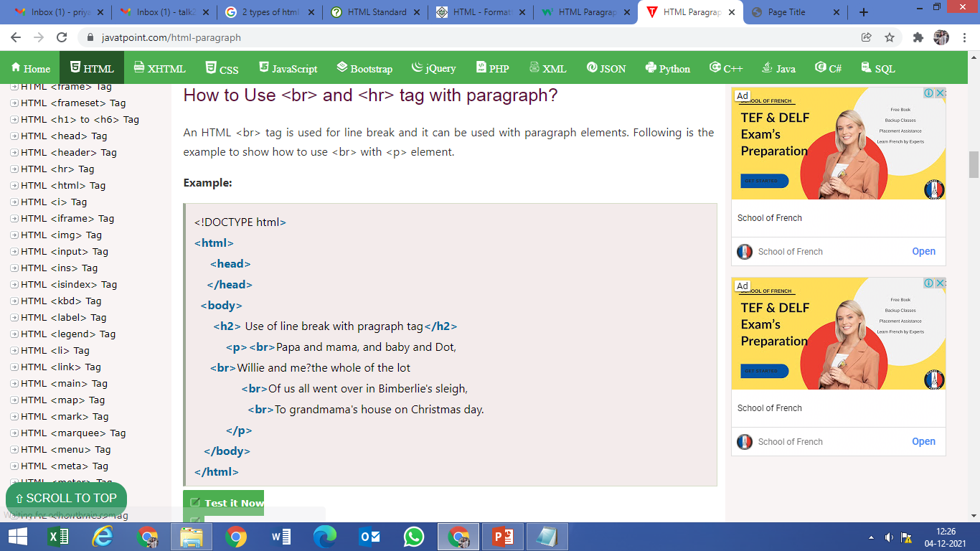
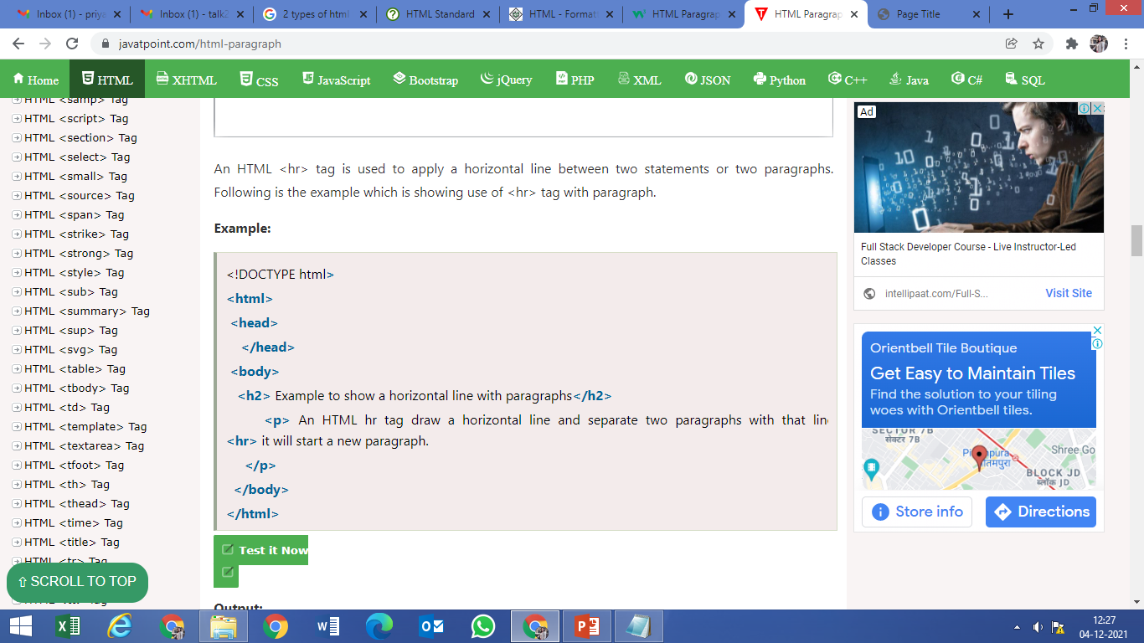
Code: Exercise

Slide 17
HTML Formatting Tags
HTML Formatting is a process of formatting text for better look and feel. HTML provides us ability to format text without using CSS. There are many formatting tags in HTML. These tags are used to make text bold, italicized, or underlined. There are almost 14 options available that how text appears in HTML and XHTML.
In HTML the formatting tags are divided into two categories:
Physical tag: These tags are used to provide the visual appearance to the text.
Logical tag: These tags are used to add some logical or semantic value to the text.

Slide 18
14 HTML formatting tags
<b> | This is a physical tag, which is used to bold the text written between it.
<strong> | This is a logical tag, which tells the browser that the text is important.
<i> | This is a physical tag which is used to make text italic.
<em> | This is a logical tag which is used to display content in italic.
<mark> | This tag is used to highlight text.
<u> | This tag is used to underline text written between it.
<tt> | This tag is used to appear a text in teletype. (not supported in HTML5). The content of a <tt>...</tt> element is written in monospaced font. Most of the fonts are known as variable-width fonts because different letters are of different widths (for example, the letter 'm' is wider than the letter 'i'). In a monospaced font, however, each letter has the same width.
<strike> | This tag is used to draw a strikethrough on a section of text. (Not supported in HTML5)

Slide 19
14 HTML formatting tags
<sup> | It displays the content slightly above the normal line.
<sub> | It displays the content slightly below the normal line.
<del> | This tag is used to display the deleted content.
<ins> | This tag displays the content which is added
<big> | This tag is used to increase the font size by one conventional unit.
<small> | This tag is used to decrease the font size by one unit from base font size.

Slide 20
HTML Exercise
Print the squares of the numbers 1 - 20. Each number should be on a separate line, next to it the number 2 superscripted, an equal sign and the result. (Example: 102 = 100)
Your web page must have used the Heading tag.
There should be a line after the heading.
The numbers and their squares should be displayed in the center of the web page.
Atleast two Square values should be highlighted.
One Square value should be Bold, One should be in Italic, One should be underlined, One wrong value displayed should be striked

Slide 21
HTML Phrase Tags
The HTML phrase tags are special purpose tags, which defines the structural meaning of a block of text or semantics of text. Following is the list of phrase tags, some of which we have already discussed in HTML formatting.
Abbreviation tag : <abbr>
Acronym tag: <acronym> (not supported in HTML5)
Marked tag: <mark>
Strong tag: <strong>
Emphasized tag : <em>
Definition tag: <dfn>
Quoting tag: <blockquote>
Short quote tag : <q>
Code tag: <code>
Keyboard tag: <kbd>
Address tag: <address>

Slide 22
1. Text Abbreviation tag
This tag is used to abbreviate a text. To abbreviate a text, write text between <abbr> and </abbr> tag.
<p>An <abbr title = "Hypertext Markup language">HTML </abbr> language is used to create web pages. </p>
2. Marked tag
The content written between <mark> and </mark> tag will show as yellow mark on browser. This tag is used to highlight a particular text.
<p>This tag will <mark>highlight</mark> the text.</p>
3. Strong text
This tag is used to display the important text of the content. The text written between <strong> and </strong> will be displayed as important text.
<p>In HTML it is recommended to use <strong>lowercase</strong>, while writing a code. </p>

Slide 23
4. Emphasized text
This tag is used to emphasize the text, and displayed the text in italic form. The text written between <em> and </em> tag will italicized the text.
<p>HTML is an <em>easy </em>to learn language.</p>
5. Definition Tag
It is used to provide any definition , also it allows to specify the keyword of the content.
<p><dfn>HTML </dfn> is a markup language. </p>
6. Quoting Text
The HTML <blockquote> element shows that the enclosed content is quoted from another source. The Source URL can be given using the cite attribute, and text representation of source can display using <cite> ..... </cite>element.
<blockquote>
The first step toward success is taken when you refuse to be a captive of the environment in which you first find yourself.</blockquote>
<cite>-Mark Caine</cite>

Slide 24
7. Short Quotations
An HTML <q> ....... </q> element defines a short quotation. If you will put any content between <q> ....... </q>, then it will enclose the text in double quotes.
Example
<p>Steve Jobs said: <q>If You Are Working On Something That You Really Care About, You Dont Have To Be Pushed. The Vision Pull You.</q></p>
8. Code Tags
The HTML <code> </code> element is used to display the part of computer code. It will display the content in monospaced font.
<p>First Java program</p>
<p><code>class Simple{ public static void main(String args[]){
System.out.println("Hello Java"); }} </code>
</p>

Slide 25
9. Keyboard Tag
In HTML the keyboard tag, <kbd>, indicates that a section of content is a user input from keyboard.
<p>Please press <kbd>Ctrl</kbd> + <kbd>Shift</kbd> + t<kbd> </kbd> to restore page on chrome.</p>
10. Address tag
An HTML <address> tag defines the contact information about the author of the content. The content written between <address> and </address> tag, then it will be displayed in italic font.
<address> You can ask your queries by contact us on <br> You can also visit at: <br>58 S. Garfield Street. Villa Rica, GA 30187.
</address>

Slide 26
Practical 2: CO1, CO2
Design the web page meeting the following given specifications:
Print a long Quote and short Quote. Cite the author of each quote.
Print some deleted and inserted text of your Choosing.
Print two addresses in the same front used on the front of envelopes ( senders address in top left corner, receivers address in the center).
Print ten acronyms and abbreviations of your choosing. Also specify the data that the abbreviations and acronyms represent.
Print a paragraph with 4-5 sentences. Each sentence should be in different font.
Write a keyboard shortcut key sentence.

Slide 27
HTML Lists
Lists are used to specify lists of information. All lists may contain one or more list elements. There are three different types of HTML lists:
Ordered List or Numbered List (ol)
Unordered List or Bulleted List (ul)
Description List or Definition List (dl)
HTML Ordered List or Numbered List displays elements in numbered format. The HTML ol tag is used for ordered list. We can use ordered list to represent items either in numerical order format or alphabetical order format, or any format where an order is emphasized. There can be different types of numbered list:
Numeric Number (1, 2, 3)
Capital Roman Number (I II III)
Small Roman Number (i ii iii)
Capital Alphabet (A B C)
Small Alphabet (a b c)
To represent different ordered lists, there are 3 types of attributes in <ol> tag.

Slide 28
Ordered List type
Example:
<ol type="I">
<li>HTML</li>
<li>Java</li>
<li>JavaScript</li>
<li>SQL</li>
</ol>
Type | Description
Type "1" | This is the default type. In this type, the list items are numbered with numbers.
Type "I" | In this type, the list items are numbered with upper case roman numbers.
Type "i" | In this type, the list items are numbered with lower case roman numbers.
Type "A" | In this type, the list items are numbered with upper case letters.
Type "a" | In this type, the list items are numbered with lower case letters.
start attribute
The start attribute is used with ol tag to specify from where to start the list items.
<ol type="1" start="5"> : It will show numeric values starting with "5".
<ol type="A" start="5"> : It will show capital alphabets starting with "E".
<ol type="a" start="5"> : It will show lower case alphabets starting with "e".
<ol type="I" start="5"> : It will show Roman upper case value starting with "V".

Slide 29
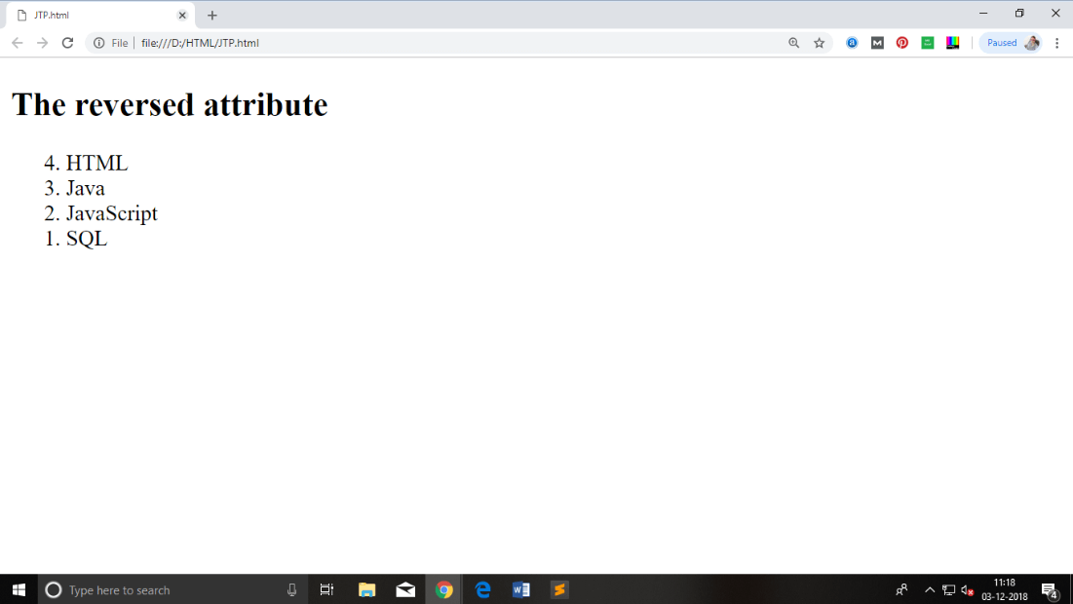
Reversed Attribute
This is a Boolean attribute of HTML <ol> tag, and it is new in HTML5 version. If you use the reversed attribute with tag then it will numbered the list in descending order (7, 6, 5, 4......1).
Example:
<ol reversed>
<li>HTML</li>
<li>Java</li>
<li>JavaScript</li>
<li>SQL</li>
</ol>

Slide 30
Unordered List/ Bulleted List
HTML Unordered List or Bulleted List displays elements in bulleted format . We can use unordered list where we do not need to display items in any particular order. The HTML ul tag is used for the unordered list. There can be 4 types of bulleted list:
disc
circle
square
none
Type | Description
Type "disc" | This is the default style. In this style, the list items are marked with bullets.
Type "circle" | In this style, the list items are marked with circles.
Type "square" | In this style, the list items are marked with squares.
Type "none" | In this style, the list items are not marked .

Slide 31
Example:
<ul type="square">
<li>HTML</li>
<li>Java</li>
<li>JavaScript</li>
<li>SQL</li>
</ul>
IMP: The type attribute is not supported in HTML5, instead of type you can use CSS property of list-style-type. Following is the example to show the CSS property for ul tag.
<ul style="list-style-type: square;">
<li>HTML</li>
<li>Java</li>
<li>JavaScript</li>
<li>SQL</li>
</ul>

Slide 32
Definition List
HTML and XHTML supports a list style which is called definition lists where entries are listed like in a dictionary or encyclopaedia. The definition list is the ideal way to present a glossary, list of terms, or other name/value list.
Definition List makes use of following three tags.
<dl> − Defines the start of the list
<dt> − A term
<dd> − Term definition
</dl> − Defines the end of the list

Slide 33
Example:
<!DOCTYPE html>
<html>
<head>
<title>HTML Definition List</title>
</head>
<body>
<dl>
<dt><b>HTML</b></dt>
<dd>This stands for Hyper Text Markup Language
</dd>
<dt><b>HTTP</b></dt>
<dd>This stands for Hyper Text Transfer Protocol</dd>
</dl>
</body>
</html>

Slide 34
Marquee Tag
An HTML marquee is a scrolling piece of text displayed either horizontally across or vertically down your webpage depending on the settings. This is created by using HTML <marquees> tag.
Syntax:
There are 10 different attributes supported in marquee tag.
<marquee attribute_name = "attribute_value"....more attributes> One or more lines or text message or image </marquee>

Slide 35
Attributes of Marquee Tag
Sr.No | Attribute Name | Description
1 | width | This specifies the width of the marquee. This can be a value like 10 or 20% etc
2 | height | This specifies the height of the marquee. This can be a value like 10 or 20% etc.
3 | direction | This specifies the direction in which marquee should scroll. This can be a value like up, down, left or right.
4 | behavior | This specifies the type of scrolling of the marquee. This can have a value like scroll, slide and alternate.
5 | scrolldelay | This specifies how long to delay between each jump. This will have a value like 10 etc.
6 | scrollamount | This specifies the speed of marquee text. This can have a value like 10 etc.
7 | loop | This specifies how many times to loop. The default value is INFINITE, which means that the marquee loops endlessly.
8 | bgcolor | This specifies background color in terms of color name or color hex value.
9 | hspace | This specifies horizontal space around the marquee. This can be a value like 10 or 20% etc.
10 | vspace | This specifies vertical space around the marquee. This can be a value like 10 or 20% etc.

Slide 36
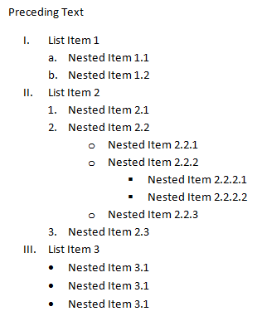
Practical 3: CO1, CO3
Print the Definition List with at least 5 definitions.
Put the horizontal line of width 100%.
Display the “ Nested List” heading using marquee tag and use all its major attributes.
Now, create the given below nested List.

Slide 37
HTML Anchor Tag
A webpage can contain various links that take you directly to other pages and even specific parts of a given page. These links are known as hyperlinks.
Hyperlinks allow visitors to navigate between Web sites by clicking on words, phrases, and images. Thus you can create hyperlinks using text or images available on a webpage
The HTML anchor tag defines a hyperlink that links one page to another page. It can create hyperlink to other web page as well as files, location, or any URL. The "href" attribute is the most important attribute of the HTML a tag. and which links to destination page or URL.
The syntax of HTML anchor tag is given below.
< a href=“ ----”> Link Text </a>

Slide 38
The target Attribute : This attribute is used to specify the location where linked document is opened.
<!DOCTYPE HTML>
<HTML>
<HEAD>
<TITLE> HYPERLINK </TITLE>
</HEAD>
<BODY>
<P> CLICK ANY OF THE FOLLOWING LINKS </P>
<a href = "/html/index.htm" target = "_blank">Opens in New</a>
<a href = "/html/index.htm" target = "_self">Opens in Self</a>
<a href = "/html/index.htm" target = "_parent">Opens in Parent</a>
<a href = "/html/index.htm" target = "_top">Opens in Body</a>
</BODY>
</HTML>
Sr.No | Option & Description
1 | _blank Opens the linked document in a new window or tab.
2 | _self Opens the linked document in the same frame.
3 | _parent Opens the linked document in the parent frame.
4 | _top Opens the linked document in the full body of the window.
5 | targetframe Opens the linked document in a named targetframe

Slide 39
Setting Link Colours
You can set colors of your links, active links and visited links using link, alink and vlink attributes of <body> tag
Navigating within the web page using the anchor tag.
It is a two step process
First create a link to the place where you want to reach with-in a webpage and name it using <a...> tag as follows
<h1> HTML Text Links < a name=“top”> </a></h1> ( Putting the heading tag is optional.
Second step is to create a hyperlink to link the document and place where you want to reach
<a href=“#top”> Go to the top </a>

Slide 40
Image Tag: Inserting Images in Web page
Images are very important to beautify as well as to depict many complex concepts in simple way on your web page.
Tag to insert image: We can insert any image in your web page by using <img> tag.
Syntax
<img src= “ Image URL” ….. Attributes – list/>
The <img> tag is an empty tag, which means that, it can contain only list of attributes and it has no closing tag.
We can use PNG, JPEG or GIF image file based on your comfort but make sure we specify correct image file name in src attribute. Image name is always case sensitive

Slide 41
The alt attribute is a mandatory attribute which specifies an alternate text for an image, if the image cannot be displayed.
we can set image width and height based on your requirement using width and height attributes. We can specify width and height of the image in terms of either pixels or percentage of its actual size.
Image Border: By default, image will have a border around it, we can specify border thickness in terms of pixels using border attribute. A thickness of 0 means, no border around the picture.
Image Alignment: By default, image will align at the left side of the page, but we can use align attribute to set it in the center or right.

Slide 42
Sample Code displaying all attributes of Image Tag
<!DOCTYPE html>
<html> <head>
<title>Set Image Alignment</title> </head>
<body>
<p>Displaying Image with all its atributes</p>
<img src="C:/Users/Priyanka\Desktop\index.jpg" alt = "Test Image" border = "3" align = "right” width=“150” height=“100”/>
</body> </html>

Slide 43
HTML comments
Comment is a piece of code which is ignored by any web browser. It is a good practice to add comments into your HTML code, especially in complex documents, to indicate sections of a document, and any other notes to anyone looking at the code. Comments help you and others understand your code and increases code readability.
HTML comments are placed in between <!-- ... --> tags. So, any content placed with-in <!-- ... --> tags will be treated as comment and will be completely ignored by the browser.

Slide 44
Key Points: HTML Comments
Comments do not nest which means a comment cannot be put inside another comment. Second the double-dash sequence "--" may not appear inside a comment except as part of the closing --> tag. You must also make sure that there are no spaces in the start-of comment string.
There should not be any space between left angle bracket and the exclamation mark. E.g. < !-- invalid comments -->
There can be Multiline comment where we can comment multiple lines by the special beginning tag <!-- and ending tag --> placed before the first line and end of the last line.

Slide 45
Practical 4: CO1, CO3
Create links to various search engine pages e.g. google, yahoo, altavista etc.
Insert one image on the web page which can be formatted using different attributes of image tag.
Create a page with a link at the top of it that when clicked will jump all the way to the bottom of the page.
Create a page with a link at the bottom of it that when clicked will jump all the way to the top of the page.
Insert one image link which one clicked opens up the resume in the new web page.
Insert comments in the HTML anchor tags( top and bottom)
Beautify and format the web page using different tags and attributes learn so far.

Slide 46
HTML Tables
The HTML tables allow web authors to arrange data like text, images, links, other tables, etc. into rows and columns of cells.
The HTML tables are created using the <table> tag in which the <tr> tag is used to create table rows and <td> tag is used to create data cells. The elements under <td> are regular and left aligned by default.
The border is an attribute of <table> tag and it is used to put a border across all the cells. If we do not need a border, then we can use border = "0".

Slide 47
Output: ????
<!DOCTYPE html>
<html> <head>
<title>HTML Tables</title> </head>
<body>
<table border = "1">
<tr> <td>Row 1, Column 1</td> <td>Row 1, Column2</td>
</tr>
<tr> <td>Row 2, Column 1</td> <td>Row 2, Column2</td>
</tr>
</table> </body> </html>

Slide 48
Output
Row 1, Column 1 | Row 1, Column 2
Row 2, Column 1 | Row 2, Column 2

Slide 49
Table Heading: Table heading can be defined using <th> tag. This tag will be put to replace <td> tag, which is used to represent actual data cell. Normally we will put your top row as table heading as shown below, otherwise we can use <th> element in any row. Headings, which are defined in <th> tag are centered and bold by default.
Cellpadding and Cellspacing Attributes
There are two attributes called cellpadding and cellspacing which we will use to adjust the white space in your table cells. The cellspacing attribute defines space between table cells, while cellpadding represents the distance between cell borders and the content within a cell.
Colspan and Rowspan Attributes:
We will use colspan attribute if you want to merge two or more columns into a single column. Similar way we will use rowspan if we want to merge two or more rows.

Slide 50
Table Height and Width: We can set a table width and height using width and height attributes. We can specify table width or height in terms of pixels or in terms of percentage of available screen area.
Tables Backgrounds
We can set table background using one of the following two ways −
bgcolor attribute − We can set background color for whole table or just for one cell.
background attribute − Wecan set background image for whole table or just for one cell.
We can also set border color also using bordercolor attribute
Table Caption
The caption tag will serve as a title or explanation for the table and it shows up at the top of the table.
Table Header, Body, and Footer
Tables can be divided into three portions − a header, a body, and a foot. The head and foot are rather similar to headers and footers in a word-processed document that remain the same for every page, while the body is the main content holder of the table.
The three elements for separating the head, body, and foot of a table are −
<thead> − to create a separate table header.
<tbody> − to indicate the main body of the table.
<tfoot> − to create a separate table footer.

Slide 51
<!DOCTYPE html>
<html> <head> <title>HTML Table Background</title> </head>
<body> <table border = "1" bordercolor = "green" bgcolor = "yellow">
<tr> <th>Column 1</th>
<th>Column 2</th>
<th>Column 3</th> </tr>
<tr> <td rowspan = "2">Row 1 Cell 1</td> <td>Row 1 Cell 2</td>
<td>Row 1 Cell 3</td>
</tr>
<tr> <td>Row 2 Cell 2</td>
<td>Row 2 Cell 3</td> </tr>
<tr> <td colspan = "3">Row 3 Cell 1</td> </tr>
</table> </body>

Slide 52
Output
Column 1 | Column 2 | Column 3
Row 1 Cell 1 | Row 1 Cell 2 | Row 1 Cell 3
 | Row 2 Cell 2 | Row 2 Cell 3
Row 3 Cell 1

Slide 53
Problem 2
Invoice
Problem 1
Item / Desc. | Qty. | @ | Price
Paperclips (Box) | 100 | 1.15 | 115.00
Paper (Case) | 10 | 45.99 | 459.90
Wastepaper Baskets | 2 | 17.99 | 35.98
Subtotal |  |  | 610.88
Tax |  | 7% | 42.76
Total |  |  | 653.64
Life Expectancy By Current Age
65 |  | 40 |  | 20
Men | Women | Men | Women | Men | Women
82 | 85 | 78 | 82 | 77 | 81
 |  | Bob | Alice
Favourite | Color | Blue | Purple
 | Flavour | Banana | Chocolate
Least Favourite | Color | Yellow | Pink
 | Flavour | Mint | Walnut
Problem 3
Favourite and Least Favourite Things

Slide 54
Solutions: 1
<table>
<caption>Life Expectancy By Current Age</caption>
<tr> <th colspan="2">65</th>
<th colspan="2">40</th>
<th colspan="2">20</th>
</tr>
<tr>
<th>Men</th> <th>Women</th> <th>Men</th> <th>Women</th> <th>Men</th> <th>Women</th> </tr>
<tr> <td>82</td> <td>85</td> <td>78</td> <td>82</td> <td>77</td> <td>81</td> </tr>
</table>
65 |  | 40 |  | 20
Men | Women | Men | Women | Men | Women
82 | 85 | 78 | 82 | 77 | 81

Slide 55
Solutions 2
Item / Desc. | Qty. | @ | Price
Paperclips (Box) | 100 | 1.15 | 115.00
Paper (Case) | 10 | 45.99 | 459.90
Wastepaper Baskets | 2 | 17.99 | 35.98
Subtotal |  |  | 610.88
Tax |  | 7% | 42.76
Total |  |  | 653.64
<table>
<caption>Invoice</caption>
<tr>
<th>Item / Desc.</th>
<th>Qty.</th>
<th>@</th>
<th>Price</th>
</tr>
<tr> <td>Paperclips (Box)</td>
<td>100</td> <td>1.15</td> <td>115.00</td> </tr>
<tr> <td>Paper (Case)</td> <td>10</td> <td>45.99</td> <td>459.90</td> </tr>
<tr> <td>Wastepaper Baskets</td> <td>2</td> <td>17.99</td> <td>35.98</td> </tr>
<tr> <th colspan="3">Subtotal</th>
<td>610.88</td> </tr>
<tr> <th colspan="2">Tax</th>
<td>7%</td> <td>42.76</td> </tr>
<tr> <th colspan="3">Total</th>
<td>653.64</td>
</tr> </table>

Slide 56
Solution 3
<table> <caption>Favorite and Least Favorite Things</caption>
<tr> <th></th><th></th> <th>Bob</th> <th>Alice</th> </tr>
<tr> <th rowspan="2">Favorite</th> <th>Color</th> <td>Blue</td> <td>Purple</td> </tr>
<tr> <th>Flavor</th> <td>Banana</td> <td>Chocolate</td> </tr>
<tr> <th rowspan="2">Least Favorite</th> <th>Color</th> <td>Yellow</td> <td>Pink</td> </tr>
<tr> <th>Flavor</th> <td>Mint</td> <td>Walnut</td> </tr>
</table>
 |  | Bob | Alice
Favourite | Color | Blue | Purple
 | Flavour | Banana | Chocolate
Least Favourite | Color | Yellow | Pink
 | Flavour | Mint | Walnut

Slide 57
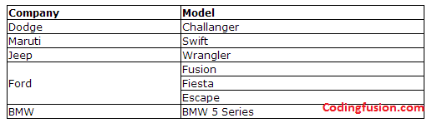
Prac 5: CO1, CO3
Write a program to create HTML table with the following output :
Apply the background colour on the table.
Apply caption,
Increase the cell padding and cell spacing.
Apply border and border color on the table.
Each Company name should be the hyperlink opening the company website.
Create one more table on the top of the web page that must have at least one image of the car.
Create the Contact Us details at the bottom of the web page.
On the bottom of the web page there must be the hyperlink to go at the top.

Slide 58
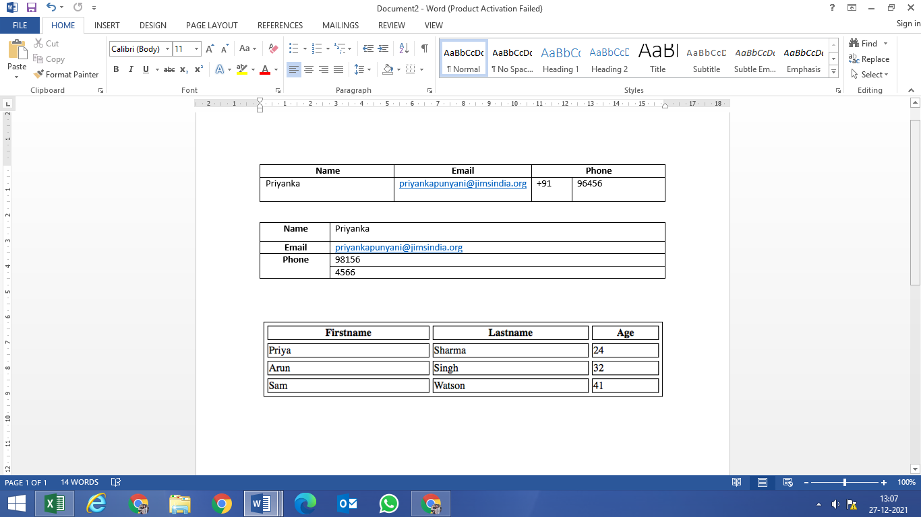
Test

Slide 59
HTML Forms
An HTML form is a section of a document which contains controls such as text fields, password fields, checkboxes, radio buttons, submit button, menus etc.
An HTML form facilitates the user to enter data that is to be sent to the server for processing such as name, email address, password, phone number, etc. .
HTML Forms are required, when you want to collect some data from the site visitor. For example, during user registration you would like to collect information such as name, email address, credit card, etc.
A form will take input from the site visitor and then will post it to a back-end application such as CGI, ASP Script or PHP script etc. The back-end application will perform required processing on the passed data based on defined business logic inside the application.
There are various form elements available like text fields, textarea fields, drop-down menus, radio buttons, checkboxes, etc.

Slide 60
HTML Form
<form action = "Script URL" method = "GET|POST"> form elements like input, textarea etc. </form>
Sr.No | Attribute & Description
1 | action Backend script ready to process your passed data.
2 | method Method to be used to upload data. The most frequently used are GET and POST methods.
3 | target Specify the target window or frame where the result of the script will be displayed. It takes values like _blank, _self, _parent etc.
4 | enctype You can use the enctype attribute to specify how the browser encodes the data before it sends it to the server. Possible values are − application/x-www-form-urlencoded − This is the standard method most forms use in simple scenarios. mutlipart/form-data − This is used when you want to upload binary data in the form of files like image, word file et
Different Form Attributes:

Slide 61
GET Method
GET method is used for requesting the URL from a web server to fetch the HTML documents. It is a conventional method for browsers to deliver the information which counted as a part of the HTTP protocol. The GET method represented in the form of URL, so that it can be bookmarked. GET is extensively used in search engines. After the submission of a query by the user to the search engine, the engine executes the query and gives the resulting page. The query results can be set as a link (bookmarked).
GET method enables the generation of anchors, which helps in accessing the CGI program with the query avoiding the usage of form. The query is constructed into a link, so when the link is visited the CGI program will retrieve the suitable information from the database.
GET method has some security issues because the inserted data is visible in the URL. Only a restricted amount of data can be passed through a GET method, as the length of the URL that a browser can traverse could be a thousand characters.
Another issue regarding GET method is that it can not deal with foreign languages. GET method is not suggested to use but still when method attributes are not defined the GET method is used as default.

Slide 62
POST Method
POST method is suitable in the condition where a significant amount of information can pass through. When a server receives the request by a form employing POST, it continues to “listens” for the left information. In simple words, the method transfers all the relevant information of the form input instantly after the request to the URL is made.
The POST method needs to establish two contacts with the web server whereas GET just makes one. The requests in the POST are managed in the same way as it is managed in the GET method where the spaces are represented in the plus (+) sign and rest characters are encoded in the URL pattern. It can also send the items of a file.

Slide 63
Get Vs. Post Method
BASIS FOR COMPARISON | GET | POST
Parameters are placed inside | URL | Body
Purpose | Retrieval of documents | Updation of data
Query results | Capable of being bookmarked. | Cannot be bookmarked.
Security | Vulnerable, as present in plaintext | Safer than GET method
Form data type constraints | Only ASCII characters are permitted. | No constraints, even binary data is permitted.
Form data length | Should be kept as minimum as possible. | Could lie in any range.
Visibility | Can be seen by anyone. | Doesn't display variables in URL.
Variable size | Up to 2000 character. | Up to 8 Mb
Caching | Method data can be cached. | Does not cache the data.

Slide 64
The GET and POST method are used for sending the data to the server, and the main difference between them is that GET method append the data to the URI defined in the form’s action attribute. Conversely, POST method attaches data to the requested body. The use of GET method is inappropriate when the sensitive information needs to be filled in the form. POST method is useful when the user requires to fill the passwords or other confidential information.

Slide 65
HTML Form Controls
There are different types of form controls that we can use to collect data using HTML form −
Text Input Controls
Checkboxes Controls
Radio Box Controls
Select Box Controls
File Select boxes
Hidden Controls
Clickable Buttons
Submit and Reset Button

Slide 66
Text Input Controls
There are three types of text input used on forms −
Single-line text input controls − This control is used for items that require only one line of user input, such as search boxes or names. They are created using HTML <input> tag.
Password input controls − This is also a single-line text input but it masks the character as soon as a user enters it. They are also created using HTML <input> tag.
Multi-line text input controls − This is used when the user is required to give details that may be longer than a single sentence. Multi-line input controls are created using HTML <textarea> tag.

Slide 67
Single-line text input controls
This control is used for items that require only one line of user input, such as search boxes or names. They are created using HTML <input> tag.
Various Attributes for input tag are:
Sr.No | Attribute & Description
1 | type Indicates the type of input control and for text input control it will be set to text.
2 | name Used to give a name to the control which is sent to the server to be recognized and get the value.
3 | value This can be used to provide an initial value inside the control.
4 | size Allows to specify the width of the text-input control in terms of characters.
5 | maxlength Allows to specify the maximum number of characters a user can enter into the text box.

Slide 68
Code and Output
<!DOCTYPE html>
<html> <head>
<title>Text Input Control</title> </head>
<body>
<form >
First name: <input type = "text" name = "first_name" /> <br>
Last name: <input type = "text" name = "last_name" /> </form> </body> </html>

Slide 69
Password input controls
This is also a single-line text input but it masks the character as soon as a user enters it. They are also created using HTML <input>tag but type attribute is set to password.
Password: <input type = “password” name=“password”/>
The various attributes provided with password type textbox is again same i.e type ( which will have “password” as its value, name, value, size and maxlength
Multiple-Line Text Input Controls
This is used when the user is required to give details that may be longer than a single sentence. Multi-line input controls are created using HTML <textarea> tag.
< textarea rows=“5” cols=“50” name=“description”>
Enter the description here
</textarea>
So various attributes with textarea tag are: name, rows and cols.

Slide 70
Checkbox Control
Checkboxes are used when more than one option is required to be selected. They are also created using HTML <input> tag but type attribute is set to checkbox..
<form>
<input type =“checkbox” name=“maths” value=“on”> Maths
<input type =“checkbox” name=“physics” value=“on”> Physics
</form>
The various attributes for checkbox tag are : type ( it will be set to checkbox), name, value ( The value that will be used when the checkbox is selected), and checked (Set to checked if you want to select it by default).
Radio Button Control
Radio buttons are used when out of many options, just one option is required to be selected. They are also created using HTML <input> tag but type attribute is set to radio.
<form>
<input type =“radio” name=“maths” value=“on”> Maths
<input type =“radio” name=“physics” value=“on”> Physics
</form>
The various attributes for checkbox tag are : type ( it will be set to checkbox), name, value ( The value that will be used when the checkbox is selected), and checked (Set to checked if you want to select it by default).

Slide 71
Select Box Control
A select box, also called drop down box which provides option to list down various options in the form of drop down list, from where a user can select one or more options.
The various Attributes of <select> tag are:
<form>
<select name = "dropdown">
<option value = "Maths" selected>Maths</option>
<option value = "Physics">Physics</option>
</select> </form>
Sr.No | Attribute & Description
1 | name Used to give a name to the control which is sent to the server to be recognized and get the value.
2 | size This can be used to present a scrolling list box.
3 | multiple If set to "multiple" then allows a user to select multiple items from the menu.

Slide 72
The various attributes of <Option>tag are:
Sr.No | Attribute & Description
1 | value The value that will be used if an option in the select box box is selected.
2 | selected Specifies that this option should be the initially selected value when the page loads.
3 | label An alternative way of labeling options
File Upload Box
If we want to allow a user to upload a file to your web site, we will need to use a file upload box, also known as a file select box. This is also created using the <input> element but type attribute is set to file.
<form>
<input type = "file" name = "fileupload" accept = "image/*" />
</form>
The various attributes of file upload box are : name (Used to give a name to the control which is sent to the server to be recognized and get the value) and other one is accept (Specifies the types of files that the server accepts.)

Slide 73
Button Controls
There are various ways in HTML to create clickable buttons. We can also create a clickable button using <input>tag by setting its type attribute to button. The type attribute can take the following values −
Sr.No | Type & Description
1 | submit This creates a button that automatically submits a form.
2 | reset This creates a button that automatically resets form controls to their initial values.
3 | button This creates a button that is used to trigger a client-side script when the user clicks that button.
4 | image This creates a clickable button but we can use an image as background of the button.
<form> <input type = "submit" name = "submit" value = "Submit" />
<input type = "reset" name = "reset" value = "Reset" />
<input type = "button" name = "ok" value = "OK" />
<input type = "image" name = "imagebutton" src = "/html/images/logo.png" /> </form>

Slide 74
Label Tag in Form
It is considered better to have label in form. As it makes the code parser/browser/user friendly.
If we click on the label tag, it will focus on the text control. To do so, we need to have for attribute in label tag that must be same as id attribute of input tag.
<form>
<label for="firstname">First Name: </label> <br/>
<input type="text" id="firstname" name="firstname"/> <br/>
HTML 5 Email Field Control
The email field in new in HTML 5. It validates the text for correct email address. You must use @ and . in this field.
<form>
<label for="email">Email: </label>
<input type="email" id="email" name="email"/> <br/>
</form>

Slide 75
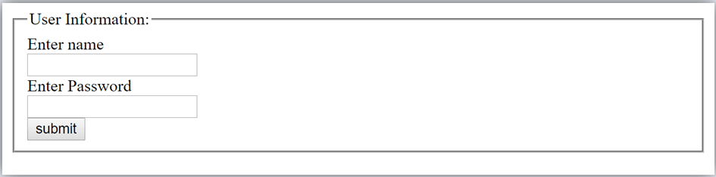
HTML <fieldset> element:
The <fieldset> element in HTML is used to group the related information of a form. This element is used with <legend> element which provide caption for the grouped elements.
<form>
<fieldset>
<legend>User Information:</legend>
<label for="name">Enter name</label><br>
<input type="text" id="name" name="name"><br>
<label for="pass">Enter Password</label><br>
<input type="Password" id="pass" name="pass"><br>
<input type="submit" value="submit">
</fieldset>

Slide 76
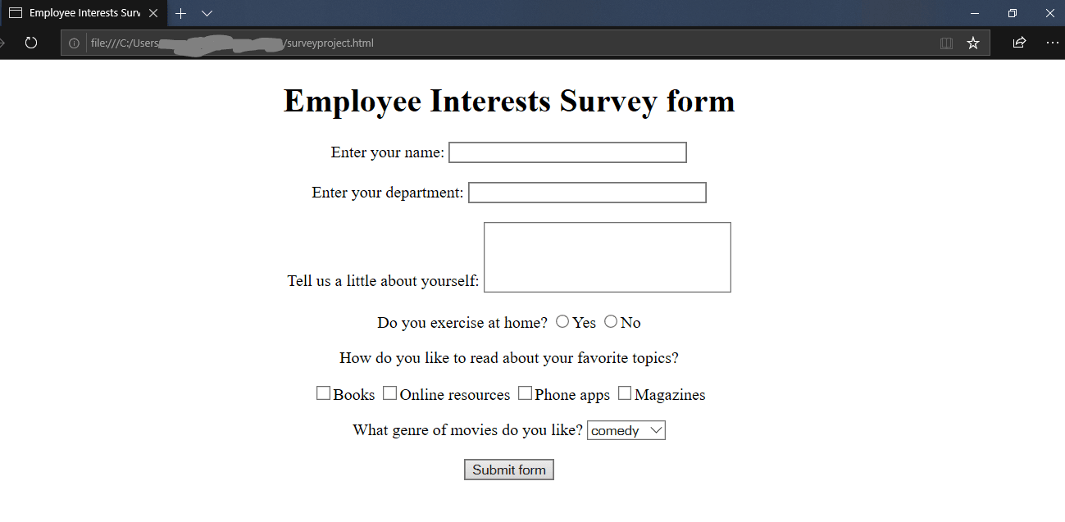
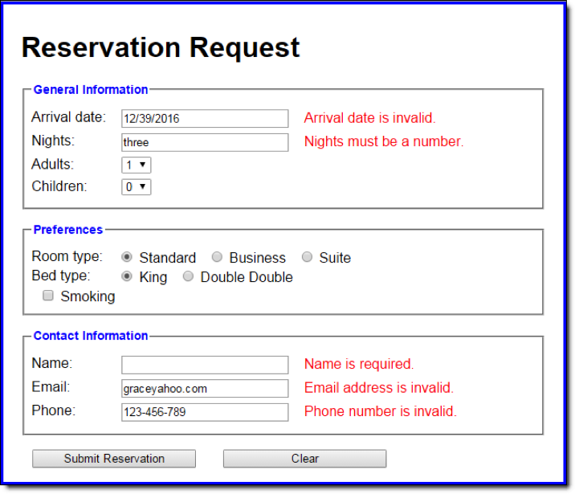
Prac 6
All the tables discussed in the class ( 3 Problem , and 3 of test)
Prac 7

Slide 77
Some more validations/ Input on form
1. <input type="button">:
The <input> type "button" defines a simple push button, which can be programmed to control a functionally on any event such as, click event.
<form>
<input type="button" value="Clcik me " onclick="alert('you ar e learning HTML')">
</form>
2. <input type="file">:
The <input> element with type "file" is used to select one or more files from user device storage. Once you select the file, and after submission, this file can be uploaded to the server with the help of JS code and file API.
<form>
<label>Select file to upload:</label> <input type="file" name="newfile">
<input type="submit" value="submit">
</form>

Slide 78
3. <input type="color">:
The <input> type "color" is used to define an input field which contains a colour. It allows a user to specify the colour by the visual colour interface on a browser.
The "color" type only supports color value in hexadecimal format, and the default value is #000000 (black).
<form>
Pick your Favorite color: <br><br>
<input type="color" name="upclick" value="#a52a2a"> Upclick<br><br>
<input type="color" name="downclick" value="#f5f5dc"> Downclick
</form>
4. <input type="date">:
The <input> element of type "date" generates an input field, which allows a user to input the date in a given format. A user can enter the date by text field or by date picker interface.
<form>
Select Start and End Date: <br><br>
<input type="date" name="Startdate"> Start date:<br><br>
<input type="date" name="Enddate"> End date:<br><br>
<input type="submit">
</form>

Slide 79
5. <input type="datetime-local">:
The <input> element of type "datetime-local" creates input filed which allow a user to select the date as well as local time in the hour and minute without time zone information.
<form>
<label>
Select the meeting schedule: <br><br>
Select date & time: <input type="datetime-local" name="meetingdate"> <br><br>
</label>
<input type="submit">
</form>
6. <input type="month">:
The <input> type "month" creates an input field which allows a user to easily enter month and year in the format of "MM, YYYY" where MM defines month value, and YYYY defines the year value.
<form>
<label>Enter your Birth Month-year: </label>
<input type="month" name="newMonth">
<input type="submit">
</form>

Slide 80
7. <input type="number">:
The <input> element type number creates input filed which allows a user to enter the numeric value. You can also restrict to enter a minimum and maximum value using min and max attribute.
<form>
<label>Enter your age: </label>
<input type="number" name="num" min="50" max="80">
<input type="submit">
</form>
8. Required Attribute:
HTML required is a Boolean attribute which specifies that user must fill that filed before submitting the form.
<input type="text" name="uname" required><br><br>
9. HTML autofocus attribute HTML5
The autofocus is a Boolean attribute which enables a field automatically focused when a webpage loads.
<input type="text" name="uname" autofocus><br><br>

Slide 81
10. HTML disabled attribute: The HTML disabled attribute when applied then it disable that input field. The disabled field does not allow the user to interact with that field.
The disabled input filed does not receive click events, and these input value will not be sent to the server when submitting the form
<input type="text" name="uname" disabled><br><br>

