Slide 1
Study of Graph Classes
Group members:
Pratik Rajani (201601072)
Milan Dungarani (201601096)
Yatin Patel (201601454)
Mentor:
Prof. Rahul Muthu

Slide 2
Definition
In the study of graph classes, we recognized and categorized various graph classes (around 35 graph classes). We created VENN-diagrams for visualization for set of graph classes. We made python library for graph classes recognition algorithm.

Slide 3
List of Graph Classes :-
Simple Graph
Multi Graph
Edgeless Graph
Regular Graph
Strongly Regular Graph
Cubic Graph
Cycle Graph
Wheel Graph
Complete Graph
Strongly Connected Graph
Bipartite Graph
Complete Bipartite Graph
Tree
Forest
Multi-Partite Graph
Complete Multi-Partite Graph
Threshold Graph
Planner Graph
Cube Graph
Harary Graph
Kneser Graph
Petersen Graph
Johnson Graph
Hamming Graph

Slide 4
List of Graph Classes (cont.) :-
Line Graph
Split Graph
Critical Graph
Cyclic Graph
Rook Graph
Moore Graph
Star Graph
Chordal Graph
Connected Graph
Paley Graph

Slide 5
Outputs
We made python library for graph classes recognition algorithm which takes directed or undirected graph as input and provides recognition of particular graph which mentioned earlier in terms of true or false.

Slide 6
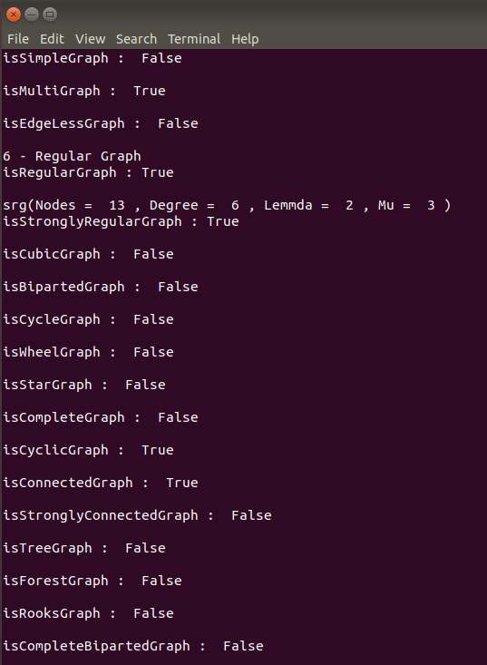
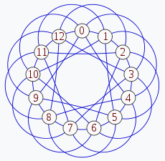
Example:
Output1:
Input:

Slide 7
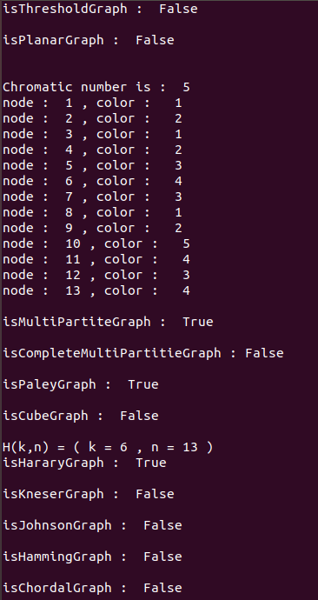
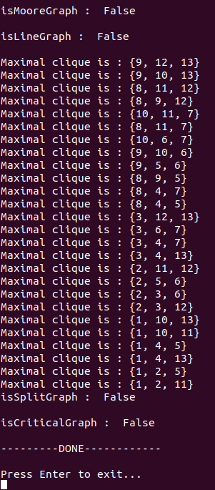
Output2:
Output3:

Slide 8
Analysis
We have made VENN-diagrams for categorization of graph classes.
However, It seems to very unclear and complex for including all graph classes into one VENN-diagram. So we have bifurcate graph classes in several parts of VENN-diagram.
VENN-diagram illustrates which graph class is subpart of or intersection of another graph class. It also tells that which condition will be necessary or sufficient for that particular graph class.

Slide 9
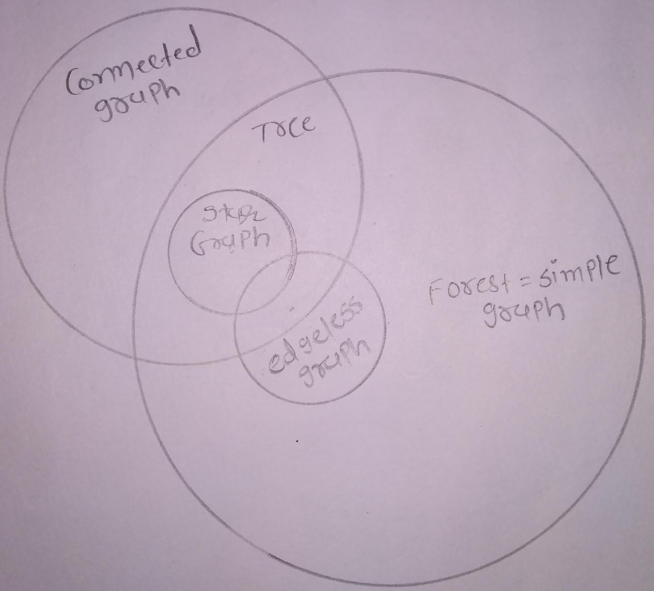
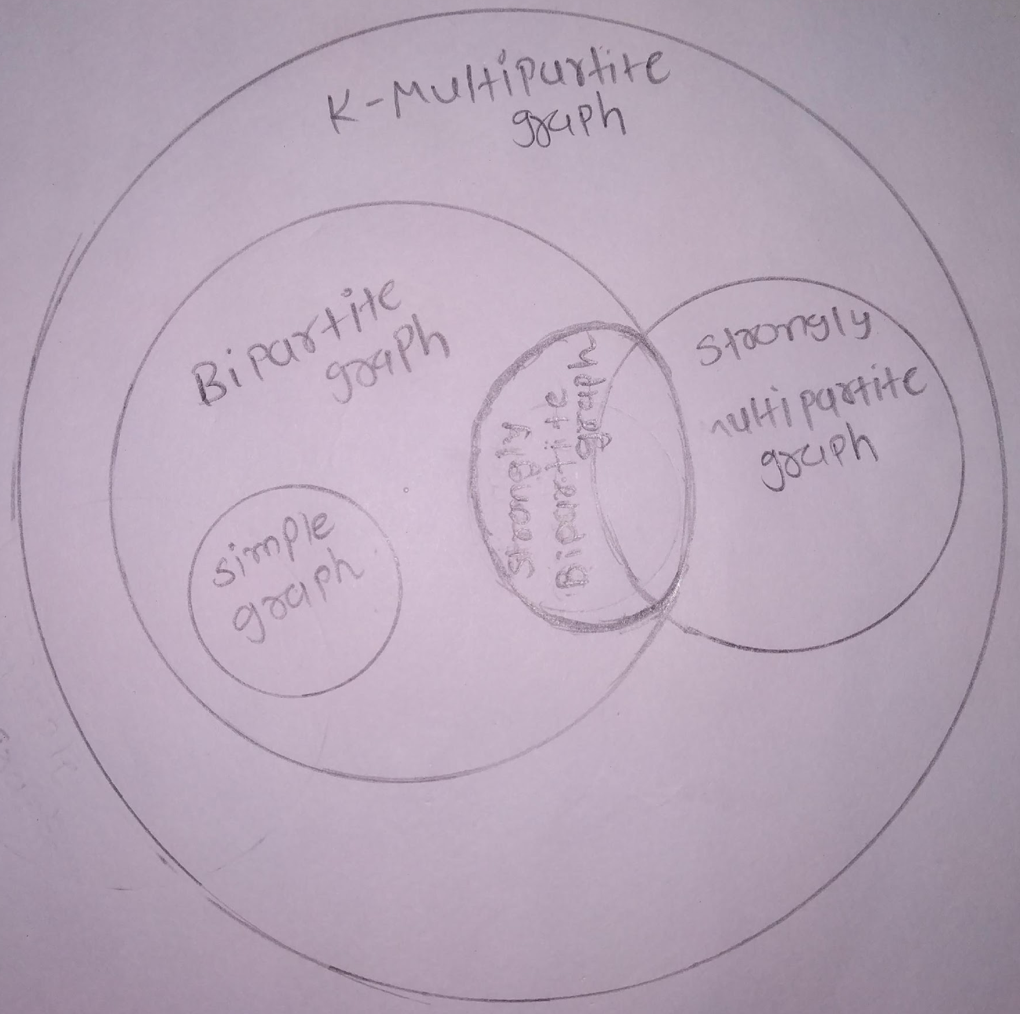

Slide 10
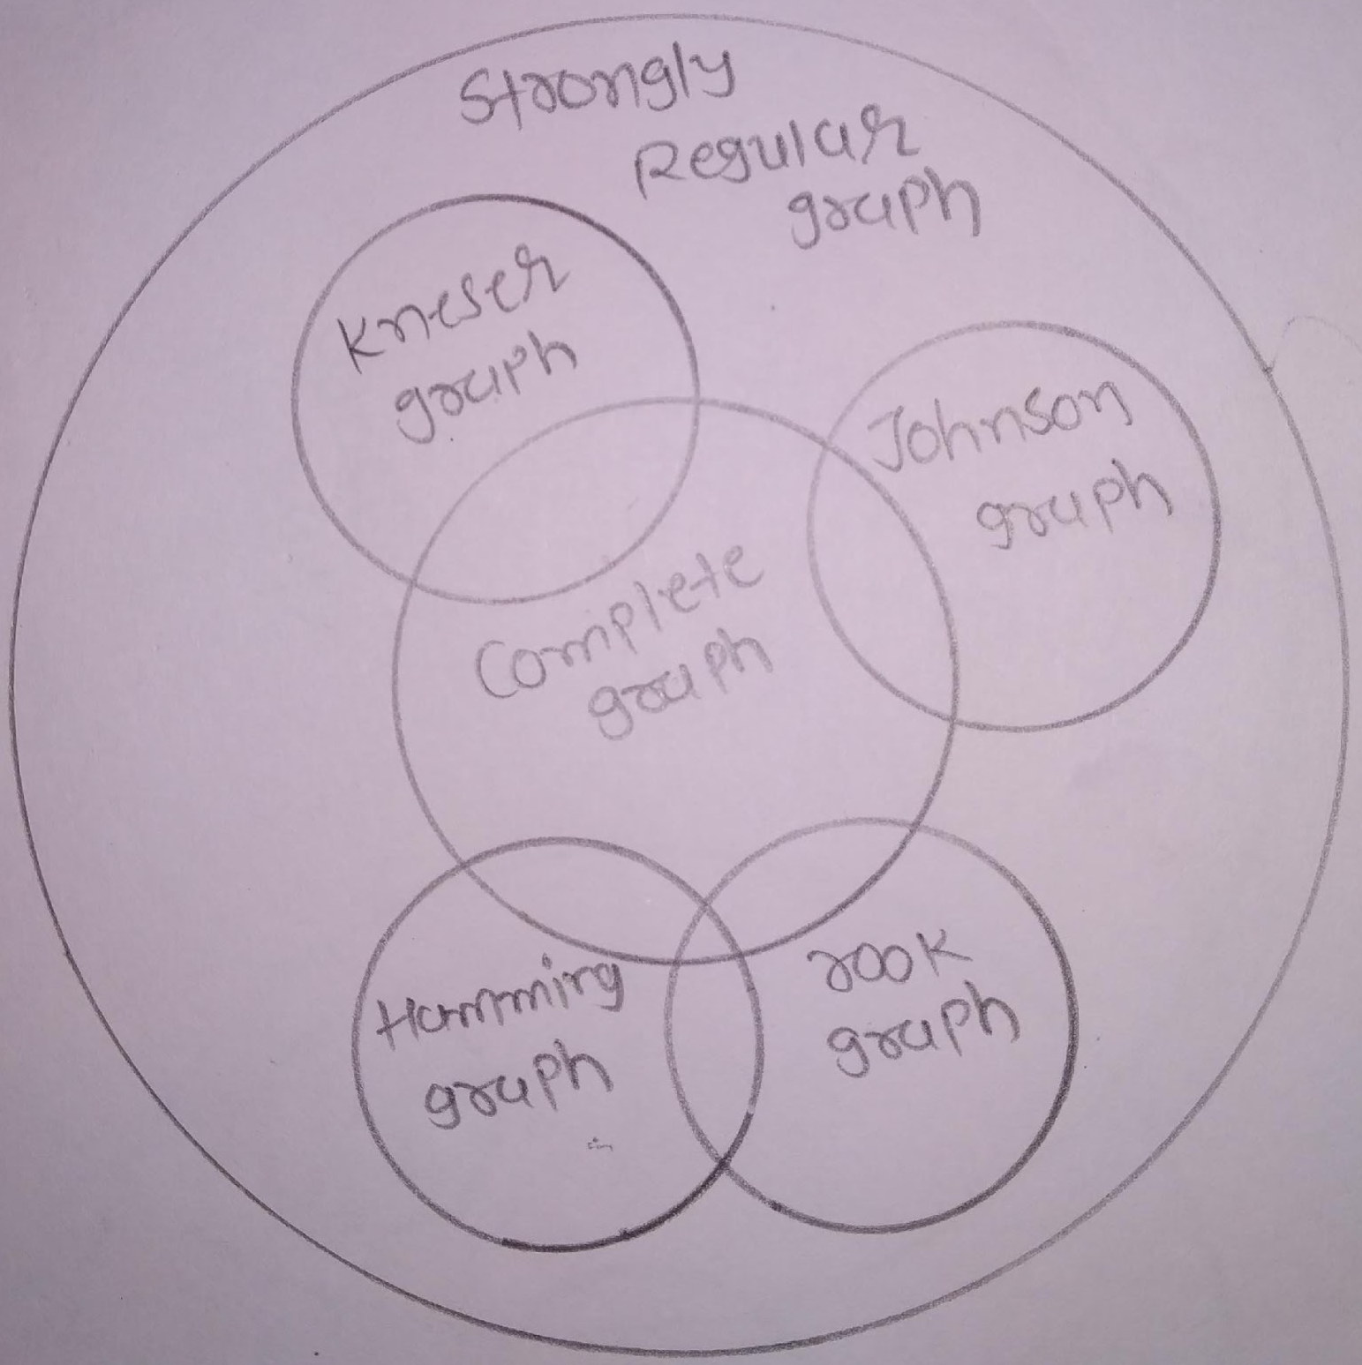
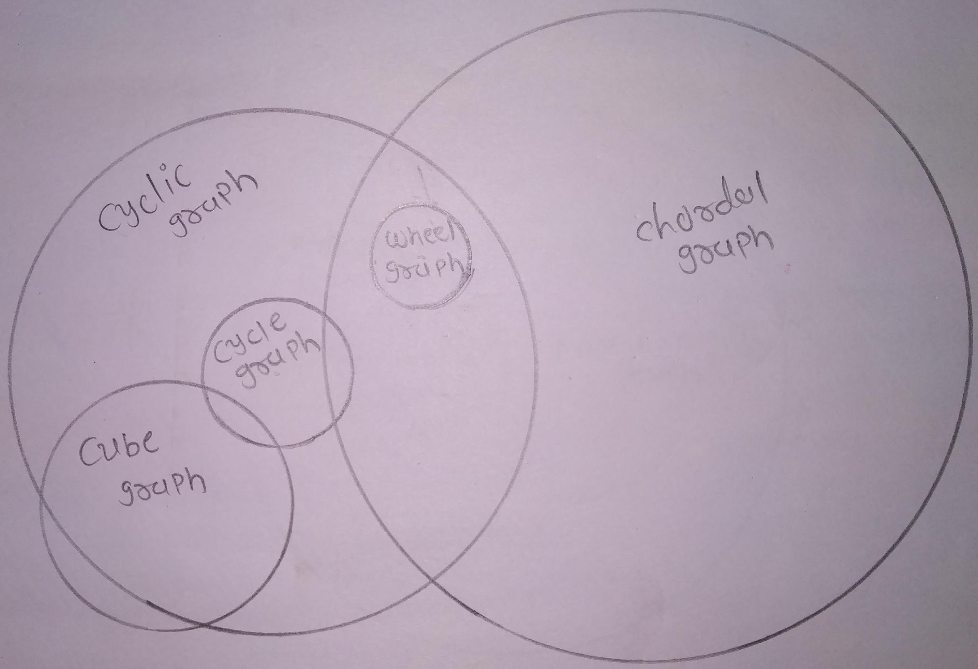

Slide 11
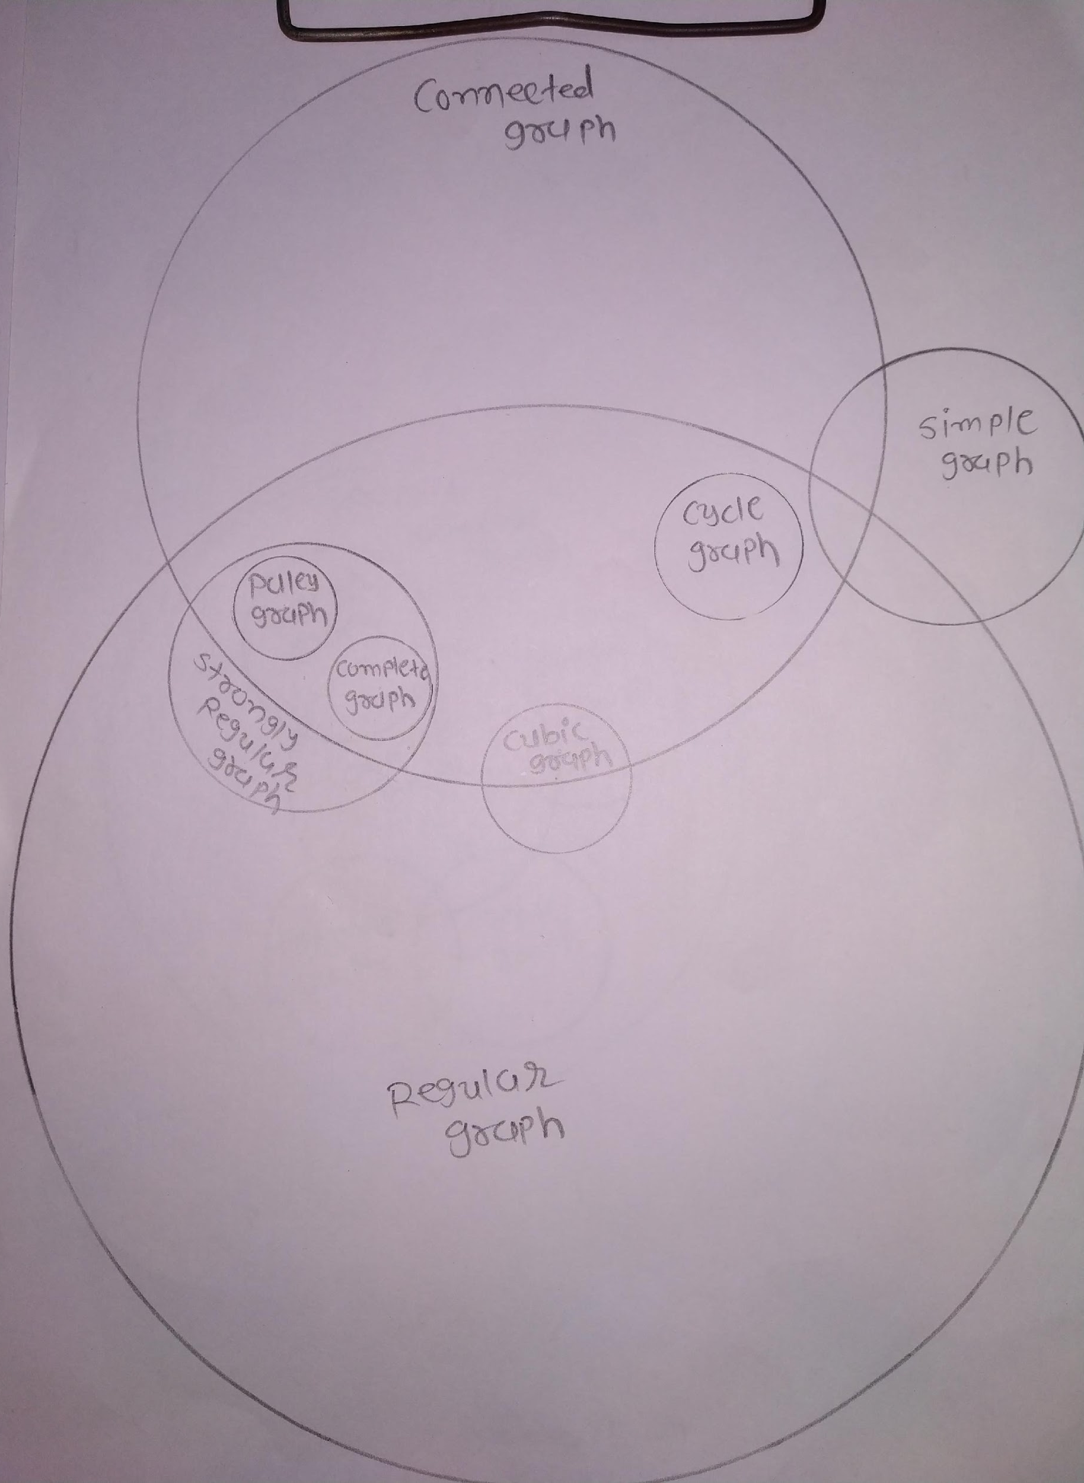

Slide 12
THANK YOU :)

