Slide 1


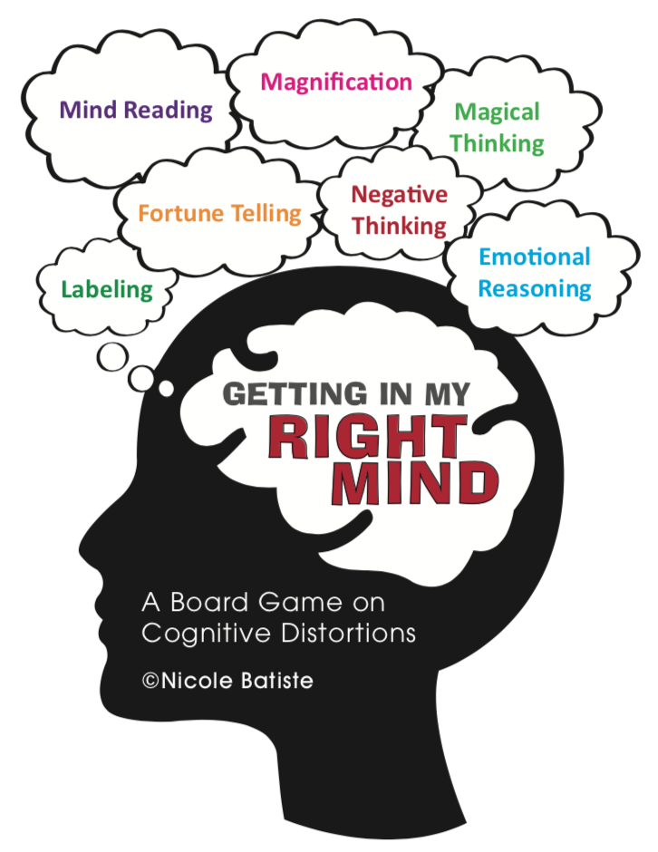
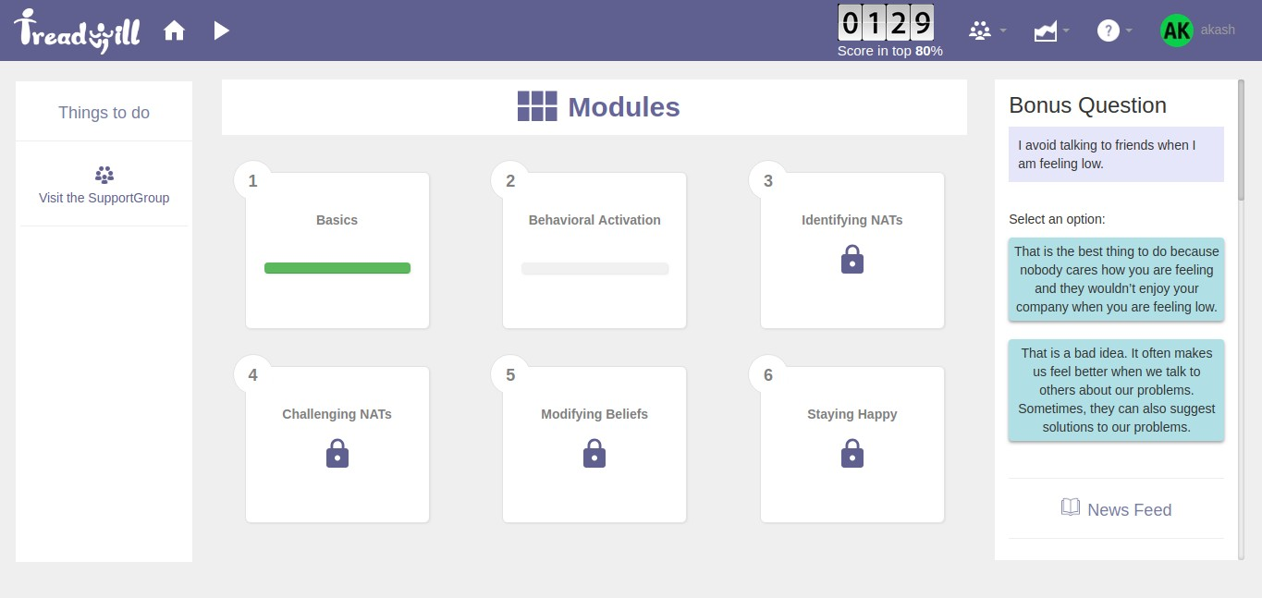
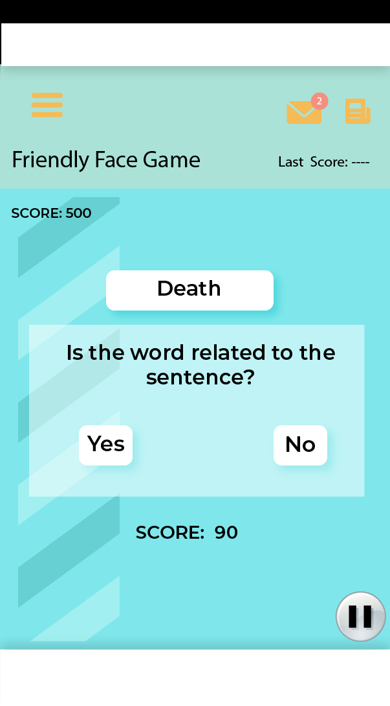
GMT PROJECT-GAMES TO TREAT
MENTAL ILLNESSES
Yatin Azad, Department of Biological Sciences and Bioengineering, IIT KANPUR
Mentor: Prof. Nitin Gupta, Department of Biological Sciences and Bioengineering, IIT KANPUR
SIMULTANEOUS LOCALIZATION AND MAPPING
Subtitle for Academic Research Poster (36x48 inches)
Your names and the names of the people who contributed to this presentation
Introduction
Cognitive Distortions
Cognitive Distortions
Cognitive Behavioral Therapy as devised by Dr.Aaron Beck is a form of structured, short-term and dynamic psychotherapy for depression. It largely focuses on modifying dysfunctional thoughts and behaviour and solving current problems
A study reported in WHO, conducted for the NCMH states that at least 6.5 per cent of the Indian population suffers from some form of the serious mental disorder, with no discernible rural-urban differences.
There is a significant shortage of professionals and, there is a need for an online, computerized tool that can provide help in a concise and effective way.
The objective of my project was to contribute in three particular games that promote adaptive and realistic thinking among individuals.
Inaccurate and deeply flawed thoughts also known as cognitive distortions form the basis of our negative emotions.
They seem to be realistic and rational on the outside but eventually build a very self-defeating perception of events on the inside. Thus, one continues to maintain a negative belief that is inconsistent and unrealistic.
By conscious realization of these thoughts and consistent denial, they can be diminished and replaced by more rational, balanced thinking.
For instance, a person might tell themselves, “I always fail when I try to do something new; I therefore fail at everything I try.” This is an example of “black or white” (or polarized) thinking.
Figure 4 : The mental imagery game in action!
Coming up with sentence word pairs for the Interpretation Bias Game
Following the same underlying concept of interpretation bias ,the second game used ambiguous sentence word pairs instead of mental imageries.to detect Cognitive Bias.
Sentence word pairs were flashed on the user’s screen and he was asked whether he finds the two to be related.
Emotionally suffering or depressed patients easily related to the negative words that the otherwise normal individual might found hard to relate.
A crucial aspect of the game remains to measure the latencies with which the user makes his choices.
Dysphoric individuals were quick to locate the negative choices.
The TreadWill Portal
Figure 1 is a snapshot of the TreadWill website
Methodology
Figure 2 shows the cognitive distortions
Cognitive Bias Modification
Many psychotherapists have talked about Induced emotional interpretation through the use of mental imagery as a mode of identifying the perceived anxiety in patients affected by depression.
The patients that were directed to imagine situations reported greater increases in positive affect and rated new descriptions as being more positive than did those in the verbal condition.
A computerized intervention to change dysfunctional thinking styles had also been described.
Implementation and Involvement
Situations for the mental imagery game
The mental imagery game is a game that induces users to imagine ambiguous situations and come up with responses that reflect how they will react when facing that situation in reality.
It had been established previously that patients who suffer from depression tend to imagine neutral or ambiguous situations negatively .
We compiled a list of possible responses to each question and then divided them into two categories-positive and negative.
Each response had an appropriate score attached to it. When the user entered a positive response, he proceeded further in the story line. Entering a negative response meant failure to complete the task followed by an alternate positive response that was suggested by us.
A set of four distinct storylines have been inscribed by me and they were programmed by my partner into the game.
Figure 5 Show the interpretation bias game being played
The Cognitive Distortion Module
To help the user identify thinking errors, we have a practice module on TreadWill.
The user is given a situation and a Negative-Automatic Thought. The user must select the Thinking error he feels is associated with it.
Explanations as to why a particular Thinking error is suitable for the given situation and NAT were missing and therefore provided by me.
Considerable progress was made into identifying and correcting possible errors in the module.
References
Positive Interpretation Training: Effects of Mental Imagery Versus Verbal Training on Positive Mood by, Emily A. Holmes, Andrew Mathews, Tim Dalgleish.
Cognitive Bias Modification Using Mental Imagery for Depression: Developing a Novel Computerized Intervention to Change Negative Thinking Styles by Tamara J. Lang, Simon E. Blackwell, Catherine J. Harmer, Phil Davison and Emily A. Holmes*.
Negative Interpretation Bias in Individuals with Depressive Symptoms by Alexandra H. Cowden Hindash ,Nader Amir.
Burns, D. D., & Beck, A. T. (1999). Feeling good: The new mood therapy.
Dr. Salil Goel
Assistant Prof. (Geoinformatics)
Email: sgoel@iitk.ac.in
Piyush Patel
Email: ppatel@iitk.ac.in
Phone: +917007188949

