Slide 1
Data Warehousing Architecture
Deepika Chaudhary

Slide 2
Properties
The following architecture properties are essential for a data ware house architecture.
Separation- Analytical and transactional processing should be kept as much apart as possible.
Scalability – H/W and S/W arch should be easy to upgrade as the data volume which has to be managed and processed and the number of user requirements.

Slide 3
Extensibility – The architecture should be able to host new applications and technologies without redesigning whole system.
Security – Monitoring access is essential because of the strategic data stored in warehouse.
Administer ability - Data warehouse mgt should not be overly difficult.

Slide 4
Goals of data warehouse System
The DW/BI system must make information easily accessible.
The DW/BI system must present information consistently – “Single Version of Truth”.
The DW/BI system must adapt to change
The DW/BI system must present information in timely way.
The DW/BI system must be secure.

Slide 5
The DW/BI system must support for more fact based decision making.
The DW/BI system must serve as the authoritative and trust worthy foundation for improved decision making.
The business community must accept the DW/BI system to deem it successful.

Slide 6
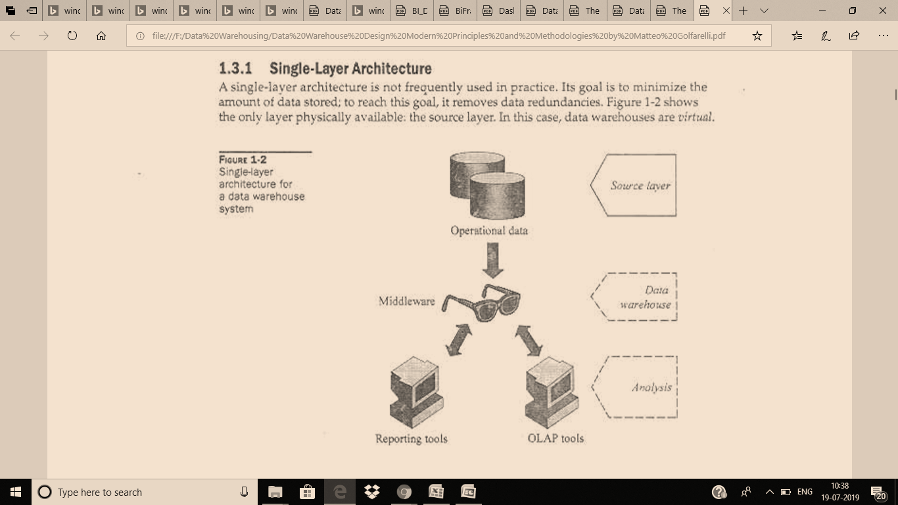

Slide 7
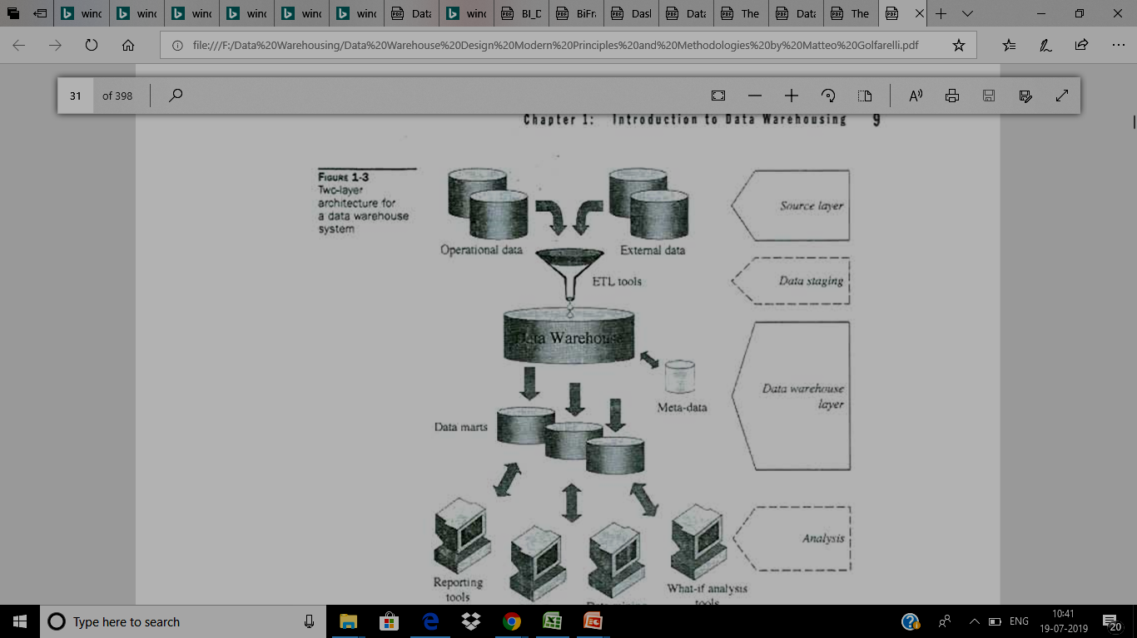

Slide 8
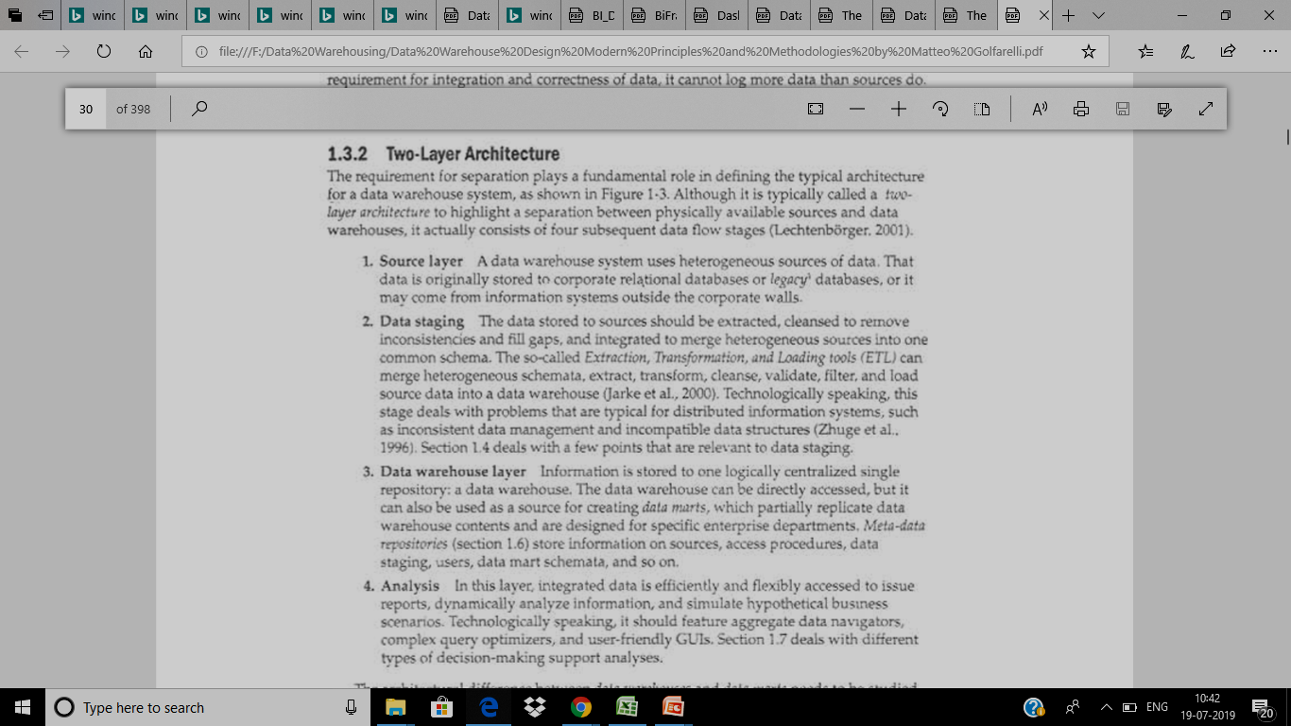

Slide 9
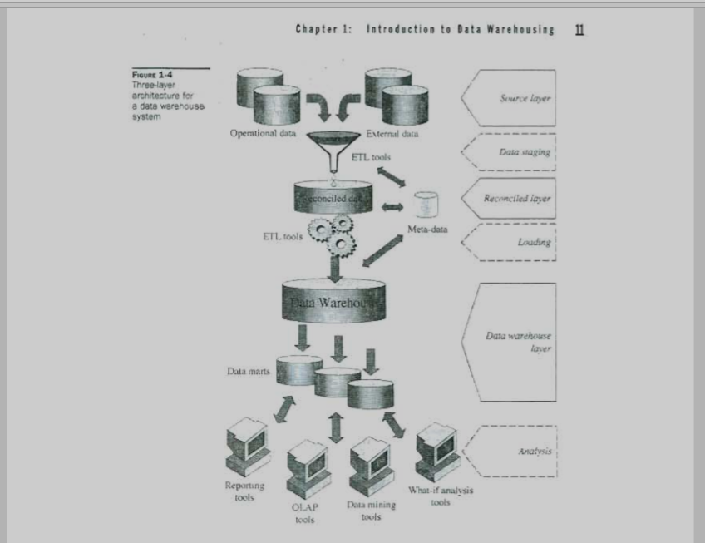

Slide 10
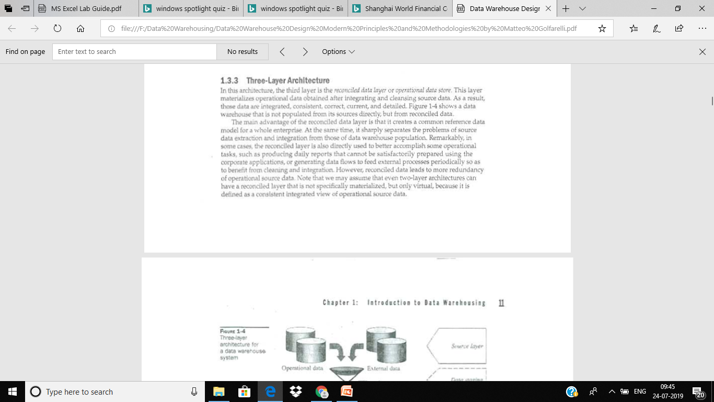

Slide 11
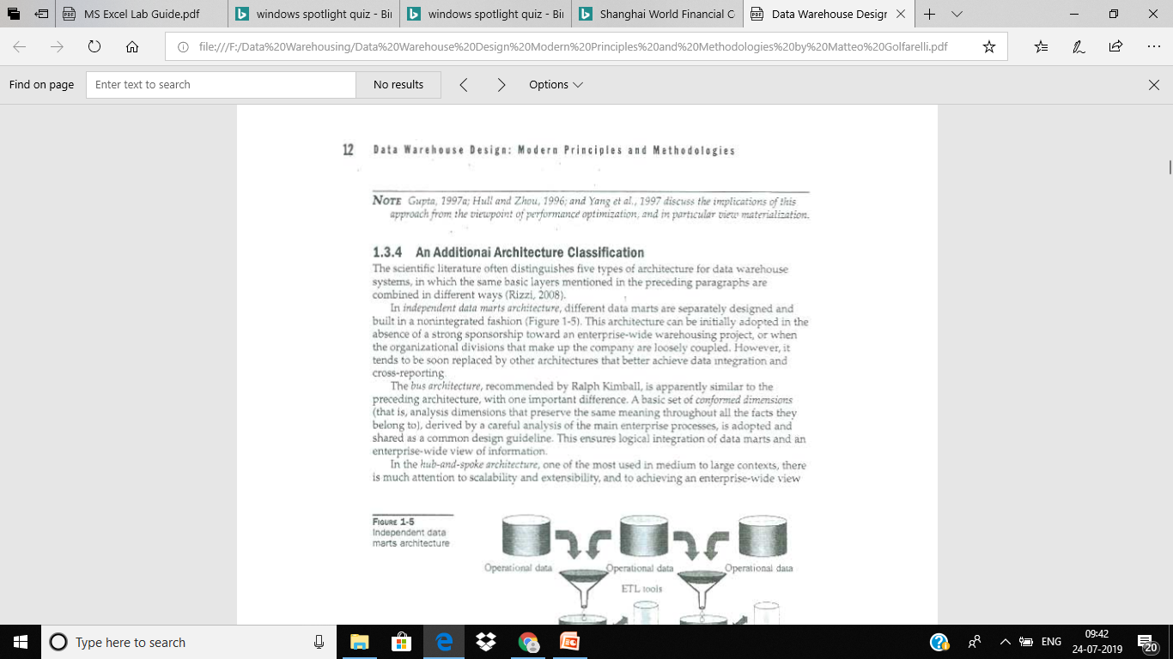

Slide 12
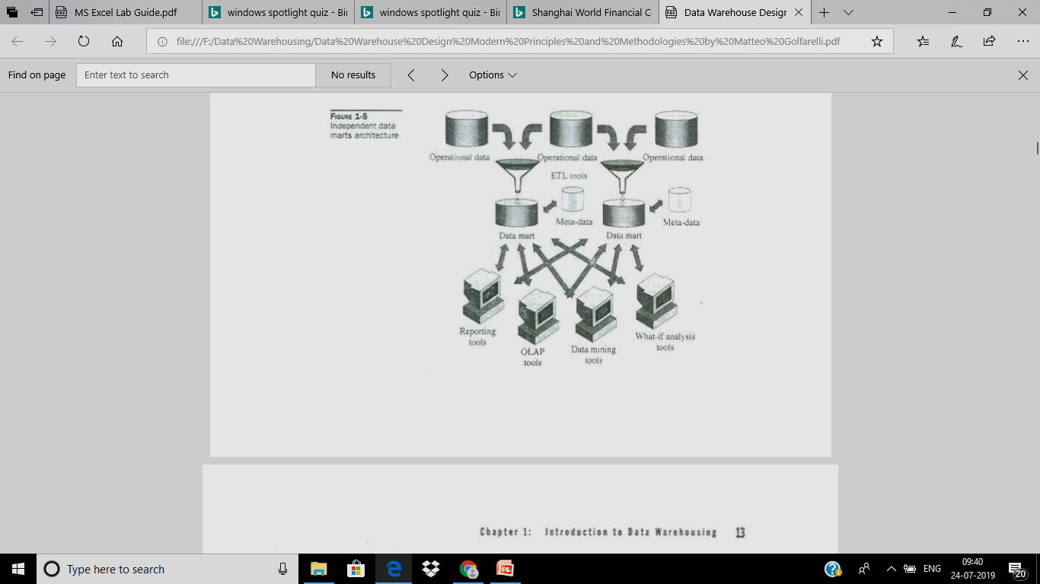

Slide 13
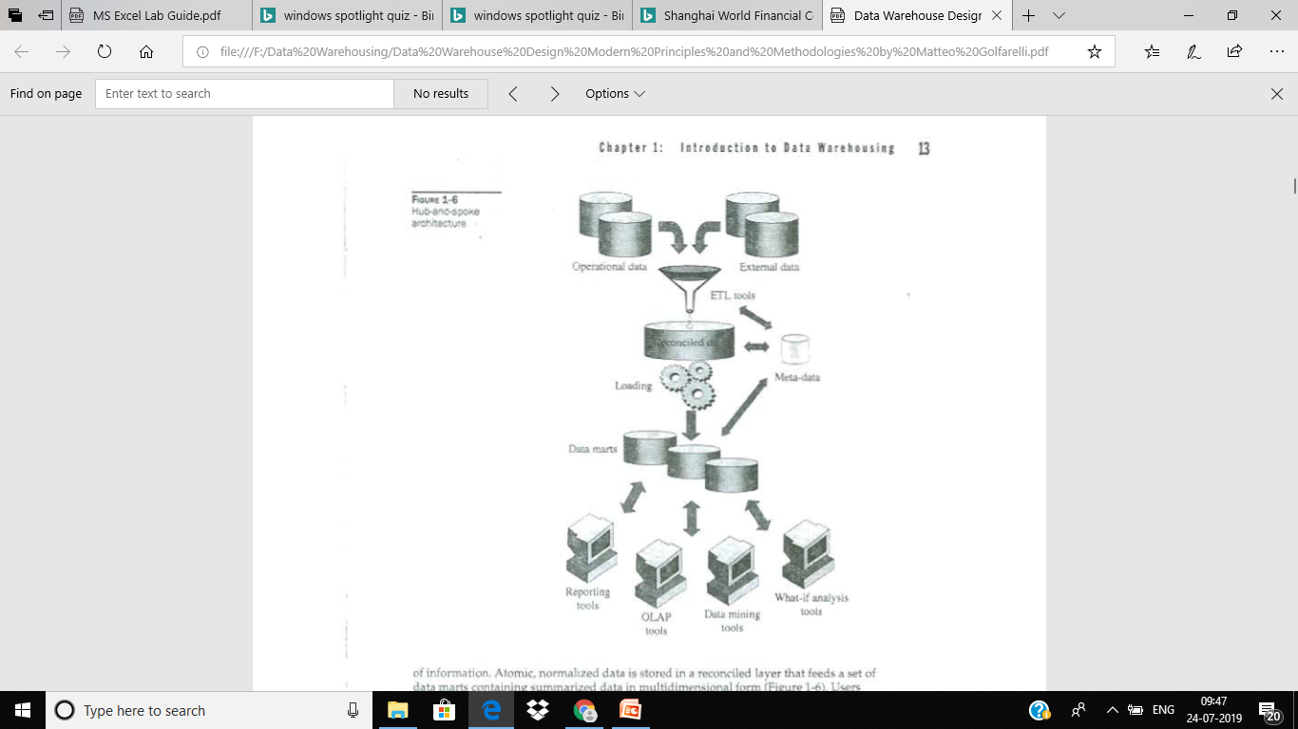

Slide 14
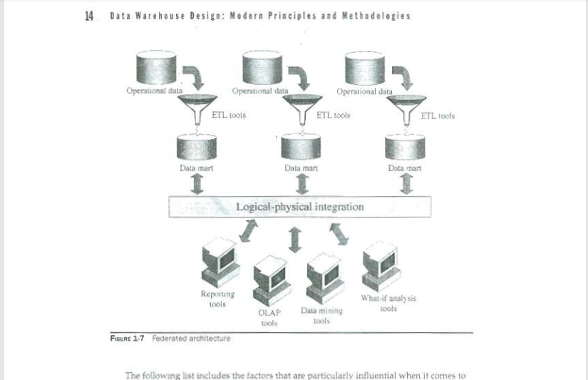

Slide 15
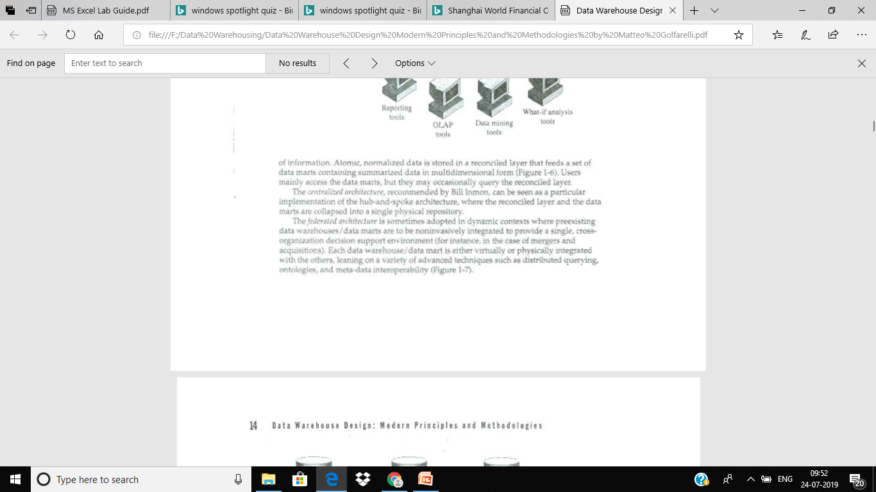

Slide 16
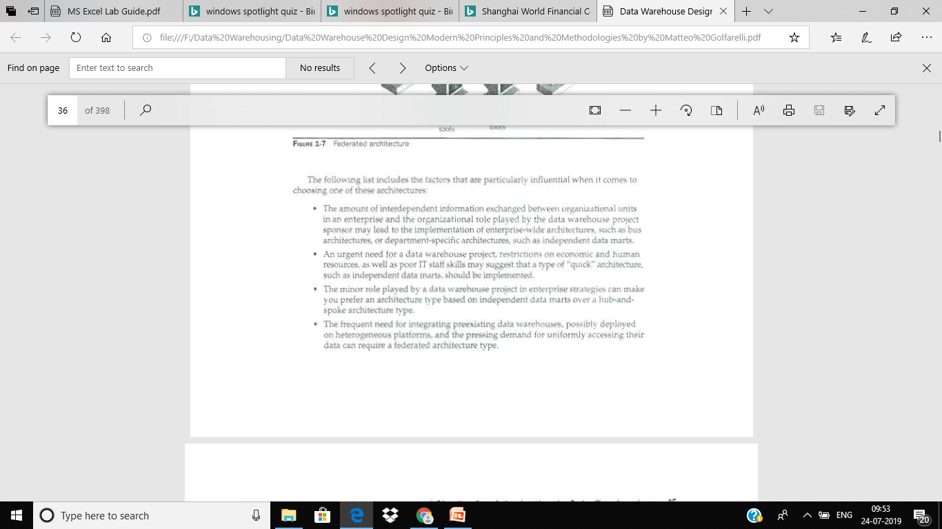

Slide 17
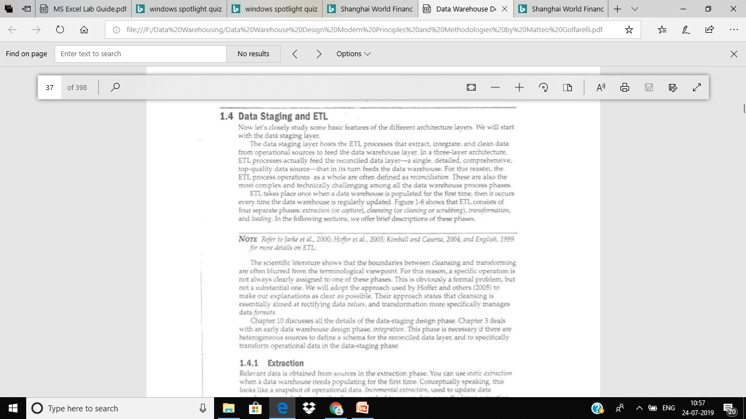
Data Staging and ETL

