Slide 1
White box testing
White-box testing of software includes close examination of procedural detail.
Logical paths through the software are tested by providing test cases that exercise specific sets of conditions and/or loops.
The "status of the program" may be examined at various points.
White-box testing, sometimes called glass-box testing, is a test case design method that uses the control structure of the procedural design to derive test cases.

Slide 2
White box testing
Using this method, we can derive test cases that
Guarantee that all independent paths within a module have been exercised at least once
Exercise all logical decisions on their true and false sides,
Execute all loops at their boundaries and within their operational bounds
Exercise internal data structures to ensure their validity.

Slide 3
Basis path testing
Path testing is a structural testing method that involves using the source code of a program in order to find every possible executable path. It helps to determine all faults lying within a piece of code.
Basis path testing is a white-box testing technique
To derive a logical complexity measure of a procedural design.
Test cases derived to exercise the basis set are guaranteed to execute every statement in the program at least one time.
Methods:
Flow graph notation
Calculate Cyclomatic Complexity
Find Independent program paths
Deriving test cases

Slide 4
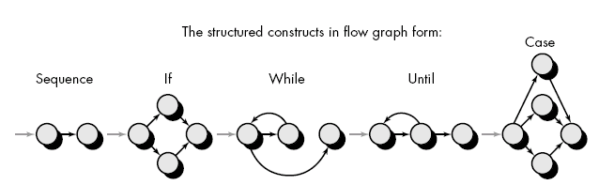
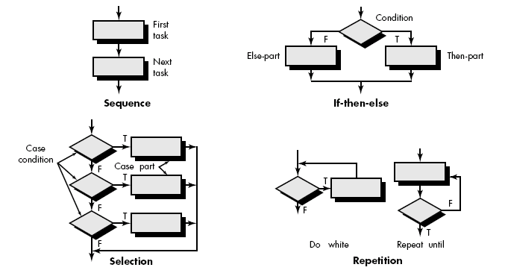
Flow Graph Notation
Start with simple notation for the representation of control flow (called flow graph). It represent logical control flow.

Slide 5
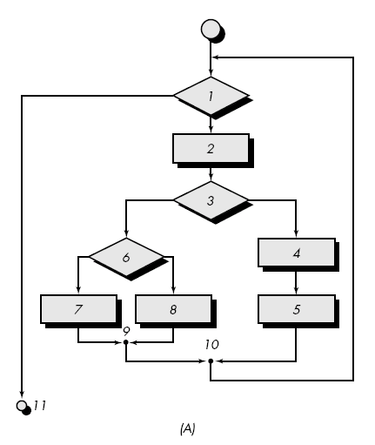
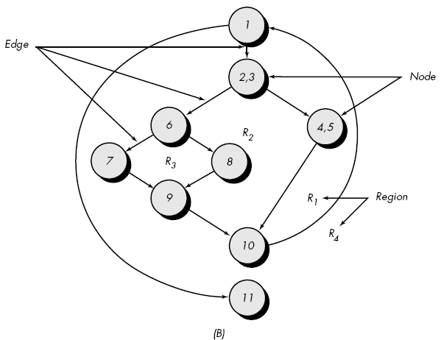
Fig. A represent program control structure and fig. B maps the flowchart into a corresponding flow graph.
In fig. B each circle, called flow graph node, represent one or more procedural statement.

Slide 6
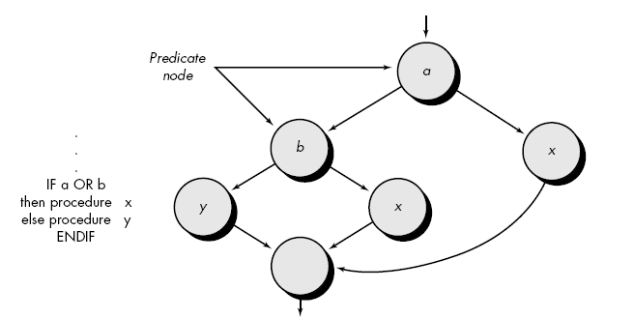
A sequence of process boxes and decision diamond can map into a single node.
The arrows on the flow graph, called edges or links, represent flow of control and are parallel to flowchart arrows.
An edge must terminate at a node, even if the node does not represent any procedural statement.
Areas bounded by edges and nodes are called regions. When counting regions, we include the are outside the graph as a region.
When compound condition are encountered in procedural design, flow graph becomes slightly more complicated.

Slide 7
When we translating procudural segment into flow graph, separate node is created for each condition.
Each node that contains a condition is called predicate node and is characterized by two or more edges comes from it.

Slide 8
Independent program paths or Cyclomatic complexity
An independent path is any path through the program that introduces at least one new set of processing statement or new condition.
For example, a set of independent paths for flow graph:
  Path 1: 1-11
  Path 2: 1-2-3-4-5-10-1-11
  Path 3: 1-2-3-6-8-9-1-11
  Path 4: 1-2-3-6-7-9-1-11
Note that each new path introduces a new edge.
The path 1-2-3-4-5-10-1-2-3-6-8-9-1-11 is not considered to e an independent path because it is simply a combination of already specified paths and does not traverse any new edges.
Test cases should be designed to force execution of these paths (basis set).
Every statement in the program should be executed at least once and every condition will have been executed on its true and false.
Basis Set

Slide 9
How do we know how many paths to looks for ?
Cyclomatic complexity is a software metrics that provides a quantitative measure of the logical complexity of a program.
It defines no. of independent paths in the basis set and also provides number of test that must be conducted.
One of three ways to compute cyclomatic complexity:
  The no. of regions corresponds to the cyclomatic complexity.
  Cyclomatic complexity, V(G), for a flow graph, G, is defined as
    V(G) = E - N + 2
    where E is the number of flow graph edges, N is the number of flow graph nodes.
  Cyclomatic complexity, V(G), for a flow graph, G, is also defined as
  V(G) = P + 1
  where P is the number of predicate nodes edges
  So the value of V(G) provides us with upper bound of test cases.

Slide 10
Flow Graph Example
FLOW CHART
FLOW GRAPH
0
0
R4
1
1
2
2
3
R3
3
6
4
6
4
R2
7
8
5
R1
7
8
5
9
9
11
10
11
10

Slide 11
Deriving Test Cases
It is a series of steps method.
The procedure average depicted.
Average, an extremely simple algorithm, contains compound conditions and loops.
To derive basis set, follow the steps.
Using the design or code as a foundation, draw a corresponding flow graph.
    A flow graph is created by numbering those PDL statements that will be mapped into corresponding flow graph nodes.

Slide 12
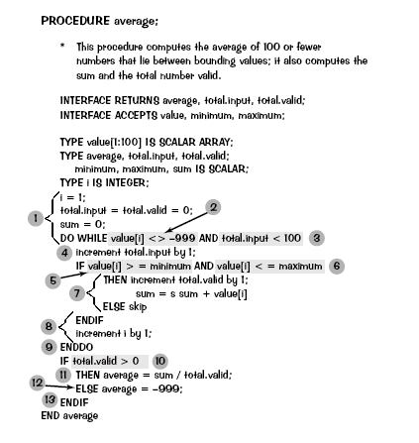
Deriving Test Cases

Slide 13
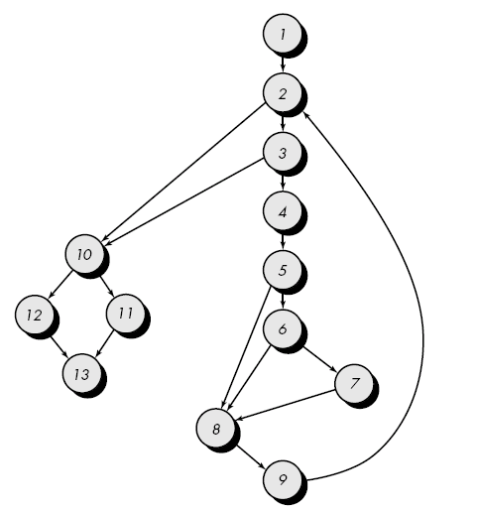
Flow graph for the procedure average

Slide 14
Determine the cyclomatic complexity of the resultant flow graph.
  V(G) can be determined without developing a flow graph by counting all conditional statements in the PDL (for the procedure average, compound conditions count as two) and adding 1
  V(G) = 6 regions
  V(G) = 17 edges - 13 nodes + 2 = 6
  V(G) = 5 predicate nodes + 1 = 6
Determine a basis set of linearly independent paths
  The value of V(G) provides the number of linearly independent paths through the program control structure.
  path 1: 1-2-10-11-13
  path 2: 1-2-10-12-13
  path 3: 1-2-3-10-11-13
  path 4: 1-2-3-4-5-8-9-2-. . .
  path 5: 1-2-3-4-5-6-8-9-2-. . .
  path 6: 1-2-3-4-5-6-7-8-9-2-. . .
  The ellipsis (. . .) following paths 4, 5, and 6 indicates that any path through the remainder of the control structure is acceptable.

Slide 15
Prepare test cases that will force execution of each path in the basis set.
  Data should be chosen so that conditions at the predicate nodes are appropriately set as each path is tested.
  Each test case is executed and compared to expected results.
  Once all test cases have been completed, the tester can be sure that all statements in the program have been executed at least once.

Slide 16
Create flow graph ,generate cyclomatic complexity and find test cases
1 int functionZ(int y)
2 {
3 int x = 0;
4 while (x <= (y * y))
5 {
6 if ((x % 11 == 0) &&
7 (x % y == 0))
8 {
9 printf(“%d”, x);
10 x++;
11 } // End if
12 else if ((x % 7 == 0) ||
13 (x % y == 1))
14 {
15 printf(“%d”, y);
16 x = x + 2;
} // End else
18 printf(“\n”);
19 } // End while
20 printf("End of list\n");
21 return 0;
22 } // End functionZ

Slide 17
Create Algorithm, flow graph ,generate cyclomatic complexity and find test cases for traingle Problem

