Slide 1
Testing as a craft
When we know what kind of error we are prone to make
If we know what kind of faults are likely to reside in software to be tested.
We can use this to employ more appropriate test case identification methods.
At this point testing really becomes a craft.

Slide 2
Error & Fault Taxonomies
Definition of error & fault hinge on the distinction between process & product
Process-refer to how we do something.
Product-end result of a process.
SQA- tries to improve the product by improving the process.
Testing is clearly more product oriented.
Faults can be classified in several ways

Slide 3
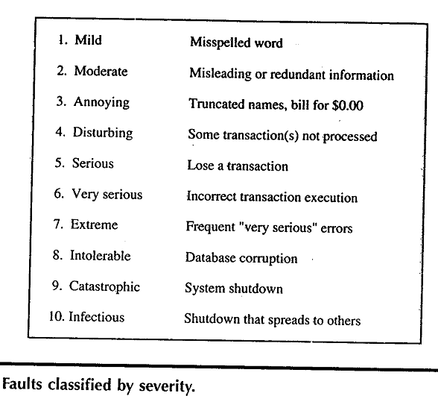

Slide 4
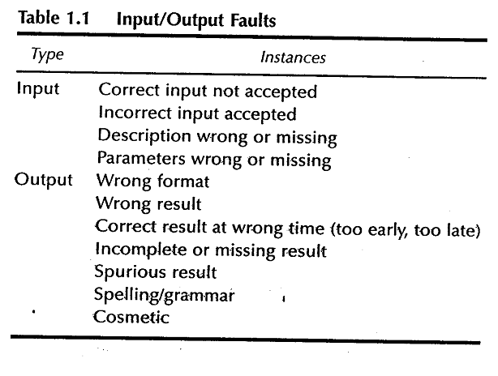

Slide 5
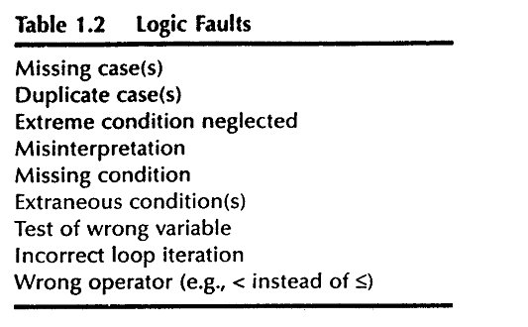

Slide 6
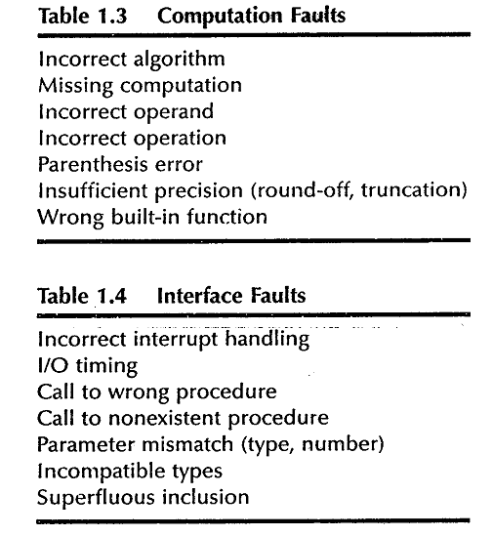

Slide 7
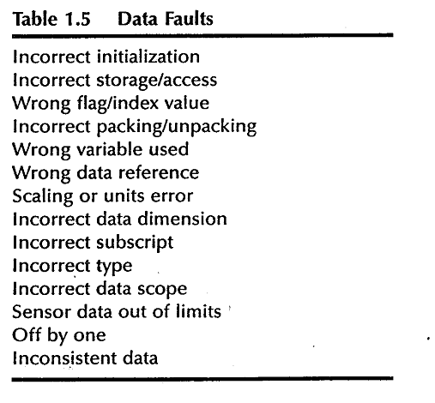

Slide 8
Levels of Testing
Levels of testing echo the levels of abstraction found in the waterfall model of the SDLC.
In functional testing 3 levels of definition (specification, preliminary design, detailed design) correspond directly to 3 levels of testing –system, integration & unit testing.

Slide 9
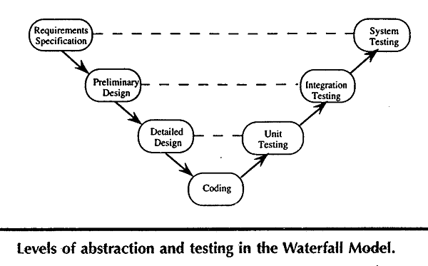

Slide 10
Example
Examples to illustrate various unit Testing methods.
  The triangle problem

Slide 11
Generalized Psuedocode
Pseudocode provides a “language neutral” way to express program source code.

Slide 12
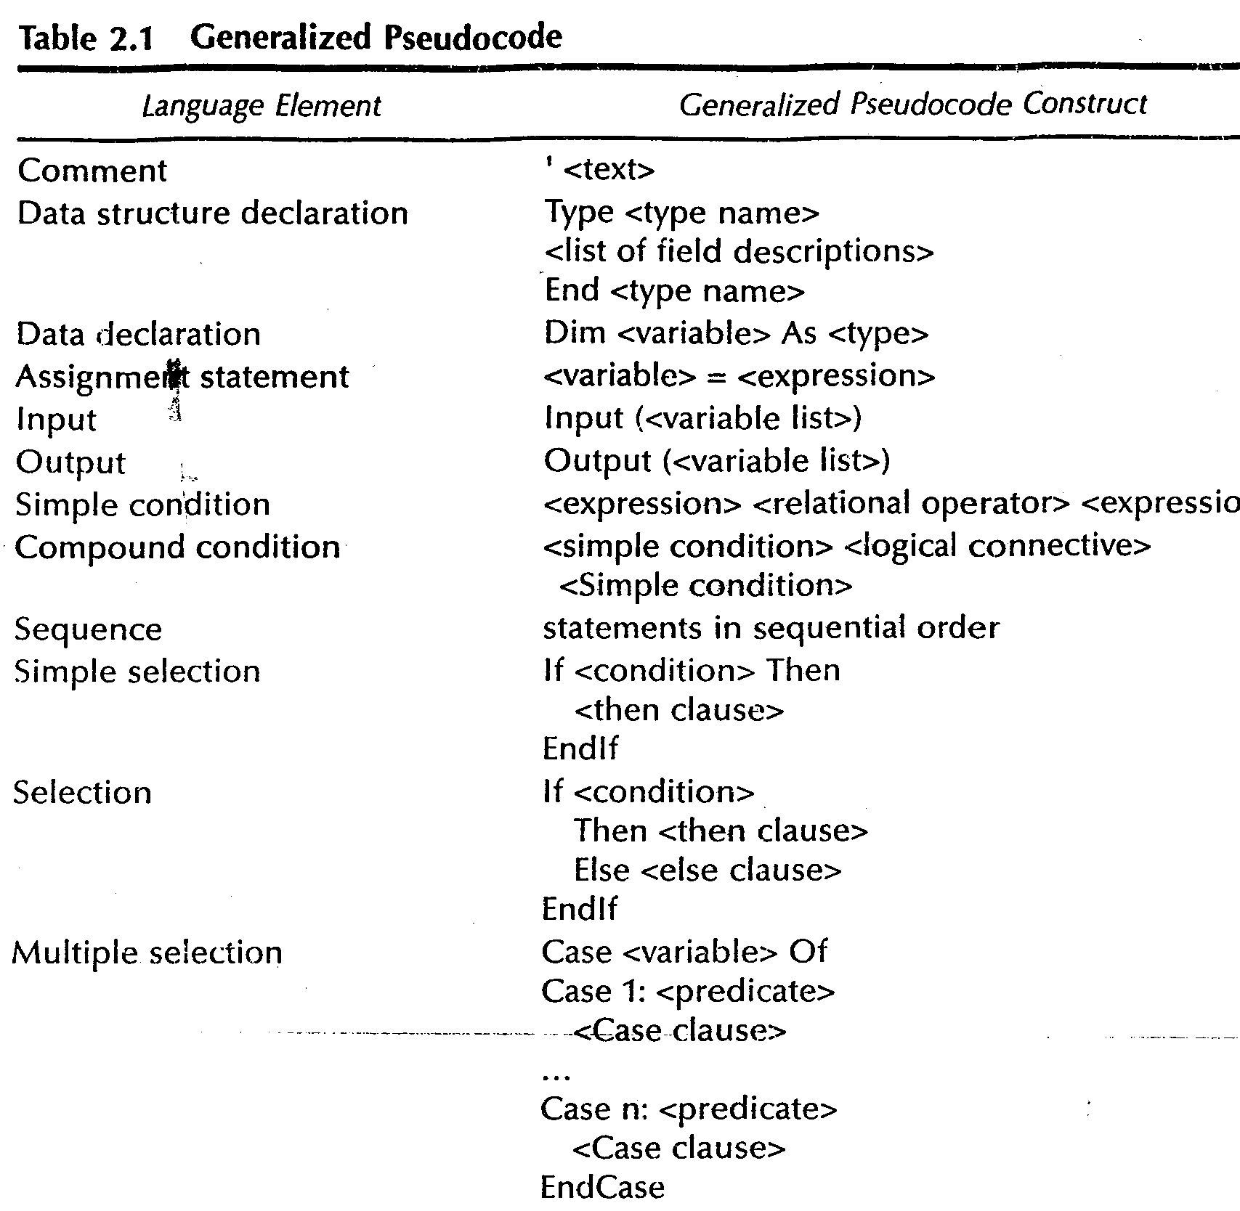

Slide 13
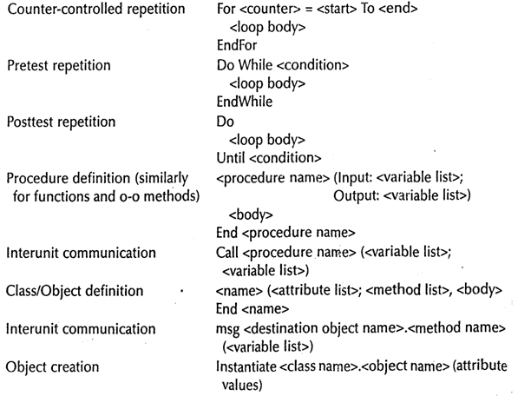

Slide 14
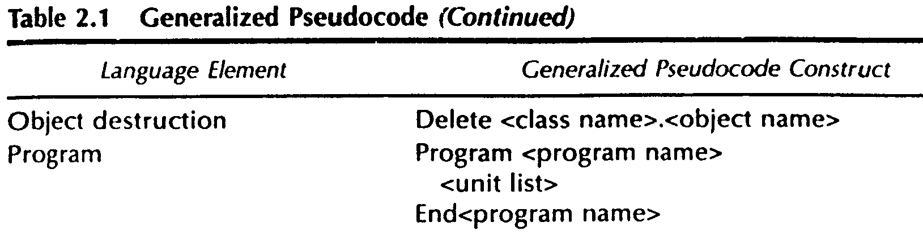

Slide 15
Triangle Problem
Problem statement
Simple version: The triangle program accepts 3 integers a, b, c as input to be sides of a triangle
o/p is type of triangle determined by 3 sides
Equilateral, Isosceles, Scalene, Not a triangle.

Slide 16
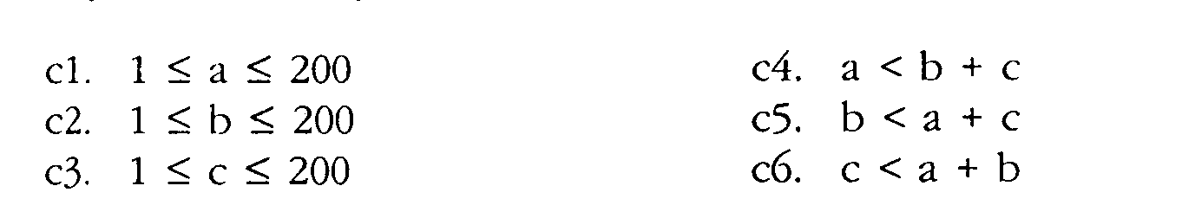
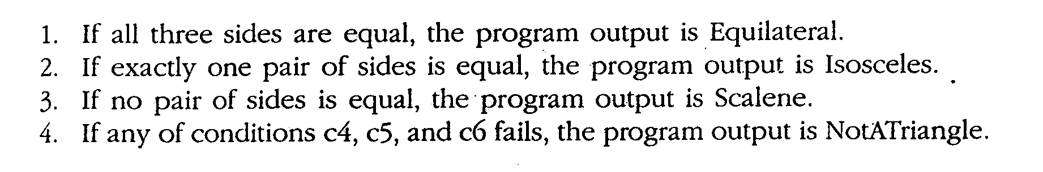
Improved version
Sides of triangle integer a, b, c must satisfy the following conditions
One of the 4 mutually exclusive output is given

Slide 17
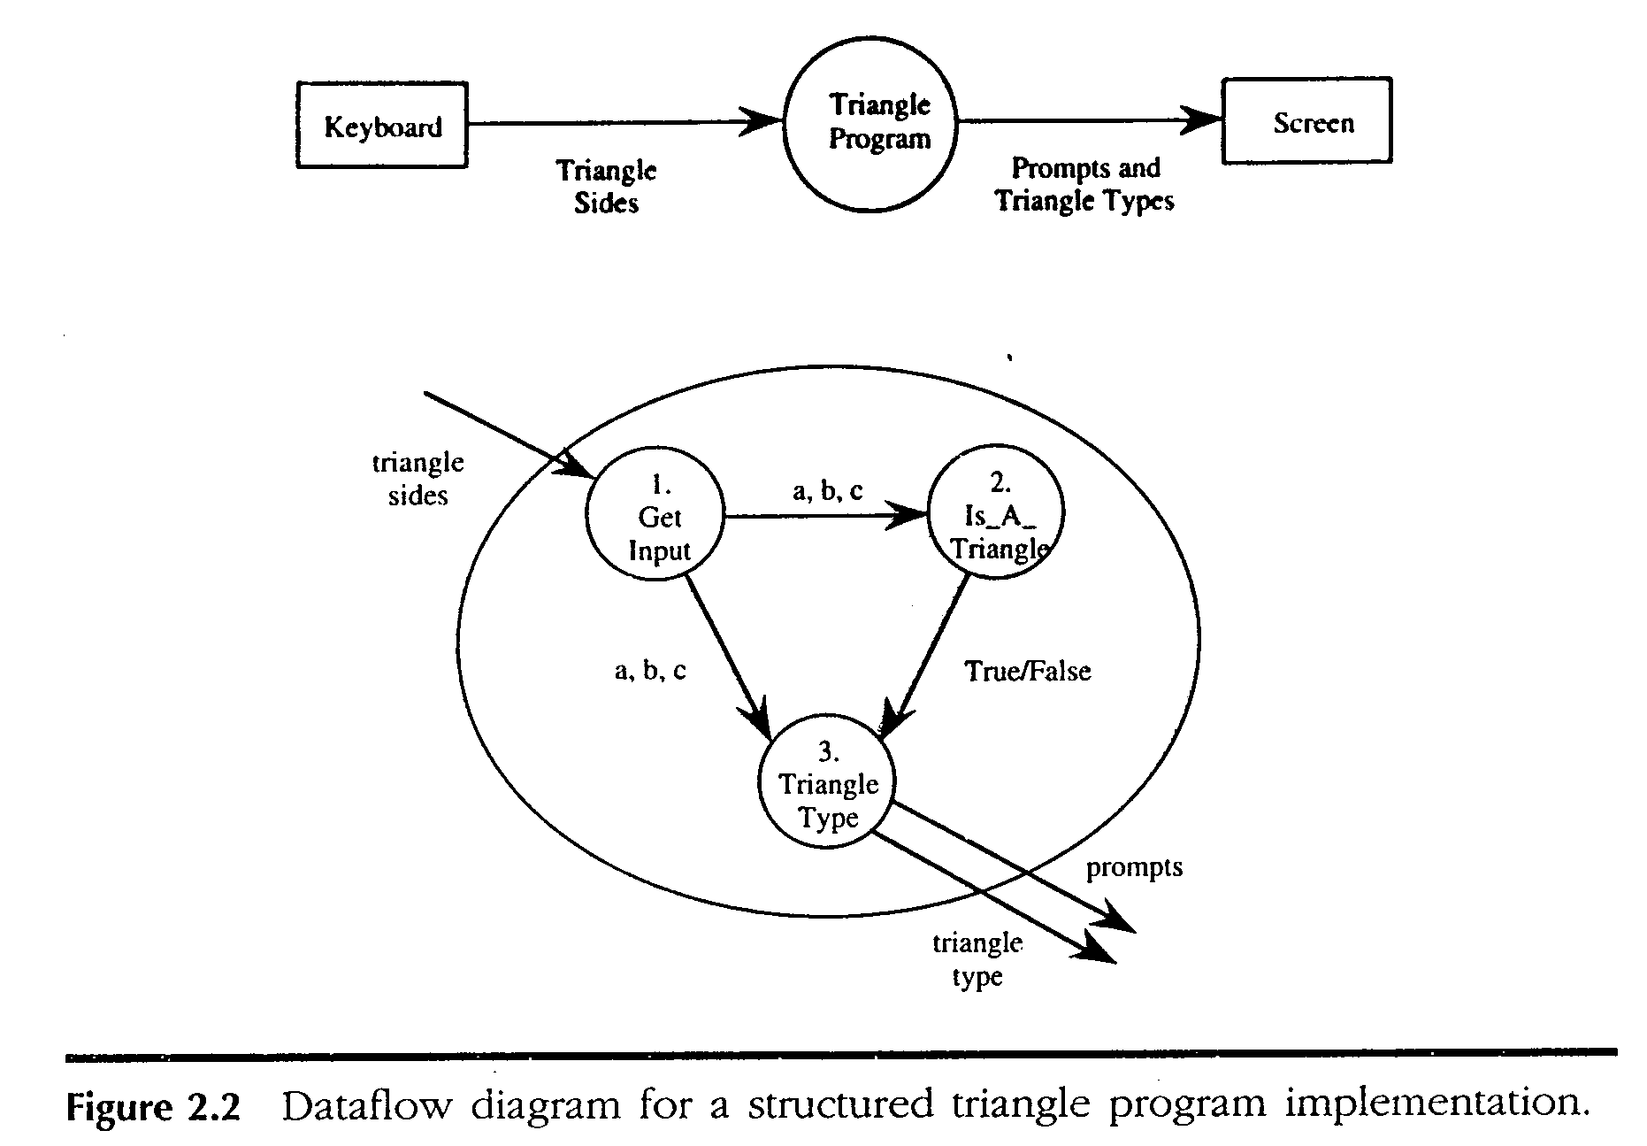

Slide 18
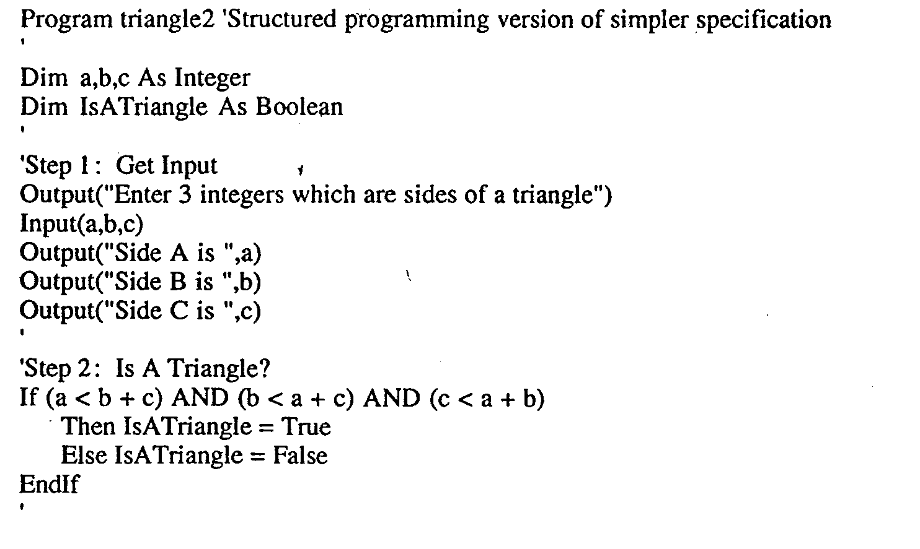

Slide 19
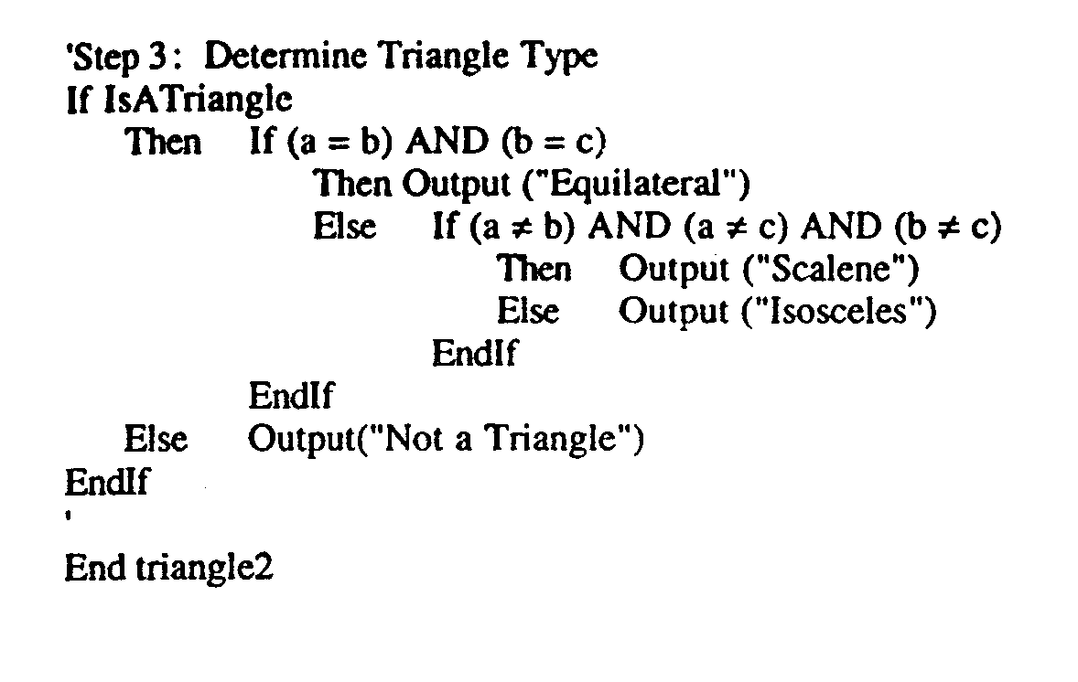

Slide 20
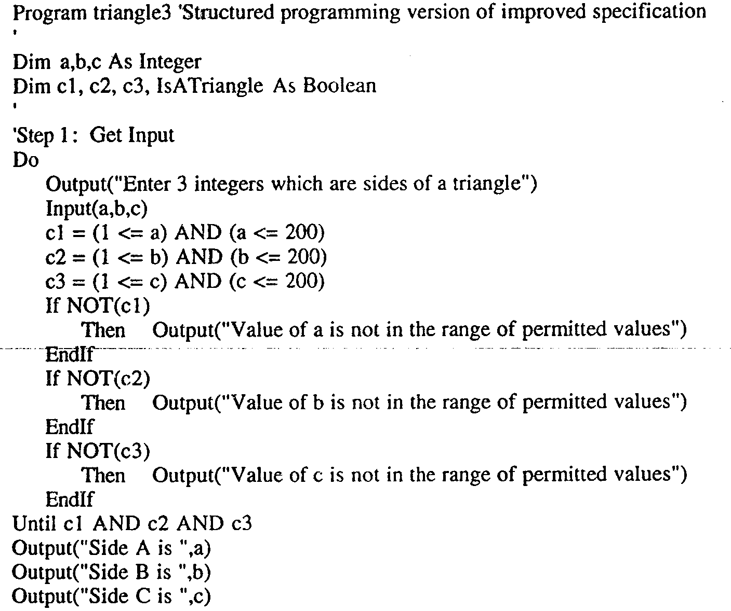

Slide 21
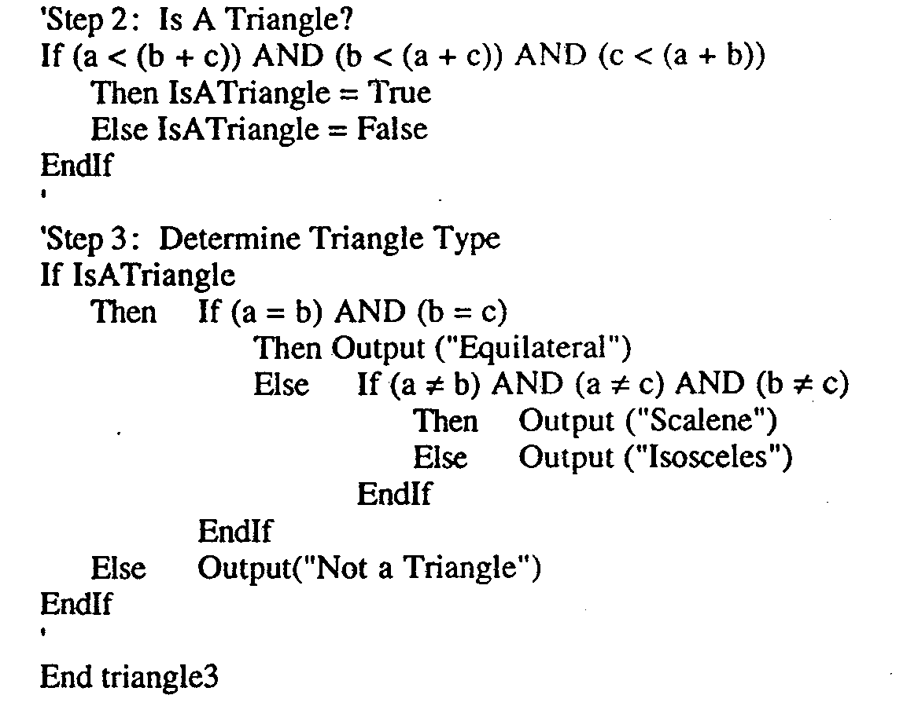

Slide 22
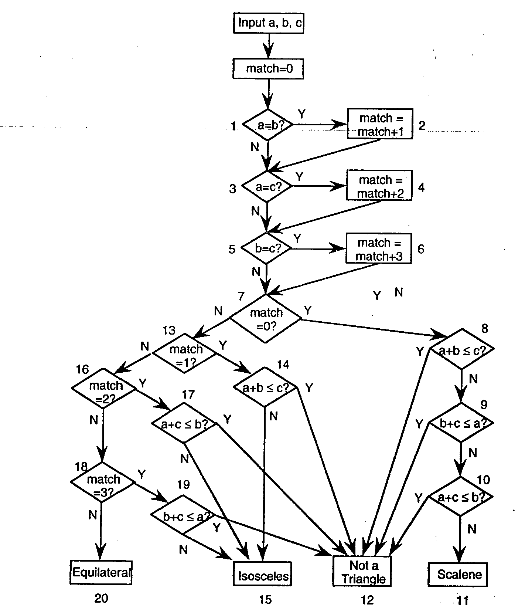
Traditional Implementation

Slide 23
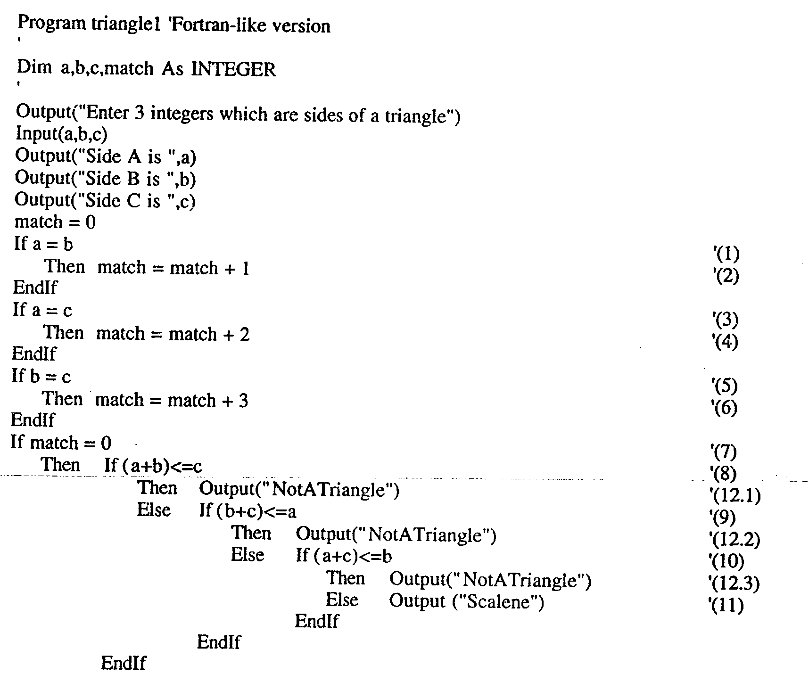

Slide 24
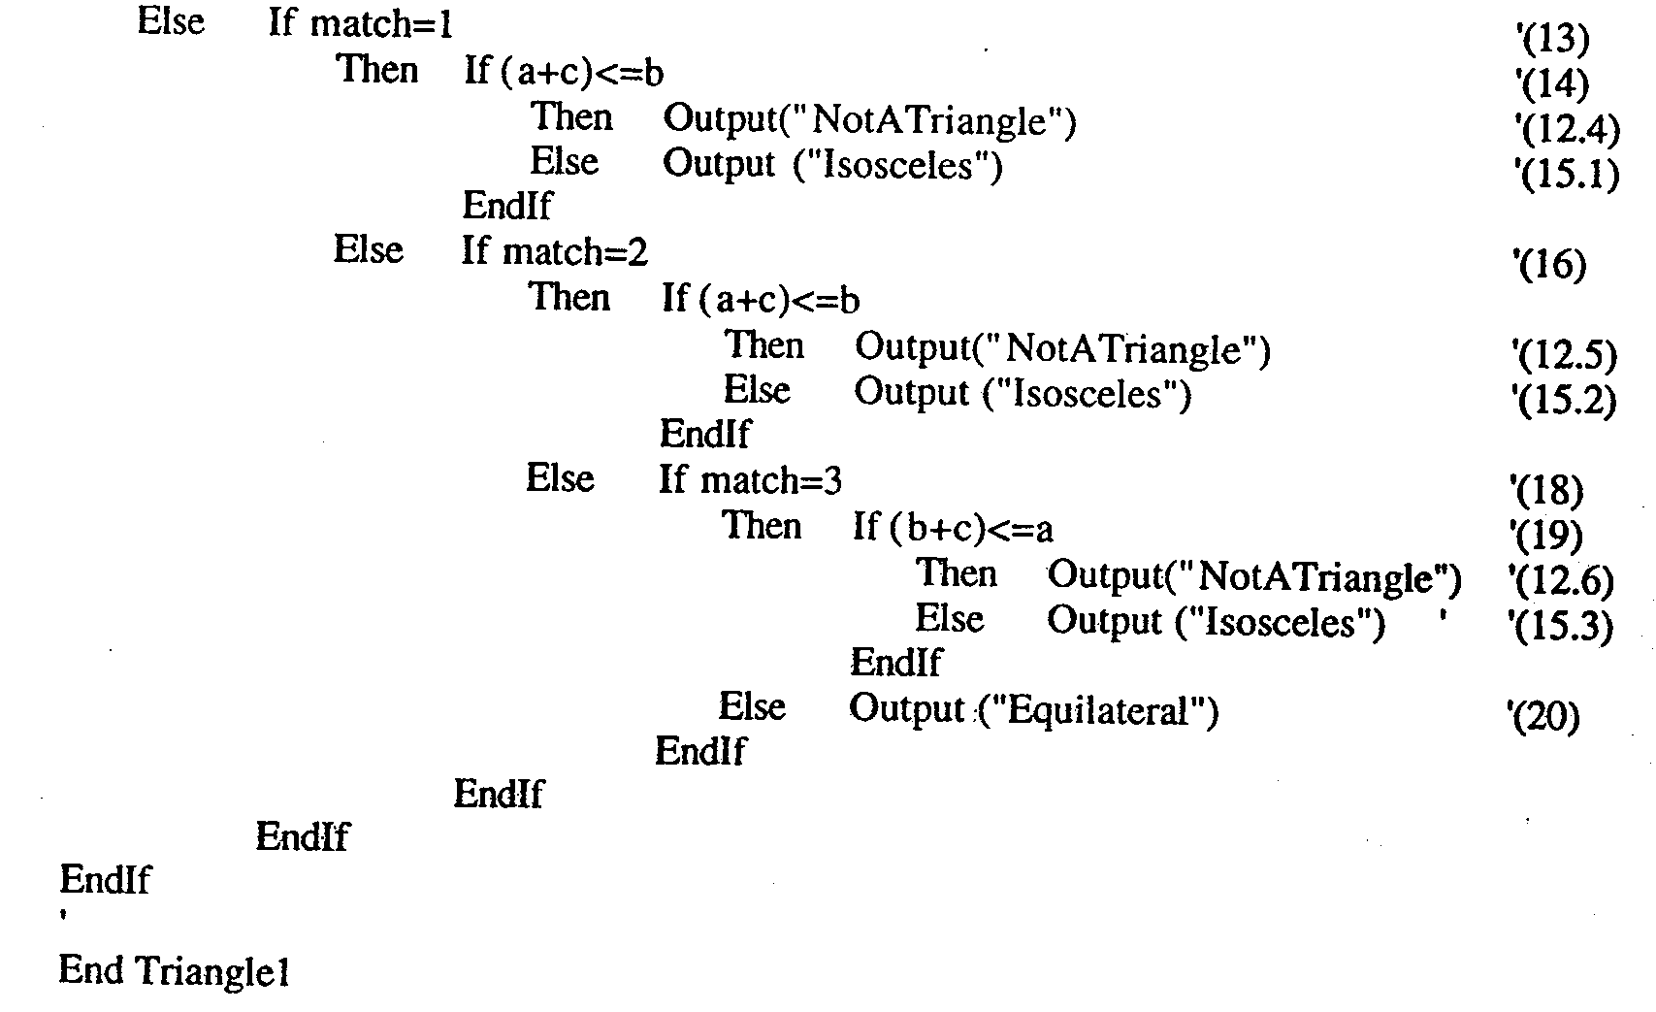

Slide 25
Multiple role of tester
Few Useful Points on Role of Software Testers:
– Testing is finally recognized as a profession which needs specialized skills set and qualifications. – Also it is convinced testing will not start once the development is completed.
– Testing needs to be start in every stage of the software development Life Cycle.
– Testers need to validate whether the requirements specification documents is developed based on the needs of the organization.

Slide 26
Multiple role of tester
Few Useful Points on Role of Software Testers:
– Testers need to be ensuring that the design documents developed based on the requirements specifications.
– Testers need to be ensure that the test cases and test plan are created based on the requirements specifications.
– Testers need to be ensuring that the defects need to find out before the test cycle starts so that the cost spends will gradually decreases.

Slide 27
Multiple role of tester
Few Useful Points on Role of Software Testers:
– Testers need to be ensuring that the defects can be reproducible by developers.
– Testers need to be ensuring that they are finding defects of the high priority scenarios first.
– If you are in Agile methodology, then testers need to make sure that defects are getting fixed on priority.
– Finding out defects in the later stage of the product will leads the cost spend to rectify the defects is very costly

Slide 28
Problem statement
Responses for invalid values of i/p values for day, month, year.
Responses for invalid combination of i/p june 31 any year.
If any of the conditions C1, C2, or C3 fails
  Corresponding variables has out-of-range values.
  Eg. “Value of month not in range 1…12”
If invalid day-month- year combination exist NextDate collapses these into one message
“Invalid input date”

Slide 29
Discussion
Two source of complexity
  Complexity of input domain
  Rule that determine when a year is leap year.
A year is 365.2422 days long
Leap years are used for the “extra day” problem.
According to Gregorian calendar
  A year is a leap year if it is divisible by 4, unless it is a century year.
  Century years are leap years only if they are multiples of 400
  So 1992, 1996, 2000 are leap years… 1900 is not

Slide 30
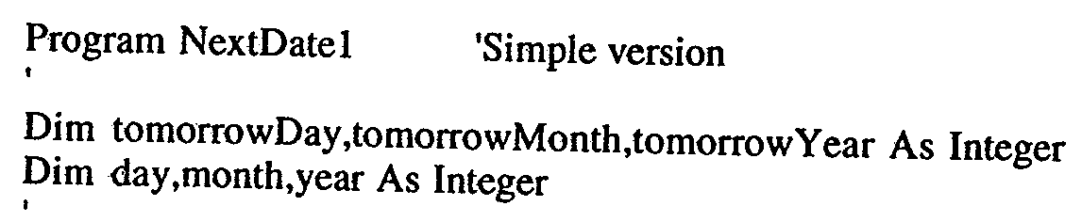
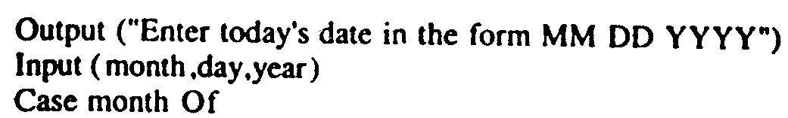
Implementation

Slide 31
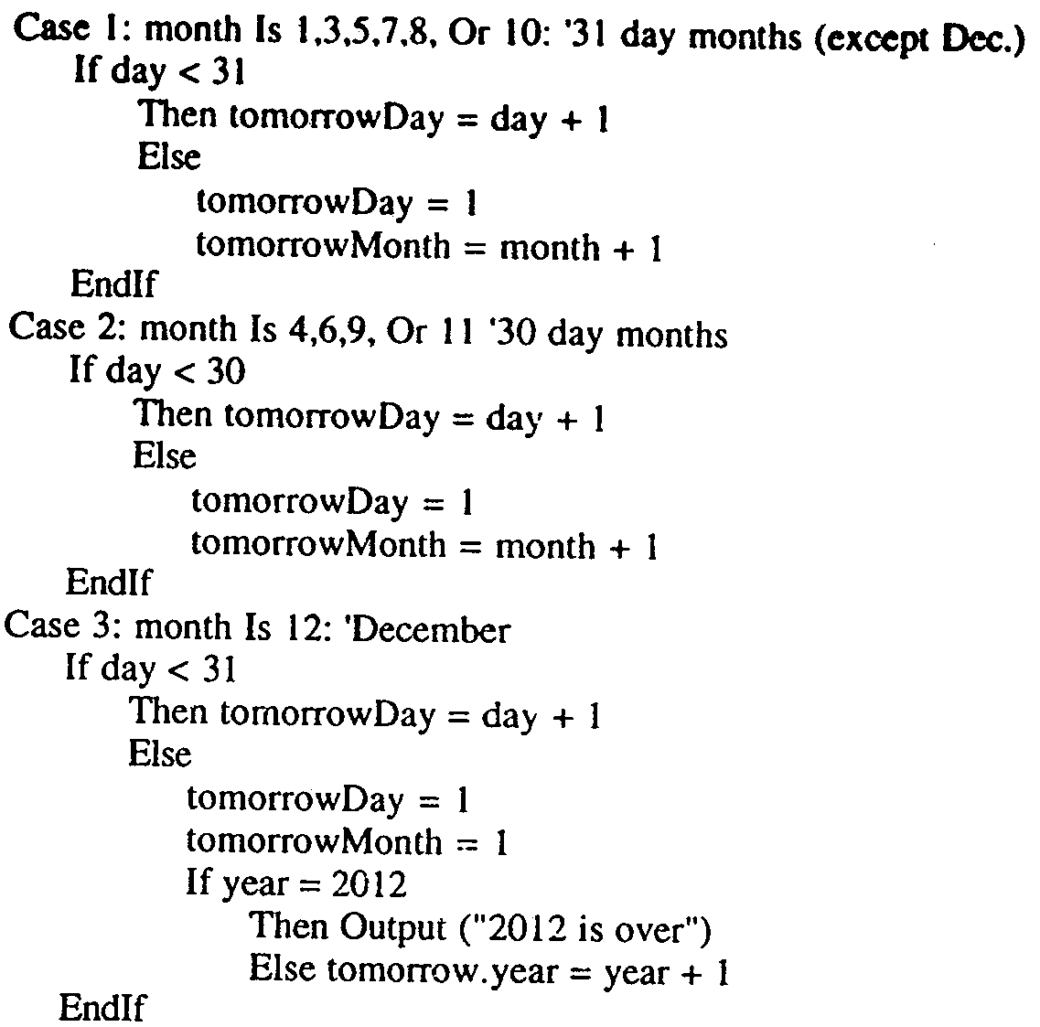

Slide 32
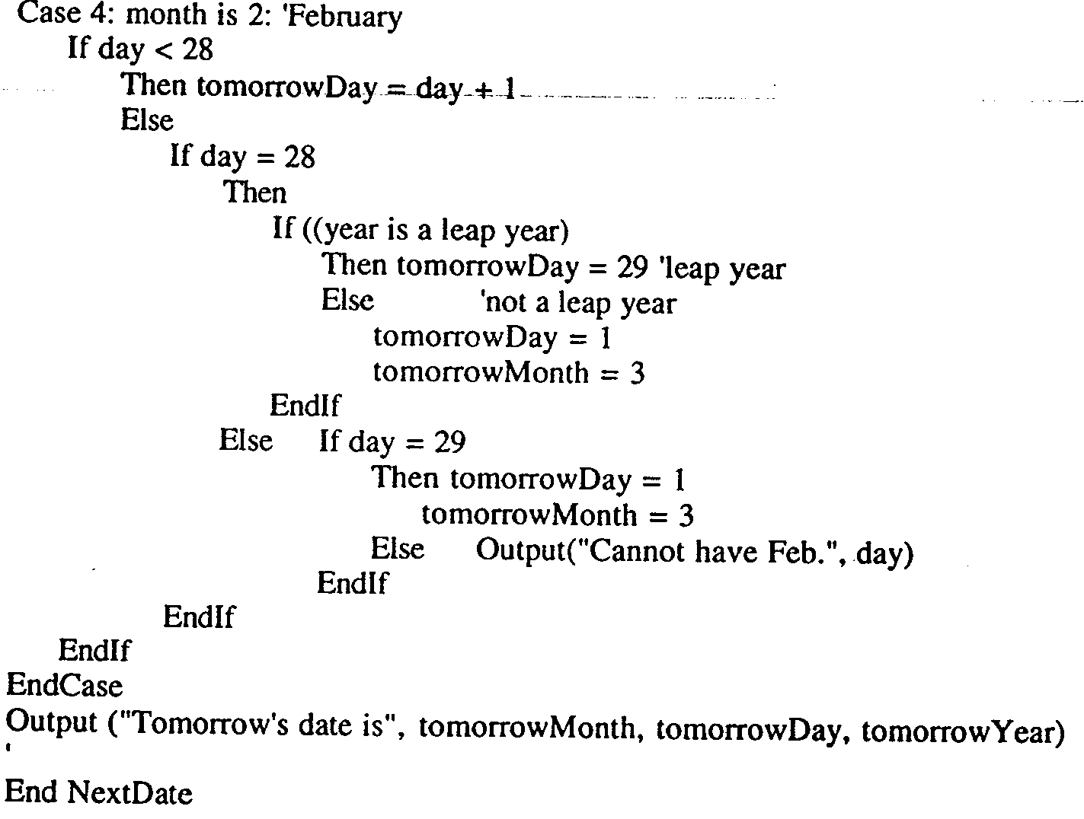

Slide 33
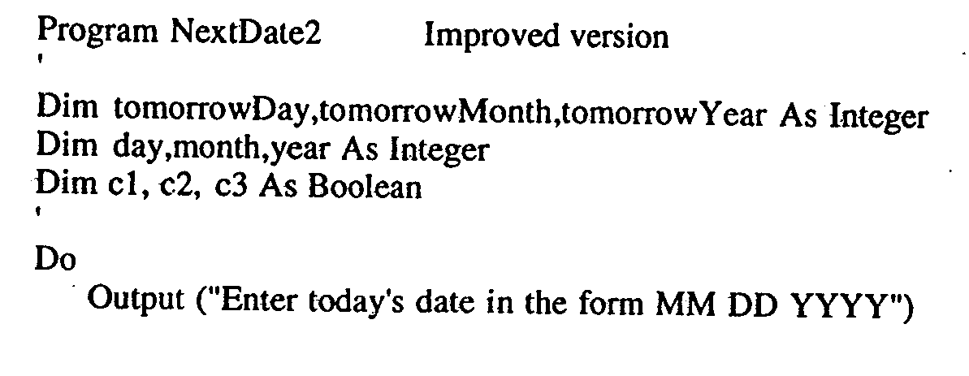
Improved Version

Slide 34
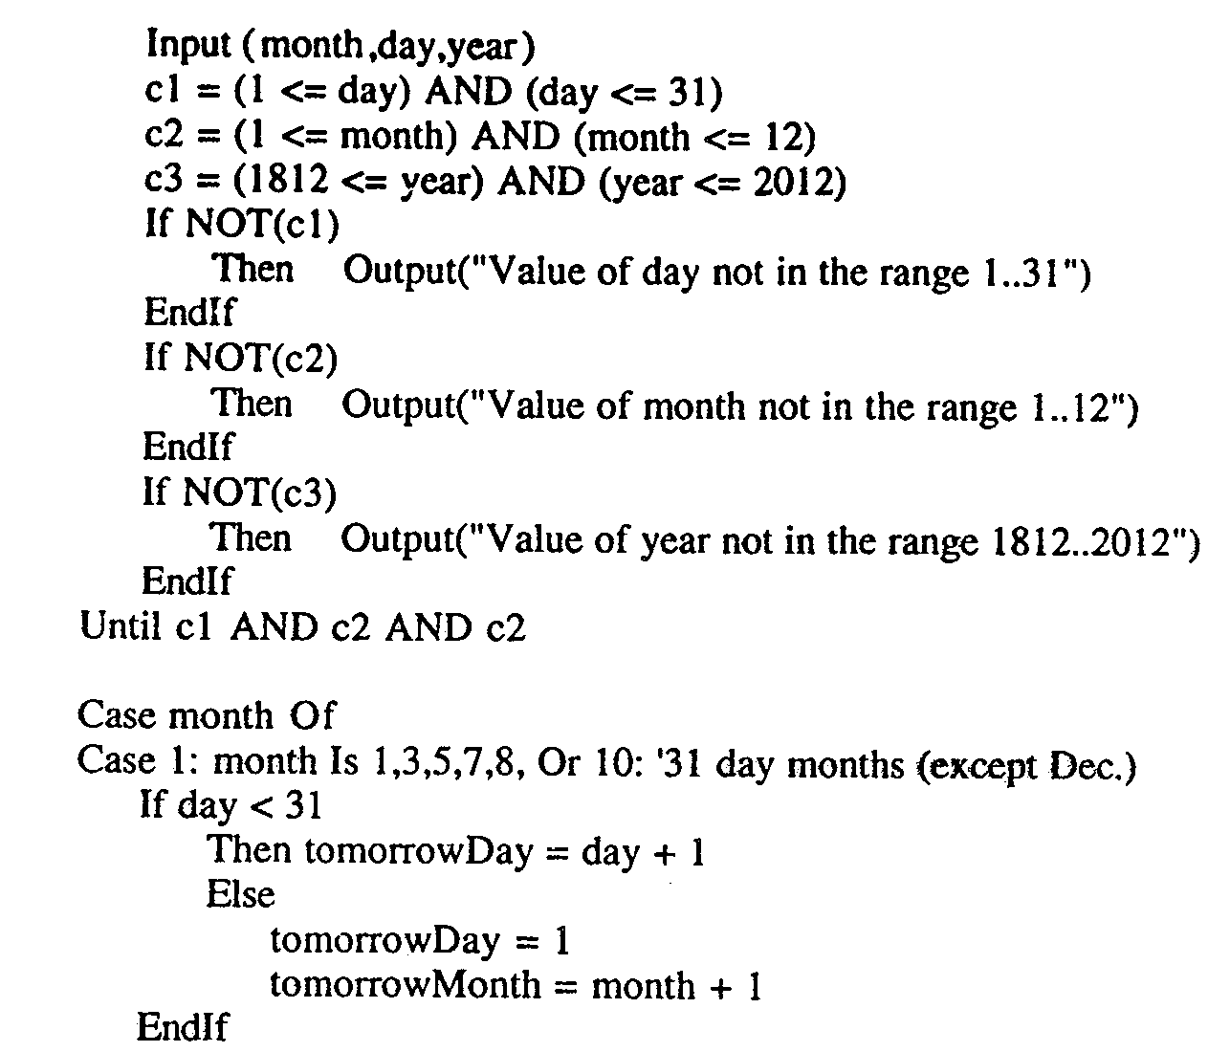

Slide 35
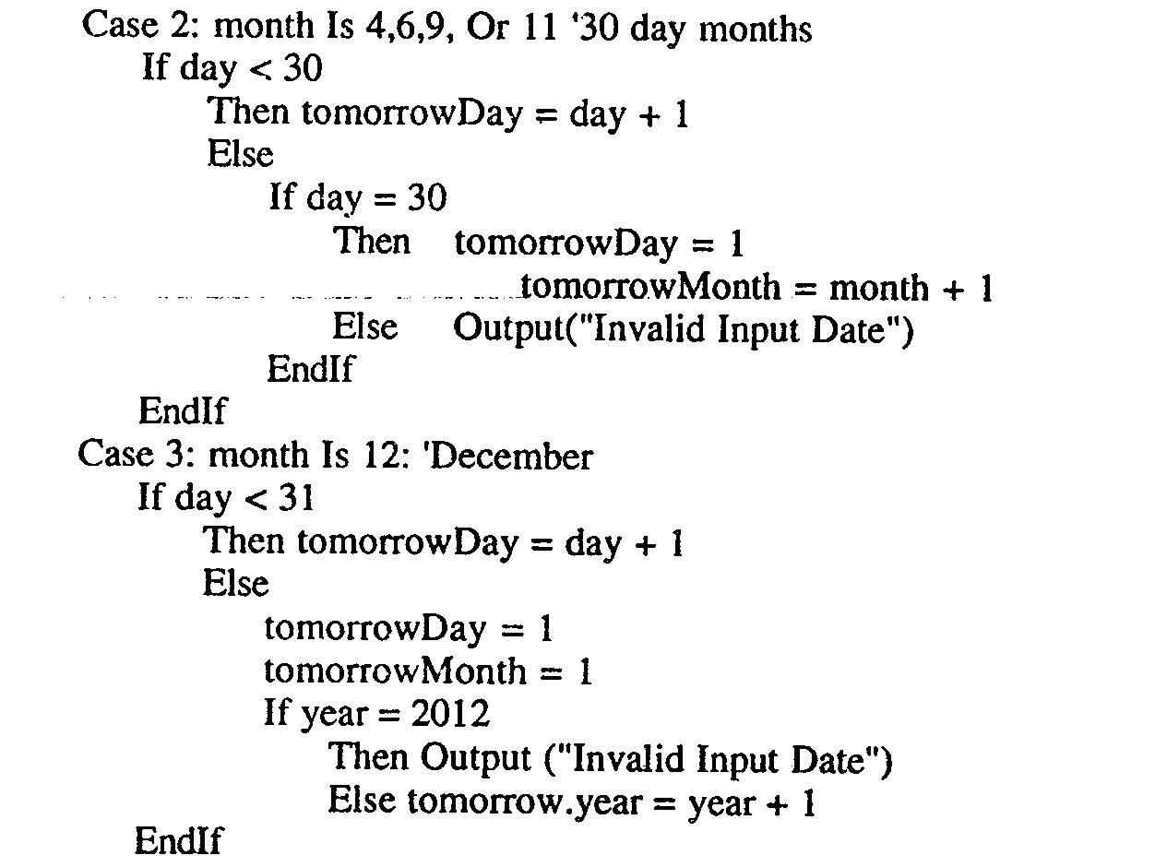

Slide 36
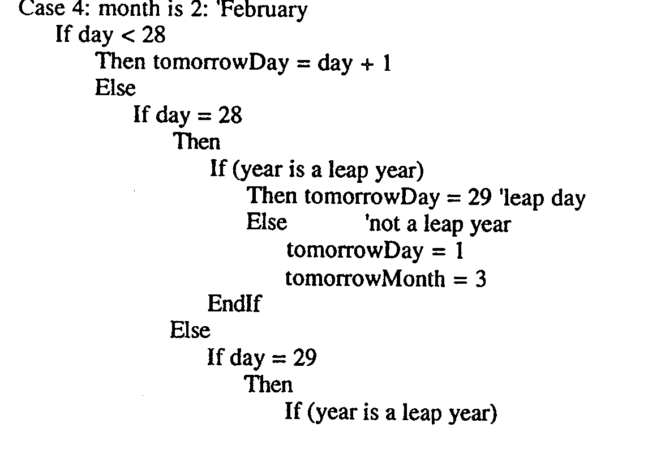

Slide 37
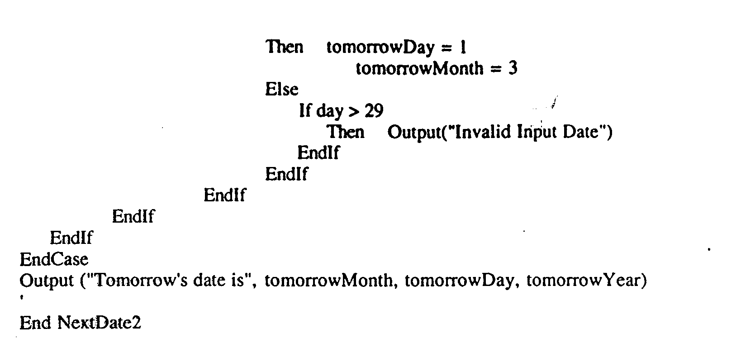

Slide 38
The commission Problem
It contains a mix of computation & decision making.
A rifle salesperson in the former Arizona territory sold rifle lock’s, stocks, & barrel’s made of a gunsmith in Missouri.
Locks cost $45, stocks cost $30, Barrel Cost $ 25.
Sales person has to sell at least 1 complete rifle per month
Production limitation such that 1 sales man can sell 70 locks, 80 stocks, 90 barrels per month.

Slide 39
After each town visit salesperson update sale of no of locks, stocks, barrels through a telegram to gunsmith
At the end of month salesperson sent a shot telegram showing -1 locks sold.
Gunman knew sales for month are over & compute the commission of sales person
  10% on sales up to $1000
  15% on the next $800
  20% on any sales in excess of $1800
  The commission program produces a monthly sales report that gave total no. of locks, barrels, stocks sold. Sales persons total dollar sale & commission.

Slide 40
Discussion
This problem separates into 3 distinct pieces
The input data portion( data validation) ignore here
Sales calculation
Commission calculation problem.

Slide 41
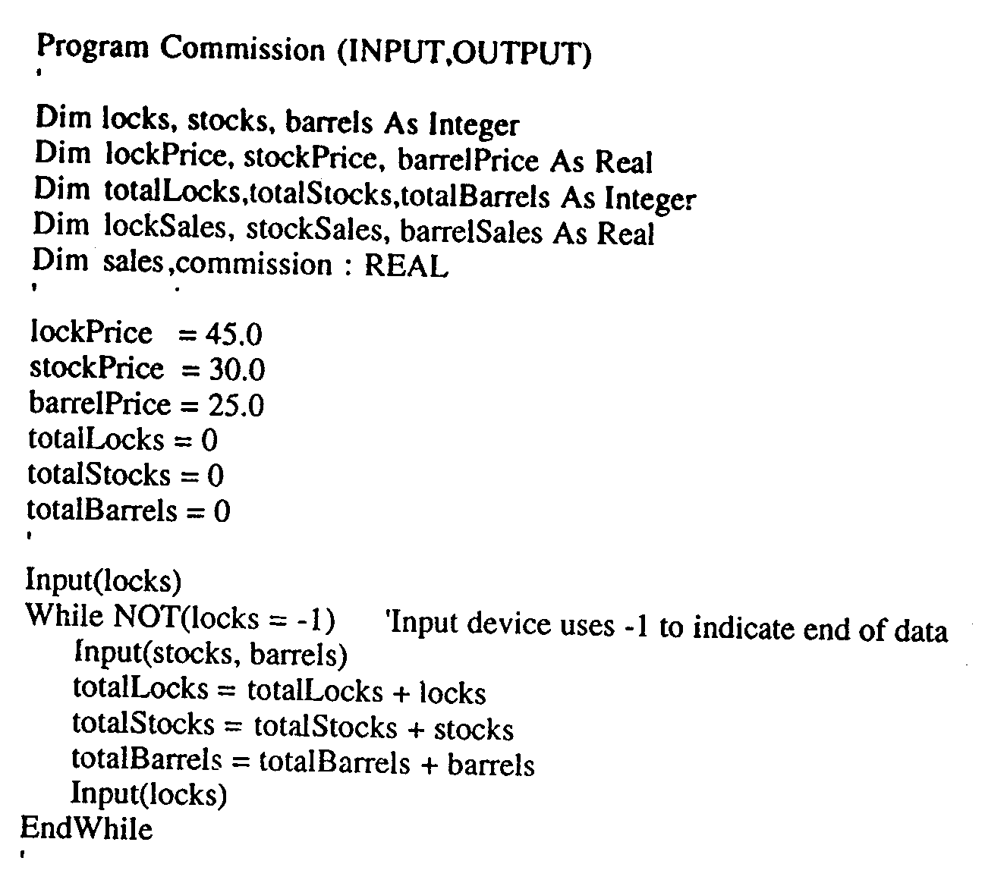
Implementation

Slide 42
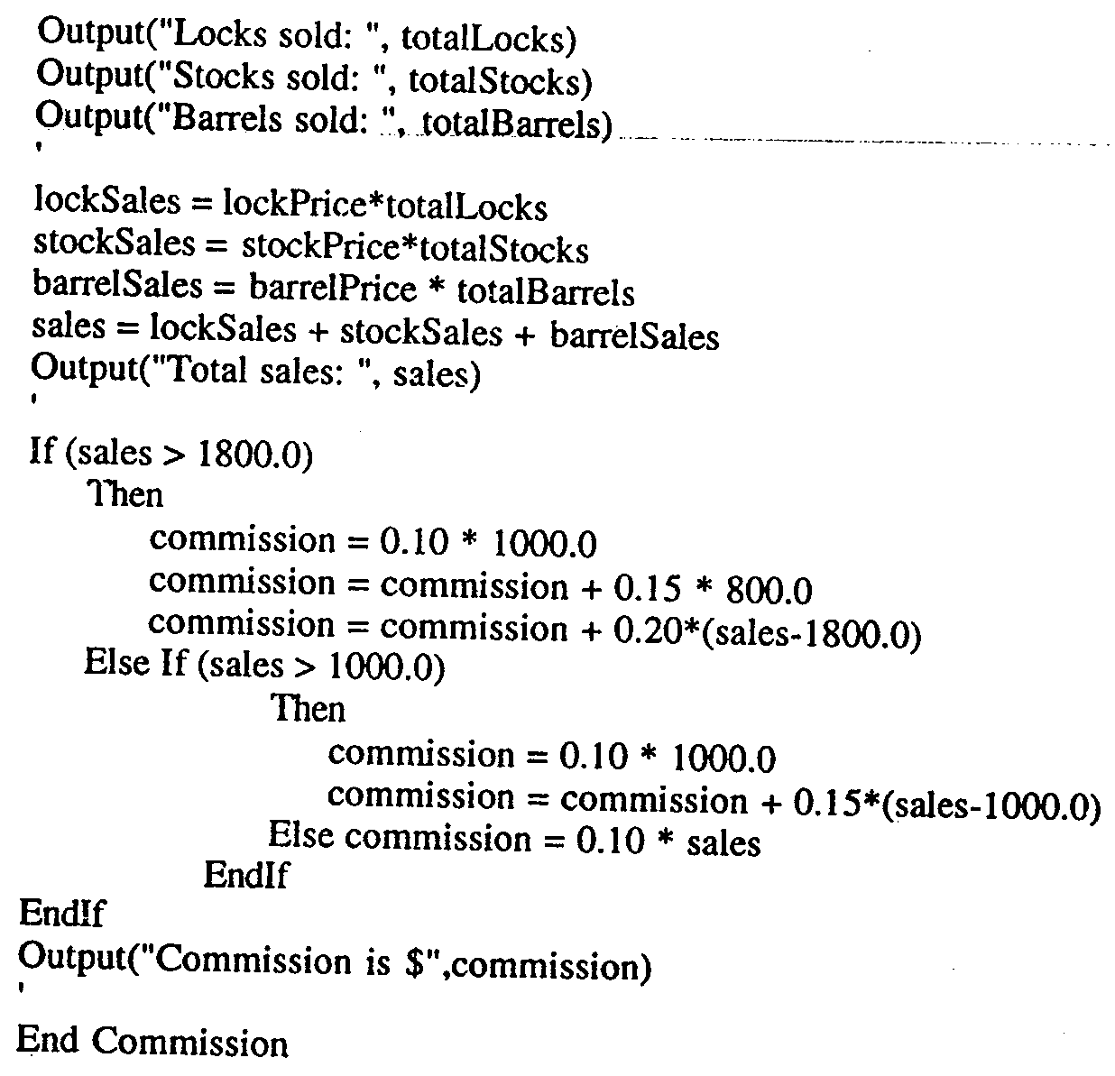

Slide 43
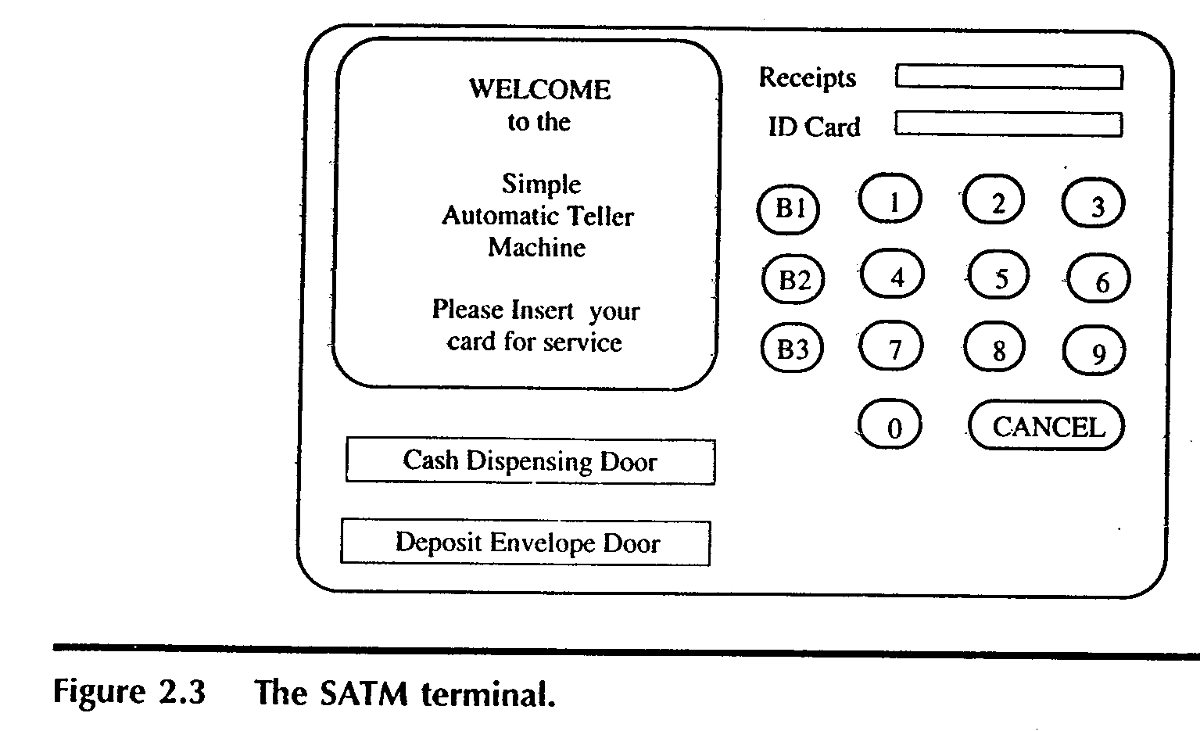
The SATM System
To better discuss the issues of integration & system testing

Slide 44
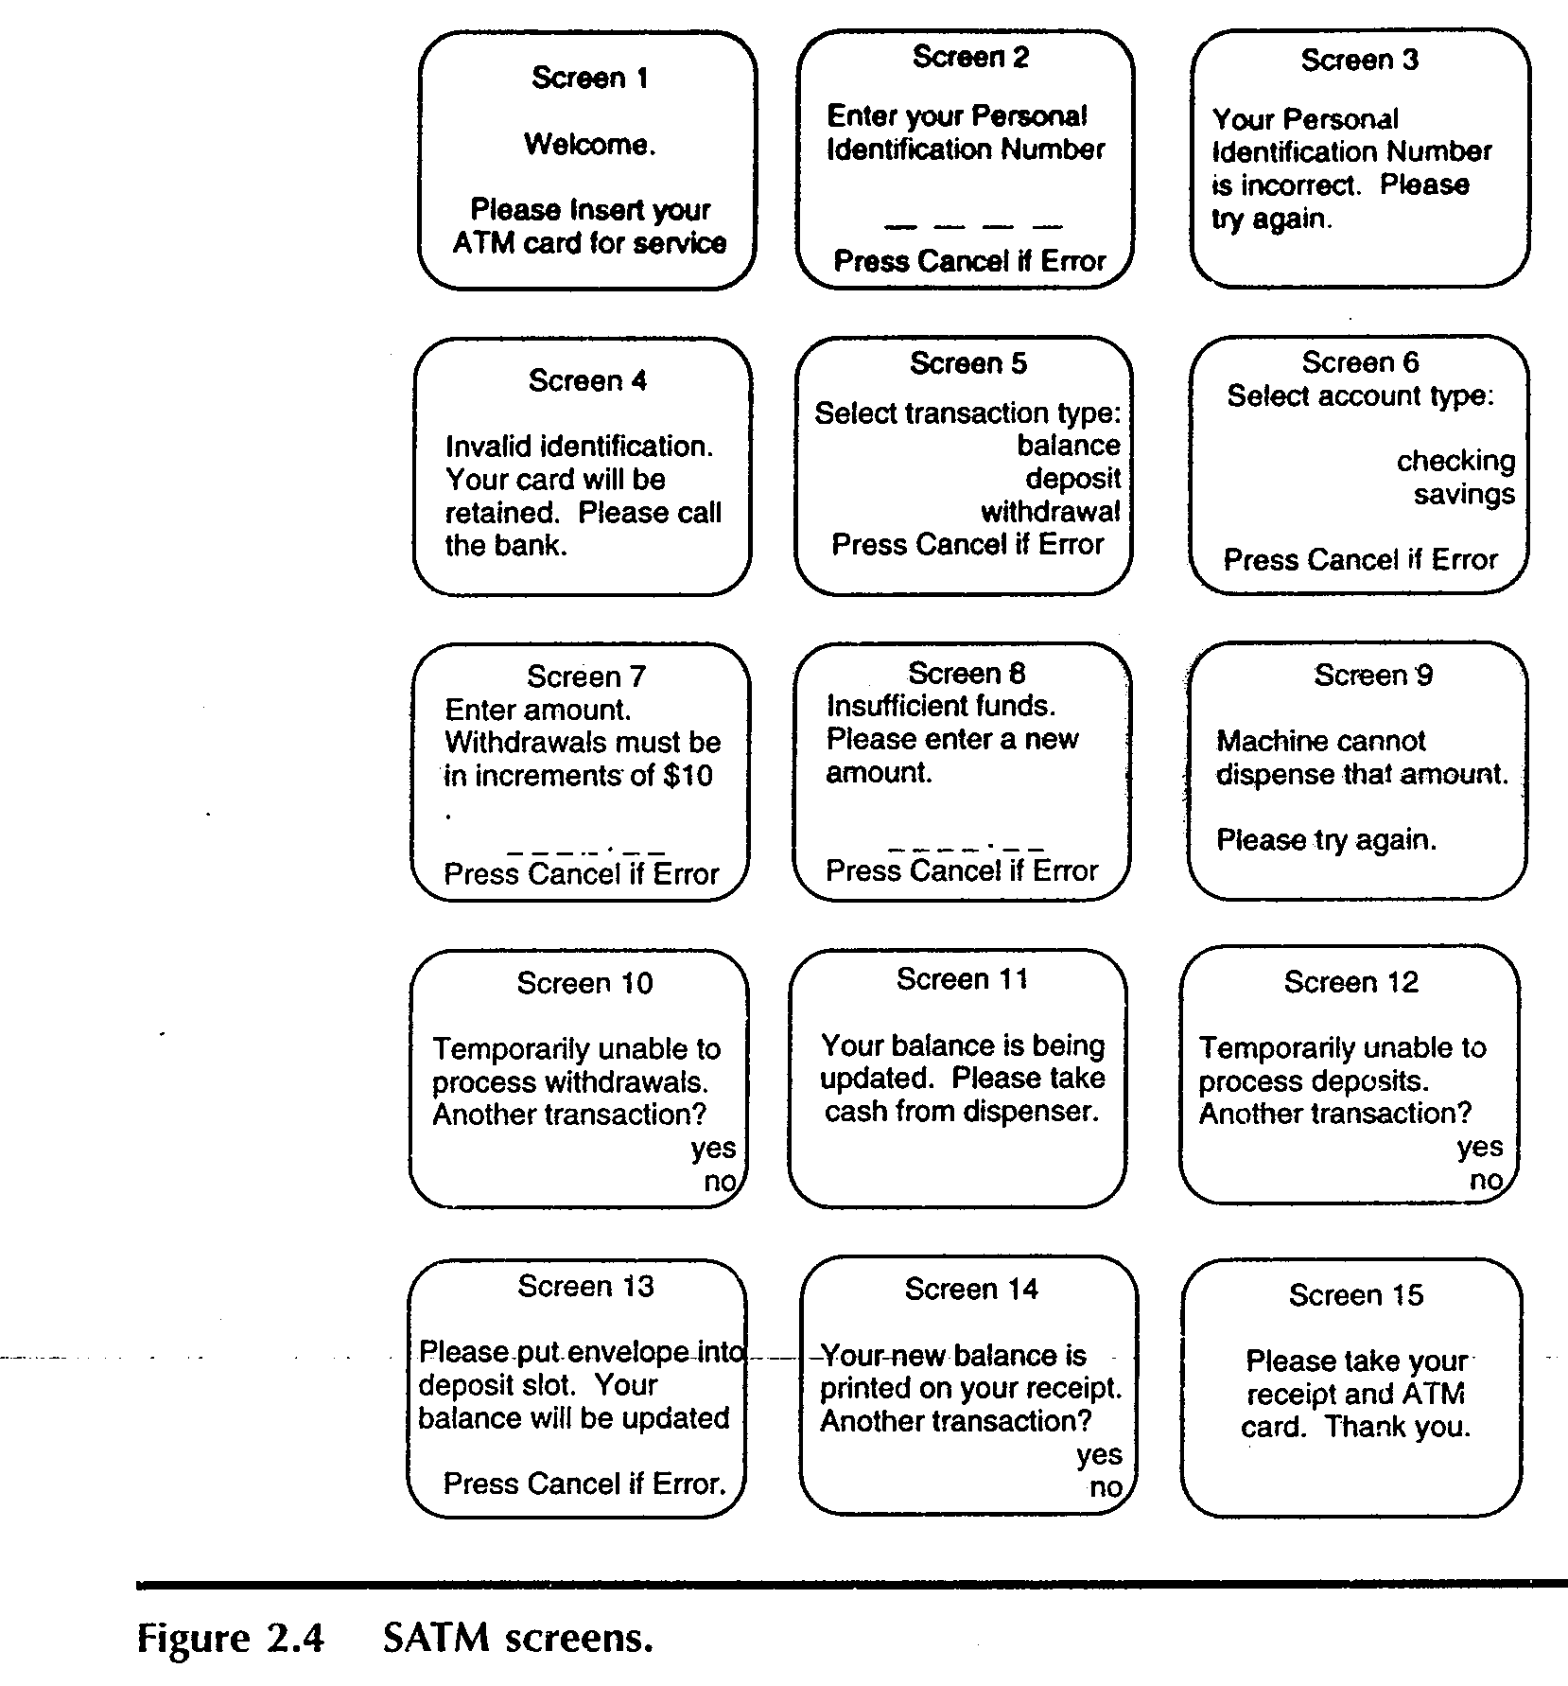

Slide 45
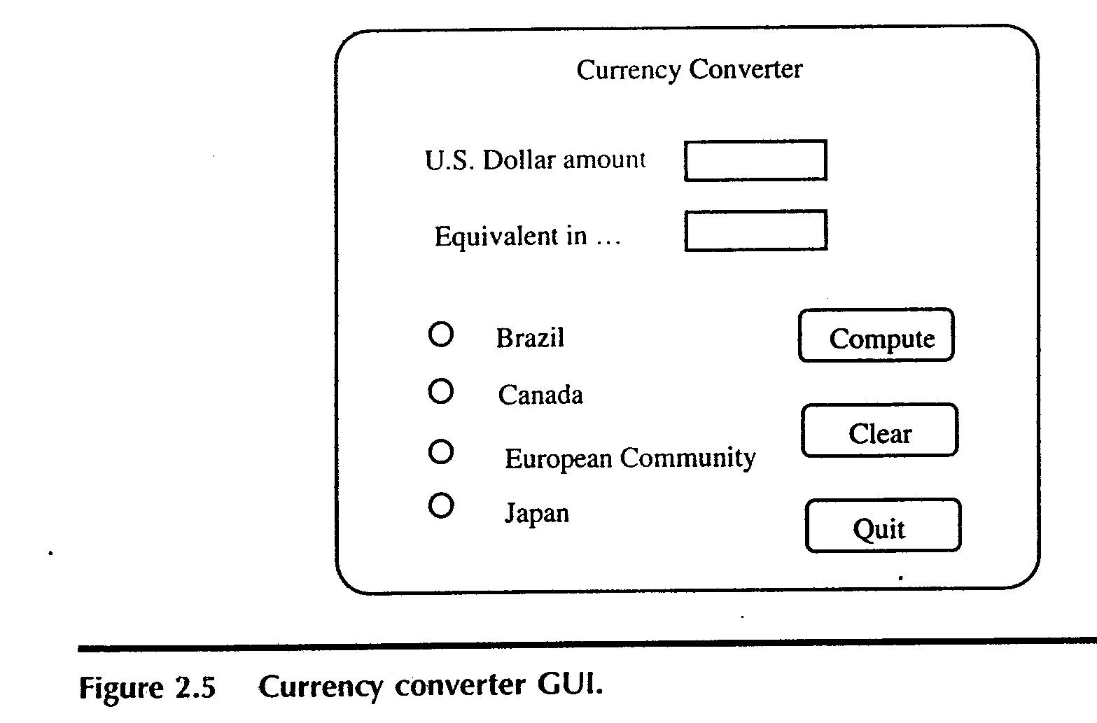
The currency converter
Another event driven program that emphasizes code associated with a GUI
A sample GUI built with visual basic is shown.

Slide 46
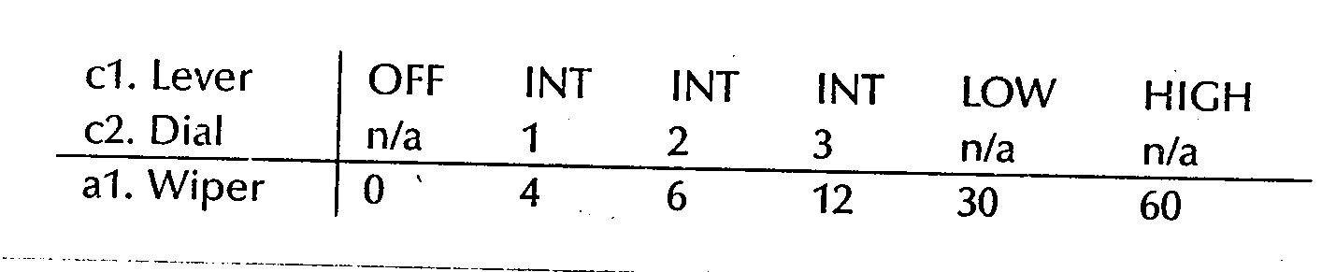
Saturn Windshield Wiper Controller

Slide 47
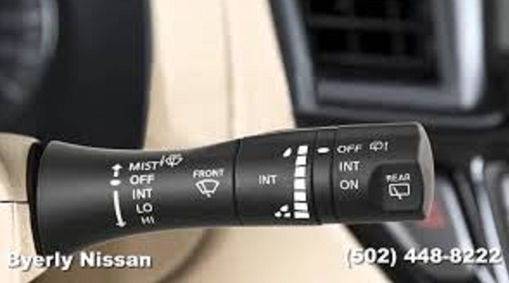

Slide 48
Thank you ???

Slide 49
References
Software Testing Craftsman’s Approach-Paul C Jorgensen.

