Slide 1
V Model of software Testing

Slide 2
Objectives
V diagram provides the basis for every type of software testing.
What are various verification activities?
What are various validation activities?
How to perform verification at each stage of SDLC?
What are various validation test plans?

Slide 3
V&V
Verification: “Are we building the product right?”
Validation: “Are we building the right product?”

Slide 4
STLC
Verifi cation and validation (V&V) are the building blocks of a testing process. The formation of test strategy is based on these two terms only. V&V can be best understood when these are modeled in the testing process.
This model is known as the Testing Life Cycle Model. Life cycle involves continuous testing of the system during the development process.

Slide 5
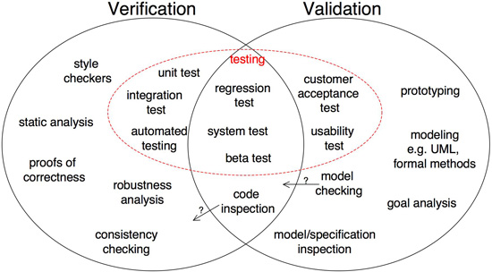
© Oxford University Press 2011. All rights reserved.

Slide 6
V-MODEL
In V-testing concept, as the development team attempts to implement the software, the testing team concurrently starts checking the software. When the project starts, both the system development and the system test process begin. The team that is developing the system begins the system development process and the team that is conducting the system test begins planning the system test process, as shown in FIGURE Both teams start at the same point using the same information. If there are risks, the tester develops a process to minimize or eliminate them.

Slide 7
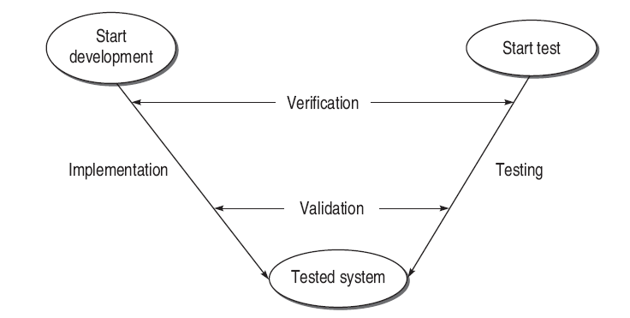
V-Model

Slide 8
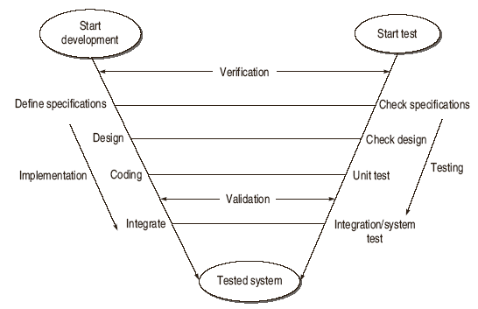
V Testing Life Cycle Model

Slide 9
V - Model
Contract
Review/Test
Warranty
User’s
Software
Requirements
Acceptance
Testing
Software
Requirements
Specification
System
Testing
Software
Development
Verification and Testing
High-level
Design
Integration
Testing
Detailed
Design
Unit
Testing
Coding

Slide 10
Validation Activities
The V&V process, in a nutshell, involves
(i) verification of every step of SDLC
(ii) validation of the verified system at the end.

Slide 11
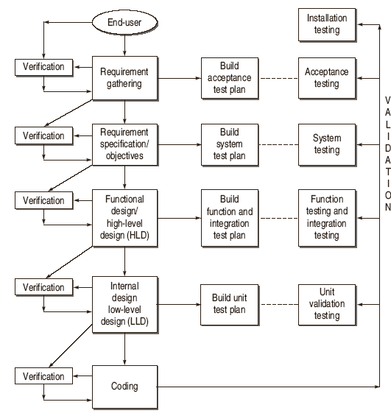
Verification and Validation (V & V) Activities

Slide 12
Verification of Requirements
Evolution of Software Testing
Correctness
Unambiguous
Consistent
Completeness
Updation
Traceability
  Backward Traceability
  Forward Traceability.

Slide 13
Verification of High Level Design
Verification of Data Design
Check whether sizes of data structure have been estimated appropriately.
Check the provisions of overflow in a data structure.
Check the consistency of data formats with the requirements.
Check whether data usage is consistent with its declaration.
Check the relationships among data objects in data dictionary.
Check the consistency of databases and data warehouses with requirements in SRS.

Slide 14
Verification of High Level Design
Verification of Architectural Design
Check that every functional requirement in SRS has been take care in this design.
Check whether all exceptions handling conditions have been taken care.
Verify the process of transform mapping and transaction mapping used for transition from the requirement model to architectural design.
check the functionality of each module according to the requirements specified.
Check the inter-dependence and interface between the modules.
Coupling and Module Cohesion.

Slide 15
Verification of High Level Design
Verification of User-Interface Design
Check all the interfaces between modules according to architecture design.
Check all the interfaces between software and other non-human producer and consumer of information.
Check all the interfaces between human and computer.
Check all the above interfaces for their consistency.

Slide 16
Verification of High Level Design
Check that the response time for all the interfaces are within required ranges.
Help Facility
error messages and warnings

Slide 17
Verify Low Level Design
Software Testing Myths
Verify the SRS of each module.
Verify the SDD of each module.
In LLD, data structures, interfaces and algorithms are represented by design notations; so verify the consistency of every item with their design notations.

Slide 18
How to Verify Code
Check that every design specification in HLD and LLD has been coded using traceability matrix.
Examine the code against a language specification checklist.
Verify every statement, control structure, loop, and logic
Misunderstood or incorrect Arithmetic precedence
Mixed mode operations
Incorrect initialization
Precision Inaccuracy
Incorrect symbolic representation of an expression
Different data types
Improper or nonexistent loop termination
Failure to exit

Slide 19
Validation
Developing tests that will determine whether the product satisfies the users’ requirements, as stated in the requirement specification.
Developing tests that will determine whether the product’s actual behavior matches the desired behavior, as described in the functional design specification.
The bugs, which are still existing in the software after coding need to be uncovered.
last chance to discover the bugs otherwise these bugs will move to the final product released to the customer.
Validation enhances the quality of software.

Slide 20
Validation Activities
Validation Test Plan
Acceptance Test Plan
System Test Plan
Function Test Plan
Integration Test Plan
Unit Test Plan
Validation Test Execution
Unit Validation Testing
Integration Testing
Function Testing
System Testing
Acceptance Testing
Installation Testing

Slide 21
https://www.guru99.com/alpha-beta-testing-demystified.html
https://www.guru99.com/white-box-testing.html
https://www.guru99.com/black-box-testing.html
https://www.softwaretestinghelp.com/gamma-testing-2/#:~:text=This%20is%20the%20final%20phase,are%20performed%20on%20the%20product.
https://www.guru99.com/adhoc-testing.html
https://aleksej7504blog.wordpress.com/2017/10/07/what-is-the-difference-between-functional-and-structural-testing/#:~:text=Structural%20is%20a%20%E2%80%9Cwhite%20box,tester%20verifies%20the%20functional%20specification.
https://en.wikipedia.org/wiki/Low-level_design
https://www.guru99.com/functional-testing-vs-non-functional-testing.html

Slide 22
Segregation of Duties (SoD) is an important control that reduces the risk of errors and fraud. ... To help keep accounting roles, responsibilities and risks clear, compliance managers have long turned to the Segregation of Duties Matrix

