Slide 1




AI-ENABLED LEARNING PLATFORM
AI Gurukul
One platform that runs the school,
teaches every child and prepares them for life
For government schools, private schools and edtech — in any language, anywhere in the world.
YJ Technosoft Private Limited
2026
Notes:
AI Gurukul is an AI-enabled learning platform. In one sentence: it runs the school, teaches every child, and prepares them for life. It is built for government schools, private schools and edtech companies, in any language, anywhere in the world. In the next nine slides I will show you the problem, how AI Gurukul solves it, and why it is different.

Slide 2






Schools run on effort, not intelligence
THE PROBLEM
Every school, in every country, struggles with the same six problems.
Teachers buried in paperwork
One pace for forty children
Families pay twice
Attendance, registers, reports and checking eat the time meant for teaching.
Fast learners get bored; slow learners fall behind quietly.
School fees, then extra tuition and coaching to fill the gaps.
Teacher absent, class lost
Leaders see data too late
One exam path for everyone
A free period today becomes a learning gap at exam time.
Principals and officers get reports weeks later, if at all.
Career and exam prep ignore what each child is good at and loves.
The result: learning gaps grow silently — and nobody sees them until the exam.
Notes:
Let's start with the problem. Teachers spend their time on paperwork instead of teaching. One teacher, one pace, forty different children. Families pay school fees and then pay again for tuition. When a teacher is absent, the class is simply lost. Leaders see data too late. And exam preparation pushes every child down the same path. The result: learning gaps grow silently until the exam reveals them.

Slide 3





Village schools feel it the hardest
THE PROBLEM · VILLAGES
Example: India — where most children study in rural government schools.
14.7 lakh
1,04,125
~36%
29 points
schools and 24.7 crore students in India
schools run by a single teacher — 33.8 lakh children
of schools still have no internet connection
rural schools trail urban schools in internet access
WHAT THIS MEANS FOR A VILLAGE CHILD
One teacher, many classes
Home language ≠ textbook
No tuition or coaching nearby
Days lost every year
Classes 1 to 5 together; little time for any one child.
Many children don't speak the textbook language at home.
JEE or NEET coaching means moving to a city.
Rain, harvest, migration and teacher leave close classes.
Source: UDISE+ 2024-25 data, as analysed by Education for All in India (2025). Rural–urban gap is in internet connectivity.
Notes:
The problem is hardest in villages. In India alone there are 14.7 lakh schools and 24.7 crore students. Over one lakh schools are run by a single teacher, serving 33.8 lakh children. About a third of schools still have no internet, and rural schools are 29 points behind urban schools. For a village child this means one teacher for many classes, a textbook in a language they don't speak at home, no tuition or coaching nearby, and many lost days every year. AI Gurukul is designed for exactly this child.

Slide 4


What is AI Gurukul?
THE SOLUTION
One AI-enabled platform where AI works in every part of school life — not as an add-on.
Smart school management
AI Gurukul is a complete school platform with an AI brain.
It runs daily school work, helps teachers teach better, gives every student a personal tutor, prepares them for exams and careers, and shows leaders exactly what is happening — live.
Live data for leaders
AI for teachers
AI
core
BUILT FOR
Government schools
Private schools
Skills and exam prep
AI tutor for students
Edtech and coaching
Notes:
So what is AI Gurukul? It is a complete school platform with an AI brain at the centre. That AI works in five places: managing the school, helping teachers, tutoring every student, preparing students for exams and careers, and giving leaders live data. It is built for government schools, private schools, and edtech and coaching companies.

Slide 5







AI in every part of a teacher's day
AI FOR TEACHERS
Less paperwork, better teaching — the teacher stays in control of every decision.
Attendance in seconds
Planning that adjusts itself
Homework, done right
Tests and exam papers
One tap, or a class photo where the school allows; parents alerted instantly.
Year-to-day lesson plans that re-plan after leave or holidays.
Right-level homework for each group; submissions tracked automatically.
Question papers in any board's pattern, with answer keys, in minutes.
Answer-sheet checking
Teaching skills coach
Smart class management
Know who needs help
Scan answer sheets; AI scores and suggests marks for the teacher to confirm.
AI reviews lesson plans and class results and suggests what to improve.
Timetable, substitutes, notices and parent messages handled for you.
Every morning: which students are falling behind, and on which topic.
Notes:
For teachers, AI works across the whole day. Attendance takes seconds. Lesson plans are drafted and re-plan themselves after leave or holidays. Homework and question papers are generated in any board's pattern. Answer sheets can be scanned and AI suggests the marks, which the teacher confirms. An AI coach helps teachers improve their own teaching. And every morning, the teacher knows exactly which students need help and on which topic.

Slide 6
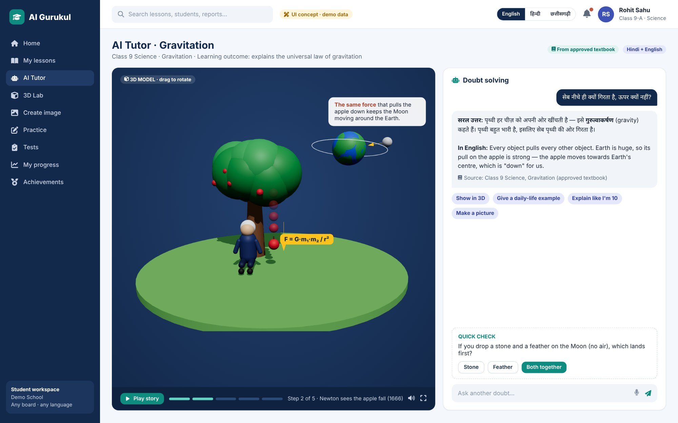
A personal tutor for every child — no extra tuition
AI FOR EVERY STUDENT
What a good private tutor does, AI Gurukul does for every student, inside the school system.
1
Doubts solved 24×7
In the student's own language, from the approved textbook.
2
See it in 3D
3D models and AI images make hard topics easy — like Newton and gravity.
3
A plan for each child
Practice on weak topics; tracks what was covered and what was really learned.
UI concept with demo data
Notes:
For students, AI Gurukul is a personal tutor. Here a student asks why an apple falls. The AI explains in simple language, in Hindi and English, from the textbook, and shows a 3D story of Newton and gravity. Every child gets a personal plan and practice on weak topics. Because this happens inside the school system, families no longer need to pay for extra tuition outside.

Slide 7

From school to career: the right path for each child
SKILL INTELLIGENCE
AI learns what each student is good at and enjoys — then prepares them for it.
Skill intelligence profile
EXAM PREPARATION — CHOSEN BY INTEREST
Example student
JEE
NEET
CUET
Olympiads
Logical reasoning
NDA
CLAT
Civil services foundation
SAT and international
Mathematics
PROFESSIONAL AND SKILL COURSES
Physics
Coding and AI
Data and analytics
Design
Biology
Finance basics
Spoken English
Entrepreneurship
Creativity
Communication
Not one exam for everyone. This student is guided towards JEE — another may be guided to NEET, design or coding.
Notes:
AI Gurukul goes beyond the syllabus. As students learn, the AI builds a skill intelligence profile — what each child is good at and enjoys. Based on that, it guides and prepares them: JEE, NEET, CUET, Olympiads and other exams, plus professional courses like coding, design and spoken English. This example student is strong in logic, maths and physics, so the path points to JEE. Another student may be guided to NEET, or to design. Not one exam for everyone — the right path for each child.

Slide 8



No class is ever lost
TEACHER ABSENT?
Three levels of backup, tried in order — the student always gets the planned lesson.
TEACHER ABSENT
1. Substitute teacher
2. Live class from a nearby school
3. AI avatar teaches
AI finds the best free teacher in the school for the same subject and approves with the principal.
Students join a live class on the same subject and the same topic, happening right now in another school.
If no live class is available, an AI avatar teaches the planned topic with 3D models, doubt-solving and practice.
Always: attendance and learning are recorded, and the syllabus plan updates itself — no gap reaches the exam.
Notes:
What happens when a teacher is absent? First, AI finds the best substitute inside the school. If no one is free, students join a live class on the same subject and the same topic from a nearby school. And if no live class is running at that time, an AI avatar teaches the planned topic, with 3D models, doubt-solving and practice. Either way, attendance and learning are recorded and the plan updates itself. No class is ever lost.

Slide 9
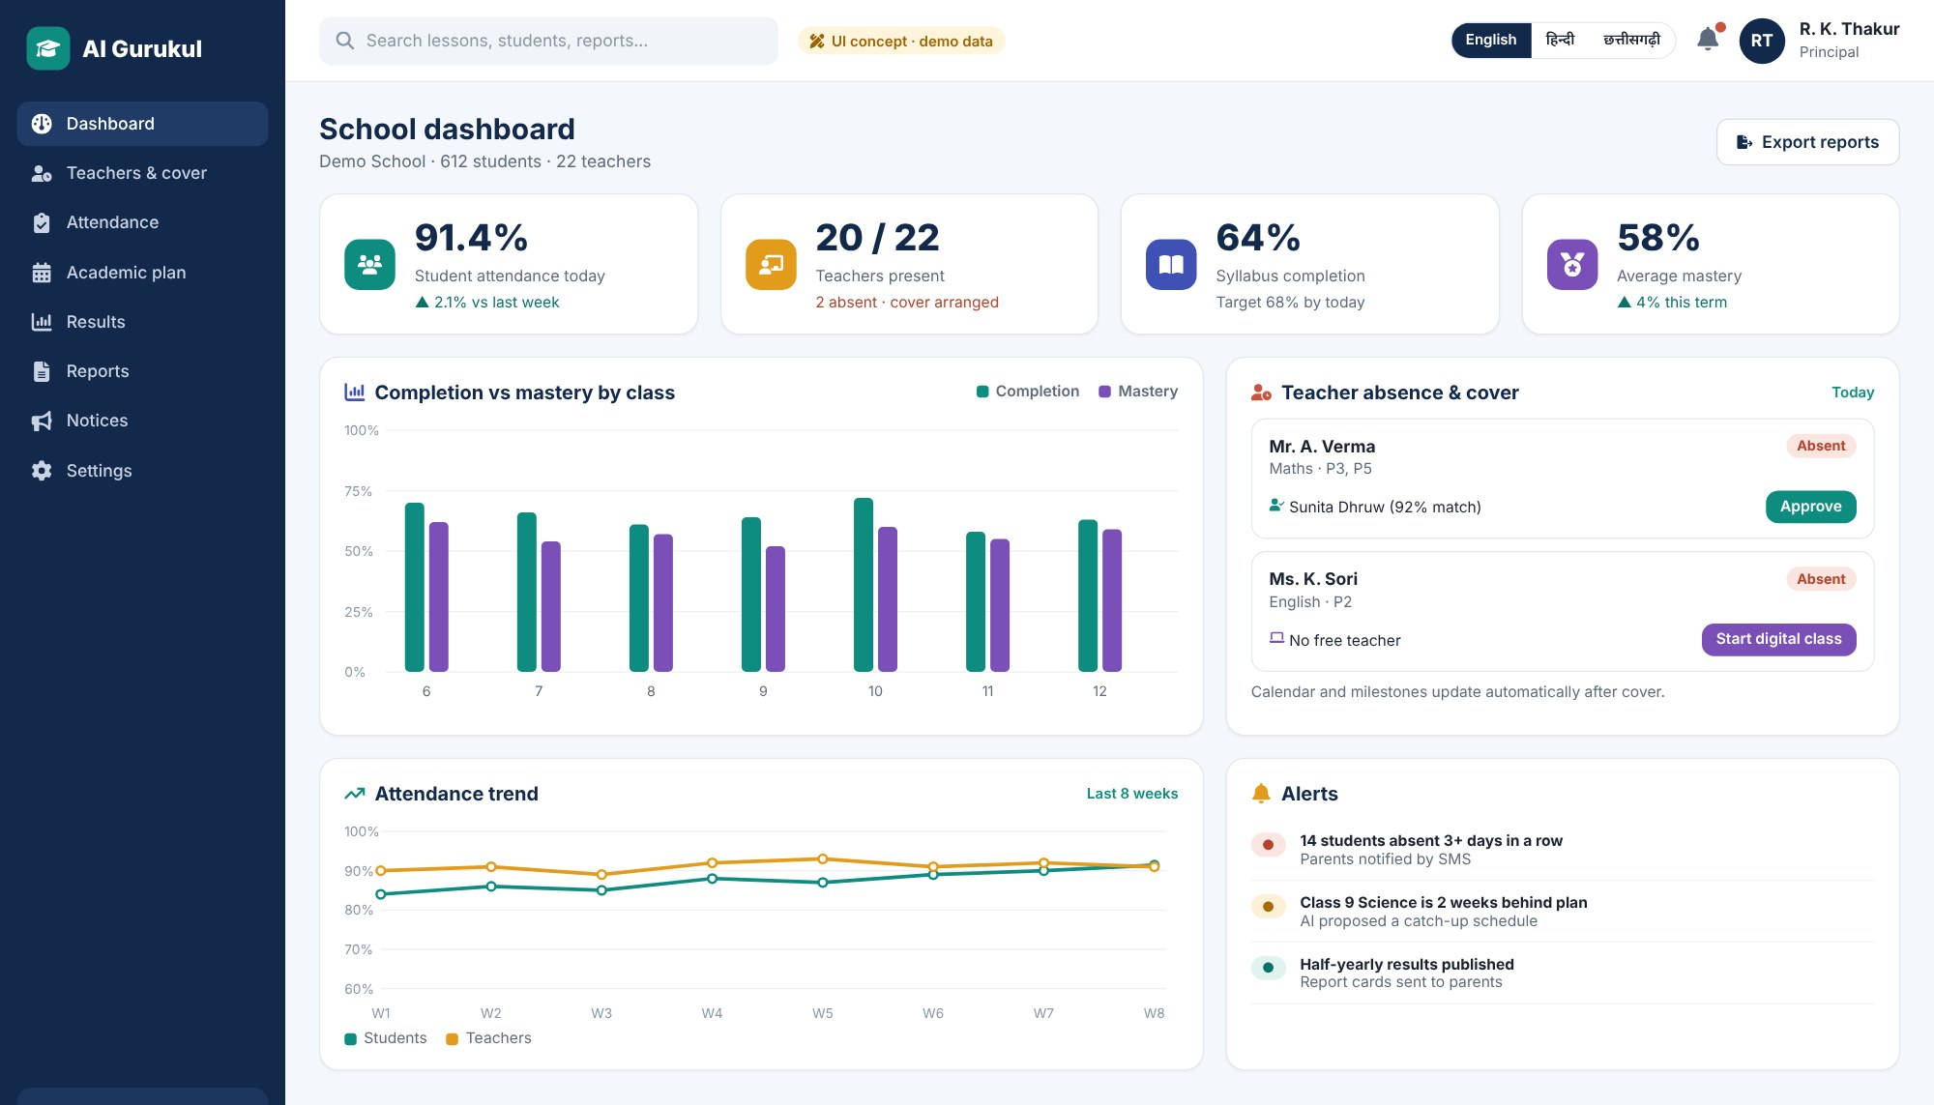


Every leader sees the truth — live
CLEAR DATA FOR LEADERS
From one classroom to a whole district or school group, with complete student records.
Principal or school owner
Attendance, syllabus progress, learning levels and teacher cover — today.
Block and district officers (BEO / DEO)
Compare schools; see which need support first, and why.
State, school group or edtech admin
Trends across every school, in one view.
Complete student record
From admission to graduation: attendance, marks, skills and progress.
Notes:
Leaders finally see the truth, live. A principal sees attendance, syllabus progress, learning levels and teacher cover for today. Block and district officers compare schools and see which need support first, and why. A state, school group or edtech company sees trends across every school. And every student has a complete digital record, from admission to graduation. No more waiting weeks for reports.

Slide 10


Every village problem has an answer
BUILT FOR VILLAGES
The same platform that serves a city school is designed first for the hardest village school.
VILLAGE PROBLEM
HOW AI GURUKUL SOLVES IT
One teacher, many classes
AI co-teacher plans multi-grade lessons; AI tutor gives each child their own practice
Teacher absent
Live class from a nearby school on the same topic — or an AI avatar teaches
No or weak internet
Offline app and school hub; syncs when signal returns
Many home languages
Explains in the child's own language, with the textbook alongside
No coaching nearby
JEE, NEET and skill courses inside the village school
Days lost to closures
Syllabus re-plans itself; lessons sent home by app, SMS and phone call
Notes:
Here is how each village problem is solved. One teacher with many classes gets an AI co-teacher for multi-grade planning, while each child practises with the AI tutor. If the teacher is absent, students join a live class from a nearby school, or the AI avatar teaches. No internet? The offline app and school hub keep everything running. Children learn in their own language. JEE, NEET and skill courses come to the village school — no need to move to a city. And when schools close for rain or harvest, the syllabus re-plans itself and lessons go home by app, SMS and phone call.

Slide 11



Learning that works even without internet
BUILT FOR VILLAGES
Content lives close to the student — the internet is only needed to sync.
AI Gurukul cloud
Broadband / 4G
sync at night
School hub ("Gurukul Box")
school
Wi-Fi
Classroom devices
Hosted in your country. Lessons, AI, reports and backups.
Small offline server in the school with all lessons, videos and 3D models. Serves them over local Wi-Fi.
Smart class, ICT lab, tablets and teacher phones — full speed with no internet at all.
Phones at home
Basic phones
mobile data,
when available
Offline app with downloaded lesson packs; answers saved and synced later.
SMS alerts and audio lessons by phone call (IVR) in the local language.
School hub hardware is optional and priced separately. Uses national rural broadband (e.g. BharatNet in India) where available.
Notes:
This is how we reach villages with weak internet. All lessons, videos and 3D models are stored close to the student. An optional school hub — a small offline server — keeps everything inside the school and serves it over local Wi-Fi, so classrooms work at full speed with no internet at all. The hub syncs with our cloud at night over rural broadband or 4G. Students take downloaded lesson packs home on the offline app, and parents with basic phones get SMS alerts and audio lessons by phone call, which work on 2G.

Slide 12


One platform, three levels of connectivity
BUILT FOR VILLAGES
The app checks the signal and switches mode by itself — no settings for students to change.
Good internet
Weak signal
No internet
4G or broadband
2G or patchy 3G
remote villages
Everything live: AI tutor, 3D, videos
Live dashboards for principals and officers
Downloads lesson packs for later
Lite mode: text first, small images
Lessons as audio + slides (≈2–3 MB per 10 min)
AI answers as short text; sync in background
Offline app with downloaded lessons and 3D
Attendance, homework and tests saved on device
School hub Wi-Fi, SMS and phone-call lessons
Design targets: core screens usable at 2G speeds • work is saved on the device first, never lost • videos download on Wi-Fi only • pages kept small for cheap data plans
Notes:
The same platform works at three levels. With good internet, everything is live. With a weak signal, the app switches to lite mode: text first, small images, and lessons as audio plus slides — about 2 to 3 megabytes for a 10-minute lesson. With no internet, students use downloaded lessons and 3D models, attendance and tests are saved on the device, and the school hub, SMS and phone-call lessons keep learning going. Nothing is lost; everything syncs when the signal returns.

Slide 13


Why it is different from other LMS platforms
WHY AI GURUKUL
Most LMS platforms store content. AI Gurukul teaches, plans and acts.
OTHER LMS PLATFORMS
AI GURUKUL
Stores content and records
Teaches, plans and suggests the next step
Same pace for every student
Personal learning path for each child
Teacher absent means a lost class
Substitute → live class → AI avatar
Exam prep needs outside coaching
Built-in JEE, NEET and skills, based on interest
Reports compiled by hand
Live dashboards for principals and officers
Needs good internet
Offline-first; works in villages on 2G or none
Usually English only
Any language the student speaks
Notes:
So why is AI Gurukul different? Most LMS platforms store content and records. AI Gurukul teaches, plans and acts. It gives each child a personal path, never lets a class be lost, builds exam preparation in based on each child's interests, gives leaders live dashboards, works offline on weak networks, and speaks the student's language.

Slide 14

ONE PLATFORM. EVERY SCHOOL. EVERYWHERE.
Built for every kind of school
Government schools
Private schools
Edtech and coaching
Any country, any board
State-wide scale, offline-first, live data for BEOs and DEOs.
AI teaching in every class; parents see why they don't need tuition.
White-label AI tutor, exam prep engine and skill courses.
CBSE, ICSE, state boards, IB, Cambridge — in any language.
Let's build the future of learning together
Start with a pilot • first release live in 8 weeks • scale when the results prove it
YJ Technosoft Private Limited
Notes:
AI Gurukul is built for every kind of school: government schools at state scale, private schools that want AI in every class, edtech and coaching companies that want an AI tutor and exam engine, and schools in any country, on any board, in any language. We suggest starting with a pilot — the first release can be live in 8 weeks — and scaling when the results prove it. Thank you.

