Slide 1

Emulated Distributed File System
Jinqiu Fan, Yating Yang

Slide 2
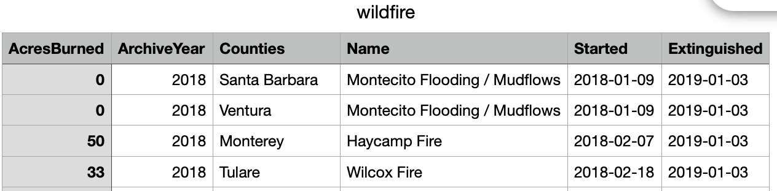
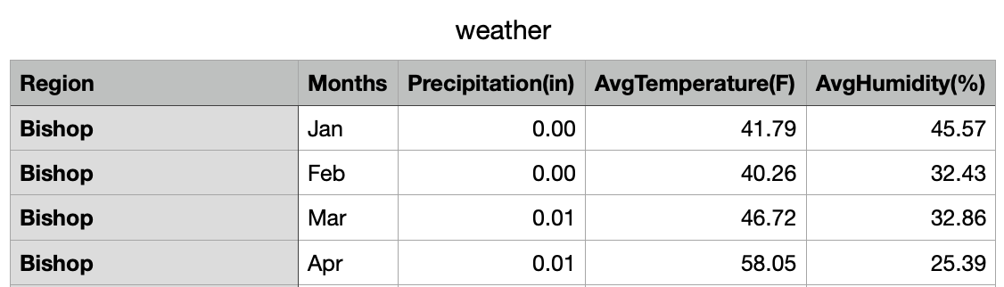
Overview
The main objective is to build an EDFS and implement PMR on data stored in EDFS.
Our project is about California Wildfires in 2018 and weather factors that might lead to the wildfires.
Task1: My-SQL based EDFS
Task2: Search function: search_wildfire(lower, upper)
Search function: search_weather(choice, month)
Analytics function: analyze_wildfire(lower, upper, num)
Task3: Web application based on Jupyter Notebook

Slide 3
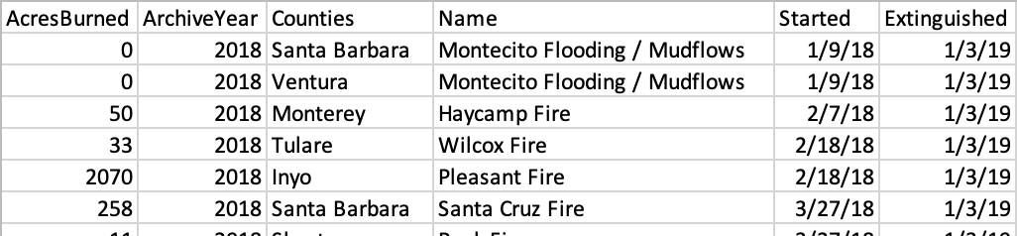
Database Structure
Metadata:
meta
dir
par
parent
child
location
type
id
id
name
Actual Data:
Partitioned file:
wildfire1
wildfire2
wildfire3

Slide 4
mkdir(directory)
eg. mkdir /user
meta
id | name | type
1 | / | d
2 | user | d
dir
partition
parent | child
1 | 2
id | location

Slide 5
ls(directory)
eg. ls /
meta
id | name | type
1 | / | d
2 | user | d
dir
partition
parent | child
1 | 2
id | location

Slide 6
put(file name, directory, k = # of partition)
put(wildfire.csv, /user, 2)
dir
parent | child
1 | 2
2 | 3
Meta Data
meta
id | name | type
1 | / | d
2 | user | d
3 | wildfire.csv | f
partition
id | location
3 | wildfire1
3 | wildfire2
Actual Data
wildfire1
wildfire1
wildfire2

Slide 7
cat(file path)
cat /user/wildfire.csv
dir
parent | child
1 | 2
2 | 3
Meta Data
meta
id | name | type
1 | / | d
2 | user | d
3 | wildfire.csv | f
partition
id | location
3 | wildfire1
3 | wildfire2
Actual Data
wildfire1
wildfire1
wildfire2

Slide 8
getPartitionLocations(file path)
getPartitionLocations(/user/wildfire.csv)
dir
Meta Data
parent | child
1 | 2
2 | 3
id | name | type
1 | / | d
2 | user | d
3 | wildfire.csv | f
meta
partition
id | location
3 | wildfire1
3 | wildfire2
Actual Data
wildfire1
wildfire1
wildfire2

Slide 9
readPartition(file path, k)
readPartition(/use/wildfire.csv, 2)
dir
Meta Data
parent | child
1 | 2
2 | 3
meta
id | name | type
1 | / | d
2 | user | d
3 | wildfire.csv | f
partition
id | location
3 | wildfire1
3 | wildfire2
Actual Data
wildfire1
wildfire1
wildfire2

Slide 10
rm(file path)
rm /user/wildfire.csv
dir
Meta Data
parent | child
1 | 2
2 | 3
meta
id | name | type
1 | / | d
2 | user | d
3 | wildfire.csv | f
partition
id | location
3 | wildfire1
3 | wildfire2
Actual Data
wildfire1
wildfire1
wildfire2

