Slide 1
Department of Computer Science & Cybersecurity
CHPATER 4.
Cloud Computing for Deep Learning
CS 5720: Neural Network & Deep Learning
Dr. I Hua Tsai, Assistant Professor

Slide 2
Neural Networks
Brief Recap of Neural Networks
Neural networks are a fundamental part of deep learning, inspired by biological neurons.
They require significant computational power for training, particularly deep neural networks (DNNs) and transformers.
Scalability is a major concern—larger datasets and more complex architectures demand high-performance hardware.

Slide 3
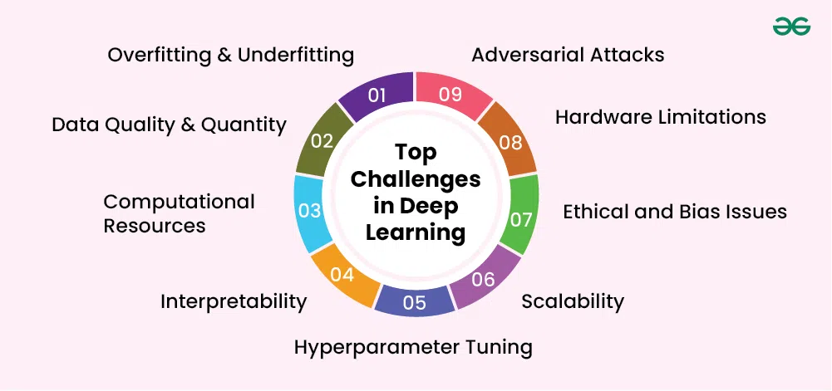
Computational Challenges
Training deep learning models on local machines can be resource-intensive and time-consuming.
Traditional setups may struggle with hardware limitations, slow processing speeds, and lack of flexibility.
Enter cloud computing—a scalable, efficient solution to overcome these bottlenecks

Slide 4
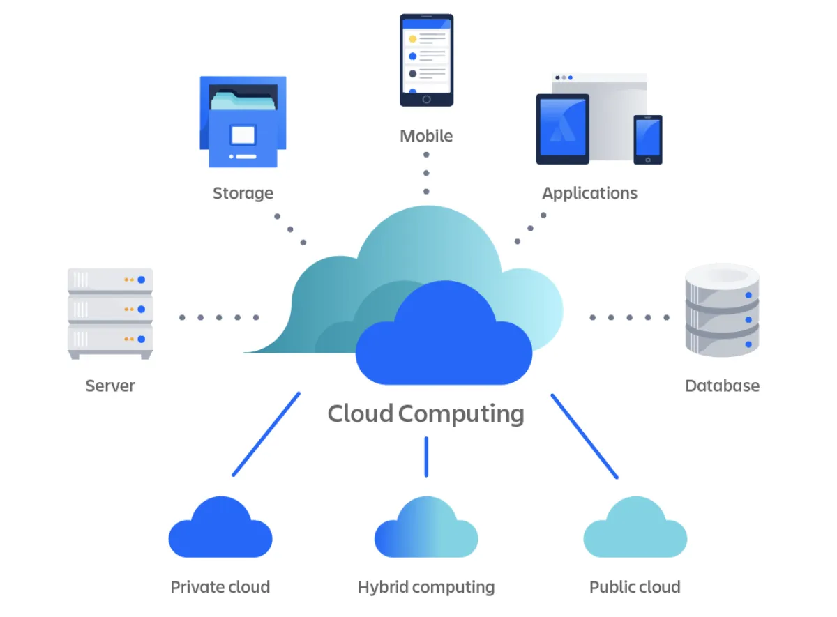
Cloud Computing
Cloud computing is a technology that enables on-demand access to computing resources—such as servers, storage, databases, networking, software, and artificial intelligence—over the internet.
Instead of relying on local hardware, businesses and individuals can use remote servers hosted in data centers to process, store, and manage data efficiently.

Slide 5
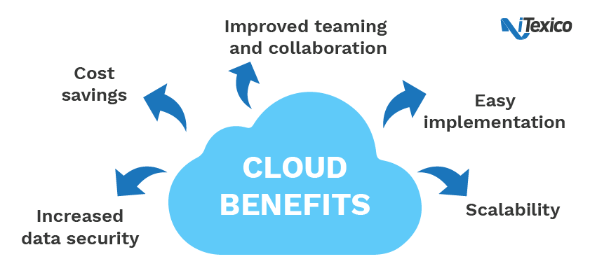
Leveraging Cloud Computing
Cloud Platforms: Utilize cloud-based platforms like AWS, Google Cloud, or Azure for accessing computational resources.
Scalable Computing: These platforms offer scalable computing power without the need for significant upfront investment.
Tools and Frameworks: Cloud services also provide tools and frameworks that simplify the deployment and management of deep learning models.

Slide 6
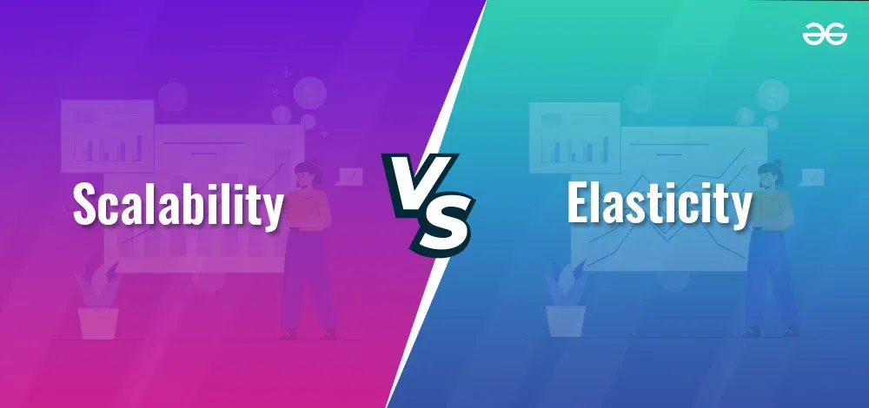
Ket features
Elasticity & Scalability:
Automatically adjust resources based on workload demands.
Elasticity refers to the ability of a system to dynamically adjust its resource allocation in response to changing demands.
Scalability refers to a system's capacity to handle growing amounts of work or users without compromising performance.

Slide 7
Aspect | Scalability | Elasticity
Definition | Ability to handle increased workload by adding resources. | Dynamic adjustment of resources based on demand fluctuations.
Resource Allocation | Resources are added or removed manually in response to workload changes. | Resources are automatically scaled up or down based on demand.
Timing | Scaling usually occurs reactively in response to increased demand. | Resources are scaled dynamically in real-time as demand changes.
Management | Typically requires human intervention for resource adjustments. | Resource allocation is automated, minimizing manual involvement.
Flexibility | Offers flexibility in scaling but may not be instantaneous. | Offers instant and automated resource adjustments as needed.
Use Cases | Commonly used in systems where workload patterns are predictable. | Ideal for applications with highly variable or unpredictable workloads.
Cost Implications | May lead to over-provisioning during low-demand periods. | Enables cost optimization by scaling resources precisely to demand.
Response Time | Scaling operations may take time to implement and may cause downtime during adjustments. | Resource adjustments are instantaneous, minimizing downtime and ensuring seamless performance.
Complexity | Generally simpler to implement and manage, especially in environments with stable workloads. | Requires sophisticated automation and monitoring systems to dynamically adjust resources based on demand.
Efficiency | May result in underutilization of resources during low-demand periods. | Optimizes resource utilization by scaling resources precisely to match demand, thus reducing waste.

Slide 8
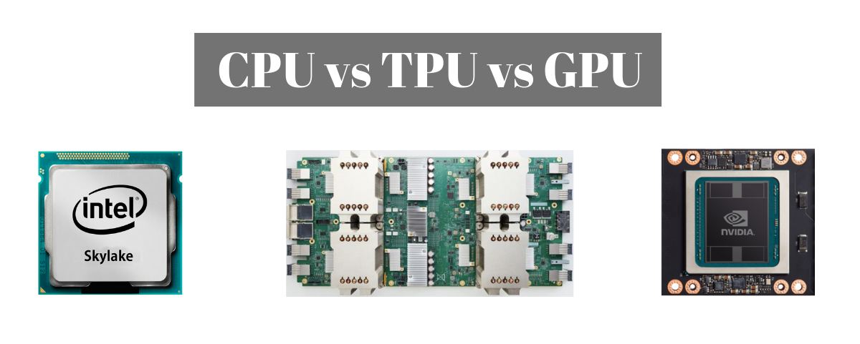
Key features
High-performance GPUs & TPUs:
Specialized hardware (e.g., NVIDIA A100, Google TPUs) accelerates model training.
GPU (Graphics Processing Unit):
GPU is a specialized processor designed to handle parallel processing efficiently. E.g.: graphics and videos, deep learning, AI, and scientific computing.
TPU (Tensor Processing Unit):
A TPU is an AI-specific accelerator developed by Google for deep learning applications.
They are faster and more power-efficient than GPUs for deep learning but are only available through Google Cloud.

Slide 9
Key features
Managed AI/ML Services:
Pre-configured environments for neural networks
AWS SageMaker, Google Vertex AI
Distributed Computing:
Enables parallel model training across multiple virtual machines

Slide 10
Real World example:
Healthcare: AI-powered diagnosis via cloud-hosted models.
Finance: Fraud detection models running on cloud platforms.
Autonomous Vehicles: Real-time data processing using cloud-based AI models.

Slide 11
Advantage
Cost-Efficiency
Pay-as-you-go pricing minimizes upfront hardware investments.
Eliminates the need for expensive on-premise infrastructure.
Accessibility & Collaboration
Teams across different regions can access shared resources, facilitating remote collaboration.
Cloud-based Jupyter notebooks (e.g., Google Colab, AWS Studio) streamline model development.

Slide 12
Advantage
Faster Experimentation & Deployment
Automated ML workflows accelerate model training, tuning, and deployment.
CI/CD pipelines for AI enable seamless integration with cloud applications.

Slide 13
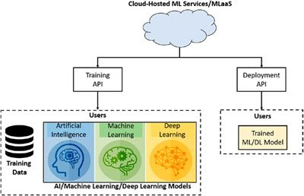
Cloud Platform
The demand for deep learning has surged, requiring powerful infrastructure to train and deploy neural networks.
Cloud platforms provide scalability, automation, and hardware acceleration to make deep learning more accessible.
Today, we will focus on three major cloud platforms: AWS, Google Cloud, and Microsoft Azure.

Slide 14
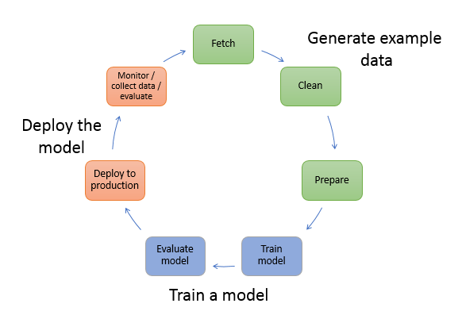
AWS (Amazon Web Services)
A leader in cloud computing, offering a robust suite of machine learning services.
Key tool: AWS SageMaker
A fully managed service that simplifies the process of building, training, and deploying deep learning models.
Supports frameworks like TensorFlow, PyTorch.
Features like automatic model tuning (Hyperparameter Optimization) and real-time inference.

Slide 15
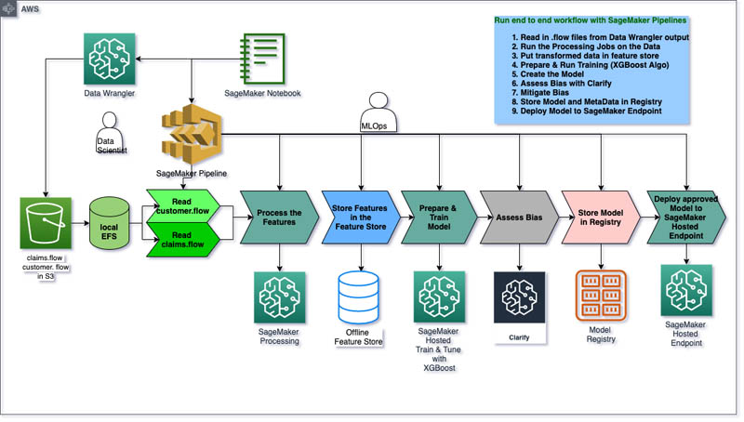

Slide 16
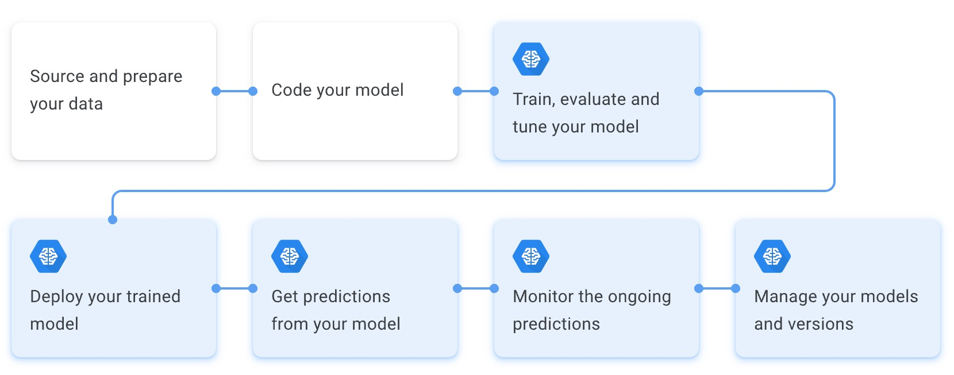
Google Cloud AI
Google Cloud AI is deeply integrated with TensorFlow, making it an ideal choice for deep learning research.
Key tool:
AI Platform (Vertex AI)Managed Jupyter Notebooks for collaborative ML development.
AutoML – Automated model training with minimal coding.
Deep Learning VM – Pre-configured instances with TensorFlow, PyTorch, and JAX.

Slide 17
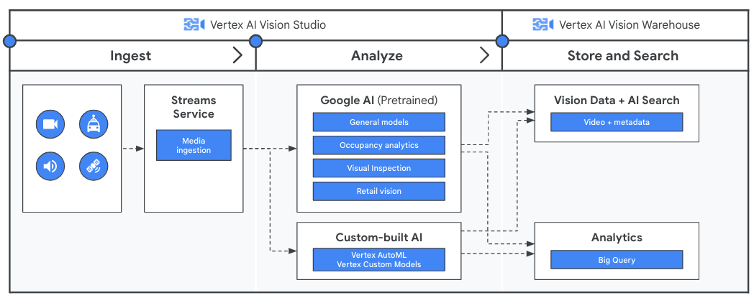

Slide 18
Microsoft Azure
Microsoft Azure offers enterprise-grade deep learning services.
Key tool: Azure Machine Learning Studio
A drag-and-drop environment for building AI models.
Supports PyTorch, TensorFlow, and Scikit-learn.
Enables automated ML and model monitoring.

Slide 19
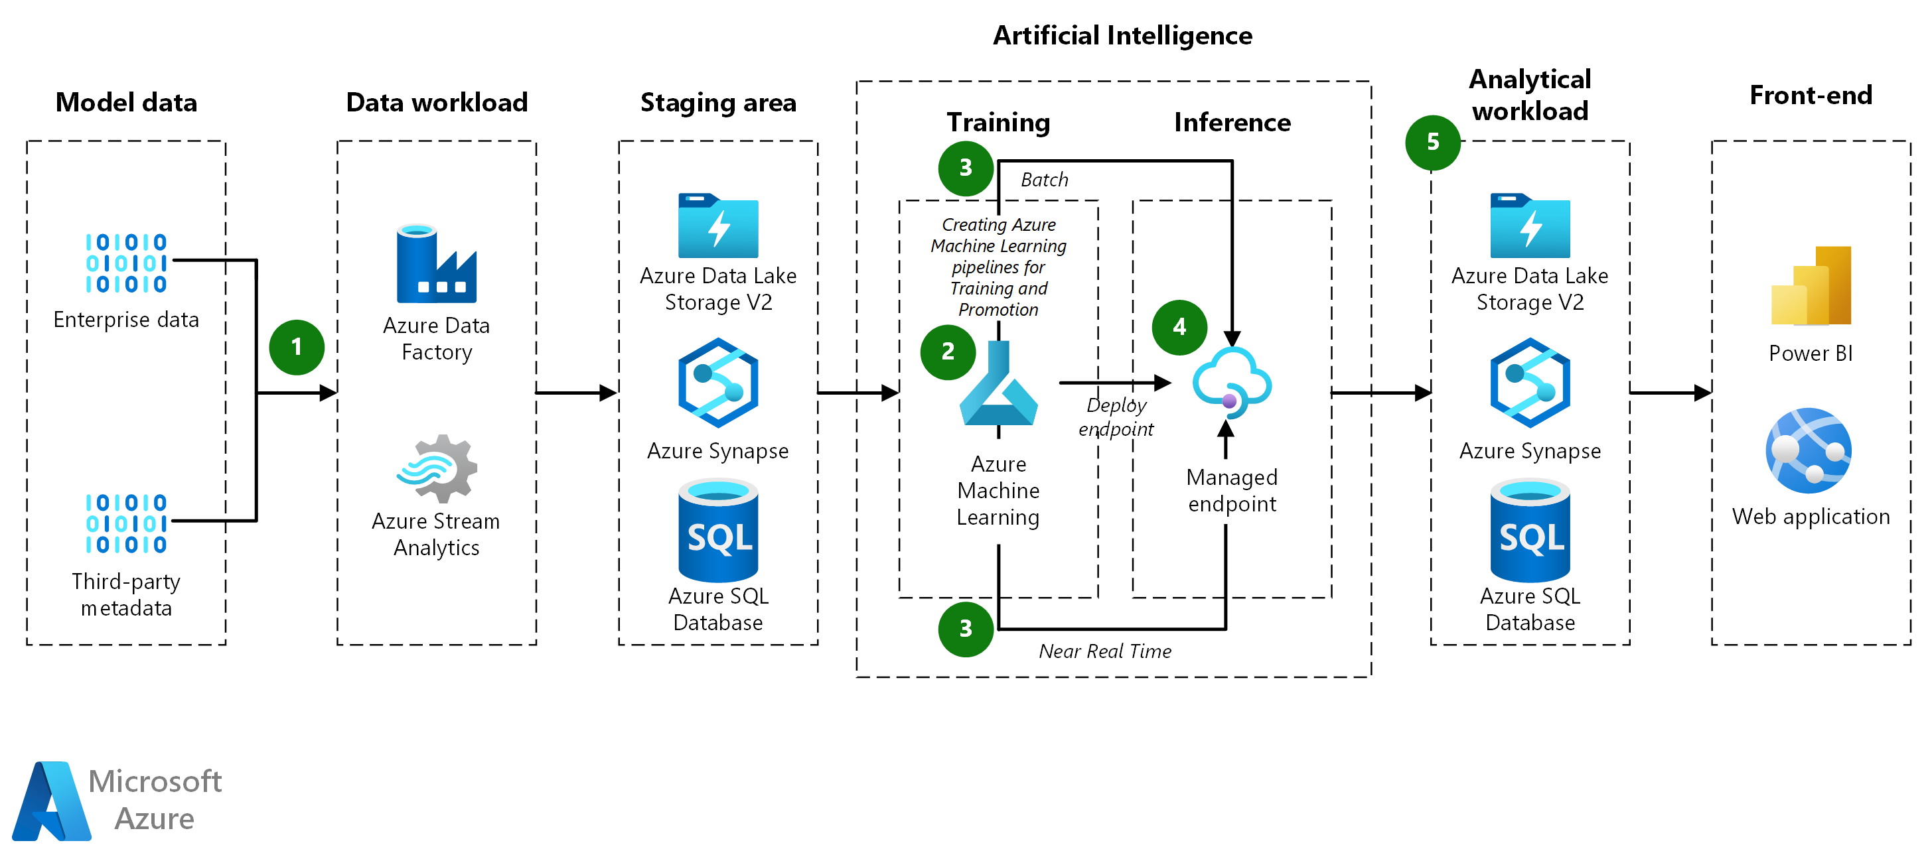

Slide 20
Feature | AWS | Google Cloud AI | Microsoft Azure AI
Best Use Case | Enterprise-grade AI & Scalability | AI Research & TensorFlow Optimization | Business AI & Enterprise Solutions
Key AI Service | SageMaker | Vertex AI | Azure Machine Learning
GPU/TPU Support | GPUs (NVIDIA A100), Inferentia | TPUs & GPUs | GPUs (NVIDIA V100, A100)
Scalability | Highly Scalable | Highly Scalable | Scalable with Hybrid Options
Ease of Use | Moderate (Complex Setup) | User-Friendly (Deep ML Integration) | Easy (No-Code & Code-Based Options)
Enterprise Integration | Strong (AWS Ecosystem) | Moderate (Google Ecosystem) | Strong (Microsoft 365, Power BI)
Pricing Model | Pay-as-you-go & Reserved Instances | Usage-Based Pricing | Subscription & Pay-as-you-go
Pre-Built AI Models | Amazon Rekognition, Lex, Polly | Vision AI, NLP API, AutoML | Azure Cognitive Services

