Slide 1
GUI Elements Automation Using Selenium WebDriver
(https://testautomationpractice.blogspot.com/)

Slide 2
Name : Yatish Kumar
Trainer Name : Navin CK
Training Program : SDET(Software Development Engineer in Test)
Organization : Wipro Limited
Project Type : Capstone Project
Technology/ Tools : Selenium WebDriver, Java, TestNG, Maven, POM

Slide 3
Introduction
Automation testing is the process of using software tools to execute test cases automatically. Selenium WebDriver is one of the most popular automation tools used for web application testing.
This project automates various GUI elements available on the Test Automation Practice website and validates their functionality.

Slide 4
Objective
Automate data entry into text fields (Name, Email, Phone, Address).
Automate selection of radio buttons and checkboxes.
Automate dropdown selections (Country, Colors, Sorted List).
Handle and validate date picker controls.
Automate file upload functionality.
Handle Simple Alert, Confirmation Alert, and Prompt Alert pop-ups.
Perform advanced user interactions such as Mouse Hover, Double Click,
and Drop, and Slider movement.
Verify that all actions are executed successfully using assertions.
Implement a maintainable framework using Page Object Model (POM).
Execute test cases using TestNG and manage dependencies with Maven.
Capture screenshots for test evidence and reporting.

Slide 5
Tools & Technologies
Tool / Technology Purpose Java Programming language used to develop the automation scripts. Selenium WebDriver Automates browser interactions and web element operations. TestNG Testing framework used for test execution, assertions, and reporting Maven Build automation and dependency management tool. Page Object Model (POM) Design pattern used to improve code reusability and maintainability. Eclipse IDE Integrated Development Environment used for coding and execution. Google Chrome Browser used for test execution. ChromeDriver WebDriver implementation used to control the Chrome browser. GitHub Repository hosting platform used for code storage and collaboration. Extent Reports Used to generate detailed HTML test execution reports. Apache Commons IO Library used for screenshot capture and file handling operations.

Slide 6
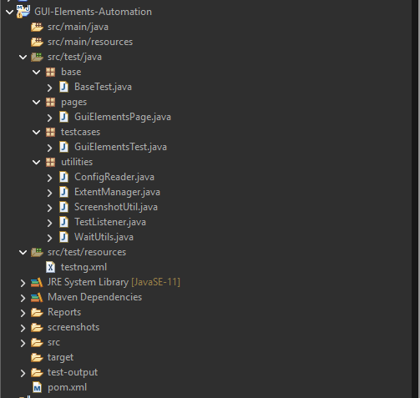
Project Structure

Slide 7
TestNG Annotations & Assertions
Annotations Used:
@BeforeMethod – Executes before every test method (used for browser setup).
@Test – Marks a method as a test case.
@AfterMethod – Executes after every test method (used for browser closure).
Assertions Used:
Assert.assertEquals()- Used to validate Name, Email, Phone, and Address fields.
Assert.assertTrue()- Used to verify Radio Button, Checkboxes, Dropdowns, Date Picker, File Upload, Alerts, Mouse Hover, Double Click, Drag and Drop, and Slider functionalities.

Slide 8
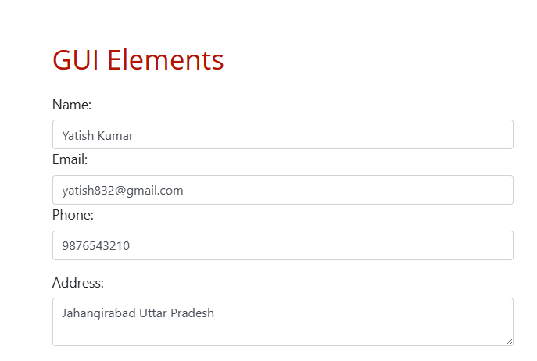
Implementation – Text Fields
Text Field
Name
Email
Phone Number
Address
Implementation
Used Selenium sendKeys() method
Entered valid test data

Slide 9
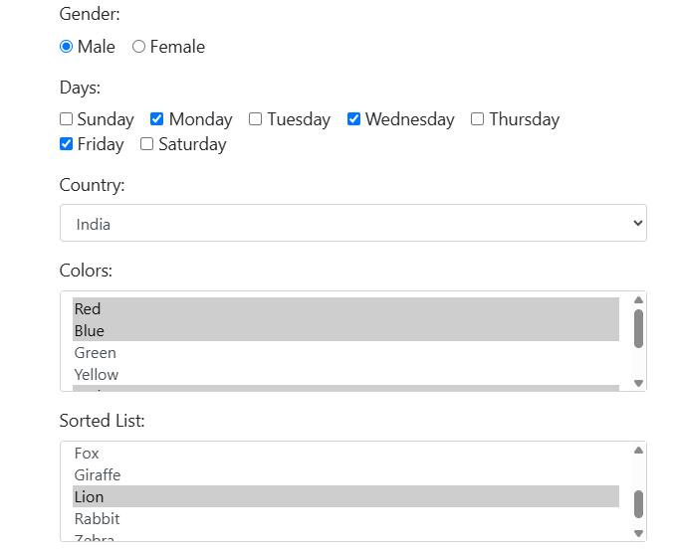
Implementation – Selection Controls
Selection Controls
Gender Radio Button
Days Checkboxes
Country Dropdown
Colors Dropdown
Animals Dropdown
Implementation
Used click() for radio & checkboxes
Used Select class for dropdowns

Slide 10
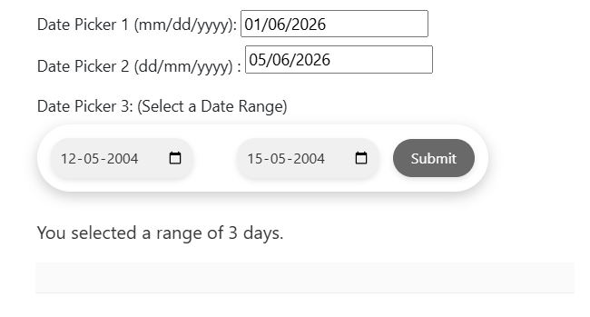
Implementation – Date Pickers
Automated Date Controls
Date Picker 1
Date Picker 2
Date Range Picker

Slide 11
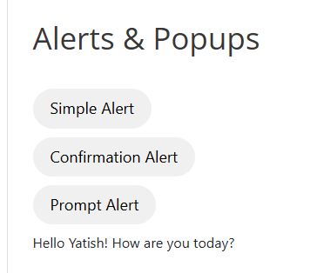
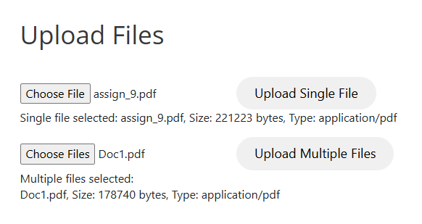
Implementation – File Upload & Alerts
Automated:
Single File Upload
Multiple File Upload
Alerts Handled:
Simple Alert
Confirmation Alert
Prompt Alert

Slide 12
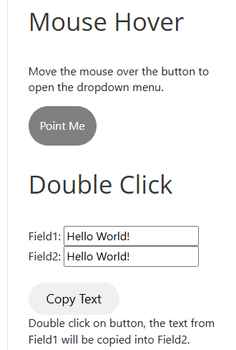
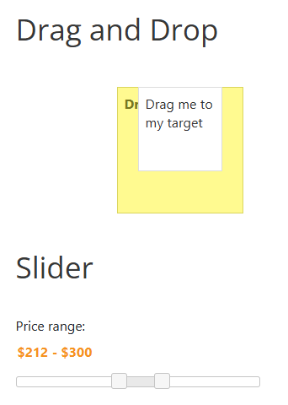
Implementation – Advanced Actions
Actions Performed
Mouse Hover
Double Click
Drag and Drop
Slider Movement
Implementation
Used Act class for Advance Actions

Slide 13
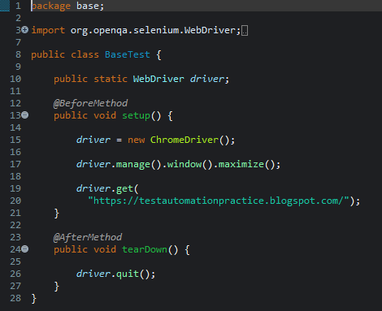
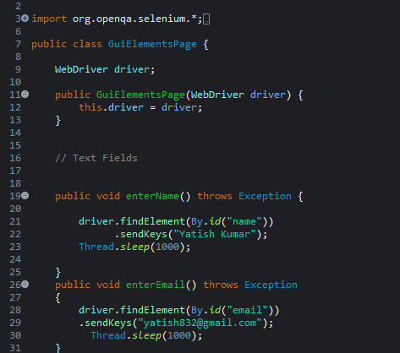
Code Snippets-

Slide 14
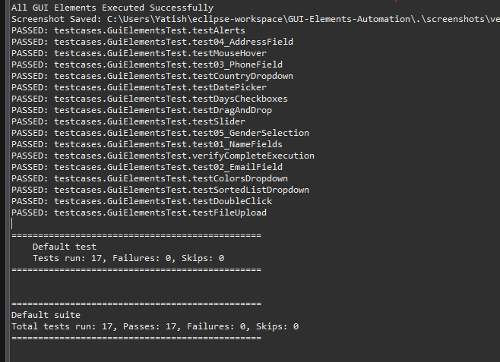
Console Output -

Slide 15
Test Scenarios – TC_001 to TC_10
Test Case ID | Test Scenario | Status
TC_001 | Name Field | ✅ Passed
TC_002 | Email Field | ✅ Passed
TC_003 | Phone Field | ✅ Passed
TC_004 | Address Field | ✅ Passed
TC_005 | Gender Selection (Radio Button) | ✅ Passed
TC_006 | Days Selection (Checkboxes) | ✅ Passed
TC_007 | Country Dropdown | ✅ Passed
TC_008 | Colors Dropdown | ✅ Passed
TC_009 | Sorted List Dropdown | ✅ Passed
TC_010 | Date Picker | ✅ Passed

Slide 16
Test Scenarios – TC_10 to TC_17
Test Case ID Test Scenario Status
TC_011 File Upload ✅ Passed
TC_012 Alert Handling ✅ Passed
TC_013 Mouse Hover ✅ Passed
TC_014 Double Click ✅ Passed
TC_015 Drag and Drop ✅ Passed
TC_016 Slider ✅ Passed
TC_017 Complete GUI Execution ✅ Passed

Slide 17
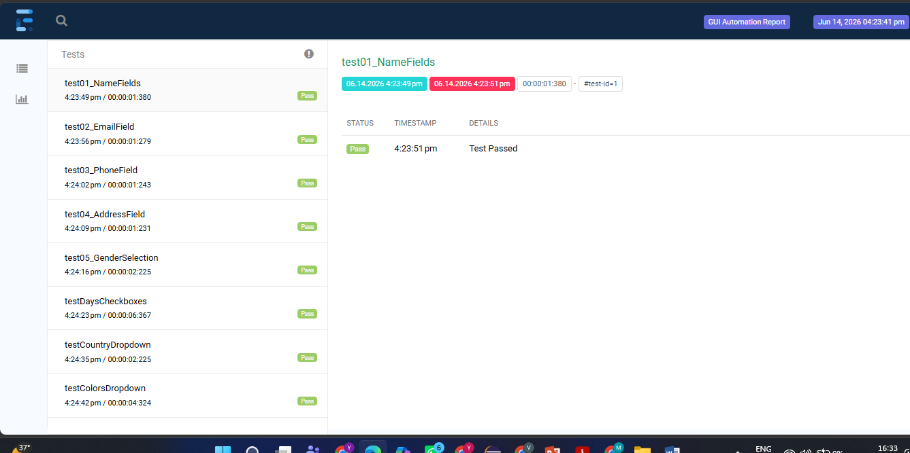
Extent Report -

Slide 18
Execution Process
Step Description
Launch Browser Chrome browser is launched using Selenium WebDriver.
2. Navigate to Website The automation script opens the Test Automation Practice website.
3. Execute Test Cases TestNG executes all GUI test cases sequentially.
4. Validate Results Assertions verify that the actual results match the expected results.
5. Capture Screenshots Screenshots are automatically captured for both passed and failed
test cases.
6. Generate Extent Report An Extent Report is generated with execution details, test status,
screenshots, and logs.

Slide 19
Challenges Faced During the Project
Handling dynamic web elements during execution.
Automating multiple date picker controls.
Managing Simple, Confirmation, and Prompt alerts.
Performing Drag and Drop functionality reliably.
Moving the slider to the required position accurately.
Implementing Mouse Hover and Double Click actions.
Uploading files using local system file paths.
Capturing screenshots during test execution.
Faced Maven dependency and project configuration issues during framework setup.
Designing and organizing the framework.

Slide 20
Future Enhancements
Implement Data-Driven Testing using Excel files.
Support Cross-Browser Testing (Chrome, Firefox, Edge).
Integrate the framework with Jenkins for automatic test execution.
Connect to SQL databases to validate backend data after UI operations.
Execute automation tests inside Docker containers for consistent and isolated test environments
Implement BDD using Cucumber for better readability and collaboration.
Execute tests in Parallel to reduce execution time.

Slide 21
Conclusion
This project successfully automated the GUI elements of a web application using Selenium WebDriver, Java, TestNG, and the Page Object Model (POM). The framework provides organized, reusable, and maintainable test scripts. Test execution was validated using assertions, and reports were generated to track the results. Version control was managed with GitHub, making collaboration and code management easier. Overall, the project demonstrates how automation testing improves software quality, reduces manual effort, saves time, and ensures reliable application testing.

Slide 22
Thank You

