Slide 1



Predicting House in Chennai: A Linear Regression Approach
This presentation outlines the process of building a linear regression model to predict house prices in Chennai, India. We will explore the dataset, perform exploratory data analysis, and implement a machine learning pipeline to train and evaluate the model.
by Yatish nayan

Slide 2
Dataset Overview
The dataset used for this project contains information about properties in Chennai. It includes features such as price, area, number of bedrooms, and location. The data is stored in a CSV file, which we will load and analyze using Python libraries.
Columns
Data Types
Price
Numeric (float, int)
Area
Categorical (string)
No. of Bedrooms
Location

Slide 3
Technologies Involved
Python: programming language for development.
Numpy : For numerical computations and array operations.
Pandas : Data manipulation and analysis.
Seaborn : Statistical data visualization.
scikit-learn : Machine learning models and evaluation metrics.
FastAPI : Fast web framework for building APIs with Python.

Slide 4
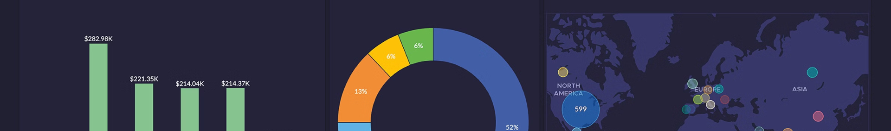
Exploratory Data Analysis (EDA)
EDA is crucial for understanding the dataset and identifying patterns and relationships. We will examine the first few rows, summary statistics, and information about the dataset. We will also check for missing values and analyze the correlation between numeric columns.
1
First Few Rows
2
Summary Statistics
Displaying the initial rows of the dataset provides a glimpse into the data structure and content.
Calculating summary statistics like mean, median, and standard deviation helps understand the distribution of numeric features.
3
Missing Values
4
Correlation Matrix
Identifying missing values is essential for handling them appropriately during data preprocessing.
Visualizing the correlation between numeric features helps understand the relationships between variables.

Slide 5


Feature Engineering
Feature engineering involves selecting relevant features and applying preprocessing techniques to prepare the data for modeling. This step ensures that the data is in a suitable format for the linear regression algorithm.
1
Feature Selection
Choosing the most relevant features for predicting prices, such as area, number of bedrooms, and location.
2
Data Preprocessing
Handling missing values, scaling numeric features, and encoding categorical features using techniques like OneHotEncoder.
3
Data Splitting
Dividing the dataset into training and testing sets to evaluate the model's performance on unseen data.

Slide 6
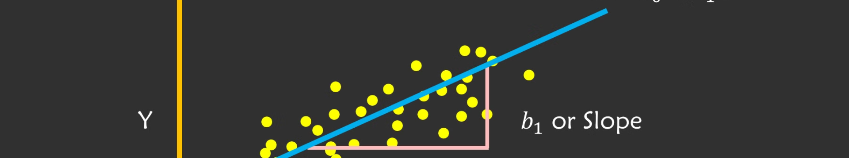
Modeling: Linear Regression
Linear regression is a statistical method used to model the relationship between a dependent variable (rent price) and one or more independent variables (features). We will use the scikit-learn library to implement the linear regression model.
Pipeline Creation
Model Training
Creating a pipeline to streamline the preprocessing and modeling steps, ensuring consistency and efficiency.
Training the linear regression model on the prepared training data to learn the relationship between features and rent prices.

Slide 7

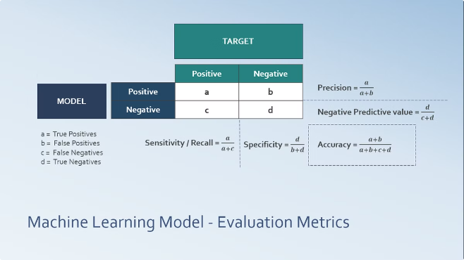
Model Evaluation
Evaluating the model's performance is crucial to assess its accuracy and effectiveness. We will use metrics such as Root Mean Squared Error (RMSE), Mean Absolute Error (MAE), and R² score to evaluate the model's predictions.
Metric
Description
RMSE
Measures the average difference between predicted and actual values.
MAE
Calculates the average absolute difference between predicted and actual values.
R²
Indicates the proportion of variance in the dependent variable explained by the model.

Slide 8





Deployment: FastAPI
To make the model accessible for real-world applications, we will deploy it using FastAPI, a modern Python web framework. FastAPI allows us to create a RESTful API that can be used to make predictions based on user input.
API Creation
Defining API endpoints to handle requests for rent price predictions.
Model Integration
Integrating the trained linear regression model into the API to make predictions.
API Deployment
Deploying the API to a web server to make it accessible to users.

Slide 9


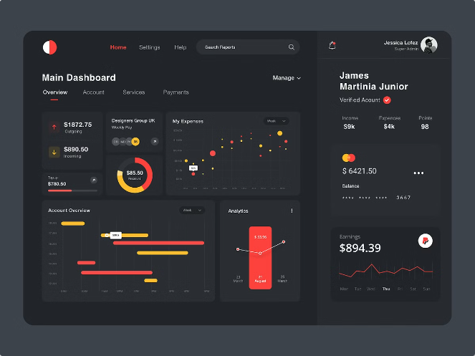



Demo: API Usage
This section demonstrates how to use the deployed API to make rent price predictions. We will provide sample input data and show the API response, illustrating the process of using the model for real-world applications.
User Input
Providing features such as area, number of bedrooms, and location as input to the API.
API Request
Sending a request to the API endpoint with the user input data.
Model Prediction
The API uses the trained model to generate a rent price prediction based on the input data.
API Response
The API returns the predicted rent price to the user.

Slide 10
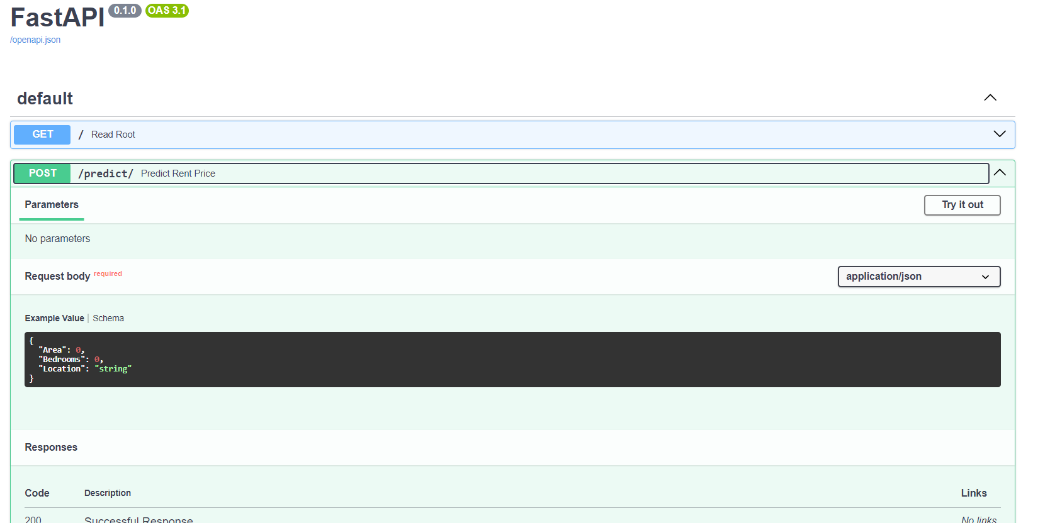
Output

Slide 11
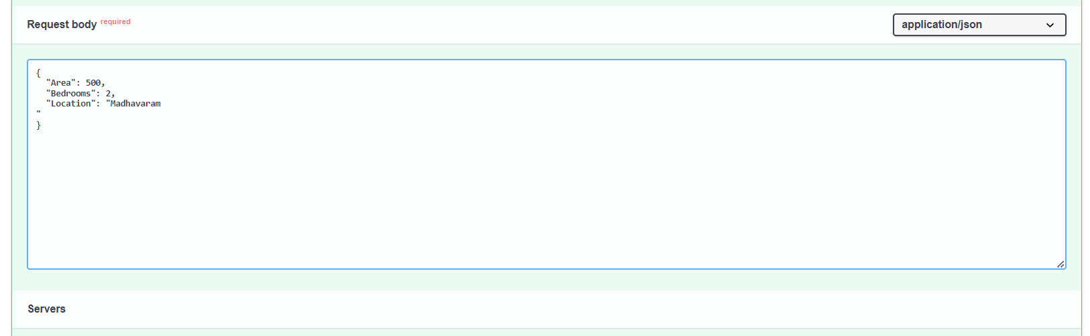

Slide 12
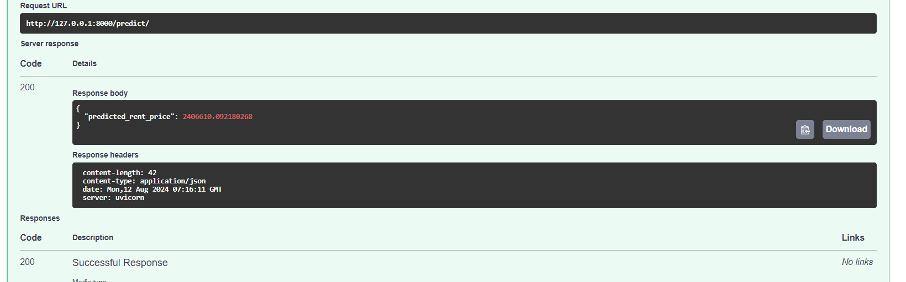

Slide 13
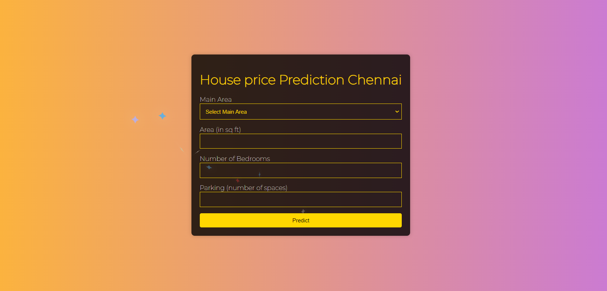

Slide 14
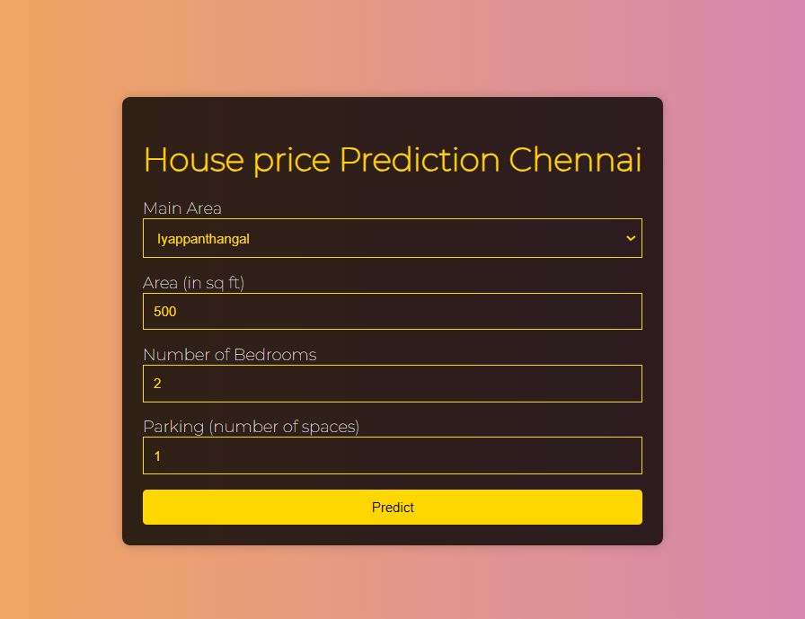

Slide 15
