Slide 1

Basic Details of the Team and Problem Statement
Ministry/Organization Name/Student Innovation: AICTE
PS Code: 1459
Problem Statement Title: Integration of Multiple Data-bases of AICTE in order to fetch Coherent Information
Team Name: HACK N’HEXA
Team Leader Name: SHRESTY BOHRA
Institute Code (AISHE): U-0147
Institute Name: Pandit Deendayal Energy University
Theme Name: Multiple Database Integration

Slide 2
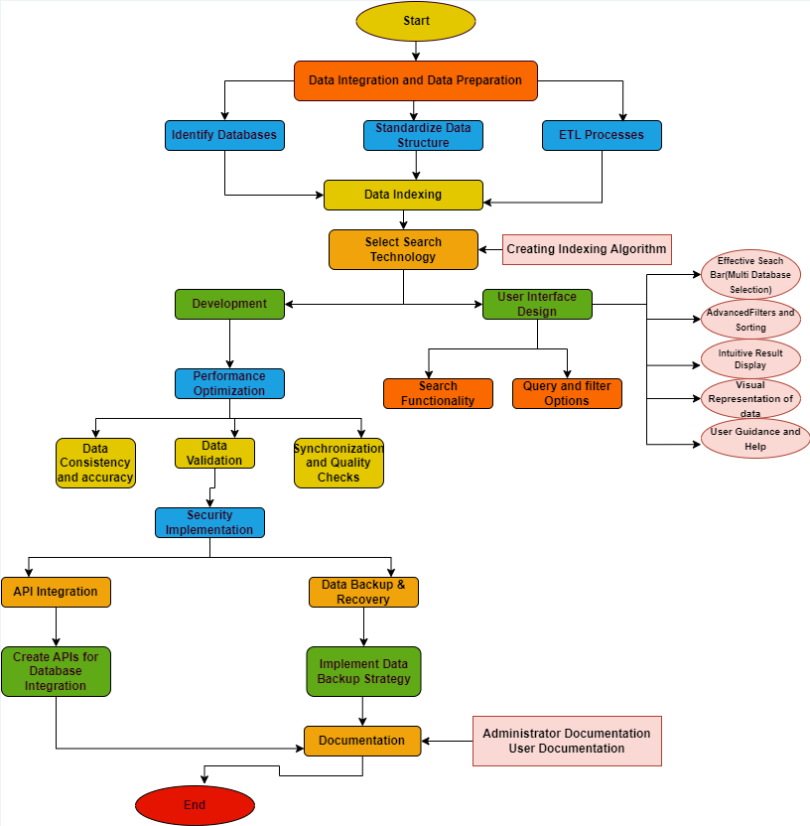
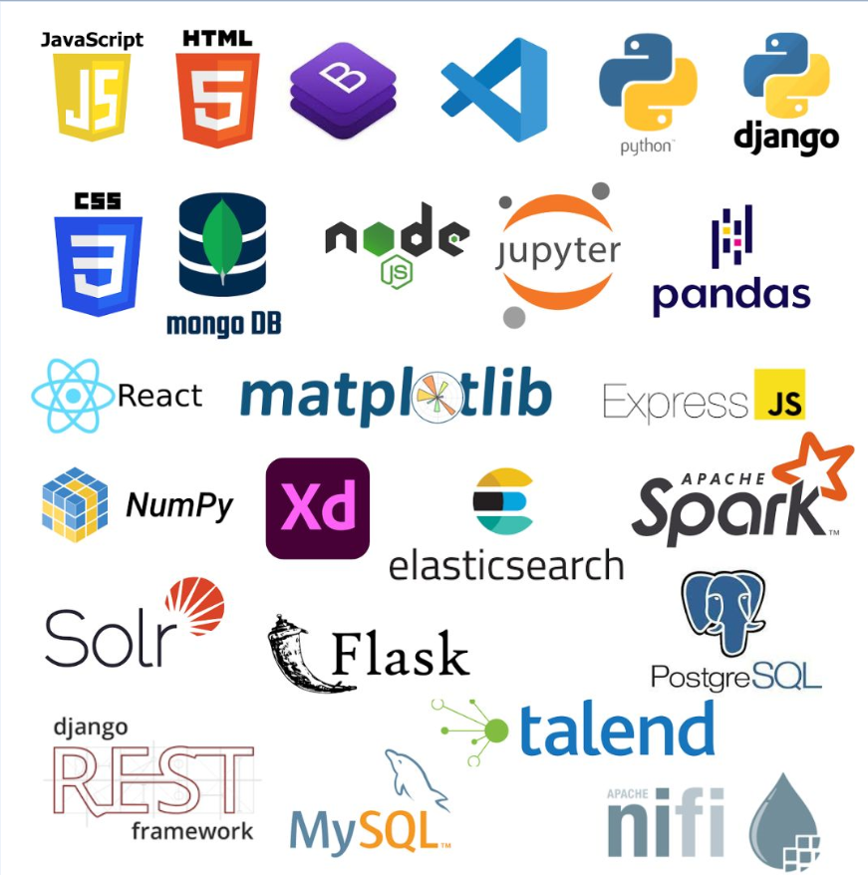
Idea/Approach Details
Describe your idea/Solution/Prototype here:
Idea: The idea is to consolidate and streamline the diverse data sources of AICTE to enable seamless access and retrieval of accurate and pertinent information. This integration seeks to enhance the efficiency of data-driven processes and decision-making in the domain of technical education regulation and management .
Our Approach:
Data Integration: Consolidate and standardize multiple databases.
Advanced Search: Optimize and implement powerful algorithms for speed and accuracy.
Data Quality & Security: Ensure data consistency, accuracy, and security through APIs and backup.
User-Friendly Interface: Create an accessible website for easy access and support.
Scalability: Design for future growth, enhancing AICTE's data retrieval efficiency.
Flow:
End Users: The primary end users are educational institutions or Accreditation Bodies, government regulatory authorities, and students. Academic Researchers, Policy Makers, Education Consultants, Credential Verifiers are also key users.
Applicability: The retrieve coherent information is highly applicable in streamlining and enhancing the technical education ecosystem in India. By centralizing and standardizing data, It empowers students, institutions, employers, and regulators, improving search, and ensuring quality. This enhances decision-making and data accessibility across the technical education landscape.
Describe your Technology stack here:

Slide 3
Idea/Approach Details
Describe your Dependencies / Show stopper here
Dependencies
Database Systems: Access to multiple external databases is crucial for consolidating data from various technical institutions.
Web Development Tools: Tools for creating a user-friendly web platform that allows seamless access to integrated data.
ETL (Extract, Transform, Load) Software: ETL tools and software for collecting, transforming, and loading data from diverse sources into a unified format.
Data Validation and Quality Checks: Automated processes and tools to perform data validation and quality checks regularly, identifying and rectifying inconsistencies.
Data Backup and Recovery, API Development: Essential resources for data backup and recovery hardware and API development tools to ensure data resilience and efficient database integration.
Data Encryption and Access Control: Tools for encrypting sensitive data and implementing access control mechanisms to secure data from unauthorized access.
Data Integration Tools and Data Integrity Measures: Tools and mechanisms for data preparation, transformation, integration, and ensuring data integrity during transfer and storage.
Data Indexing Tools: Tools and software for creating indexes, optimizing search algorithms, and improving data retrieval speed.
Uniqueness
Comprehensive Integration: Combines data from diverse sources for a holistic view.
Advanced Search and Indexing: Employs state-of-the-art search algorithms and indexing techniques for faster and precise data retrieval.
Automated Data Validation: Implements automated processes to systematically verify and maintain data quality and reliability, reducing the need for manual checks.
API Integration: Smooth database connections through well-designed APIs and implement backup solutions.
Data Consistency: Establishes a system of routine checks and validation procedures.
Show stopper
Weak Data Security: Poses a major risk to the project.
Data Quality and Standardization Issues: Hampers reliable integration and disrupts efficient data handling.
Describe your Use Cases here
Advanced Technologies Integration: Utilizing the integrated data for the implementation of cutting-edge technologies such as artificial intelligence, machine learning, data science, blockchain, and IoT to enhance educational processes, ensure data security, to predict student’s performance , automate administrative tasks, and conduct in-depth research on education and workforce trends.
Policy Alignment: Government uses integrated data to align policies and investments with national development goals in technical education.
Elevating India's Education Ecosystem: Integrated data supports career guidance services and educational startups, elevating India's education ecosystem.
Global Education Partnerships: AICTE can foster international collaborations by sharing standardized data with global educational bodies in the field of technical education.
Enhanced Decision-Making and Stakeholder Communication: Integrated data enables better decision-making for policy and funding, addressing education gaps, and enhancing communication with stakeholders through reports and dashboards.
Educational Enrichment:- Enhanced course selection, scholarship access, faculty development, student achievement, data-driven decision-making, improved accreditation, ensuring higher quality of education.

Slide 4
Team Member Details
Team Leader Name: SHRESTY BOHRA
Branch (Btech/Mtech/PhD etc): Btech Stream (ECE, CSE etc): CSE Year (I,II,III,IV): III
Team Member 1 Name: KHUSHAL JAIN
Branch (Btech/Mtech/PhD etc): Btech Stream (ECE, CSE etc): CSE Year (I,II,III,IV): III
Team Member 2 Name: YATRI PATEL
Branch (Btech/Mtech/PhD etc): Btech Stream (ECE, CSE etc): CSE Year (I,II,III,IV): III
Team Member 3 Name: RASHI BATRA
Branch (Btech/Mtech/PhD etc): Btech Stream (ECE, CSE etc): CSE Year (I,II,III,IV): III
Team Member 4 Name: TANYA KHUNTETA
Branch (Btech/Mtech/PhD etc): Btech Stream (ECE, CSE etc): CSE Year (I,II,III,IV): III
Team Member 5 Name: AARYAN PATEL
Branch (Btech/Mtech/PhD etc): Btech Stream (ECE, CSE etc): CSE Year (I,II,III,IV): III
Team Mentor 1 Name: PAYAL CHAUDHARI
Category (Academic/Industry): Academic Expertise (AI/ML/Blockchain etc):Blockchain, Cloud Security, IOT
Domain Experience (in years): 18

