Slide 1
Introduction of Bluetooth Technology
August 30, 2000
WS KANG
Principal Engineer
Network Solution Lab.
Corporate R&D Center
Samsung Electronics

Slide 2
Who Started Bluetooth?
The Bluetooth SIG (Special Interest Group) was formed in February 1998
  Ericsson
  IBM
  Intel
  Nokia
  Toshiba
  Now 9 Promoter member 3COM,LUCENT,MS ,Motorola (1999)
There are 1800+ adopter companies
The Bluetooth SIG went “public” in May 1998
The Bluetooth SIG work (the spec: >1,500 pages) became public on July 26, 1999

Slide 3
The Bluetooth Technology
Creates an open industry standard to revolutionize wireless connectivity for personal and mobile devices.
Substitutes a wireless air link for physical connections between electronic devices located in a single area (the piconet).
Establishes rapid, ad-hoc connections between one or more devices with required security (point to point, paired, or multipoint).
Permits instantaneous, effortless exchange of voice and data between suitably configured devices (the profiles).
Accelerates the growth of mobile data connectivity.

Slide 4
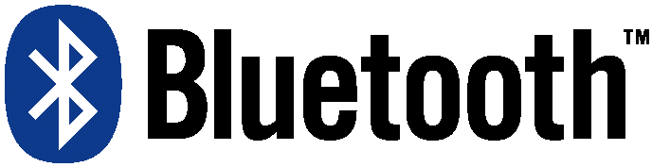
The Bluetooth Technology
Features
  Flexible network topology
  Low energy consumption
  Robust data
  High quality voice transfer
Bluetooth values Trade Marked
  Freedom
  Simplicity
  Reliability
  Versatility
  Security

Slide 5


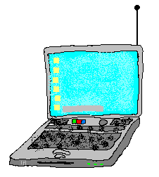






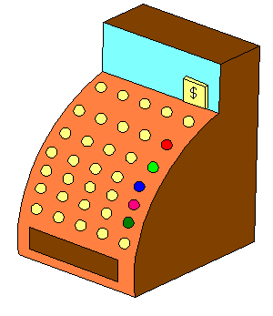
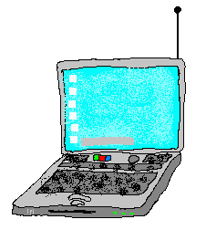

What does Bluetooth do for you?
Landline
Cable Replacement
Data/Voice Access Points
Personal Ad-hoc Connectivity

Slide 6
What is Bluetooth?
A Short Range Wireless Communication Technology
  Intended to create Personal Area Network or PAN(s)
  Operating Range of 10 Meters(optional 100 meters mode)
Operates in Free Scientific Communication Band
  2.4 GHz to 2.5 GHz
Provides Multiple Levels of Security
  Frequency Hopping
  Data Whitening
  Data Encoding
  Data Encryption
Targeted at all types of Devices
  Wiresless Telephones(Cellular, Portables, Satellite, etc.)
  Computers, PDAs, Peripherals, etc.
  Set-top Boxes, Audio Systems, Cameras and Camcorders, etc.
  Comsumer Electronics, Headsets, Remote controls, etc.

Slide 7
What is in the Bluetooth Specification?
Applications
TCP/IP
HID
RFCOMM
Application Framework and Support
Data
Control
Host Controller Interface
Audio
L2CAP
Link Manager and L2CAP
Link Manager
Baseband
Radio & Baseband
RF
A hardware/software description
An application framework

Slide 8

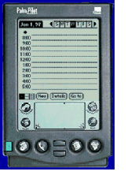
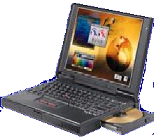


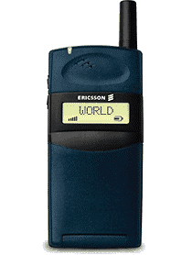
Usage scenarios: Synchronization
User benefits
Proximity synchronization
Easily maintained database
Common information database
Sharing Common Data…

Slide 9


Usage scenarios: Headset
User benefits
Multiple device access
Cordless phone benefits
Hand’s free operation
Wireless Freedom…

Slide 10

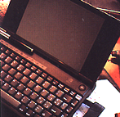

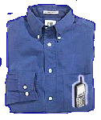
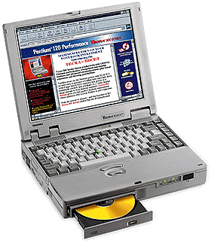
Usage scenarios: Data access points
PSTN, ISDN,
LAN, WAN, xDSL
User benefits
No more connectors
Easy internet access
Common connection experience
Remote Connections...

Slide 11

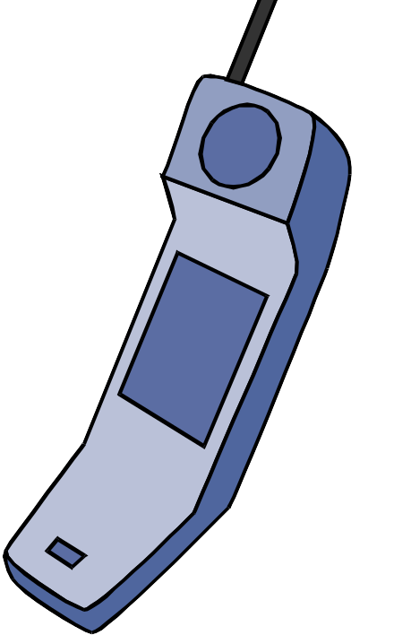
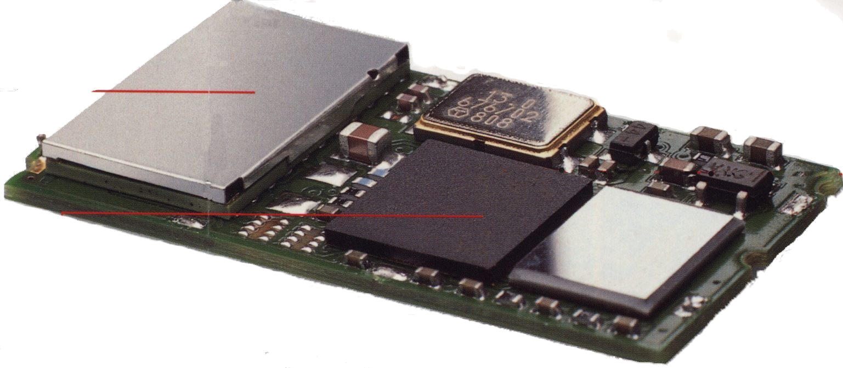
Bluetooth System Overview
Bluetooth Block Diagram
Bluetooth Module
FLASH
Host
Processor
RF
Transceiver
Baseband
Processor
H
C
I
DC Power
Ref Osc
Bluetooth modules include subsystems:
  Radio
  Baseband
  Software
  ...and Applications Development Tools
8
Notes:
First solutions will be dongles.
Bluetooth will look like a stand-alone peripheral

Slide 12
Radio
frequency synthesis: frequency hopping
  2.402 + k MHz, k=0, …, 78
  1,600 hops per second
conversion bits into symbols: modulation
  GFSK (BT = 0.5; 0.28 < h < 0.35);
  1 MSymbols/s
transmit power
  0 dbm (up to 20dbm with power control)
receiver sensitivity
  -70dBm @ 0.1% BER

Slide 13
Radio Basics: Receiver
RF energy
Digital data
Antenna
Filter
LNA
RF
Mixer
Selectivity
Filter & Gain
Demodulator
VCO
The RF Transceiver contains both Receiver and Transmitter.
The receiver selects the desired signal and removes all other signals present at the antenna (strong interferers will be present both in and out of the ISM band).
The desired signal is downconverted to baseband and demodulated.
A digital bit stream representing the demodulated data is output to the baseband sub-system for further processing.

Slide 14
Radio Basics: Transmitter
RF energy
Digital data
Antenna
Filter
PA
RF
Mixer
modulator
VCO
The transmitter accepts digital data at it’s input and performs modulation, upconversion, filtering and amplification.
The RF signal at the antenna must meet strict criteria (spectral occupancy, frequency accuracy, spurious emissions, radiated energy).

Slide 15
The Baseband
The Bluetooth baseband processor manages all physical and link layer functions including low level control of the system hardware
  A digital IC
  Functions implemented in both hardware and software
  Format conversion
  Sample rate & receive error reconciliation
  Radio Control
  Name request
  Link address inquiries
  Connection set-up
  Authentication
  Link mode negotiation and set-up for data and voice
  Control of the Bluetooth module's power mode - sniff, hold, park
  Frame scheduling
  Data routing
  Correlation & down-sampling
  Packet encoding/decoding
  Error correction encoding/error detection & correction
  Data whitening/de-whitening
  Ciphering/deciphering
  CRC coding
  Buffer PCM data
  Host Controller Interface

Slide 16
The Bluetooth network topology
Radio designation
  Connected radios can be master or slave
  Radios are symmetric (same radio can be master or slave)
Piconet
  Master can connect to 7 simultaneous or 200+ inactive (parked) slaves per piconet
  Each piconet has maximum capacity (1 Mbps)
  Unique hopping pattern/ID
Scatternet
  High capacity system
  Minimal impact with up to 10 piconets within range
  Radios can share piconets!
S
M
P
S
sb
S
P
P
sb
M
S

Slide 17
The Bluetooth network topology
Master / Slave relationship between Devices
  Master controls entire piconet
    A piconet is a group of devices controlled by one master
  Maximum number of devices in a single Piconet
    One Master
    7 Active Slave Devices
    255 Standby Slave Devices
Devices can participate in more than one Piconet
  Devices can act as slave to other Piconets
  Participation in more than on Piconet creats a scatternet
  Slave devices to one Piconet can be Master to Another
    A device can only be Master to a single Piconet
Masters and Slaves can exchange roles
  Exchange of roles creates a new Piconet
  All devices are informed and coordinated with new master

Slide 18
Creating a Piconet
D
slave D
C
slave C
A
master A
B
slave B

Slide 19
Scatternet
slave 3
slave 1
master A
master B
slave 4
slave 5
slave 2

Slide 20
Scatternet
slave 3
slave 1
slave 6
master A
slave 4 / master B
slave 5
slave 2

Slide 21
Operational States
Standby
  Waiting to join a piconet
Inquire
  Ask about radios to connect to
Page
  Connect to a specific radio
Connected
  Actively on a piconet (master or slave)
Park/Hold
  Low-power connected states
Sniff
  Duty cycle of the slave’s listen activity can be reduced
Unconnected:
Standby
Standby
Detach
Connecting
states
Inquiry
Page
T =2s
tpcl
T =0.6s
tpcl
Active
states
Transmit
Connected
data
AMA
AMA
T =2ms
T =2ms
tpcl
tpcl
Low-power
states
PARK
HOLD
PMA
AMA
releases
AMA address

Slide 22
Operational States
master
active slave
parked slave
standby

Slide 23
Inquiry
A

Slide 24
Sniff Mode
ACL
ACL
ACL
MASTER
LOST
SLAVE 1
SNIFF INTERVAL
SLAVE 2

Slide 25
Park Mode
active slave
master
parked slaves
BEACON
PM_ADDR

Slide 26
Park Mode
PARK INTERVAL
BC
ACL
ACL
BC
MASTER
SLAVE X
SLAVE 2
SLAVE Y

Slide 27
Baseband link types
Polling-based (TDD) packet transmissions
  1 slot: 0.625msec (max 1600 slots/sec)
  master/slave slots (even-/odd-numbered slots)
  polling: master always “polls” slaves
Synchronous connection-oriented (SCO) link
  “circuit-switched”
    periodic single-slot packet assignment
  symmetric 64Kbps full-duplex
Asynchronous connection-less (ACL) link
  packet switching
  asymmetric bandwidth
    variable packet size (1-5 slots)
      max. 721 kbps (57.6 kbps return channel)
      108.8 - 432.6 kbps (symmetric)
0 1 2 3 4 5 6 7 8 9 10 11 12 13 14 15 16 17 18 19 20 21 22
master
SCO
slave
ACL

Slide 28
Mixed Link Example
SCO
ACL
SCO
ACL
ACL
SCO
SCO
ACL
MASTER
SLAVE 1
SLAVE 2
SLAVE 3

Slide 29
Addressing
Bluetooth Device Address (BD_ADDR)
  48-bit IEEE 802 address
  24-bit lower address part (LAP)
  8-bit upper address part (UAP)
Active Member Address (AM_ADDR)
  3-bit active slave address
  all-zero broadcast address
Parked Member Address (PM_ADDR)
  8-bit parked slave address

Slide 30
FH/TDD Channel
f(2k)
f(2k+1)
f(2k+2)
master
t
slave
t
625 μs

Slide 31
Frequency Hopping
freq
2.402
2.480
master
slave
time

Slide 32
Physical Channel
master BD_ADDR → hop sequence
master CLOCK → phase
slave 2
slave 1
master
slave 3
slave 4

Slide 33
Hop Selection
NATIVE CLK
phase
HOP
sequence
offset
MASTER BD_ADDR

Slide 34
Packet Format
72b
54b
0-2745b
access code
packet header
payload

Slide 35
Access Code
34
24
6
BCH LAP BRK
4
64
4
PREAMBLE
SYNC WORD
TRAILER
LSB
MSB

Slide 36
Packet Header
3
4
1
1
1
8
AM_ADDR
TYPE
FLOW
ARQN
SEQN
HEC
parameter
information
AM_ADDR
slave active member address
TYPE
payload type
FLOW
LC flow control
ARQN
ACK/NAK
SEQN
retransmit ordering
HEC
header error check

Slide 37
MULTI-SLOT PACKETS
625 μs
f(k)
f(k+1)
f(k+2)
f(k+3)
f(k+4)
f(k+5)
f(k)
f(k+3)
f(k+4)
f(k+5)
f(k)
f(k+5)

Slide 38
Packet Types
segment
type
SCO link
ACL link
0000
NULL
NULL
1
0001
POLL
POLL
0010
FHS
FHS
0011
DM1
DM1
0100
DH1
0101
HV1
2
0110
HV2
0111
HV3
1000
DV
1001
AUX1
1010
DM3
3
1011
DH3
1100
1101
4
1110
DM5
1111
DH5

Slide 39
Data Rates (kb/s)
type
symmetric
asymmetric
DM1
108.8
108.8
108.8
DH1
172.8
172.8
172.8
DM3
258.1
387.2
54.4
DH3
390.4
585.6
86.4
DM5
286.7
477.8
36.3
DH5
433.9
723.2
57.6

Slide 40
Error Correction
Forward-Error Correction (FEC)
  1/3 rate: bit-repeat code
  2/3 rate: (15,10) shortened Hamming code
Automatic Repeat reQuest (ARQ)
  1-bit fast ACK/NAK
  1-bit sequence number
  header piggy-backing

Slide 41
ARQ Scheme
A
B
B
X
C
MASTER
G
F
H
SLAVE 1
Z
Z
SLAVE 2
NAK
ACK

Slide 42
Bluetooth Security Features
Fast frequency hopping (79 channels)
Low transmit power (range <= 10m)
Authentication of remote device
  based on link key (128 Bit)
  May be performed in both directions
Encryption of payload data
  Stream cipher algorithm (≤ 128 Bit)
  Encryption Key (8-128 bit) derived from link key
  Frequent resynchronized
  Affects all traffic on a link
Initialization(Pairing)
  PIN entry by user
Application Level Security

Slide 43
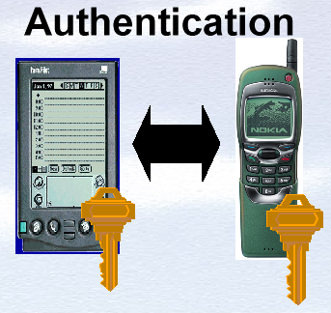
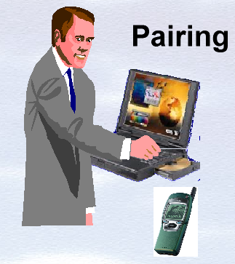
Bluetooth Security Features
Based on Stored keys
No user intervention
Access to both devices
Manual input of PIN

Slide 44
Bluetooth System Interfaces
Baseband
Memory
System
Control
Radio to
Baseband
DC Power
DC Power
System Ctrl
Bluetooth
Baseband
Processor
Host
Controller
FLASH
Bluetooth
Radio
Antenna
HCI
Voice
Voice IF
App.-specific
Reference
Oscillator
Application
Specific

Slide 45
Bluetooth Modules
A complete Bluetooth system can be manufactured from a small Radio module and other components.
To allow a minimum size, the radio is assembled and tested on a substrate with embedded RF features.
Then the radio is assembled with other components onto the complete module, which can be tested more simply.
Radio Module substrate
assembled on Bluetooth PCB
Radio
ASIC
XTAL
ROM
Baseband
ASIC
Complete Bluetooth
Module

Slide 46
The Components of Bluetooth Modules
RADIO - a mixed signal IC, analog and digital circuits:
  modulates RF carrier with data for transmission
  demodulates received signals to extract data stream
  synthesizes required frequencies for RX and TX
BASEBAND PROCESSOR - mostly digital IC :
  extracts information for host from RX data stream; configures TX data from host into Bluetooth packets
MICROCONTROLLER - Manages the links; turns components on and off; a digital IC
MEMORY - integrated RAM, ROM; integrated or separate Flash ROM ; a digital IC :
  stores configuration information
  stores short term operating information
ANTENNA - transducer to convert signal between conducted and radiated forms. Usually best outside the module.

Slide 47
Logical Combinations of Functionality Integrated in Modules
RADIO ONLY
  Portable phones! Phones contain powerful processors and memory capable of providing baseband and control functions
  A cost-effective solution is often to provide a module containing only the radio function
RADIO + BASEBAND
  ….if phone processor does not have excess capacity to support Bluetooth TX data formatting and RX synchronization.
RADIO + BASEBAND + MICROCONTROLLER + MEMORY
  For retrofit upgrade and unhosted applications - headsets, PC cards
  Appropriate to include crystal and voltage regulation also

Slide 48
Types of Applications for Modules
HOSTED: ALREADY CONTAINS A MICROCONTROLLER; may be able to share memory, crystal oscillator, codec
  Portable phones
  Personal Computers
  PDAs
UNHOSTED: Often an excessory to a hosted application; must be complete and self-sufficient
  Headset for use with cell phone, or peronal audio
  Mouse for PC
  Joystick controller for video game

Slide 49
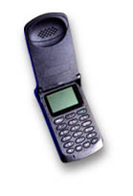
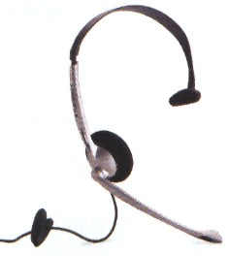
Hosted Bluetooth Module Design
Cell Phone
Pros:
Smaller size
Lower cost
Improved performance?
Time-to-market?
Standard interface
Cons:
Software upgrades
FLASH
Bluetooth
Component
Host
Processor
ROM
RF
Transceiver
Baseband
Processor
H
C
I
Power
Ref osc

Slide 50
in Cellular Applications
Bluetooth Baseband Integration
Cell Phone
Pros:
Smaller size
Lower cost memory?
Cons:
Software upgrades
IC Development
RF interface
FLASH
Bluetooth
Component
Host
Processor
ROM
RF
Transceiver
Bluetooth
Processor
Power
Ref osc

Slide 51


Bluetooth Software
vCard/vCal
WAE
AT
Commands
OBEX
WAP
UDP
TCP
IP
Host Software
PPP
Virtual OS Layer
SD Client
SD Server
TCS BIN
RFCOMM
SCM
DBM
L2CAP
HCI - Host Driver
Audio
HCI Transport/Drivers
PCMCIA
USB
Serial
HCI
USB
Serial
PCMCIA
SSI
HCI Transport/Drivers
BB SW
Host Controller
Flash Loader
Link Manager
RTOS
LC Driver
Timer Driver
IRQ Driver
Flash Driver
Baseband w/ Link Controller ASIC
Bluetooth RF Module

Slide 52
Link Manager
Link management
  setup and configuration
  packet selection for quality of service required
  packet transfers
Security
  authentication
  pairing
  create/change link keys
  encryption including key management
Piconet management
  Attach and detach slaves
  Establishing ACL/SCO connections
  master/slave switching
  name requests
  Handling of low power modes : hold, park, sniff modes
Hardware-dependent functionality and features

Slide 53
Logical Link Control and Adaptation Protocol (L2CAP)
Protocol multiplexing
  enables usage of several higher layer protocols simultaneously
  identifies packets with required protocols
  passes packets for higher layer protocols to appropriate handler
Segmentation and Reassembly
  segments higher layer protocol packets into appropriate data link packets and reassembles them again.
  Adds logical channel bits for ACL packets
  hides data link packet lengths for higher layer protocols
Quality of Service
  negotiates service type for link
  monitors link quality and adjusts for rate, latency, delay
  allocates channels for SCO connections
Hardware independent(ideally)

Slide 54
Host Controller Interface (HCI)
Provides a common interface between the Bluetooth host and a Bluetooth module
  Interfaces in spec 1.0: USB; UART; RS-232
Defines a boundary which allows the independent development of Bluetooth hardware and software
Defines a set of messages that are used by upper layer protocols to control and receive notifications from the Bluetooth hardware
Provides a flow control capability that regulates the flow of data between the host and the host controller

Slide 55
HCI Transport Protocols
The HCI transport protocols describe how HCI commands, event packets, and data packets are communicated between a host and the Bluetooth module.
The Bluetooth specification supports the following transport protocols:
  USB Transport protocol
  PC Card transport protocol
  RS232 Transport protocol
  UART Transport protocol

Slide 56
Service Discovery Protocol(SDP)
Bluetooth SDP enables Bluetooth devices to discover the characteristics and capabilities of other Bluetooth devices within RF proximity
Within Bluetooth SDP, a service is:
  any information, resource, or facility that is provided by (or through) one Bluetooth device that is advertised as available to be used by nearby Bluetooth devices
Bluetooth SDP does not provide a general purpose service access/usage mechanism; SDP only enables discovery of services

Slide 57
Service Discovery Protocol(SDP)
Motivation
  Bluetooth environment is qualitatively different from traditional network environments
  Highly dynamic
  Based upon device proximity
  Device-based, rather than network-based
Focus
  Service discovery within Bluetooth environment
  Optimized for dynamic nature of Bluetooth
  Services offered by or through Bluetooth devices

Slide 58
SDP Client and Server Roles
SDP Server: offers one or more services
  Maintains a database of service information containing one service record for each service offered
  Each service record contains a list of attributes describing the service
SDP Client: needs a service
  Searches for services based on the desired attributes of those services
  Requests additional attributes of the found services

Slide 59
SDP Client and Server Roles
Service
Records
DB
SDP Client
SDP Server
BT_module_Ctrl
BT_module_Ctrl
L2CAP
CO
L2CAP
CO
LM
LM
Baseband
ACL
Baseband
ACL
SDP Client Role
SDP Server Role

Slide 60
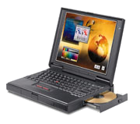

RFCOMM
Provide support for legacy applications that use serial cables
  It emulates the 9 wires of an RS232 serial cable
Leverage the existing standard
GSM TS 07.10
The scope is point-to-point communication between Bluetooth devices
It is a simple transport protocol
  with framing, multiplexing
  Plus additional provisions
  RS232 signal status
  Remote line status
  Remote port setting
  Parameter negotiation

Slide 61
RFCOMM
Protocol Stack
Applications
AT Com.
OBEX
TCP/IP
PPP
TCS
RFComm
SDP
L2CAP
HCI
Audio
Link Manager (LM)
Baseband
Bluetooth Radio
Notes:
Obex from IrDA supports mechanism for object exchange
vCard from IrMC is a format for Business Cards
vCal from IrMC is a format for Calendars
Protocol for Still Images is not decided yet. It could be
TranP from IrDA is a protocol for transfer of images
JetSend originally from HP is a more general alternative for transfer of images
WAP (Wireless Application Protocol) is intended for Internet applications in small devices with low bandwidth

Slide 62
Profiles using RFCOMM
Serial Port Profile
  Serial port emulation for legacy applications
Not explicitly using serial port emulation:
  Dial-up networking
  Fax
  Headset
  Generic Obex (Object Push, File Transfer, Synchronisation)
  LAN Access

Slide 63
Profiles
Define how to implement specific usage models
“Sometimes” define which application to use
Define which provided and adapted protocols to use
Put requirements on each individual protocol
Define which options are considered mandatory
Define parameter ranges
VCARD
Applications
OBEX
TCP
IP
Provided
Protocols
RFCOMM
SDP
TCS
Adapted
Protocols
L2CAP
Basic
Protocols
LM
Base
Radio

Slide 64


Fax Profile
Synchronization
Intercom Profile
Profiles
DT
Gateway
IrMC
IrMC
Terminal
Dial-up Networking
File Transfer Profile
Profiles
DT
Gateway
Client
Server
Cordless Telephony
Profile
Headset Profile
Object Push Profile
Audio
Headset
Push
Push
Terminal
Gateway
LAN Access Profile
Client
Server
Based on
AT Commands
Generic Object
Exchange
Client
Server
Generic Access
Profile
Service Discovery
Application Profile
Serial Port Profile
A-Party
B-Party
Device A
Device B
Local
Remote
Protocols
RFCOMM
SDP
RFCOMM
SDP
TCS Binary
L2CAP
L2CAP
L2CAP

Slide 65
Bluetooth Profile Hierarchy
Generic Access Profile
Service Discovery Profile
Serial Port Profile
Cordless Telephony Profile
Intercom Profile
Dial-up Networking Profile
Fax Profile
Headset Profile
LAN Access Profile
Generic Object Exchg Profile
File Transfer Profile
Object Push Profile
Synchronization Profile

Slide 66
Generic Access Profile
This profile defines the generic procedures related to discovery of Bluetooth devices (idle mode procedures) and link management aspects of connecting to Bluetooth devices (connecting mode procedures).
Defines procedures related to use of different security levels.
The profile includes common format requirements for parameters accessible on the user interface level.

Slide 67
Service Discovery Application Profile
This profile defines the features and procedures for an application in a Bluetooth device to discover services registered in other Bluetooth devices and retrieve any desired available information pertinent to these services.
Reveals higher level services available to users
Provides Plug and Play information

Slide 68
Cordless Telephony Profile
This profile defines the features and procedures that are required for interoperability between different units active in the ‘3-in-1 phone’ use case.
The scope of this profile includes the following layers/protocols/profiles: Bluetooth Baseband, Link Manager Protocol, L2CAP, Service Discovery Protocol, Telephony Control Protocol Specification (TCS-Binary) and the General Access Profile.

Slide 69
Intercom Profile
This profile defines the requirements for Bluetooth devices necessary for the support of the intercom functionality within the 3-in-1 phone use case.
The requirements are expressed in terms of end-user services, and by defining the features and procedures that are required for interoperability between Bluetooth devices in the 3-in-1 phone use case.

Slide 70
Synchronization Profile
This application profile defines the application requirements for Bluetooth devices necessary for the support of the Synchronization usage model.
Synchronization is built on an IrDA foundation, reuses many existing protocols.
vCard and vCalendar objects can be synchronized between separate devices using the Obex protocol.

Slide 71
Serial Port Profile
This profile defines the interoperability requirements for Bluetooth devices necessary for setting up emulated serial cable connections using RFCOMM between two peer devices. Is built on the Generic Access Profile
Two roles: initiator & responder (DevA & DevB)
  Relates to which device sets up RFCOMM connection, with no relation to application behaviour (e.g. client/server roles)
Requires a helper application to set up virtual serial port and connection
Security is mandatory to support, but optional to use

Slide 72
Serial Port Profile
Application A
Application B
Host
System
Software
Serial
Port
Config.
Serial
Port
Config.
Host
System
Software
SDP
RFCOMM
RFCOMM
SDP
L2CAP
L2CAP
HCI - Host Driver
HCI - Host Driver
HCI Transport/Drivers
HCI Transport/Drivers
UART
USB
UART
USB
Bluetooth Module
Bluetooth Module
Device A
Device B

Slide 73

Serial Port Profile - Step by step
What steps are required to set up a
virtual serial cable between two devices?

Slide 74
Step by Step - Inquiry
The initiator device performs an INQUIRY to find the other device within range
All the nearby devices
(in discoverable mode) respond.
The initiating device sorts through the responses and lets user pick one.

Slide 75
Step by Step - Baseband
baseband
The device initiates a PAGE to synchronize with the chosen responder
The device creates a baseband ACL connection

Slide 76
Step by Step - Service Discovery
Service Information
SDP
L2CAP
baseband
The device uses SDP to retrieve details of the Serial Port service - RFCOMM server channel number in particular
The Service Name information may be presented to the user for verification

Slide 77
Step by Step - RFCOMM
RFCOMM
L2CAP
baseband
Create L2CAP channel to RFCOMM entity in responder
Starts RFCOMM multiplexer session on L2CAP channel
(Optionally, negotiate parameters for the yet to be opened DLC)
Request an RFCOMM data link connection (DLC)

Slide 78
Step by Step - Security (optional)
RFCOMM
L2CAP
PAIRING
baseband
Either device may request that Pairing be performed. Pairing requires the use of a shared secret PIN
Either device may request that the baseband link is encrypted

Slide 79
Step by Step - Application
Application
RFCOMM
L2CAP
baseband
The application software is now able to communicate through the virtual serial port

Slide 80
Summary
Protocols defined for communication
  HCI supports common interface to hardware modules
  L2CAP provides common base for data communication
  SDP provides basis discovery mechnisms
Profiles defined for interoperability
  Specifies protocol ladder from PHY to APP

Slide 81
Role of Testing in the Qualification Program
BT Qualification Program
  Goal: To ensure interoperability between different BT devices even from different vendors
  Method: Every BT device has to pass the Qualification Process by performing successfully the relevant test cases

Slide 82
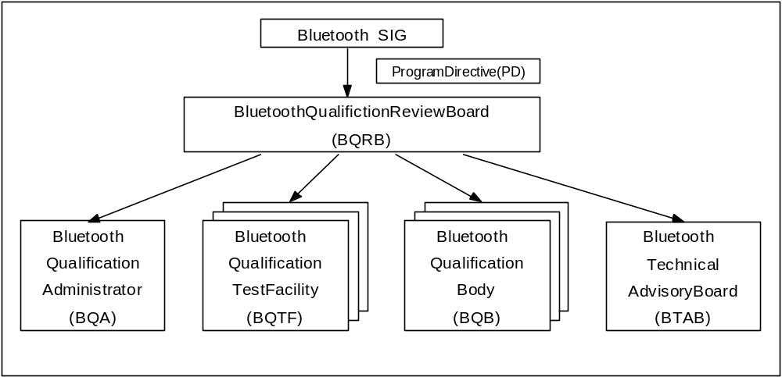
Authority delegation for Bluetooth Qualification Program

Slide 83
Bluetooth Qualification Review Borad(BQRB)
Each bluetooth SIG Promoter company appoints one delegate
Responsible for setting up and maintaining Qualification criteria and rules
Selects, hires and manages a BQA to a administer the program according to policies
Definies the recognition requirements to become a BQTF and BQA
Rotating Chair

Slide 84
Bluetooth Qualification Administrator(BQA)
Implements the Qualification Program
Interface between BQRB and
  BQBs,
  BQTFs,
  prospective BQB candidates
  prospective BQTF candidates
Maintains listings of:
  Recognized BQBs
  Accredited BQTFs
  Qualified (listed) products
  Approved waivers
Disseminates information on the program

Slide 85
Bluetooth Qualification Body(BQB)
Authorized to list products as qualified based on:
  Applicable Test Results in accordance with the TCRL
  Declarations of Compliance from the manufacturer
Responsible for:
  Checking completeness of material received
  Verifying authenticity of material received
  Maintaining confidential material
  Advising manufacturer on qualification process
Independent of product development efforts
Over 12 BQB’s today

Slide 86
Bluetooth Qualification Test Facility(BQTF)
Independent testing facility which is accredited by BQRB to test products for compliance with the Bluetooth test requirements
Required for testing Category A Test Cases
  No Category A Test Cases currently
  Other services possible (interoperability testing)
Accreditation Requirements include:
  Quality
  Certification in accordance with ISO Guide 25, EN45001
  Bluetooth knowledge & test capability
  Independent of product development efforts
No accredited BQTF’s today
  BQRB is now reviewing applications

Slide 87
Bluetooth Technical Advisory Board(BTAB)
Consists of BQBs, BQTF representatives and other technical experts
Provides information and recommendations to the BQRB
Advisory Tasks
  Proposals and advice to BQRB
  Proposals and advice to BQA
  Proposals and advice to the Bluetooth “Specification Authors”
Knowledge Depository Tasks
  Solutions to testing Bluetooth devices
  Knowledge of inconstancy of the Bluetooth Specifications

Slide 88
Bluetooth Qualification Process
Declaration and
documentation
review
Product
tested
Qualified
products lists
BQA
BQB
Manufacturer
BQTF
Documents pulled
from web side
Test report
checked by BQB
Qualification
Program Documents

Slide 89
Bluetooth Qualification Process
Manufacturer obtains required documents from Bluetooth website
Four categories of tests
  A - Validated and commercially available in at least 1 implementation
  B - Declaration with evidence
  C - Declaration without submitting evidence
  D - Informative
Bluetooth Qualification Test Facility (BQTF) needed for
  category A tests
  interoperability with “Blue Units” from Ericsson and Nokia

Slide 90
Bluetooth Qualification Process
Compliance Folder provided to Bluetooth Qualification Body (BQB)
  Test results for category A, B, and C. D is optional
  Declaration of Compliance
  Implementation conformance statement(ICS) which specifies the Bluetooth capabilities that are implemented in the product including profiles implemented
BQB reviews results and lists the product in the Approved Product Database
Bluetooth Quality Administrator maintains the Approved Product Database on the website

Slide 91
Bluetooth Qualification Requirements
Conformance Test Requirements
  Bluetooth RF-Test Specification
    defines RF conformance test cases
  Bluetooth Protocol and Profile Test Specification
    defines Protocol and Profile conformance test cases
  The objective of the RF and Protocol test specification
    To provide a basis for conformance tests for Bluetooth devices giving a high probability of compliance with the Bluetooth Core Specifications
  Conformance tests are performed by an accredited BQTF according to the information in the test case reference list
  RF, protocol and profile conformance testing results shall be reported in a Test Report and submitted to the BQB for review

Slide 92
Bluetooth Qualification Requirements
Interoperability Test Requirements(application profile)
  Bluetooth Profile Interoperability Test Specification
    defines profile interoperability test cases
  Interoperability testing results shall be reported in a Test Report and submitted to the BQB for review
Bluetooth Components Requirements
  Bluetooth component
    A product marketed to a manufacturer for integration into an end-user product, containing at least the hardware for Bluetooth radio and/or baseband functions
  Example of Bluetooth component : A Bluetooth module to be permanently mounted in a computer
  The module may be pre-qualified in a reference design
  It’s up to the test house to judge what tests that can be omitted when qualifying the final product

Slide 93
Bluetooth Qualification Requirements
Bluetooth Accessory Products Requirements
  Bluetooth Accessory
    A product marketed to the end-user, containing at least the hardware for Bluetooth radio and baseband
  Example of accessories : PC-card, USB dongle
  Has to be submitted for Qualification installed in a host device
  Complete Qualification is required

Slide 94
Types of Testing
Conformance Testing
  finally: BT device is tested against a validated BT test system in a accredited test house (BQTF)
  intermediate: manufacturer has to provide evidence on test cases
Interoperability Testing (application profile)
  finally: device against device testing by using Designated Profile Interoperability Testers (DPIT)
  intermediate: engineering evidence
Interoperability Testing against Blue Units (lower layers)

Slide 95
BT Test Specifications
BT Informal Test Specifications (ITS)
Conformance Testing
Interoperability Testing
RF:
Final
Early Phase
Protocols:
Baseband
LMP
L2CAP
Service Disc.
Profiles:
Gen. Access
Serialport
others: TBD
Application
Profiles:
Headset
Dialup NW
File Transf.
...

Slide 96
Necessory Information for Testing
Test Specifications
Test Case Reference list(TCRL)
  List of all test cases
  Provides status / information on each test case
  Periodically updated
  Specifies categories for each test case
    A ➔ Commercial available and to be executed at BQTF
    B ➔ Declare with evidence that the issue has been tested
    C ➔ Declare without evidence that the issue has been tested
    D ➔ For information only

Slide 97
Necessory Information for Testing
Bluetooth ICS / IXIT Proforma document
  ICS (Implementation Conformance Statement)
    reference document for the conformance assessment process related to the Implementation Under Test(IUT)
    Provides an overview of the implementation
  IXIT(Implementation Extra Information for Testing) proforma
    a questionnaire containing questions related to the parameterisation of the tests and of the IUT
  The IXIT, in conjunction with the ICS, will be used by the BQTF to produce the test plan
  Device / implementation information document to be filled out by the manufacturer
  Derived by ETSI guidelines
  Annex includes ( to be filled out )
    Implementation Conformance Statement (ICS) tables
    Implementation Extra Information for Testing (IXIT) tables
    ICS / IXIT tables cover
      RF
      Protocols
      Application / Transport Profiles

Slide 98
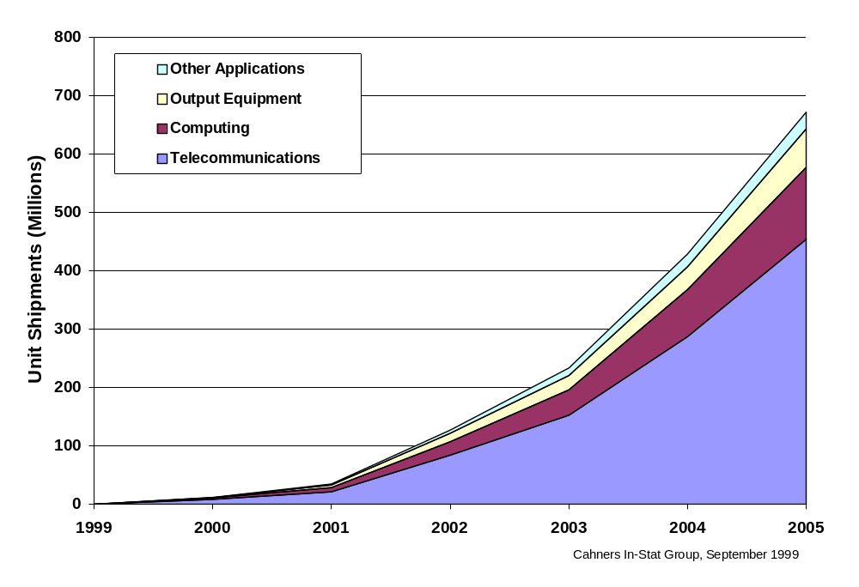
Bluetooth Product Forecast

Slide 99
Wireless Market Trends
Consumers want connectivity at all times - in the workplace, while travelling and at home
General Packet Radio Service (GPRS) and other 3rd Generation cellular network technologies will be available at the end of 2000.
Wireless technology and internet access is becoming pervasive in homes, offices and pocket devices
This offers business opportunities to service providers, OEM manufacturers and semiconductor companies
Three enabling wireless technologies - wireless LANs, cellular packet data and Bluetooth

Slide 100
Bluetooth Benefits
For Consumers
  Convenience of wireless connections
  Reliable connections for secure transactions
  Lower cost wireless solutions
For Producers
  Standardized connectivity and protocols
  Opportunities for product enhancement and differentiation
  Reduced interoperability concerns
For Providers
  Increased consumer acceptance of wireless solutions
  Accelerated demand for wireless data services

Slide 101
Bluetooth Evolution
Rich A/V
1.0
2.0
Headset
Headset
Ericsson
Ericsson
Intel
3Com
Intel
Obex
E-Obex
Bandwidth
Sync
Lucent
Sync
HID
Toshiba
Microsoft
Toshiba
Conference
Conference
Printing
Nokia
Nokia
IBM
Motorola
Automotive
Image
IBM
PAN
2000
2002
2004
PAN
Content delivery
Service delivery
Assumed connectivity
Point-to-point
Cable replacement

