Slide 1
Install VSC
Visual Studio Code

Slide 2
Get & Install
Go To https://code.visualstudio.com/docs?dv=win
Download the Visual Studio Code installer for Windows
.NET framework 4.5.2 is installed on your system
Once it is downloaded, run the installer (VSCodeSetup-version.exe).
Add VSC path to your “%PATH%” environment variable
Node.js debugger

Slide 3
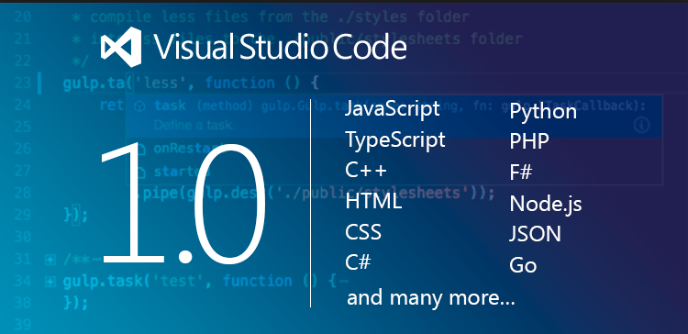
Question and Answers

