Slide 1
TACTLINK
SQUAD–DRONE INTERACTION
DEFENSE / WORKING SIMULATION
Add the drone to the squad.
DRONE TEAMMATE
Plan the mission. Signal changes as the squad moves.
THE SQUAD
ONE SQUAD. SHARED DRONE SUPPORT.
ILLUSTRATIVE SQUAD CONCEPT
WHY NOW: Army drone specialists may join squads. [1]
[1] Task & Purpose · Aug. 31, 2026
DNHACKS / DEFENSE / SIMULATION PROTOTYPE
01
Notes:
0:00–0:15. Tactlink is about adding the drone to the squad. Soldiers communicate intent to teammates through familiar signals; we want the squad to interact with a drone in that same natural way. A conversation with a Mach Industries representative helped shape this goal. Today we demonstrate that interaction in a connected simulation, not physical flight. The conversation is design input, not an endorsement.

Slide 2
TACTLINK
01 / PROBLEM → PROPOSED INTERACTION
The squad needs to adapt. Eyes stay up.
OPERATING CONTEXT: GPS-DENIED ENVIRONMENTS
WORKFLOW DESCRIBED TO US
TACTLINK / ONBOARD VISION CONCEPT
Small, chest-mounted tablet
Signal directly to the drone
VISUAL COMMAND
Attention moves to the interface.
Change intent while facing the squad.
INTENDED IMPACT
Redirect drone support as squad needs change.
Discovery: team conversation with a Mach Industries representative (paraphrased; informal user input).
Today: connected simulation. Onboard vision is planned; GPS-independent navigation is a separate requirement.
DNHACKS / DEFENSE / SIMULATION PROTOTYPE
02
Notes:
0:15–0:40. A Mach Industries representative described soldiers using a small, chest-mounted tablet in GPS-denied environments. That prompted our design question: can a soldier redirect a drone by signaling it directly while staying engaged with the squad? The intended benefit is more dynamic drone support as needs change. We demonstrate gesture-driven changes in simulation today; onboard perception is planned. The diagram interprets our informal user discovery; it is not a measured comparison or a claim about every military workflow. We have not measured attention or response-time improvements. Visual commands require visibility and do not provide GPS-independent navigation.

Slide 3
TACTLINK
02 / THE INSPIRATION
Human intent, in more than one form.
THE HACKATHON PROMPT
OUR EXTENSION
“Flight paths in plain English”
Why not communicate with hand gestures, too?
Plan and adjust a flight path using natural language.
Another human way to express intent and change drone behavior.
Natural-language planning inspired us. Gesture interaction became our working demonstration.
Source: DNHacks Defense inspiration prompt, “Flight paths in plain English” (provided by team).
DNHACKS / DEFENSE / SIMULATION PROTOTYPE
03
Notes:
0:40–0:55. The hackathon prompt proposed flight paths in plain English. That inspired us to ask: why not communicate in another human way, through gestures? Our working demonstration focuses on gesture interaction; natural-language mission planning remains in development. The full original prompt is in the hidden appendix. The source prompt is inspiration, not evidence that we implemented its flight-controller or verification requirements.

Slide 4
TACTLINK
03 / LIVE DEMO · 45 SECONDS
Four commands. One continuous demo.
01
02
03
04
Orbit
Move
Return
Stop
Circle the operator.
Follow directional intent.
Overhead to the sender.
Open-palm emergency stop.
LIVE SETUP
Phones as operators → Main computer → Shared 3D simulation
DNHACKS / DEFENSE / SIMULATION PROTOTYPE
04
Notes:
0:55–1:40. Begin with a preassigned mission running in the 3D simulation, then show a gesture interrupting that flight. Demonstrate orbit, directional movement, return overhead to the sender, and open-palm stop. Explain that the route was created in the 2D planner. Keep the full sequence within 45 seconds. The phones and main computer are connected; this is simulated flight. Switch back to slide 4 after the demonstration.

Slide 5
TACTLINK
04 / MISSION PLANNING + LIVE CONTROL
Plan the route. Adapt mid-flight.
A planned mission stays responsive to the operator.
01 PLAN IN 2D
02 VISUALIZE IN 3D
03 INTERRUPT BY GESTURE
Build the mission in a flight planner.
See the mission in a virtual world.
Change drone behavior mid-flight.
POSSIBLE USE CASE
Send a drone between operators to provide overwatch.
DNHACKS / DEFENSE / SIMULATION PROTOTYPE
05
Notes:
1:40–2:10. Tactlink also has mission planning. We build a route in a conventional 2D flight planner and visualize that mission in a 3D virtual world. Mid-flight, a hand gesture can interrupt the planned behavior. That makes the operator dynamic: plan ahead, then respond as the situation changes. We built the integration connecting the planner, custom gesture sequences, operator context, and simulated drone actions. A possible use case is sending a drone to another operator for overwatch. All flight behavior shown is simulated. Do not imply that interrupted routes automatically resume; that has not been confirmed.

Slide 6
TACTLINK
05 / VALIDATION & DEPLOYMENT
A working prototype. A testable path.
WORKS IN SIMULATION
NEXT VALIDATION GATES
Stop
01
Measure
Open-palm intervention
Errors, latency, unintended commands
Continue
02
Stress-test
Assigned path or idle without a hand
Visibility and competing operators
Select
03
Integrate
Preference for the nearest operator
Onboard compute and physical flight
TODAY: Connected phone prototype. No physical flight data. GPS-independent navigation remains separate.
DNHACKS / DEFENSE / SIMULATION PROTOTYPE
06
Notes:
2:10–2:35. The simulation implements emergency stop, path continuation or idle when no hand is visible, and a preference for the nearest operator. Those behaviors are not yet a validated safety system. Today the phones require connectivity, and we have no physical flight data. Next we will measure errors and latency, test visibility and competing commands, then integrate onboard compute and flight control. Visual commands require line of sight, and GPS-independent navigation remains a separate requirement.

Slide 7
TACTLINK
CUSTOM MACHINE LEARNING
A gesture vocabulary we can train.
We trained a model on our own hand signals.
Our custom gesture-training pipeline shows that the command vocabulary can expand beyond preset gestures.
Record examples
Label the signals
Train the model
Connect commands
Build the vocabulary around the people using it.
DNHACKS / DEFENSE / SIMULATION PROTOTYPE
07
Notes:
2:35–2:55. We went beyond a fixed set of gestures: we built a custom gesture-training pipeline and trained a model on our own hand signals. Record examples, label them, train the model, and connect recognized gestures to commands. That demonstrates a vocabulary we can develop around the people using it. This training was demonstrated in desktop experiments. The current phone demo uses a separate gesture-rule layer. Do not imply retraining the hand-tracking backbone or deploying the trained model to the phone.

Slide 8
TACTLINK
06 / THE VISION
One drone. Two ways to communicate.
Follow the mission. Adapt through gestures and spoken commands.
HAND GESTURES
Demonstrated in simulation
“Take a picture of my location.”
UNDERSTAND INTENT
SPOKEN COMMANDS / IN DEVELOPMENT
Translate it into action
DNHACKS / DEFENSE / SIMULATION PROTOTYPE
08
Notes:
2:55–3:10. Plan ahead, then adapt in the moment. Our simulation combines 2D mission planning, 3D visualization, and mid-flight gesture intervention. Our vision adds spoken commands alongside gestures. Spoken requests, such as take a picture of my location, would expand what an operator can ask it to do. Natural-language commands and image capture are not demonstrated capabilities; this is an illustrative future request. End here. The remaining slides are hidden Q&A backup.

Slide 9
TACTLINK
APPENDIX / Q&A
Deployment questions we must answer.
Hardware & cost
Select compute after measuring latency, power, thermal load, and flight-time impact.
Integration
Connect perception to a flight controller; validate command and link-loss behavior.
Security
Nearest-person preference is not authorization. Validate who may issue commands.
Adoption & testing
Test gesture learnability, gloves, distance, lighting, occlusion, and competing signals.
Field readiness
Plan physical trials, applicable flight approvals, and GPS-independent navigation separately.
DNHACKS / DEFENSE / SIMULATION PROTOTYPE
A1
Notes:
Q&A only. These are planned deployment considerations, not completed capabilities. No cost estimate, field validation, procurement commitment, or regulatory approval has been established. Jetson-class onboard compute is an option; no specific board is validated.

Slide 10
TACTLINK
APPENDIX / EVALUATION PLAN
Turn the next demo into evidence.
Command success
Correct action / attempted commands, broken down by gesture.
Response time
Time from completed gesture to simulated action; report median and slow cases.
False activation
Count unintended commands during ordinary movement and no-command periods.
Operator selection
Test overlapping gestures, near-equal distances, and return-to-sender behavior.
Stop behavior
Measure stop response and observe the resulting simulated drone state.
DNHACKS / DEFENSE / SIMULATION PROTOTYPE
A2
Notes:
Q&A only. This is a proposed evaluation plan. No measured results are claimed. Record the number of trials, test conditions, and failures. Simulation measurements do not establish physical-drone reliability.

Slide 11
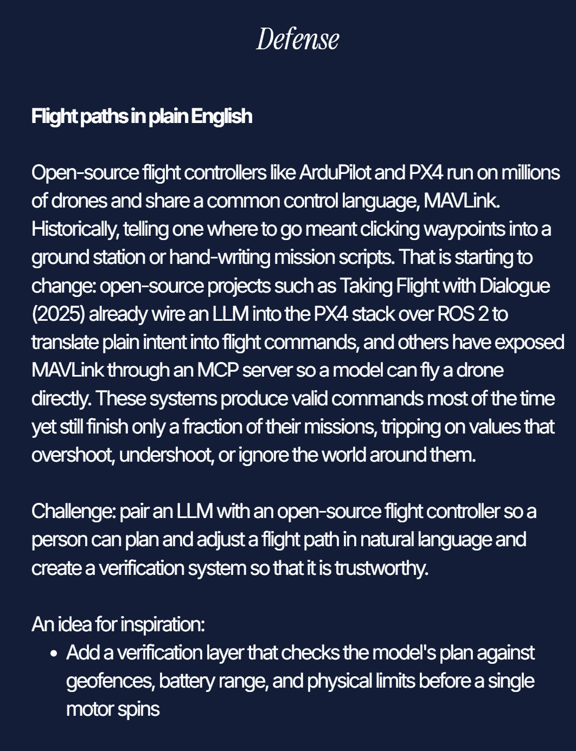
TACTLINK
APPENDIX / ORIGINAL INSPIRATION
The prompt that started the idea.
Natural-language path planning suggested a broader question: how else do people communicate intent?
Tactlink explores gestures alongside spoken commands.
DNHACKS / DEFENSE / SIMULATION PROTOTYPE
A3
Notes:
Source: original team-provided image DNhacks_inspo_prompt.png, DNHacks Defense inspiration prompt titled Flight paths in plain English. Reproduced as supplied. This is historical inspiration; technical claims in the prompt are not independent evidence of Tactlink capabilities. Natural-language mission planning remains in development.

