Slide 1
Olympic Insights
INTERNATIONAL OLYMPIC COMMITTEE | DATA ANALYTICS CASE STUDY
Using Data Analytics
Medal trends, athlete performance and sport dominance across 126 years of Games (1896 to 2022)
PREPARED BY
Yavan Pratap
yavan.pratap13@gmail.com
linkedin.com/in/yavan-pratap-singh
Notes:
Introduce the project: an IOC-style problem statement solved with Power BI and DAX on historical Olympic data.

Slide 2




The Challenge: Insights for the IOC
Track achievements
PROBLEM STATEMENT
Medal counts by country, athlete and sport over time.
The IOC wants advanced insights into athlete performance, country-wise medal trends and sport-specific dominance across the Olympic Games, built from historical data to support strategic planning and athlete development.
Evaluate performance KPIs
Medal efficiency, participation and podium share.
TOOLKIT
Plan what comes next
Power BI
DAX
Data Modelling
Olympic CSVs
Spot trends that guide strategy and athlete development.
Notes:
Frame the business problem: the IOC wants to track achievements, evaluate KPIs and plan ahead.

Slide 3
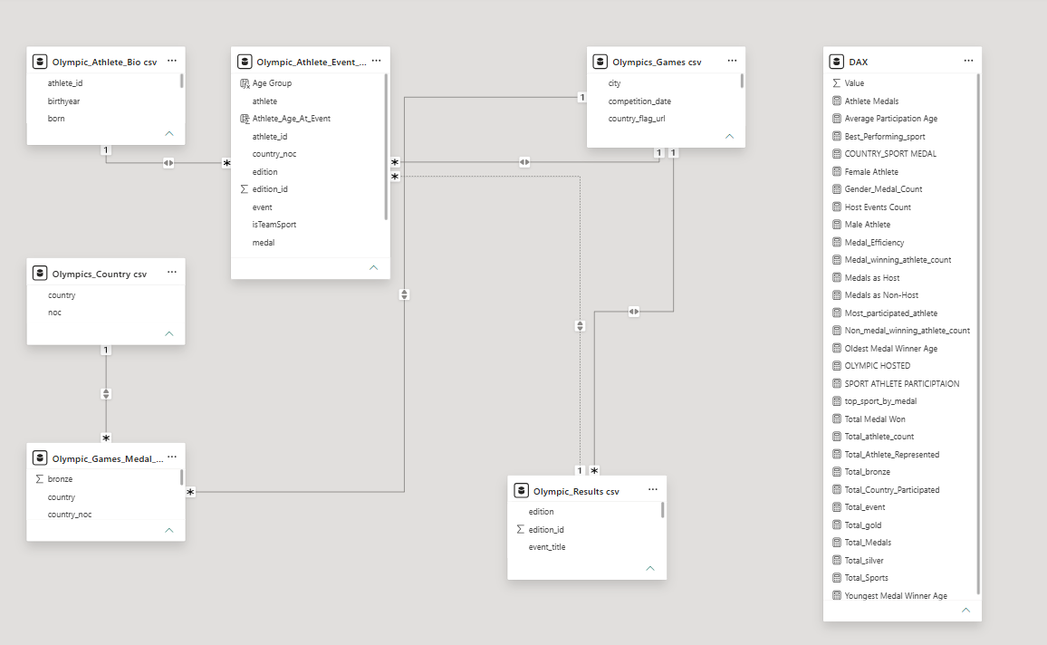



Data Model: How the Tables Connect
6 linked tables
Athlete Bio, Athlete Event, Games, Country, Medal Tally and Results.
One-to-many links
Keyed on athlete_id, edition_id and country_noc.
25+ DAX measures
A dedicated measures table powers every KPI and visual.
Notes:
Walk through the model: fact table of athlete results at the centre, dimension tables around it, and a separate table that holds all DAX measures.

Slide 4






Dashboard Roadmap: Six Pages, One Story
1. Global Medal Overview
2. Country Insights
3. Athlete Spotlight
Total medals and countries
Top countries by medals
Medal trend by edition
Athletes, medals, efficiency
Gold, silver, bronze split
Athletes by country
Top medal-winning athletes
Most Olympic appearances
Medalists vs all athletes
4. Sports & Events
5. Host Country
6. Gender & Demography
Total sports and events
Top sports by medals
Country dominance by sport
Events hosted per country
Host vs non-host medals
Host medal trend
Male vs female athletes
Age groups and averages
Youngest and oldest winners
Notes:
Overview of the six navigable pages in the Power BI report.

Slide 5
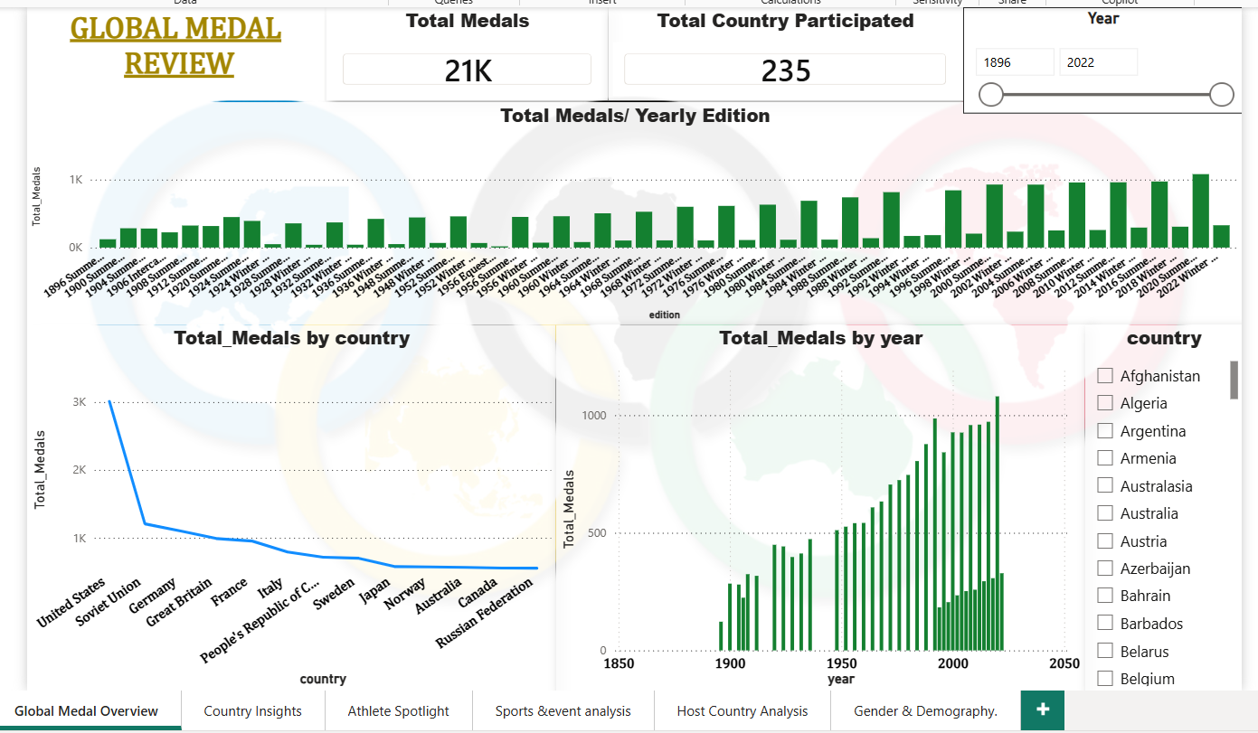
Global Medal Overview
21K
Medals awarded
235
Countries participated
126
Years covered, 1896 to 2022
KEY INSIGHT
Medals per edition rose from about 100 in 1896 to 1,000+ in recent Summer Games, and the USA leads all nations with roughly 3K medals.
Notes:
Global view: total medals, countries, medals per edition and the top countries. Use the year slider to filter.

Slide 6
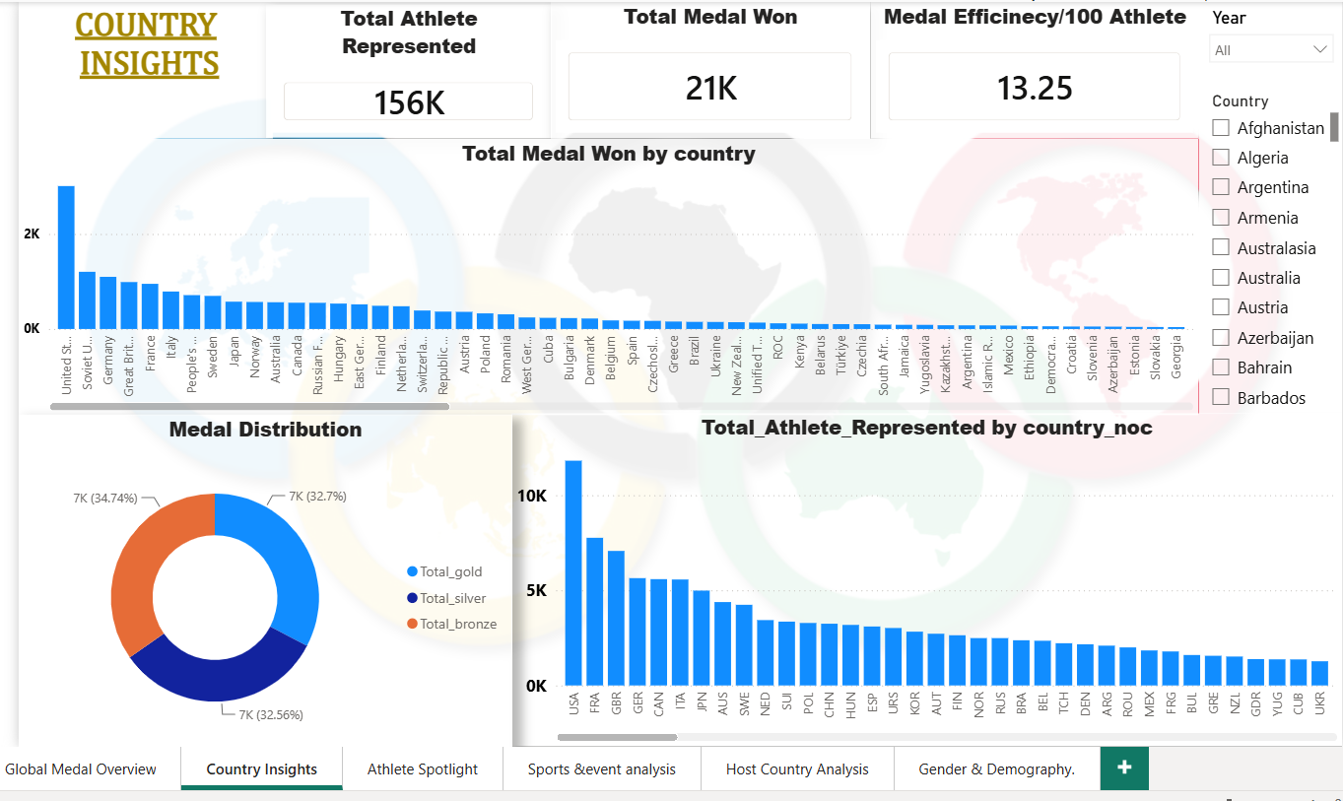


Country Insights
USA stands apart
About 3K medals, ahead of the Soviet Union, Germany, GB and France.
Efficiency: 13.25
Medals per 100 athletes, across 156K athlete entries.
Balanced podium
Gold 32.7%, silver 32.6% and bronze 34.7% of all medals.
Notes:
Country page: athletes represented, medals won and medal efficiency per 100 athletes.

Slide 7
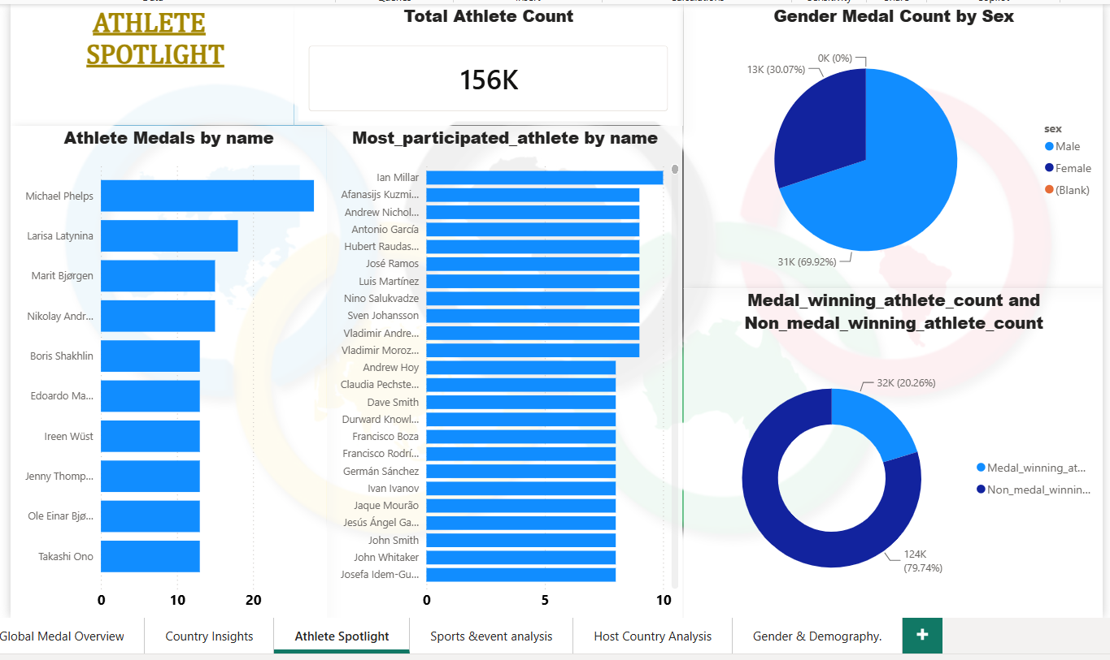
Athlete Spotlight
156K
Athletes in the dataset
20%
Athletes who won a medal
10
Most appearances (Ian Millar)
KEY INSIGHT
Michael Phelps tops the medal table, followed by Larisa Latynina and Marit Bjørgen. Four in five athletes never reach the podium.
Notes:
Athlete spotlight: top medal winners, most participated athletes, gender split of medals and medalists vs non-medalists.

Slide 8
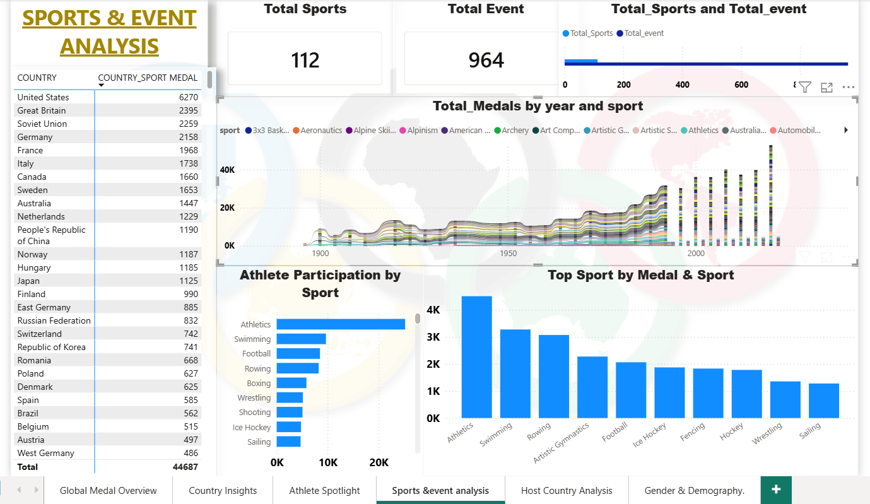
Sports & Event Analysis
Huge breadth
112 sports and 964 events captured in the data.
Athletics leads
Most medals (about 4.5K) and athletes, then Swimming and Rowing.
Country dominance
USA holds 6,270 sport medals, ahead of GB (2,395) and USSR (2,259).
Notes:
Sports page: totals, top sports by medals, athlete participation by sport and country dominance table.

Slide 9
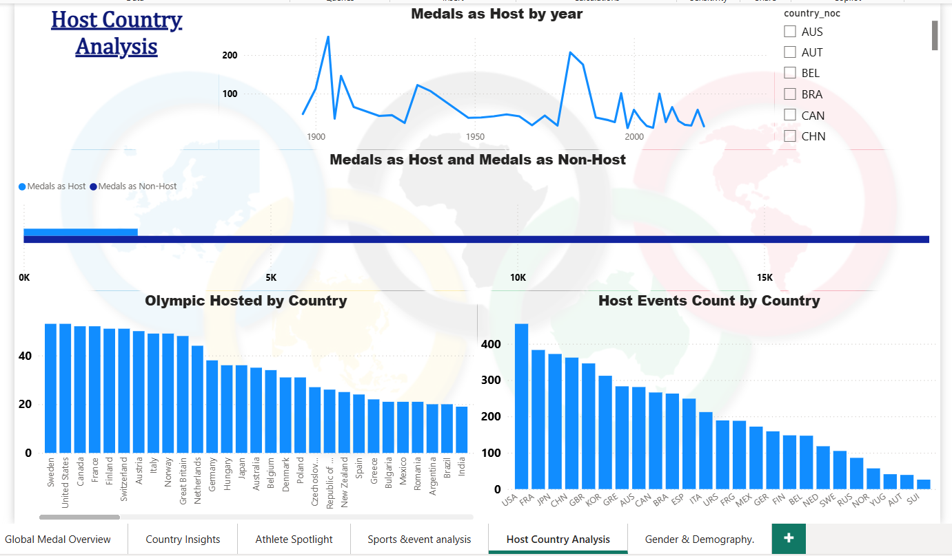
Host Country Analysis
USA
Most host events (about 460)
FRA
Second, with about 385 events
JPN
Third, with about 375 events
KEY INSIGHT
Host-year medal hauls peak near 1904 and again in the 1980s, yet host medals remain a small slice of the overall total.
Notes:
Host page: medals as host by year, host vs non-host medals, Olympics hosted and host events per country.

Slide 10
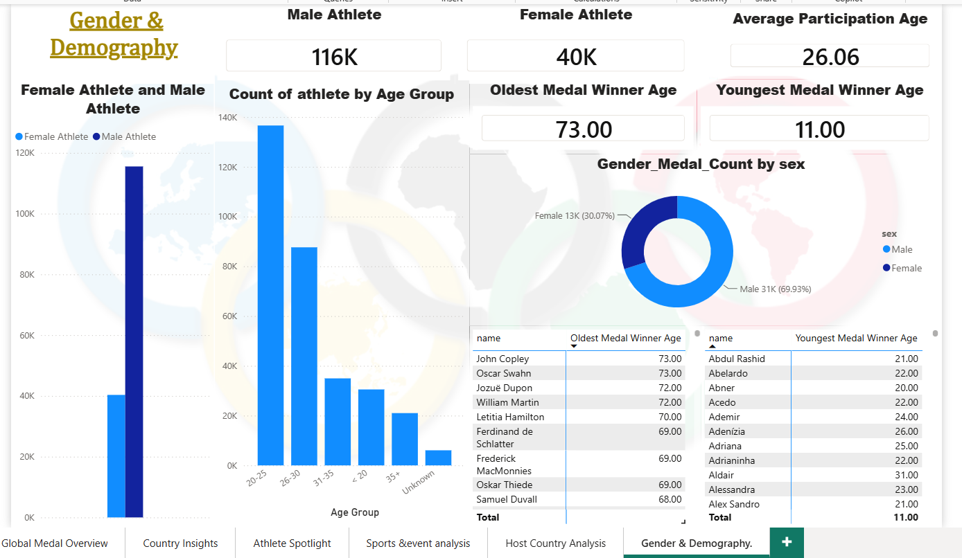


Gender & Demography
116K vs 40K
Male vs female athletes; women won about 30% of medals.
Average age 26
26.06 years, with ages 20 to 25 the largest group.
Age is no barrier
Youngest medal winner is 11, the oldest is 73.
Notes:
Demography page: athlete counts by sex, age groups, average age and youngest/oldest medal winners.

Slide 11
Key Takeaways & Next Steps
What's next
Medal powerhouses
A selective podium
1
Forecast medal counts for upcoming Games with time-series models
USA leads with about 3K medals, ahead of the Soviet Union and Germany.
Only 20% of athletes medal; efficiency is 13.25 per 100 athletes.
2
Add population and GDP context to medal efficiency
3
Track growth in women's participation by edition
Sport concentration
Room to grow
4
Publish to Power BI Service for IOC stakeholders
Athletics, Swimming and Rowing deliver the most medals.
Women are 26% of athletes (40K of 156K) and won 30% of medals.
Notes:
Summarise the four main findings, then position forecasting and richer context as next steps.

Slide 12
Thank You
Let's turn Olympic data into decisions
Yavan Pratap
yavan.pratap13@gmail.com
linkedin.com/in/yavan-pratap-singh
Notes:
Close and invite questions.

