Slide 1
dnAQET:A Framework to Compute a Consolidated Metric for Assessing the Quality of de novo Assemblies
Gokhan Yavas, PhD
Computer Scientist
NCTR, FDA

Slide 2
Introduction
de novo assembly is crucial towards achieving the goal of precision medicine and personalized genome as NGS has become cheaper, hence more affordable
Numerous tools have been proposed for de novo assembly
SOAPDenovo2, ALLPATHS-LG, ABySS, MaSuRCA for short read assembly
Celera, Falcon, Canu, Mecat for long read assembly

Slide 3
Introduction
Only a handful of quality Assessment Tools for de novo assemblies are available :
QUAST (Gurevich et al., 2013) and QUAST-LG (Mikheenko et al., 2018): Alignment of contigs to a trusted reference
REAPR (Hunt et al., 2013): Alignment of reads to the contigs
COMPASS

Slide 4
dnAQET framework
Our framework produces quality scores both for
individual scaffolds/contigs of a de novo assembly
the whole de novo assembly
with respect to a trusted reference genome

Slide 5
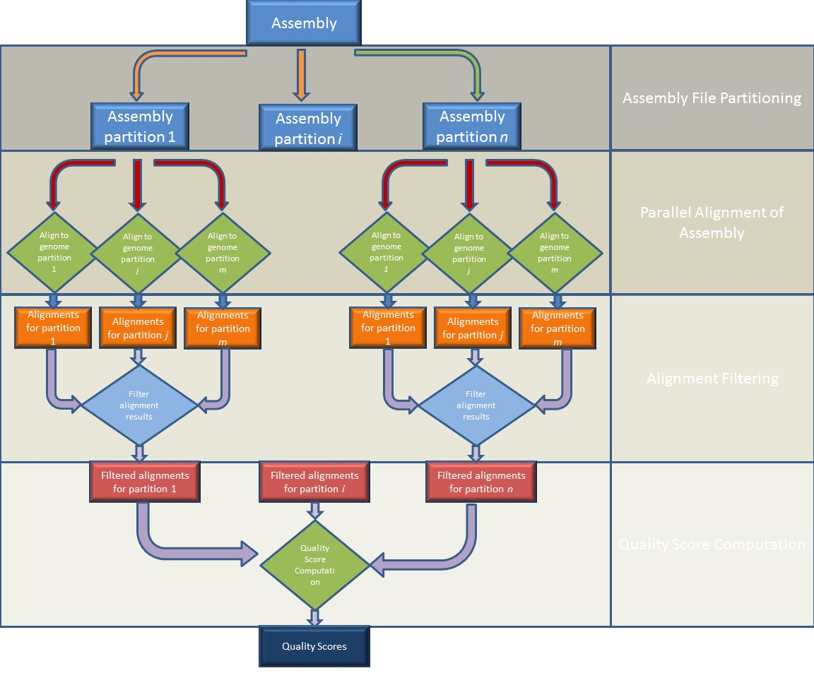
dnAQET is composed of two steps:
1. Parallel Alignment Step
2. Quality Computation Step

Slide 6
Alignment
For reference alignment, there are two available tools:
Nucmer in the Mummer4 package, (Marçais et al., 2018)
Minimap2 (Li, 2018)
Both tools are designed to do mapping between long nucleotide sequences
Both tools are extremely fast

Slide 7

Quality score for scaffolds
Given a scaffold s, the quality score Q(s) is calculated as:
$Q\left(s\right)=L\left(s\right)×\frac{R\left(s\right)}{1+P\left(c\right)}$
Reward assigned to s
Penalty assigned to s
Length scaling factor

Slide 8
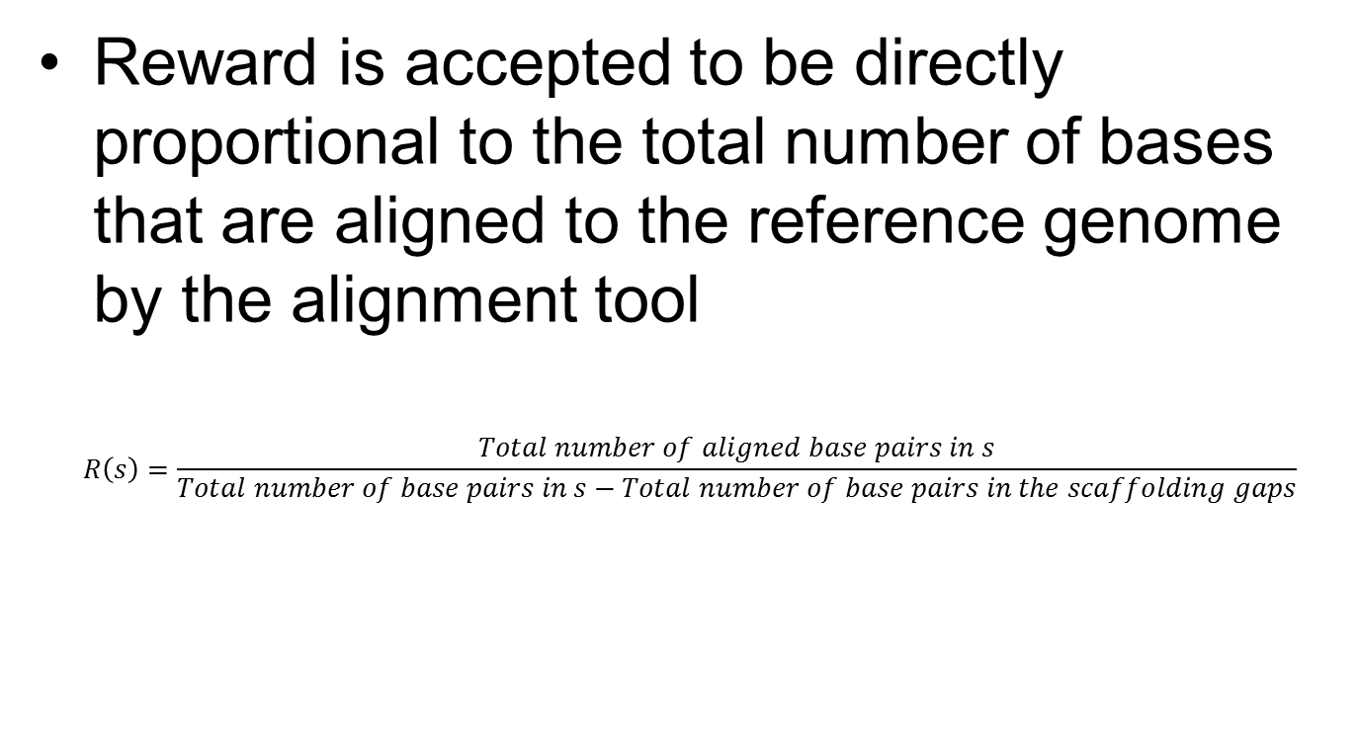
Reward
Reward is accepted to be directly proportional to the total number of bases that are aligned to the reference genome by the alignment tool
$$R\left(s\right)=\frac{Total number of aligned base pairs in s}{Total number of base pairs in s−Total number of base pairs in the scaffolding gaps}$$

Slide 9
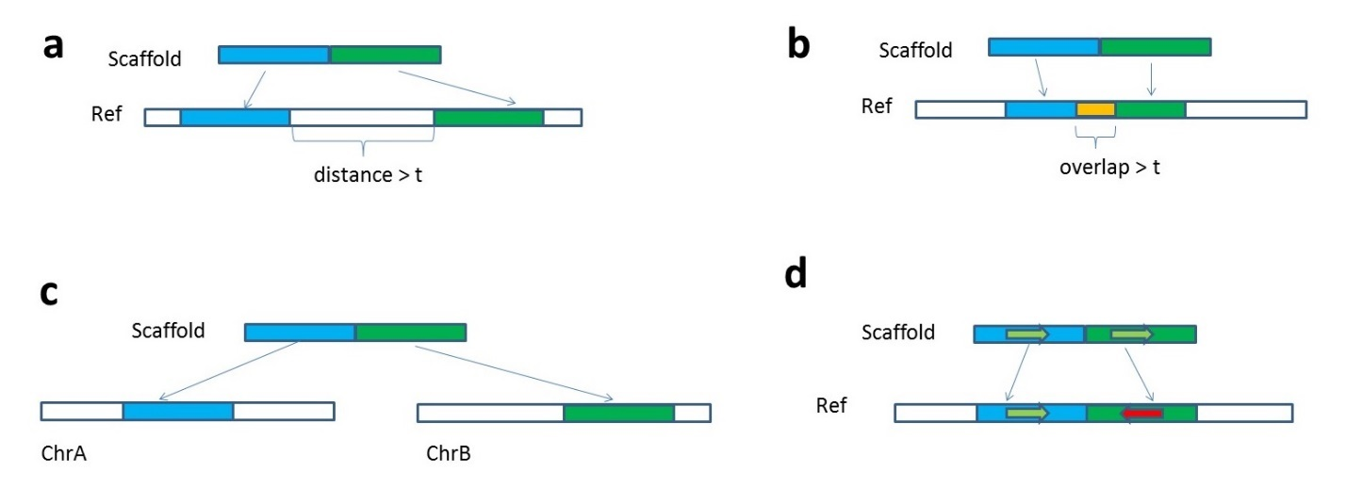
Penalty due to misassembly
Three types of misassembly considered:
Relocation: due to distance (a) and overlap (b)
Translocation
Inversion

Slide 10
Penalty due to misassembly
It is still possible to observe misalignment between two identical long fragment sequences (>1MB), which is considered as artifact of MUMmer and MiniMap2
due to
gaps (ambiguous sequences), repetitive sequences in the reference genome
and limitations of alignment algorithms,

Slide 11
Estimating the artifacts (noise)
Use a regression model to estimate the expected artifact given a scaffold size l, and relocation threshold, t
For each reference chromosome, we generate artificial contigs (with coverage 1X) and align them back to the reference

Slide 12

Estimating the artifacts (noise)
Total misassembly identified for each scaffold is fit to the following model via least-squares regression
$$ε=α_{c}l+ β_{c}t+k_{c}$$
Identified artifact
Predicted Model parameters for chromosome c

Slide 13
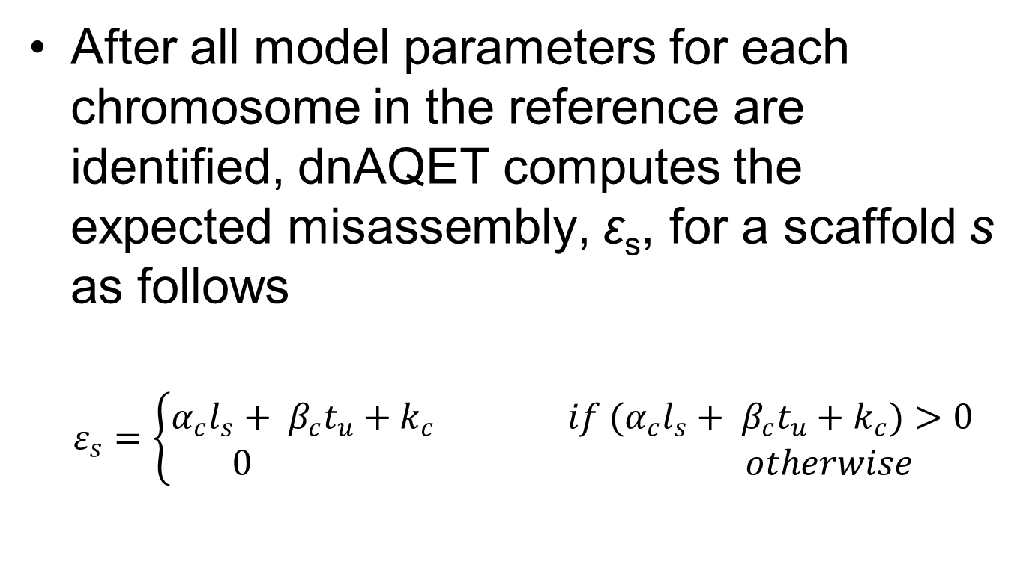
Estimating the artifacts (noise)
After all model parameters for each chromosome in the reference are identified, dnAQET computes the expected misassembly, ε_{s}, for a scaffold s as follows
$$ε_{s}=\left\{\begin{aligned}α_{c}l_{s}+ β_{c}t_{u}+k_{c} if (α_{c}l_{s}+ β_{c}t_{u}+k_{c})>0 \\ 0 otherwise\end{aligned}\right.$$

Slide 14
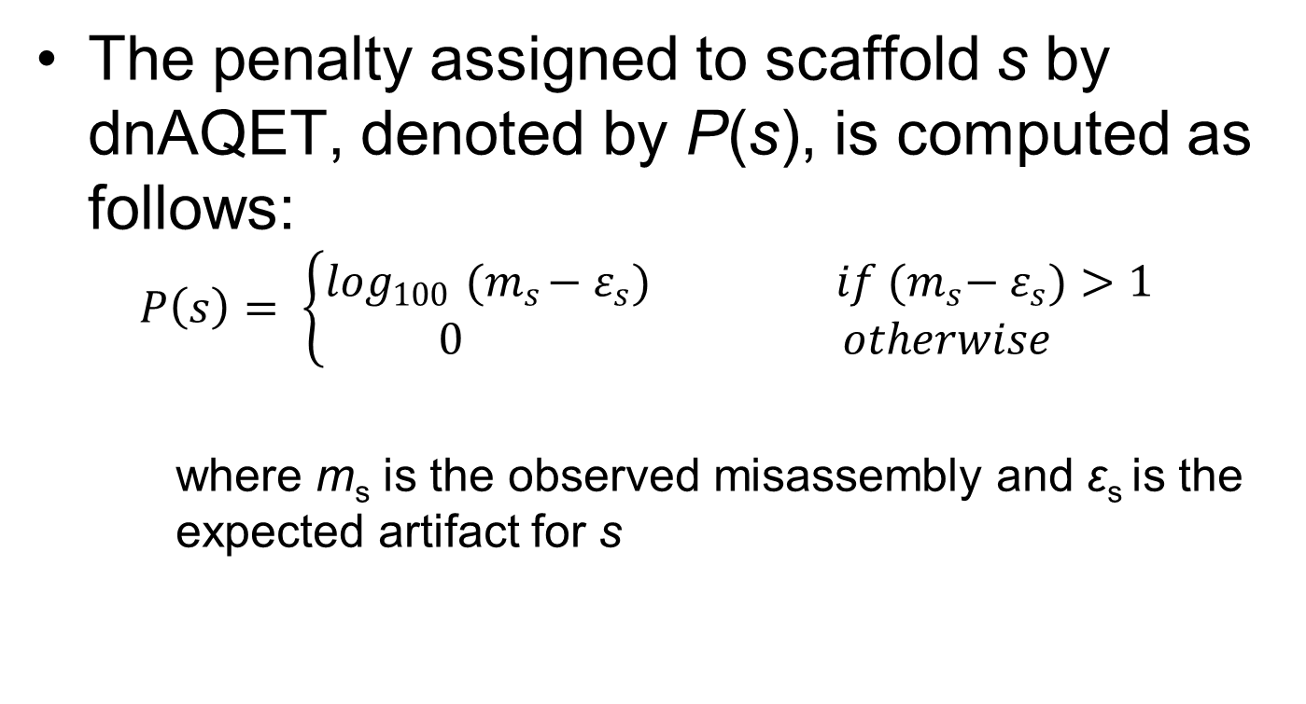
Penalty due to misassembly
The penalty assigned to scaffold s by dnAQET, denoted by P(s), is computed as follows:
$$P\left(s\right)= \left\{\begin{aligned}\log_{100}{ (m}_{s}−ε_{s}) if{ {(m}_{s}− ε}_{s})>1 \\ 0 otherwise\end{aligned}\right.$$
where m_{s} is the observed misassembly and ε_{s} is the expected artifact for s

Slide 15
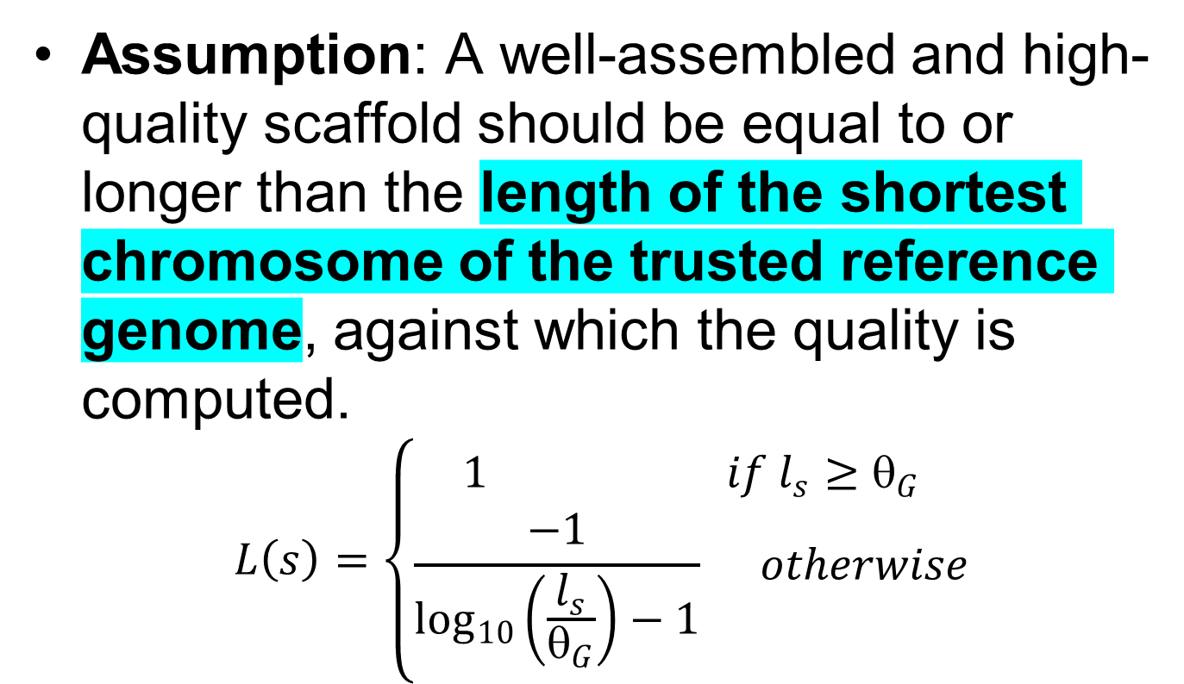
Scaling the quality based on the length of the scaffold
Assumption: A well-assembled and high-quality scaffold should be equal to or longer than the length of the shortest chromosome of the trusted reference genome, against which the quality is computed.
$$L\left(s\right)=\left\{\begin{aligned}1 if l_{s}≥θ_{G} \\ \frac{−1}{\log_{10}\left(\frac{l_{s}}{θ_{G}}\right)−1} otherwise\end{aligned}\right.$$

Slide 16
Quality evaluation for whole assembly
Three factors considered:
1. the distribution of the quality scores of the scaffolds of the assembly,
2. the reference genome coverage provided by the scaffolds at different quality thresholds, and
3. the redundancy of the scaffolds in the assembly.

Slide 17
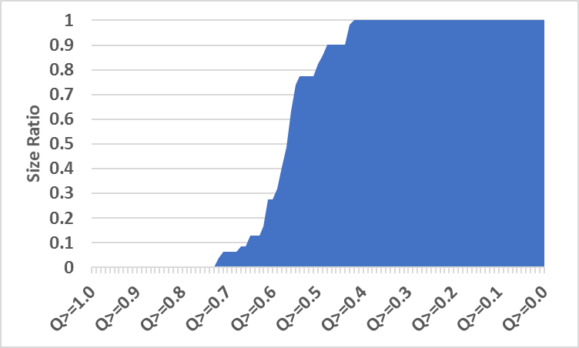
Quality evaluation for whole assembly
1. plot the ratio of the total number of base pairs of the scaffolds meeting the specified quality thresholds (from 0 to 1 with an 0.01 increment), to the whole assembly size
Δ_{A}

Slide 18
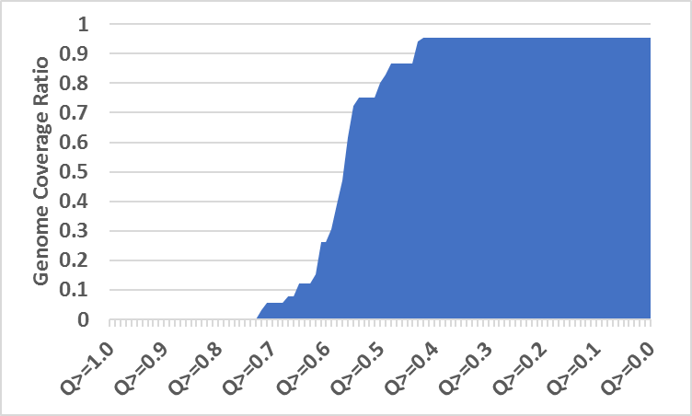
Quality evaluation for whole assembly
2. plot the reference genome coverage at the specified quality thresholds (from 0 to 1 with an 0.01 increment)
Ω_{A}

Slide 19
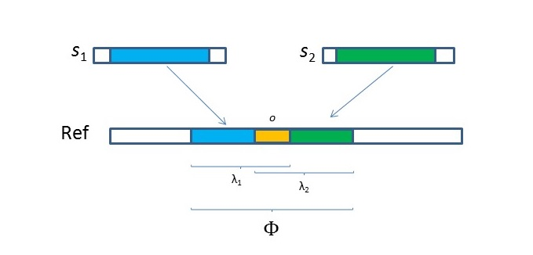

Quality evaluation for whole assembly
3. Inverted Redundancy
$$Π_{A}=\frac{Φ_{A}}{\sum_{s_{i}∈A}{λ_{i}}}$$

Slide 20
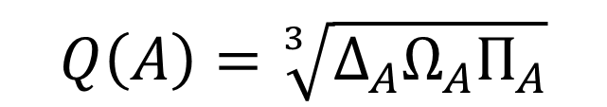
Quality evaluation for whole assembly
final quality score for an assembly A
$$Q\left(A\right)=\sqrt[3]{∆_{A}Ω_{A}Π_{A}}$$

Slide 21
Performance evaluation
Used two types of data for evaluation
Various reference genome builds of 5 organisms
Human, mouse, rat, chimpanzee and zebrafish
6 de novo assemblies for sample NA24385 with the data generated from PacBio platform
Mecat5X, Mecat25X, Mecat50X and Mecat70X
Celera
Falcon

Slide 22
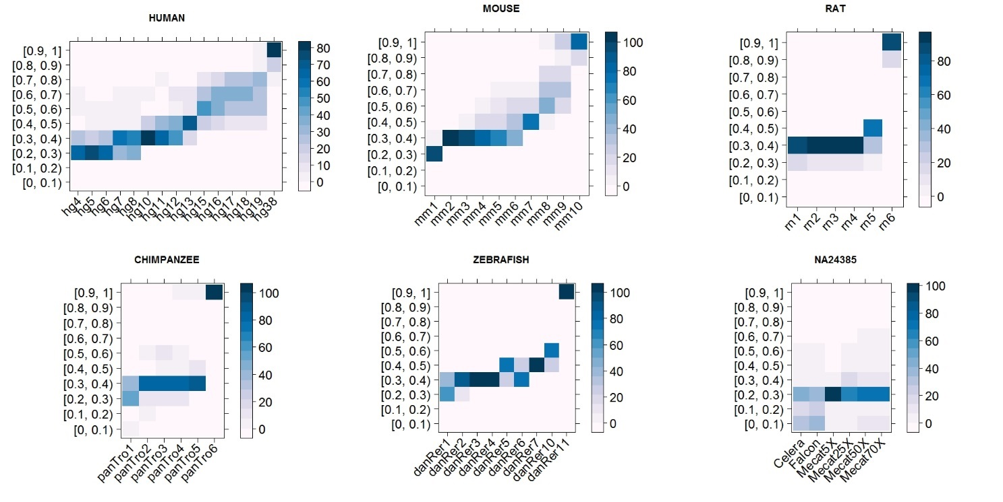
Scaffold qualities
Expectation: the quality scores of the chromosomes of a later build of genomes should be higher than those of the ones from an older build

Slide 23
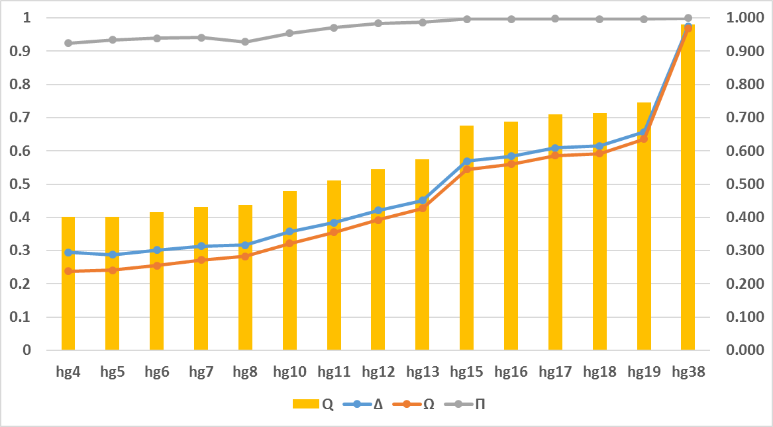
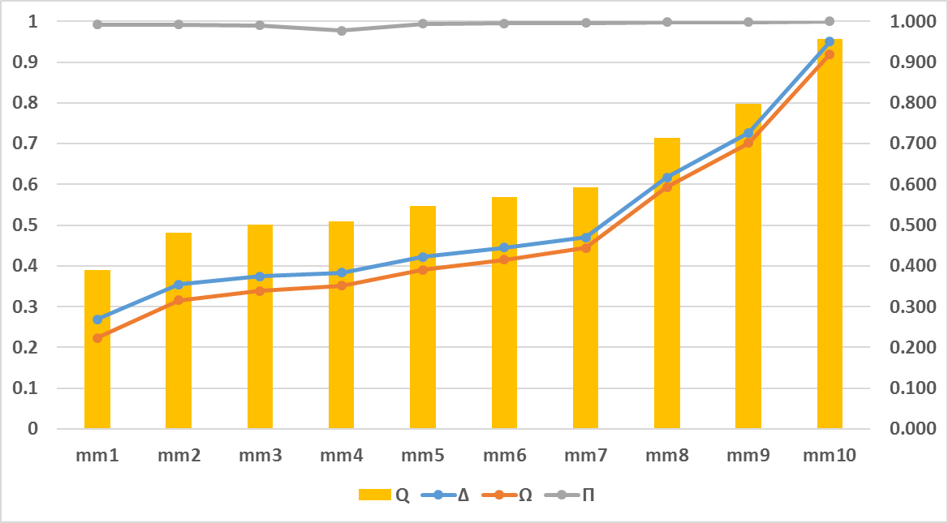
Assembly qualities
Expectation: the quality score of a later reference genome build should be higher than that of an older build
human
mouse

Slide 24
Assembly qualities
No other tool reported in the literature that produces a quality score that unifies multiple measures
Hence, no direct comparison is possible
Compare rankings provided by other metrics to dnAQET’s quality score rankings
Use QUAST-LG to produce other metrics

Slide 25
Assembly qualities
The Pearson correlation coefficients between the rankings of quality scores yielded from dnAQET and QUAST-LG and the rankings of the reference genome builds by hypothesis.
 | Human | Mouse | Rat | Chimpanzee | Zebrafish
1. dnAQET Score | 1.00 | 1.00 | 1.00 | 1.00 | 0.98
2. Genome fraction (%) | 1.00 | 1.00 | 1.00 | 1.00 | 0.95
3. Total aligned length | 0.97 | 0.99 | 0.94 | 0.94 | 0.75
4. # indels per 100 kbp | 1.00 | 0.95 | 1.00 | 0.66 | 0.98
5. # mismatches per 100 kbp | 0.99 | 0.99 | 1.00 | 0.49 | 0.98
6. NA50 | 1.00 | 0.96 | 1.00 | 0.43 | 0.97
7. LA50 | 1.00 | 0.96 | 1.00 | 0.43 | 0.97
8. # scaffold gap ext. mis. | 0.99 | 0.96 | 0.94 | 0.43 | 0.97
9. # N's per 100 kbp | 0.89 | 0.99 | 0.43 | 1.00 | 0.82
10. # misassemblies | 1.00 | 0.96 | 0.83 | 0.26 | 0.90
11. # local misassemblies | 0.99 | 0.99 | 0.94 | 0.09 | 0.88
12. Unaligned length | 0.98 | 0.96 | 1.00 | 0.09 | 0.83
13. Misass. contigs length | 0.73 | 0.41 | 0.26 | 0.60 | -0.22
14. Total length | -0.64 | 0.36 | 0.54 | -0.60 | 0.70

Slide 26
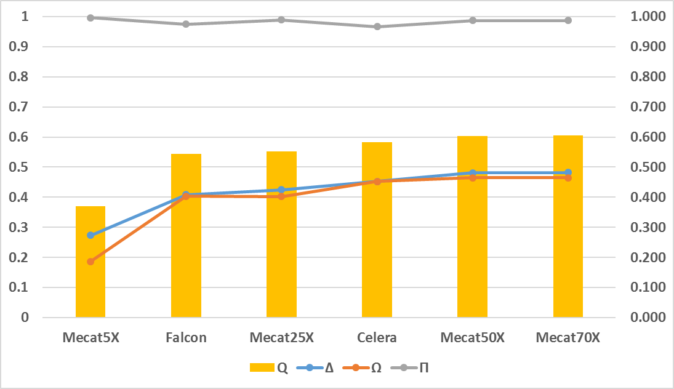
Real data assembly qualities

Slide 27
Real data assembly qualities
No inherent ranking of these assemblies available
Used a method called z-score based ranking from Assemblathon2 (Bradnam et al, 2013) to obtain the ranking
Mecat70X > Mecat50X > Mecat25X > Celera> Falcon > Mecat5X

Slide 28
Real data assembly qualities
Metric | Pearson Correlation Coefficient
dnAQET score | 0.94
Largest contig | 0.77
N50 | 0.77
NG50 | 0.77
N75 | 0.77
L50 | 0.77
LG50 | 0.77
L75 | 0.77
Largest alignment | 0.77
NGA50 | 0.77
NA75 | 0.77
NA50 | 0.71
# indels per 100 kbp | 0.37
Total length | 0.14
Total aligned length | 0.14
Genome fraction (%) | 0.09
# mismatches per 100 kbp | 0.09
# misassemblies | -0.03
# possible TEs | -0.03
# local misassemblies | -0.09
# unaligned mis. contigs | -0.09
Unaligned length | -0.09
# misassembled contigs | -0.14
# unaligned contigs | -0.14
Misassembled contigs length | -0.77

Slide 29
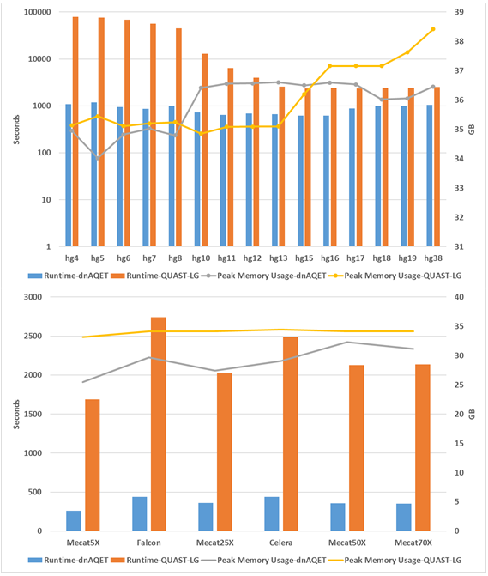
Runtime and peak memory usage performance

Slide 30
Conclusions
We proposed a novel framework to evaluate the quality scores of individual scaffolds as well as de novo assemblies
Our quality score unifies multiple crucial metrics into a single score
Helps the end-user to assess the overall quality of the assembly using a single score

Slide 31
Conclusions
Provided strong evidence for the capability of dnAQET to assign precise quality scores
Using reference genome builds for 5 organisms and 6 assemblies for a real sample

Slide 32
Acknowledgements
Wenming Xiao
Huixiao Hong

Slide 33

Questions?

Slide 34
