Slide 1

And introduction to data warehousing
Notes:
The goal of this lecture is to
This is the 10,000 foot view of the course.
Help you understand how and why data warehousing exists
Introduce you to the terminology associated with data warehousing
Show you where we’ll go in the course

Slide 2
Section: Introduction

Slide 3
Agenda:
Define data warehousing
Explain 4 characteristics of a data warehouse
Discuss the relationship between data warehouse, business intelligence and analytics.
Explain the 5 types of analytics
Demonstrate how the process of data warehousing works
Learn about the fathers of data warehousing
Cover our case studies

Slide 4
Connect Activity: Introduction to DW
When you hear the word "data warehouse" describe in a few words what comes to mind.
Write them down on a piece of paper, then at the end of this chapter, revisit your responses and asses how your/their ideas match up with the formal definition of a data warehouse.

Slide 5
Section: What is data warehousing?
Notes:
Managing multiple databases
ETL – Moving data around
Unified repository of data
Retrieving data from a source system
Data Analysis
Prepare data for query and analysis
Derive insights from data

Slide 6
What is the most important asset of any organization?
Notes:
What do you think it could be? The products it sells? It’s customers? It’s revenue stream?

Slide 7
answer
DATA
Why?
Notes:
Think about it this way

Slide 8
Without data:
Do you know your customers?
Understand their needs?
Can you figure out what products to put on sale?
Which ones to discontinue?
Do you know your expenses?
Your profitability?
Notes:
The answer is a resounding …

Slide 9
NOPE
Notes:
Which is why data is so valuable. With it you can’t value other things like customers products, or revenue streams.

Slide 10
This reminds me of a story…
Notes:
All of this reminds me of a story.

Slide 11
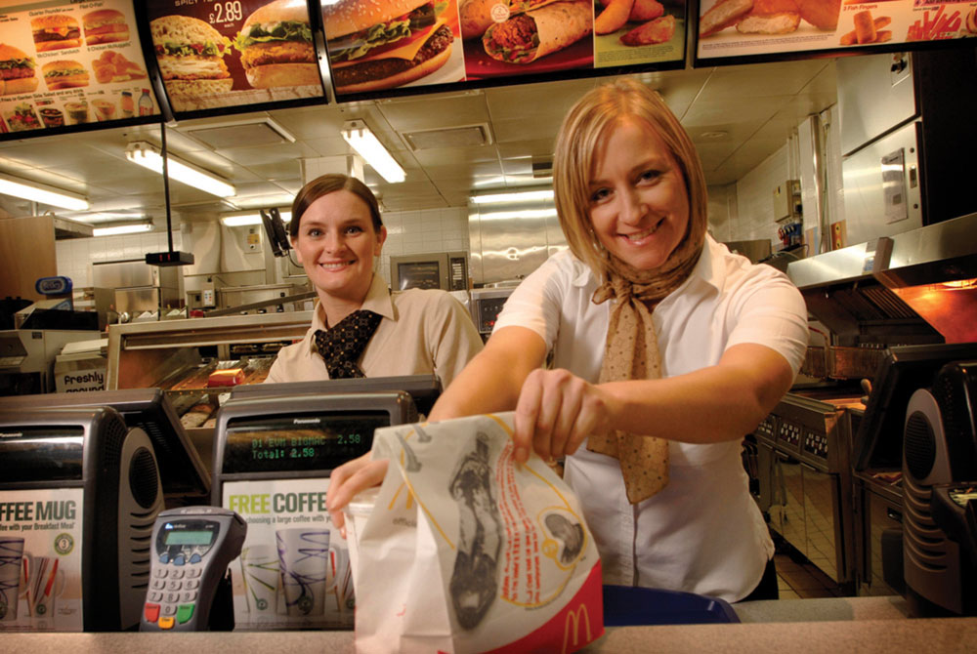
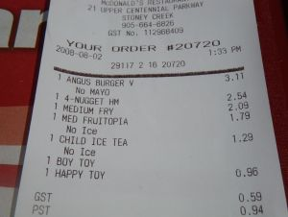
The information needs of an organization…
Notes:
Imagine we work for a fast-food company. Now imagine you start at the bottom working the register, then move on to fries, then to store manager, then regional manager, and finally all the way to up the executive team.
Think of your informational needs as you work you way up through the organization. Are they the same? Different?

Slide 12
The information needs of an organization…
Each level of an organization has different informational needs and requirements:
Customers who purchase fries are also likely to buy milkshakes.
How many fries did I sell this week?
Strategic Management
Tactical Management
Do you want fries with that?
Demand for fries in our China locations is up 200%
Operational Management
Non-Management
Organizational Hierarchy
Notes:
We moved up from non management through to strategic management our informational needs changed.

Slide 13
The information needs of an organization…
Data like this goes into a…
Notes:
When you buy a burger and get a receipt that’s part of a transaction. And the data goes into a

Slide 14
Starts with the OPERATIONAL Database (OLTP)
On-Line Transaction Processing System
Typically stored in a Relational Database or files.
Highly Normalized (Data stored as efficiently as possible, lots of tables.)
Optimized for processing speed and handling the “now”.
Designed for capturing data, not for reporting on it.
Designed to support the operational needs of the organization.
Notes:
[After slides]
These are great at storing and processing data but not designed to allows us to report on it in ways which meet all the informational needs of the organization.

Slide 15
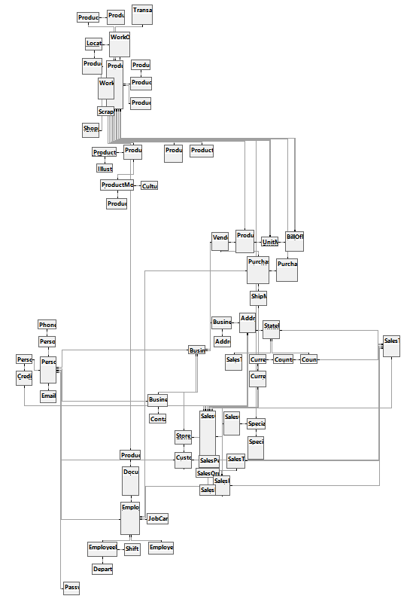
Transactional Databases Are Complex
⬅Adventure works fictitious bicycle manufacturer. 72 tables.
Blackboard Learning Management System. 592 tables.
SU’s Oracle PeopleSoft ERP Implementation. 40,000+ tables.
Notes:
Why so complex? They’re designed to minimize data redundancies and store data efficiently. As such they have many tables, generally the more tables the more complex the database.

Slide 16
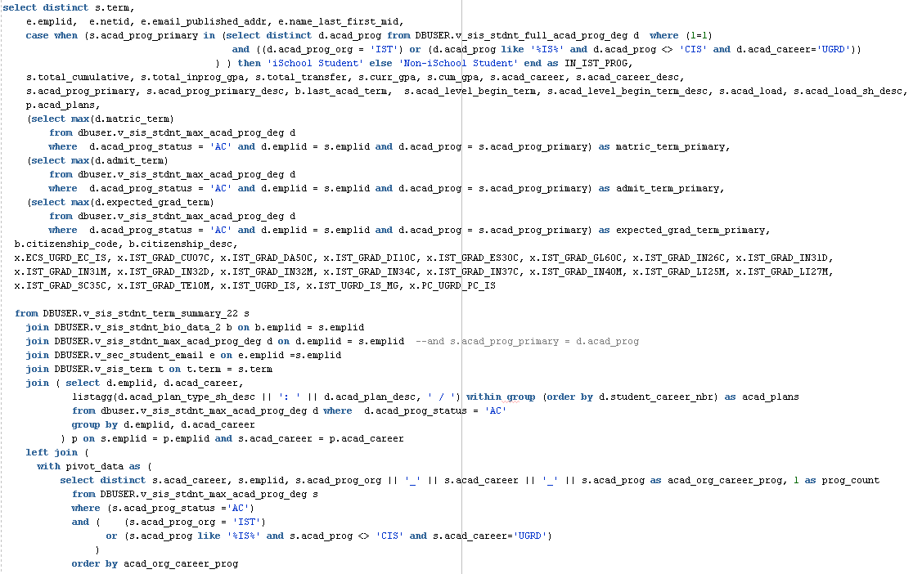
Example: A Query of “iSchool Students”

Slide 17
Issues Reporting with Transactional Databases
Difficult, time-consuming and error prone
Many joins, sub-selects, Due to vast number of tables.
How do you know your query is correct?
Resource-intensive
The database is not optimized for this purpose.
Multi table joins are RAM and CPU hogs
Impossible
Transactional systems are flushed or archived frequently to maintain performance.
You can’t query data you no longer have
Notes:
Resource Intensive
- Optimized writes, not reads.
Impossible
- Some transactional database do not store data in a format conducive to the informational need. They lack trending and historical information.

Slide 18
Solution? The Data Warehouse
Designed to support an organization’s informational needs.
Data is re-structured conducive to reporting and analytic applications.
OLTP databases are data sources for the Data Warehouse.
Data grows over time; existing data in the warehouse never changes.

Slide 19
Check Yourself: Data Warehouse Definiition
True or False: The purpose of a data warehouse is to address the informational needs of an organization?
Notes:
TRUE

Slide 20
Section: Characteristics of the Data WArehouse

Slide 21
4 Characteristics of the Data Warehouse
Subject-Oriented
Non-Volatile
Integrated
Time-Variant

Slide 22
Subject-Oriented
Optimized to give answers to diverse questions
Used by all functional areas
Built around business entities and processes
Orders
Products
Shipping

Slide 23
Non-Volatile
2018
Data are never removed or changed
Data are always growing over time
Historical data. It happened! We donot re-write history!
2017
Orders
2016

Slide 24
Integrated
Centralized in one place
Holds data retrieved from entire organization
"Single version of the truth."
Marketing OLTP Customer
Website Customer
DW Customer

Slide 25
Time-Variant
Flow of data through time
Data reflects as it was at that point in time.
Invoice #: 12345
Amount: $55.90
Date: 4/1/2016
Customer: Michael Fudge
Address: 1313 Mockingbird
Invoice #: 52949
Amount: $95.50
Date: 11/4/2017
Customer: Michael Fudge
Address: 1600 Pennsylvania

Slide 26
Check Yourself: SNIT Matching
Student data is contained within 3 different OLTP systems
Business processes and entities, like: Enrollments, Students, Course Schedules
Student GPA's are different each semester
When a student drops a class they are not removed, but a drop record is added.
non-volatile
subject-oriented
integrated
time-variant
Notes:
1 = C
2 =B
3 =D
4= A

Slide 27
Section: Business Intelligence and Analytics

Slide 28
Connect Activity: BI
What do you think of when you hear the term "business intelligence"? Express your answer in a few words.
I'll jot them down!

Slide 29
Business Intelligence
Analytical and Decision-Support capabilities of the Data warehouse.
Informed decision making.
The presentation of actionable information.
The “Glitz and Glam” of Data Warehousing
Notes:
What is BI?

Slide 30
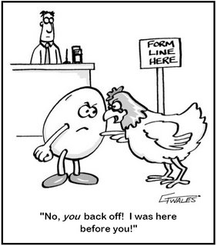
Data Warehouse or Business Intelligence?
Is the data warehouse a component of business intelligence?
or
Is business intelligence a component of the data warehouse?
Notes:
Both of your textbook authors believe they are components to a larger system. For Inmon they’re part of the CIF.

Slide 31
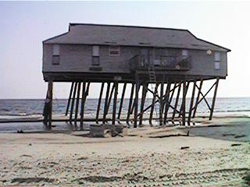

DW is the Foundation for BI
Notes:
Like a solid foundation, Data warehousing makes BI easy.

Slide 32
Section: 5 types of analytics

Slide 33
Analytics is the Technology-Driven Analysis of Data
Retrospective: Traditional Business Intelligence / Reporting “What Happened?”
Diagnostic: Analytic Dashboard / Drill-Down “Why did it happen?”
Descriptive: Real-time Dashboard “What is happening now?”
Predictive: Machine Learning / Forecasting “What is likely to happen?”
Prescriptive Analytics: Make a decision or Take Action “What should I do about it?”
Notes:
Retrospective: Traditional Business Intelligence / Reporting
“What Happened?”
Example: a report listing sales by quarter
Diagnostic: Analytic Dashboard / Drill-Down
“Why did it happen?”
In the Q4: there are more sales than the other quarters. We drill down to find additional purchases in the holiday season.
Descriptive: Real-time Dashboard
“What is happening now?”
Real time view of sales as they happen.
Predictive: Machine Learning / Forecasting
“What is likely to happen?”
We know for the past 4 years 4Q sales are up, so we use the data to estimate 4Q sales for this year.
Prescriptive Analytics: Make a decision or Take Action
“What should I do about it?”
Since we know 4Q sales are up, can we advise how to stock stores accordingly?

Slide 34
Comparison of Analytics
Prescriptive
Predictive
Difficulty
“Foresight”
Descriptive
Diagnostic
“Insight”
Retrospective
“Hindsight”
Business Value
Notes:
Retrospective: “What Happened?”
Diagnostic: “Why did it happen?”
Descriptive: “What is happening now?”
Predictive: “What is likely to happen?”
Prescriptive: “What should I do about it?”

Slide 35
Comparison of Analytics
Business Intelligence
Prescriptive
Predictive
Difficulty
“Foresight”
Descriptive
Diagnostic
“Insight”
Business Analytics
Retrospective
“Hindsight”
Business Value
Notes:
Retrospective: “What Happened?”
Diagnostic: “Why did it happen?”
Descriptive: “What is happening now?”
Predictive: “What is likely to happen?”
Prescriptive: “What should I do about it?”

Slide 36
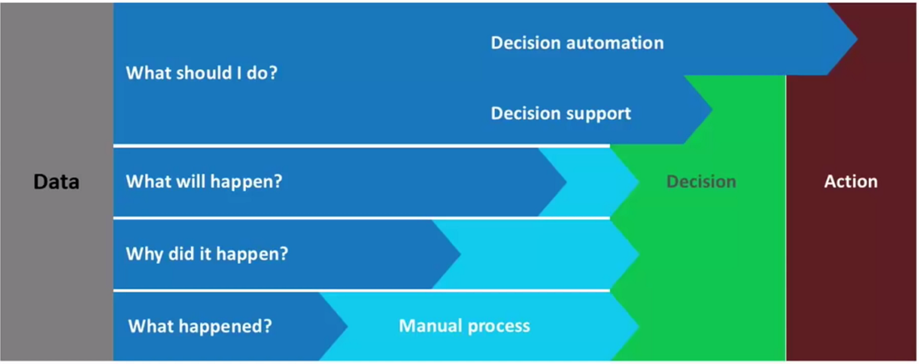
The Evolution of the Analytics Process
Difficulty
Notes:
From decision to action, how much is manual and how much is automated.
With Retrospective analytics, we know what happened, then there is a great deal of manual effort to turn that into decisions and actions.
With Diagnostic Analytics, we know why something happened, but we still need manual effort to turn that into decisions and actions.
With Predictive analytics we know what’s going to happen so very little manual intervention is required to make a decision or take an action.
With Prescriptive analytics the process through to decision or action is automated. Automated decision making is called “decision support” while automated actions are called “decision automation”

Slide 37
Check yourself. What Type of analytics?
For each of the following, answer Retrospective, Diagnostic, Descriptive, Predictive, or Prescriptive
A system automatically blocks a TCP/IP port 22 on all enterprise servers based log data of incoming attack vectors.
A Bar chart of student GPA’s by their major.
A map of current traffic patterns and congestion.
Based on prior trends, the iSchool is 90% certain they will require two sections of IST718 next fall.
The medical urgent care office manager can determine that the spike in visits on Thursdays is due to a beach volleyball league on that same night.

Slide 38
Section: From Source to Business Intelligence a 10,000 Ft View.

Slide 39
But how does this work?
Here’s a hyper-abridged example…

Slide 40
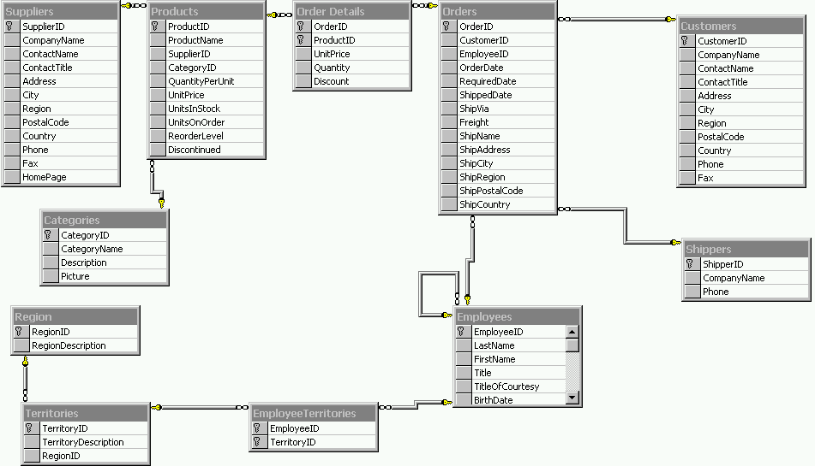
#1: We Have AN OLTP Database
Insufficient reporting capabilities
Can only report “In the now”
It takes complex queries to get questions answered.
Database optimized for CRUD, not analytics.

Slide 41
#2: Identify business process to model
Business Process & Grain
Orders – products sold to customers over time by sale.
One row per product order (product on the order)
Dimensions
Products, Employees (Sales), Time (Order Date), Customer
De-normlized so they are easier for business users to understand.
Facts
Order Quantity, Order Amount
Things we can measure or quantify across dimensions
This represents our Data Mart in the Data Warehouse

Slide 42
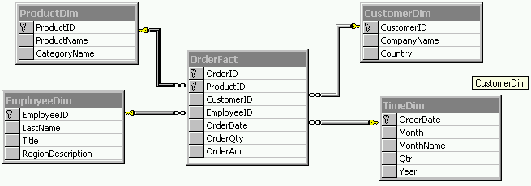
#3: Create Northwind Orders Star Schema
Data mart is implemented as a star schema in a RDBMS.
This is called ROLAP.
Fact Table + outer Dimensions
No data (yet)
Fields are based on what’s available in the source data

Slide 43
#4: Create Northwind Source to Target Map
ProductDim
CustomerDim
How does the OLTP align with OLAP?
Helps us define the ETL process
Fact Table:
OrderFact
EmployeeDim
TimeDim

Slide 44
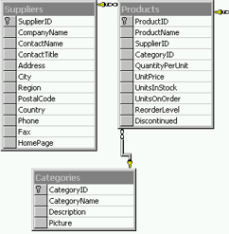

#5: Populate targets with ETL
Products Source
ProductsDim
ETL Stands for Extract-Transform-Load.
Dimensions before Facts.
Need a strategy to handle changes to data.
Tooling exists to assist with the process.
Data

Slide 45
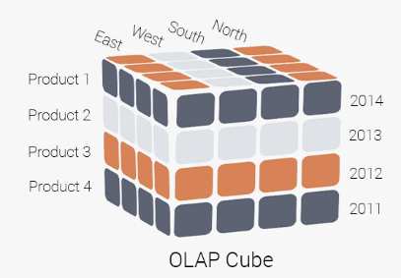
#6 Build a Cube (MOLAP)
Build aggregations of facts across dimensions.
Static ah-hoc reporting structure.
Add a semantic model to address hierarchies and formatting.
Uses a special database: MOLAP

Slide 46
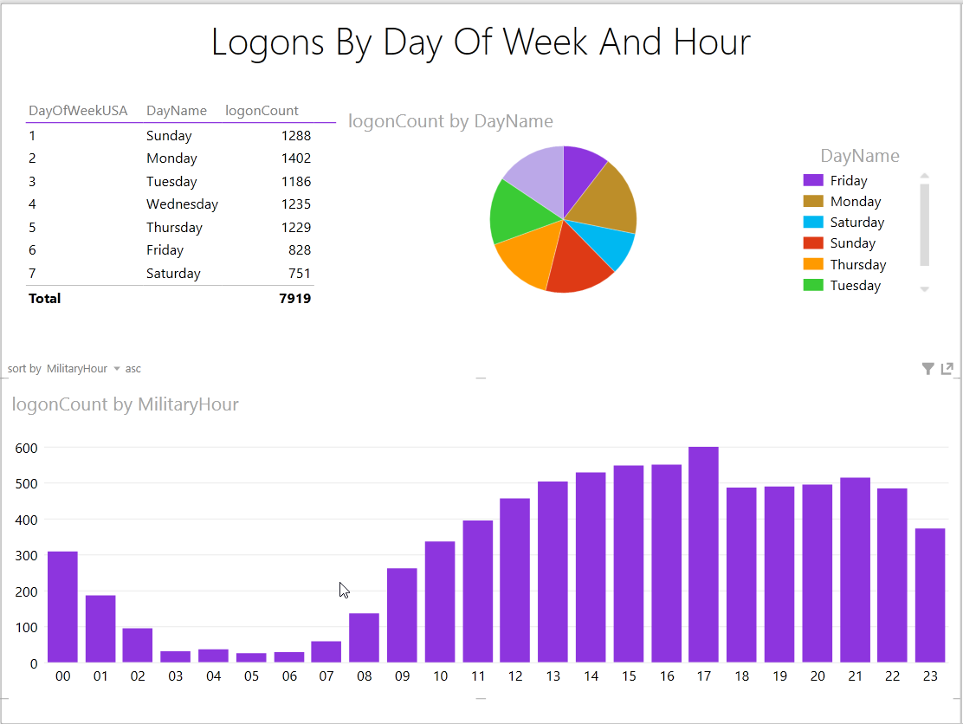
#7: Visualize with a BI Tool
You can easily query star schemas and Cubes in a variety of BI tools like Excel, PowerBI or Tableau

Slide 47
Check Yourself:
You probably noticed we make a "copy" of the data from the source system to the data warehouse.
Can you think of 2 reasons why the data must be a copy?
HINT: Think of the 4 characteristics of a DW.
Notes:
Here are 3 reasons:
It's obvious that we need to manipulate the schema from it's original form into a star schema but the deeper question is why?
We want to ensure our data reflects what happened over time, not what is happening "now"
We want our data to be integrated. How do you do that when here are multiple sources?

Slide 48
Section: The DW in Action

Slide 49
Demo: Visualizing Adventure Works Internet Orders with Excel
Explain "Adventure Works"
Explore OLTP
Explore the DW
Example of BI in action
As you watch the demo take notes:
Write down any questions you have as they arise during the demo
Did the demo help clarify doubts or misconceptions you may had had from earlier in the lesson? Which ones?
Notes:
We will have a discussion after the demo!

Slide 50
Let's Discuss Your Questions / Clarifications
Which aspects of the demo cleared up doubts you had about the process? Explain.
Which aspects raised more questions? What are they?

Slide 51
Section: Fathers of DW

Slide 52
The Fathers of Data Warehousing
 | W.H. Inmon | Ralph Kimball
The “Father” of… | Data Warehousing | Business Intelligence
Invented: | Data Warehousing | Dimensional Models
Data warehouse is: | Normalized tables | Dimensional Models
Purpose of a data warehouse: | Data integration | Query
Million Dollar Idea: | “Corporate Information Factory” | “Kimball Lifecycle”
Approach: How is the Data Warehouse built? | Data-First (Iterative, Bottom-Up) | Process-First (Waterfall, Top-down)

Slide 53
Kimball V Inmon
Inmon Data Warehouse
Kimball Data Warehouse
Relational Modeling
Entity-Relationship Model
Tables in 3rd Normal Form
Many tables using joins
Built for data integration
Indirect access of data by users.
Dimensional Modeling
Fact tables and Dimensions / Star Schema
Tables are de-normalized
Easier for end users to understand
Built for a-hoc queries
Direct access of data by users.

Slide 54
Kimball Data Warehouse
Data Warehouse
OLTP Source System Data
Data Mart
Business Intelligence
Staging
Data Mart
Staging
Data Mart

Slide 55
Inmon Data Warehouse
Data Warehouse
OLTP Source System Data
Normalized
Data
Data Mart
Business Intelligence
Staging
Data Mart
Staging
Data Mart

Slide 56
Why Inmon Data Warehouse?
If the goal is data mart, why go through the added complexity?
Building data marts from source data is more difficult than from data warehouse data.
Normalized DW data can be used for a variety of purposes beyond analytical queries.
Less stress on source systems.
"Single Version of the Truth"

Slide 57

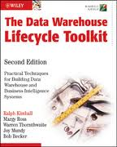
Your Textbooks
“What”
Inmon
“How To”
Kimball
We’ll use the Inmon definitions, and apply the Kimball Approach.

Slide 58
Check Yourself: Kimball and Inmon
Compare and contrast the Inmon and Kimball definitions of Data Warehouse. How are they similar? Different?
Notes:
The inmon definition says data warehouse data should be in 3NF (Relational Modeling). The kimball definition says the data warehouse data should be stored as star schemas (Dimensional Modeling).
They both agree that star schemas are useful for analytical reporting, but Inmon says these are not part of the data warehouse itself.
They both agree DW is about the business user, but how they get there is a bit different.
Kimball believes data warehouses are user-focused, while inmon believes they are internal; a data feeder of application which are user-focued.

Slide 59
Section: Corporate Information Factory

Slide 60
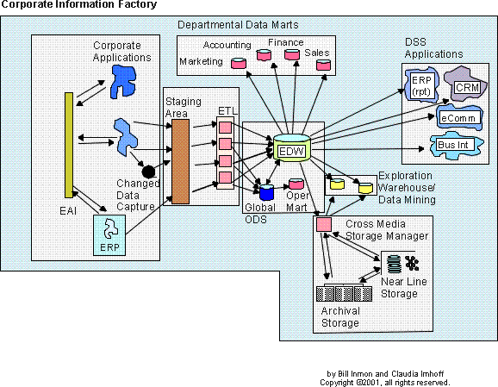
Inmon’s Corporate Information Factory
A reference architecture for an “Information Ecosystem”
Notes:
The CIF is a reference architecture for which components are required to do data warehousing.
It demonstrates how the pieces and parts work together to build an information ecosystem.
Briefly explain how all the parts work.

Slide 61
Section: Kimball Lifecycle

Slide 62
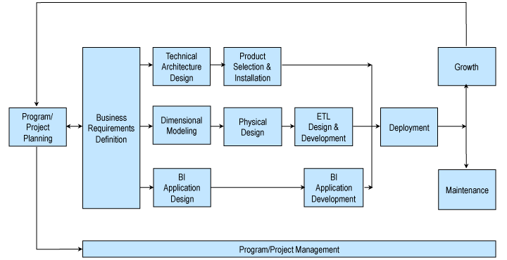
The Kimball Lifecycle
Notes:
Describes an approach / methodology for building a data warehouse projects.
Briefly explain the diagram and which parts can be done in parallel.

Slide 63
Section: Class Case Studies

Slide 64
Our Case Studies
Sample OLTP Systems
Highly Normalized
Represent actual business and their processes
Used in your homework, labs, for in-class demos, and for your group project

Slide 65
OLTP Databases Used in This Class
Northwind
Fictitious company called Northwind Traders which deals in the import/export of specialty foods
Used in homework and labs
Fudgemart & FudgeFlix
Fictitious conglomerate Fudgemart, Inc. with two subsidiaries one in E-Commerce and the other in the Movie rental business.
Used for in-class demos and student projects

Slide 66
Data Profiling:
Examining your data so that you understand its characteristics:
Purpose of the data
What "one row" of the data means
How the tables connect to each other
Business Keys
Assess the quality of the data.
"Getting to know your data" because
"You cannot model that which you do not understand."
Notes:
Purpose of the data – what's in this table?
What "one row" of the data means – does one row mean product or category of product?
How the tables connect to each other – how do I represent an "order"
Business Keys – which columns are used by a business user to uniquely define an entity? NOT a PK.
Assess the quality – does it have what you need? In the format you need it?

Slide 67
Walk-Through: OLTP Databases
Walk through the Case-Study Databases:
Northwind
Fudgemart
Fudgeflix
ExternalSources

