Slide 1
Hit Level Data Analysis

Slide 2
Goal
Analyze a provided hit level data file and provide information regarding the performance of various search engines and the key words which redirect the customers to the 'Esshopzilla' site.

Slide 3
Business Problem
How much revenue is the client getting from external Search Engines, such as Google, Yahoo and MSN
Which keywords are performing the best based on revenue?

Slide 4


Assumptions
The given data has only one completed order per each ip
The orders whose `pagename` does not have `Order Complete` are not considered for this analysis because they don’t generate revenue
The external sources for this client are only bing, google and yahoo

Slide 5
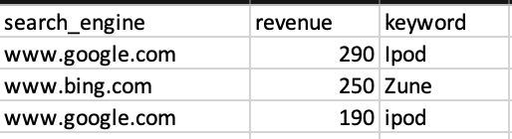
Output tsv file:

Slide 6
For more queries:
The data is updated to Glue Data Catalog and Athena to make it available to Business Analysts for any further analysis because they can run simple queries over the data in s3.

Slide 7
Use of Athena to answer the business questions

Slide 8
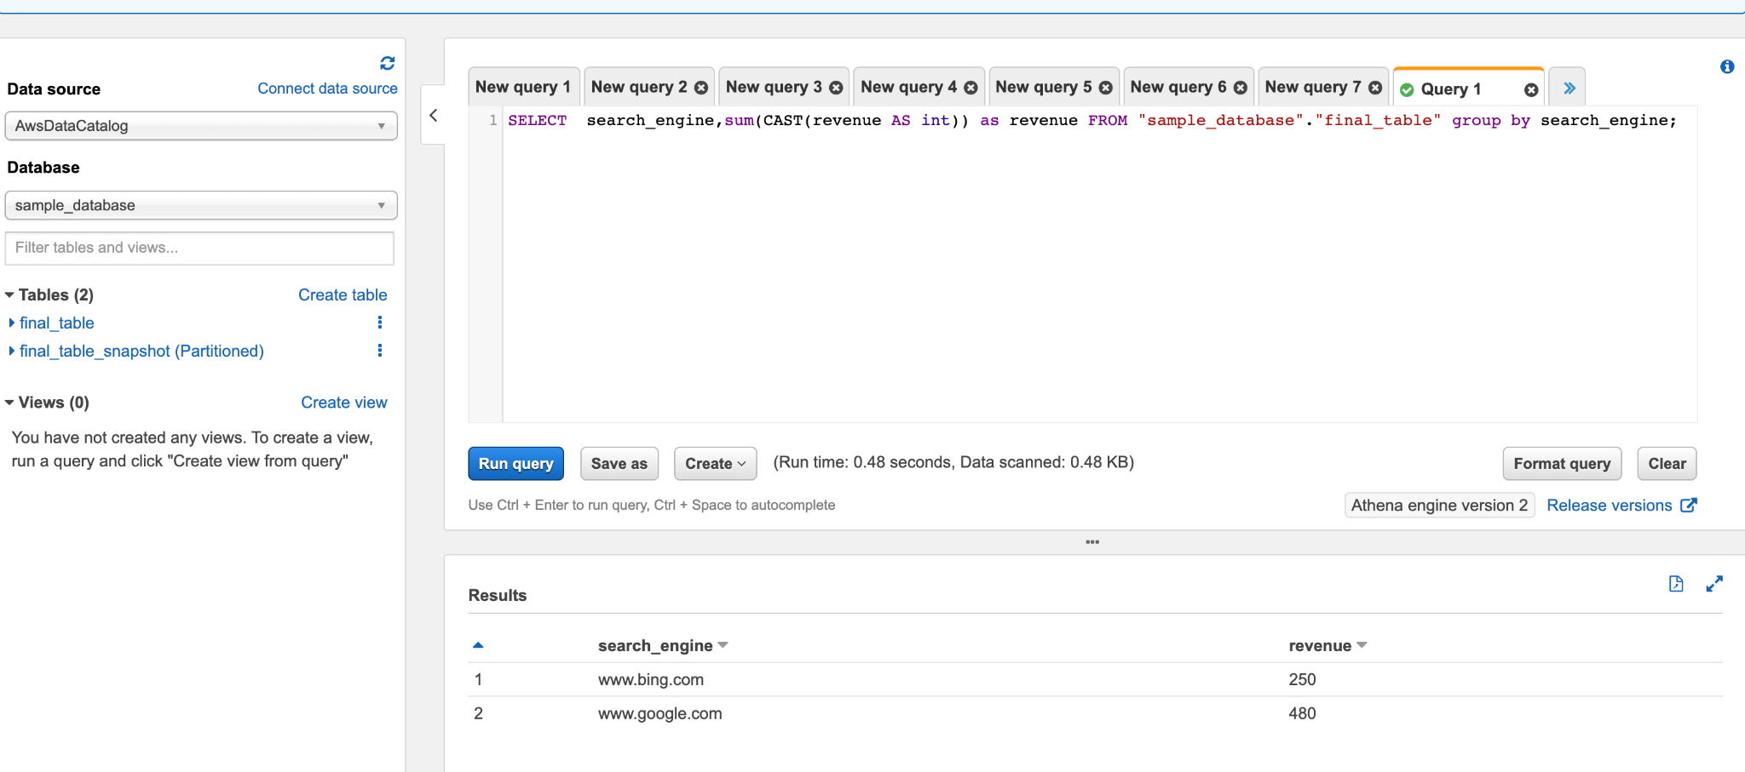

Slide 9
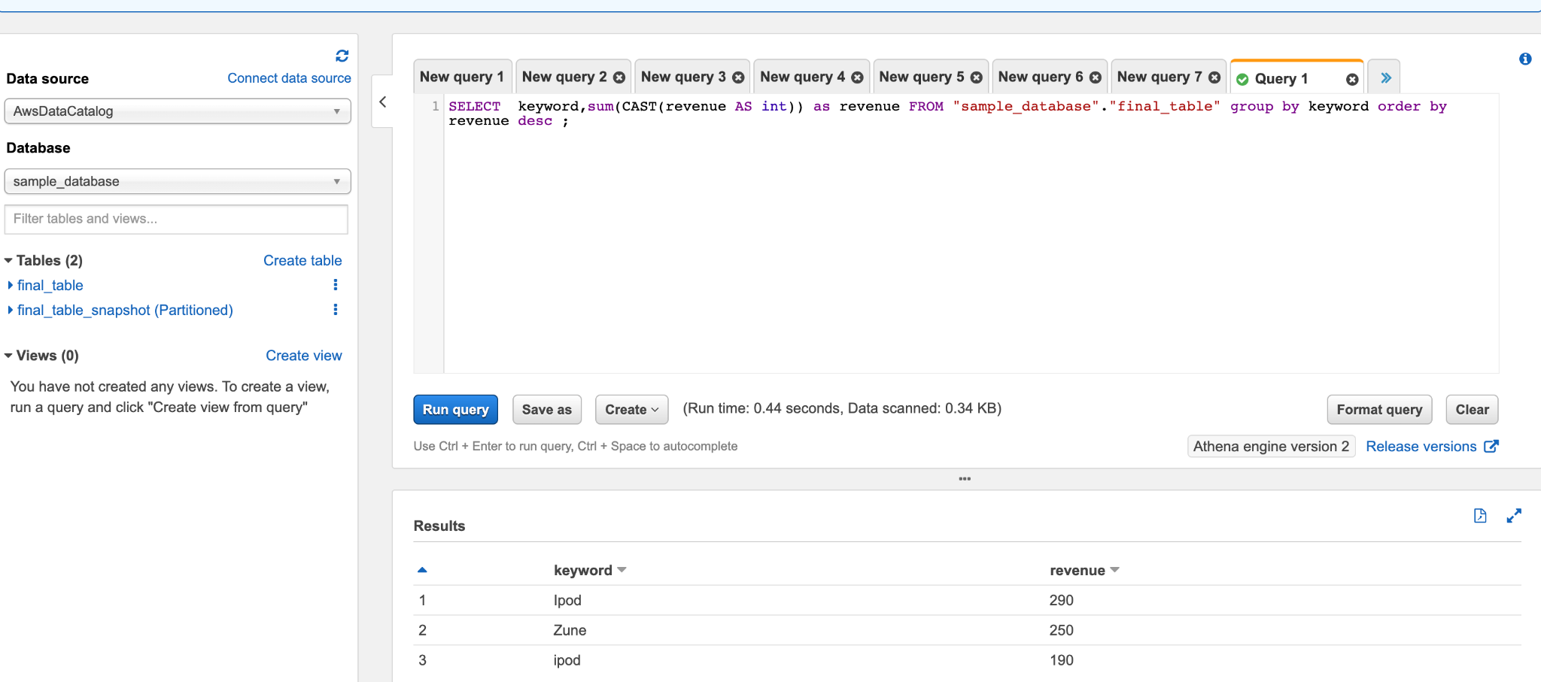

Slide 10
THANK YOU

