Slide 1
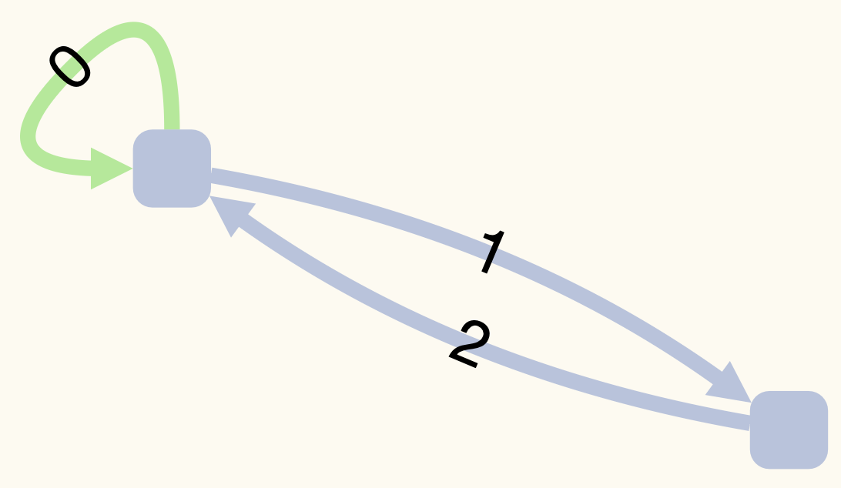
A GraphWalker model (on the left) is a Loop-Permitting Directed Multigraph.
There can be multiple edges in the same direction between two vertices (messes up with test gen. algos)
We must generate a Simple Graph (on the right) by converting every edge to a vertex.
Vertex Coverage in the Simple Graph = Edge Coverage in the GraphWalker model.
Edge Coverage in the Simple Graph = Edge Pair Coverage in the GraphWalker model.
For Vertex Coverage in the GraphWalker model => Delete all multiple edges to obtain the Simple Graph.

Slide 2
Test Requirements are a set of vertex paths (or paths, in short).
We construct a Path Graph of Test Requirements where
”s” represents the start and it is an empty path.
Every edge is a splice between two paths that does NOT unintentionally cover another test requirement.
We do NOT need a “t” to represent test termination, because we can terminate the test at any vertex.
 | TEST REQUIREMENTS FOR PRIME PATH COVERAGE
p0 | 00
p1 | 0120
p2 | 121
p3 | 1201
p4 | 2102
p5 | 212

Slide 3
We must convert the Path Graph into an acyclic Hyper-Path Graph
A hyper-path is either a path or a cycle of hyper-paths.
We incrementally replace every cycle with a hyper-path.
The final Hyper-Path Graph has only two vertices!
The original GraphWalker model is restartable, i.e., there always exists a path back to the initial element.
Therefore, the GraphWalker model is strongly connected.
So, we do not need Minimum Flow Algorithm.

Slide 4
Remember the original Path Graph.
Just rotate and combine hyper-paths until they form a fully splicable path trace.
We must splice “s” and the final path trace.
Rotate the final path trace until we get the shortest test.
To reproduce:
git clone https://github.com/yavuzkoroglu/gwplus.git
cd gwplus
make bin/toygraph
bin/toygraph
p0 | 00
p1 | 0120
p2 | 121
p3 | 1201
p4 | 2102
p5 | 212
s -> p3 does NOT exist in the Path Graph
Test Path = 0120121200
Test Length = 10
Test Path = 001201212
Test Length = 9

