Slide 1
DOMAIN APPLICATIONS
Hospital Readmission Risk Prediction
& HSE Cost-Impact Analysis
Predicting 30-day readmission and mapping each patient to an Irish HSE post-discharge care pathway.
Name - Ya Wai Thone
Student ID - 24264245

Slide 2
1
THE PROBLEM
Readmission is a quality signal and a cost
30-day readmission is a recognised marker of care quality and a major cost pressure for the HSE.
Research question: Can a machine-learning model reliably rank diabetic patients by 30-day readmission risk, and can those predictions be stratified into clinically meaningful tiers mapped to HSE care pathways?
~70k
130
9%
real patient admissions
US hospitals (UCI diabetes dataset)
readmitted within 30 days
Binary target — readmitted within 30 days: Yes / No

Slide 3
2
METHOD & MODEL
Data Preparation and
Cleaning
›
Exploratory Data Analysis
›
Data Preprocessing and Feature Engineering
›
›
RFE
feature selection
›
SMOTE
class balance
›
LightGBM
+ LR baseline
›
Threshold
tuning
Top predictors were clinically sensible
AUC-ROC
Time in hospital
0.648
Number of diagnoses
Number of medications
LightGBM (vs 0.638 logistic regression)
Number of lab procedures
Age & discharge destination

Slide 4
3
THE CONTRIBUTION
Three risk tiers → HSE post-discharge pathways
Risk tier
% of patients
30-day readmission
HSE pathway
Low
62.9%
6.4%
Routine GP follow-up (standard discharge)
Medium
32.1%
11.3%
Community-nurse call + medication review within 7 days
High
5.0%
26.8%
Discharge-planning team referral + 48-hour follow-up call
High tier = just 5% of patients but nearly 3× the average readmission rate — so intensive resources target exactly where they're needed.

Slide 5
4
BUSINESS VALUE
From prediction to a costed business case
Cost parameters (published HSE / literature)
Estimated net saving per cohort
Acute bed-day cost
€878
~€207,000
Avg. readmission stay
5.8 days
Cost per readmission
€5,092
Targeting High + Medium tiers at 20% intervention effectiveness.
Intervention effectiveness
20%
Cost-saving while intervention stays below €136 / patient. Sensitivity analysis: only loses money if interventions are both expensive and weak.

Slide 6
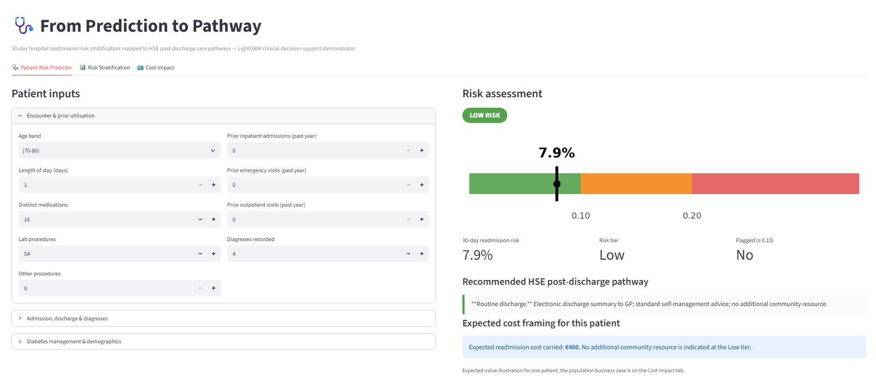
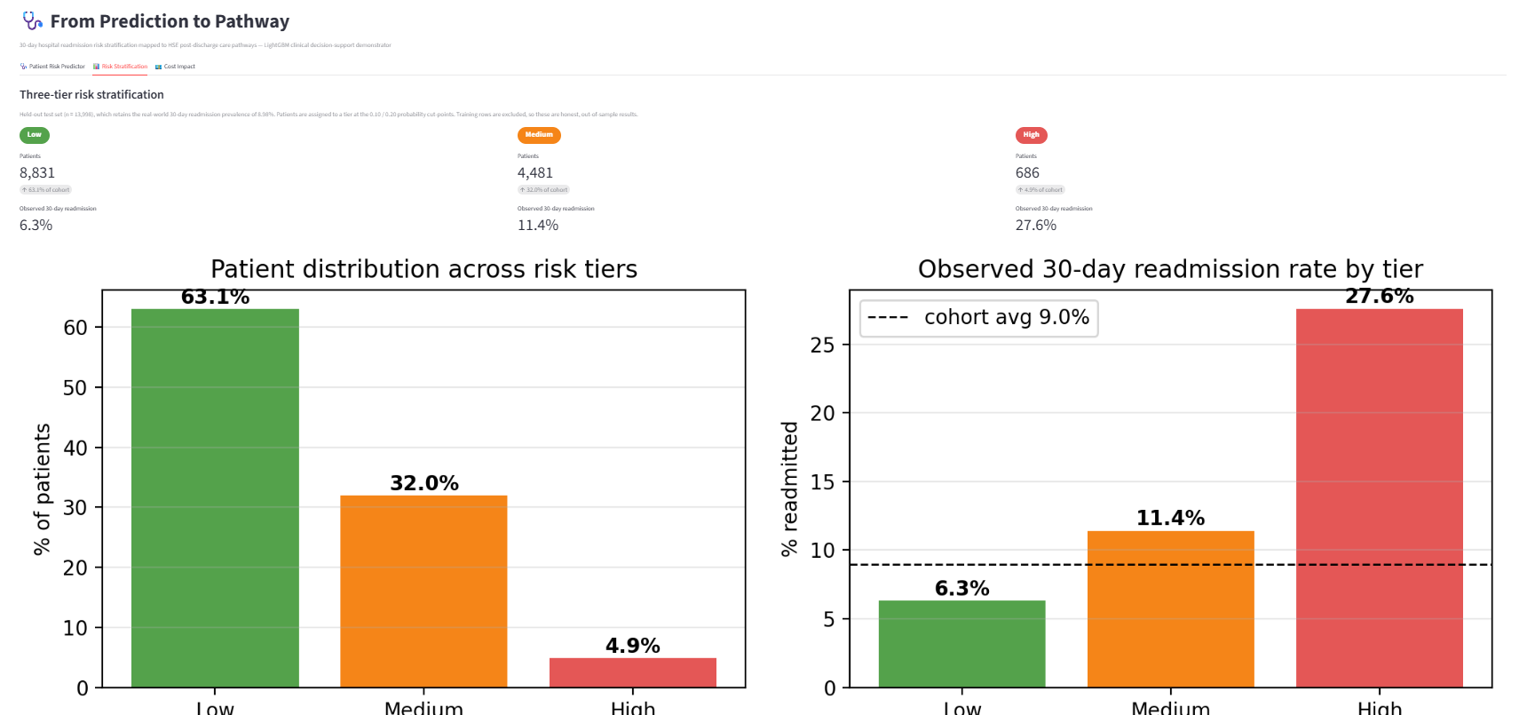
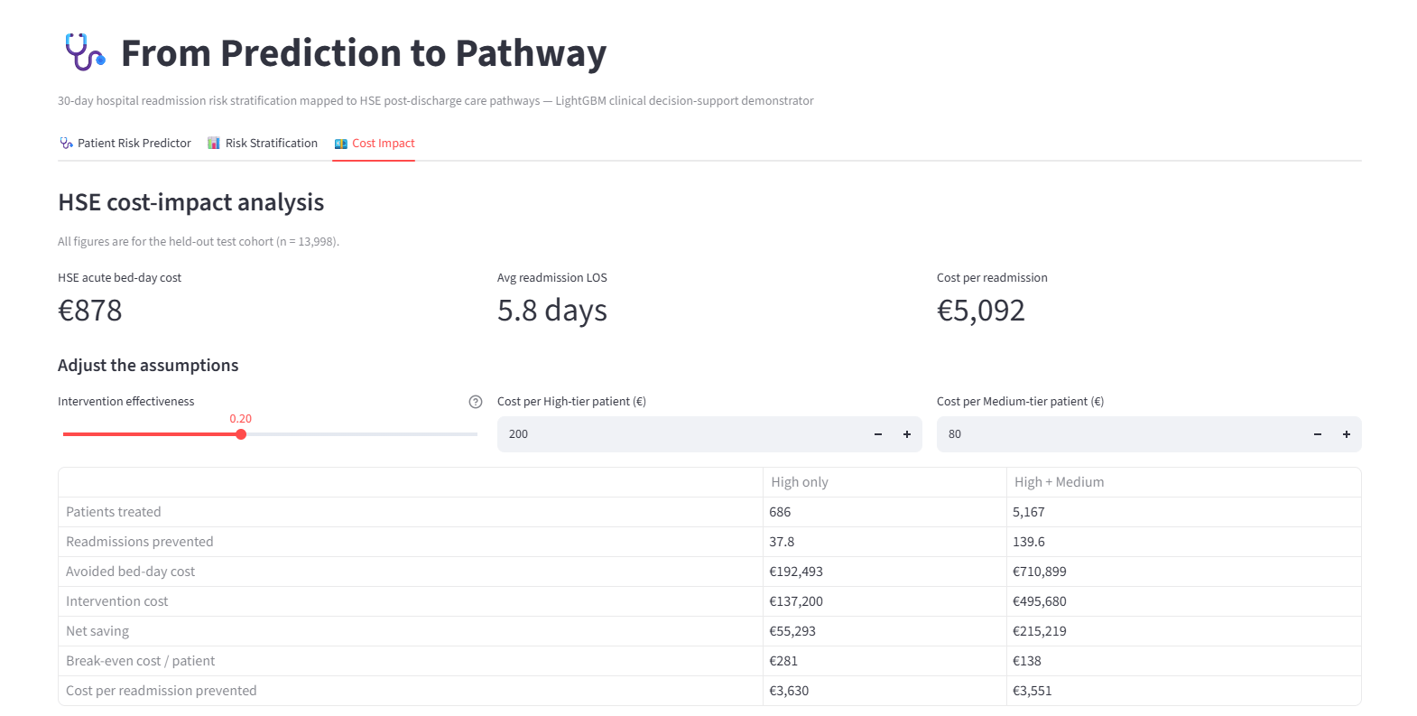
5
DECISION-SUPPORT TOOL
A working Streamlit tool
The whole project, operational: a clinician or manager can use the model directly.
Patient Risk Assessment
Risk Stratification
Cost-Impact Analysis
Enter a patient → risk score, tier & recommended pathway
Cohort split across Low / Medium / High tiers
Population savings

Slide 7
Conclusion
A model turned into a costed, actionable pathway aligned with the Irish health service.
Risk stratified into three HSE post-discharge tiers, not a bare yes/no output.
Interpretable and leakage-free methods; savings framed for reinvestment into care.
Thank you

