Slide 1
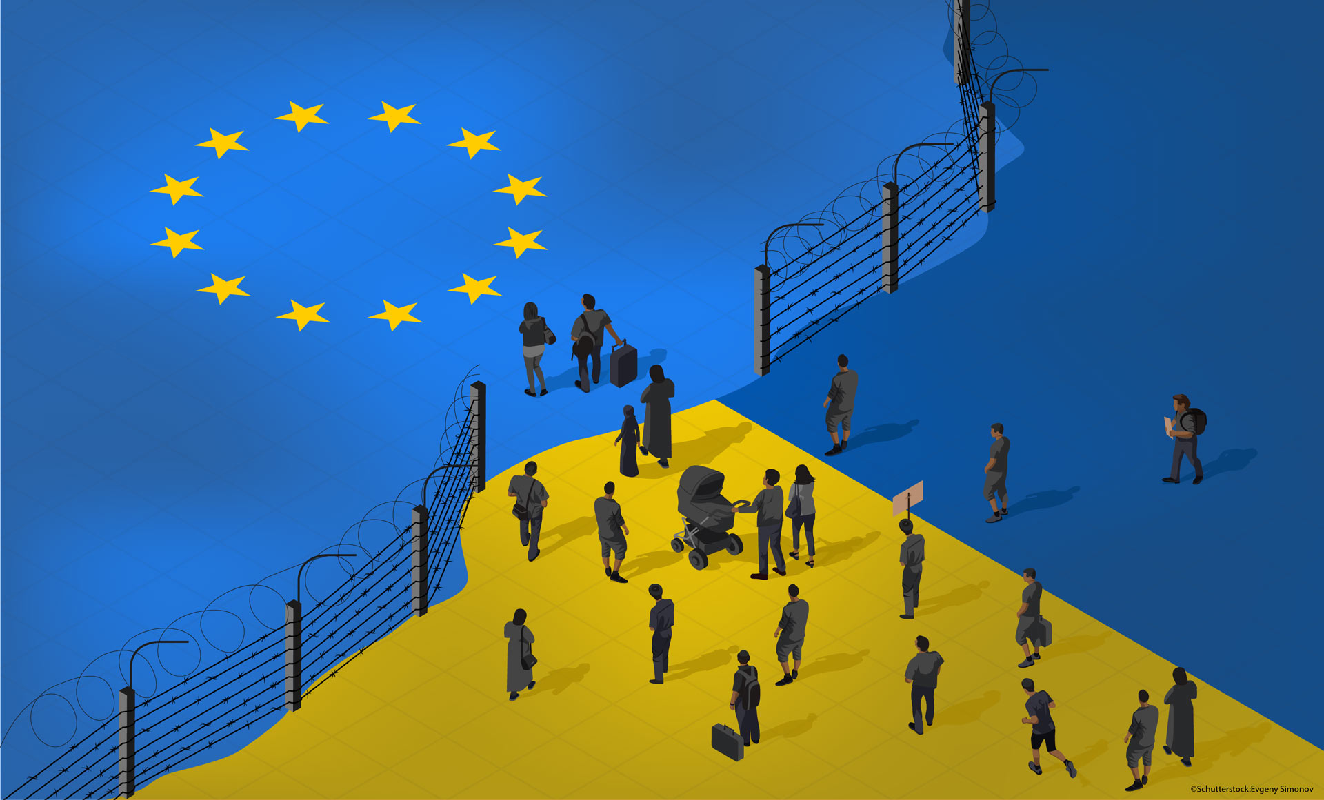
Integrating Security and Privacy Goals:
Sustainable and Ethical Data Governance in Migration Technologies
A critical analysis of the 2024 Greek Ministry of Migration ruling and 2025 EU-US Data Partnership within the framework of Global Sustainability, SGD 10 and SGD 16.
Pawan Mukesh Badsewal, Hailan Jin, Chanlin Naicker, Ya Wai Thone, Dhruv Hitendra Waghela
07 November 2025

Slide 2
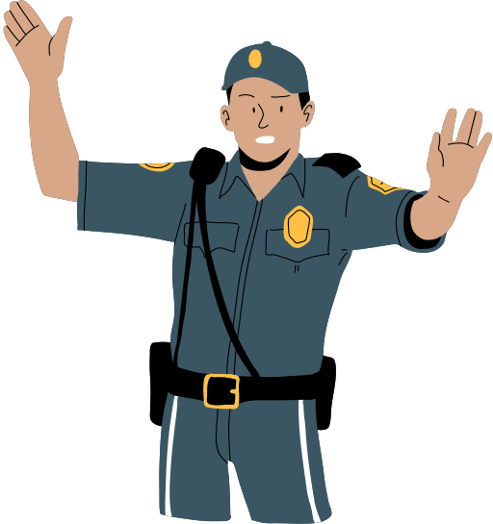
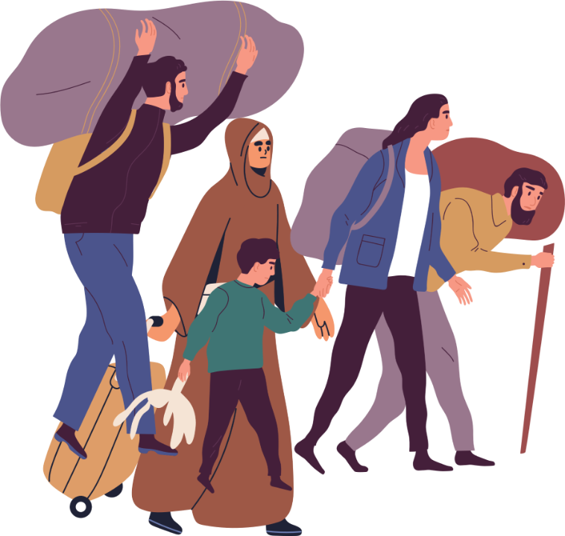
OVERVIEW
In 2025, the United Nations reported a record breaking, 122 million forcibly displaced people worldwide due to violence and conflict.
Biometric, surveillance and predictive technologies are being used widely by government, cooperations and NGOs.
These technologies improve security, efficiency, and scalability, but have raised significant ethical, legal and social concerns.
Key challenges include:
- Data Privacy and Consent
- Transparency and Accountability
- Significant humanitarian right violations of vulnerable populations
Current governance and regulatory frameworks are currently behind. This exposes gaps in oversight and protection.
Addressing these issues is critical in supporting the UN SGDs - SGD 10 (Reduce inequality within and among countries) and SGD 16 (Promotion of peaceful and inclusive societies, justice for all, building of accountable, inclusive institutions)

Slide 3
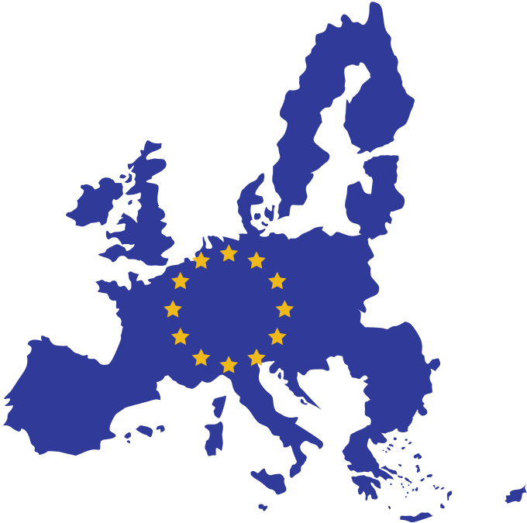

Data Governance in EU Migration Management
Despite strong legal frameworks such as the
GDPR, the EU’s approach to governing migration
data raises major ethical concerns. The increasing
use of massive biometric and algorithmic
processes increases the concerns of transparency,
responsibility, and protection of vulnerable
populations.
The moral execution of data management in the EU migration management and its contribution to Sustainable Development Goals (SDG) 10 and 16.

Slide 4
Regulatory Frameworks Vs Implementation Failures
Legal Foundation
GDPR
The center of the data governance, which provides the principles of lawful processing and high-quality accountability.
EU Charter
Officially identifies privacy and data protection as a basic human right and has incorporated them in the law of the continent.
AI Act
Broadens the protection against the high-risk technologies used in the migration control, and thus, it adds to the pre-existing protection.
Independent oversight bodies
EDPS (European Data Protection Supervisor)
Monitors the processing of personal information by the EU institutions, bodies, offices and agencies, as well as having the power of enforcement and expert advice.
EU-LISA (European Union Law Information Service)
The management of the operational part of the IT systems pertaining to freedom, security and justice, such as Eurodac, EES, and ETIAS, and protecting the data integrity and security is handled by European Union Law Information Service.
Current Facing Problems
Coerced Consent
Vulnerable groups are often usually coerced into providing their biometric data in order to get essentials such as food and shelter.
Weak accountability
Lack of Data Protection Impact Assessments (DPIAs) in several EU migration structures (e.g., EURODAC, EES, ETIAS) is an example of regulatory gaps.
EURODAC - European Dactyloscopy System (Fingerprints of asylum applicants).
EES & ETIAS - Entry/Exit System and Travel Information and Authorization System (Border monitoring).
SIS & VIS - Schengen Information System and Visa Information System (Security and visa data).
Purpose Limitation
The data collected to support humanitarian efforts is later on used to serve an auxiliary purpose like deportation, or even to other security agencies as described in the EBSP proposal.
Socio-technical failures
The data recycling, lack of redress opportunities, and institutional trust destruction are relevant socio-technical gaps.

Slide 5
Strengthening Governance & Sustainability
Governance of Biometrics
Stakeholder Involvement
Ethics at each step
Structured Stewardship
Strengthen rules and regulations on biometric information, face recognition, and analytics.
Trace data in the life cycle and perform independent audits.
Involve the human-rights non-governmental organizations, the migrant's advocacy groups, and international organizations like the UNHCR.
Make sure that an audit by the European Data Protection Supervisor (EDPS) and EU-LISA is multi-tiered.
Implement Data Governance Council & Data Stewards
The collection of data, throughout its lifetime, has to be carefully recorded.
Use a RACI matrix to define the flows of Responsibility, Accountability, Consultation, and Information.
Implementation of Ethical Impact Assessments (EIAs) in conjunction with the conventional DPIAs
The main issues that DPIAs deal with are risk and legal compliance.
EIAs look deeper into the issues of ethics.

Slide 6

Rising Use of Biometric and Personal Data
Biometric systems used for border control and refugee identification.
Increasing data
sharing between EU agencies and third countries.
Weak consent and unclear governance mechanisms.
Lessons from the Greek Data Protection Case
Greek authorities failed to safeguard asylum seekers data.
Violation of GDPR principles and lack of oversight.
Highlighted ethical and institutional weaknesses.
Impacts on Vulnerable Populations
Disproportionate surveillance and discrimination risks.
Violates humanitarian neutrality and fairness.
Weakens trust in public institutions.

Slide 7


Understanding Privacy and Protection:
GDPR as a Safeguard
Article 6 and 7 defines the lawfulness of personal data processing and consent requirements, respectively.
Article 9 restricts processing of biometric data.
Requires explicit consent and purpose limitation.
III. Public-interest exceptions are often misused.
I. Fragmented data systems across agencies (Frontex, Europol, etc.)
II. Weak coordination and inconsistent consent standards
III. Limited monitoring on cross-border data sharing.

Slide 8


Challenges of Data Privacy
Lack of transparency in data use and storage.
Potential misuse for surveillance or deportation.
Public trust and institutional accountability are at risk.
• Establish independent data protection officers.
• Increase transparency and accountability in data sharing.
•Promote ethical AI and data minimization.
Building
Ethical Data
Governance

Slide 9
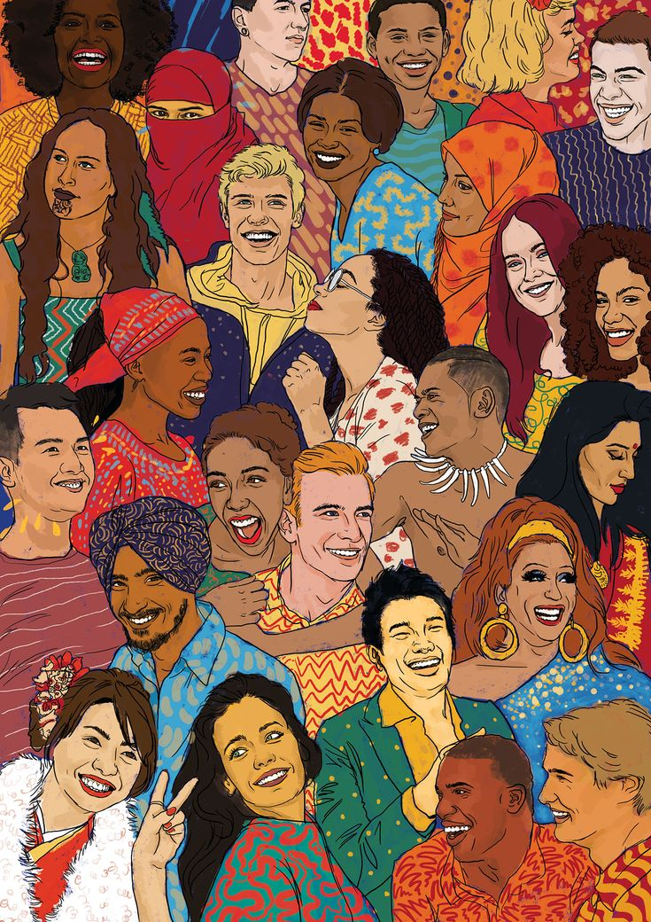



ETHICAL
LEGAL
SOCIAL

Slide 10




ETHICAL
Utilitarian
Deontological
Virtue
Veil of Ignorance
Improved identification and Verification procedures
Aids in fraud detection, safety and greater public security.
Robustness
Increased efficiency
“greatest good”

Slide 11
ETHICAL
Utilitarian
Deontological
Virtue
Veil of Ignorance
Improved identification and Verification procedures
Aids in fraud detection, safety and greater public security.
Robustness
Increased efficiency
“greatest good”
Fundamental rights under GDPR such as privacy and consent concerns – use of DPIA
Risks of Misuse
Migrants possible distrust in authoritative figures
Ethical conflict
“duties, morals and intrinsic ethics”

Slide 12
ETHICAL
Utilitarian
Deontological
Virtue
Veil of Ignorance
Improved identification and Verification procedures
Aids in fraud detection, safety and greater public security.
Robustness
Increased efficiency
“greatest good”
Fundamental rights under GDPR such as privacy and consent concerns – use of DPIA
Risks of Misuse
Migrants possible distrust in authoritative figures
Ethical conflict
“duties, morals and intrinsic ethics”
Institutional Virtues : Fairness, trust, respect, empathy, transparency
Bias and Discrimination Risks – AFR technologies
Lack of respect and dignity – erodes public trust
Importance of Moral Evaluation
“character and moral virtues of actors”

Slide 13
ETHICAL
Utilitarian
Deontological
Virtue
Veil of Ignorance
Improved identification and Verification procedures
Aids in fraud detection, safety and greater public security.
Robustness
Increased efficiency
“greatest good”
Fundamental rights under GDPR such as privacy and consent concerns – use of DPIA
Risks of Misuse
Migrants possible distrust in authoritative figures
Ethical conflict
“duties, morals and intrinsic ethics”
Institutional Virtues : Fairness, trust, respect, empathy, transparency
Bias and Discrimination Risks – AFR technologies
Lack of respect and dignity – erodes public trust
Importance of Moral Evaluation
“character and moral virtues of actors”
Systematic disadvantages/bias aimed at certain individuals
Protection of vulnerable groups
considering each
group and factors.
Focus from institutions by embedding fairness
“impartial choices”

Slide 14


Data collection and processing should comply with data regulations to protect individual rights.
GDPR requires biometric data to be processed with explicit consent with measure to prevent misuse - Article 32(2)
Use of alternative approaches to protect privacy - synthetic data
Non-compliance can result in sanctions or heavy penalties - Greece
Internation transfer requires sustainable legal frameworks and global cooperation – complications with differing national laws.
Proposed EU-US border agreement risks violating EU privacy laws such as the EU-US Umbrella Agreement.
LEGAL
Biometric technologies can aid in undermining or promotion of social inclusion.
There are risks of social profiling which can reinforce social inequalities.
Sociocultural, religious ( such as ethnic or religious attire) and personal considerations (reluctance to use biometric capturing. systems) should be respected to avoid embarrassment or exclusion.
High scrutiny on vulnerable groups can result in public distrust harming national cohesion.
Exposure of sensitive information can lead to emotional distress or financial harm.
SOCIAL

Slide 15

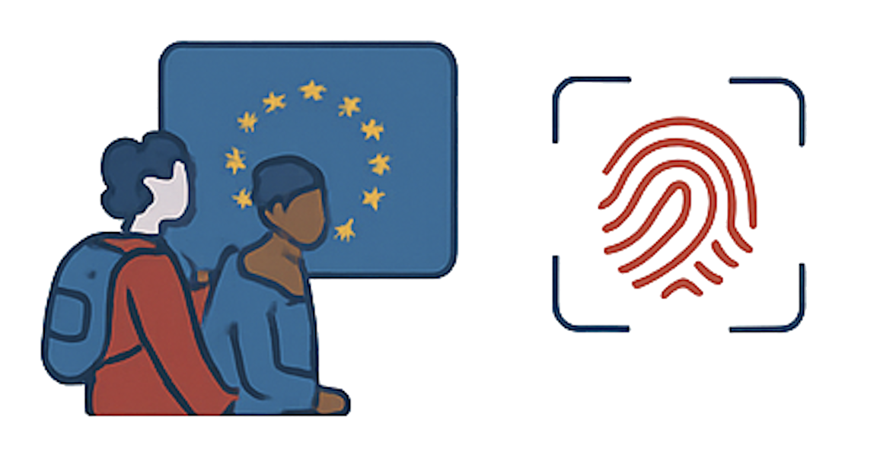

REMEDIES
Context & Challenge
EU uses fingerprints & facial scans to improve border security this raises ethical & social issues for vulnerable groups
Key risks are unclear rules, lack of consent, technical mistakes
Principles for Ethical Governance
Strong Leadership & Accountability: Dedicated teams oversee data handling from start to finish
Stakeholder Input: EDPS, EU-LISA, NGOs, UNHCR, migrant groups
Regular Privacy & Ethics Reviews: Ensure ongoing compliance & risk mitigation
Clear Consent: Migrants understand data collection & usage
Data Minimization: Collect only necessary info & encrypt/anonymize
No Discrimination: Rawls’ philosophy ensures fairness by testing of AI models and the use of diverse datasets for training
Transparency & Accountability: Public reports, easy access to correction/deletion of data
Staff Training & Technical safety: Encryption and strict access control sreduce risks
Incident Response & Audit: Early detection of risk and external audits
Reduces inequality (SDG 10): Promotes fair treatment of migrants and refugees
Builds fair, trustworthy institutions (SDG 16): Builds trustworthy digital institutions through transparent and accountable data handling
Contributes to social cohesion by promoting fairness and accountability.

Slide 16

CONCLUSION
The EU has strong data protection frameworks like the GDPR, EU Charter of Fundamental Rights, and AI Act, but major gaps remain in migration data governance.
Biometric and personal data are widely collected yet often mismanaged, leading to privacy risks and ethical concerns.
Key issues include weak enforcement, fragmented accountability, and poor ethical oversight.
To achieve SDG 10 (Reduced Inequalities) and SDG 16 (Peace, Justice, and Strong Institutions), governance must become ethical, transparent, and rights-based.
Regular audits, training programs, and stakeholder participation can build accountability and trust.
Migration systems must be guided by ethical integrity, social responsibility, and human rights, ensuring equality, transparency, and sustainable development.

Slide 17

MOVING FORWARD
Focus on advancing ethical, legal, and technical aspects of EU migration data governance.​
Integrate Ethical Impact Assessments (EIAs) with existing data protection frameworks.​
Study cross-border legal harmonization to improve accountability and compliance.​
Explore privacy-preserving technologies like encryption, anonymization, and synthetic data.​
Assess the long-term social and institutional impacts on equality, justice, and public trust.

Slide 18
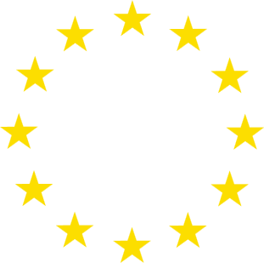
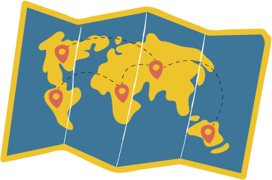

Thank You

