Slide 1
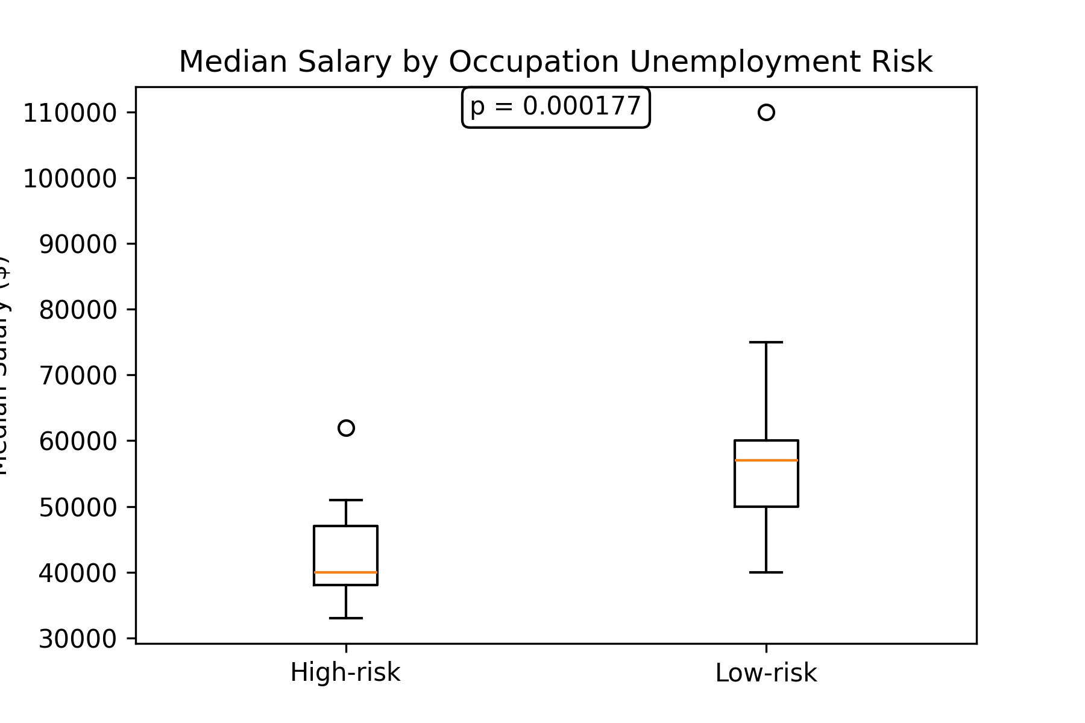
Figure 1 ttest

Slide 2
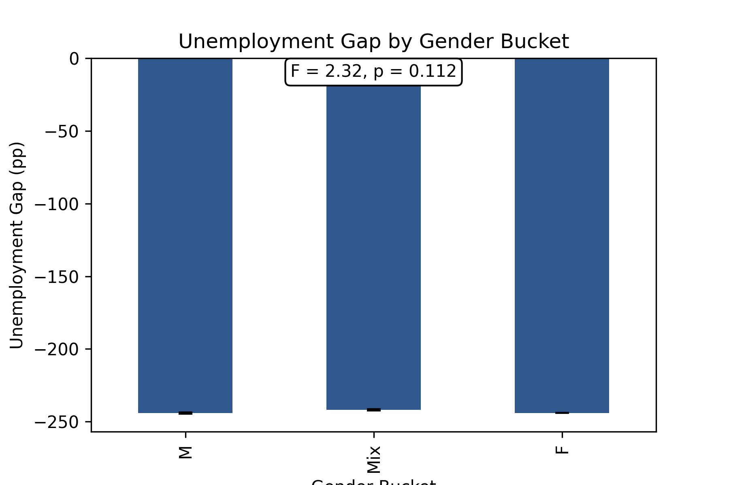
Figure 2 anova

Slide 3
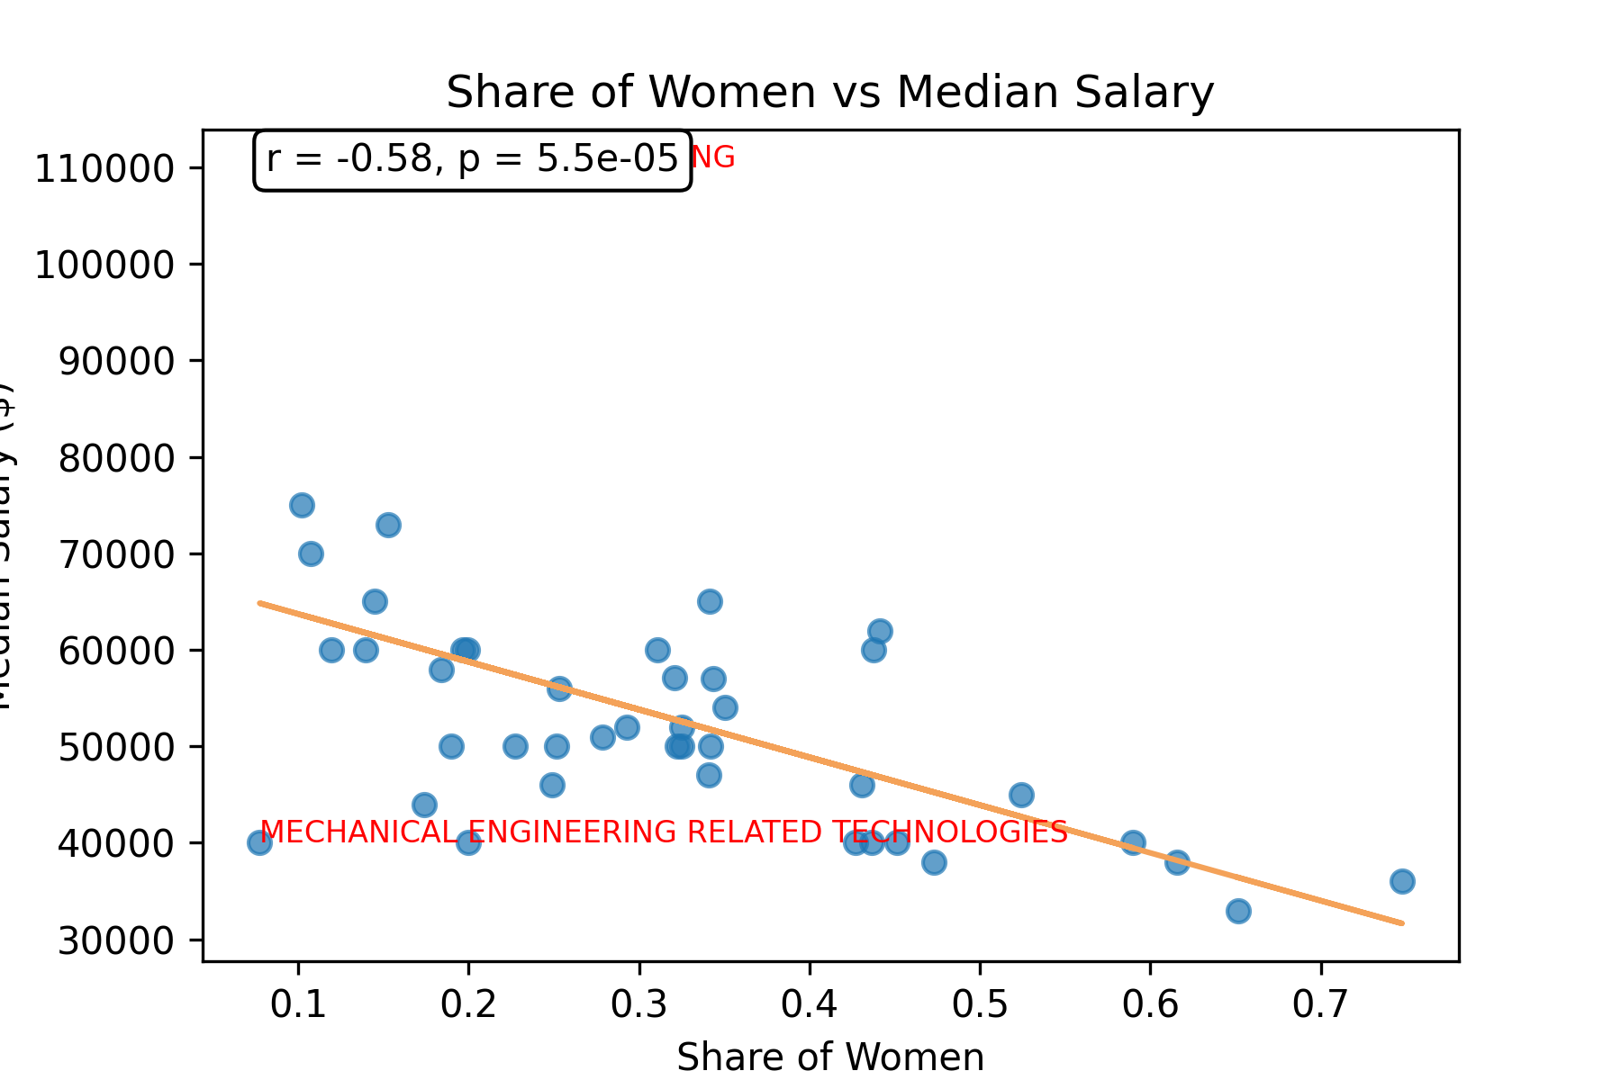
Figure 3 corr

Slide 4
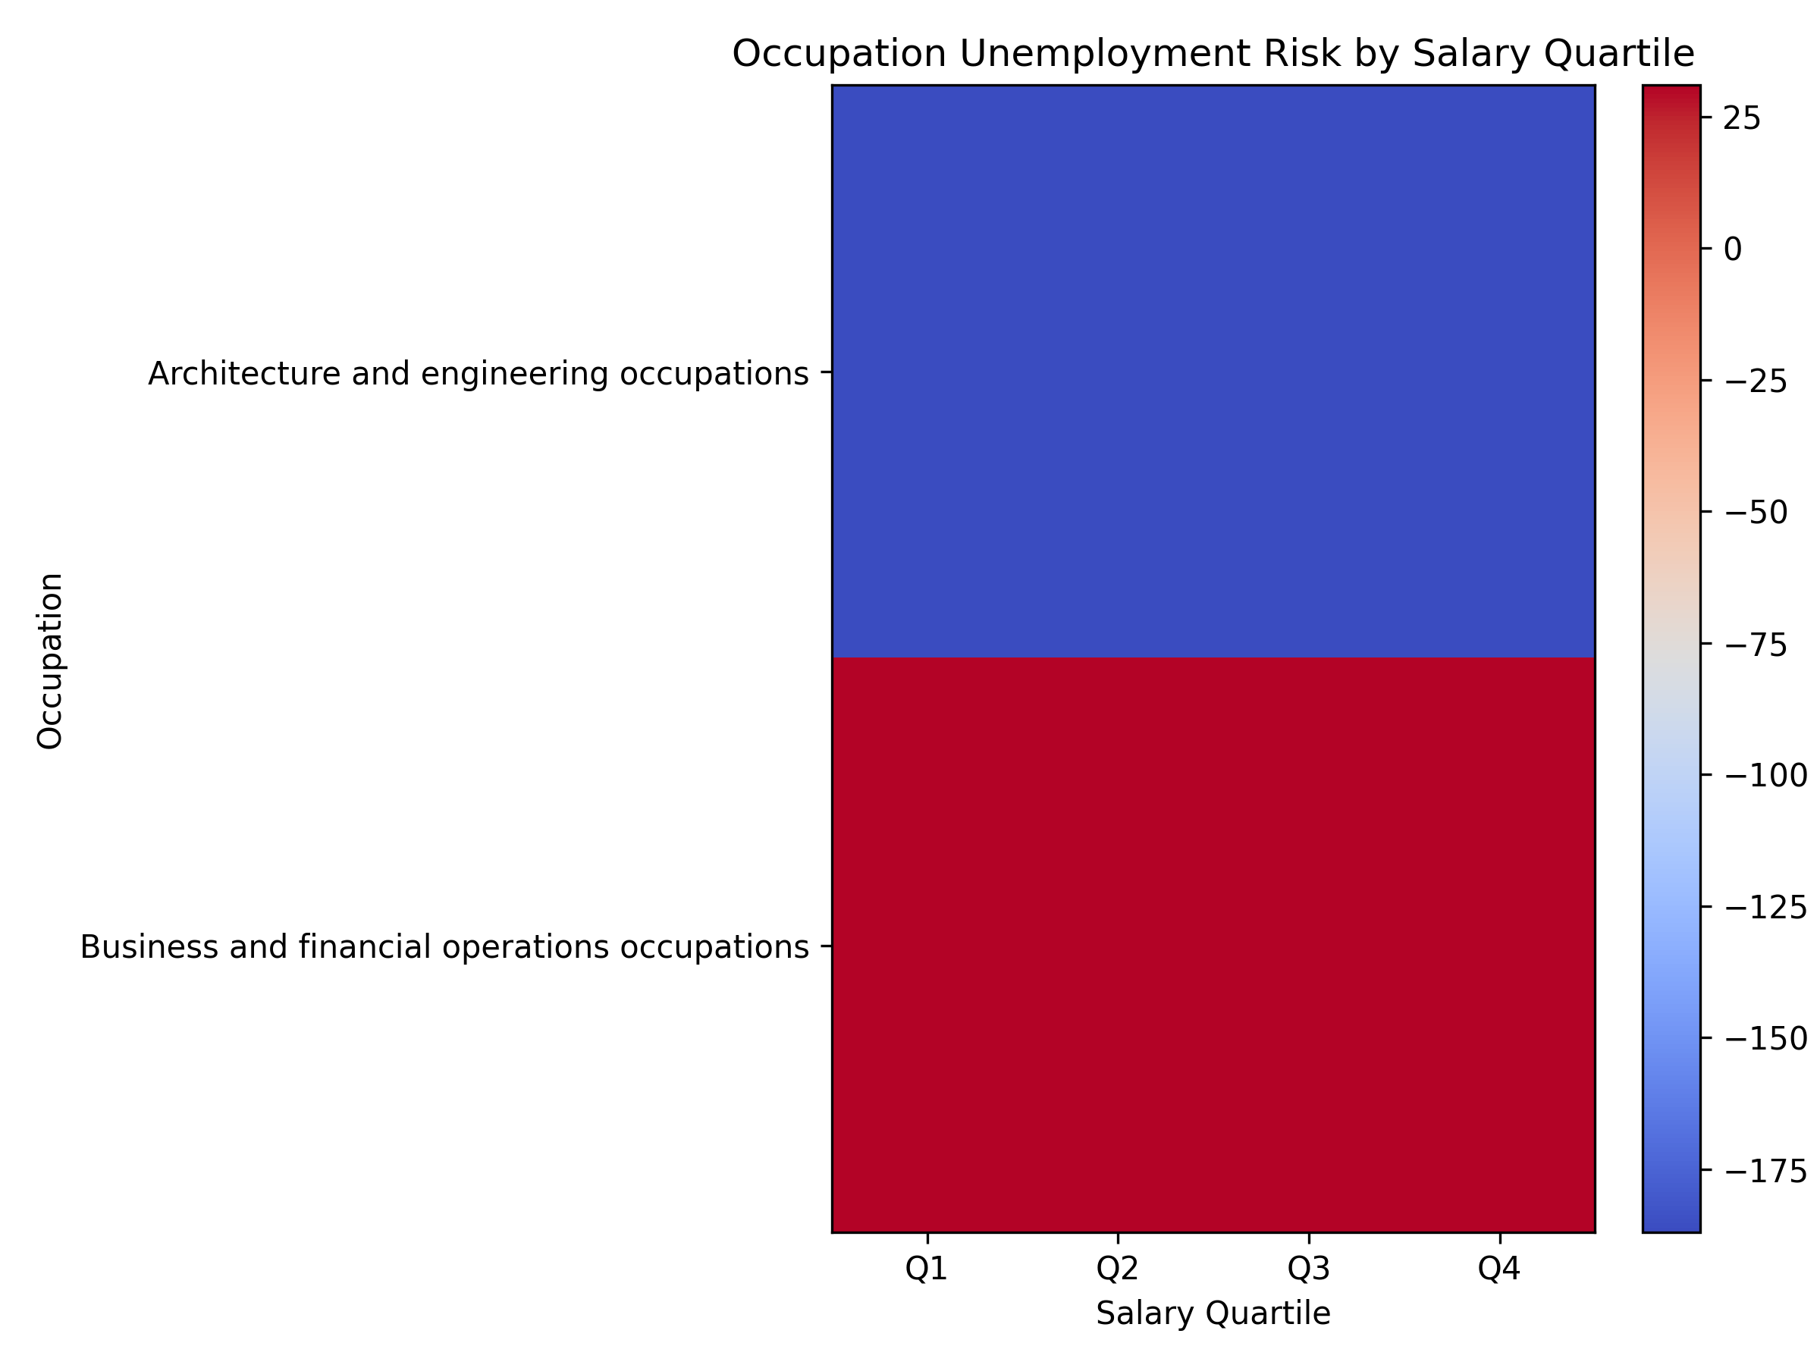
Figure 4 heatmap

Slide 5
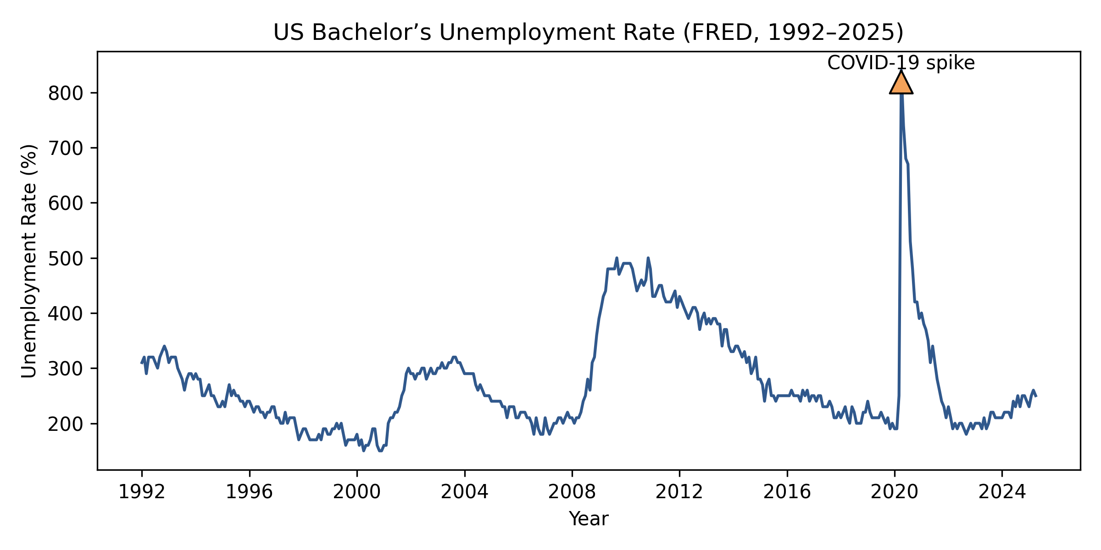
Figure 5 timeseries

