Slide 1
Appendix A
The Order Fulfillment Process Model
Marcello La Rosa
Stephan Clemens
Arthur ter Hofstede

Slide 2
Overview
Process domain
Organizational model
Process nets
Conclusions
Notes:
A number of YAWL features will be showcased through the various process nets

Slide 3
Process domain
Inspired by the VICS industry standard (Voluntary Inter-industry Commerce Solutions: www.vics.org)
Logistics domain: this reference model can be used by large organizations that need to interact with suppliers and logistics providers
Goal: emit a purchase order and deliver the order items to the customer

Slide 4
Organizational model
Fictitious organization “Genko Oil company”, featuring four departments:
  Order Management Department
  Supply Department including Warehouse
  Carrier Department
  Finance Department.

Slide 5
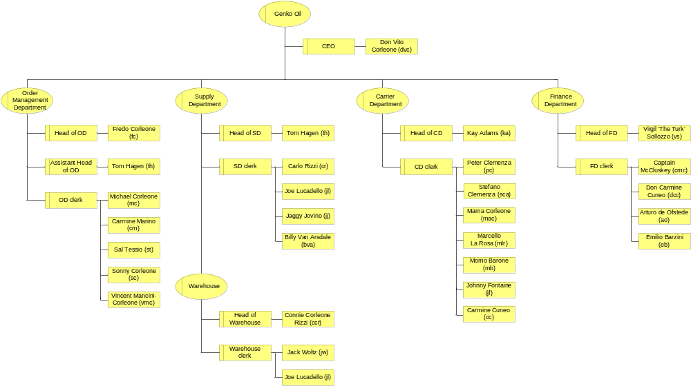
Process participants

Slide 6
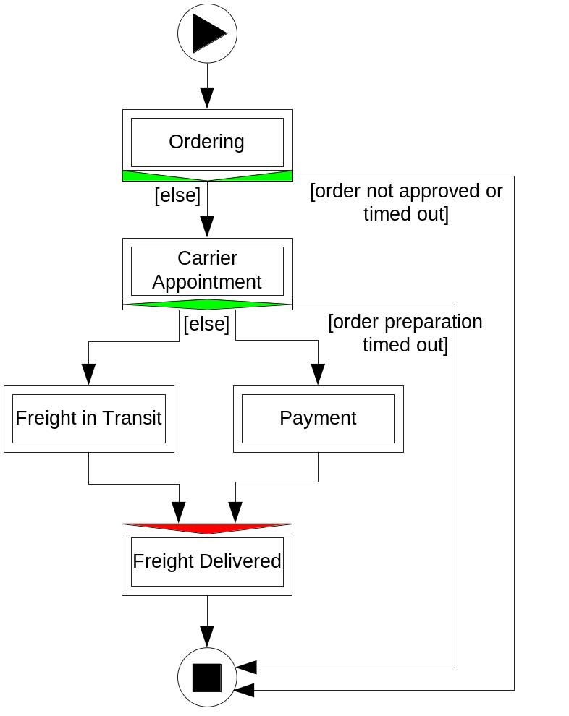
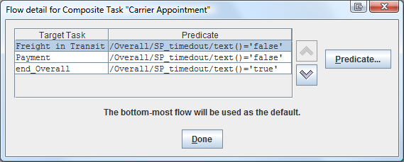
Overall net
Three main phases:
Ordering
Logistics, including:
  Carrier Appointment
  Freight in Transit
  Freight Delivered
Payment
Each (sub-)phase is captured
by a YAWL composite task.
possible deadlock:
avoided by the
Flow Predicates

Slide 7
Assumptions
In order to keep the model manageable, the following simplifying assumptions were made:
an order does not lead to more than one shipment
orders from different clients may be combined into a single shipment
a single package only occupies a fraction of a truck and can correspond to one of a fixed number of sizes

Slide 8
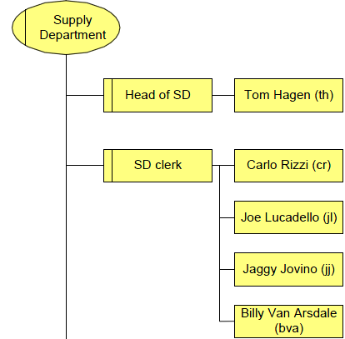
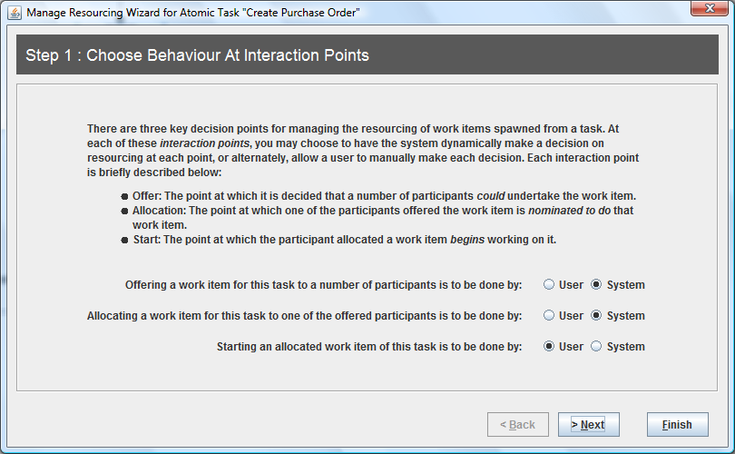
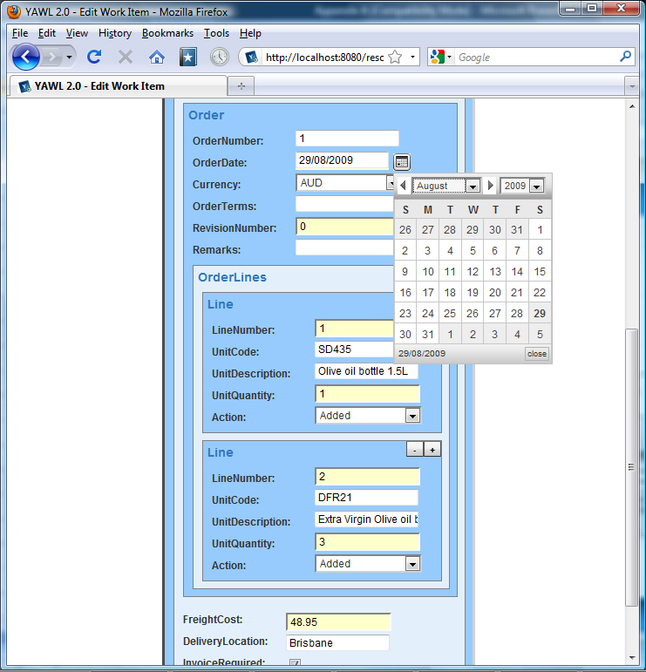
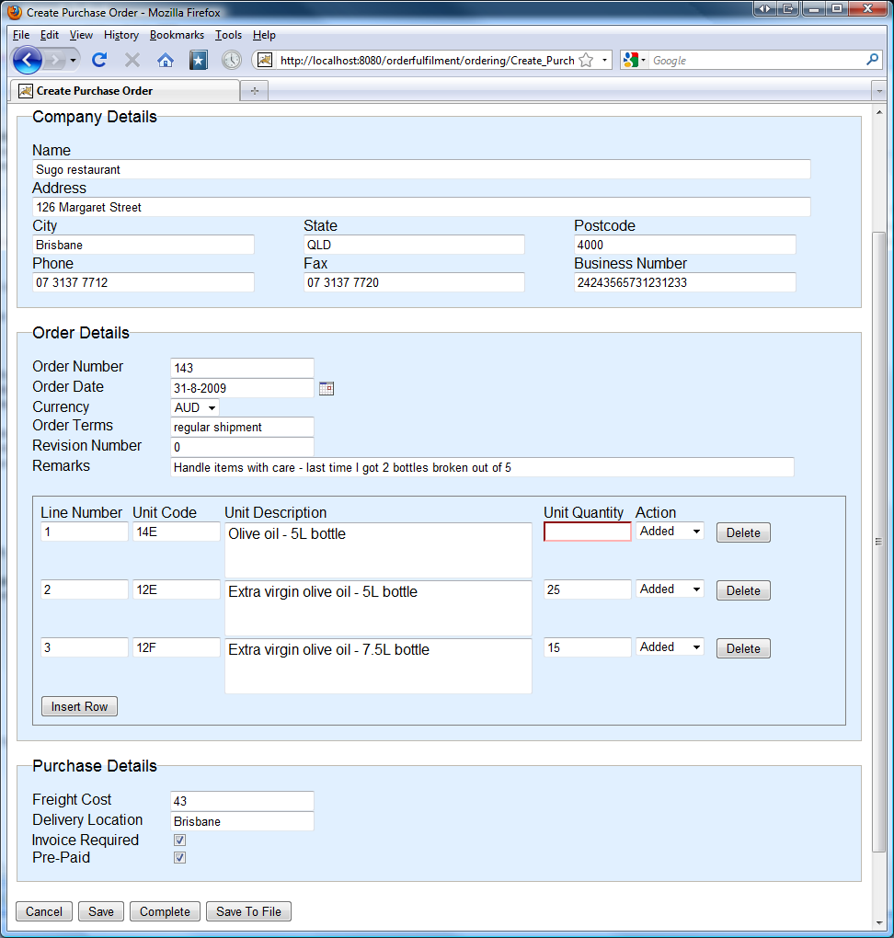
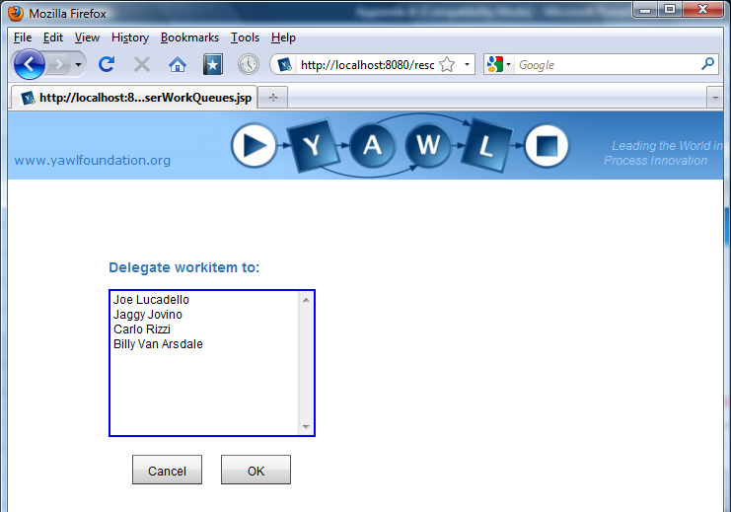
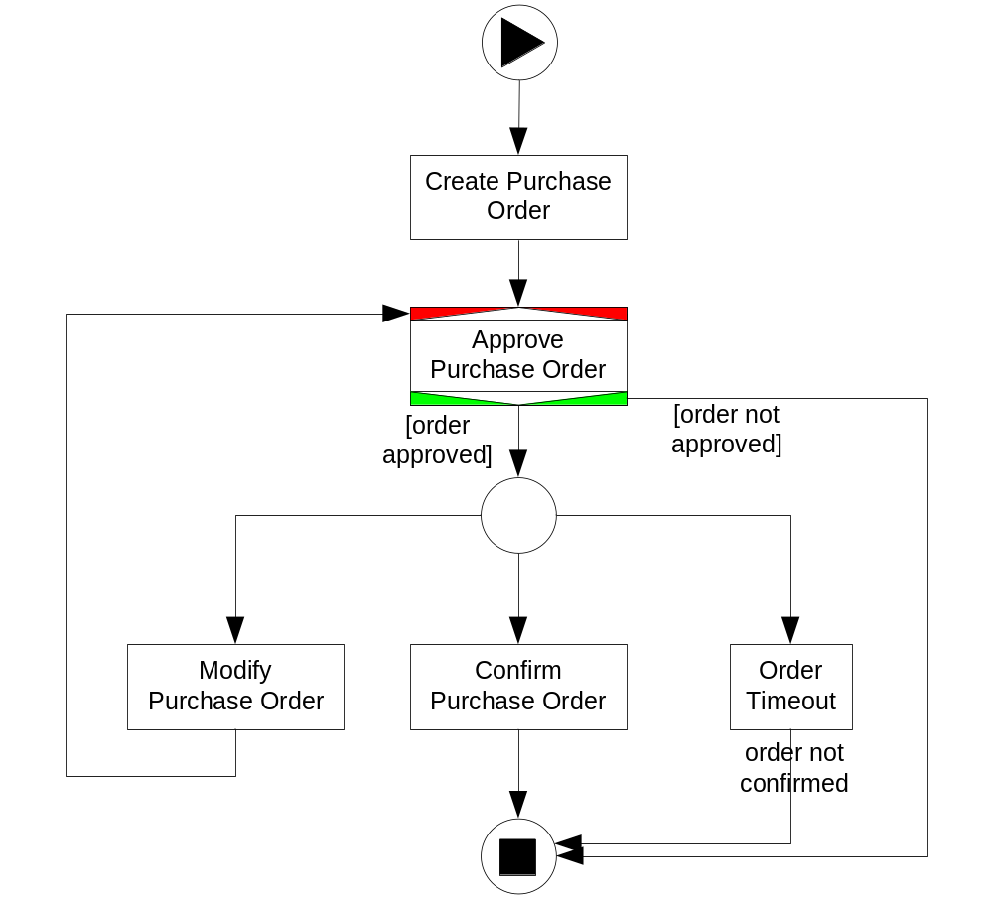
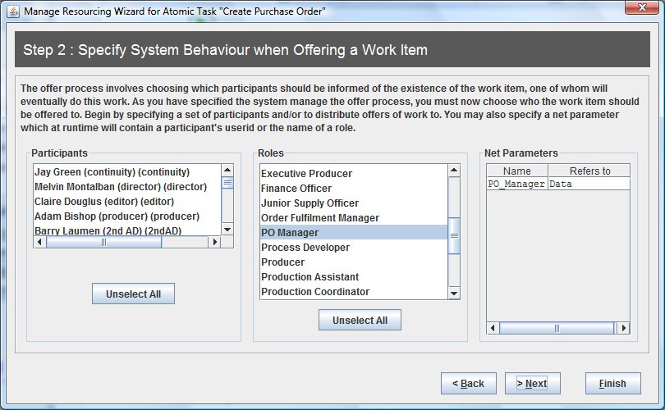

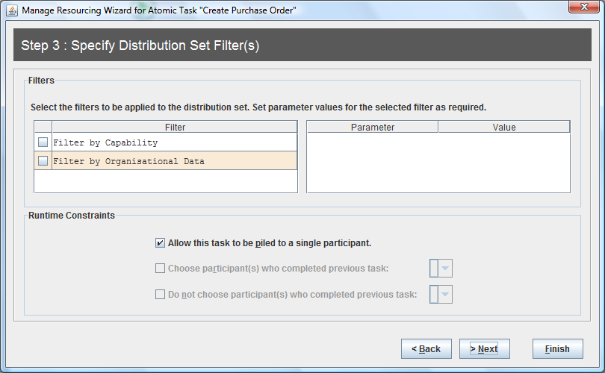
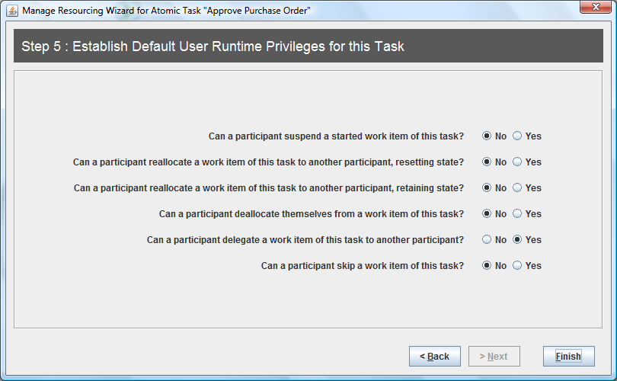
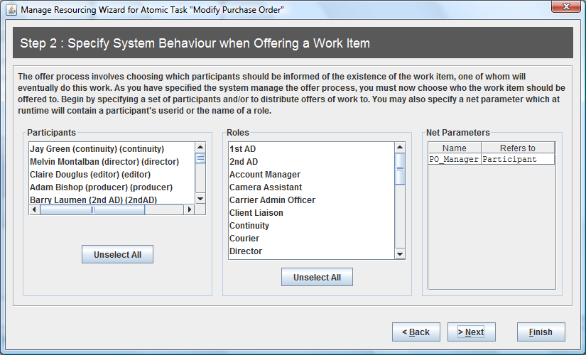
Ordering subnet
Deals with the creation, modification and approval of a Purchase Order.
Modification and final confirmation of the Purchase Order can be done within a given timeframe (3 days).
deferred allocation
runtime filter: Pile task
to single participant
delegation
JavaFaces form
custom form

Slide 9
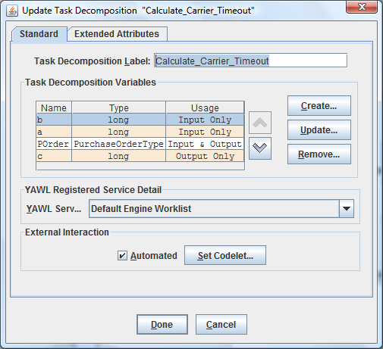
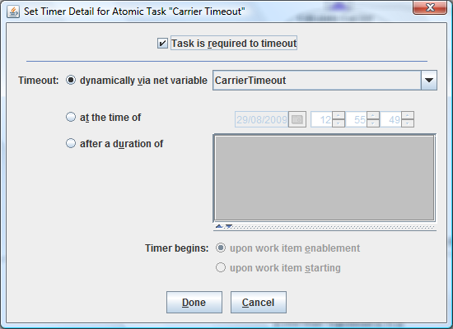
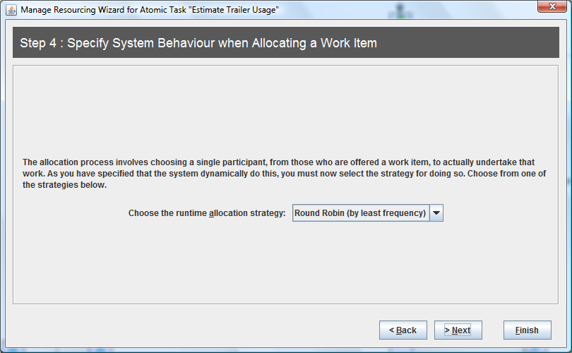
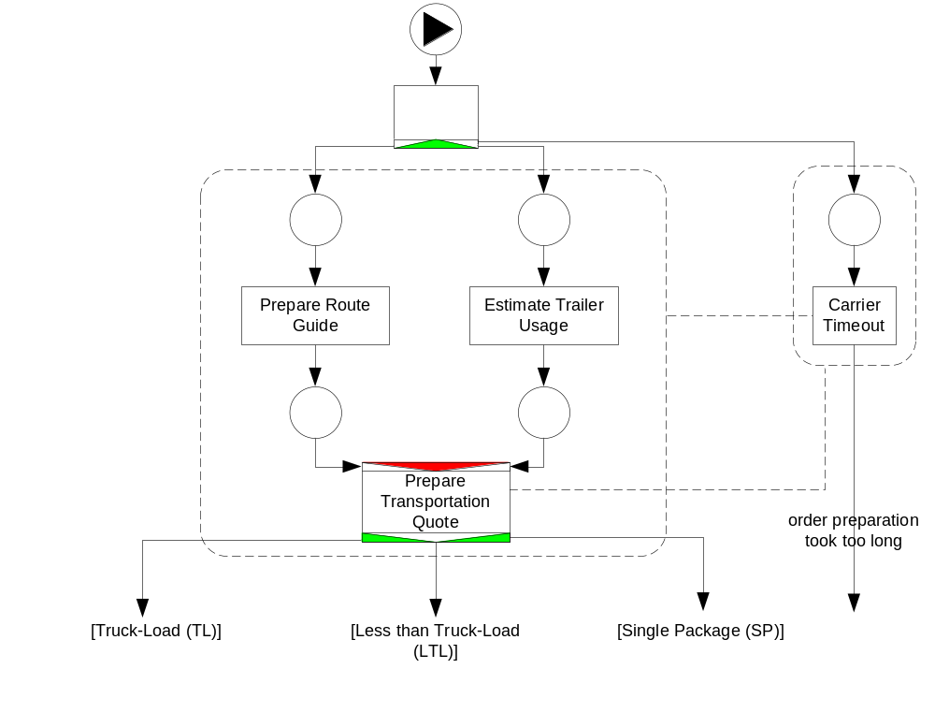

Carrier Appointment subnet (fragment)
Deals with:
preparation of Route Guide
estimation of Trailer Usage
(within 5 days)
Transportation Quote
arrangement of Delivery
and Pickup Appointments
(not shown)
Shipment Notice
(not shown)
Automated task
Dynamically set
Timeout (on starting)
Allocation strategy:
Round Robin
by least frequency
3 types of carrier usage: TL, LTL, SP
determine different shipment costs

Slide 10
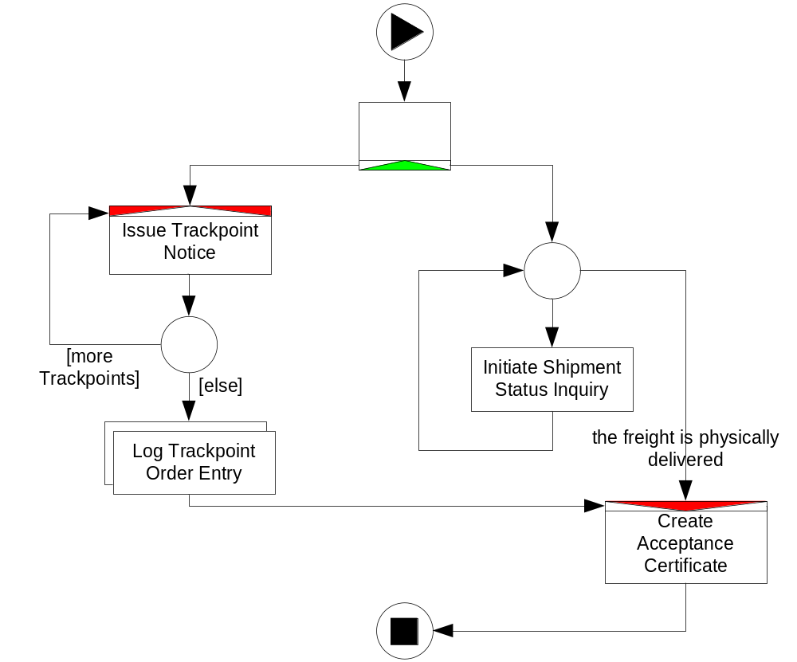
Freight in Transit subnet
Starts after the freight
has been picked up and
shipped
Concerned with:
tracking the order
delivery progress
handling client inquiries
MI task: one instance
for each order entry

Slide 11
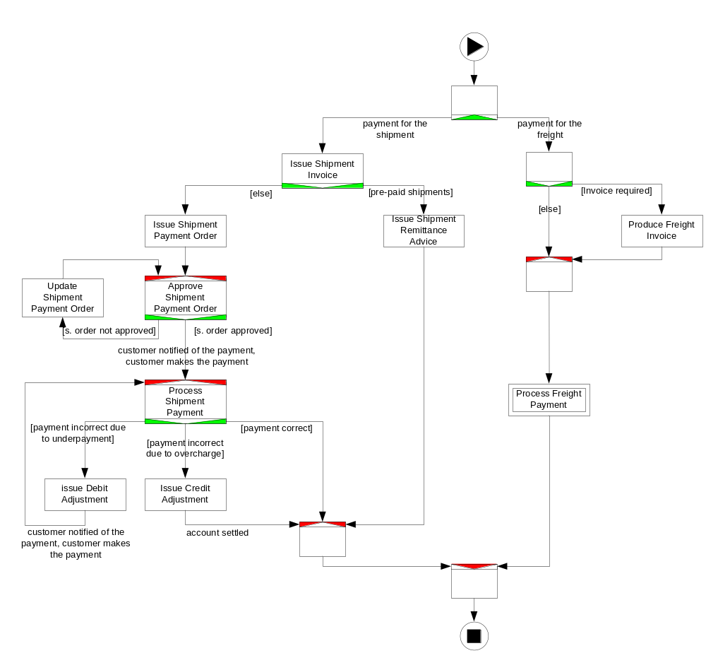
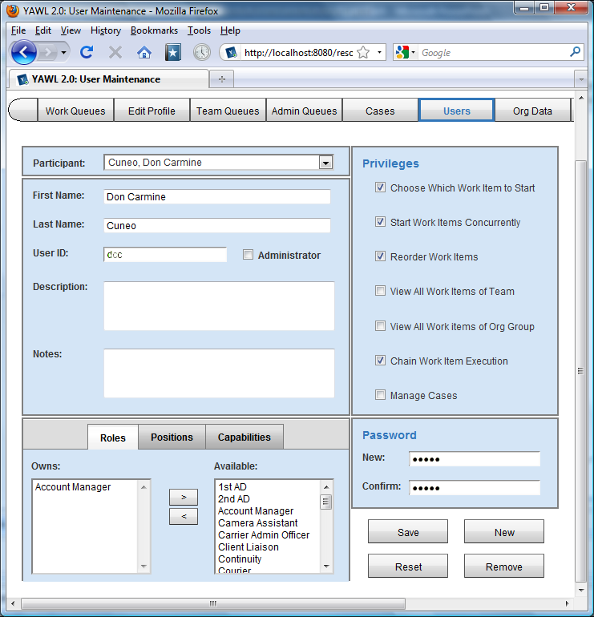
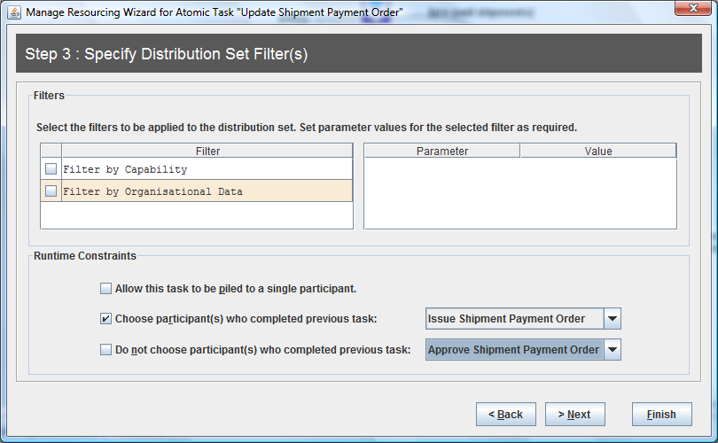
Payment subnet
In parallel to Freight in Transit
Two components:
shipment payment
  pre-paid
  non pre-paid
freight payment
Retain
familiar
Privileges:
Chain execution
of work items for
Account Manager
Notes:
Any participant with role of Account Manager has the privilege to chain the execution of work items assigned to them. In this way an Account Manager can have tasks Issue Debit Adjustment and Issue Credit Adjustment of sub-process Payment immediately started for them upon completion of task Process Shipment Payment.

Slide 12
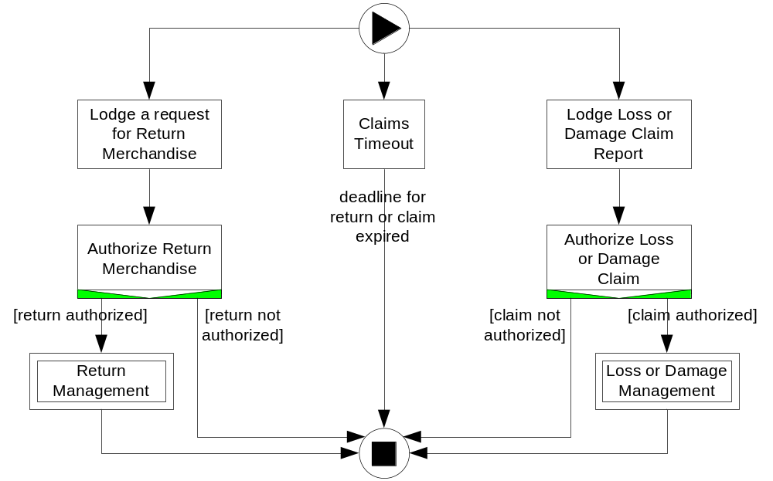
Freight Delivered subnet
After the freight has been delivered
Allows clients to:
request a Return
of Merchandise
lodge a Loss or
Damage Claim
within a timeframe
(specified in the
Shipment Notice)
Dynamically set
Timeout (on enablement)

Slide 13
Conclusions
Complex process inspired by a real industry standard
Exploits a number of advanced YAWL functionalities for defining the process control-flow, data and resource perspectives
Specification files and documentation available in each YAWL distribution, under folder ‘[YAWL Installation folder]/misc/examples/orderfulfillment/’

