Slide 1
Chapter 1
Introduction
Wil van der Aalst
Michael Adams
Arthur ter Hofstede
Nick Russell

Slide 2
Business Process Management (BPM)
BPM views processes as central in an organization
Potential for substantial cost & time savings (e.g. business process improvement)
Managerial and technical ramifications

Slide 3
Business Process Automation
In order to fully capitalize on modeling efforts, process models should serve as the blueprint for subsequent automated support
Process automation (through a BPMS) offers a number of benefits:
  Adherence to the process model (compliance)
  Explicit representation of control-flow
    Process model changes do not require low-level coding efforts
  Explicit representation of resource involvement
    Work can directly be routed to the right resources
    Aspects such as workload and work history can be taken into account in work assignment
  Coupling of processes and data assists with data accuracy
  Monitoring support
    Identification and resolution of bottlenecks
  Post-execution analysis (process mining)
    Identification of opportunities for process improvement

Slide 4
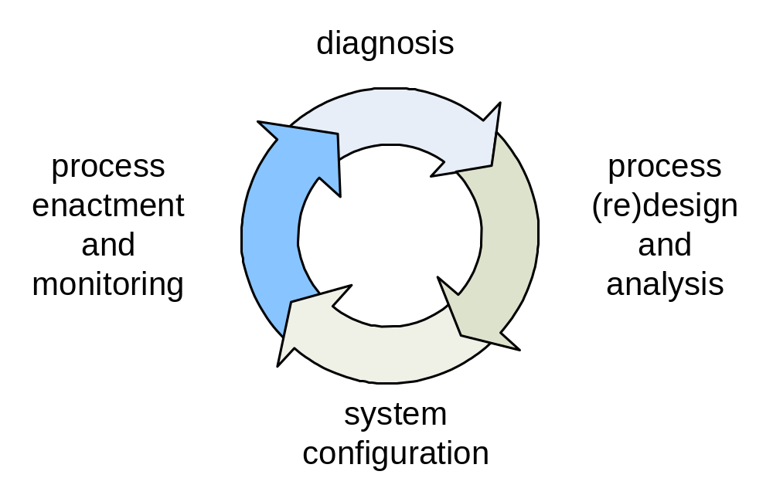
BPM Life-Cycle

Slide 5
Business Process Automation
No consensus has been reached irt to describing executable business processes
Main causes:
  Complexity of business processes
  Failure of standardization efforts

Slide 6
On the Role of Models
Insight
Analysis
  Performance
  Verification
Enactment

Slide 7
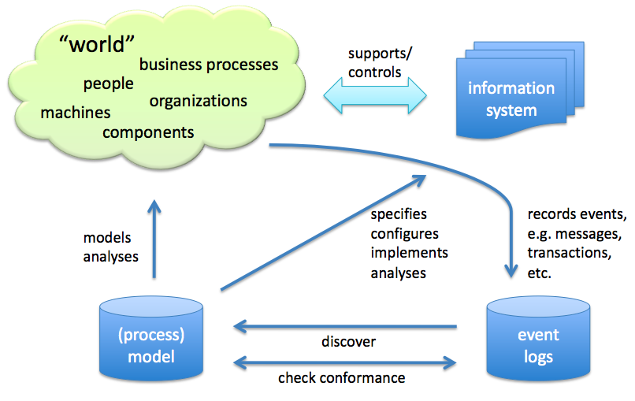
On the Role of Models

Slide 8
BPM Standard Approaches
XPDL 1.0
  WfMC (nineties)
  Aimed to support interoperability
  Minimalistic
  Not well defined
BPEL
  Merger of IBM’s WSFL and Microsoft’s XLANG
  Largely, though not fully, block-structured
  More powerful than predecessors
  No support for involvement of human resources
  No graphical representation (rather XML is used)

Slide 9
BPM Standard Approaches (cont’d)
BPMN (pre 2.0)
  Graphical front-end
  Not executable directly, transformation required
  Graph-structured rather than block-structured
    Mapping to BPEL not straightforward
  Fairly strong support for specification of control-flow dependencies
  Lacking sufficient support for involvement of human resources
  Not formally defined
XPDL 2.0
  XML serialization of BPMN

Slide 10
BPM Standard Approaches (cont’d)
Event-driven Process Chains (EPCs)
  A-W Scheer, early nineties
  Supported by ARIS environment
  Not a standard, though widely used (esp. Germany)
  Not very expressive
  Not executable
  Extensions exist for data and resources
  Formalized by Wil van der Aalst (1999), OR-join connector probematic though due to “vicious circles”

Slide 11
BPM Standard Approaches (cont’d)
UML Activity Diagrams
  OMG
  Version 1.4 based on state charts
  Version 2.0 inspired by Petri nets
    Concept of place missing though (hence difficult to represent certain scenarios)
    No direct mapping
    No simple and clear semantics
  Not intended for direct execution
  No OMG endorsed formalization
  Eclipsed by BPMN for business process specification

Slide 12
The Workflow Patterns Initiative
Joint initiative by Eindhoven University of Technology (the Netherlands) and Queensland University of Technology (Australia) started in 1999
Aims to address lack of commonly accepted foundation for workflow management
  WfMC’s proposal lacked precision and expressiveness
This foundation provides:
  Unbiased comparison of approaches to business process specification
  Basis for adaptation and refinement of such approaches
Emphasis on suitability rather than on expressive power
Patterns-based approach
  Technology independent
  Description, motivation, issues, solutions
  Three point evaluation scale

Slide 13
The Workflow Patterns Framework - Timeline
2000
2003
Jun 2005
Oct 2005
Sep 2006
time
Jun 2006
revised
Resource P:s - 43
Data P:s - 40
Control-flow P:s 43
Control-flow P:s 20
Exception P:s
N. Russell
W. van der Aalst
A. ter Hofstede
D. Edmond
N. Russell
A. ter Hofstede
W. van der Aalst
N. Mulyar
W. van der Aalst
A. ter Hofstede
B. Kiepuszewski
A. Barros
N. Russell
A. ter Hofstede
D. Edmond
W. van der Aalst
N. Russell
W. van der Aalst
A. ter Hofstede
Resource definition
& work distribution
in a process
Data representation
and handling in a
process
Exception handling
in a process
The ordering of
activities in a
process
- 23 new patterns
Formalised in
CPN notation
CoopIS’2000
DAPD’2003
CAiSE’2005
ER’2005
CAiSE’2006
TR
These perspectives follow S. Jablonski and C. Bussler’s classification from:
Workflow Management: Modeling Concepts, Architecture, and Implementation. International Thomson Computer Press, 1996
www.workflowpatterns.com

Slide 14

The Workflow Patterns Framework - Timeline
time
2000
2003
Jun 2005
Oct 2005
Jun 2006
Sep 2006
revised
Control-flow P:s 20
Resource P:s - 43
Data P:s - 40
Exception P:s
Control-flow P:s 43
COSA
FLOWer
Eastman
Meteor
Mobile
I-Flow
Staffware
InConcert
Eva
l
ua
t
I
on
s
Domino Workflow
Visual Workflow
Forte Conductor
MQSeries/Workflow
SAR R/3 Workflow Verve Workflow
Changengine
Staffware
WebSphere MQ
FLOWer
COSA
iPlanet
Staffware
MQSeries
FLOWer
COSA
Staffware
WebSphere MQ
FLOWer
COSA
iPlanet
Staffware
WebSphere MQ
WebSphere I.D.
FLOWer
COSA
iPlanet
SAP
Filenet
Oracle BPEL
XPDL, BPEL4WS, BPML,
WSFL, XLANG, WSCI,
UML AD 1.4 UML AD 2.0, BPMN
BPEL4WS
UML AD 2.0
BPMN
XPDL, BPEL4WS
UML AD 2.0, BPMN
XPDL 2.0,
BPEL4WS 1.1, BPMN
BPEL4WS, XPDL 2.0,
UML AD 2.0
BPMN, EPC (ARIS)
L a n g u a g e D e v e l o p m e n t: YAWL

Slide 15
Petri nets
Defined by Carl Adam Petri in the early sixties
Provide formal theory for concurrency
(Informal) Definition
  Bipartite graph consisting of places (represented by circles) and transitions (represented by bars or boxes)
  A marking assigns tokens to places
  A transition is enabled when all its input places contain at least one token
  An enabled transition can fire, which removes a token from each of its input places and produces a token for each of its output places
Their suitability for workflow specification was argued by Wil van der Aalst in the nineties:
  Graphical nature
  Direct support for the notion of state
  Existence of a variety of analysis techniques

Slide 16
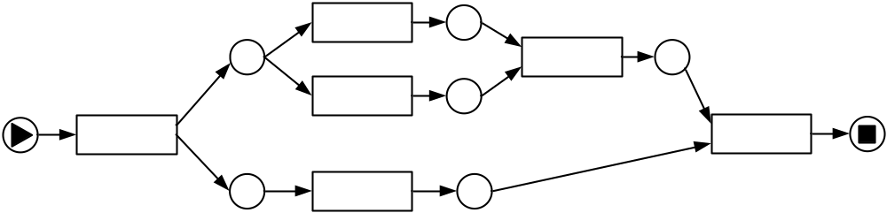
Petri nets: A Simple Example
Have Car Fixed
Settle Bill
Obtain Quote
Buy New Car
Lodge Final
Insurance Claim
Lodge Preliminary
Insurance Claim

Slide 17
Workflow nets
Defined by Wil van der Aalst in the mid nineties
(Informal) Definition:
  Petri net with unique input and unique output place
  All elements are on a path from the input place to the output place
Graphical abbreviations for XOR/AND splits and joins
Automated verification support provided by Woflan (Workflow Analyzer), ProM, WoPeD

Slide 18
Emergence of YAWL
Defined by Wil van der Aalst and Arthur ter Hofstede in 2002
Yet Another Workflow Language
Intention: to provide comprehensive support for the workflow patterns
Inspired by Workflow nets, but with direct support for
  Cancelation
  Multiple executions of the same task in the same process instance
  Synchronization of active paths only (OR-join)
Formal semantics
Reset nets useful for reasoning about YAWL nets
  Reset nets are Petri nets with a special reset arc
  A reset arc with source place p and target transition t removes all tokens from p upon firing t

Slide 19
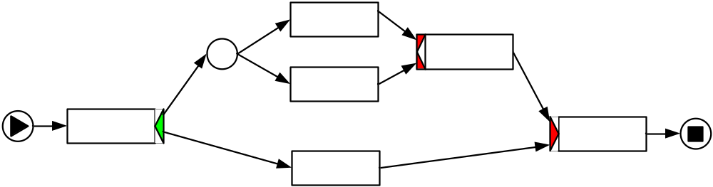
YAWL: A Simple Example
Have Car Fixed
Settle Bill
Obtain Quote
Buy New Car
Lodge Final
Insurance Claim
Lodge Preliminary
Insurance Claim

Slide 20
YAWL Support Environment
Development started in 2003
Build time
  Editor
Runtime
  Engine (control-flow and data)
  Resource Service (resources)
  ….
www.yawlfoundation.org

Slide 21
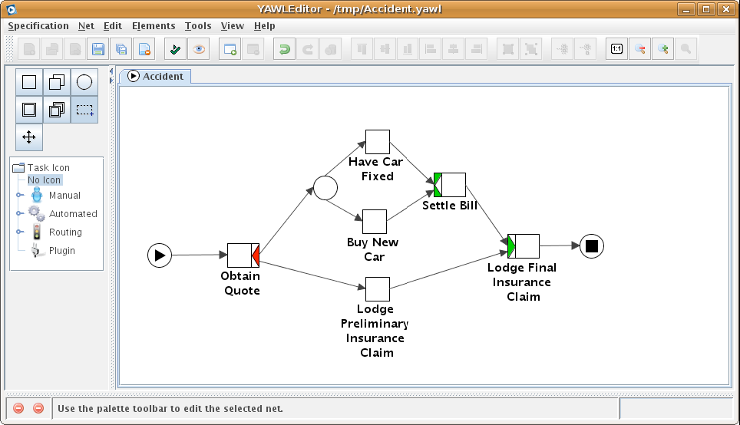
YAWL Editor Screen Shot

Slide 22
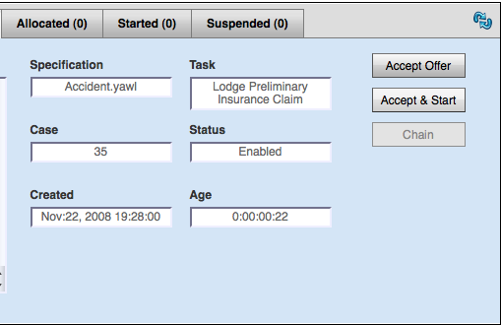
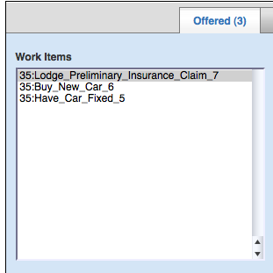
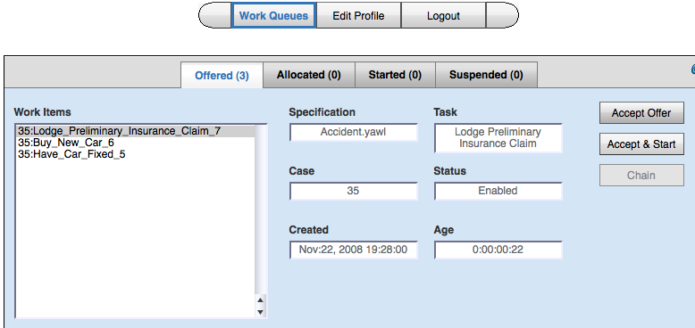
YAWL Engine – Worklist Screenshot

Slide 23
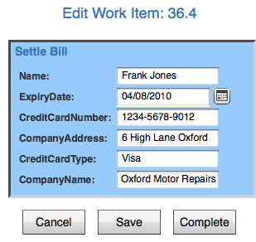
YAWL System – Sample Work Item

Slide 24
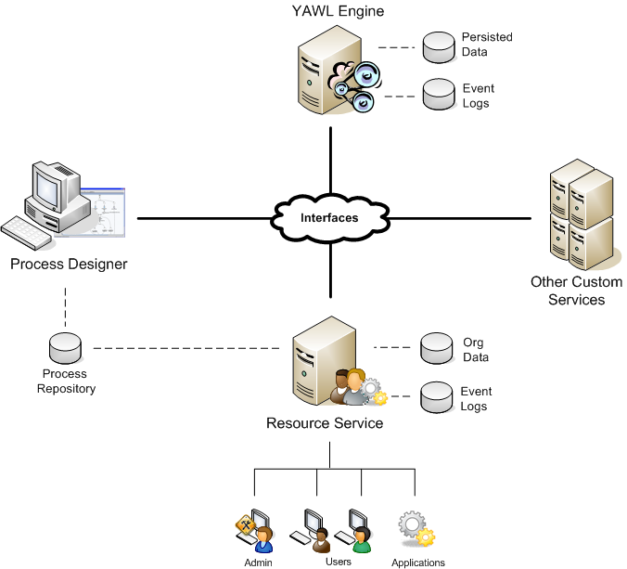
YAWL System – Simplified Architecture
Persisted Data
Event Log
YAWL Engine
Interfaces
Process Designer
Other Custom Services
Org Data
Event Logs
Process
Repository
Resource Service
Admin Users Applications

Slide 25
Positioning of YAWL
Comprehensive approach for the Workflow Patterns
  Not through a “construct-per-pattern” approach as in BPMN
  Original control-flow patterns, resource patterns, and exception handling patterns
Formal semantics
  Original definition of YAWL: state-transition system
  Latest definition: CPN (Colored Petri nets) interpreter
  This removes ambiguity and provides opportunities for verification
Sophisticated flexibility support
  Exceptions
  Dynamic workflow
  Declarative workflow

Slide 26
Positioning of YAWL environment
Support environment is open source
  Currently LGPL
  No acquisition costs
  Avoids vendor lock-in
Service-oriented architecture
  Facilitates integration with other systems and extensions
Link with ProM (Process Mining) environment
  Log analysis
  Simulation based on current state
Benefits of BPMN can be leveraged
  YAWL supports arbitrary cycles (in contrast to BPEL)
  BPMN2YAWL plugin

Slide 27
Overview
Part II: Concepts
Part III: Flexibility and Change
Part IV: The Core System
Part V: Services
Part VI: Positioning
Part VII: Advanced Topics
Part VIII: Case Studies
Part IX: Epilogue
Appendix A: Order Fulfilment Example
www.yawlbook.com

Slide 28
Credits and References
Thanks for Petia Wohed for creating the slides showing the history of the Workflow Patterns initiative
W.M.P. van der Aalst. Three good reasons for using a Petri-net-based workﬂow management system. In S. Navathe and T. Wakayama, editors, Proceedings of the International Working Conference on Information and Process Integration in Enterprises (IPIC’96), pages 179–201, Cambridge, Massachusetts, USA, November 1996.
W.M.P. van der Aalst. The application of Petri nets to workﬂow management. The Journal of Circuits, Systems and Computers, 8(1):21–66, 1998.
W.M.P. van der Aalst. Formalization and veriﬁcation of Event-driven Process Chains. Information and Software Technology, 41(10):639–650, 1999.

Slide 29
References (cont’d)
W.M.P. van der Aalst, L. Aldred, M. Dumas, and A.H.M. ter Hofstede. Design and Implementation of the YAWL System. In Proceedings of the 16th International Conference on Advanced Information Systems (CAiSE'2004), Riga, Latvia, June 2004. Springer Verlag.
W.M.P. van der Aalst and A.H.M. ter Hofstede. Workflow Patterns: On the Expressive Power of (Petri-net-based) Workflow Languages (Invited Talk). In K. Jensen, editor, Proceedings of the Fourth Workshop on the Practical Use of Coloured Petri Nets and CPN Tools (CPN 2002), volume 560 of DAIMI, pages 1-20, Aarhus, Denmark, August 2002.
W.M.P. van der Aalst and A.H.M. ter Hofstede. YAWL: Yet Another Workflow Language, Information Systems 30(4):245-275, 2005.
W.M.P van der Aalst, A.H.M. ter Hofstede, B. Kiepuszewski, and A.P. Barros. Workflow Patterns. Distributed and Parallel Databases, 14(3), pages 5-51, July 2003.

Slide 30
References (cont’d)
Nick Russell. Foundations of Process-Aware Information Systems. PhD Thesis, Queensland University of Technology, Brisbane, Australia, 2007.
N. Russell, W.M.P. van der Aalst, and A.H.M. ter Hofstede. Workflow Exception Patterns. In E. Dubois and K. Pohl, editors, Proceedings of the 18th International Conference on Advanced Information Systems Engineering (CAiSE 06), volume 4001 of Lecture Notes in Computer Science, pages 288-302. Springer-Verlag, Berlin, 2006.
N. Russell, W.M.P. van der Aalst, A.H.M. ter Hofstede, and D. Edmond. Workflow Resource Patterns: Identification, Representation and Tool Support. In O. Pastor and J. Falcao e Cunha, editors, Proceedings of the 17th Conference on Advanced Information Systems Engineering (CAiSE'05), volume 3520 of Lecture Notes in Computer Science, pages 216-232. Springer-Verlag, Berlin, 2005.
Nick Russell and A.H.M. ter Hofstede. Surmounting BPM Challenges: The YAWL Story. Special issue of Computer Science - Research and Development on Flexible Process-aware Information Systems 23(2):67-79, May 2009.

Slide 31
References (cont’d)
Nick Russell and A.H.M. ter Hofstede. newYAWL: Towards Workflow 2.0. In K. Jensen and W. van der Aalst, editors, Special issue of LNCS Transactions on Petri Nets and Other Models of Concurrency (ToPNoC) II on Concurrency in Process-Aware Information Systems, volume 5460 of Lecture Notes in Computer Science, pages 79-97, 2009.
Nick Russell, Arthur H.M. ter Hofstede, and Wil M.P. van der Aalst. newYAWL: Specifying a Workflow Reference Language using Coloured Petri Nets. Eighth Workshop and Tutorial on Practical Use of Coloured Petri Nets and the CPN Tools, Aarhus, Denmark, October 2007.
N. Russell, A.H.M. ter Hofstede, W.M.P. van der Aalst, and N. Mulyar. Workflow Control-Flow Patterns: A Revised View. BPM Center Report BPM-06-22 , BPMcenter.org, 2006.
N. Russell, A.H.M. ter Hofstede, D. Edmond, and W.M.P. van der Aalst. Workflow Data Patterns: Identification, Representation and Tool Support. In L. Delcambre et al., editors, Proceedings of the 24th International Conference on Conceptual Modeling (ER 2005), volume 3716 of Lecture Notes in Computer Science, pages 353-368. Springer-Verlag, Berlin, 2005.

Slide 32
References (cont’d)
J.L. Peterson. Petri Net Theory and the Modelling of Systems. Prentice-Hall, Upper Saddle River, New Jersey, USA, 1981.
C.A. Petri. Kommunikation mit Automaten. PhD thesis, Institut für instrumentelle Mathematik, Bonn, Germany, 1962.
W. Reisig. Petri Nets, An Introduction. EATCS, Monographs on Theoretical Computer Science. Springer, Berlin, Germany, 1985.

