Slide 1
Chapter 2
The Language: Rationale and Fundamentals
(Part I)
Nick Russell
Arthur ter Hofstede

Slide 2
Acknowledgement
The slides for Chapter 2 (parts I-V) use slides prepared by or inspired by slides of the following people:
  Wil van der Aalst, TUE & QUT
  Michael Adams, QUT
  Lachlan Aldred, QUT
  Bartek Kiepuszewski, Moreton, BMS, Cutter Consortium
  Marcello La Rosa, QUT
  Petia Wohed, SU/KTH
  Moe Wynn, QUT

Slide 3
Overview
Fundamental theory
Introduction to BPM
Patterns
  Control-flow
Control-flow specification in YAWL
Pattern (cont’d)
  Data (incl how realised in YAWL)
  Resources (incl how realised in YAWL)
Syntax of YAWL (ORM and set theory)
Example: Order fulfillment

Slide 4
Part I: Fundamentals
Overview:
  Petri nets
  Mapping workflow concepts to Petri nets
  Some fundamental results
  Workflow nets
  Reset nets
  Coloured Petri Nets

Slide 5
Petri Nets
Originate from C.A. Petri’s PhD thesis (1962)
Technique for the description and analysis of concurrent systems
Graphical notation
Formal
Based on a few simple concepts, yet expressive
Many analysis techniques exist
Many extensions and variants have been defined over the years

Slide 6
Applications
Applications in many different areas, such as databases, software engineering, formal semantics, etc etc
There are two main uses of Petri nets for workflows:
  Specifications of workflows
  Formal foundation for workflows (semantics, analysis of properties)

Slide 7
Petri Nets: Definition
Petri Nets consist of places and transitions
Places can be input/output of transitions
Places represent states, transitions represent state changes
Places are represented by circles, transitions by thick bars
Formally a Petri net N is a triple (P, T, F) where
  P is a finite set of places
  T is a finite set of transitions
  F ⊆ (P x T ∪ T x P) is the flow relation
p • = {t ∈ T | (p, t) ∈ F}, • p = {t ∈ T | (t, p) ∈ F}, etc

Slide 8
Petri nets: graphical symbols
place
transition
arc

Slide 9
Petri Net: Example
t1
p1
p3
t2
p4
p2
t3
P = {p₁, p₂, p₃, p₄}
T = {t₁, t₂, t₃}
F = {(p₁, t₁), (p₂, t₁), (t₁, p₃), (p₂, t₂), (t₂, p₄), (p₄, t₃), (t₃,p₂)}
t₁ • = {p₃}; • t₁ = {p₁, p₂}; • p₂ = {t₃}; • p₁ = ∅; p₂ • = {t₁, t₂}

Slide 10
Petri Nets: Example
p1
p2
t2
p3
t3
t1
P = ...
T = …
F = ...
t₁ • = … ; • t₁ = … ; • p₂ = … ; p₂ • = ...

Slide 11
Markings
Markings assign tokens (graphically represented as black dots) to places; they represent a state of the system.
Formally, a marking M of a Petri net N = (P,T,F) is a function M: P -> NAT.
The marking below is formally captured by {(p₁,1),(p₂,2),(p₃,0)}. We will also denote this as p₁+2p₂.
Within Petri net N = (P,T,F) and markings M and M′, M ≥ M′ iff for all p in P: M(p) ≥ M′(p). M > M′ iff M ≥ M′ and M ≠ M′.
p1
p2
p3

Slide 12
Enabled Transitions
Transitions may change a marking by firing.
Only enabled transitions may fire.
Informally, a transition is enabled if each of its input places contains at least one token.
Formally, a transition t is enabled in a marking M iff for each p, with p ∈•t, M(p) > 0. (see definition 2.7 of [DE95])

Slide 13
Firing Transitions
In a marking, any enabled transition may fire, in which case a token is removed from each of its input places and a token is produced for each of its output places.
Formally, the marking M′ resulting from firing enabled transition t in marking M, notation M →^{t} M′, is defined by:
  M′(p) = M(p) if p ∉ •t ∪ t• or p ∈ •t ∩ t•
  M′(p) = M(p) - 1 if p ∈ •t and p ∉ t•
  M′(p) = M(p) + 1 if p ∈ t• and p ∉ •t
  (see e.g. [DE95] definition 2.7)
We write M → M′ iff M →^{t} M′ for some transition t. We write
M →^{σ} M′ iff M = M₀ →^{t0} M₁ →^{t1} M₂ … M_{n-1} →^{tn-1} M_{n} = M′ and
σ = t₀ t₁… t_{n-1}. Note that the transitions do not have to be different!
If σ does not matter we write M →* M′.

Slide 14
Firing a Transition: Example
BEFORE
AFTER

Slide 15
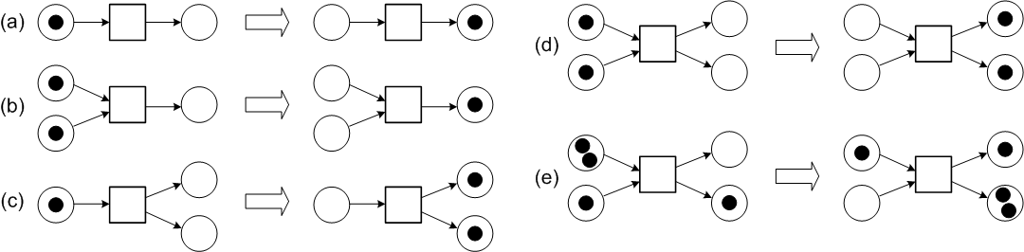
Firing Transitions: Further Examples

Slide 16
Petri nets: Concrete Example
(source [DE95] p. 4)
candy storage
ready for insertion
insert coin
refill
dispense
candy
reject coin
holding
coin
accept coin
request for refill
ready to dispense

Slide 17
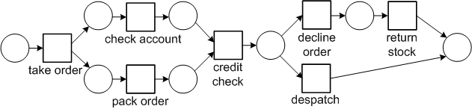
Petri nets: Order Fulfillment Example

Slide 18
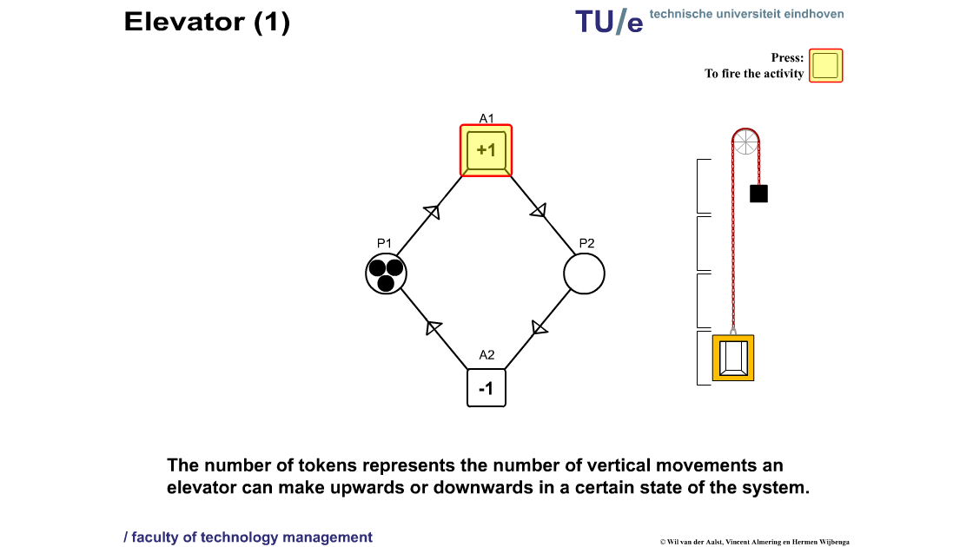
Petri net example: Elevator 1
Animation by Wil van der Aalst, Vincent Almering and Herman Wijbenga

Slide 19
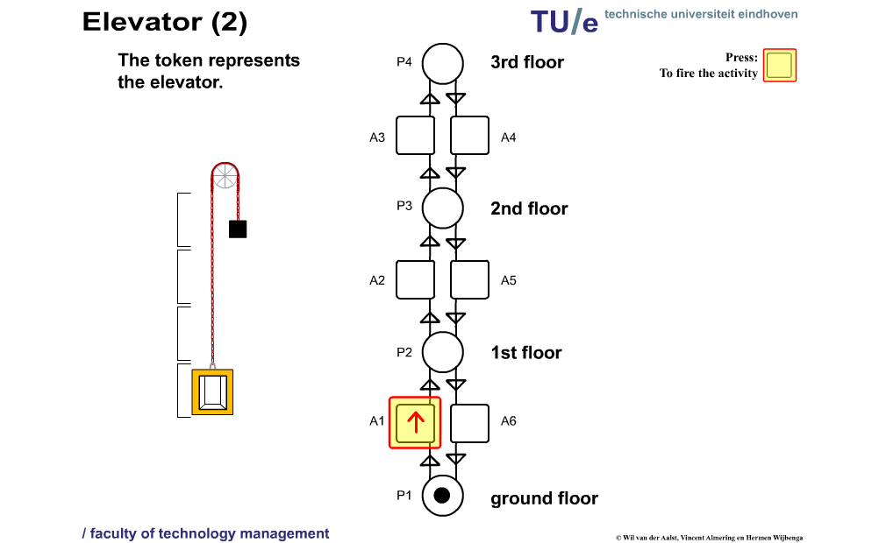
Petri net example: Elevator 2
Animation by Wil van der Aalst, Vincent Almering and Herman Wijbenga

Slide 20
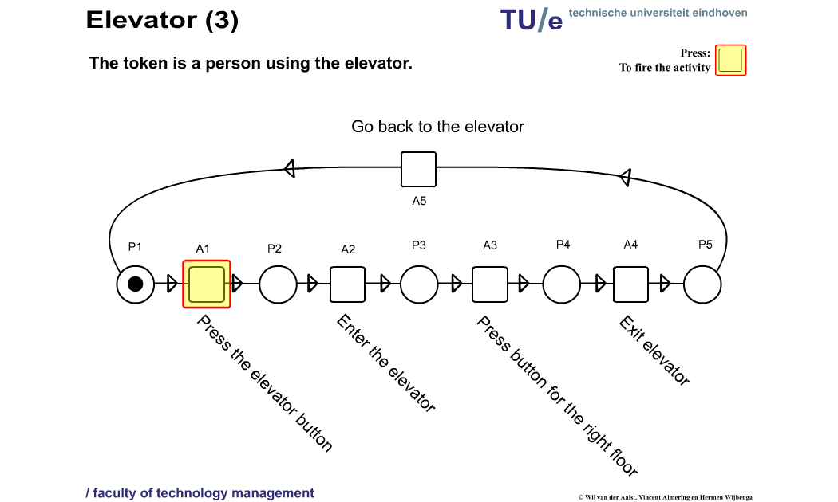
Petri net example: Elevator 3
Animation by Wil van der Aalst, Vincent Almering and Herman Wijbenga

Slide 21
Modelling Exercises
Two traffic lights at an intersection. If one is red, the other should be green etc. (many discussions on modelling traffic lights through Petri nets can be found on the internet)
A producer and a consumer producing and consuming (resp.) indefinitely. The consumer cannot consume more than the producer has produced thus far. How does your model change if the buffer between them is of limited size? (this is a well-known concurrency problem)
Two parallel processes with two critical sections. If one of the two processes is in its critical section, the other process should not be able to enter its critical section and vice versa. (this is also a well-known concurrency problem)

Slide 22
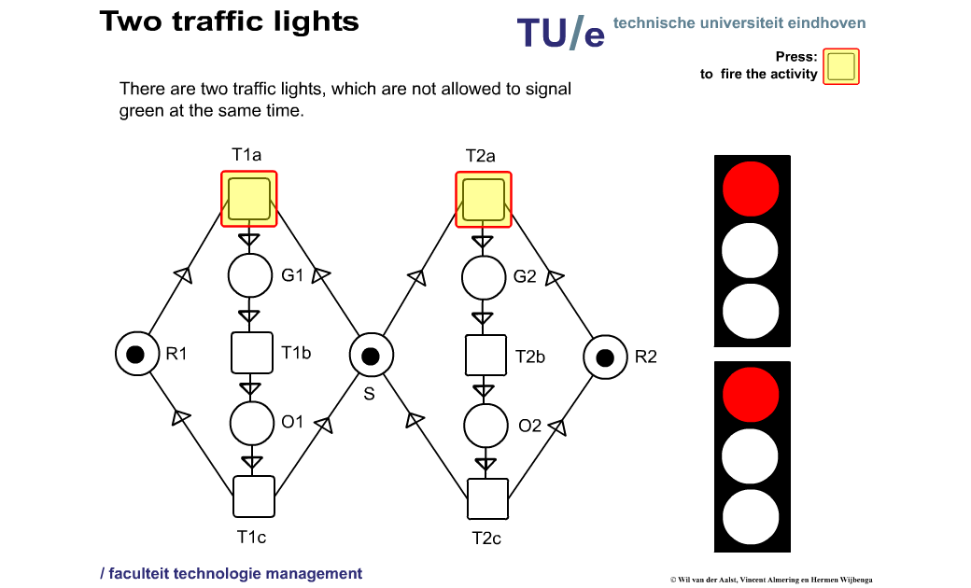
Solution Traffic Lights
Animation by Wil van der Aalst, Vincent Almering and Herman Wijbenga

Slide 23
Reachable and Coverable Markings
For a Petri net an initial marking M₀ needs to be specified.
A marking M is reachable iff it results from firing a number of transitions in the initial marking, i.e., M₀ →* M (see e.g. Definition 2.8 in [DE95]). We will denote the fact that a marking M′ is reachable from a marking M as M →* M′.
A marking M is coverable iff a reachable marking M′ exists such that M′ ≥ M (see e.g. Definition 5 in [HAAR09]).
Example: Given the Petri net and marking of the slide “Markings”, p1+p2+p3 is a reachable marking, while p1+p3 is a coverable marking (but not reachable).
To decide whether a given marking M is reachable is a DSPACE(exp)-hard problem. Only in the early eighties was an algorithm found, settling the question whether the problem was decidable at all.

Slide 24
Properties
A Petri net N with initial marking M₀ is live iff for every reachable marking M and every transition t there exists a marking M’ reachable from M which enables t. (see definition 2.16 of [DE95])
A Petri net N with initial marking M₀ is deadlock free iff every reachable marking enables some transition (see definition 2.16 of [DE95]). In a workflow context this definition is usually adapted a bit (see later), as one would not like to consider the empty marking to be a deadlock.
A Petri net N with initial marking M₀ is k-bounded iff for every reachable marking M, M(p) ≤ k (k is the minimal number for which this holds). (see definition 2.20 of [DE95]). A 1-bounded net is called safe. A net is bounded if a natural number k can be found such that the net is k-bounded.
A Petri net N is strongly connected iff for every pair of nodes x and y there is a path from x to y and vice versa.

Slide 25
Exercise
Is the vending machine live?
Is it deadlock free?
Is it bounded?
Can a marking be reached with tokens both in “ready for insertion” and “ready to dispense”?
Give an example of a marking that is coverable but not reachable.

Slide 26
Free Choice Petri nets
Many verification problems in Petri nets have a high complexity.
Free Choice Petri nets are a subclass of Petri nets with a “nice” tradeoff between expressiveness and analyzability (see e.g. [DE95]).
All elementary workflow concepts are essentially free choice.
In a Free Choice Petri net “the result of the choice between two transitions can never be influenced by the rest of the system” [DE95]

Slide 27
Example of a Conflict

Slide 28
Free Choice Petri nets: Definition
(see [DE95] p63-64)
In a Free Choice Petri net, every pair of transitions either share all their input places, or they share none.
Formally, a Petri net N = (P,T,F) is free choice iff for all transitions t,t’:
  •t ∩ •t’ ≠ ∅ ⇒ •t = •t’

Slide 29
Application of Petri nets:
Analysis of elementary workflow concepts
Now that we understand the basics of Petri nets we can use them in order to understand the semantics of elementary modeling concepts.
This will increase our understanding of control-flow concepts in workflows, both in terms of the semantics of the concepts and some fundamental expressiveness results.
This work is all based on [KHA03]:
  B. Kiepuszewski, A.H.M. ter Hofstede and W.M.P. van der Aalst. Fundamentals of Control Flow in Workflows. Acta Informatica 39(3):143-209, 2003.

Slide 30
Elementary Workflow Concepts
When it comes to control flow, almost all Workflow Management Systems (WFMSs) support elementary concepts such as sequence, and-split, or-split, and-join, and or-join.
The Workflow Management Coalition (WfMC) has given definitions of these notions (see sources and references). However, due to the informal nature of these definitions, different interpretations are possible.
In fact the extent to which various commercial workflow management systems have taken different interpretations of these basic control flow concepts is striking.
We will examine the definitions of the WfMC and provide formal interpretations of some interpretations in terms of Petri nets.

Slide 31
Evaluation Strategies
Fundamentally different interpretations of the basic control flow concepts can be chosen. Corresponding evaluation strategies that can be observed in commercial WFMSs are:
  Standard (e.g. Forte Conductor, Verve Workflow)
  Safe (e.g. Staffware, I-Flow, HP Changengine)
  Synchronizing (e.g. MQ/Series Workflow, Inconcert)

Slide 32
Evaluation Strategies
Standard: true token propagation. Receipt of such a token implies that the corresponding activity needs to be executed.
Safe: almost the same as standard, except new instances of an already executing activity will not be created
Synchronizing: true/false token propagation. When a true token is received the corresponding activity is executed, while if a false token is received it is skipped. Tokens needs to be received from all incoming branches before tokens can be passed on.

Slide 33
Activities
According to the WfMC [WfMC], an activity is “A description of a piece of work that forms a logical step within a process. An activity may be a manual activity, which does not support computer automation, or a workflow (automated) activity. A workflow activity requires human and/or machine resources(s) to support process execution; where human resource is required an activity is allocated to a workflow participant.”

Slide 34
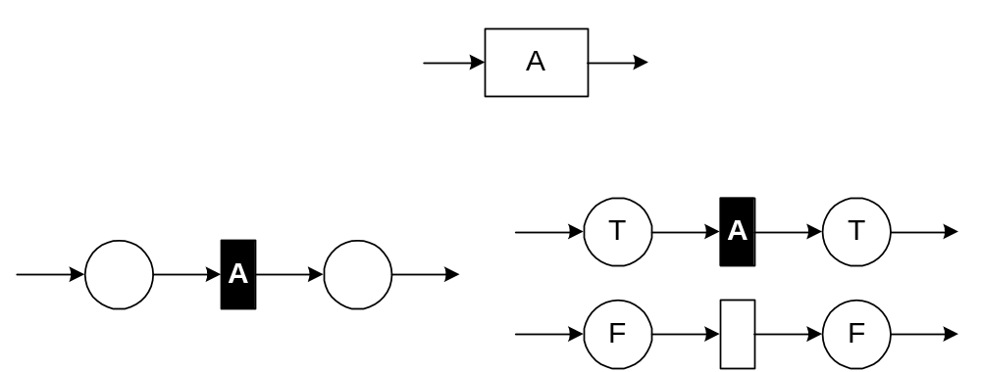
Activity: Formal Semantics
(source: [KHA03], p. 149 & 156)
Standard/Safe
Synchronizing

Slide 35
Sequence
(source: [KHA03], p. 149)
An activity has to await successful completion of another activity.
The translation below is for standard/safe workflows, but can easily be adapted for synchronising workflows.

Slide 36
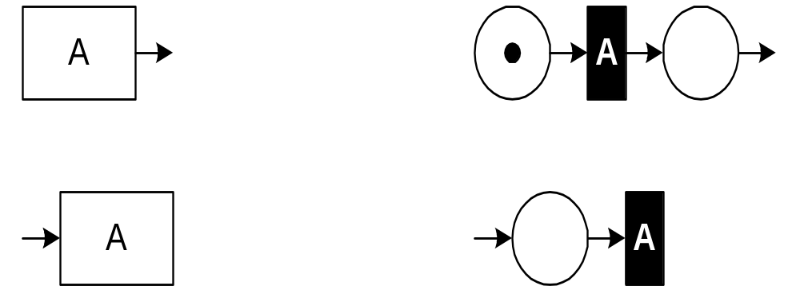
Initial/Final Activities
(source: [KHA03], p. 149)
Initial activities have no incoming branches, while final activities have no outgoing branches.
Below are the translations for standard/safe workflows; again, they can easily be adapted for synchronizing workflows.
initial
final

Slide 37
xor-split
According to the WfMC [WfMC], an or-split is “A point within the workflow where a single thread of control makes a decision upon which branch to take when encountered with multiple alternative workflow branches.”
Note that the exclusive nature of the choice, i.e. only one of the outgoing branches can be chosen, means that this concept is sometimes referred to as an xor-split

Slide 38
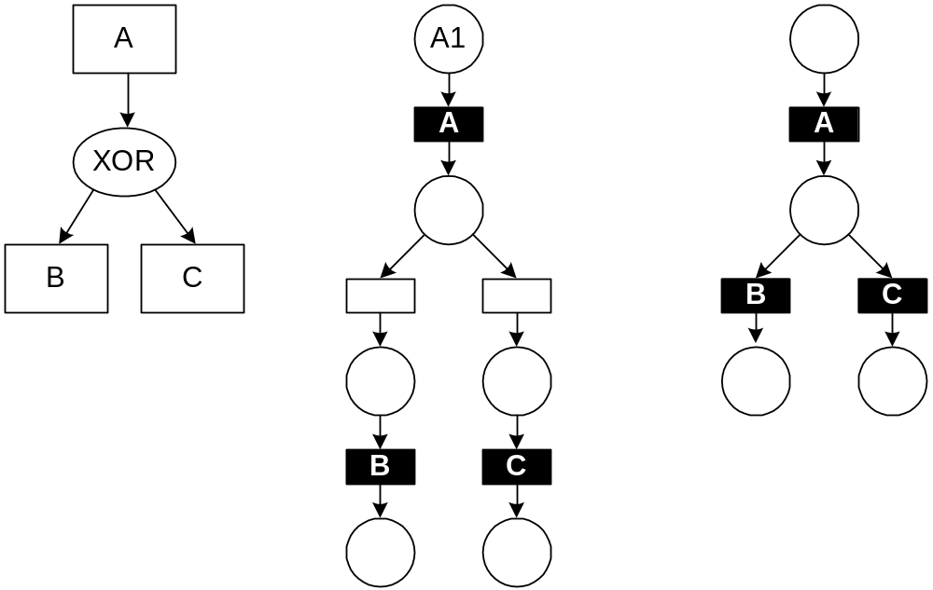
xor-split: Standard/Safe Workflows
(source: [KHA03], p. 149)
(
)

Slide 39
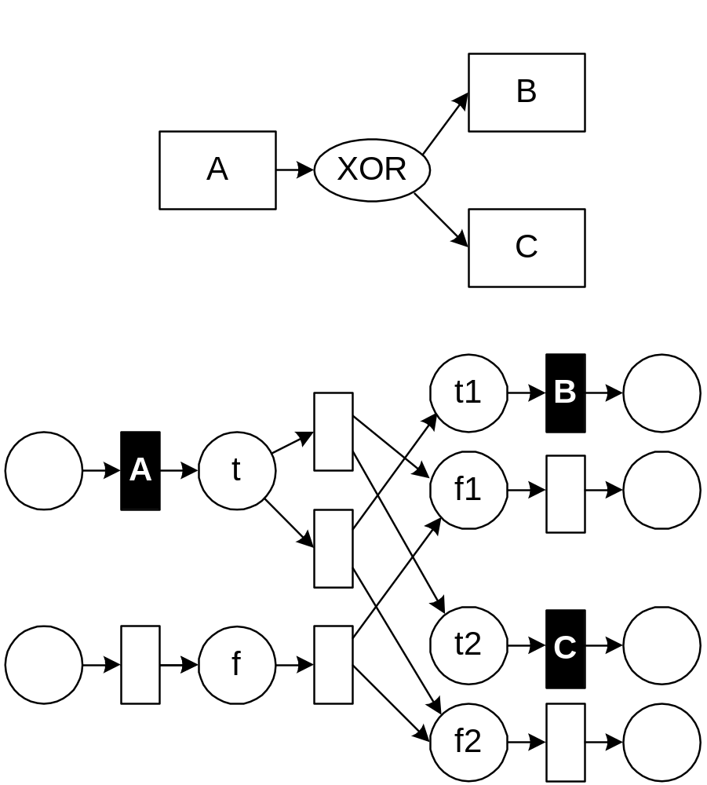
xor-split: Synchronizing Workflows
(source: [KHA03], p. 157)

Slide 40
and-split
According to the WfMC [WfMC], an and-split is “A point within the workflow where a single thread of control splits into two or more threads which are executed in parallel within the workflow, allowing multiple activities to be executed simultaneously (see Parallel Routing).”
The WfMC [WfMC] additionally states that “In certain workflow systems all the threads created at an And-Split must converge at a common And-Join point (Block Structure); in other systems convergence of a subset of the threads can occur at different And-Join points, potentially including other incoming threads created from other And-Split points (Free Graph Structure).”

Slide 41
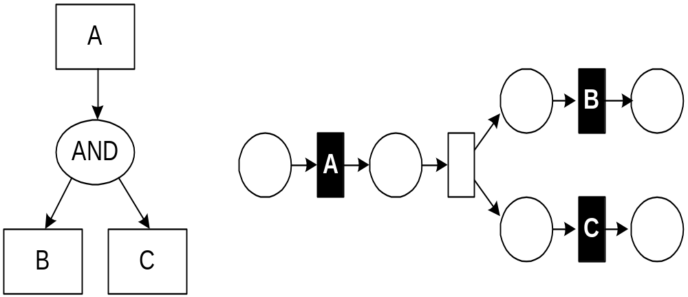
and-split: Standard/Safe Workflows
(source: [KHA03], p. 149)

Slide 42
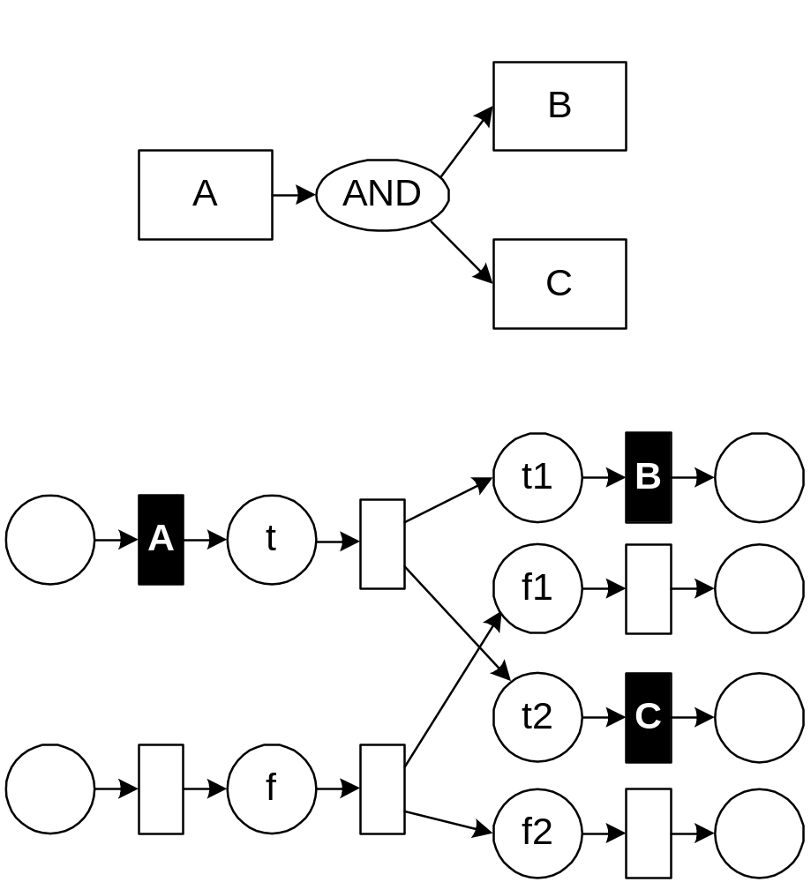
and-split: Synchronizing Workflows
(source: [KHA03], p. 149 & 157)

Slide 43
and-join
According to the WfMC [WfMC], an and-join is “A point in the workflow where two or more parallel executing activities converge into a single common thread of control.”
Question: What should happen when one or more of the incoming branches do not terminate?

Slide 44
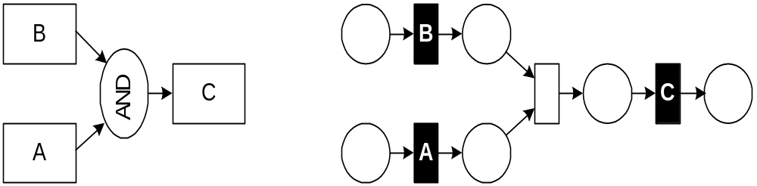
and-join: Standard/Safe Workflows
(source: [KHA03], p. 150)

Slide 45
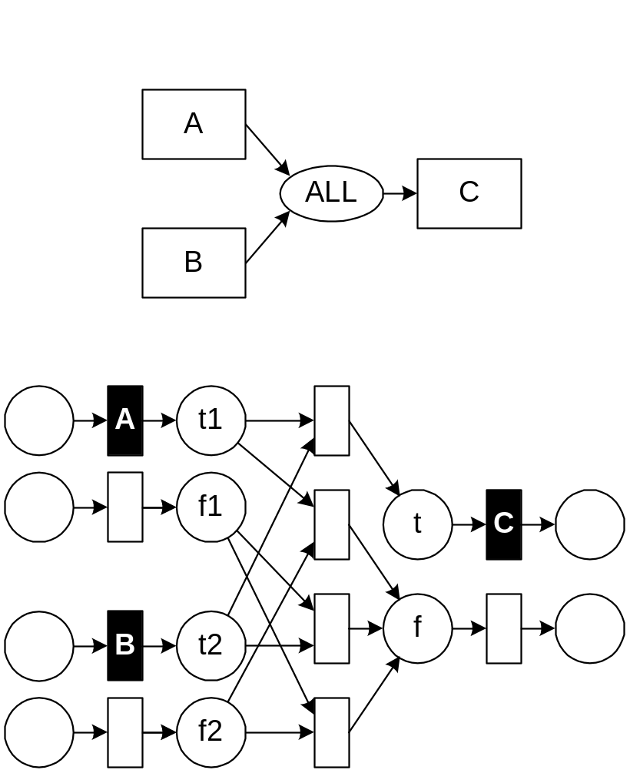
and-join: Synchronizing Workflows
(source: [KHA03], p. 158)

Slide 46
xor-join
According to the WfMC [WfMC], an or-join is
“A point within the workflow where two or more alternative activity(s) workflow branches re-converge to a single common activity as the next step within the workflow. (As no parallel activity execution has occurred at the join point, no synchronisation is required.)”
Last sentence in brackets: WfMC assumes workflows to be safe (though up to the designer to ensure that).
We will prefer to refer to this type of or-join as an xor-join and reserve the term or-join for another synchronization construct.

Slide 47
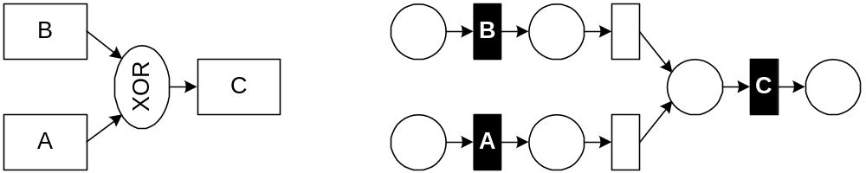
xor-join: Standard/Safe Workflows
(source: [KHA03], p. 150)

Slide 48
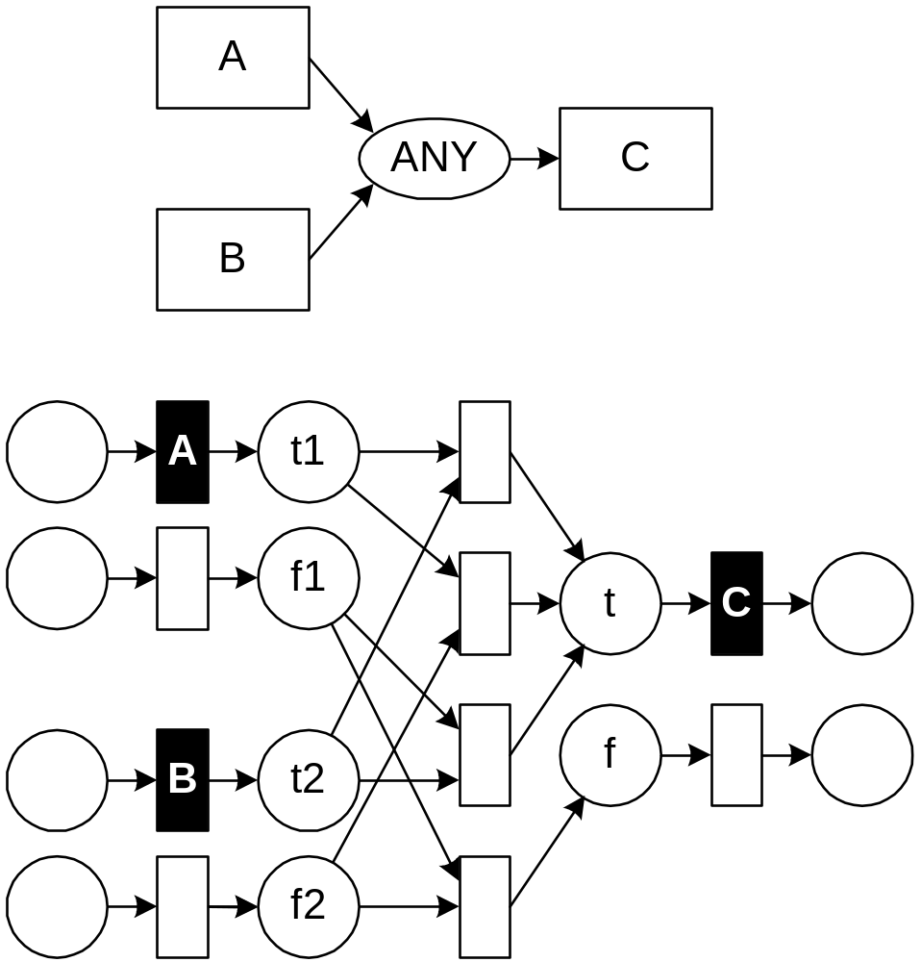
xor-join: Synchronizing Workflows
(source: [KHA03], p. 158)

Slide 49
Exercise
(source: [KHA03], p. 153)
Map the following Standard Workflow to a Petri net
C
A
XOR
AND
AND
XOR
B
D

Slide 50
A new class: structured workflows
We will study a fourth (abstract) class of workflows, the structured workflows.
This class was investigated in [KHN00] and Bartek Kiepuszewski’s PhD thesis.
We will present some fundamental results for this class.
First we briefly look at the notion of equivalence in the context of process modelling.
Then we define what a structured process model is.
Thereafter we look at the relationship between unstructured and structured process models, specifically the question whether all unstructured process models can be converted to structured ones?
We then conclude with considering the significance of the deferred choice.

Slide 51
Equivalence Considerations:
Moment of Choice
A
XOR
XOR
versus
A
A
B
C
B
C
In process algebra terms: a(b+c) ≠ ab + ac
(see e.g. [BW90])

Slide 52
Equivalence Considerations:
Parallelism
XOR
AND
versus
A
B
A
B
B
A
Did we loose something here?

Slide 53
What is a Structured Process Model?
Sequence
Split/Join - C ∈ {AND,XOR,OR}
S1
S2
S1
C
C
Sn
Loop
XOR
S1
XOR
S2

Slide 54
Mapping Unstructured Process Models to Structured Process Models
Question: Why is this not the same as removing
goto-statements in normal programming?
Answer: due to the occurrence of parallelism and the
required notion of equivalence (roughly: bisimulation)

Slide 55
Unstructured to Structured
Theorem 4.1 [KHB00] There are arbitrary well-behaved workflow models that cannot be modelled as structured workflow models
B
AND
D
A
AND
AND
F
C
AND
E

Slide 56
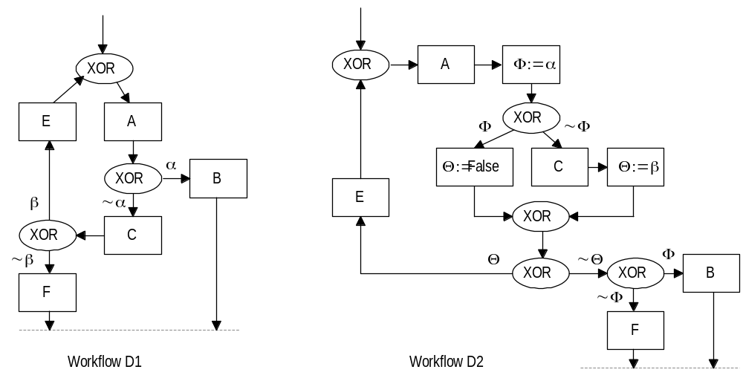
Unstructured to Structured
Theorem 4.2 [KHB00] Arbitrary loops add expressive power

Slide 57
Explicit Choice vs Deferred Choice
Is the choice by the system (based on available data) or by the environment (e.g. user, timer, message)?
Moment of choice is fundamentally different.
Observable behaviour is different (work lists!)
Often overlooked in the past, modern approaches tend to recognise this difference though.
We will look at these concepts again in the context of the workflow control-flow patterns.

Slide 58
Explicit Choice vs Deferred Choice
(source: [KHA03], p. 149)

Slide 59
Workflow nets:
Motivation and Definition
Wil van der Aalst has proposed the use of Petri nets for workflow modelling. In [Aalst96] three benefits are argued:
  Petri nets are formally defined;
  Petri nets support the notion of being “in between” performing tasks through the notion of place;
  Petri nets have associated analysis techniques.
He proposes a particular subclass of Petri nets, called Workflow nets (WF-nets) for this purpose.
Definition [AH02, p271-272] A Petri net PN = (P, T, F) is a WF-net (Workflow net) if and only if:
    There is one source place i ∈ P such that •i = ∅
    There is one sink place o ∈ P such that o• = ∅
    Every node x ∈ P ∪ T is on a path from i to o.

Slide 60
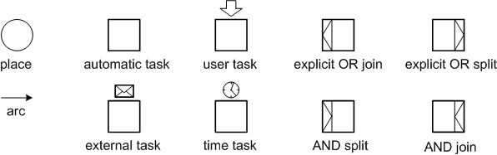
Workflow Net Constructs

Slide 61
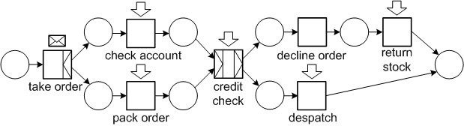
Workflow Net Example

Slide 62
Workflow nets: Soundness
In [AH02] a number of so-called soundness criteria are formulated. The following definitions are adapted from Definition 12, p. 275:
  [Option to Complete] Given an initial marking i, from every marking M reachable from i, i →* M, a marking M’ can be reached that covers o, i.e. M →* M’ and M ≥ o.
    In practical terms this means that the net is free of deadlock and infinite loops.
  [Proper Completion] Any marking M reachable from i, M →* i, that marks output place o, M ≥ o, marks no other place and only has one token in o, i.e. M = o.
    When the workflow terminates no other tasks are still running and termination is signalled only once.
  [No Dead Tasks] For every transition t a marking M reachable from i, i →* M can be found that enables t.
    The workflow does not contain any superfluous parts that can never be activated.
  Exercise: Create seven WF-nets each violating a different combination of soundness conditions of WF-nets.

Slide 63
Workflow nets: How to decide soundness?
(see [AH02] p276)
In [Aalst97] it was shown that soundness for a WF-net could be determined in terms of liveness and boundedness. In [AH02] p.276 this is explained as determining that a workflow net PN is sound is equivalent to determining to whether the net PN’ which is constructed through the addition of an extra transition t, where •t = {o} and t• = {i}, is live and bounded.
As pointed out in [AH02] p.277, the computational complexity of determining whether a WF-net is sound may be quite high. Restrictions (e.g. requiring the net to be free choice) can be imposed to make this more tractable, see the discussion in [AH02] p277-286.
At Eindhoven University of Technology the Workflow Analyzer (WOFLAN) was developed which is freely available for download.

Slide 64
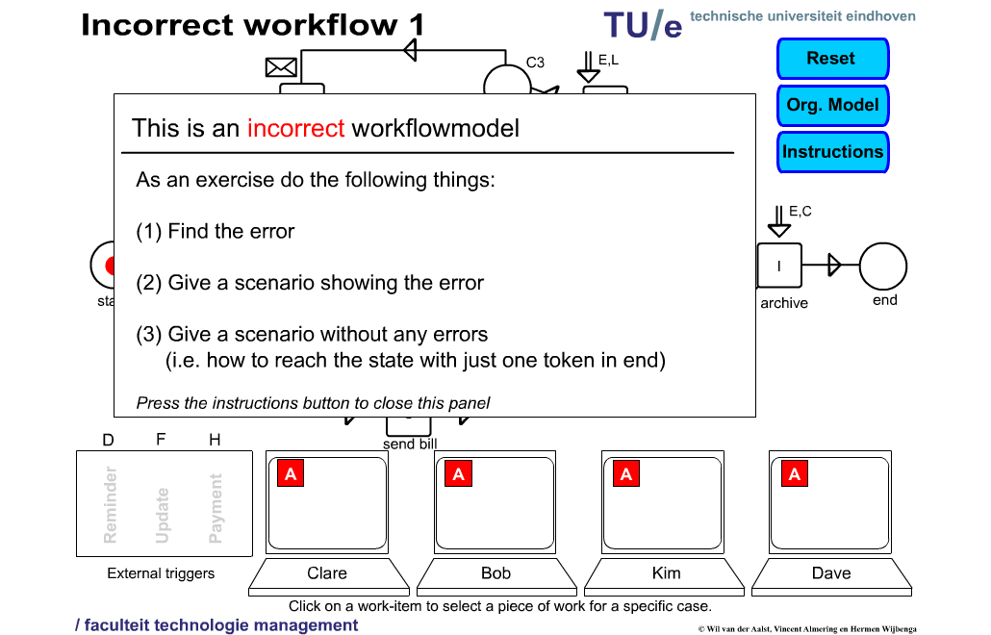
Workflow Animation – Erroneous WF
Animation by Wil van der Aalst, Vincent Almering and Herman Wijbenga

Slide 65
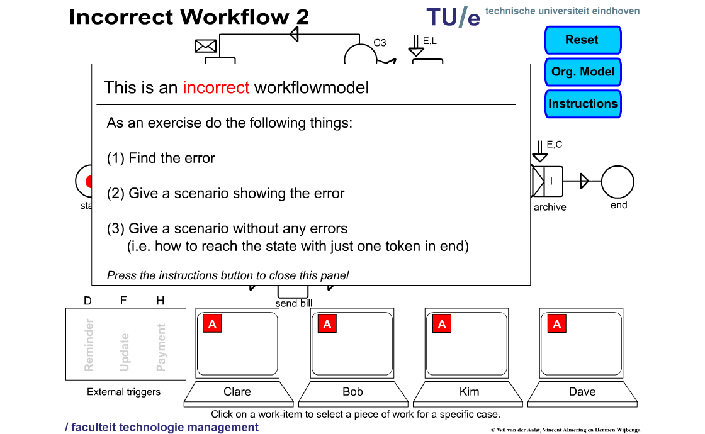
Workflow Animation – Another Erroneous WF
Animation by Wil van der Aalst, Vincent Almering and Herman Wijbenga

Slide 66
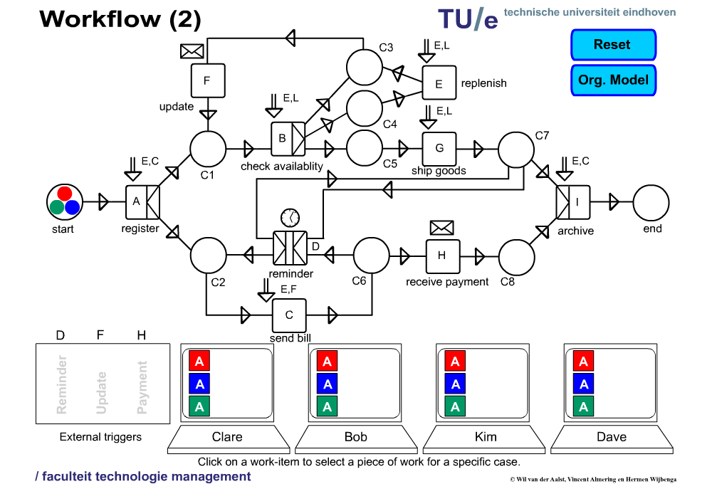
Workflow Animation – Correct WF
Animation by Wil van der Aalst, Vincent Almering and Herman Wijbenga

Slide 67
Reset nets
Reset nets extend Petri nets with a special type of arc, the reset arc.
This directed arc connects a place to a transition.
Multiple arcs may point at the same transition.
When a transition fires all tokens (if any) are removed from these so-called reset places.
Reset nets provide a natural semantics for YAWL as they can capture the notion of cancellation.
Techniques from reset nets can be exploited for the purposes of analysing YAWL nets. They are also used in the formal definition of the OR-join.
The reset arc extension comes at a price though: reachability is no longer decidable. Luckily coverability still is.
Formal definitions are based on [DFS98, FRSB02, FS01].

Slide 68
Reset nets: formal definition
Syntactically a Reset net is a tuple (P, T, F, R) where
  (P, T, F) is a Petri net;
  R: T → 2^{P} is a function associating reset places with transitions.
Let N = (P, T, F, R) be a Reset net and M a marking.
  A transition t ∈ T is enabled iff •t ≤ M.
  An enabled transition t can fire thus changing the state to M’, denoted M →^{t} M’, with M’ = (M − •t)[P\R(t)] +t•.
The definition of occurrence sequence extends naturally from Petri nets.

Slide 69
Reset nets
place
transition
arc
reset arc

Slide 70
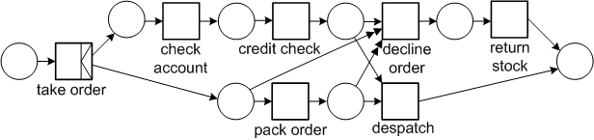
Reset nets

Slide 71
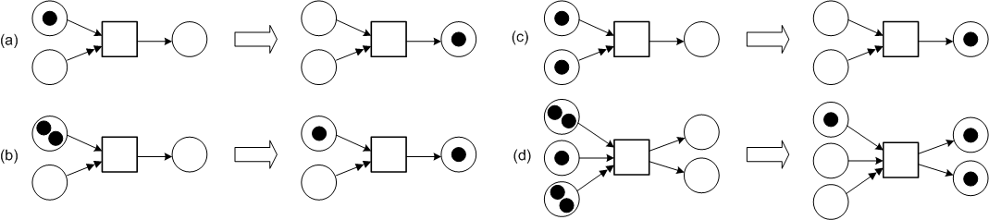
Reset nets

Slide 72
Coloured Petri nets
Higher level Petri nets extend Petri nets with:
  Types for places
  Arc annotations
  Transition conditions
  Hierarchy
  Time
They are Turing-complete.
A notable example of High-level Petri nets is Coloured Petri nets (CPN) [JK09]. This notation has extensive tool support. The functional language ML is used for capturing types and transition conditions.
CPN will be used to further explain the various control-flow patterns in order to reduce potential ambiguity.

Slide 73
Coloured Petri nets: simple example
INT x INT
<5,6>
<2,2>
<x,y>
<y,x,z+3>
x+y>z
<7,”hi”>
<z,s>
INT x INT x INT
<concat(s,s)>
INT x STRING
STRING
Is the transition enabled? If so, what is the result of firing it?

Slide 74
Sources and References
[Aalst96] Wil M. P. van der Aalst. Three Good Reasons for Using a Petri-net-based Workflow Management System. In S. Navathe and T. Wakayama, editors, Proceedings of the International Working Conference on Information and Process Integration in Enterprises (IPIC’96), pages 179-201, Cambridge, Massachusetts, November 1996.
[Aalst97] Wil M.P. van der Aalst. Verification of Workflow Nets. In P. Azéma and G. Balbo, editors, Applications and Theory of Petri Nets 1997, volume 1248 of Lecture Notes in Computer Science, pp 407-426, Springer Verlag, 1997.
[AH02] Wil M.P. van der Aalst and Kees M. van Hee. Workflow Management: Models, Methods, and Systems. The MIT Press, 2002.
[JB96] S. Jablonski and C. Bussler. Workflow Management: Modeling Concepts, Architecture and Implementation. International Thomson Computer Press, 1996.
[BW90] J. Baeten and W.P. Weijland. Process Algebra. Cambridge Tracts in Theoretical Computer Science 18, Cambridge University Press, 1990.
[DE95] J. Desel and J. Esparza. Free Choice Petri Nets. Cambridge Tracts in Theoretical Computer Science 40, Cambridge University Press, 1995.
[DFS98] C. Dufourd, A. Finkel, and P. Schnoebelen. Reset nets between decidability and undecidability. In K. Larsen, S. Skyum, and G. Winskel, editors, Proceedings of the 25th International Colloquium on Automata, Languages and Programming (ICALP’98), volume 1443 of Lecture Notes in Computer Science, pages 103–115, Aalborg, Denmark, July 1998. Springer.
[FRSB02] A. Finkel, J.-F. Raskin, M. Samuelides, and L. van Begin. Monotonic extensions of petri nets: Forward and backward search revisited. Electronic Notes in Theoretical Computer Science, 68(6):1–22, 2002.
[FS01] A. Finkel and Ph. Schnoebelen. Well-structured transition systems everywhere! Theoretical Computer Science, 256(1–2):63–92, April 2001.
[JK09] K. Jensen and L.M. Kristensen. Coloured Petri Nets: Modelling and Validation of Concurrent Systems, Springer 2009.
[Peterson81] J.L.A. Peterson. Petri net theory and the modeling of systems. Prentice Hall, 1981.
[HAAR09] A.H.M. ter Hofstede, W.M.P. van der Aalst, M. Adams, and N. Russell (editors). Modern Business Process Automation: YAWL and Its Support Environment. Springer, 2010.
[WfMC] Workflow Management Coalition - Terminology & Glossary, Document number WFMC-TC-1011, Document Status 3.0, February 1999. Downloaded from http://www.aiim.org/wfmc/mainframe.htm. (this document contains the quoted definitions)
[KHA03] B. Kiepuszewski, A.H.M. ter Hofstede and W.M.P. van der Aalst. Fundamentals of Control Flow in Workflows. Acta Informatica 39(3):143-209, 2003.
[KHB00] B. Kiepuszewski, A.H.M. ter Hofstede, C. Bussler. On Structured Workflow Modelling. Proceedings CAiSE’2000, Lecture Notes in Computer Science 1789, Stockholm, Sweden, June 2000.
[Kie03] B. Kiepuszewski. Expressiveness and Suitability of Languages for Control Flow Modelling in Workflows. PhD thesis, Queensland University of Technology, Brisbane, Australia, 2003.
www.workflowcourse.com (among others for the animations)

Slide 75
End of Part I

