Slide 1
Chapter 2
The Language: Rationale and Fundamentals
(Part III)
Nick Russell
Arthur ter Hofstede

Slide 2
Overview
Fundamental theory
Introduction to BPM
Patterns
  Control-flow
Control-flow specification in YAWL
Pattern (cont’d)
  Data (incl how realised in YAWL)
  Resources (incl how realised in YAWL)
Syntax of YAWL (ORM and set theory)
Example: Order fulfillment

Slide 3
Part III: Intro to YAWL
What is YAWL?
Rationale
Control-flow concepts
Initial brief overview of data perspective

Slide 4

YAWL Overview
Collaboration between TU/e and QUT
Based on Workflow Patterns Initiative
YAWL: 2002 – newYAWL: 2007
System development
  Open source (currently LGPL)
  Governed by YAWL Foundation
  Industry collaboration
    first:utility
    Intercontinental Hotels Group (- 2007)
    GECKO
    Knexus Research Corporation / US Naval Research Laboratory
Main publication
  W.M.P. van der Aalst and A.H.M. ter Hofstede. YAWL: Yet Another Workflow Language, Information Systems 30(4):245-275, 2005
  Citations: 600+ (Google Scholar); 170+ (Scopus); 140+ (Web of Science)
URLs:
  www.yawlfoundation.org (research)
  www.sourceforge.net/projects/yawl (system)

Slide 5
YAWL Highlights
Based on the (old) control-flow and the resource patterns
Extends workflow nets
Formalisation
Sophisticated verification support
  Transition invariants
  Reset net analysis
Sophisticated flexibility support
  Exception handling
  Dynamic workflow
  Declarative workflow

Slide 6
YAWL vs Petri/workflow nets
Petri nets have difficulties capturing:
  The General Synchronising Merge
  Patterns involving Multiple Instances
  Cancellation of a certain part of a process
For the Control Flow Perspective, YAWL takes some concepts from Petri/Workflow nets and adds constructs for:
  OR-join to deal with General Synchronising Merge
  Multiple Instance (MI) tasks
  Cancellation regions
  “Syntactic Sugar” (various splits/joins, direct connections between tasks)

Slide 7
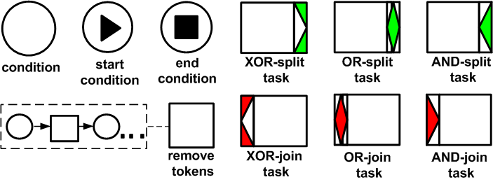
YAWL notation
Composite task
Multiple Instance task

Slide 8
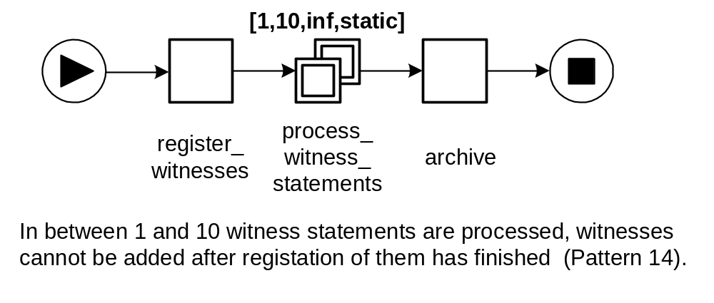
Multiple Instances Example I
(source: [AH05])

Slide 9
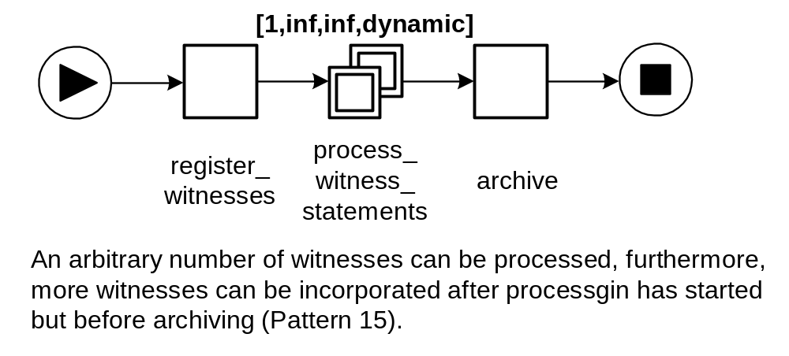
Multiple Instances Example II
(source: [AH05])

Slide 10
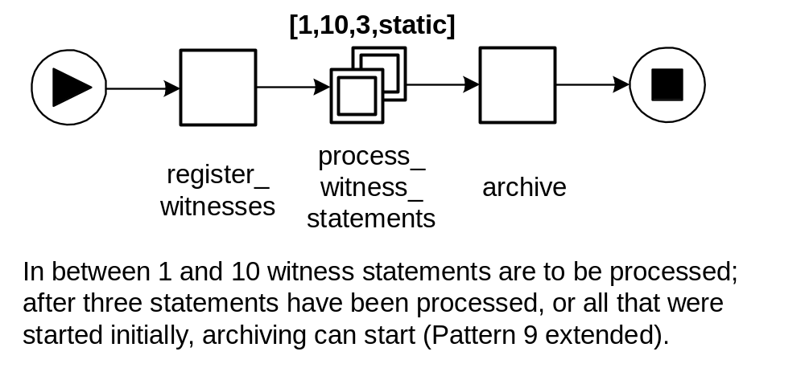
Multiple Instances Example III
(source: [AH05])

Slide 11
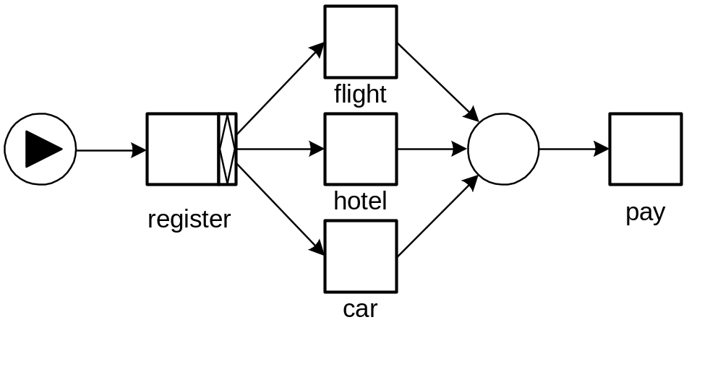
General YAWL Example I
(source: [AH05])

Slide 12
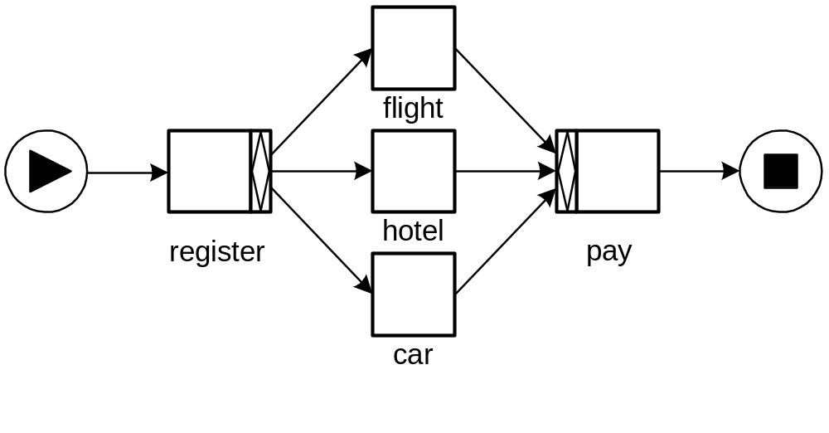
General YAWL Example II
(source: [AH05])

Slide 13
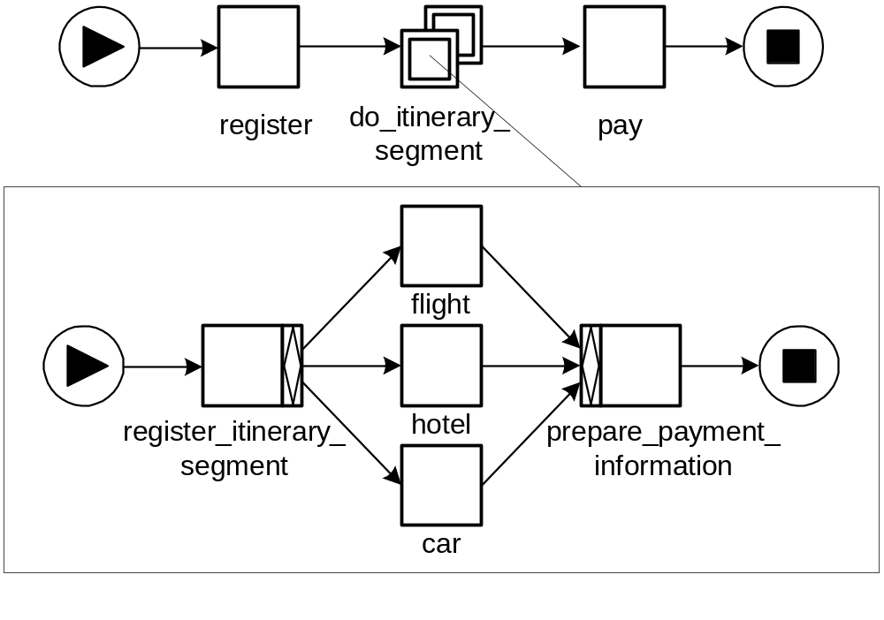
General YAWL Example III

Slide 14
Cancellation in YAWL
The concept of cancellation region generalises the cancel activity and cancel case patterns
Syntactically, a cancellation region consists of a number of tasks and places (possibly including implicit ones!) part of the same composite task and attached to a so-called cancellation task (also part of the same composite task).
Semantically, upon completion of the cancellation task all tokens in the cancellation region (or in decompositions of tasks in that region etc) are removed.

Slide 15
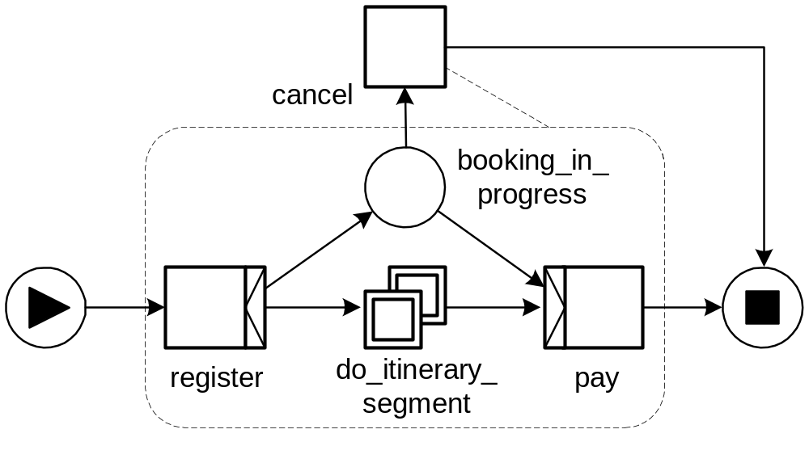
General YAWL Example IV

Slide 16
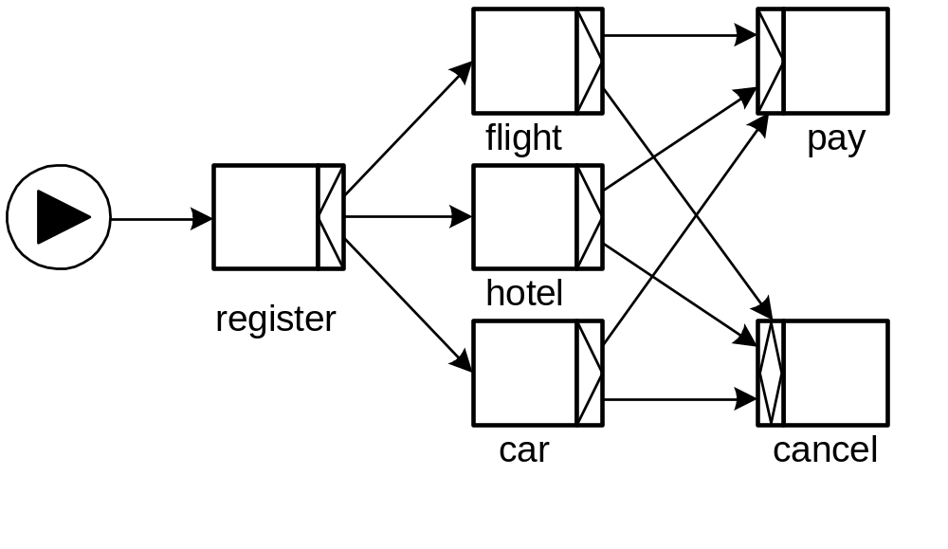
General YAWL Example VI
(source: [AH05], p. 257)

Slide 17
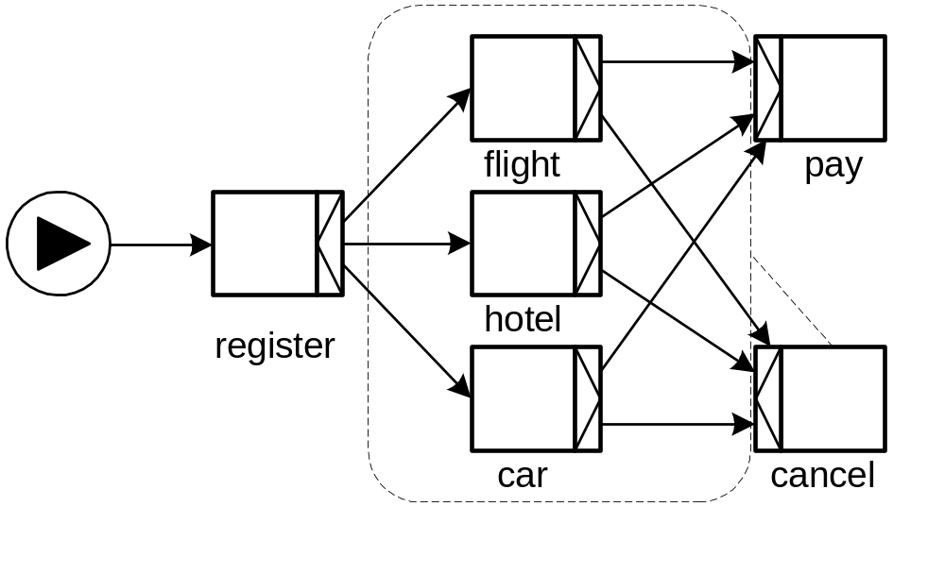
General YAWL Example VII
(source: [AH05], p. 257)

Slide 18
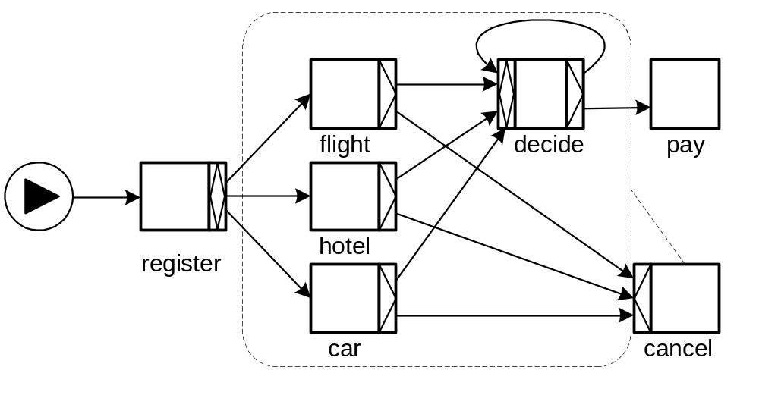
General YAWL Example VIII
(source: [AH05], p. 257)

Slide 19
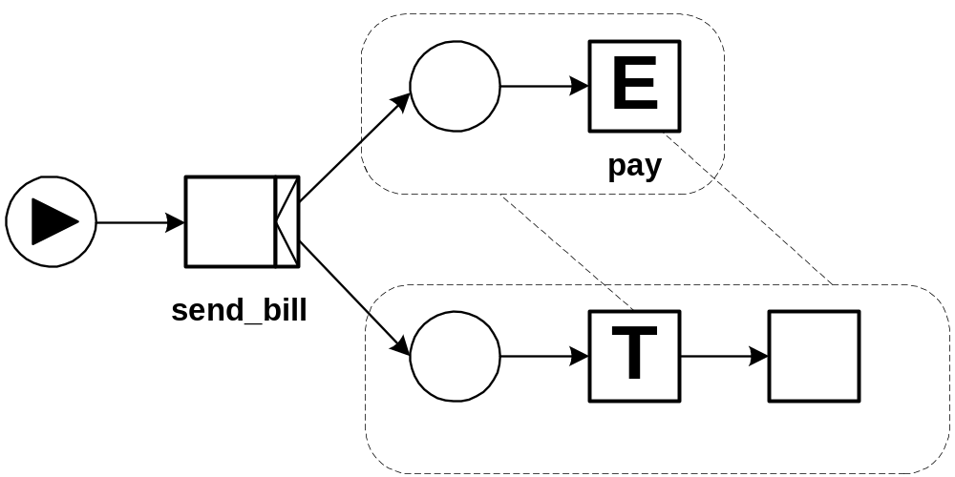
YAWL Example with Time
(source: [AH05])
T represents a time-out task
What are the disadvantages of using an
external service for deadline notification?

Slide 20
New approach to time
Tasks can have an associated timer
Timer can be based on variable, hence dynamic
Timing can be
  On enablement
  On start

Slide 21
Exercise
Consider a credit card application process. The process starts when an applicant submits an application (with the proposed amount). Upon receiving an application, a credit clerk checks whether it is complete. If not, the clerk requests additional information and waits until this information is received before proceeding. For a complete application, the clerk performs further checks to validate the applicant’s income and credit history. Different checks are performed depending on whether the requested loan is large (e.g. greater than $500) or small. The validated application is then passed on to a manager to decide whether to accept or reject the application. In the case of acceptance, the applicant is notified of the decision and a credit card is produced and delivered to the applicant. For a rejected application, the applicant is notified of the decision and the process ends. Model this process in YAWL.
(credit: Moe Wynn and Chun Ouyang)

Slide 22
A Brief Overview of the Data Perspective in YAWL
The data patterns (discussed subsequently) were finalized after the initial data perspective for YAWL was developed
Hence the data perspective in YAWL is not based on a comprehensive analysis of the data perspective
The data perspective in YAWL relies on XML technology, in particular XML Schema, XPath and XQuery
Specifying expressions in a correct manner can be non-trivial. Errors in XPath/XQuery expressions are a frequent source of errors
In order for data to be accessible for a task the data item needs to be passed down the hierarchy
When discussing the data patterns, the data perspective in YAWL will be explained in more detail

Slide 23
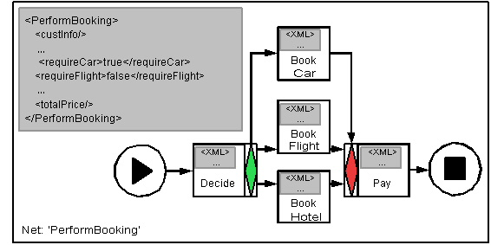
Native Use of XML
The data inside of YAWL exists as many XML documents

Slide 24
Native Use of XML #2
The functionality of the YAWL business processing engine uses XML standards internally to perform the actions that one would expect of a Business Process System:
Data Validation: XML Schema
Transformations: XQuery
Decision making: XPath

Slide 25
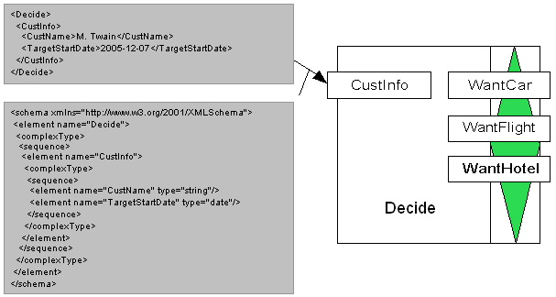
Native Use of XML #3:
Strong Data Typing

Slide 26
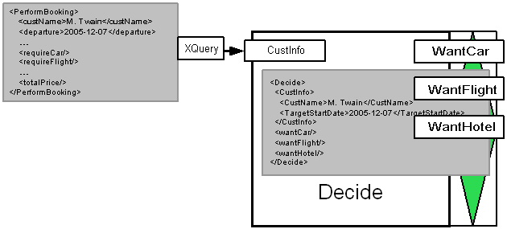
Native Use of XML #4:
Transformations in Data Passing

Slide 27
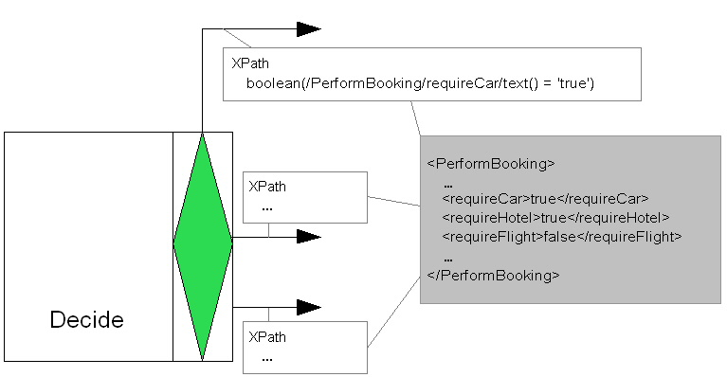
Native use of XML #5:
System Decisions

Slide 28
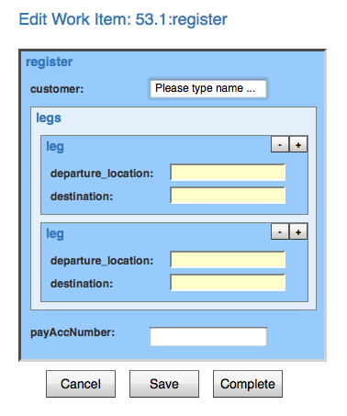
Native Use of XML #6: Generation of XForms

Slide 29
Sources and References
[Aalst96] Wil M. P. van der Aalst. Three Good Reasons for Using a Petri-net-based Workflow Management System. In S. Navathe and T. Wakayama, editors, Proceedings of the International Working Conference on Information and Process Integration in Enterprises (IPIC’96), pages 179-201, Cambridge, Massachusetts, November 1996.
[Aalst97] Wil M.P. van der Aalst. Verification of Workflow Nets. In P. Azéma and G. Balbo, editors, Applications and Theory of Petri Nets 1997, volume 1248 of Lecture Notes in Computer Science, pp 407-426, Springer Verlag, 1997.
[AH02] Wil M.P. van der Aalst and Kees M. van Hee. Workflow Management: Models, Methods, and Systems. The MIT Press, 2002.
[AH05] Wil M.P. and der Aalst and Arthur H.M. ter Hofstede. YAWL: Yet Another Workflow Language. Information Systems 30(4):245-275, 2005.
[JB96] S. Jablonski and C. Bussler. Workflow Management: Modeling Concepts, Architecture and Implementation. International Thomson Computer Press, 1996.
[BW90] J. Baeten and W.P. Weijland. Process Algebra. Cambridge Tracts in Theoretical Computer Science 18, Cambridge University Press, 1990.
[Peterson81] J.L.A. Peterson. Petri net theory and the modeling of systems. Prentice Hall, 1981.
[DE95] J. Desel and J. Esparza. Free Choice Petri Nets. Cambridge Tracts in Theoretical Computer Science 40, Cambridge University Press, 1995.
[HAAR09] A.H.M. ter Hofstede, W.M.P. van der Aalst, M. Adams, and N. Russell (editors). Modern Business Process Automation: YAWL and Its Support Environment. Springer, 2010.
[WfMC] Workflow Management Coalition - Terminology & Glossary, Document number WFMC-TC-1011, Document Status 3.0, February 1999. Downloaded from http://www.aiim.org/wfmc/mainframe.htm. (this document contains the quoted definitions)
[KHA03] B. Kiepuszewski, A.H.M. ter Hofstede and W.M.P. van der Aalst. Fundamentals of Control Flow in Workflows. Acta Informatica 39(3):143-209, 2003.
[KHB00] B. Kiepuszewski, A.H.M. ter Hofstede, C. Bussler. On Structured Workflow Modelling. Proceedings CAiSE’2000, Lecture Notes in Computer Science 1789, Stockholm, Sweden, June 2000.
[Kie03] B. Kiepuszewski. Expressiveness and Suitability of Languages for Control Flow Modelling in Workflows. PhD thesis, Queensland University of Technology, Brisbane, Australia, 2003.
www.workflowcourse.com (among others for the animations)

