Slide 1
Chapter 3
Advanced Synchronization
Moe Wynn
Wil van der Aalst
Arthur ter Hofstede

Slide 2
Overview
Introduction
Informal semantics
Formal semantics
Algorithm
Optimisation
Conclusions

Slide 3
The Many Ways to Join
A
When is task D enabled?
Three choices: XOR, AND, and OR
AND-join
  Full synchronization
XOR-join
  No synchronization
OR-join
  Active paths synchronization
B
D
C

Slide 4

Non-local semantics of a General OR-Join
("bus driver semantics")

Slide 5
Advanced Synchronization: OR-join
Synchronization is only performed for active threads
Difficult to formally capture a desired informal semantics
Difficult to determine when to enable an OR-join task
Synchronizing Merge pattern in Workflow patterns

Slide 6
Different interpretations
OR Gateway in BPMN
OR-join in Event-driven Process Chains (EPCs)
OR-join in workflow systems e.g. InConcert, eProcess, MQ workflow
Syntactic restrictions
Vicious Circles
Local semantics
No formal semantics

Slide 7
Informal semantics

Slide 8
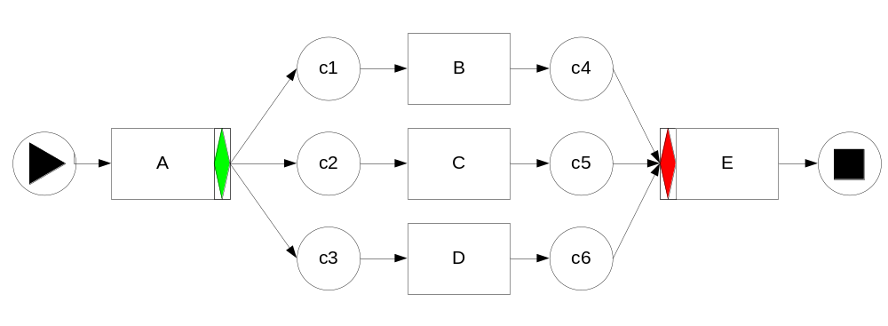
OR-join
An OR-join is enabled at a marking iff
  there is at least one token in one of its input conditions and
  It is not possible for more tokens to arrive in other empty input conditions in the reachable markings from the current marking
An OR-join task is not enabled at a marking iff
  it is possible to place tokens in the unmarked input conditions of an OR-join task in the reachable markings from the current marking
Enabled?
Notes:
c4 – Enabled (Not possible to have more tokens in c5 and c6)
c2+c3+c4 – Not Enabled
c3+c4+c5 – Not Enabled
c4+c5+c6 - Enabled

Slide 9
Challenges
How to capture the non-local semantics?
Formal semantics without syntactical restrictions
  Structural restrictions - InConcert, eProcess, MQ Workflow (acyclic)
  True/False tokens
Complications for complex workflows
  Unstructured
  Cancelation regions
  Multiple OR-joins
  Loops

Slide 10
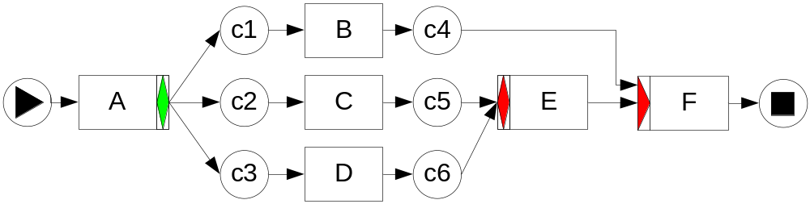
Unstructured workflows
E should only wait for tokens in c5 and c6 (two paths)
Not the three paths from the corresponding OR-split after A

Slide 11
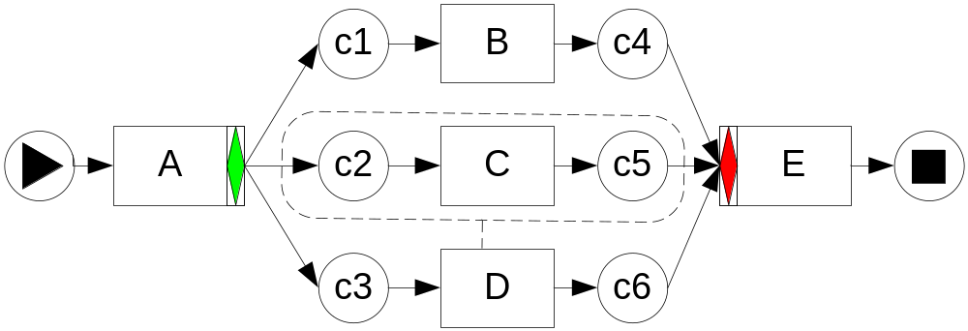
Cancelation regions
Cancellation region of task D – c2, C, c5
M=c2+c3+c4 -C-> M’= c3+c4+c5, E is not enabled
M=c3+c4+c5 -D-> c4+c6 (Remove token from c5), E is enabled
How to predict that E should be enabled at c3+c4+c5 without doing a reachability analysis?

Slide 12
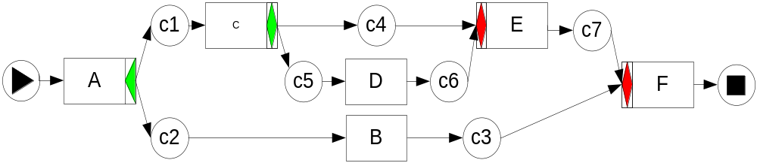
Multiple OR-joins
Two OR-joins E and F
What happens at marking c1+c3?
How should we treat E when considering when F should be enabled?

Slide 13
Formal semantics

Slide 14
Considerations
How to deal with complex constructs supported in YAWL?
  Unstructured workflows
  Cancelation, hierarchy, multiple instances, loops
  Multiple OR-joins
Reset nets – extend Petri nets with reset arcs
OR-join semantics are defined in terms of Reset nets
  Support for cancelation regions

Slide 15
Reset nets
Complexity of a reset arc
Transition removes all tokens and not just one when it fires
Reset action can be ineffective
A reset arc can affect any place in the entire net
Reachability notion is undecidable for reset nets with more than two reset arcs
Coverability notion is decidable using backwards firing algorithm

Slide 16
Backwards firing rule
Backwards search techniques of Well-structured Transition Systems
Input places that are not reset places
  Add one token
Output places that are not reset places
  Remove one token
Reset places that are also input places
  Add one token (coverability)

Slide 17
Semantics (Reset nets)
An OR-join in a YAWL net is enabled at a marking M iff
  M has tokens in one or more input conditions of the OR-join and
  there is no marking in the future states of the corresponding reset net that covers M.
Notes:
Not a reachable marking, only a coverable marking
Need to convert a YAWL net into a reset net

Slide 18
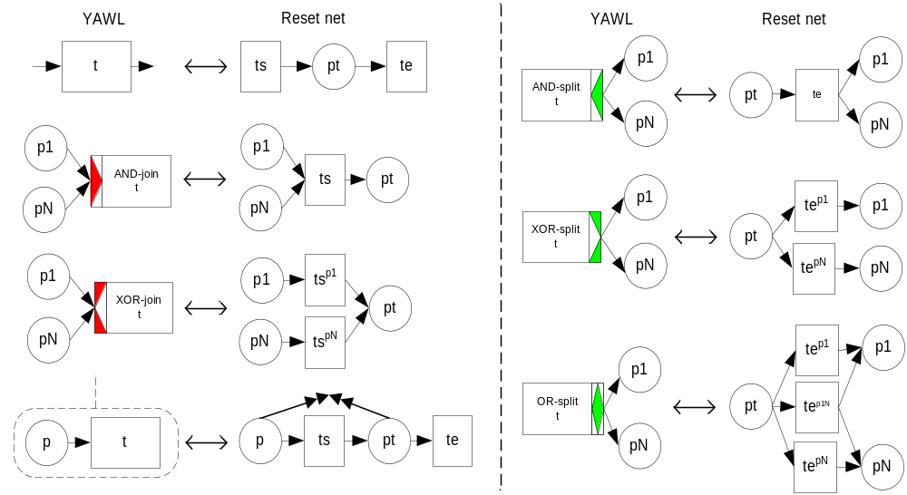
Transformations
Notes:
Note: No transformation for other OR-joins in the net.

Slide 19
Constructs affecting the semantics
Cancelation regions (reset nets)
Structured, unstructured and infinite loops (coverability)
Composite tasks, Multiple instances (atomic tasks)
Multiple OR-joins
    Ignore other OR-joins
    Treat them as AND-joins (Pessimistic)
    Treat them as XOR-joins (Optimistic)

Slide 20
Characteristics
General
  no syntactical restriction
  closely matches the informal semantics
  behave as expected even for unsound nets
Formal
  defined using reset nets formalism
  decided using backwards coverability algorithm
Decidable
  algorithm is applicable for workflows with cancelation, multiple OR-joins and loops

Slide 21
Algorithm

Slide 22
Algorithm
Transform a YAWL net into a Reset-net
Generate a set of possible enabling markings X
For each marking x in X, generate a set of backwards coverable markings X’
Check if the current Marking M or a smaller marking is found in X’
If so, returns False – the OR-join is not enabled at M
Otherwise, returns True - the OR-join is enabled at M

Slide 23
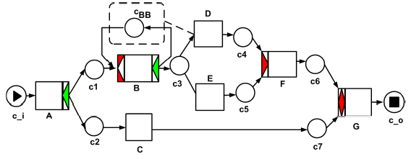
At marking c1+c7 task G is enabled if and only if ....
Example

Slide 24
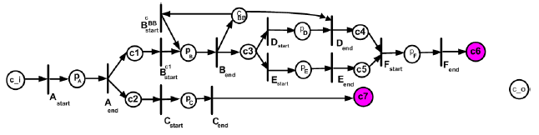
At marking c1+c7 task G is enabled if and only if ....
Example (Reset net)
... it is possible to cover c6+c7!

Slide 25
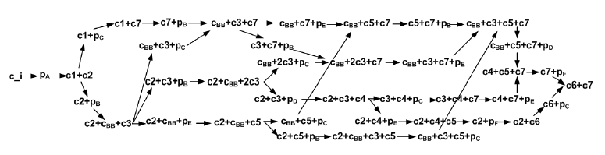
G is not enabled !

Slide 26
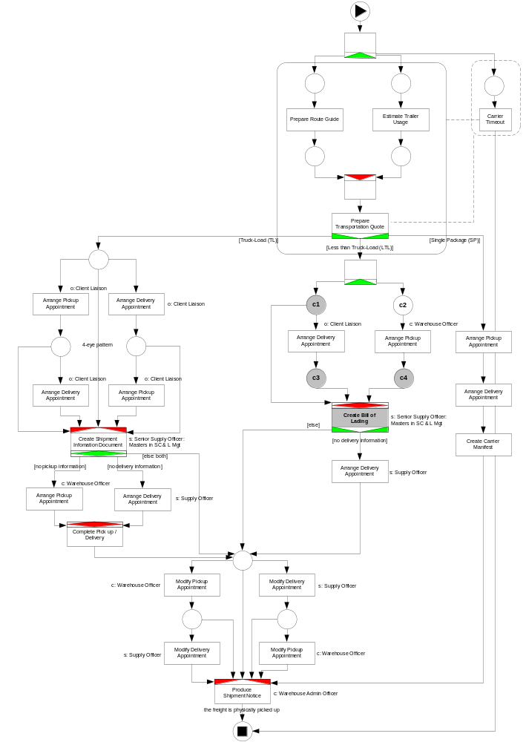
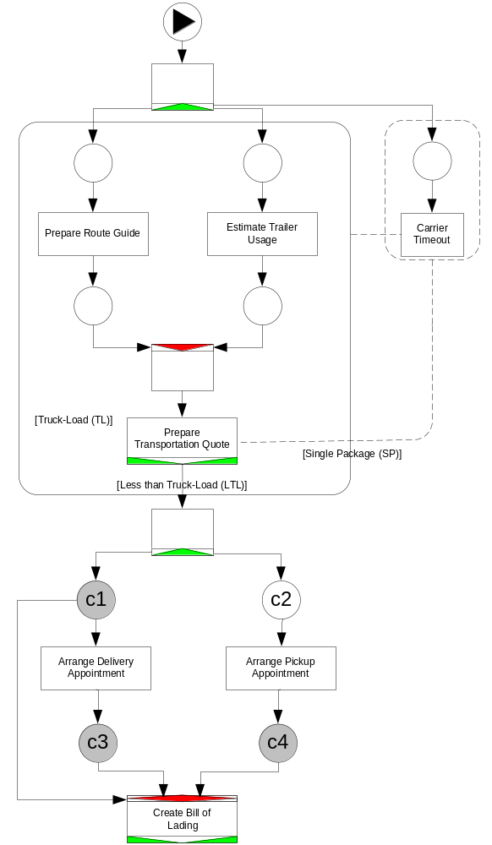
Carrier Appointment Example
OR-join Analysis: Create Bill of Lading
c1+c2 -> False (can cover c1+c4)
c2+c3 -> False (can cover c3+c4)
c1+c4 -> True
c3+c4 -> True

Slide 27
Optimization

Slide 28
Optimization
  Structural restriction
    Remove parts of the net not associated with an OR-join
    Restrict the search space using structural info
    Apply once for each OR-join
  Active projection
    Ignore parts of the net that cannot be marked from a given marking
    Restrict the search space using marking-dependent info
    Apply once for every marking change

Slide 29
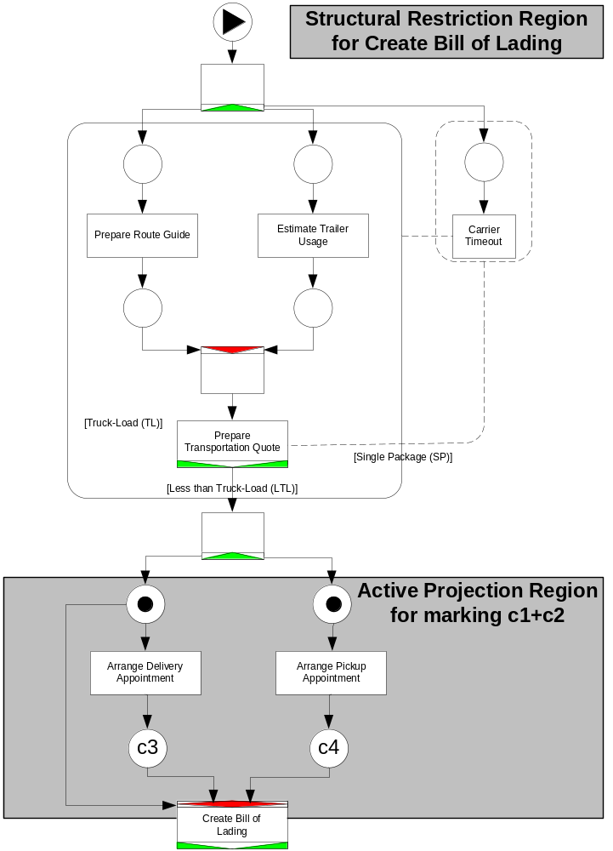
Applying Optimisation to Carrier Appt example

Slide 30
Implementation in YAWL
OR-join enabling algorithm
  Computationally very expensive
Engine
  Algorithm with optimization techniques
Editor
  Reduction rules for OR-joins
  Soundness property
  OR-joins in a cycle
  Unnecessary OR-joins check

Slide 31
Conclusions
Introduction
  Advanced synchronization: the OR-join construct in YAWL
Informal semantics
  Wait to synchronize and proceed when it is not possible
Formal semantics
  Reset nets, Backwards coverability
Algorithm
  Expensive, repetitive
Optimization
  Structural restriction, Active projection

