Slide 1
Chapter 6
Declarative Workflow
Maja Pesic
Helen Schonenberg
Wil van der Aalst

Slide 2
Outline
1 Introduction
2 Constraint-Based Workflow Specification
3 Enactment of Constraint Model Instances
4 Dynamic Instance Change
5 Conclusions

Slide 3
1 Introduction
Why declarative workflows?
Procedural vs. declarative workflows.
Combining procedural and declarative workflows.

Slide 4
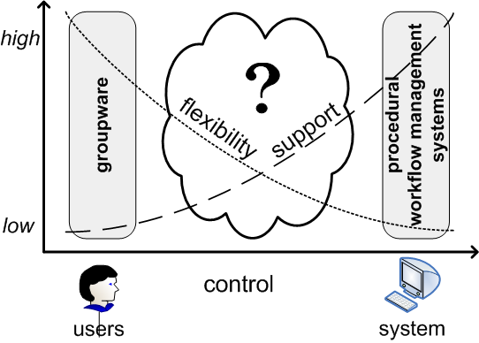
Flexibility vs. Support

Slide 5
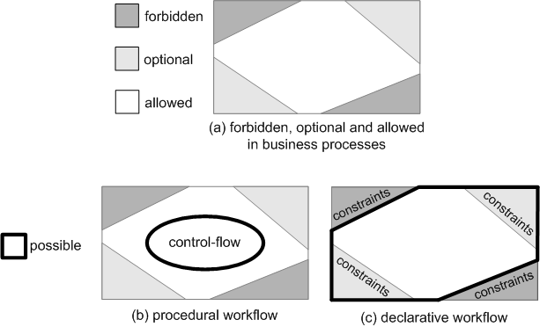
Procedural vs. Declarative Workflow

Slide 6
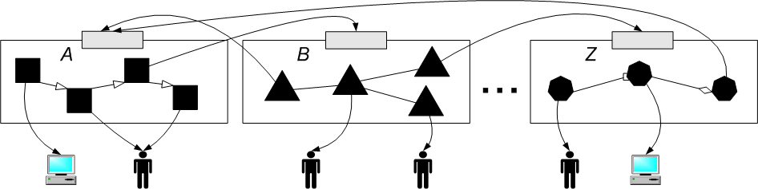
Workflow Decomposition
Combining various workflow languages (e.g., A, B, …, Z)
Combining various approaches (e.g., procedural and declarative)

Slide 7
2 Constraint-based workflow specification
Specifying constraints with Linear Temporal Logic.
Constraint templates.
Constraints.
The ConDec language.
Constraint workflow models.
Truck Load and Less Than Truck Load ConDec models.
Verification of constraint models.

Slide 8
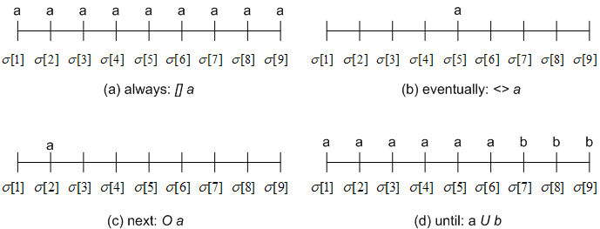
Linear Temporal Logic
Standard operators
Temporal operators
negation: !a
conjunction: a /\ b
disjunction: a \/ b
implication: a -> b
equivalence: a <-> b
true
false
always: [] a
eventually: <> a
next: O a
until: a U b
weak until: a W b = (<> a) -> (a U B)

Slide 9
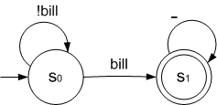
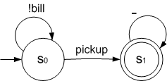
Specifying Constraints with LTL
Automaton can be generated for LTL constraint = exactly the set of all execution traces that satisfy the constraint.
LTL formula for constraint | automaton representing satisfying traces | semantics
<> bill |  | Task bill must be executed at least once.
(! bill) W pickup |  | Task bill can not be executed until (i.e., before) task pickup is executed.

Slide 10
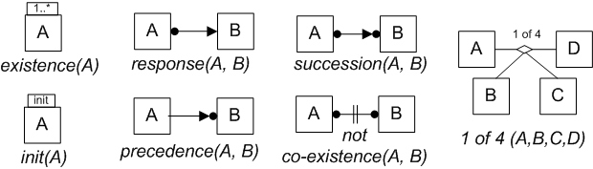
Constraint Templates
“Declarative workflow patterns”
A template has:
  name
  LTL formula
  graphical representation
  existence(A) : <> A
  init(A): A
  response(A,B): []( A -> <> B)
  precedence(A,B): (!B) W A
  succession(A,B): response(A,B) /\ precedence(A,B)
  not co-existence: !( <>A /\ <>B )
  1 of 4(A,B,C,D): <>A \/ <>B \/ <>C \/ <>D

Slide 11
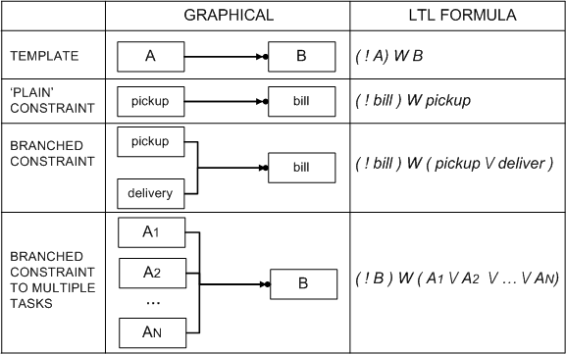
Constraints
are created from templates
can be “branched”

Slide 12
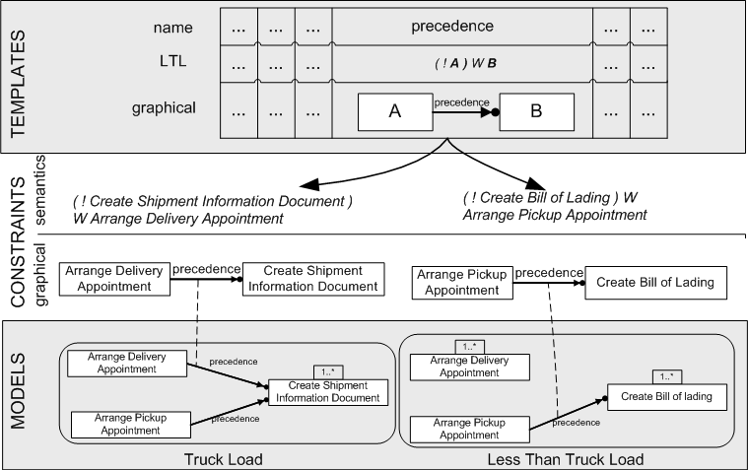
An Example Language: ConDec
Has more than 30 templates: existence, relation (ordered and not ordered), negative relation, and choice (standard and explicit).

Slide 13

Constraint Workflow Models
A constraint model has:
  set of tasks: T={t1,t2,…,tn}
  Set of mandatory constraints (must be followed): CM={cm1,cm2,…,cmp}
  optional constraints (can be violated): CO={co1,co2,…,cok}
Traces that satisfy a constraint model are:
  if CM = Ø : all traces, represented by automaton
  if CM ≠ Ø : traces that satisfy formula F= cm1/\cm2/\…/\cmp, represented by automaton automatically generated for F

Slide 14
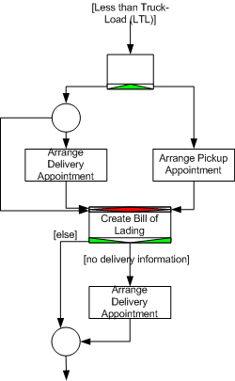
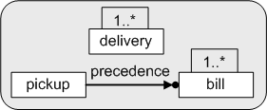
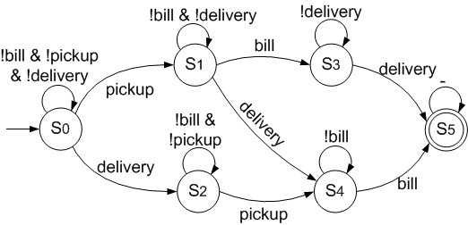
Less Than Truck Load (LTTL)
Constraints:
<> delivery
<> bill
(!pickup) W bill
(b) ConDec model
(a) YAWL model
(c) automaton generated for the ConDec model

Slide 15
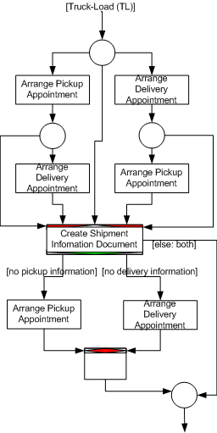
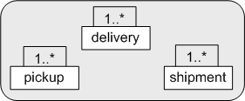
Truck Load (TL)
Constraints:
<> delivery
<> bill
<> shipment
(b) ConDec model
(a) YAWL model

Slide 16
Verification of Constraint Models
By analyzing the automaton generated for the model two types of errors can be detected:
  Dead task is a task that can never be executed. None of the transitions in the automaton allows the task.
  A conflict exists if there is no way to satisfy all mandatory constraints in the model. The generated automaton is empty, there is no trace that satisfies this model.

Slide 17
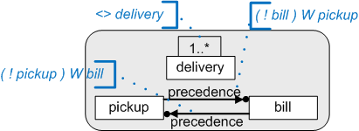
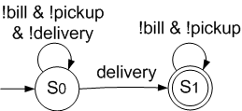
Example: Model with a Dead Task
(a) ConDec model
None of the transitions allows task pickup, i.e., task pickup is dead.
None of the transitions allows task bill, i.e., task bill is dead.
(b) automaton generated for the ConDec model

Slide 18
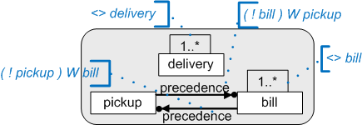

Example: Model with a Conflict
(a) ConDec model
The generated automaton is empty, there is no trace that satisfies this model.
(b) automaton generated for the ConDec model

Slide 19
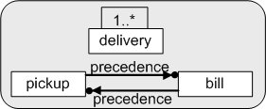
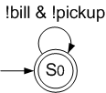
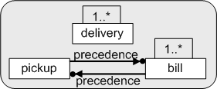
Detecting the Cause of Error
By searching through the powerset of mandatory constraints and analyzing these automata, the exact subset of constraints that causes the error can be detected.

Slide 20
3 Enactment of Constraint Model Instances
Instances of Constraint Models
Monitoring States of Constraints
Monitoring State of the Instance
Enforcing Correct Instance Execution
Enforcing Correct Instance Completion
Dynamic Instance Change

Slide 21
Constraint Model Instance
Instance = constraint model + trace
Trace is a sequence of executed tasks.
At the end of the execution, instance’s trace must satisfy all mandatory constraints from instance’s model.
During the execution of one instance it is necessary to:
  monitor constraint states,
  monitor instance state,
  enforce correct execution, and
  enforce correct completion.

Slide 22
Monitoring Constraint States
Every time a new task is executed, the states of constraints are “calculated”.
Based on the current trace a constraint can be:
  satisfied,
  temporarily violated, the constraint is not satisfied, but it is possible to satisfy it in the future, and
  violated, the constraint is not satisfied and it is not possible to satisfy it in the future.

Slide 23
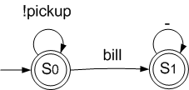
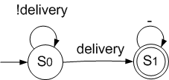


Determining Constraint States
The state is determined by the automaton generated form the constraint’s formula:
  satisfied: trace is accepted by the automaton,
  temporarily violated, trace can be replayed on the automaton but it is not accepted by the automaton, and
  violated, trace can not be replayed on the automaton.
(a) precedence constraint and its automaton
(b) existence constraint and its automaton
Trace 1 | State of constraint
 | (a) | (b)
initial | sat. (S0) | tmp. viol. (S0)
pickup | sat. (S1) | tmp. viol. (S0)
delivery | sat. (S1) | sat. (S1)
bill | sat. (S1) | sat. (S1)
Trace 2 | State of constraint
 | (a) | (b)
initial | sat. (S0) | tmp. viol. (S0)
delivery | sat. (S0) | sat. (S1)
Trace 3 | State of constraint
 | (a) | (b)
initial | sat. (S0) | tmp. viol. (S0)
delivery | sat. (S0) | sat. (S1)
bill | viol. (?) | sat. (S1)

Slide 24
Monitoring Instance States
For the instance state everything holds like for the constraint state, but now we use the automaton created for the instance’s model.
(a) Less Than Truck Load (LTTL) ConDec model
(b) automaton generated for the LTTL model
Trace 1 | State of instance
initial | tmp. viol. (S0)
pickup | tmp. viol. (S1)
delivery | tmp. viol. (S4)
bill | sat. (S5)
Trace 3 | State of instance
initial | tmp. viol. (S0)
delivery | tmp. viol. (S2)
bill | viol. (?)
Trace 2 | State of instance
initial | tmp. viol. (S0)
delivery | tmp. viol. (S2)

Slide 25
Enforcing Correct Instance Execution
Making sure that users do not execute tasks that make the instance violated.
Enabling only tasks that are allowed by the automaton.
(a) Less Than Truck Load (LTTL) ConDec model
Trace 1 | Enabled tasks and executed task
initial | pickup, delivery (S0)
pickup | bill, pickup, delivery (S1)
delivery | bill, pickup, delivery (S4)
bill | bill, pickup, delivery (S5)
(b) automaton generated for the LTTL model
Trace 3 | Enabled tasks and executed task
initial | pickup, delivery (S0)
delivery | pickup, delivery (S2)
bill | Not possible to execute – bill was not enabled!
Trace 2 | Enabled tasks and executed task
initial | pickup, delivery (S0)
delivery | pickup, delivery (S2)

Slide 26
Enforcing Correct Instance Completion
Making sure the instance can be closed only when it is satisfied.
Allowing completion only when the automaton is in the accepting state.
(a) Less Than Truck Load (LTTL) ConDec model
(b) automaton generated for the LTTL model
Trace 1 | Enabled tasks and executed task
initial | can’t close (S0)
pickup | can’t close (S1)
delivery | can’t close (S4)
bill | CAN CLOSE (S5)
Trace 2 | Enabled tasks and executed task
initial | can’t close (S0)
delivery | can’t close (S2)

Slide 27
Dynamic Instance Change
The change is allowed only if the new model does not bring the instance into the violated state.
(a) original model
(b) automaton generated for the original model
Instance 1
Trace | State
initial | temporarily violated (S0)
pickup | temporarily violated (S1)
delivery | temporarily violated (S4)
bill | satisfied (S5)
Instance 2
Trace | State
initial | temporarily violated (S0)
pickup | temporarily violated (S1)
bill | temporarily violated (S3)
delivery | satisfied (S5)

Slide 28


Making Instance Change
(a) original model
(b) new model
(b) automaton generated for the new model
Instance 1 (change refused)
Trace | State
initial | satisfied (S0)
pickup | satisfied (S0)
delivery | violated (?)
bill
Instance 2 (change accepted)
Trace | State
initial | satisfied (S0)
pickup | satisfied (S0)
bill | satisfied (S1)
delivery | satisfied (S1)

Slide 29
4 Conclusions
Procedural Workflows and Declarative Workflows
Flexibility and Support in Declarative Workflows

Slide 30
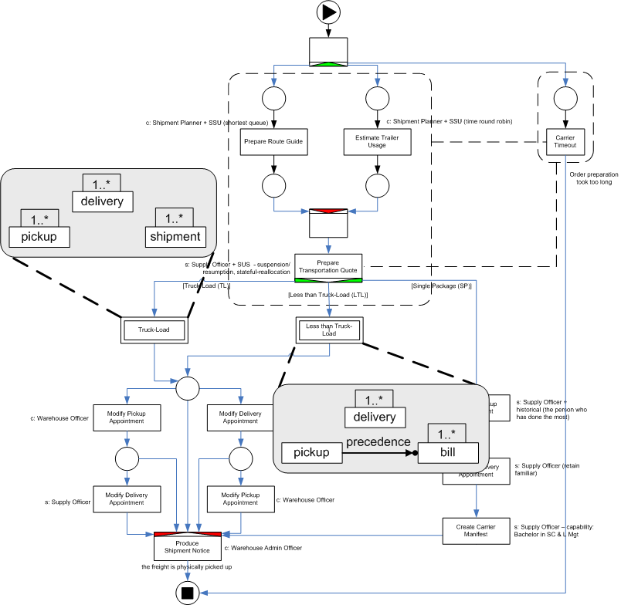
Procedural Workflows and Declarative Workflows
none is better solution
should be combined
implementation in YAWL

Slide 31
Flexibility and Support in Declarative Workflows
flexibility
support
by design
by underspecification
by change
by deviation
model verification
monitoring instance state
monitoring states of constraints
ensuring correct instance execution
ensuring correct instance completion

