Slide 1
Chapter 8
The Design Environment
Stephan Clemens
Marcello La Rosa
Arthur ter Hofstede

Slide 2
Outlook
The GUI of the Editor
Setting up Control Logic
Specifying Data Aspects
Defining Resource Perspective
Error Reporting
Specification File
Notes:
The Editor in YAWL

Slide 3
The Editor GUI

Slide 4
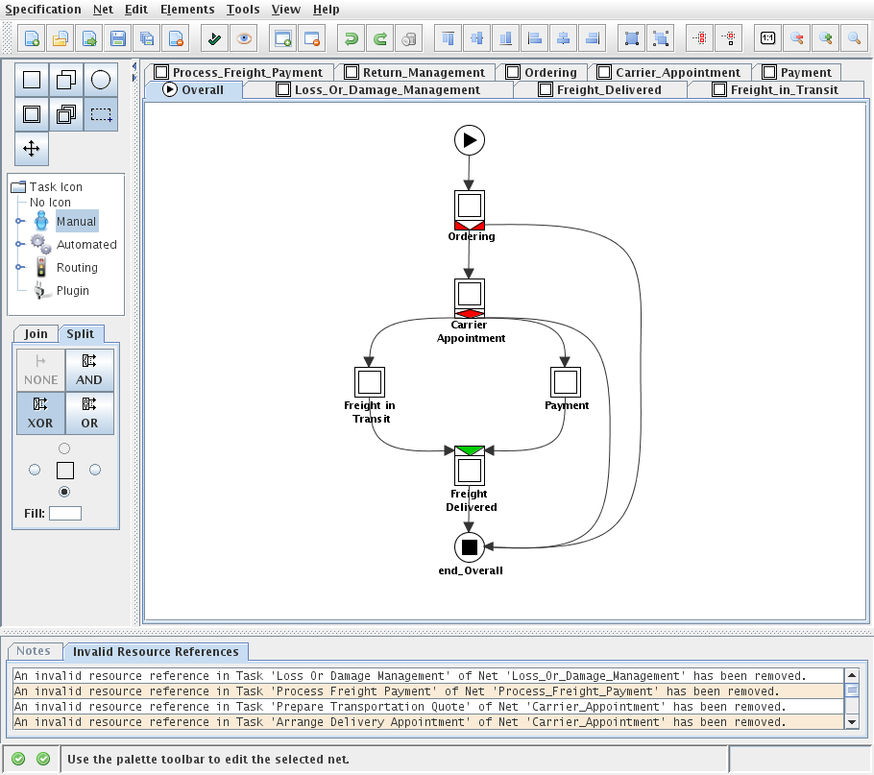
GUI of the Editor
Specification Maintenance
New specification
Open specification
Import deprecated ‘*.ywl’ specification
Save specification
Save specification under different filename
Close specification

Slide 5
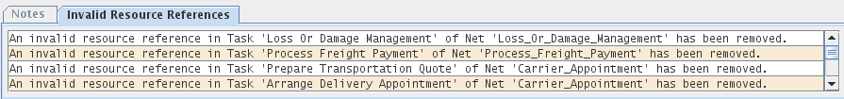

GUI of the Editor
Specification …
Verification
Analysis

Slide 6
GUI of the Editor
Net Maintenance
Add new net to specification
Remove net from specification

Slide 7
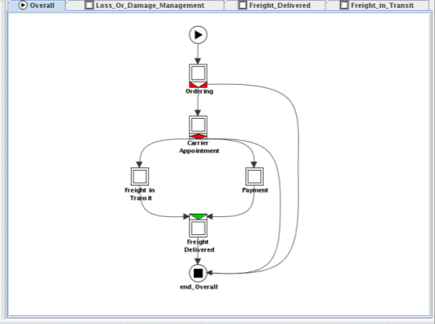
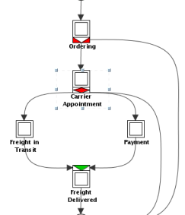
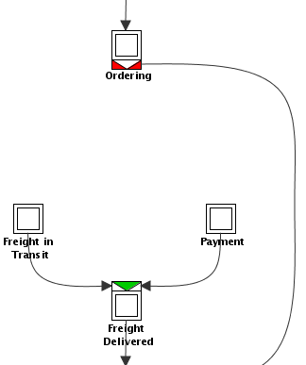
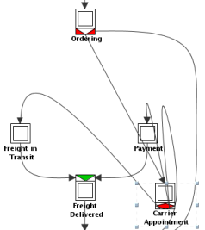
GUI of the Editor
Edit Options
Undo
Redo
Delete
selected
Element

Slide 8
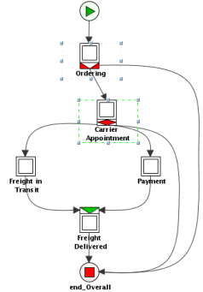
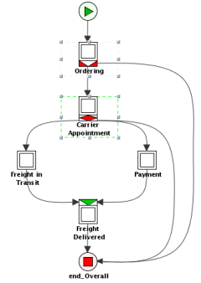
GUI of the Editor
Alignment Options

Slide 9
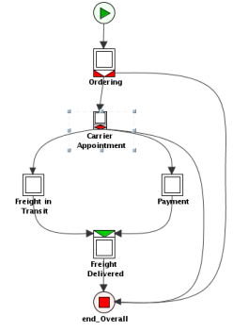
GUI of the Editor
Element Size Options
Increase
Decrease

Slide 10
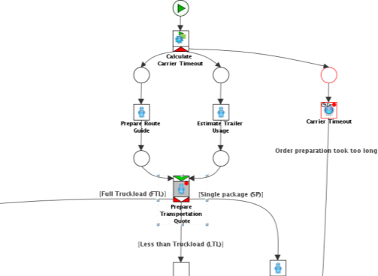
GUI of the Editor
Cancellation Sets
Add selected elements
to cancellation set
Remove selected
elements from
cancellation set

Slide 11
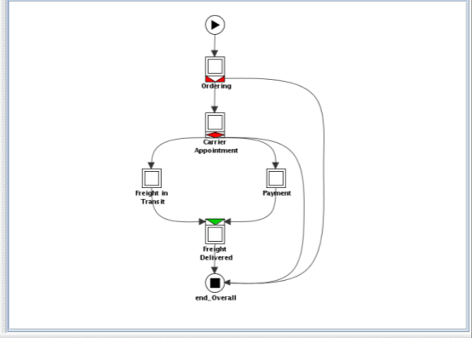
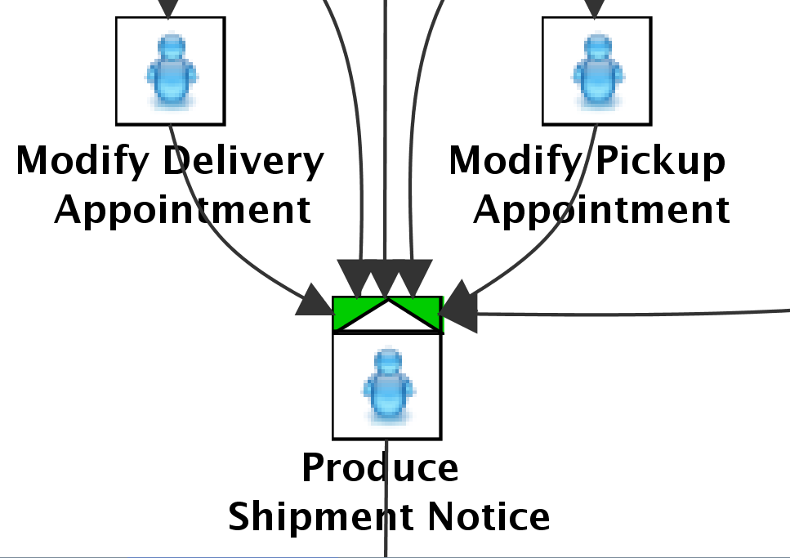
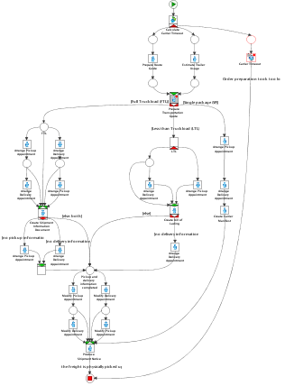
GUI of the Editor
Zoom Options
1:1 mapping
Zoom-Out
Zoom-In
Magnifier
Notes:
Carrier Appointment net out-zoomed
Magnifier on three selected tasks

Slide 12
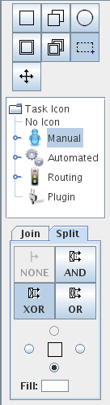
GUI of the Editor
Workflow-Elements and Tools
Single atomic task
Multiple atomic task
Condition
Composite task
Multiple composite task
Marquee Tool
Drag Tool

Slide 13
GUI of the Editor
Tasks Icons

Slide 14
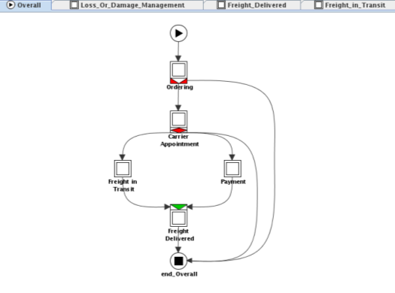
GUI of the Editor
Task decorations
Splits & Joins
Positioning constructs
Colorizing

Slide 15
GUI of the Editor
Status Panel
Engine Status (active: green, inactive: red)
Resource Service Status (active: green, inactive: red)
Hints & Messages

Slide 16
Process Control Logic

Slide 17


Setting up the Process Control Logic
Mandatory Elements within a YAWL specification
Input Condition
Output Condition
Task hierarchy:
Task
Atomic
Composite
Single
Multiple
Single
Multiple
Manual
Automated
Routing
Manual
Automated

Slide 18
Setting up the Process Control Logic
Mandatory Elements within a YAWL specification
Input Condition
Output Condition
Task hierarchy:
Task
Atomic
Composite
Single
Multiple
Single
Multiple
Manual
Automated
Routing
Manual
Automated

Slide 19
Setting up the Process Control Logic
Mandatory Elements within a YAWL specification
Input Condition
Output Condition
Task hierarchy:
Task
Atomic
Composite
Single
Multiple
Single
Multiple
Manual
Automated
Routing
Manual
Automated

Slide 20
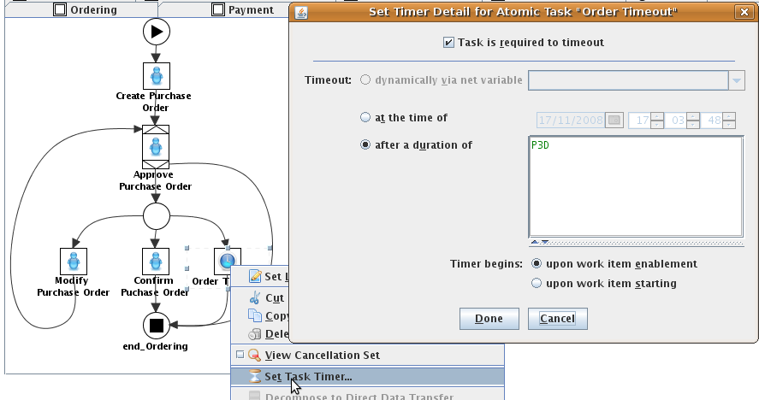
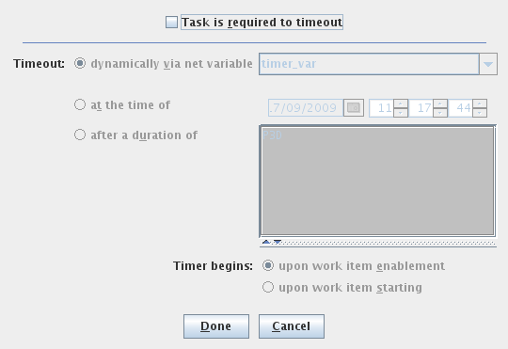
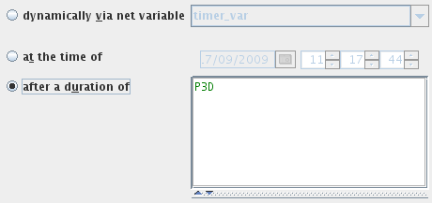
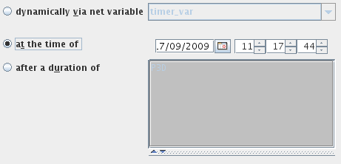
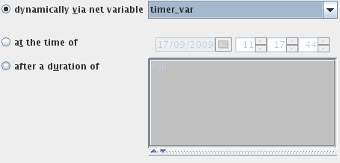

Timer task
Atomic single instance task executed within a given timeframe
Define duration at design time
Format:
PnDTnHnMnS, where nD represents the number of days, T is the date/time separator, nH the number of hours, nM the number of minutes and nS the number of seconds
Activation on:
  enablement
  start
Define point in time at design time
Point in time or duration defined via net variable of type YTimerType
In this example dialogue
‘P3D’ defines that the
timer task triggers within
3 days.

Slide 21
Routing conditions
A task with multiple incoming/outgoing flows need to be decorated with a join/split construct
Routing conditions need to be applied for XOR- and OR-splits
Conditions are expressed based on XPath
In terms of XOR-splits the condition order determines the evaluation order of predicates
  Control is passed to first target task whose predicate evaluates to true
  The last entry within the ordered conditions is the default flow. I.e. if no predicate evaluates to true, control is passed to the target task of the last ordered flow
In case of OR-splits, control is passed to all target tasks whose predicates evaluate to true

Slide 22
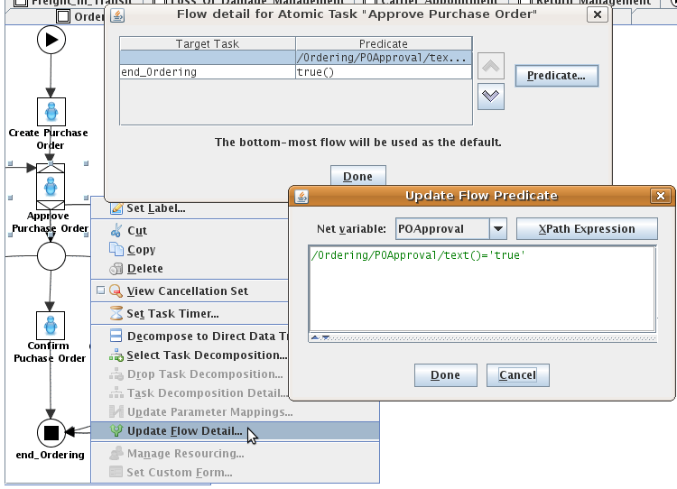
XOR-split Example
Ordered routing condition table
Determine order
Specify predicate

Slide 23
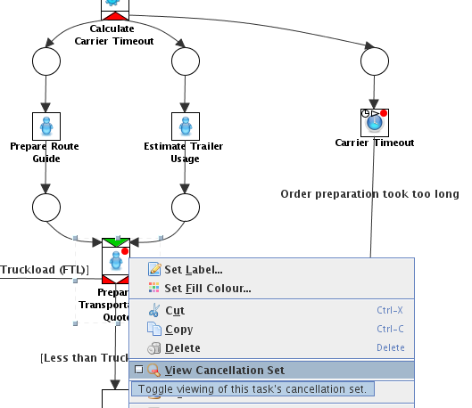
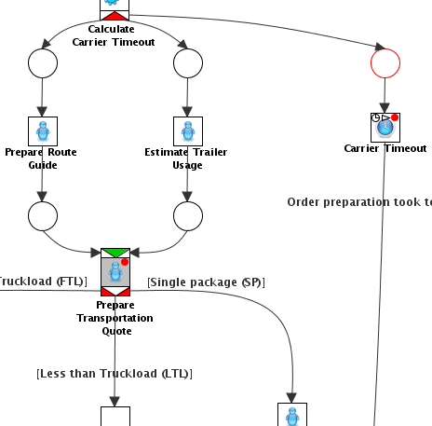

Cancelation Set
Activation of a cancellation set
  Tasks that are associated with a cancelation set are marked by a red dot
  Open context menu of
  a task
  Select View
  Cancellation Set
Add workflow element to cancelation set
  The task Carrier Timeout can be added to the cancelation set by
  selecting the task
  and clicking on
  in the toolbar

Slide 24
Data Aspects

Slide 25
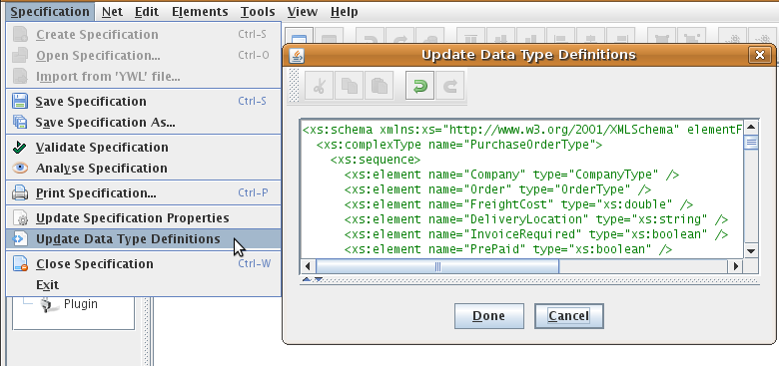
XML Schema type definition
Editor provides support for
  Simple XML Schema types
  Complex XML compositions

Slide 26
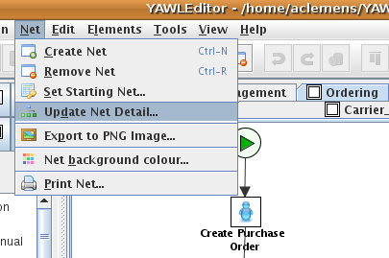
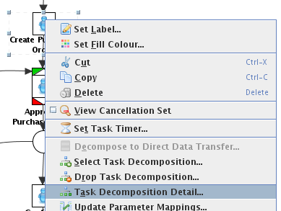
Decomposition
Contain variables to enable nets and tasks to read and modify data
  Unique label
  One or multiple variables
Net decomposition: Net → Update Net Detail…
Task decomposition: Context menu of a task→ Task Decomposition Detail…

Slide 27
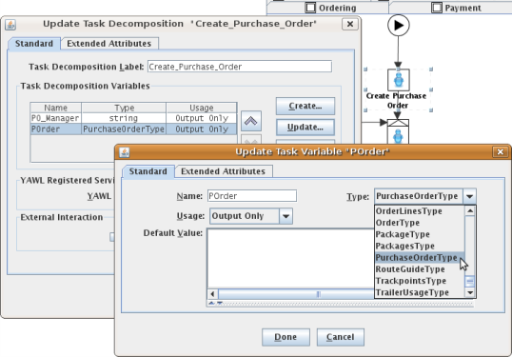
Decomposition
Net- and Task-Decomposition dialogue allows to specify
  Decomposition label (unique identifier)
  Variable name
  Data type (simple or complex data type)
  Type of usage
  Default value
  External attributes

Slide 28
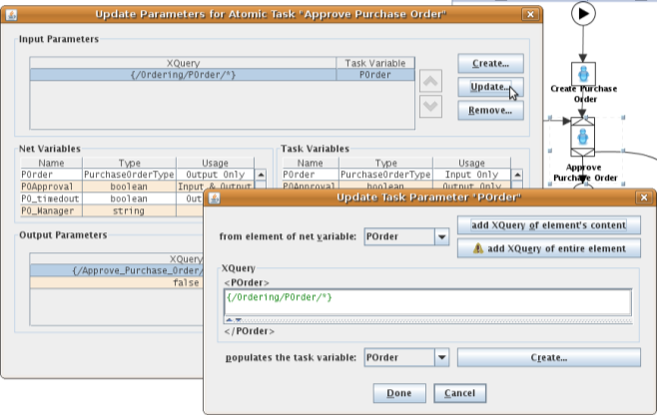
Decomposition - Mapping
In- and output mapping defines how data is transferred between net and task variables
The mapping is based on XQuery expressions

Slide 29
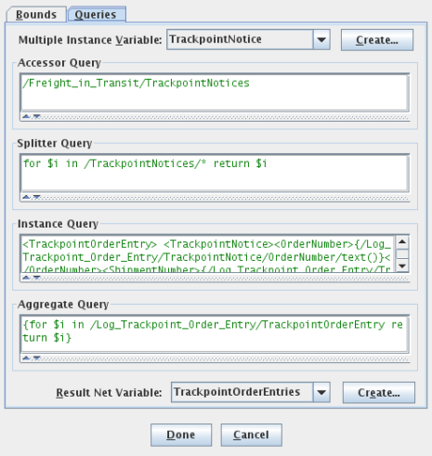
Multiple Instance Task
  Aggregate Query, generates the overall result
  Result Net Variable, contains the generated overall result
Beside in- and output mappings, multiple instance tasks need additional information:
  Multiple Instance Variable, contains data to be distributed to various task instances
  Accessor Query, manipulates the content of the instance variable before the unique values are split out
  Splitter Query, passes a unique value to each instance task
  Instance Query, transforms the returned XML document of each task instance into a suitable form for the subsequent Aggregate Query
  Aggregate Query, generates the overall result
  Result Net Variable, contains the generated overall result

Slide 30
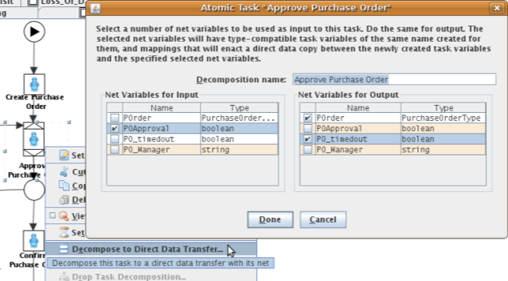
Decomposition – The Lazy Way
The “Decomposition to direct data transfer” dialogue allows to quickly create a task decomposition
The respective task should not have a decomposition assigned
A set of net variables can be selected and used as template for the
task variables
Variables, data
types, in- and
output
mappings are
automatically
generated

Slide 31
Resource Perspective

Slide 32
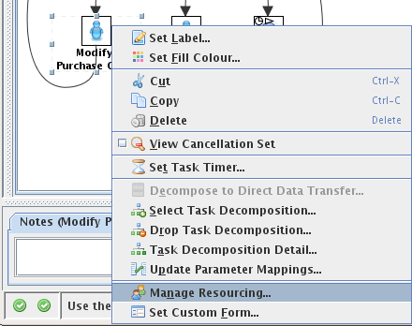
Resource Manager Wizard
Resource Manager Wizard allows to easily assign participants to a manual task
In order to invoke the wizard
  A decomposition need to be assigned to the task
  The task must be related to the default worklist
  The Editor has to be connected
  to a running Resource Service
  Should the Resource Service
  be active but stated as offline,
  a connection can be establish-
  ed via the menu entry Tools →
  Resource Service Connection
  Settings

Slide 33
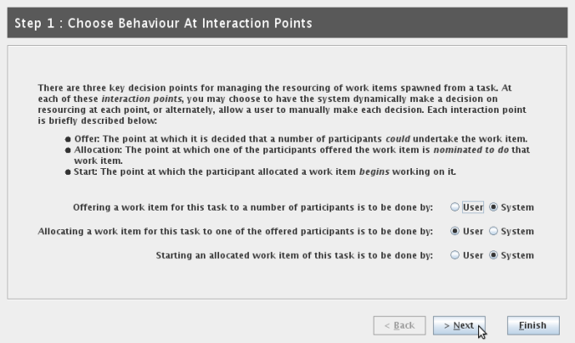
Step 1 - Interaction Points
Specification of how a manual task should be offered, allocated and started:
  User-initiated
  System-initiated

Slide 34
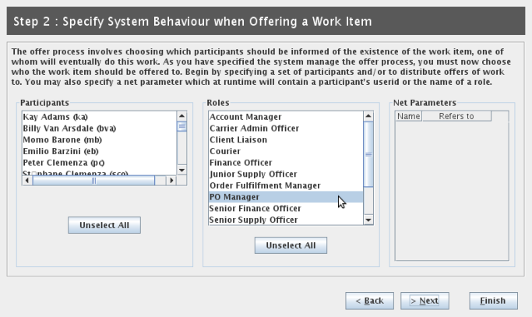
Step 2 - Offering a Work Item
Specification of what resources will be offered a work item by selecting:
  Individual participants
  Roles
  Resources
  defined via
  net para-
  meters, i.e.
  late-bind-
  ing

Slide 35
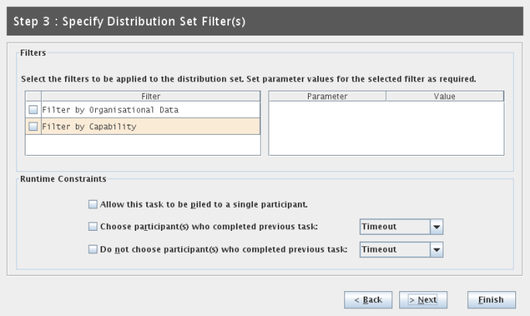
Step 3 - Distribution Set Filters
Restriction of selected resources to those who
  Belong to a certain organization group
  Have appropriate capabilities

Slide 36
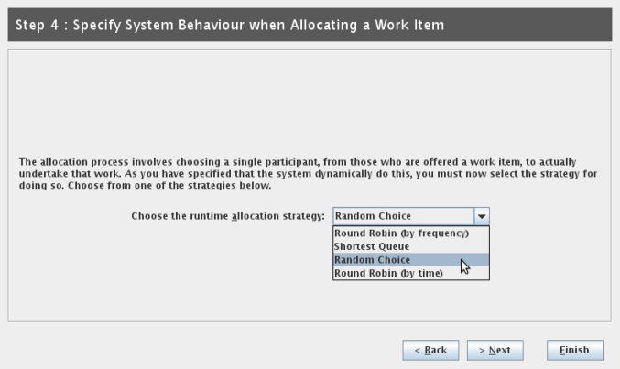
Step 4 - Allocating a Work Item
If the work item allocation is system initiated, an allocation strategy needs to be specified

Slide 37
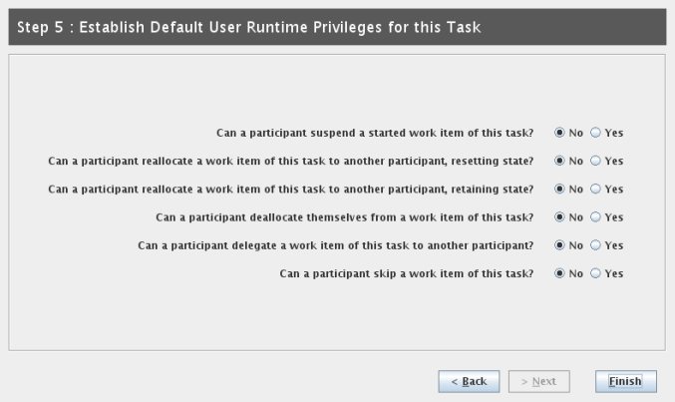
Step 5 - Runtime Privileges
Allows the specification of several participant priviliges for runtime
E.g. suspending or skipping the execution of a work item

Slide 38
Error Reporting &
Specification File

Slide 39
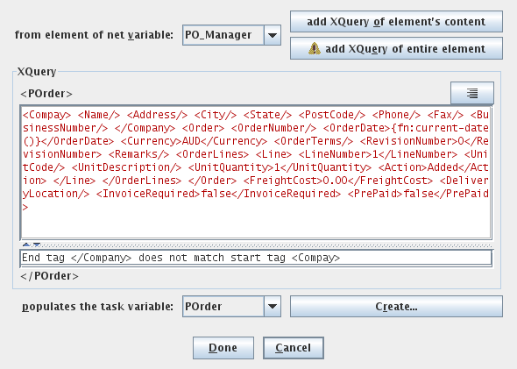
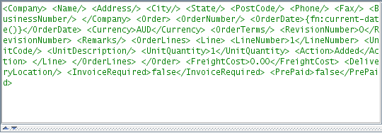
Error Reporting
Verification of XQuery and XPath expressions
Suggestion for error resolution

Slide 40
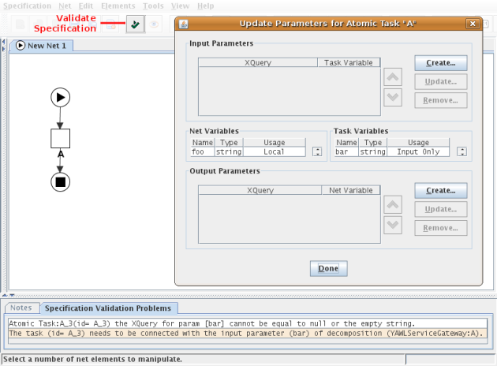
Error Reporting
Validation of specification
Generation of entries that indicate about specification inconsistencies
In the figure
on the right, the
wf-designer is
informed about
the missing in-
bound mapping
for variable bar
of task A

Slide 41
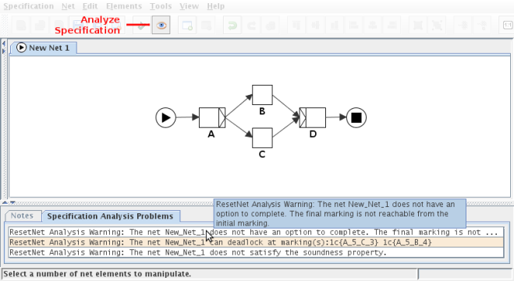
Error Reporting
Verification and analysis of specification
Detection of behavioral problems of the specification, e.g.
  Deadlock
  Unnecessary
  cancellation
  set members
  Unnecessary
  OR joins
The figure on
the right shows
a specification
with a potential
deadlock

Slide 42

Specification File
YAWL Workflow specifications are serialized into an XML document with the file extension *.yawl
The document is separated in two parts with
  Conceptual information
    Decompositions
    Workflow elements
    Relations
  Layout information for
  visualization purposes
    Placement of
    workflow elements
    Applied icons
    Used fonts …
…
<container id="Create_Purchase_Order_104">
<vertex>
<iconpath>.../Manual.png</iconpath>
<attributes>
<bounds x="177.0" y="80.0" w="32.0" h="32.0" />
</attributes>
</vertex>
<label>
<attributes>
<bounds x="144.0" y="112.0" w="96.0" h="28.0" />
</attributes>
</label>
</container>
…

