Slide 1
Chapter 9
The Runtime Environment
Michael Adams

Slide 2
Topics
Basic Operations
Engine Internal Architecture
Lifecycle
Persistence & Logging

Slide 3

Runtime
In terms of the YAWL System, runtime is when:
  the host server is operational
  the Engine is running in its Servlet Container (e.g. Tomcat) and accepting requests to:
    load specifications
    start process instances (cases)
    check work items in and out
    process interface calls
    generate case and work item events
    handling case data mappings
    progressing cases as per their control flow

Slide 4
Basic Operations
The Engine will prepare work items for execution according to control-flow, but:
  it is not responsible for how the work is performed; rather it delegates responsibility to a custom service
  it knows nothing about users, but only of custom services
  it is unconcerned with how work items are resourced
It does manage two perspectives:
  control-flow: determining which task(s) are enabled at certain times during the life-cycle of a process, based on flows, conditions, splits, joins and so on
  data: mapping values to and from tasks and their parent nets, performing transformations and evaluating expressions using the specified XPath and XQuery predicates

Slide 5
Process Specifications
A specification is expressed as an XML document that describes the structure, format, data and layout of a process that has been expressed graphically in the Editor, and written when saved to file.
Each specification is loaded into the Engine via Interface A. Once loaded, the Engine stores the specification until such time it is manually unloaded (which will only succeed if there are no process instances based on it currently running).
The Engine can execute a number of cases at the same time, each one an instance of some specification
  several versions of the same specification can be loaded at the same time

Slide 6
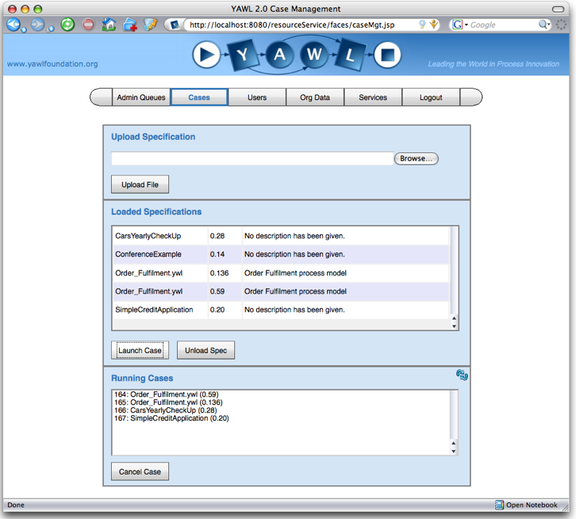
The Case Management Form
Notes:
This form is used to load and unload specifications, as well as launching and cancelling cases. Note that there is two versions of the order fulfilment specification loaded, each one with a case running against it.

Slide 7
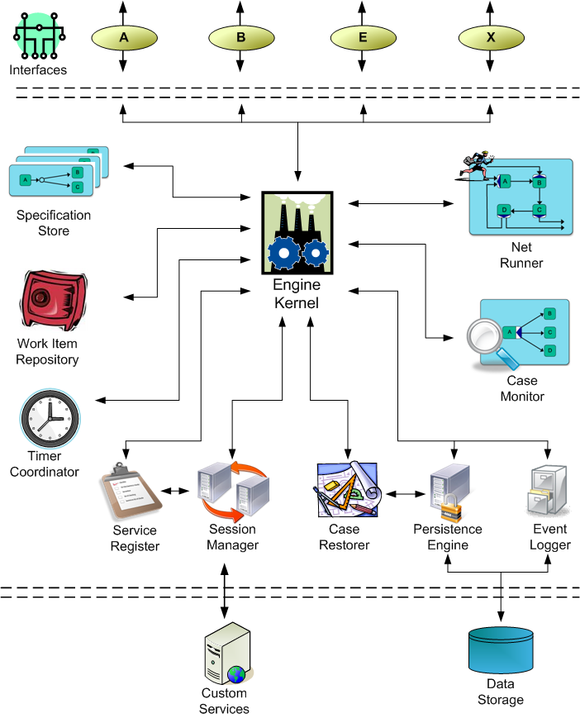
Engine Internal Architecture

Slide 8
Engine Internal Architecture: The Kernel
The Engine Kernel co-ordinates the various components, and manages interface communications.
Through the Kernel, specifications are loaded, case instances are started and cancelled, work items are managed, services are registered and so on.
The Kernel also takes care of the data-perspective, mapping values to and from tasks and their parent nets, evaluating XQuery predicates and storing those results.

Slide 9
Engine Internal Architecture
Specification Store: a repository of specifications (in XML) from which process instances are started
Net Runner: progresses the control-flow of a net
  each root net and each sub net of a case has its own Net Runner
Work Item Repository: maintains cached, ordered sets of ‘live’ work items
Case Monitor: tracks the status of all current cases
  passes this data to services
Timer Coordinator: manages expiry times and associated actions for all timed tasks
  one Timer Coordinator within the Engine manages all timers for all tasks

Slide 10
Engine Internal Architecture
Service Register: maintains the set of currently registered custom services
Session Manager: maintains active sessions between the Engine and custom services
  manages the session handle for each service session
Persistence Engine: manages runtime object persistence to permanent storage
  All runtime requests to persist objects, and to retrieve objects from persistence, pass through this component.
Case Restorer: when the Engine is (re)started, its job is to restore all the case instances that were running when the Engine was shutdown
Event Logger: handles the logging of all process events

Slide 11
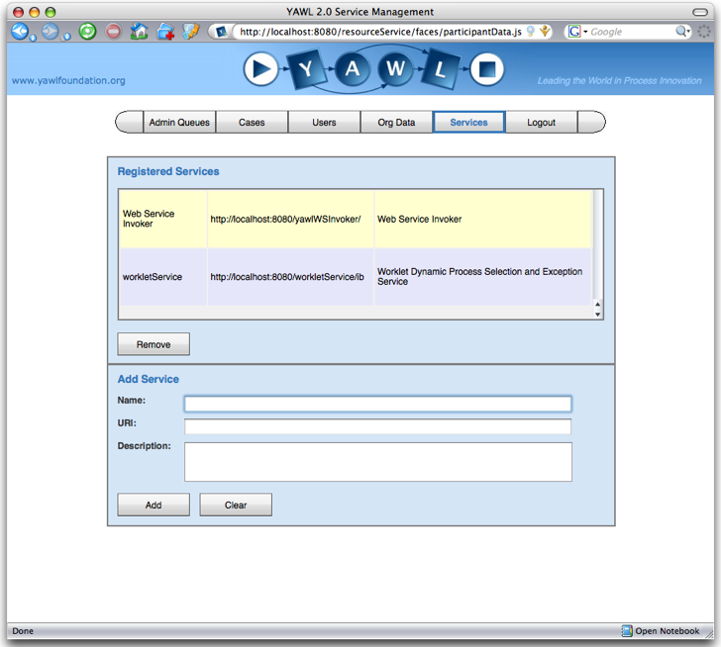
The Service Management Form
Notes:
This form is used to register custom services with the engine

Slide 12
Lifecycle
If a task definition has a decomposition, its work items are created to allow interaction with the external environment (i.e. custom services and applications)
If there is no decomposition for a task (a so-called placeholder or empty task), the task is automatically created and immediately completed within the Engine
When a case starts, and when each task within it completes, the Engine analyses the current state of the case to determine which task or tasks it should next make available for execution
  in workflow net terms, it examines the current marking of the net to determine which transitions (tasks) have tokens in each of their input places (conditions), taking into account what type of join decorator (if any) the task has

Slide 13
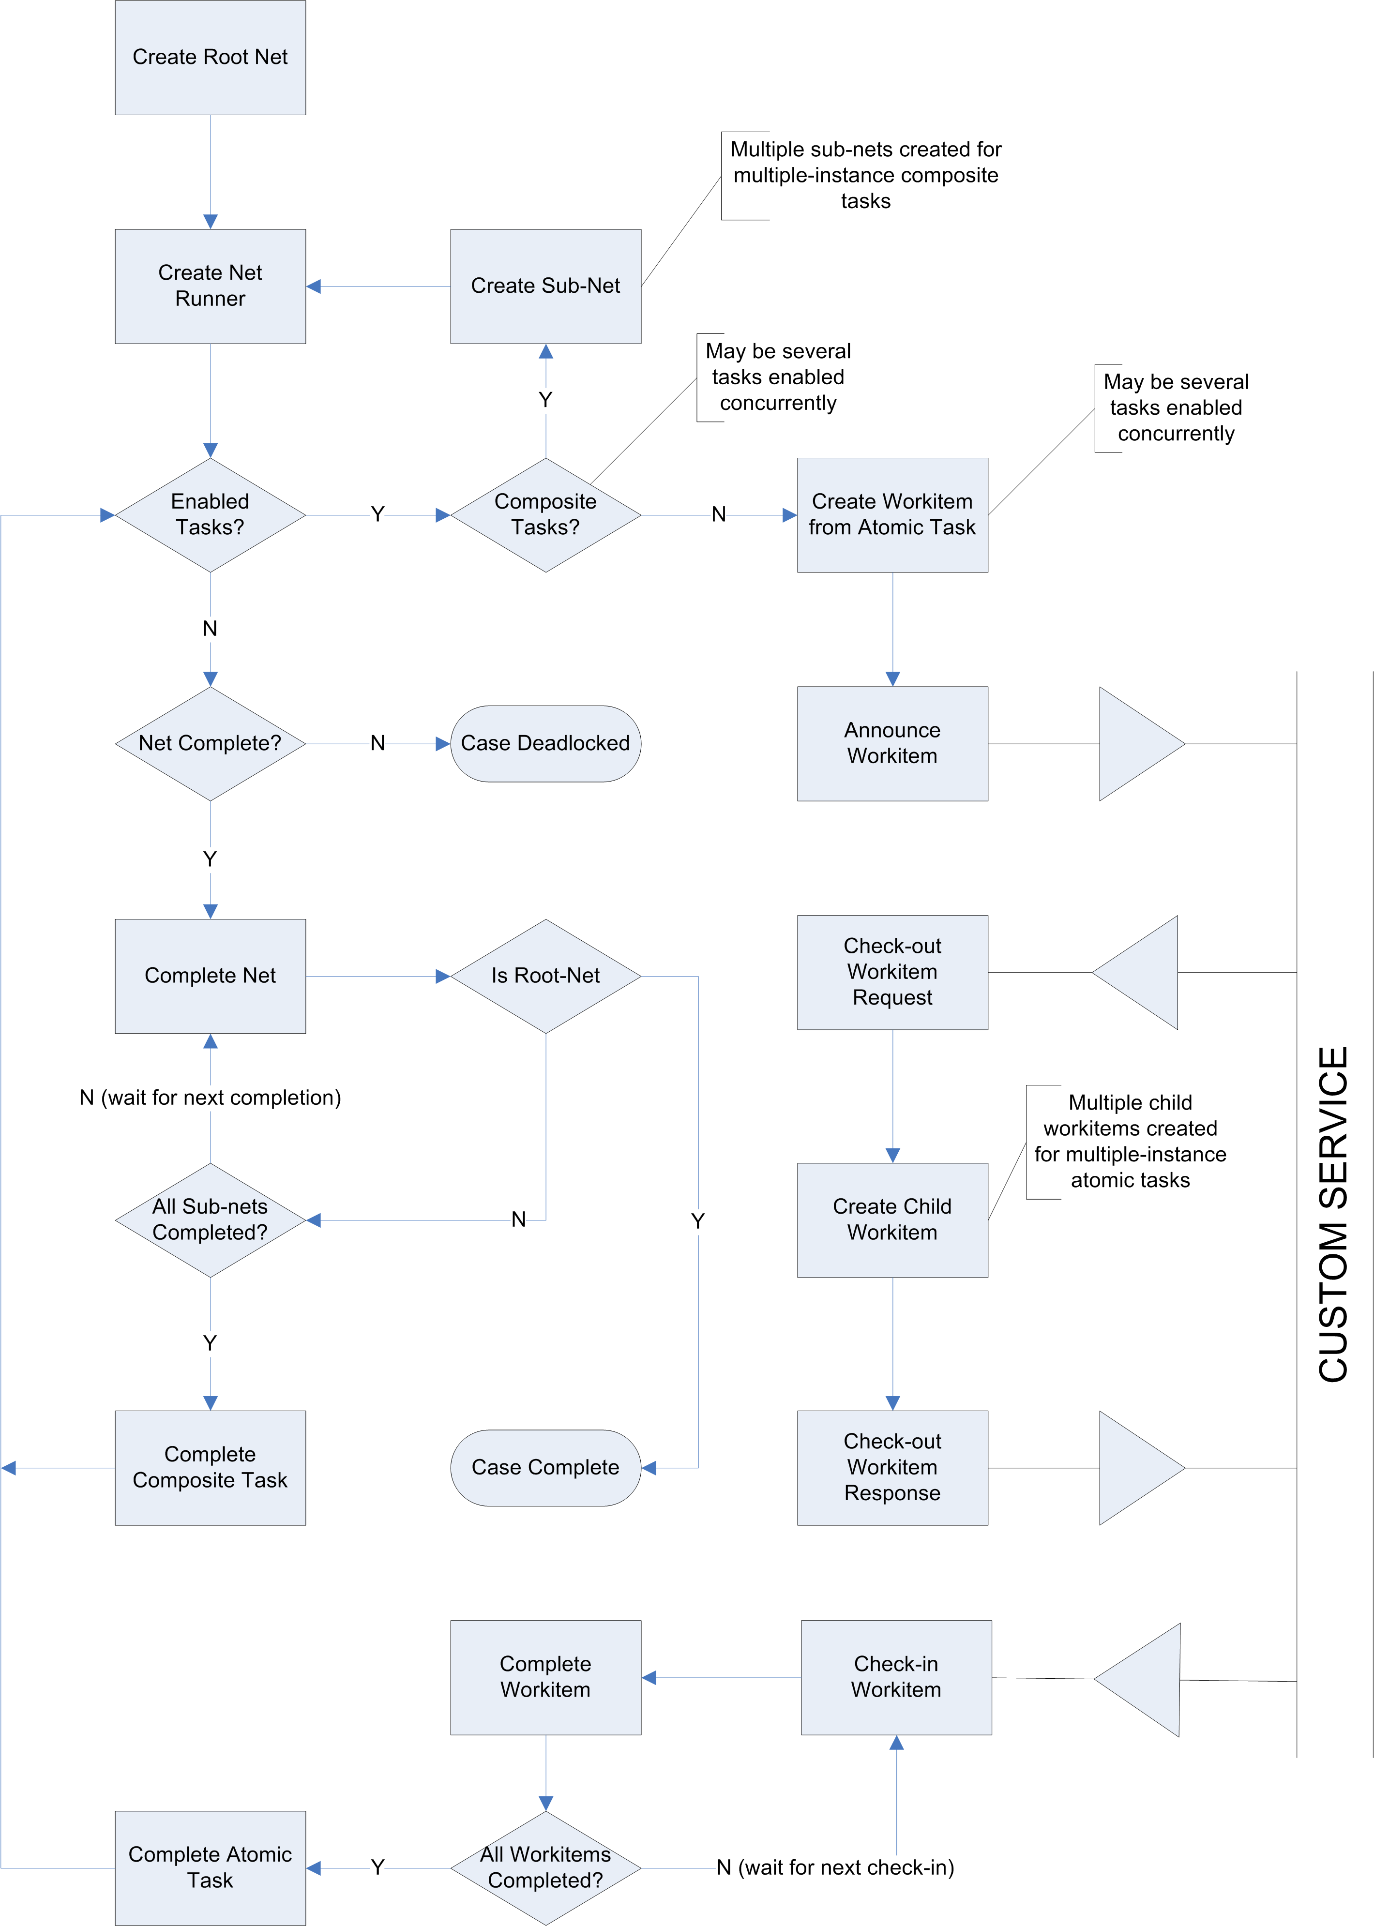
YAWL Case Lifecycle

Slide 14
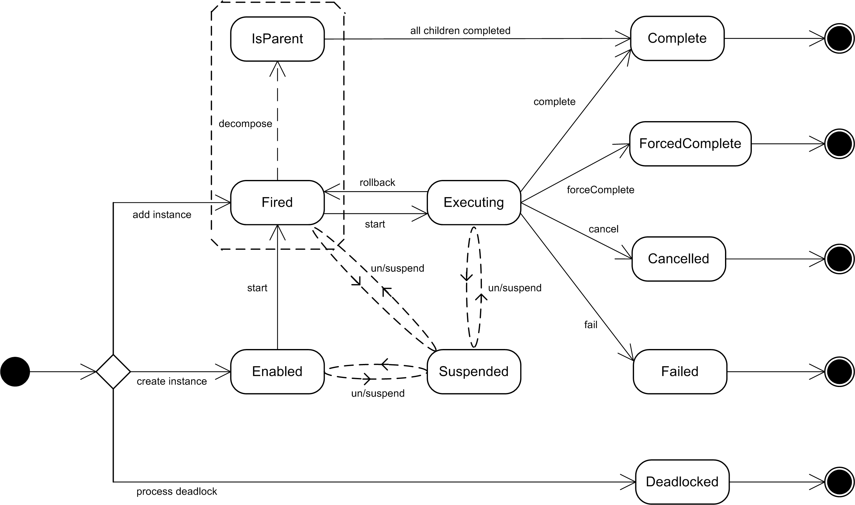
Work Item Lifecycle

Slide 15
Persistence
To guard against the potential loss of process information as a result of server downtime, all YAWL process instances may be persisted
Data persistence means saving all data relevant to each executing process to permanent data storage (i.e. a disk)
In the event of an outage, on restart the process can be ‘reconstituted’ from the stored data, and work can continue on the process as if the outage had not occurred
In YAWL, persistence is configured on by default and recommended, although it can be configured off if desired

Slide 16
Persistence
For a successful restart, it is important that all the necessary data and descriptors of a process are stored, and can be reassembled from that stored data
This requires that data be inserted, updated or removed at every event and milestone in the process life-cycle
All relevant aspects of a process instance are persisted, and updated if those values change
When an instance (case, task or token) completes, all references to it are removed from the persistence tables.

Slide 17
Process Logging
Process logging plays two fundamental roles:
  it provides an audit trail of interactions between the workflow Engine and its environment; and
  it represents a historical archive of process executions, which may later be analyzed for insights into the operation of specifications
YAWL’s process logs detail:
  each executing case from commencement to completion (or cancelation)
  the enabling of each work item and each of its status changes through to completion (or cancelation)
  all changes made to work item and net data values
Configurable logging is supported, that is the logging of user-defined data attributes, values and descriptors associated with certain parts of the process data

Slide 18
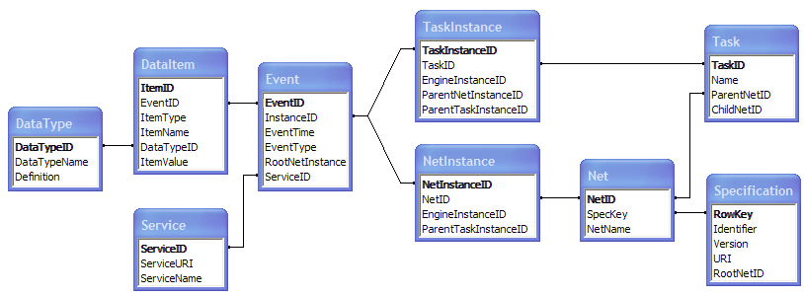
Process Logging

Slide 19
Summary
Basic Operations
Engine Internal Architecture
Lifecycle
Persistence & Logging

