Slide 1
Chapter 10
The Resource Service
Michael Adams

Slide 2
Topics
Functional Overview
Organizational Model
Service Architecture
Initial Distribution
Privileges
The Worklist

Slide 3

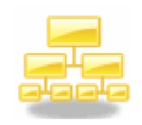
The Resource Service
The resource perspective is primarily responsible for modeling an organizational structure, and the people who populate it, in a computational form, so that a person may be coupled with tasks and data emanating from the control-flow and data perspectives
The YAWL Resource Service provides full support for 37 of the 43 identified resource patterns (the remaining six being particular to the case-handling paradigm) and so may be considered the pre-eminent implementer of workflow resource pattern support

Slide 4
The Resource Service
Provides the resource perspective for specifications
  completely separate from the Engine
Basic role is to allocate work items to resources for processing
It has four primary components:
  Resource Manager: handles all the resource patterns
  Worklist: a web-based user interface
  Forms Connector: show either custom designed or dynamically generated forms for work items
  Codelet Server: for executing codelets

Slide 5
The Resource Service
A resource may be a person (participant), or an application, service or codelet
Each participant may perform one or more Roles, hold one or more Positions (each of which belongs to an Org Group) and possess a number of Capabilities
Workflow tasks that require resourcing at runtime have their resourcing requirements specified at design time using the Editor

Slide 6


Task vs Work Item
A YAWL process specification will contain a number of task definitions, and control-flow, data and resourcing specifications are all defined with reference to tasks at design time
At runtime, each task acts as a template or contract for the instantiation of one or more work items
  That is, a work item is a runtime instance derived from a task definition
task
work items

Slide 7
The Resource Service – Design Time
For a manual task, a designer may provide details of a distribution set of resources to which the task should be offered at runtime
A distribution set may consist of the union of:
  zero or more individual participants,
  zero or more roles, and
  zero or more dynamic variables (which at runtime will be supplied with details of participants and/or roles)
The resultant distribution set may be further filtered by specifying that only those participants with certain capabilities, occupying certain positions and/or being members of certain org groups, be included

Slide 8
A Distribution Set – Design Time
Participants
Roles
Variables
Notes:
Conceptually, a distribution set is defined as the union of a number of participants, roles and variables. Some of the participants specified may also belong to some of the roles specified. Also, the net variables at runtime also may refer to a participant or role that is already included in the set. Thus the distribution set is strictly a set – when it all breaks down to a set of participants, duplicates are ignored

Slide 9
Resource Service Runtime
At runtime, the Resource Service receives EnabledWorkItemEvent notifications from the Engine via Interface B for all enabled work items that are not specifically registered with another YAWL Service
For manual tasks, it will use the resourcing specification defined at design time to determine the initial distribution set of participants, and then apply the defined filters, constraints and allocation strategies to that set before distributing the work item to the appropriate participant(s)
For automated tasks, the service retrieves a reference to the specified codelet (if any) and then executes it using the work item’s data as inputs

Slide 10
A Distribution Set - Runtime
Participants
Roles
Variables
Notes:
At runtime, roles (whether specified directly or via a variable) are deconstructed to a set of participants.

Slide 11


Distribution Set: Constraints
A designer may also specify certain constraints to apply, for example:
  Four Eyes Principle (or Separation of Duties): a certain work item must not be performed by the same participant who completed an earlier specified work item in a process, or
  Retain Familiar: if a participant who is a member of the distribution set of a work item is the same participant who completed a particular previous work item in the process, then they must also be allocated the new work item.

Slide 12
Resourcing Interaction Points
There are three interaction points – places in a work item’s lifecycle where resourcing decisions are to be made – up to and including the moment the work item is placed in a work queue
At each interaction point, the decision may be:
  system-initiated – automatically performed by the system, using parameters set at design time, or
  user-initiated – manually performed by a participant or administrator at runtime

Slide 13
Resourcing Initiation Points
The three interaction points are:
  Offer: The work item is offered to one or more participants for execution. There is no implied obligation (from a system perspective) for the participant to accept the offer
  Allocate: The work item is allocated to a single participant, so that the participant is committed (willingly or not) to performing that work item at a later time. If the work item was previously offered to several other participants, the offer is withdrawn from them at this time; and
  Start: The work item is started by the allocated participant (i.e. enters executing state)

Slide 14

Offer
If a work item’s offer interaction is user-initiated, it is passed to the administrator’s Unoffered queue so that it can be manually offered to one or more participants
If an offer interaction is system-initiated, the work item is offered to one or more participants based on the resourcing parameters defined for it at design time, by placing it on the participants’ Offered queue

Slide 15

Allocate
If a work item’s allocation interaction is user-initiated, one of the participants offered the work item may manually choose to allocate the task to him/herself
If the allocation interaction is system-initiated, an allocation strategy (e.g. random choice, round robin, shortest queue), as defined at design time, is invoked that selects a single participant from those offered
In either case, the work item is placed on that participant’s Allocated queue and removed from the Offered queues of all other Offered participants.

Slide 16

Start
If a work item’s start interaction is user-initiated, a participant must manually select it from their Allocated queue to start its execution
If a start interaction is system-initiated, the work item is automatically started
In either case, the work item is placed on the participant’s Started queue for action
Thus, there are eight different interaction point combinations
Each participant may have, at any particular time, work items in any of three personal work queues, one for each of the interaction points (a fourth queue, Suspended, is a derivative of the Started queue).

Slide 17
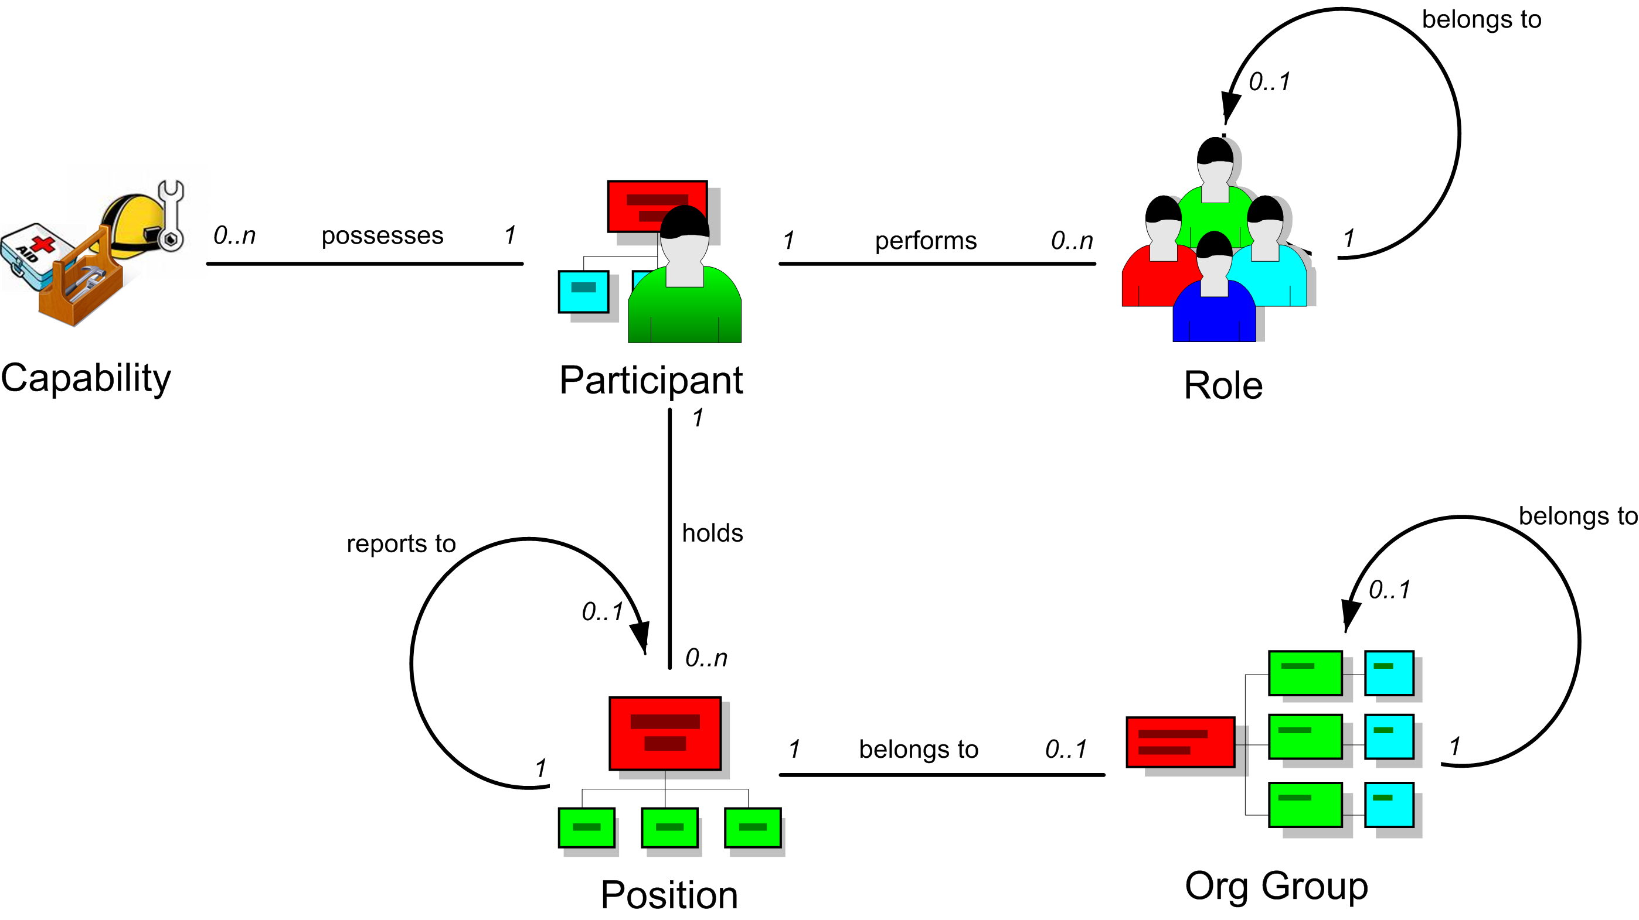
YAWL Organisational Model
*all relations are from the perspective of a unique participant

Slide 18
Role
Generally, a role is a duty or set of duties that are performed by one or more participants
  For example, bank teller, police constable, credit officer, auditor, properties manager and junior programmer are all examples of roles that may be carried out within an organization
There may be several participants performing the same role
  For example, a bank may have a number of tellers
A certain participant may perform multiple roles
Further, a role may belong to a larger, more general role
  For example, the roles junior teller and senior teller may both belong to a more general role called ‘teller’

Slide 19
Capability
A capability is some desired skill or ability that a participant may possess
  For example, first aid skills, health and safety training, a forklift license or a second language may all be considered as useful capabilities that a participant may possess
There may be several participants possessing the same capability, and a certain participant may possess a number of capabilities
A capability (or capabilities) may be included in a filter defined at design time that is run over the distribution set for a task at runtime, meaning that those participants within the distribution set that don’t possess the specified capability or capabilities are removed.

Slide 20
Position (1)
A position typically refers to a unique job within an organization for the purposes of defining lines-of-reporting within the organizational model
  Examples might include CEO or Bank Manager, or may be internal job codes (such as ‘TEL0123’)
Generally a participant will hold exactly one position, and each position in the model will contain exactly one participant, but to maximize flexibility these restrictions are not enforced in the YAWL model
A position may report to zero or one other positions
  for example, bank teller ‘TEL0123’ may report to the Bank Manager

Slide 21
Position (2)
Like capabilities, a position (or positions) may be included in a filter defined at design time that is run over the distribution set for a task at runtime
Positions are also used at runtime to enable resource patterns such as delegation, reallocation and viewing of team work queues

Slide 22
Org Group
An organizational group (org group) is a functional grouping of positions
  Common examples might include Marketing, Sales, Human Resources and so on, but may be any grouping relevant to an organization.
In the YAWL model, each position may belong to zero or one org groups
Further, like roles, an org group may belong to a larger, more general org group
  For example, the groups Marketing and Sales may each belong to the more general Production group
  Org groups are often also based on location
Like positions, org groups may be included in a filter defined at design time

Slide 23
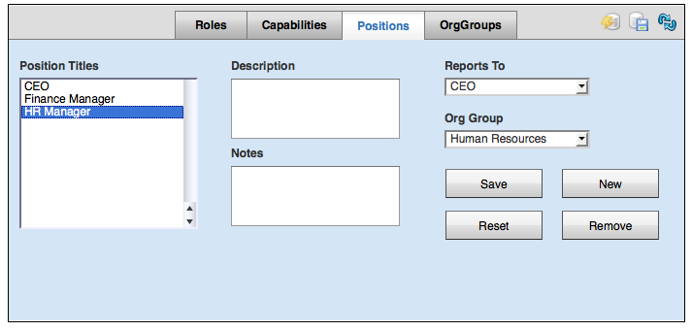
Org Data Maintenance
The Org database may be populated and maintained via the User Management and Organizational Data Management forms, part of the toolset available to Re- source Service administrators.

Slide 24
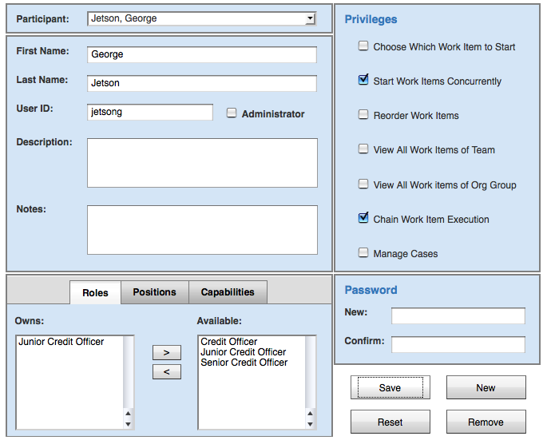
Org Data Maintenance

Slide 25
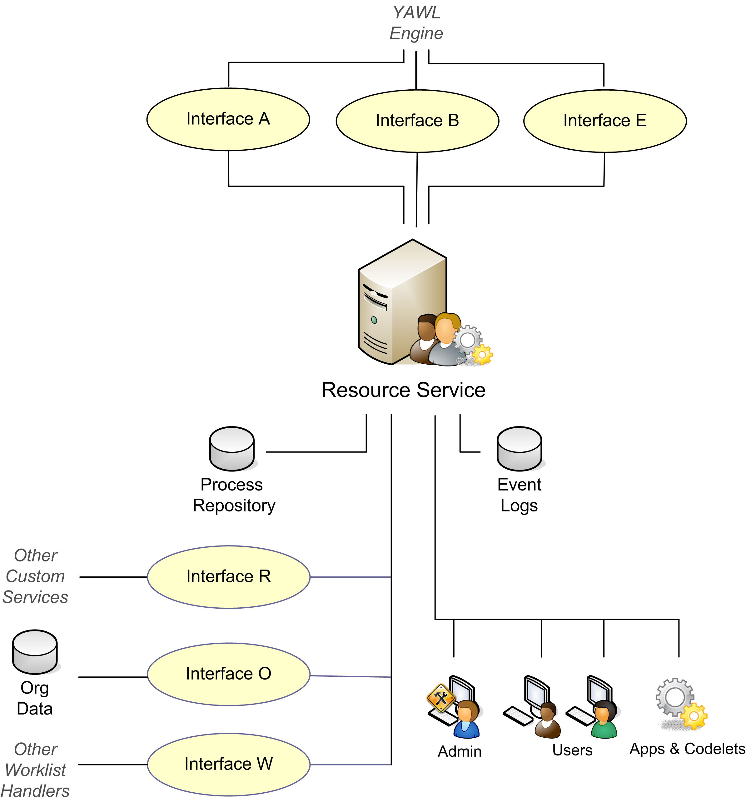
Resource Service Architecture
The Resource Service is the largest and most complex of the YAWL Custom Services, and consists of a number of components.
Also, much of the service has pluggable interfaces, where end-user organizations can add their own customizations.

Slide 26
The Resource Service Interfaces
In addition to communicating with the Engine through Interfaces A, B & E, the Resource Service exposes functionality through three interfaces of its own:
  Interface O provides an interface to organizational data sources, allowing pre-existing data sources to be directly ‘plugged in’ to the service.
  Interface R provides access to the organizational data by authorized external clients (such as, but not limited to, the Editor).
  Interface W exposes the entire worklist routing functionality, to allow external, specialized worklists to be developed and implemented.

Slide 27
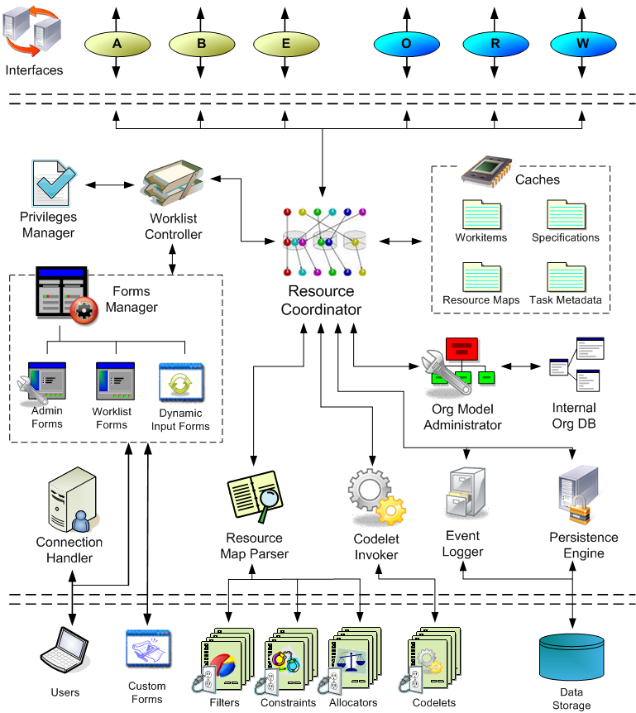
Resource Service Internal Architecture

Slide 28
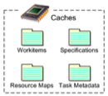
Internal Architecture Components
Caches
  Work Items: all work items received from the Engine, and all items in work queues are actually references to the work item cache. This cache is persisted.
  Specifications: each loaded specification
  Task Metadata: descriptors of each task (parameters, data schemas etc)
  Resource Maps: created from resource specifications & used to distribute work items to resources

Slide 29
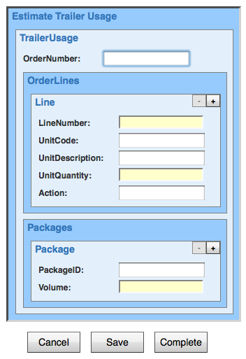
Internal Architecture Components
Forms Manager: populates and displays forms (admin, work items – custom and dynamic
A complete forms rendering engine is encapsulated by the service, and is responsible for taking a work item’s data parameter set, expressed as an xs:schema, and rendering it as a web-based form with an appropriate set of input fields.

Slide 30




Internal Architecture Components
Worklist Controller: maintains work queues for each participant
Privileges Manager: ensures correct authorisations are applied for each participant
Org Model Administrator: loads and maintains the org model (both internal and external)
Resource Map Parser: parses specification XML into Resource Maps – unique to each task

Slide 31




Internal Architecture Components
Codelet Invoker: executes codelets on behalf of work items
Connection Handler: manages user sessions
Event Logger: keeps a process log of all process & service events
Persistence Engine: saves all runtime objects to persistent data storage

Slide 32
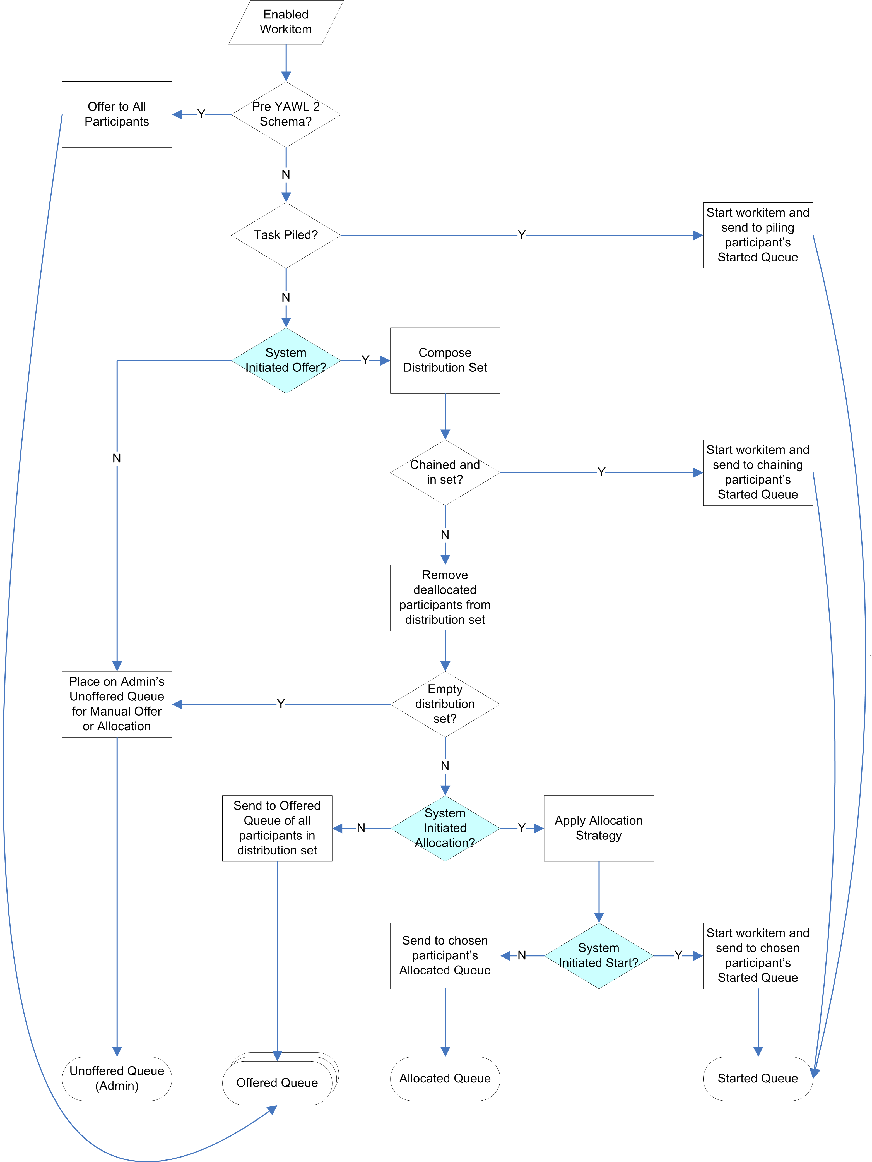
Initial Distribution
When the engine notifies the service of an enabled work item, the service undertakes to distribute the work item to resource(s) using the resourcing specifications for the task from which the work item was created, as specified at design time.

Slide 33
After Distribution
Given the appropriate privileges, a participant may:
  If allocated:
    deallocate it (removes themselves from the distribution set and redistribute the item);
    delegate it (to a member of their ‘team’); or
    skip the work item (complete it immediately without first starting it)
  If started:
    reallocate it (to a member of their team), and in doing so may preserve the work done within the work item thus far (stateful reallocation), or to reset the work item data to its original values (stateless reallocation).

Slide 34


After Distribution
A participant with the necessary privileges may choose to:
  Pile a task, so that all future instances of work items of the task across all current and future cases of the process are directly allocated to the participant, overriding any design time resourcing specifications
  Chain a case, which means that for all future work items in the same process instance where the distribution set specified includes the participant as a member, each of those work items are to be automatically allocated to the participant and started.
Finally, an administrator has access to a Worklisted queue, which includes all of the currently active work items of all participants, whether offered, allocated, started, or suspended

Slide 35
Privileges
Privileges are a way of controlling the access of participants to certain functionalities of the Service.
There are three categories of privileges:
  User vs. Administrator access
  User Privileges – granted to a participant by an administrator via the User Management form. These privileges apply to the participant at all times
  User-Task Privileges – specified on a task-by-task basis at design time

Slide 36
User Privileges
Privilege | Granted | Denied
Choose which work item to start | Can choose allocated items to start in any order | Can only choose the oldest allocated item to start
Reorder work items | same as above | same as above
Start work items concurrently | Can have several items started at once | Can only have one item started at a time
View all work Items of Team | Can view team’s work items on Team Queues form | Can’t view team’s work items on Team Queues form
View all work Items of Org Group | Can view Org Group’s work items on Team Queues form | Can’t view Org Group’s work items on Team Queues form
Chain work item execution | Can chain work items for a case | Can’t chain work items for a case
Manage Cases | Can access the Case Management form | Can’t access the Case Management form

Slide 37
User-Task Privileges
Privilege | When Granted…
Can suspend | suspend a started work item
Can reallocate stateless | transfer the work item to another participant, with all data updates reset
Can reallocate stateful | transfer the work item to another participant, with all data updates preserved
Can deallocate | reject allocation of the work item; the work item is redistributed with the participant removed from the distribution set
Can delegate | delegate the work item to a subordinate team member (by position)
Can skip | immediately complete the task without performing its work
Can pile | immediately redirect all future instances of this work item to the participant

Slide 38
The Worklist
Each participant has access to their own worklist, which is a graphical representation of their work queues via a series of web forms
Each worklist consists of four work queues: Offered, Allocated, Started and Suspended
  Depending on a participant’s privileges, there are a number of actions that can be performed on a work item in each queue
The layout of each work queue is similar
  On the left is a list of work items currently held in that queue
  In the centre are fields that describe the selected work item
  On the right are a set of buttons representing the actions that may be taken on that queue for the selected work item

Slide 39
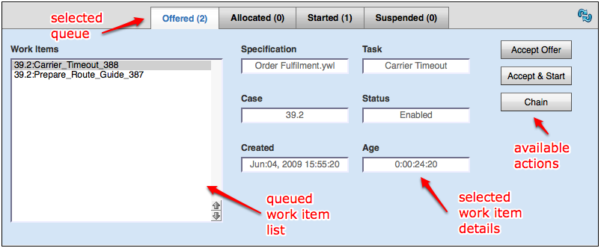
Offered Queue
The Offered queue lists the work items that have been offered to a participant. Each work item in an offered queue may have potentially been offered to a number of participants.

Slide 40
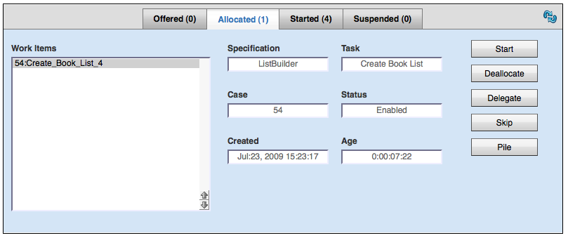
Allocated Queue
The Allocated queue lists the work items that have been allocated to a participant
  Unlike an offer, a work item on an allocated queue means that it has been allocated to that participant alone

Slide 41
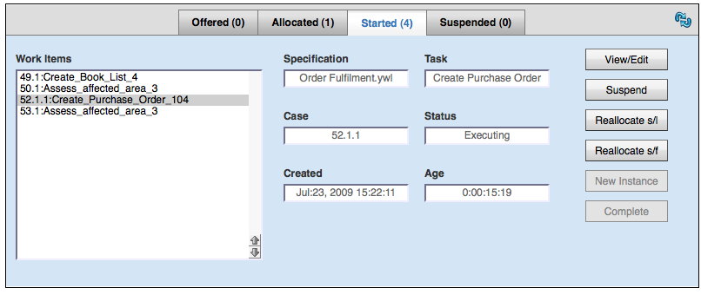
Started Queue
The Started queue lists the work items that have been started by or for a participant.

Slide 42
Summary
Functional Overview
Organizational Model
Service Architecture
Initial Distribution
Privileges
The Worklist

