Slide 1
Chapter 12
The Declare Service
Maja Pesic
Helen Schonenberg
Wil M.P. van der Aalst

Slide 2
Outline
1 Introduction
2 Service Architecture
3 Constraint Templates
4 Constraint Workflow Models
5 Verification of Constraint Models
6 Execution of Constraint Model Instanced
7 Optional Constraints
8 Dynamic Instance Change
9 Decompositions of YAWL and Declarative Workflows
10 Conclusions

Slide 3
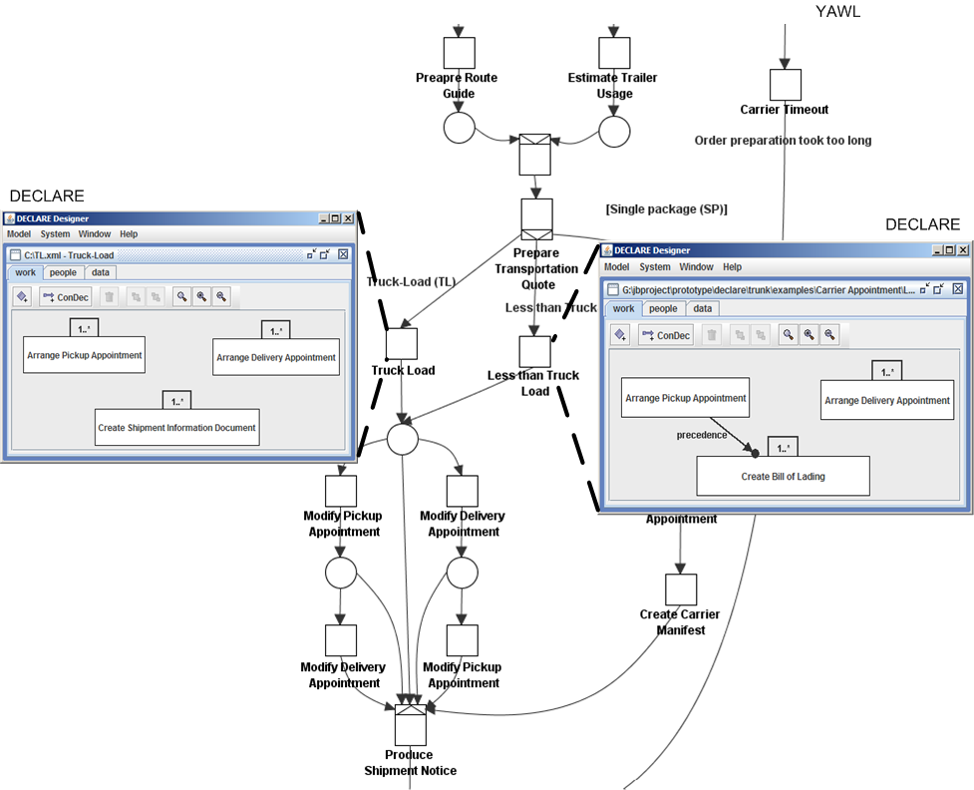
1 Introduction
The Declare Service allows for arbitrary decompositions of YAWL workflows and (declarative) DECLARE workflows.
DECLARE is a constraint-based workflow management system.

Slide 4
2 Service Architecture
The Declare Service is a custom YAWL service (Interface B)
The Declare Service is a bridge between YAWL and DECLARE
Functionality of DECLARE becomes available in YAWL

Slide 5
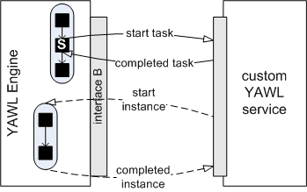
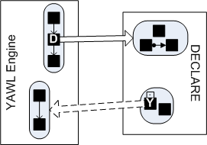
DECLARE as a Custom YAWL Service
custom service interface
DECLARE as a service

Slide 6
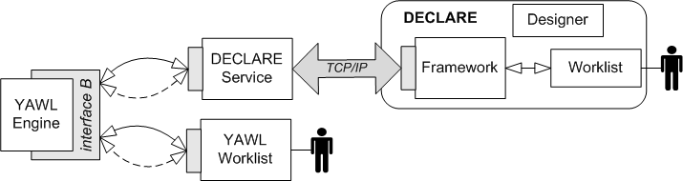
YAWL, the Declare Service and DECLARE
The Declare Service is a bridge between YAWL and DECLARE.

Slide 7
Functionality of DECLARE
Defining constraint templates.
Making constraint models.
Verifying constraint models.
Enacting instances of constraint models.
Dynamically (i.e., at run time) changing and migrating instances of constraint models.
Integrating YAWL and DECLARE.

Slide 8
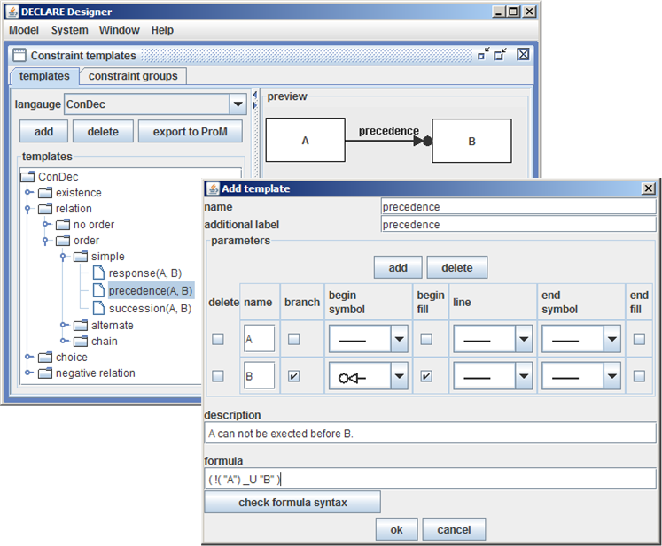
3 Constraint Templates
Language is a set of templates.
Each template has a:
  name
  one or more parameters,
  description, and
  Linear Temporal Logic formula.

Slide 9
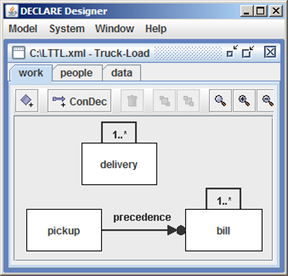
4 Constraint Workflow Models
Tasks + constraints.

Slide 10
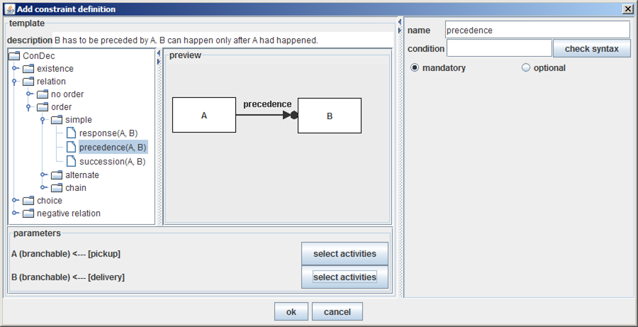
Creating Constraints from Templates
Each parameter in the template is replaced by one or more (if branching) tasks in the model.

Slide 11
5 Verification of Constraint Models
DECLARE uses automata generated from LTL specifications of constraints to detect:
  dead tasks and
  conflicts.
In addition, DECLARE searches through he powerset of constraints to detect the exact group of constraints that causes each error.

Slide 12
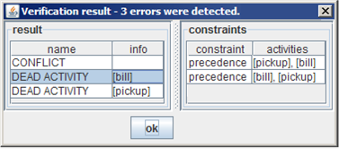
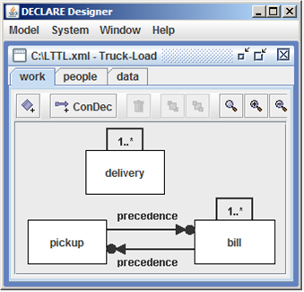
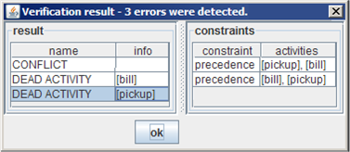
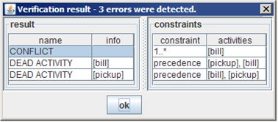
Verification: An Example

Slide 13
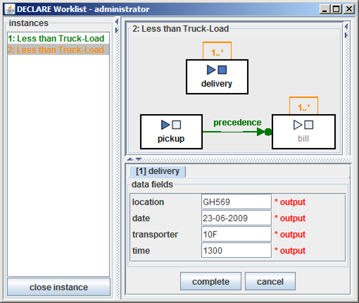
6 Execution of Constraint Model Instances
The Worklist tool the whole model of each instance is presented.
Tasks are executed by double-clicking on them.
Colors show states of instances and constraints:
  satisfied,
  temporarily violated,
  violated.
The user decides when to
close an instance.

Slide 14
7 Optional Constraints
Constraints can be:
  mandatory, i.e., have to be satisfied at the end of the execution, and
  optional, i.e., can be violated at the end of the execution.
Each optional constraint in a constraint model has additional information that is displayed as a warning when the constraint is about to be violated..

Slide 15
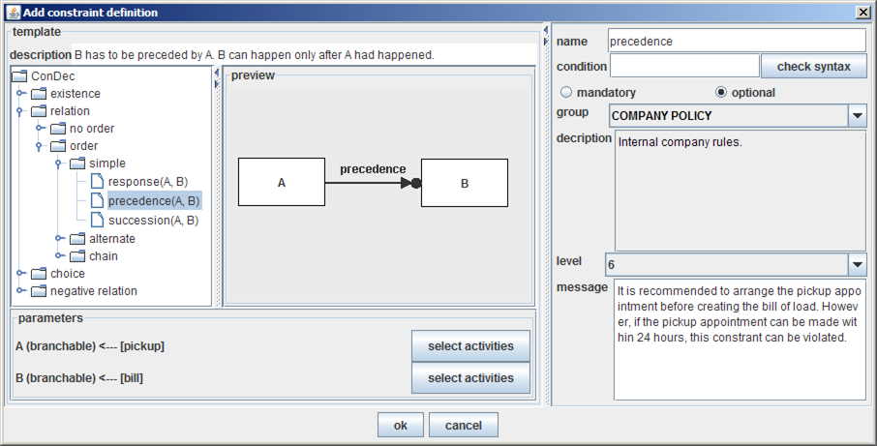
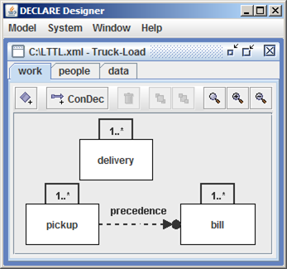
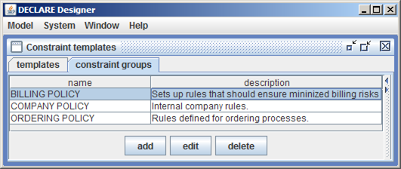
A Model with an Optional Constraint
DECLARE model
optional constraint
warning groups

Slide 16
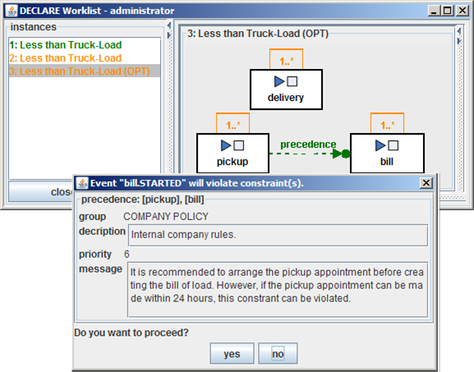
Warning when Violating Optional Constraint
The additional information provided with the optional constraint is used for run-time warnings about possible violations.

Slide 17
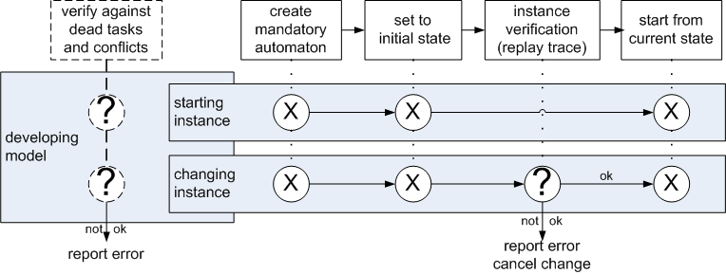
8 Dynamic Instance Change
Tasks and constraints can be added and/or removed during execution.
The change is applied only if the new model does not violate the instance:

Slide 18
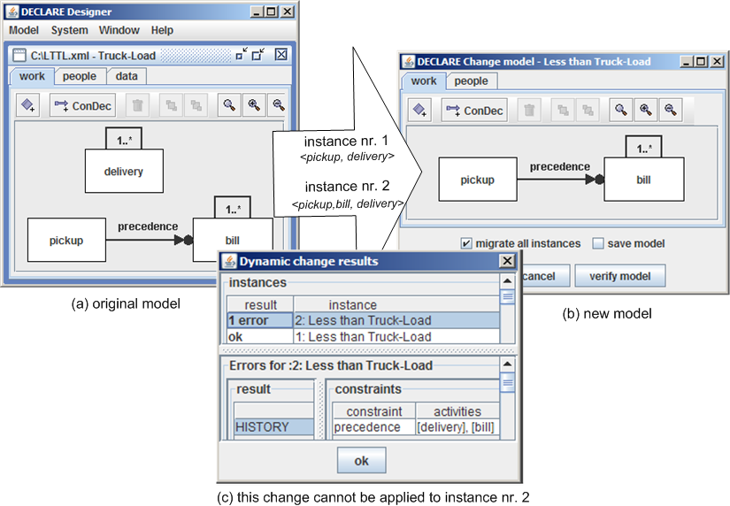
An Example of Dynamic Change

Slide 19
9 Decompositions of YAWL and DECLARE Workflows
Possible to create arbitrary decompositions of YAWL (procedural) and DECLARE (declarative) workfows:
  DECLARE model as a subworkflow in YAWL workflow net.
  YAWL net as a subworkflow in DELCARE model.

Slide 20
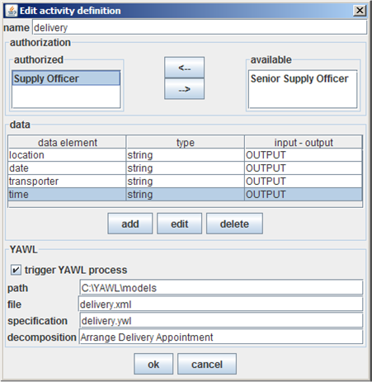
YAWL Net as a Subworkflow
DELCARE task is delegated to YAWL,
DECLARE task enacts a new case of the specified specification in YAWL.

Slide 21
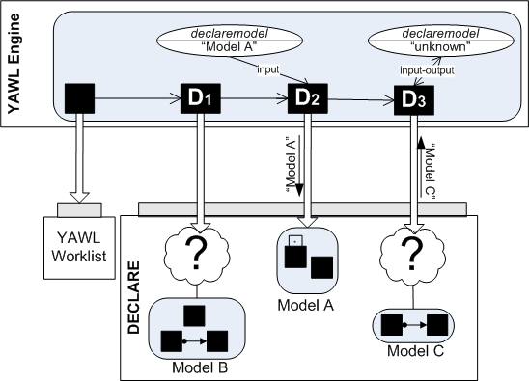
DECLARE Model as a Subworkflow
YAWL task is delegated to the Declare Service,
YAWL task enacts a new case of
  the specified DECLARE model, or
  DECLARE user selects the DECALRE model to be enacted.

Slide 22
10 Conclusions
The Declare Service is a custom YAWL service (Interface B).
The Declare Service is a bridge between YAWL and DECLARE.
By using YAWL, the Declare Service and DECLARE procedural and declarative workflows can be defined.
Due to the service –oriented architecture of YAWL and its Interface B, even more approaches can be combined (i.e., Worklets, Exclets, etc.)

Slide 23
Decomposition of the Order Fulfillment Workflow

