Slide 1
Chapter 13
The Business Process Management Notation
Gero Decker
Remco Dijkman
Marlon Dumas
Luciano Garçia-Bañuelos

Slide 2
Contents
BPMN
BPMN and YAWL
Modelling aspects in BPMN:
  Control-flow
  Data
  Resource
  Exception
Transforming BPMN into YAWL:
  Control-flow
  Data
  Resource
  Exception

Slide 3
BPMN
The Business Process Modelling Notation (BPMN)
Graphical notation for conceptual processes
Covers control, data, authorization, exception
Standardized by OMG
Current version 1.2
more Trackpoints
Issue
Log Trackpoint
Trackpoint
Order Entry
Notice
Create
Acceptance
Freight delivered
Certificate
Initiate
Shipment
24
hours
Status Inquiry

Slide 4
BPMN and YAWL
BPMN
more
abstract
more
requirements
oriented
more
implemnt.
freedom
more
business
oriented
YAWL
more
concrete
more
implemnt.
oriented
less
implemnt.
freedom
more
technology
oriented

Slide 5
Modelling with BPMN – Control Flow
Activities
task
loop
collapsed
ad
-
hoc
multi
-
instance
sub
-
process
sub
-
process
task
+
~
+

Slide 6
Modelling with BPMN – Control Flow
Events
start event
decorations:
message
intermediate
event
error
end event
time

Slide 7
Modelling with BPMN – Control Flow
Gateways
AND
XOR
Event-based

Slide 8
Modelling with BPMN – Control Flow
Example
more Trackpoints
Issue
Log Trackpoint
Trackpoint
Order Entry
Notice
Create
Acceptance
Freight delivered
Certificate
Initiate
Shipment
24
hours
Status Inquiry

Slide 9
Modelling with BPMN – Data
Example
Trackpoints
Trackpoint Notices
Trackpoint Order
Acceptance Certificate
Entries Log
more Trackpoints
Issue
Log Trackpoint
Trackpoint
Order Entry
Notice
Create
Acceptance
Freight delivered
Certificate
Initiate
Shipment
24
hours
Status Inquiry

Slide 10
Modelling with BPMN – Resource
Example
more Trackpoints
r
e
i
r
r
a
Issue
C
Trackpoint
Notice
r
n
r
e
i
e
i
c
Log Trackpoint
r
m
i
r
d
f
a
f
Order Entry
C
A
O

Slide 11
Modelling with BPMN – Exception
Exception events
'Throw' events
'Catch' events
Throw
Catch
Exception event

Slide 12
Modelling with BPMN – Exception
Example
Ordering
O
rder not
Create
Approve
approved
Confirm
Purchase
Purchase
O
rder
Purchase
Order
Order
approved
Order
Modify
Purchase
Order
Order not
Order
approved
timed out

Slide 13
BPMN to YAWL – Control Flow
Trivial cases
Timeout
/
Receive

Slide 14
BPMN to YAWL – Control Flow
Non-Trivial cases
Multiple subsequent gateways
Multiple start events
Multiple end events
Multi-instance tasks

Slide 15
BPMN to YAWL – Data
Data is loosely defined in BPMN
Data handling is strict in YAWL
Hence, data usage must restricted in BPMN
(to be able to map to YAWL)

Slide 16
BPMN to YAWL – Data
Restricted usage:
Define data types in XML Schema
Define expressions in XQuery

Slide 17
BPMN to YAWL – Data
Restricted usage
Process
assignment at
end of task
has variables
Task
assignment at
start of task
has variables

Slide 18
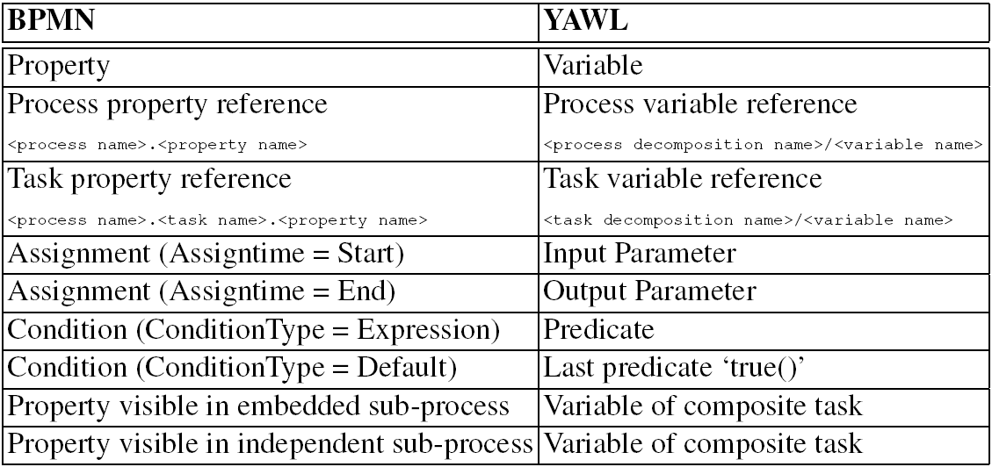
BPMN to YAWL – Data
Mapping is now trivial

Slide 19
BPMN to YAWL – Resource
Mapped from swimlanes
Swimlanes are loosely defined in BPMN
more Trackpoints
r
e
i
r
r
a
Issue
C
Trackpoint
Notice
r
n
r
e
i
e
i
c
Log Trackpoint
r
m
i
r
d
f
a
f
Order Entry
C
A
O

Slide 20
BPMN to YAWL – Exception
Throw/catch event
e
:=
true
~
e
B
B
+
e
C
e
C
default
:
e
:=
false

Slide 21
BPMN to YAWL – Exception
Timer event
A
B
A
B
e
C
e
C

Slide 22
BPMN to YAWL – Exception
Rule event
A
1
A
2
B
A
1
A
2
B
~
e
+
e
:=
true
e
e
C
C
default
:
e
:=
false

Slide 23
Conclusion
BPMN is used more for conceptual modelling
YAWL is used for workflow modelling
In a process design project BPMN comes before YAWL
BPMN can be mapped to YAWL
This helps in a design step

