Slide 1
Chapter 14
EPCs
Jan Mendling

Slide 2
Agenda
Introduction to EPCs
Mapping EPCs to YAWL
Mapping YAWL to EPCs
Transformation based on Reachabilty Graph

Slide 3
EPC Background
Event-Driven Process Chains (EPCs) have been invented in joint research project by IWi Saarbrücken and SAP in the early 1990s
EPCs are part of the ARIS (Architecture of Integrated Information Systems) methodology defined by Scheer
They are promoted by respective ARIS modeling tool family distributed by IDS Scheer AG
EPCs are used in many large scale industry projects where the ARIS software of IDS Scheer is used
EPCs are used a.o. as the language of the
SAP Reference Model

Slide 4
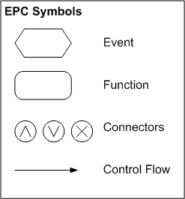
Introduction to EPCs
Functions
Events
Connectors (and,xor,or)
Control flow arcs

Slide 5
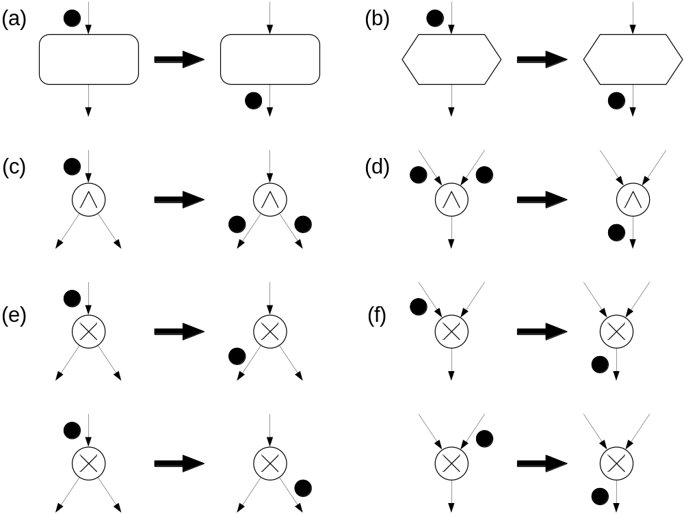
EPC Semantics: Transition Relation
Cuntz, Kindler, 2004

Slide 6
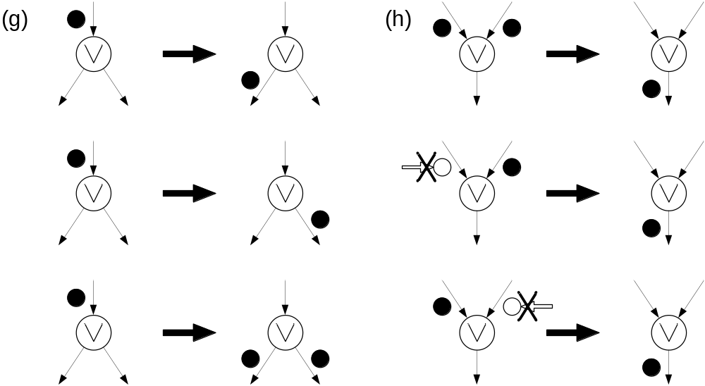
EPC Semantics: Transition Relation II
Non-local semantics

Slide 7
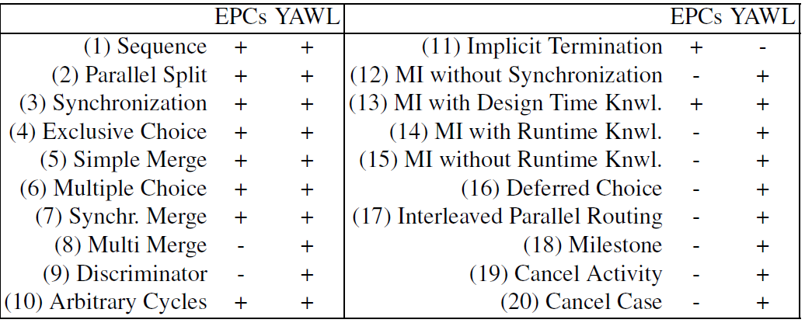
Workflow Pattern Support

Slide 8
Mapping EPCs to YAWL Challenges
State representation
There is no direct counterpart for YAWL conditions in EPCs
Connector chains
There can be several connectors in a row while in YAWL splits and joins are part of tasks
Multiple start and end events
EPCs can have multiple start and end events while YAWL requires one unique start and one unique end

Slide 9
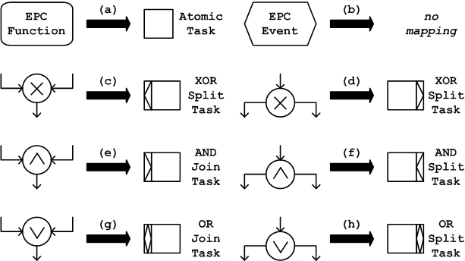
Mapping EPCs to YAWL

Slide 10
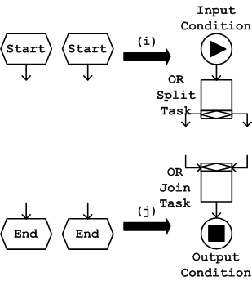
Mapping EPCs to YAWL (Cont.)

Slide 11
Mapping YAWL to EPCs Challenges
Free choice property
EPCs are free choice while YAWL can have non-free choice behavior
Multiple instantiation
YAWL offers multiple instantiation, EPCs do not
Cancellation
YAWL offers cancellation, EPCs do not
Syntax
In EPCs functions and events have to alternate

Slide 12
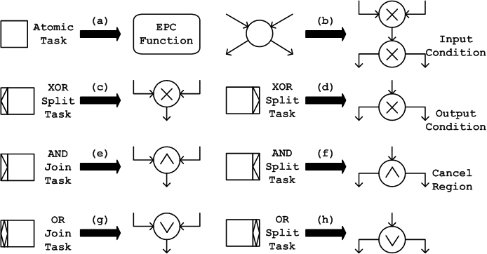
Mapping YAWL to EPCs

Slide 13
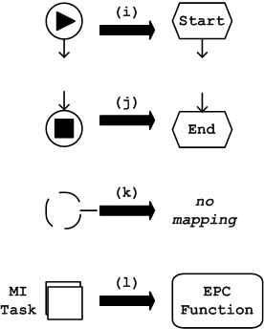
Mapping YAWL to EPCs

Slide 14
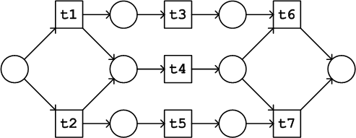
Non-free choice behavior
non-free choice

Slide 15
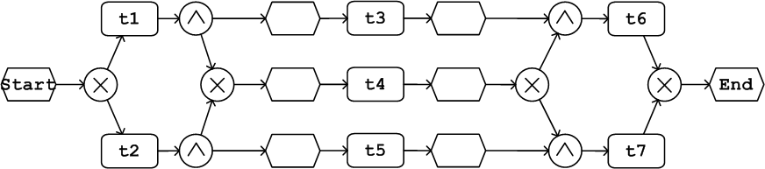
A corresponding EPC
free choice

Slide 16
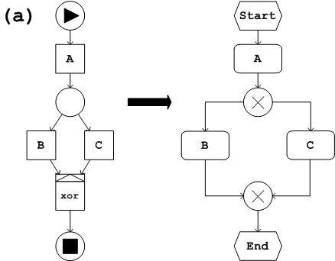
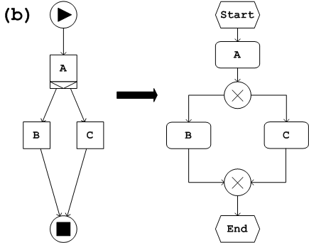
Different YAWL, same EPC

Slide 17
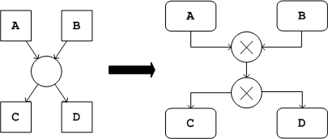
A YAWL condition and two EPC connectors

Slide 18
Transformation using synthesis
Take YAWL
Calculate Reachability Graph
Synthesize EPC
Take EPC
Calculate Reachability Graph
Synthesize YAWL

Slide 19
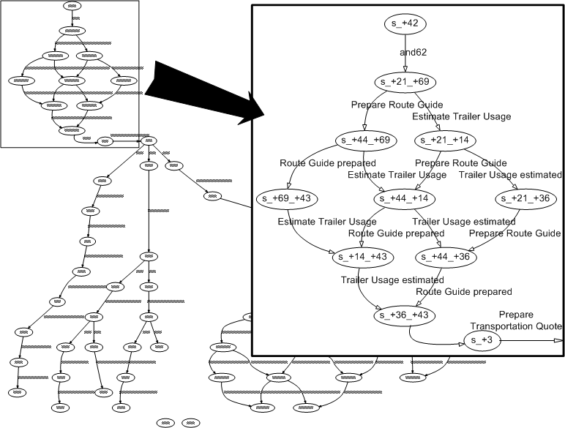
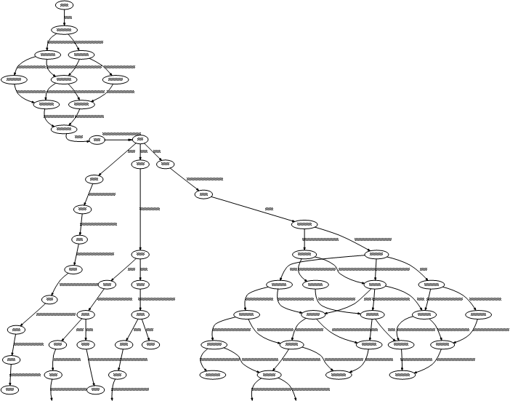
Reachability Graph

Slide 20
Summary
EPCs are heavily used in industry practice
A mapping to YAWL is rather straight-forward
A mapping from YAWL to EPCs is challenging due to missing non-free-choice, cancellation and multiple instance support
A behavior-preserving transformation is possible using the reachability graph and synthesis techniques.

