Slide 1
Chapter 15
The Business Process Execution Language
Chun Ouyang
Marlon Dumas
Petia Wohed

Slide 2
Outline
Introduction
  Web Services Business Process Execution Language (BPEL)
Overview of BPEL
  Through the YAWL prism
  The Order Fulfillment process in BPEL
Workflow patterns support
  Original control-flow patterns
  Pattern-based comparison: BPEL vs. YAWL
Summary
  Differences between BPEL and YAWL

Slide 3
Introduction
Standardization efforts towards the definition of languages for capturing business processes
BPEL is a language for defining executable business processes
BPEL “competes” with YAWL?
  Different motivation and design leads to profound differences between them
  The intention is not to claim one outperforms the other, but to look into the differences between them
Focus on differences between BPEL and YAWL in terms of modeling constructs

Slide 4
Overview of BPEL
BPEL is used to specify business collaborations and to implement them as composite Web services
  Capture business logic and behavior of service interactions
  Support service composition at executable level
BPEL draws upon concepts and constructs from imper-ative programming languages, and extends them with those related to Web services and business processes
  Messaging: send, receive, send/receive
  Concurrency: block-structured parallel execution, race conditions, event-action rules
  XML typing: XML Schema, WSDL, XPath, XSLT
BPEL evolution
  BPEL 1.1 and BPEL 2.0

Slide 5
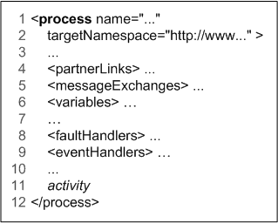
BPEL Process Definition
BPEL defines an executable process by specifying
  Activities and their execution order
  Partners interacting with the process
  Data necessary for and resulting from the execution
  Messages exchanged between the partners
  Fault handing in case of errors and exceptions
Example: a simplified structure of a BPEL process

Slide 6
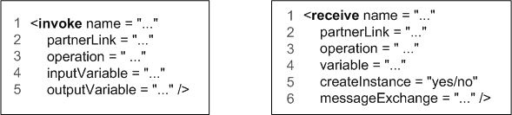
BPEL Activities
Basic activities
  invoke: invoking operations offered by partner Web services
  receive: waiting for messages from partner Web services
  reply: for capturing interactions
  wait: delaying the process execution
  assign: updating variables
  throw: signaling faults
  rethrow: propogating the faults that are not solved
  compensate: triggering a compensation handler
  empty: doing nothing
  exit: ending a process immediately

Slide 7
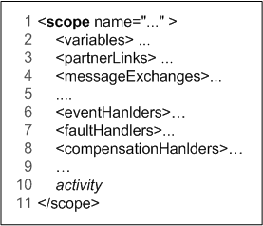
BPEL Activities (cont’d)
Structured activities
  sequence: activities being executed sequentially
  flow: activities being executed in parallel
  if: capturing conditional routing
  pick: capturing race conditions
  while: structured looping
    Condition is evaluated at the beginning of each iteration
  repeatUntil: structured looping
    Condition is evaluated at the end of each iteration
  forEach: executing multiple instances
  of an activity with synchronisation
  scope: grouping activities into blocks
    Fault handler
    Event handler
    Compensation handler

Slide 8
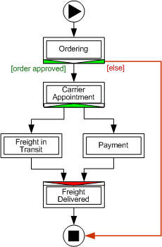
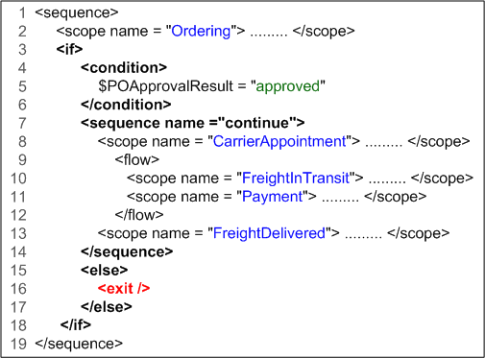
Example: Order Fulfillment Process
In YAWL
In BPEL

Slide 9
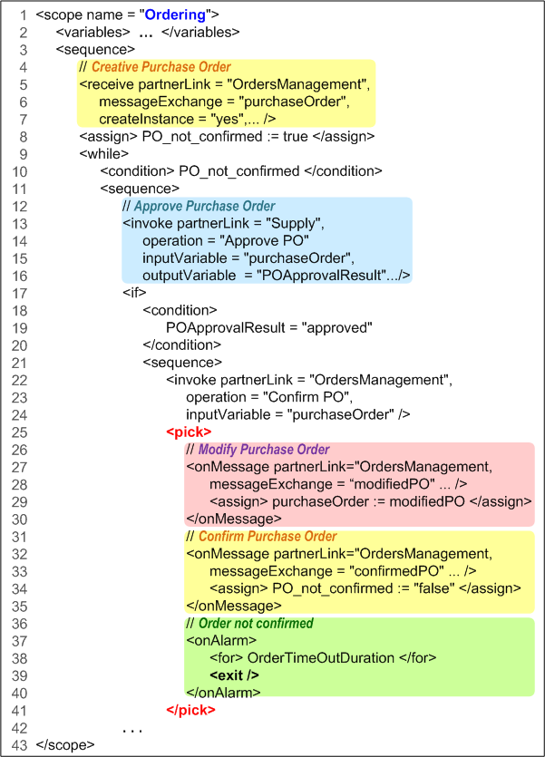
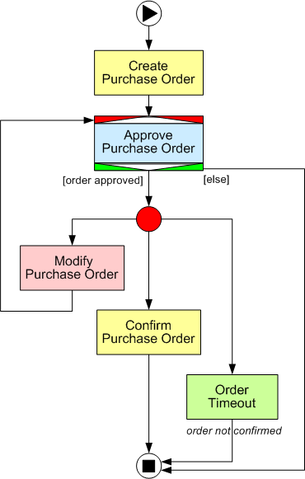
Example (cont’d): Ordering Subprocess

Slide 10
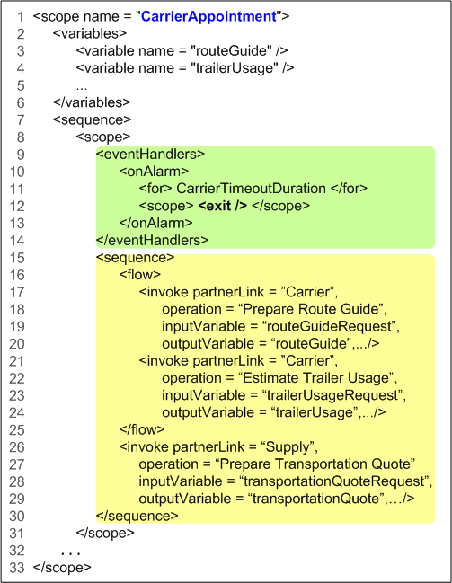
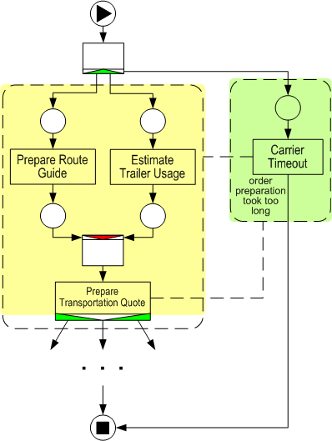
Example (cont’d): Carrier Appointment
Order preparation phase

Slide 11
BPEL Control Links
BPEL activities are blocked-structured constructs
Control links allow the definition of directed acyclic graphs of activities
  Link one activity (X) to another activity (Y)
  Join condition
  Transition condition
Restrictions of using control links
  Not to form a loop
  Not to cross the boundary of a loop
  Etc.

Slide 12
Workflow Patterns Support
Workflow patterns
  Control-flow patterns
  20 original control-flow patterns
Comparison between BPEL and YAWL in terms of their support for control-flow patterns
  20 original control-flow patterns are used
YAWL supports 19 patterns
BPEL 2.0 supports 16 patterns
  BPEL 1.1 supports 13 patterns

Slide 13
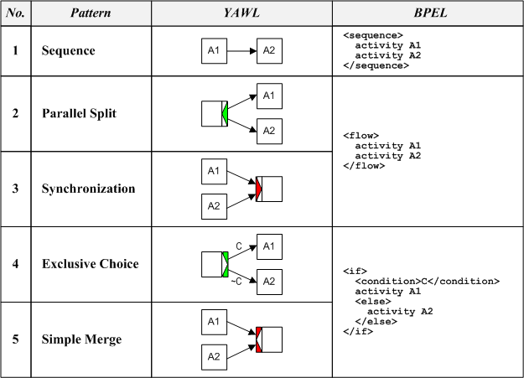
BPEL vs. YAWL:
Basic Control Flow Patterns

Slide 14
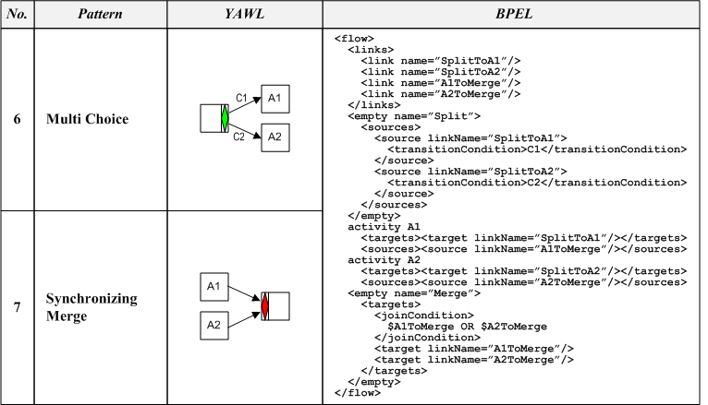
BPEL vs. YAWL:
Advanced Branching & Synchronization Patterns

Slide 15
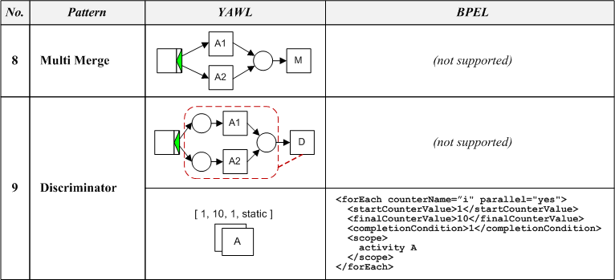
BPEL vs. YAWL:
Advanced Branching & Synchronization Patterns

Slide 16
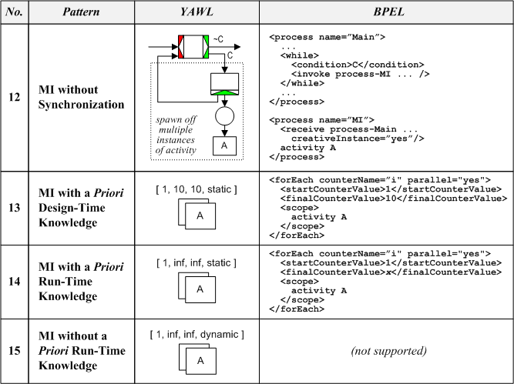
BPEL vs. YAWL:
Multiple Instance (MI) Patterns

Slide 17
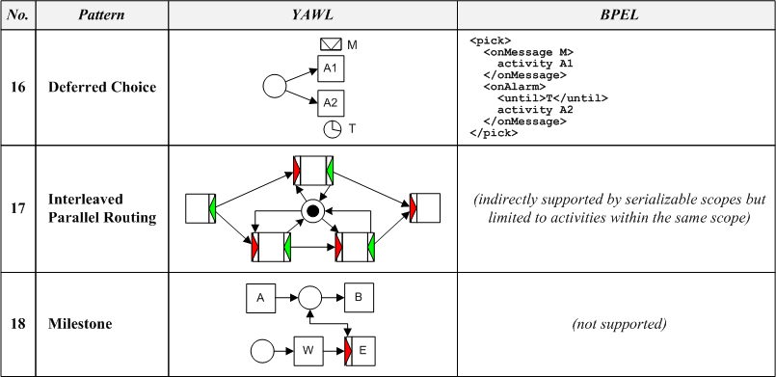
BPEL vs. YAWL:
State-based Patterns

Slide 18
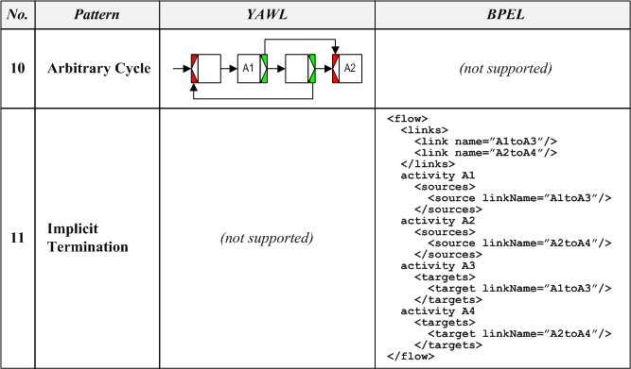
BPEL vs. YAWL:
Iteration & Termination Patterns

Slide 19
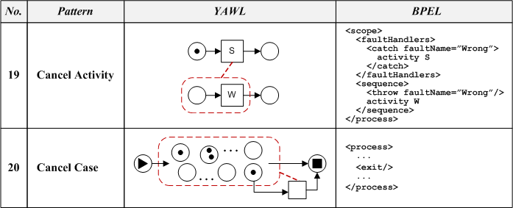
BPEL vs. YAWL:
Cancellation Patterns

Slide 20
Summary
Differences between BPEL and YAWL:
Nature of modeling constructs:
  block-structured vs. graph-oriented
Focus on capturing business processes:
  message exchange vs. interrelated tasks
Support for human tasks
  separate extensions vs. part of the core system
Formal semantics
  lack of formal semantics vs. sound mathematical foundation
Graphical notation
  lack of a standardised graphical notation vs. one unique graphical notation
Tool Support
  a number of tools developed by IT industry player vs. a single system mainly developed by academia

