Slide 1
Chapter 17
Process Mining and Simulation
Moe Wynn
Anne Rozinat
Wil van der Aalst
Arthur ter Hofstede
Colin Fidge

Slide 2
Overview
Introduction
Preliminaries
Process mining (with ProM)
Process simulation for operational decision support
Tools: YAWL, ProM & CPN Tools
Conclusions

Slide 3
Introduction
Correctness, effectiveness and efficiency of business processes are vital to an organization
Significant gap between what is prescribed and what actually happens
Process owners have limited info about what is actually happening
Model-based (static) analysis
  Validation
  Verification (correctness of a model)
  Performance analysis
Process Mining – post-execution analysis
Process Simulation – ‘what-if’ analysis

Slide 4
Preliminaries

Slide 5
Preliminaries: Data Logging
Keeping track of execution data
  Activities that have been carried out
  Timestamps (Start and end times of activities)
  Resources involved
  Data
Purposes
  Audit trails
  Disaster recovery
  Monitoring
  Data Mining
  Process Mining
  Process Simulation

Slide 6
Preliminaries: Process Mining
Event logs (recorded actual behaviors)
Covers a wide-range of techniques
Provide insights into
  control flow dependencies
  data usage
  resource involvement
  performance related statistics etc.
Identify problems that cannot be identified by inspecting a static model alone

Slide 7
Preliminaries: Process Simulation
Develop a simulation model at design time
Carry out experiments under different assumptions
Used for process reengineering decisions
Data input is time-consuming and error-prone
Requires careful interpretation
  Abstraction of the actual behavior
  Different assumptions made
  Inaccurate or Incomplete data input
  Starts from an empty initial state

Slide 8
More on Process Mining

Slide 9


Process Mining
Process discovery: "What is really happening?"
Conformance checking: "Do we do what was agreed upon?"
Performance analysis: "Where are the bottlenecks?"
Process prediction: "Will this case be late?"
Process improvement: "How to redesign this process?"
Etc.

Slide 10
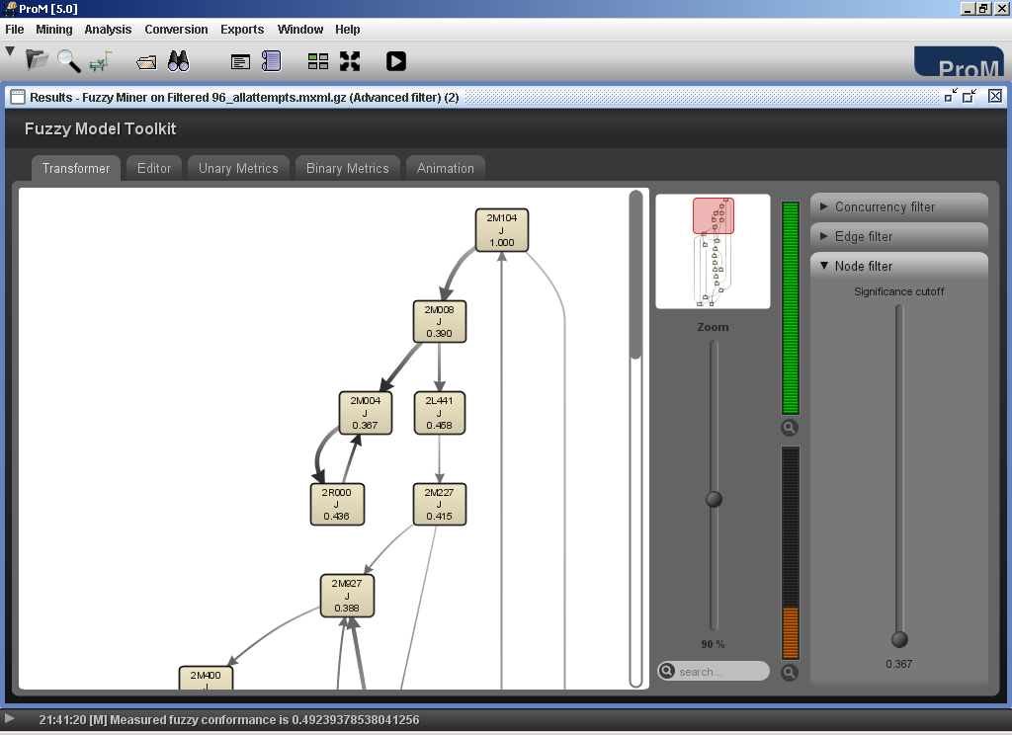

Example: mining student data
Process discovery: "What is the real curriculum?"
Conformance checking: "Do students meet the prerequisites?"
Performance analysis: "Where are the bottlenecks?"
Process prediction: "Will a student complete his studies (in time)?"
Process improvement: "How to redesign the curriculum?"

Slide 11
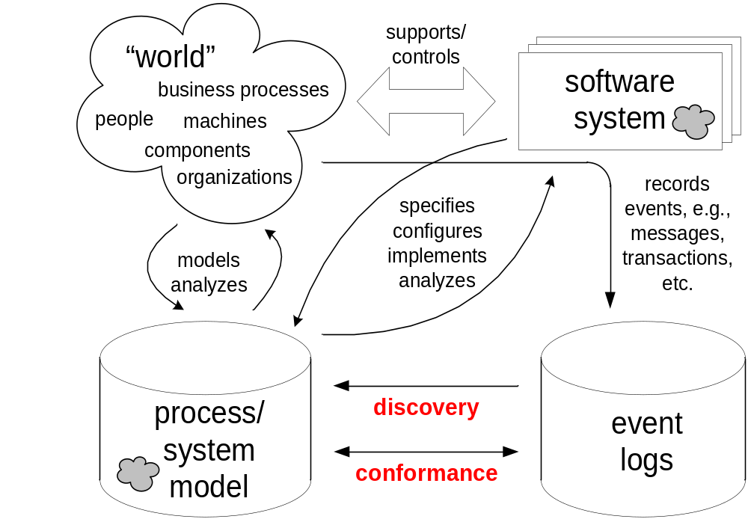
Process mining: Linking events to models

Slide 12


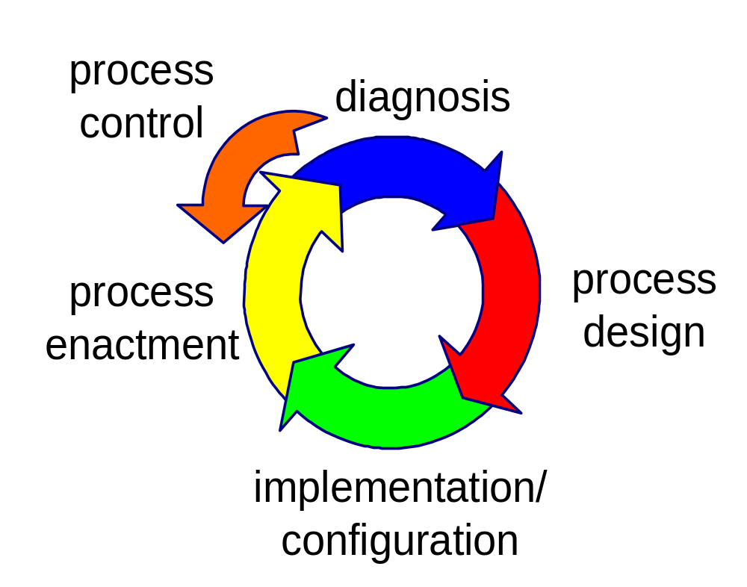

Where to start?
process mining

Slide 13
Process Mining with ProM

Slide 14
ProM framework
One of the leading approaches to Process Mining http://www.processmining.org/
Covers a wide range of analysis approaches
250+ plug-ins
  Process Discovery
  Social Network
  Conformance Checking
Conversion capabilities between different formalisms
  Petri nets, EPCs, BPMN, BPEL, YAWL
Mining XML (MXML) log format

Slide 15
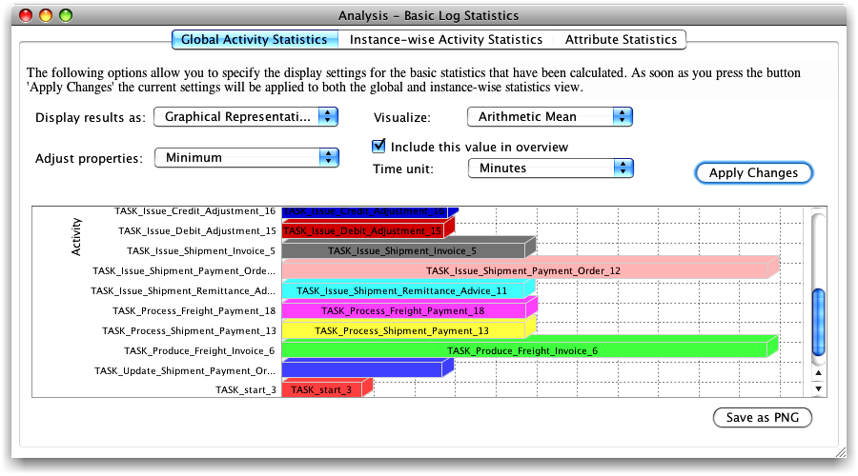
Basic Performance Analysis

Slide 16
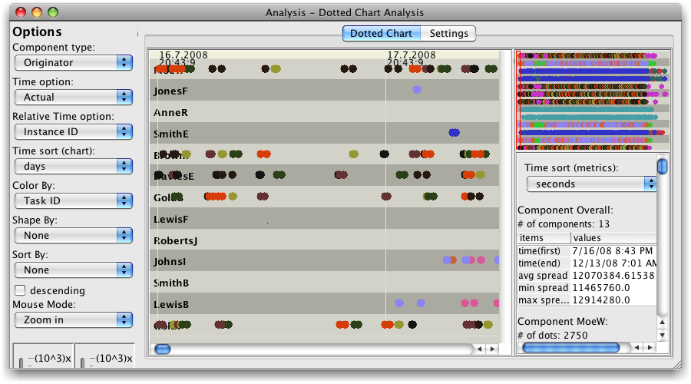
Resource Analysis

Slide 17
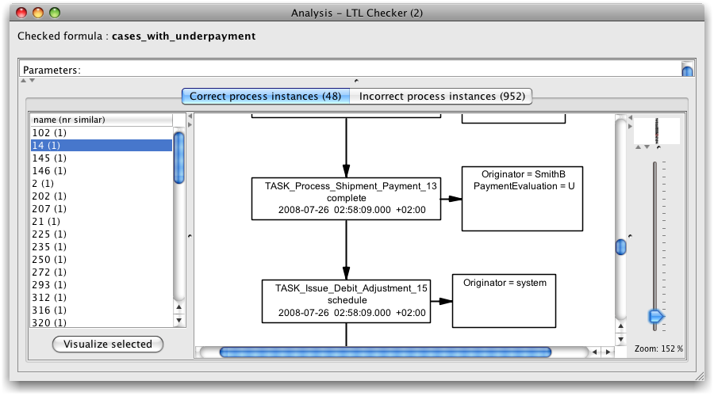
LTL Checker

Slide 18
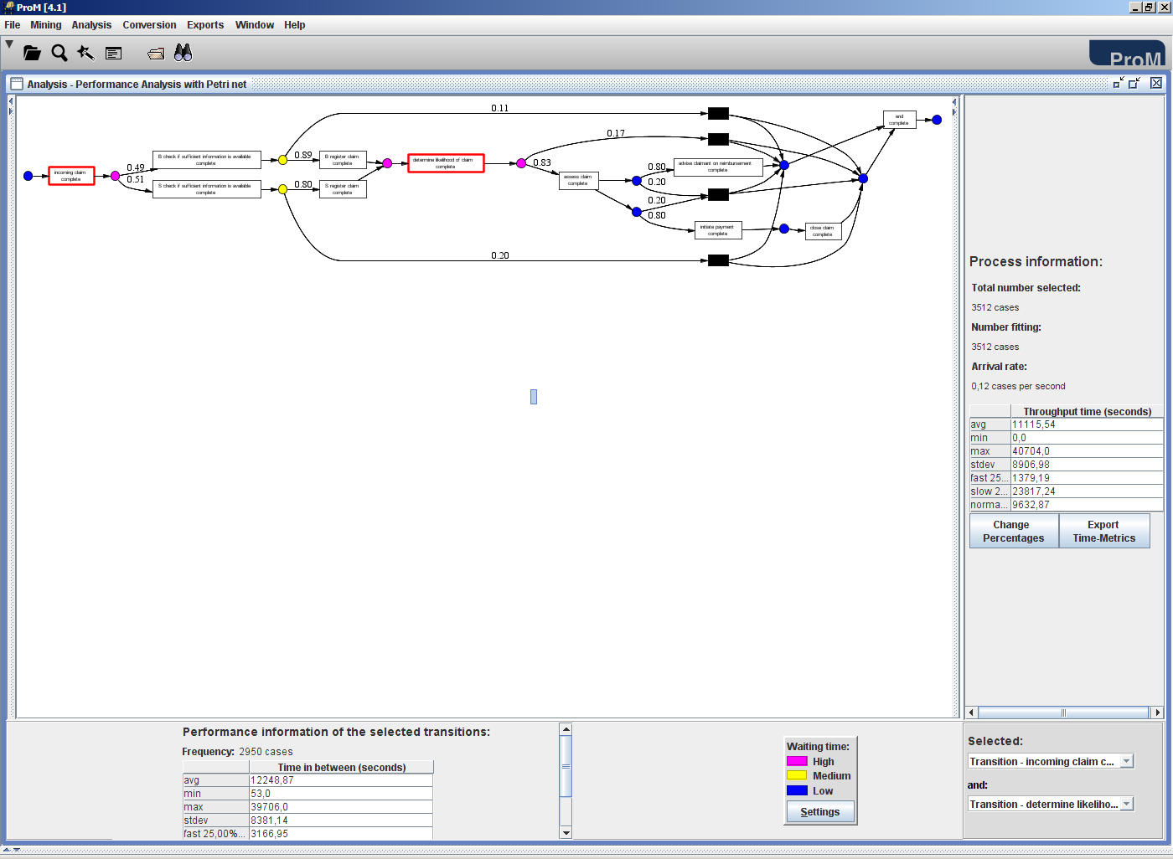
Performance analysis showing bottlenecks
bottle-necks
throughput time
flow time from A to B

Slide 19
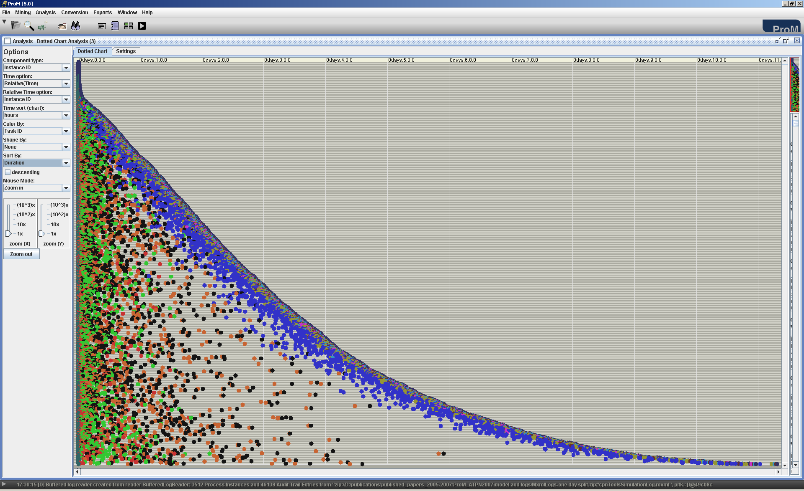
Dotted chart analysis
short cases
time
(relative)
46138 events
long cases
cases

Slide 20
ProM and YAWL
YAWL logs workflow events and data attributes
An extractor function available as a ProMImport plug-in
ProM can analyze YAWL logs in MXML format
Prom can transform YAWL models into Petri nets
<Process id="Payment_subprocess.ywl">
<ProcessInstance id="3f9dfc70-5420-40e7-b9f7-329b5c6f0ded">
<AuditTrailEntry>
<WorkflowModelElement>Check_PrePaid_Shipments_10</WorkflowModelElement>
<EventType>start</EventType>
<Timestamp>2008-07-08T10:11:18.104+01:00</Timestamp>
<Originator>JohnsI</Originator>
</AuditTrailEntry>
<AuditTrailEntry>
<Data><Attribute name="PrePaidShipment">true</Attribute></Data>
<WorkflowModelElement>Check_PrePaid_Shipments_10</WorkflowModelElement>
<EventType>complete</EventType>
<Timestamp>2008-07-08T10:11:28.167+01:00</Timestamp>
<Originator>JohnsI</Originator>
</AuditTrailEntry>
</ProcessInstance>
</Process>

Slide 21
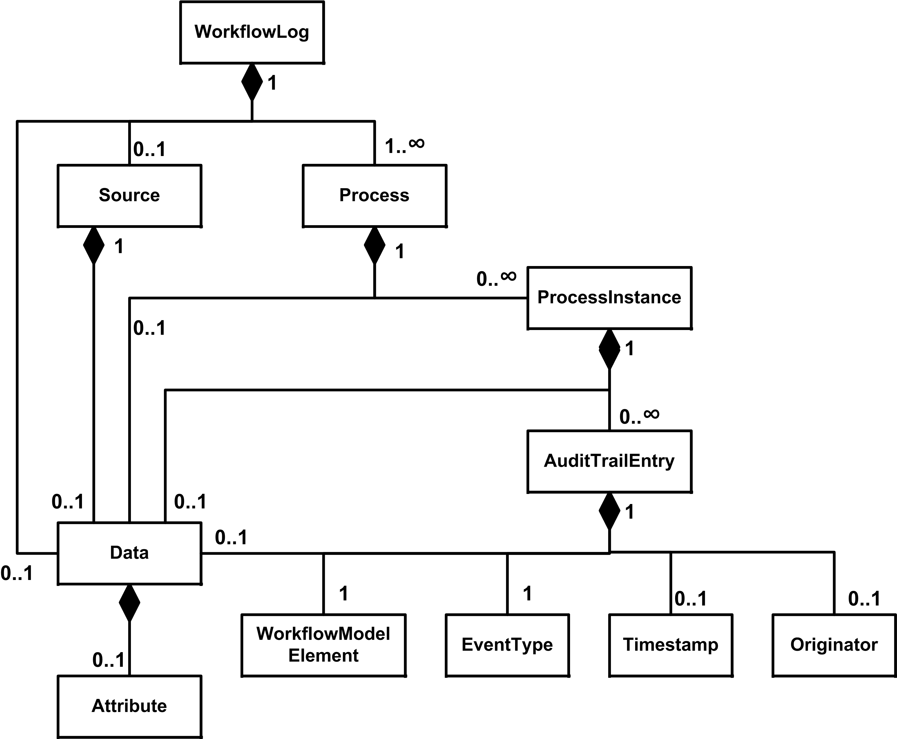

Starting point: event logs
YAWL logs or other event logs, audit trails, databases, message logs, etc.
unified event log (MXML)

Slide 22
Process Simulation

Slide 23
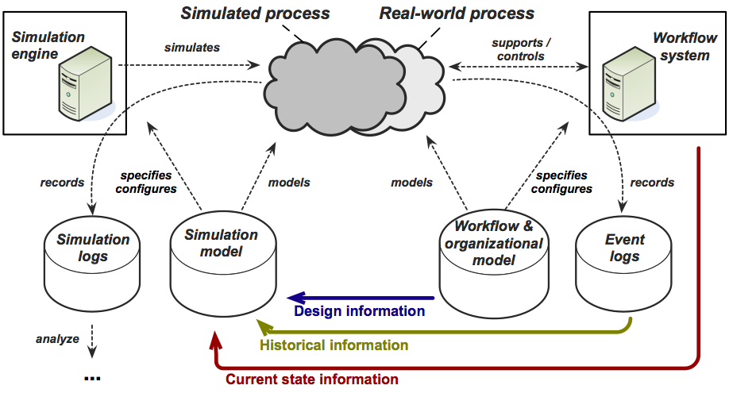
Integrated Simulation Approach

Slide 24
Linking process mining to simulation
Gather process statistics using process mining techniques
Calibrate simulation experiments with this data
Analyze simulation logs in the same way as execution logs

Slide 25
Data sources for process characteristics
Design (Workflow and Organizational Models)
  Control and data flow
  Organizational model
  Initial data values
  Role assignments
Historical (Event logs)
  Data value range distributions
  Execution time distributions
  Case arrival rate
  Resource availability patterns
State (Workflow system)
  Progress state
  Data values for running cases
  Busy resources
  Run time for cases

Slide 26
Tools: YAWL, ProM and CPN Tools

Slide 27
Architecture II
YAWL
  Create and execute process models
  Maintain organizational models
  Extractor functionalities for event logs, organizational models and current state of the workflow system
ProM
  Translate and integrate all the components into a Petri nets model
  Analyze event logs and simulation logs
CPN Tools
  Run simulation experiments
  Incorporate current state of workflows
  Generate simulation logs

Slide 28
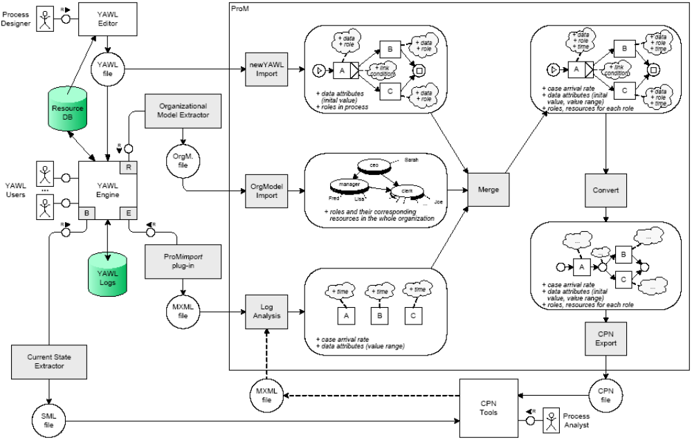
Tool: Architecture

Slide 29
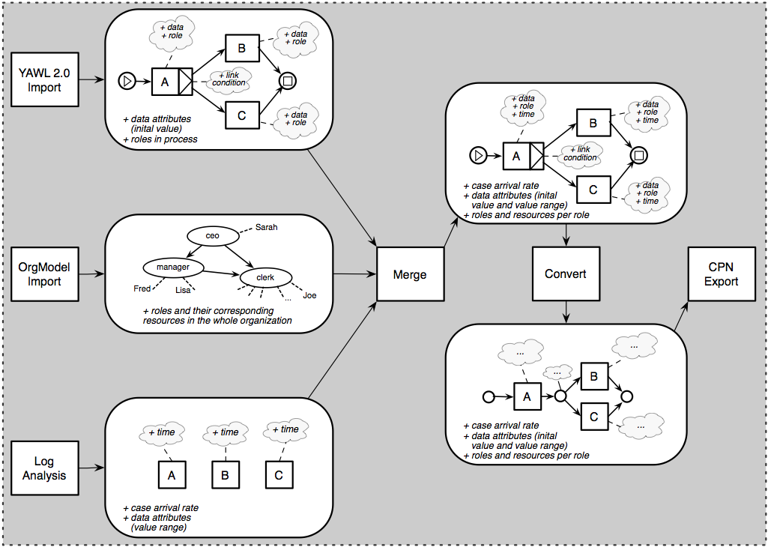

Slide 30
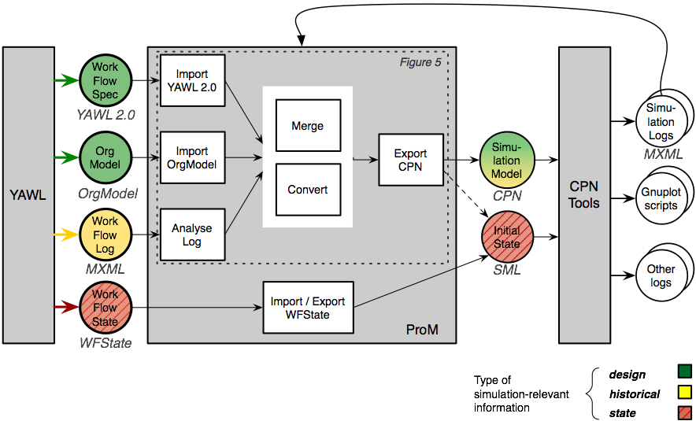
Tool: Architecture
Use existing models

Slide 31
Tool: Architecture II
Use existing models
Derive parameters

Slide 32
Tool: Architecture III
Use existing models
Derive parameters
Consider current state

Slide 33
Tool: Architecture IV
Use existing models
Derive parameters
Consider current state
Simulation logs in MXML

Slide 34
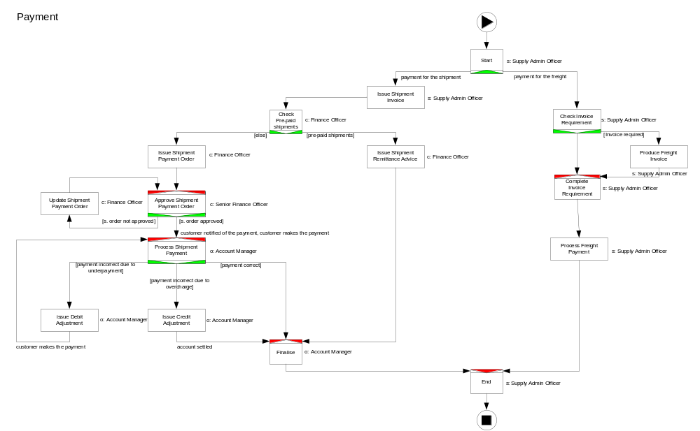
Simulation: Example

Slide 35
Simulation: Example
13 staff members
  5 `supply admin officers‘
  3 `finance officers'
  2 `senior finance officers'
  3 `account managers‘
Case arrival rate: 50 payments per week
Throughput time: 5 working days on average
30% of shipments are pre-paid
50% of orders are approved first-time
20% of payments are underpaid
10% of payments are overpaid
70% of payments are correct
80% of orders require invoices
20% of orders do not require invoices
  Assumption: Payment process running in YAWL for some time.

Slide 36
Simulation: Scenario
4 weeks till the end of financial year
A backlog of 30 payments (some for more than a week)
Goal: All payments to be processed in 4 weeks time
Run simulation experiments to
  see if the backlog can be cleared using current resources
  evaluate the effect of avoiding underpayments
Possible remedial action: Allocate more resources

Slide 37
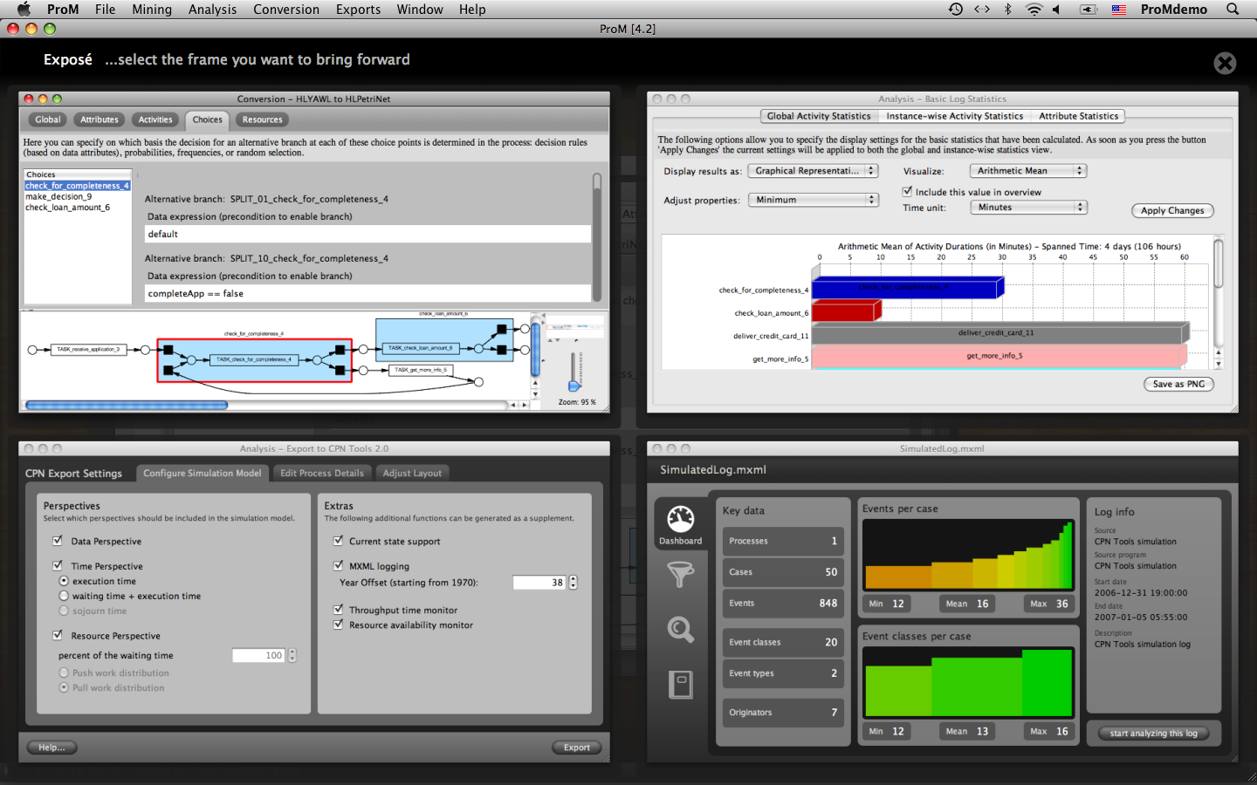
ProM screenshots

Slide 38
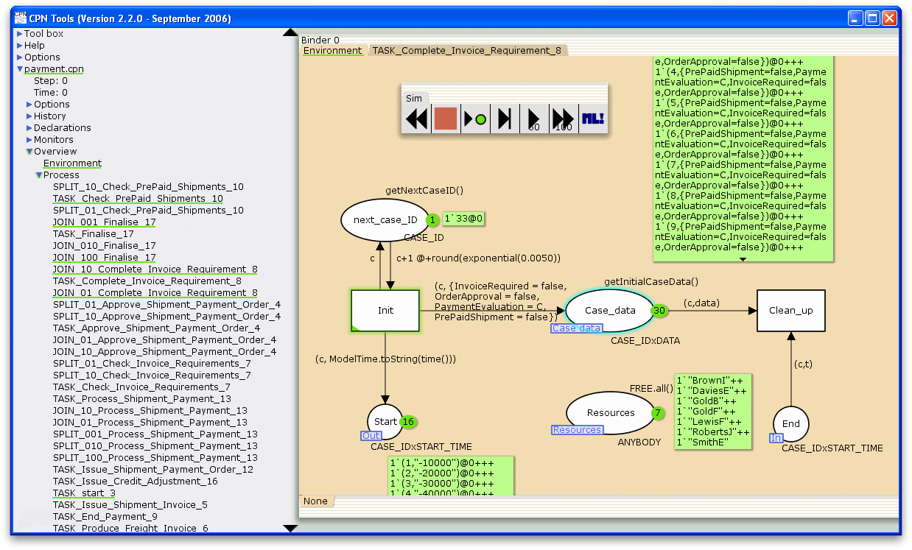
CPN Tools

Slide 39
Four Scenarios
An empty initial state ( ‘empty’)
After loading the current state file with the 30 applications currently in the system (‘as is’)
After loading the current state file but adding 13 extra resources (‘to be A’)
After loading the current state file but changing the model so that underpayments are no longer possible (‘to be B')

Slide 40
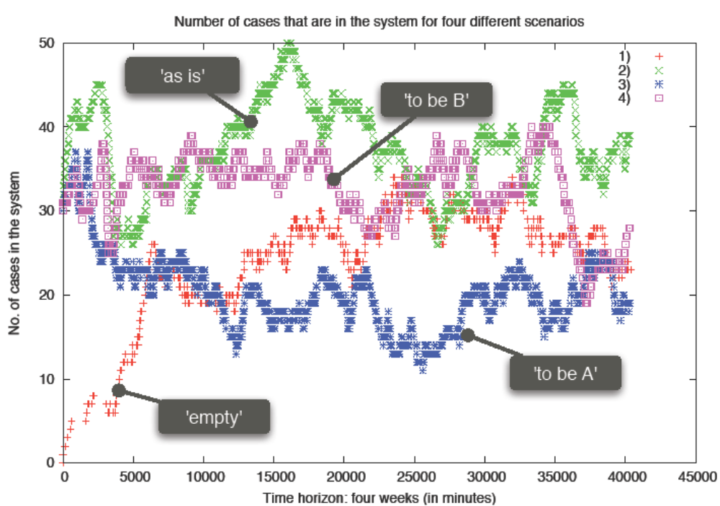
Evaluation
Notes:
The differences between these four scenarios can be seen clearly in the figure. In the case of the `empty‘ scenario the simulation starts with zero payment process instances
in the system. This does not reflect the normal situation nor does it capture our current backlog of cases.
Only after the processing `pipeline' fills does this simulation represent the normal behavior of the payment process (i.e. with around 50 applications arriving per
week). This highlights the value of starting the simulation with the actual current state of the system.
The other three scenarios load a defined initial state, which contains the 30 cases that are assumed to be currently in the
system. Furthermore, one can observe that in the scenarios where extra resources are added to the process or underpayments are avoided (the `to be A' and `to be B'
trajectories), the case load decreases more quickly to an acceptable level than without further intervention (the `as is' trajectory).
However, the `to be B' scenario, which simulates the process under the assumption that there will be no further underpayments, does not seem
to perform as well as we might have thought. In this way, the effect of possible measures to address the problem at hand can be assessed,
i.e. we can compare different `what if' scenarios in terms of their estimated effects.
Note that the figure merely shows scenarios. Of course it is vital not to do an analysis just based on example scenario's. CPN Tools supports
the notion of replication to do many experiments. This can be used to compute confidence intervals. By doing so it is possible to indicate how reliable the results
are, e.g., the statement ``after one week the number of cases in the system will be less than 30'‘ can be made with 95 percent confidence.

Slide 41
Simulation for operational decision support
Combine the real process execution log (`up to now') and the simulation log (which simulates the future `from now on')
Look at the process execution in a unified manner
Track both the history and the future of current cases

Slide 42
Conclusions
Introduction
  Concise assessment of reality needed for processes
Preliminaries
  Data logging, Process Mining, Process Simulation
Process mining with ProM
  Understanding process characteristics
Process simulation
  Operational decision support
  Utilizing log info for simulation experiments
Tools: YAWL, ProM & CPN Tools
  Payment example
Conclusion

