Slide 1
Chapter 20
Verification
Eric Verbeek
Moe Wynn

Slide 2
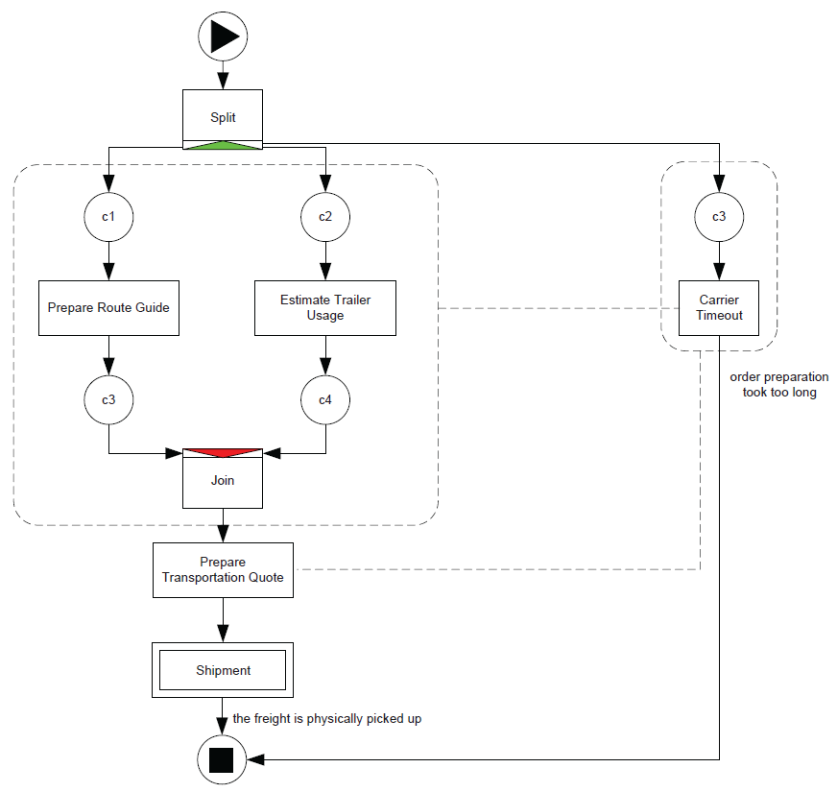



Introduction
Notes:
This slide shows a first version of the Carrier Appointment decomposition, which is used throughout the YAWL book. For sake of readability, the part between the Prepare Transportation Quote and the output condition has been replaced by a single composition task named Shipment. This version was replaced by the version used in the book, as it contains a subtle error that was overlooked by the YAWL experts that designed the entire model.

Slide 3
Overview
Introduction
Preliminaries
Soundness
Reduction rules
Invariants
Tools
Conclusions
Notes:
Bridge to Preliminaries:
YAWL has been inspired by a class of Petri nets called WF-nets. For these WF-nets, a soundness criterion has been defined, which can be transferred to YAWL nets with ease.

Slide 4
Preliminaries

Slide 5
Preliminaries: Soundness
Option to complete
  Any executing instance of the YAWL net must eventually terminate.
Proper completion
  At the moment of termination there must be precisely one token in the end condition and all other conditions are empty.
No dead tasks
  Any task can be executed for some case.
Notes:
However, possibly, these requirements are too strong. As an example, consider a YAWL net that includes two decision points (say, two XOR splits) that are controlled by the same case attribute. As a result, if we go left at the first decision point, we also go left at the second, and vice versa. However, as we abstract from the data perspective when considering soundness, the fact that both decisions are synchronized
is lost, and the possibility that we go left at one and right at the other is also taken into account. As a result, the YAWL net may be considered not sound, while in fact it is. The relaxed soundness property takes these synchronized decision points into account.

Slide 6
Preliminaries: Relaxed soundness
For every task, some proper completing case must exist
Allows for a simplistic view on the OR-join
Notes:
Still, the relaxed soundness property requires the entire state space to be constructed, which is known to be impossible in general. For many YAWL nets, it will be possible to construct the entire state space, but YAWL nets exist for which this is not possible. Therefore, our approach so far (soundness and relaxed soundness) is not complete. To make the approach more complete, we introduce a third notion of
soundness, called weak soundness.

Slide 7
Preliminaries: Weak soundness
Waek option to complete
  It is possible to complete a case.
Proper completion
  Once a case has been completed, no references to that case are left behind.
No dead tasks
  Any task can be executed for some case.
Notes:
Note that only the first requirement differs from the soundness requirements.
YAWL is grounded in reset nets to provide support for cancelation regions. Recall that a reset net is a Petri net that allows transitions to reset places, that is, to remove all tokens from these places.
YAWL’s cancelation regions can be modeled by reset nets in a natural way: If some task cancels a region, then the corresponding transition resets all places in the corresponding region.

Slide 8
Preliminaries: Reset nets
Places
  P
Transitions
  T
Flow relation
  F = (P X T) U (T X P)
Reset relation
  R = T X P
Task captured by
  Busy place
  Start transition for every possible input combination
  Complete transition for every possible output combination
Notes:
A reset net is a Petri net that allows transitions to reset places, that is, to remove all tokens from these places.
YAWL’s cancelation regions can be modeled by reset nets in a natural way: If some task cancels a region, then the corresponding transition resets all places in the corresponding region.

Slide 9
Preliminaries: Reset nets
Cancellation regions
OR-join semantics
Coverability is decidable
  Soundness and relaxed soundness require reachability ☹
  Weak soundness requires coverability ☺
Weak option to complete
  The completion state is coverable from the initialstate.
Proper completion
  No state exceeding the proper completion state is coverable from the initial state.
No dead tasks
  For every task a state is coverable that enables the task.

Slide 10
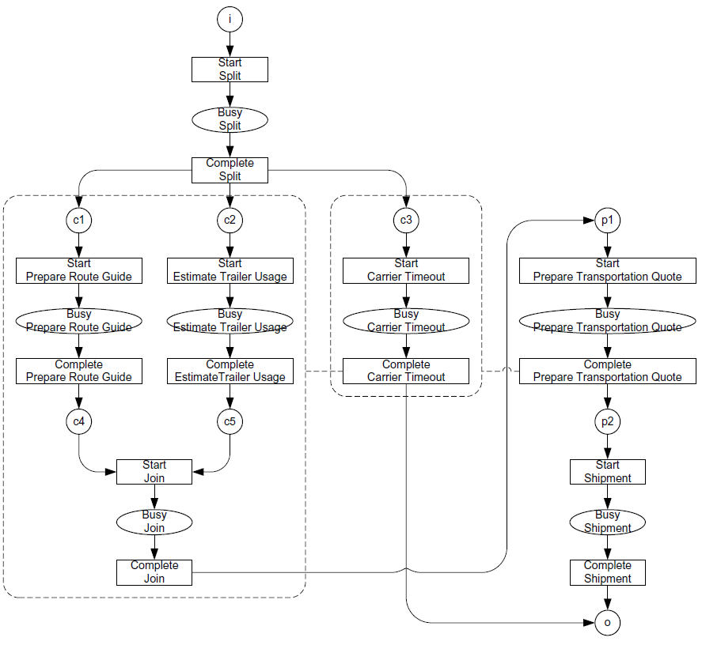
Preliminaries: Reset net
Notes:
The example as a Reset net, including the problematic state and enabled transition.

Slide 11
Soundness

Slide 12
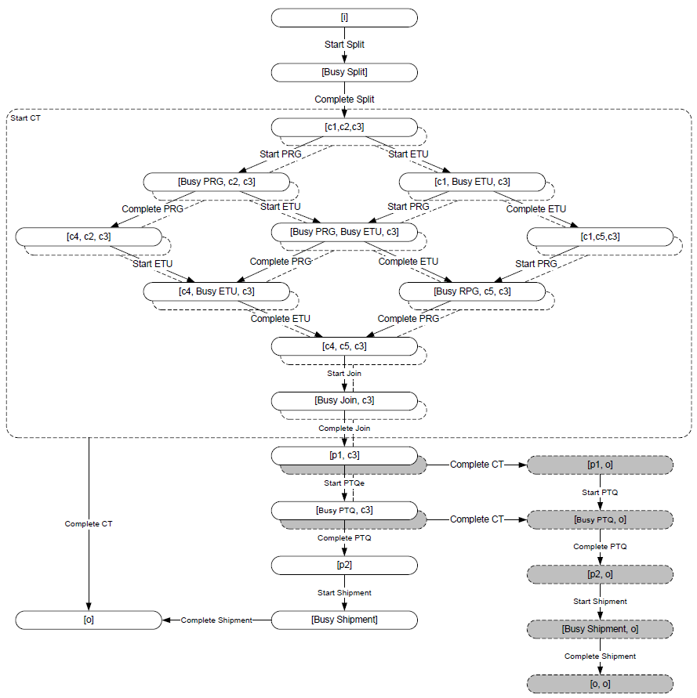
Soundness: State space
Notes:
For the example, the state space CAN be constructed. The dotted states can be reached through executing the Start Carrier Timeout (Start CT) transition. As a result we can decide soundness on this state space:
Option to complete: It is always possible to mark place o ☺
Proper completion: States exist that exceed [o] ☹
No dead tasks: For any transition an edge exists ☺.
Conclusion: This YAWL net is not sound ☹. Perhpas it is relaxed sound? Filled states are now to be ignored, as they do not lead to proper completion. All transitions occur in the remaining state space, hence the YAWL net is relaxed sound.
Until now, we have kind of overlooked the possible problem that a YAWL task is not a transition and vice versa. In the example, every task was captured by a single Start transition and a single Complete ransition, but this need not be the case. A second fragment from the same model clarifies this.

Slide 13
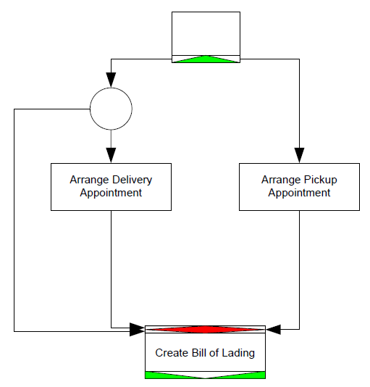
Soundness: OR-constructs
Notes:
This fragment includes the Create Bill of Lading task that has an OR-join semantics. When converting such an OR-join to a reset net, there are no alternatives but to introduce a transition for every possible input combination. However, from the seven possible input combinations only two are covered by proper completing execution paths.

Slide 14
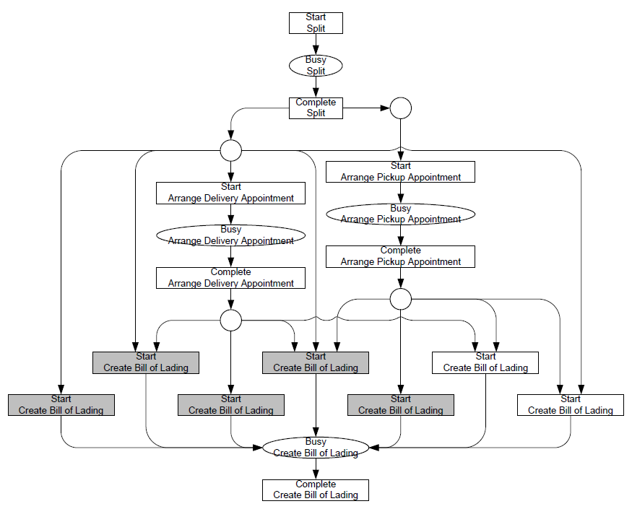
Soundness: OR-constructs
Notes:
Now, for verification it is important to note that all inputs are covered by the relaxed sound transitions. As a result, all inputs to this task are viable. If some inputs (outputs) of some tasks are not covered by relaxed sound transitions, then a warning can be issued that some incoming (outgoing) edge of the corresponding task cannot be successfully traversed; if such an edge would be traversed, proper completion would be impossible. When taking relaxed soundness into account, we can disregard possible input combinations that cannot lead to proper completion, which enhances the effectiveness (more warnings can be issued).
In a similar way, we can use relaxed soundness and the state space to detect whether some tasks or conditions can be removed from a certain cancelation region. If a certain task cannot cancel a given task or condition, or if canceling this given task or condition prohibits proper completion, then a warning can be issued that the cancelation region can be simplified by removing from it the given task or condition. However, these warnings can also be achieved by using the coverability property:
-A condition can be removed from a task’s cancelation region if the state where (1) the condition is satisfied and (2) the task is enabled, cannot be covered from the initial state.
-A task can be removed from another task’s cancelation region if the state where both tasks are enabled is not coverable from the initial state.

Slide 15
Soundness: Nets with OR-joins
Soundness
  Attempt to construct the state space of YAWL net
  Use the YAWL semantics
  Convert OR-joins to XOR-joins + translations to reset nets to determine whether an OR-join should be enabled
Weak-soundness
  Coverability analysis
  Limited result available
Warnings for unnecessary OR-joins
Warnings for OR-joins in a cycle
Notes:
For the YAWL nets with OR-joins (and cancellation regions), we attempt to construct a state space using the YAWL semantics (including the fact that we determine whether an OR-join is enabled by converting other OR-joins to XOR-joins and check for backwards coverability of a bigger marking). However, if the set cannot be constructed, then only limited results are available for such nets. Because of the expensive nature of OR-join enablement algorithm, we provide a warning when a net contains OR-joins that could be replaced with either an AND-join or an XOR-join. As the OR-join semantics can result in livelock in a vicious cycle, we also provide warnings when two or more OR-joins are in a cycle with the potential to become a vicious cycle. This check is available from YAWLEditor 2.0 version.

Slide 16
Soundness: Nets without OR-joins
Soundness
  Reset net
  Reachability analysis
  Undecidable in the general case
Weak-soundness
  Reset net
  Coverability analysis
  Decidable
Unnecessary Cancellation Regions
  Reset net
  Coverability analysis

Slide 17
Reduction rules
Notes:
The success of our verification approach hinges on the ability to generate a state space. If we can construct a state space, then we can decide soundness, and we can provide a complete diagnosis report. Otherwise, we have to revert to using either relaxed soundness or weak soundness (or structural invariant properties), in which cases the results might be incomplete. Although it is known that construction of a state space is infeasible for some YAWL nets, we want to improve our chances of success in case it is feasible. This means that we try to avoid a state space explosion as much as possible. A popular way to do so, is to reduce the size of the model beforehand, that is before generating its state space.
Of course, if we reduce the model, we change it in some way. This makes diagnosing possible errors in the model a very complex task, as we need to be aware of this change and we need to be able to transfer errors in the reduced model to errors in the original model. A fine point to note is that the reduction should be such that any errors present in the original model are also present in the reduced model: The reduction should preserve the sought-after qualities, which in our case is the soundness property.
Reductions can be applied on either the YAWL net, or on the underlying Reset net. For the latter, it is important to note that (ideally) there should be no OR-joins present in the YAWL net, as these do not transfer well onto reset net constructs. Therefore, we first assume that no OR-joins are present, and introduce a number of reset net-based reduction rules. Later on, we will transfer these reduction rules to
the level of the YAWL net and allow for OR-joins as well.

Slide 18
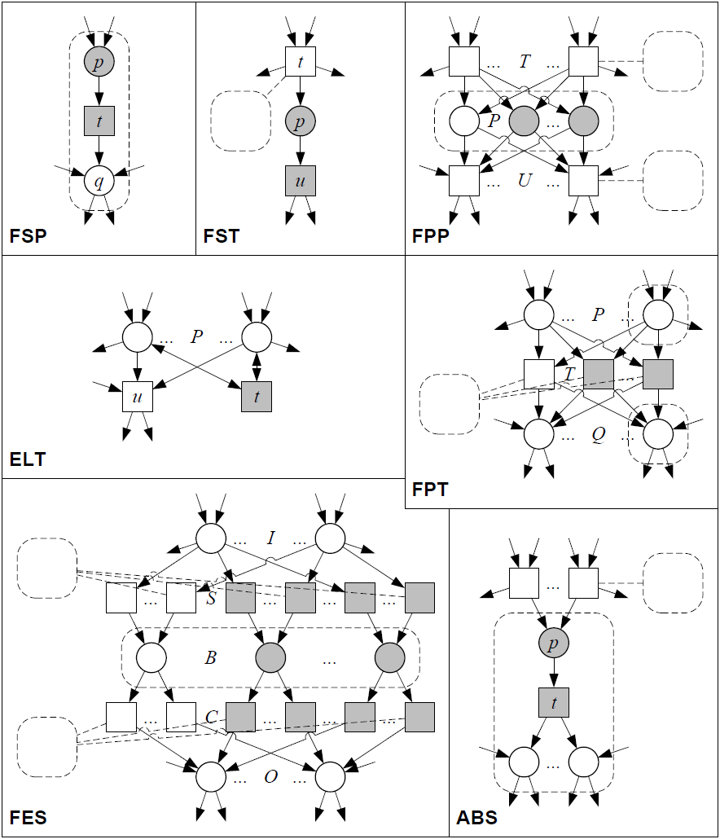
Reduction rules: Reset net

Slide 19
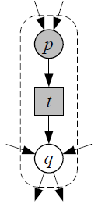
Reduction rules: Reset nets: FSP
Fusion of Series Places (Murata)
Reduces size of state space
Soundness-preserving:
  Transition t should not reset any place
  Places p and q should be reset by the same set of transitions.
Notes:
As t has only p as input and only q as output, the remainder of the net cannot influence the moment t is being executed. In other words, transition t is some kind of loose cannon. However, the moment t executes should not matter, as after it has been removed it cannot matter anymore. Therefore, we cannot allow t to reset any place, unless we can guarantee that the effect of this reset is always identical. In
general, this requires a state space search, which is not a good idea as we are still trying to reduce the net prior to constructing a state space.
To see this, it helps to consider the tokens in place p to be present in some way in place q as well. After all, any token from p can be transferred to q by executing transition t at any moment in time. Therefore, any transition that resets p should reset q as well, as in the mean time the token it was about to reset may have been transferred by t to q.

Slide 20
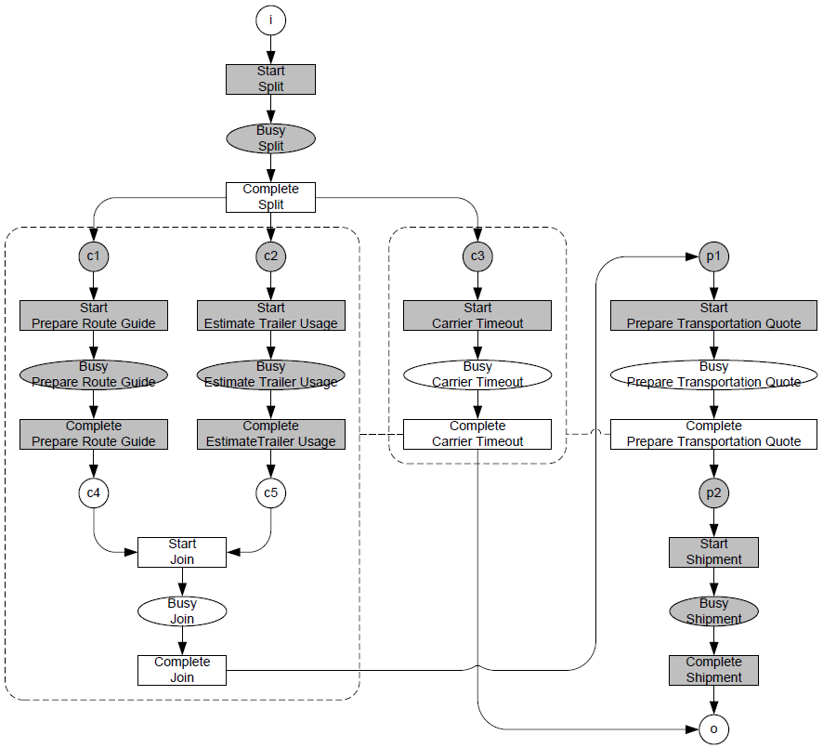
Reduction Rules: Reset nets: FSP
Notes:
Filled transitions and places have been removed by the rule.

Slide 21
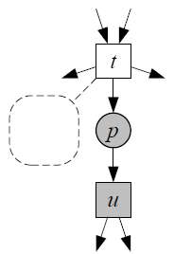
Reduction Rules: Reset nets: FST
Fusion of Series Transitions (Murata)
Reduces size of state space
Soundness preserving:
  Place p is reset by the same set of transitions as any output of transition u is.
  Transition u does not reset.

Slide 22
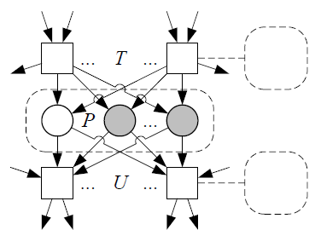
Reduction Rules: Reset nets: FPP
Fusion of Parallel Places (Murata)
Enables other rules
Soundness preserving:
  All places in P are being reset by the same set of transitions.

Slide 23
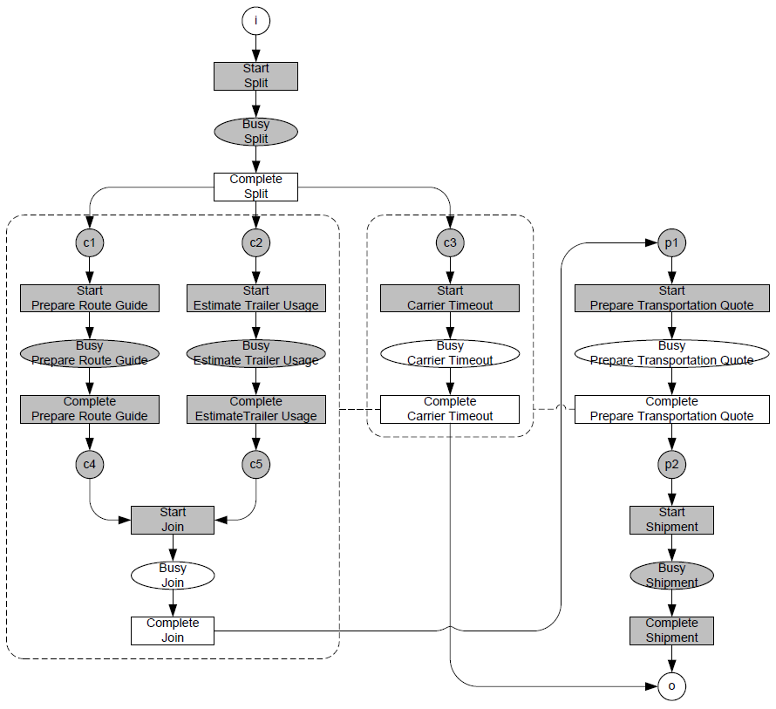
Reduction Rules: Reset nets: FPP

Slide 24
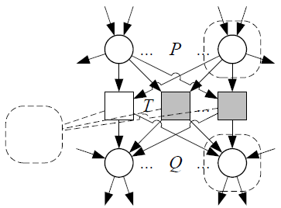
Reduction Rules: Reset nets: FPT
Fusion of Parallel Transitions (Murata)
Enables other rules
Soundness-preserving:
  All transitions in T reset the same set of places.

Slide 25
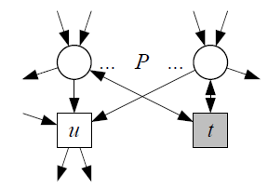
Reduction Rules: Reset nets: ELT
Elimination of self-Loop Transitions (Murata)
Enables other rules
Soundness preserving:
  Transition t resets no place.
Notes:
Note that in the setting of a YAWL net, its counterpart (ELP) makes no sense.

Slide 26
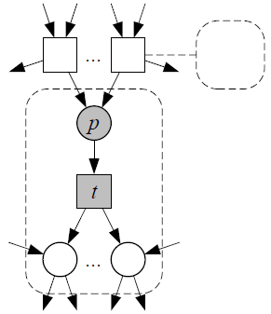
Reduction Rules: Reset nets: ABS
ABStraction (Desel & Esparza)
Reduces size of state space
Soundness-preserving:
  Place p is reset by the same set of transitions as any output of transition t is.
  Transition t does not reset any place.

Slide 27
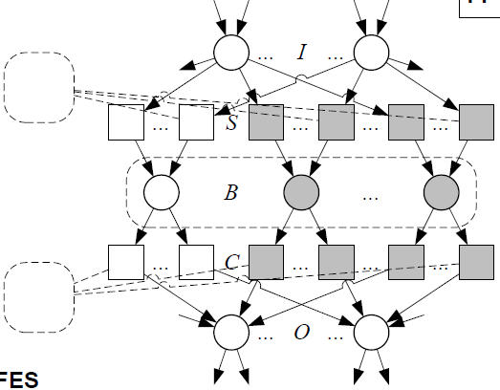
Reduction Rules: Reset nets: FES
Fusion of Equivalent Subnets
Enables other rules

Slide 28
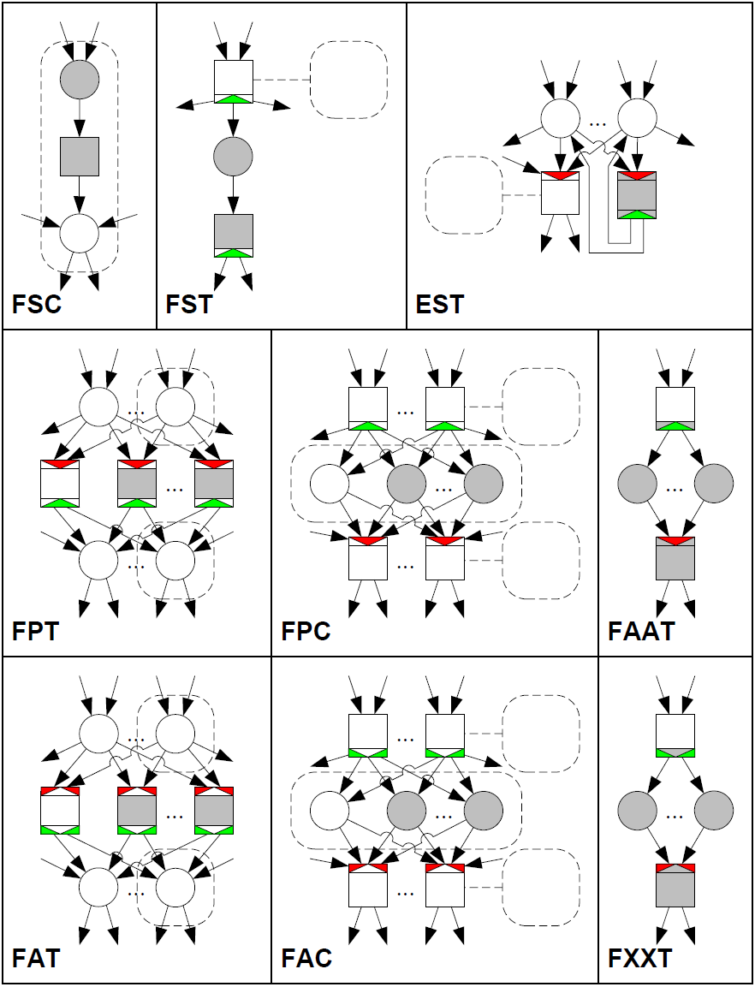
Reduction Rules: YAWL nets

Slide 29
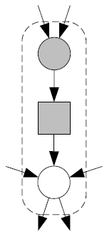
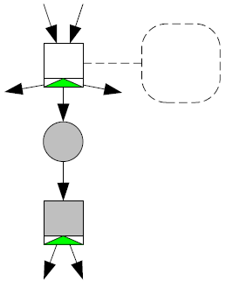
Reduction Rules: YAWL nets: FS[CT]
The Fusion of Series Conditions rule
  allows to remove a condition and a task, provided that:
    the task does not reset and
    the place is reset by the same set of transitions as the output condition of the transition is.
The Fusion of Series Tasks rule
  allows to remove a condition and a task, provided that:
    the task does not reset and
    the place is not being reset.

Slide 30
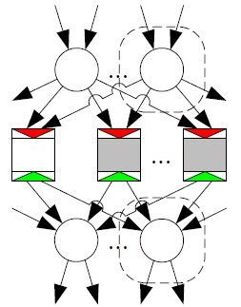
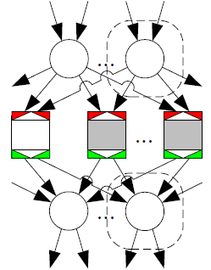
Reduction Rules: YAWL nets: F[PA]T
The Fusion of Parallel Tasks rule
  allows to remove all-but-one parallel AND-join-AND-split tasks
The Fusion of Alternative Tasks (FAT) rule
  allows to remove alternative XOR-join-XOR-split tasks.

Slide 31
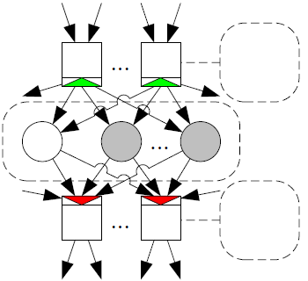
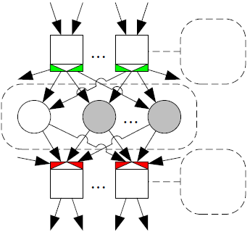
Reduction Rules: YAWL nets: F[PA]C
The Fusion of Parallel Conditions rule
  allows to remove all-but-one parallel conditions, provided that:
    all input tasks are AND-splits and
    all input transitions are AND-joins
The Fusion of Alternative Conditions rule
  allows to remove all-but-one alternative conditions, provided that:
    all input tasks are AND-splits and
    all input transitions are AND-joins.

Slide 32
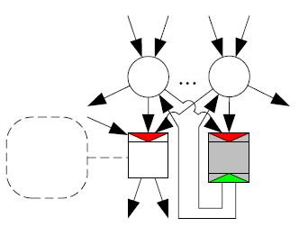
Reduction Rules: YAWL nets: EST
The Elimination of Self-loop Tasks rule
  allows to remove an AND-join-AND-split task for which the set of input conditions is identical to the set of output conditions, provided that:
    some other AND-join task contains at least the set of output conditions.

Slide 33
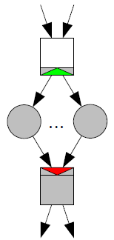
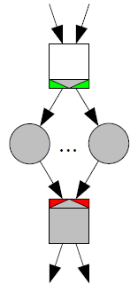
Reduction Rules: YAWL nets F[AX]²T
The Fusion of AND-join-AND-split Tasks rule
  allows to merge an AND-split task and an AND-join task, provided that:
    the output conditions of the former match the input conditions of the latter
The Fusion of XOR-join-XOR-split Tasks (FXXT) rule
  allows to merge an XOR-split task and a XOR-join task, provided that:
    the output conditions of the former match the input conditions of the latter

Slide 34
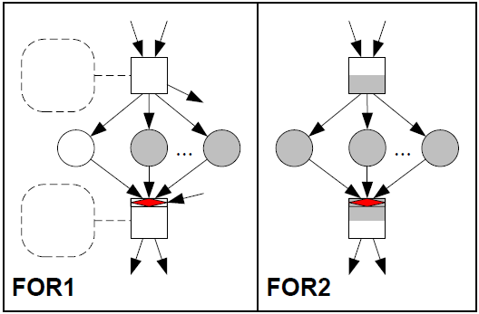
Reduction Rules: YAWL nets: OR-joins

Slide 35
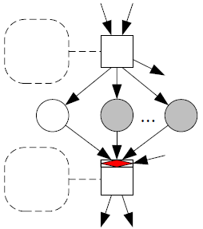
Reduction Rules: YAWL nets: FOR1
Similar to the F[PA]C rules, but
  requires only one split task and one join task, whereas the other two rules allow for multiple splits and joins, and
  allows for the join construct to be an OR-join, whereas the parallel rule requires an AND-join and the alternative rule an XOR-join.
Allows to remove all-but-one condition, provided that:
  the conditions are being canceled by the same set of tasks,
  the OR-join task is the output of every condition from the set,
  the other task is the input of every condition from the set, and
  the OR-join task is not on some cycle with any other OR-join task.

Slide 36
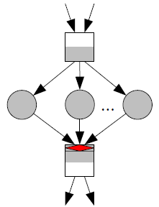
Reduction Rules: YAWL nets: FOR2
Specialization of FOR1 rule:
  forbids the OR-join task to have additional inputs,
  forbids the other task to have additional outputs,
  forbids both tasks to have a (non-empty) cancelation region, and
  forbids the OR-join to be on some cycle with some other OR-join task.
Allows to merge two tasks, while removing all conditions in-between.

Slide 37
Invariants
Notes:
Transition invariants are structural properties, which means that they can be decided using only the structure (and not the behavior, that is, the state space) of the net. Thus, if constructing the state space is no option, we could still construct transition invariants, and use these invariants for diagnostic purposes.

Slide 38
Invariants: Relaxed soundness
Any relaxed sound transition is on some proper execution path.
Any proper execution path corresponds to a cyclic execution path after having short-circuited the net.
Any corresponding cyclic execution path corresponds to a semi-positive transition invariant that covers t.
Transition invariant:
  A weighted sum of transitions such that the current state would not change if all these transitions would be executed simultaneously according to their weight.
  A negative weight means the transition is to be executed in reverse (inputs and outputs swapped).
Semi-positive:
  All weights are at least 0.

Slide 39
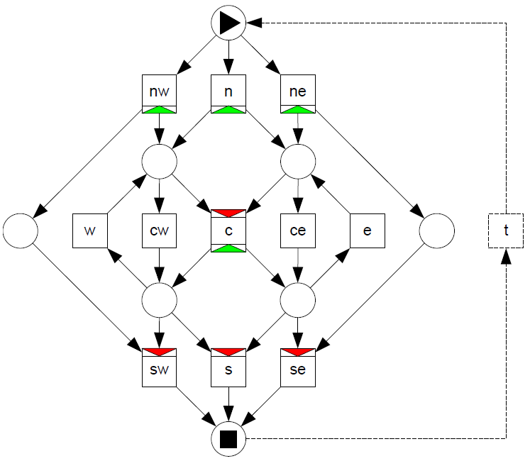





Invariants: Example
Notes:
Possible execution paths in this net include:
- n c s,
- n c e ce s, and
nw cw w cw sw.
Although this invariant satisfies the requirements (it is semi-positive and it covers t) it does not correspond to a proper execution path as the path blocks after having executed nw. The root cause of this is that not every invariant may be realizable in the model.

Slide 40
TOOLS
Tools

Slide 41
Tools: YAWL Editor
State space construction
  YAWL net if OR-joins present
  Reset net otherwise
YAWL net reduction
Reset net reduction
Soundness
  Provided that a state space could be constructed, weak soundness otherwise
Notes:
The techniques mentioned in this presentation have been implemented in two tools: The YAWL Editor and WofYAWL. Whereas the Editor is part of the entire YAWL suite, the WofYAWL tool is a stand-alone tool which works on YAWL Engine files.

Slide 42
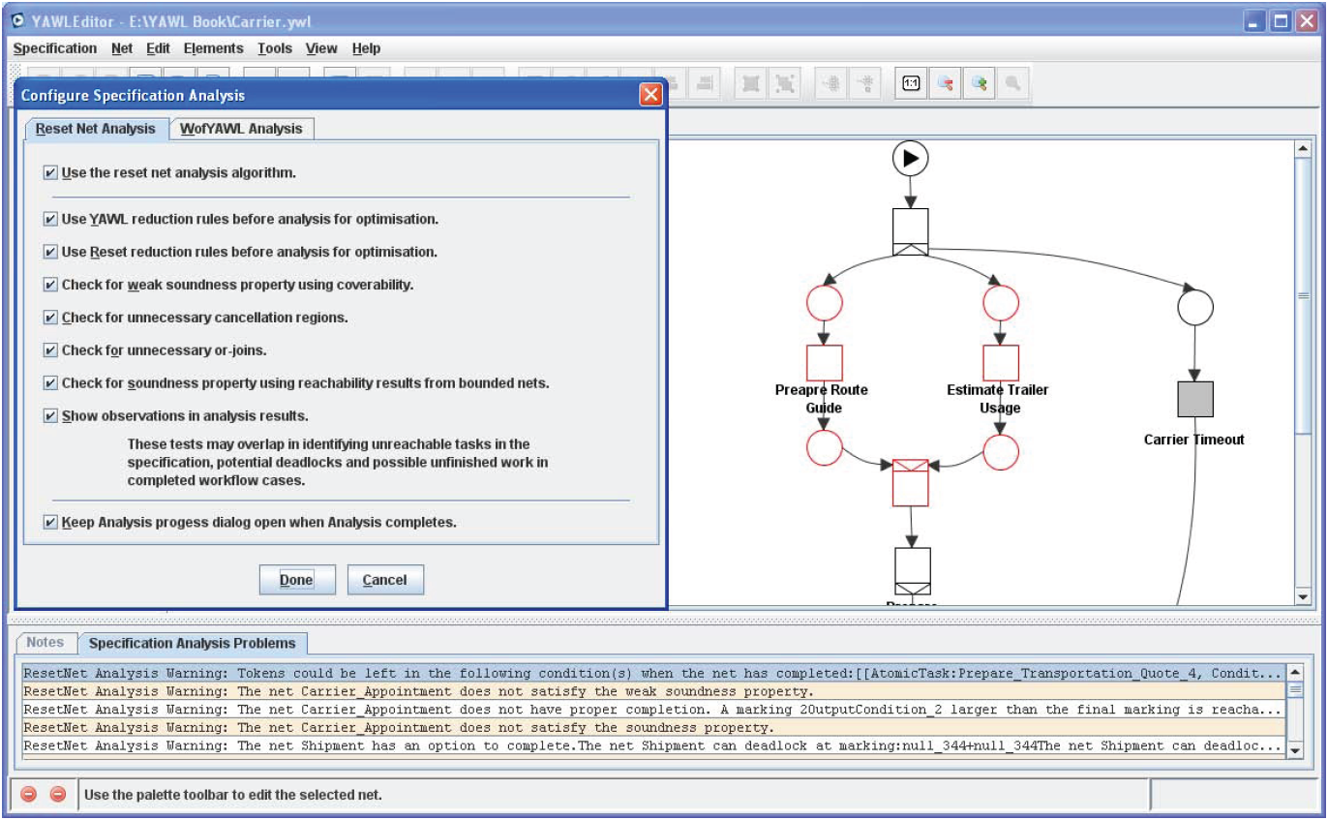
Tools: YAWL Editor: Example

Slide 43
Tools: YAWL Editor: Additional Properties
Unnecessary OR-joins
  Provided that a state space could be constructed, check if an OR-join can be replaced with an XOR-join or an AND-join
OR-joins in a cycle (version 2.0 onwards)
  Detect a potential vicious cycle situation
Unnecessary Cancellation Regions
  Check for places and tasks in the model that can never be cancelled as specified
Notes:
In addition to the checking whether a model is sound or weak-sound, you can also check for unnecessary OR-joins and cancellation regions. These properties are intended to improve the quality of the model. From the editor version 2.0, it is also possible to detect whether two or more OR-joins are in a cycle – potentially resulting in these OR-joins waiting for one another to be enabled (A live-lock situation).

Slide 44
Tools: WofYAWL
Spin-off of Woflan
Loosely integrated in YAWL Editor
Uses YAWL Engine file
State space construction
  Reset net only
Reset net reduction
Relaxed soundness
  Provided that a state space could be constructed, otherwise transition invariants to approximate relaxed soundness.

Slide 45
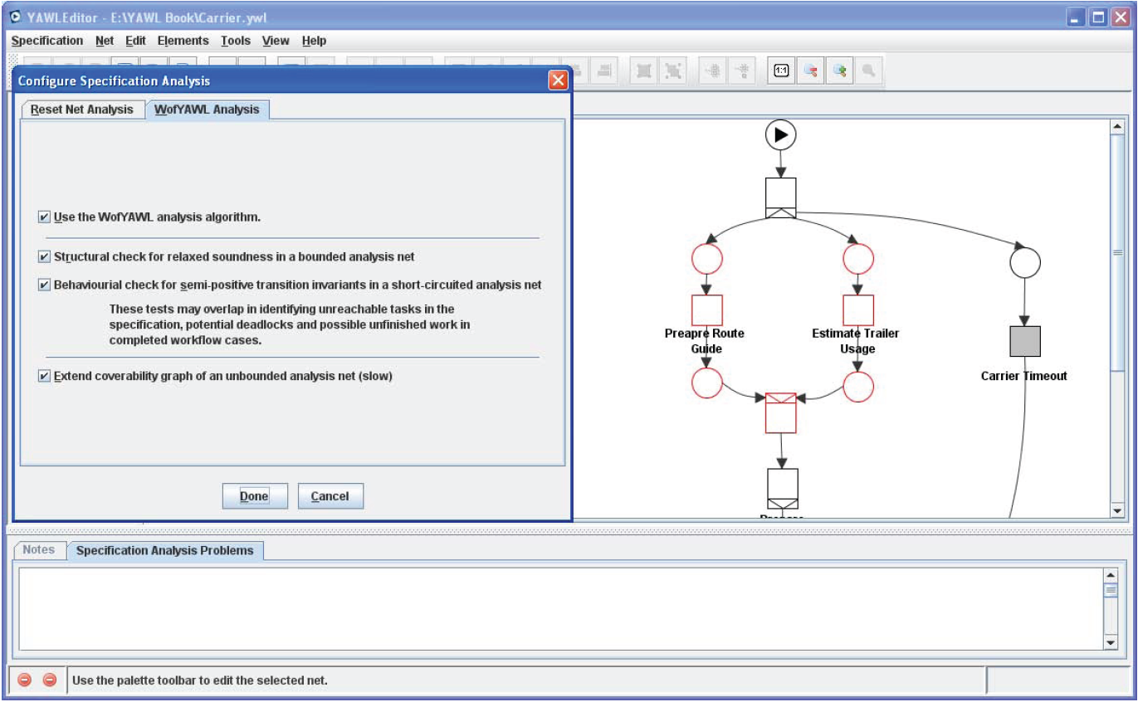
Tools: WofYAWL: Example

Slide 46
Conclusions
Introduction
Preliminaries
  Soundness, relaxed soundness, weak soundness, Reset nets
Soundness
  State space! Otherwise only weak soundness
Reduction rules
  Reset nets, YAWL nets, OR-joins
Invariants
  Structural property, relaxed soundness, approximation
Tools
  YAWL Editor, WofYAWL
Conclusions

