Slide 1
Chapter 21
YAWL4Healthcare
Ronny Mans
Wil van der Aalst
Nick Russell
Arnold Moleman
Piet Bakker
Monique Jaspers

Slide 2

Motivation
Pressures on healthcare providers
High quality care
Patient safety
Cost reduction
Streamlined processes
Increased demand for
Technological support
Monitoring
Workflow

Slide 3
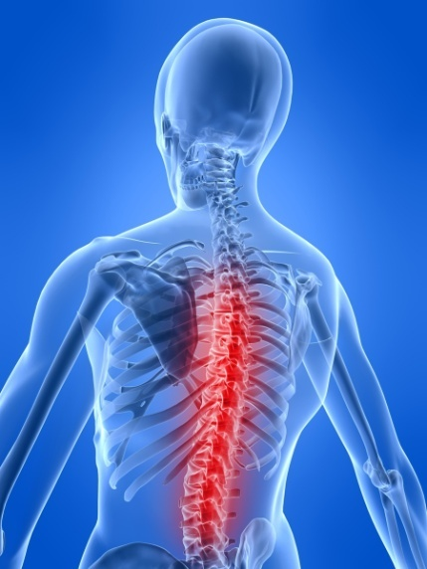
Motivation
But healthcare processes are
  Diverse (wide range of offerings)
  Distributed (involve multiple staff & departments)
  Variable (similar diagnosis ≠ same treatment)
Process flexibility
is a key consideration

Slide 4
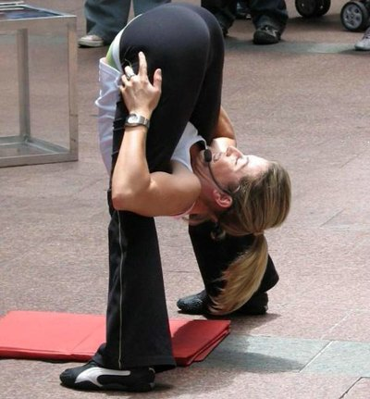
Motivation
Flexible workflow technology in the healthcare domain?
... how? .. where? .. what kind?

Slide 5
Motivation
What are the considerations with regard to process flexibility
when applying workflow technology in hospitals?

Slide 6
Overview
Healthcare Processes
Gynecological Oncology
Realization (YAWL, FLOWer, ADEPT1, Declare)
Conclusions

Slide 7
Overview
Healthcare Processes
Gynecological Oncology
Realization (YAWL, FLOWer, ADEPT1, Declare)
Conclusions

Slide 8

Healthcare Processes
Various healthcare processes
  Diverse (wide range of offerings)
  Distributed (involve multiple staff & departments)
  Variable (similar diagnosis ≠ same treatment)
  Characterization ?

Slide 9
Healthcare Processes
Concepts for the delivery of care:
Managed care
Stepped care
Integrated care

Slide 10
Healthcare Processes
Managed Care
Continuous improvement of measurable results
Focus:
  Effectiveness
  Quality
  Price
  Extent of care
Care process needs to be highly structured!
Example: Shouldice Hospital in Canada (hernia repair)

Slide 11
Healthcare Processes
Stepped Care
Delivery right intensity of care at the right moment
Care is gradually offered
Chronic diseases
Treatment typically takes years
Tests or treatments performed at regular intervals
Example: Rheumatoid arthritis

Slide 12
Healthcare Processes
Integrated Care
Bringing together:
  inputs, delivery, management and organization of services
related to
  diagnosis, treatment, care, rehabilitation, health promotion
Combine parts into one coherent activity
Multidisciplinary treatment
Typically intensive period of care in order to diagnose and treat patient
Example: Breast cancer

Slide 13
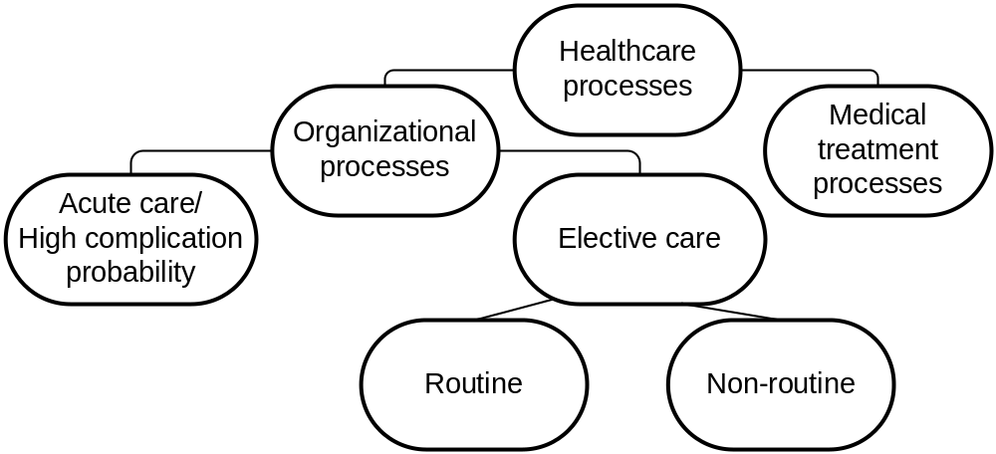
Healthcare Processes
completely planned
evidence knowledge base
diagnostic-treatment path
step-by-step
some parts can be planned
  evidence
  patient condition
  kind of complaints
  clear understanding of complaints
Organizational tasks
repetitive
non-trivial
no support for medical decision making
critically ill patients
rapidly changing conditions
low predictability
postponement of treatment
can be planned (but varies)
Diagnostic-therapeutic cycle
patient observation
medical reasoning
decision making
Main kinds of healthcare processes:

Slide 14
Overview
Healthcare Processes
Gynecological Oncology
Realization (YAWL, FLOWer, ADEPT1, Declare)
Conclusions

Slide 15
Gynecological Oncology
AMC hospital
Outpatient clinic
Diagnostic process (referral hospital → diagnosis)
Representative healthcare process
  Complex set of possible diagnostic paths
  Multiple disciplines
  Inherent need for flexibility

Slide 16
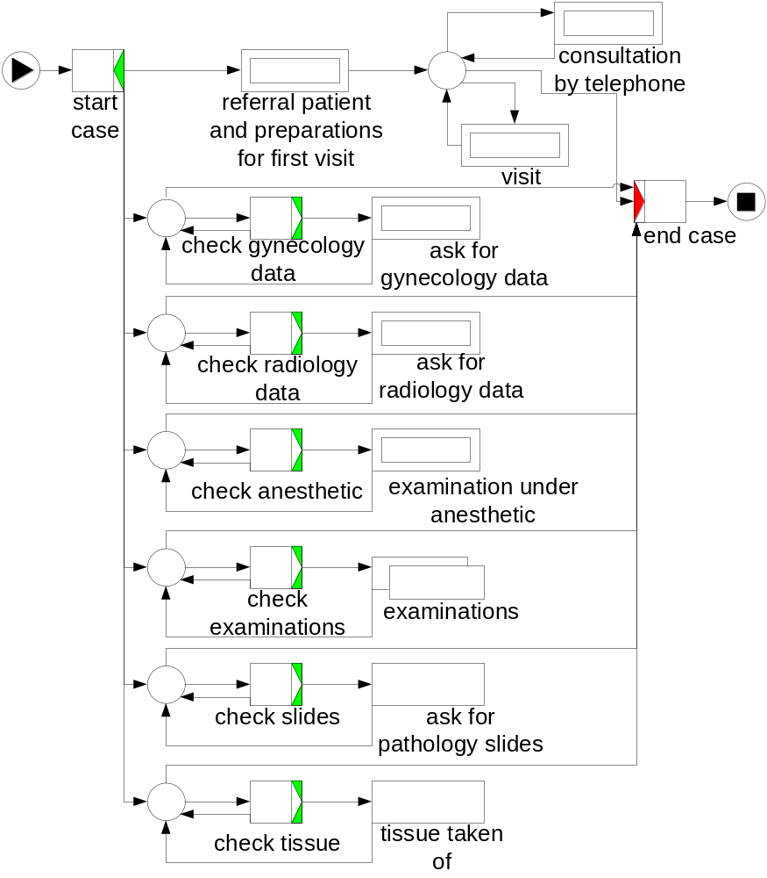
Gynecological Oncology
Outpatient clinic:
Referral
Outpatient clinic:
Visit
Outpatient clinic:
Consultation by telephone
Examinations

Slide 17
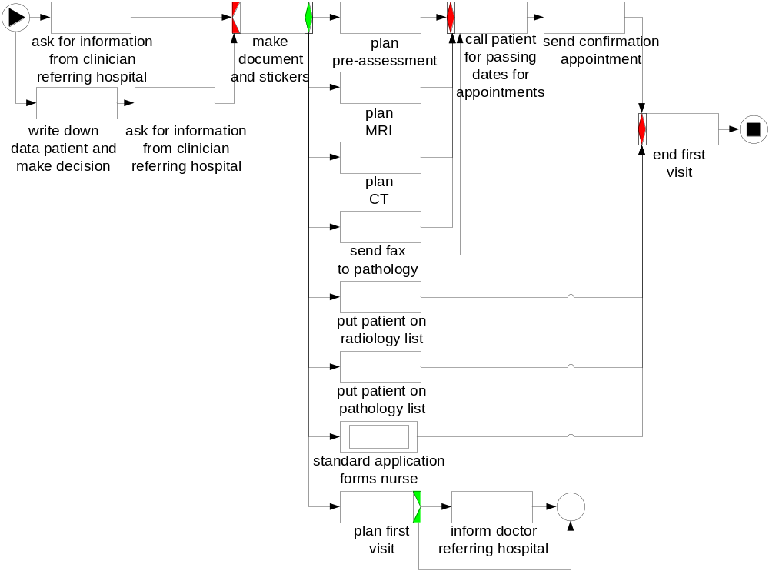
Gynecological Oncology
Standardized procedure
Receive call from referring clinician
Planning of first visit
Administrative tasks

Slide 18
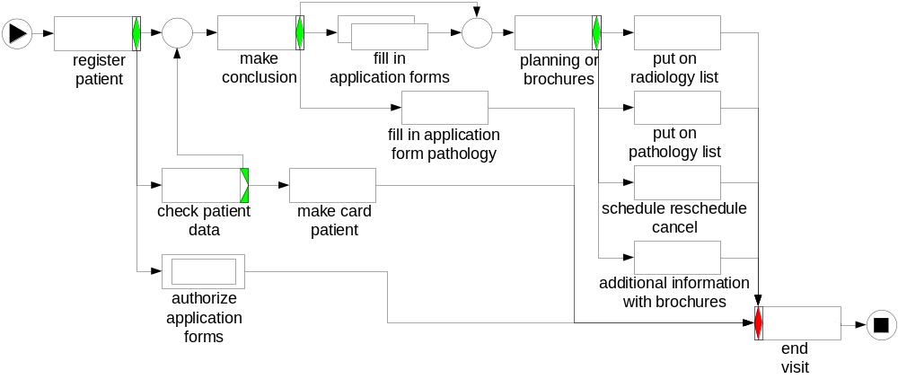
Gynecological Oncology
discuss status
decide about tests
Filling in of forms for tests
Administrative tasks
Administrative tasks

Slide 19
Gynecological Oncology
Which kind of healthcare process?
Elective care process
Examinations:
No support in selecting most appropriate test(s)
And so on…
Many organizational tasks
Many organizational tasks

Slide 20
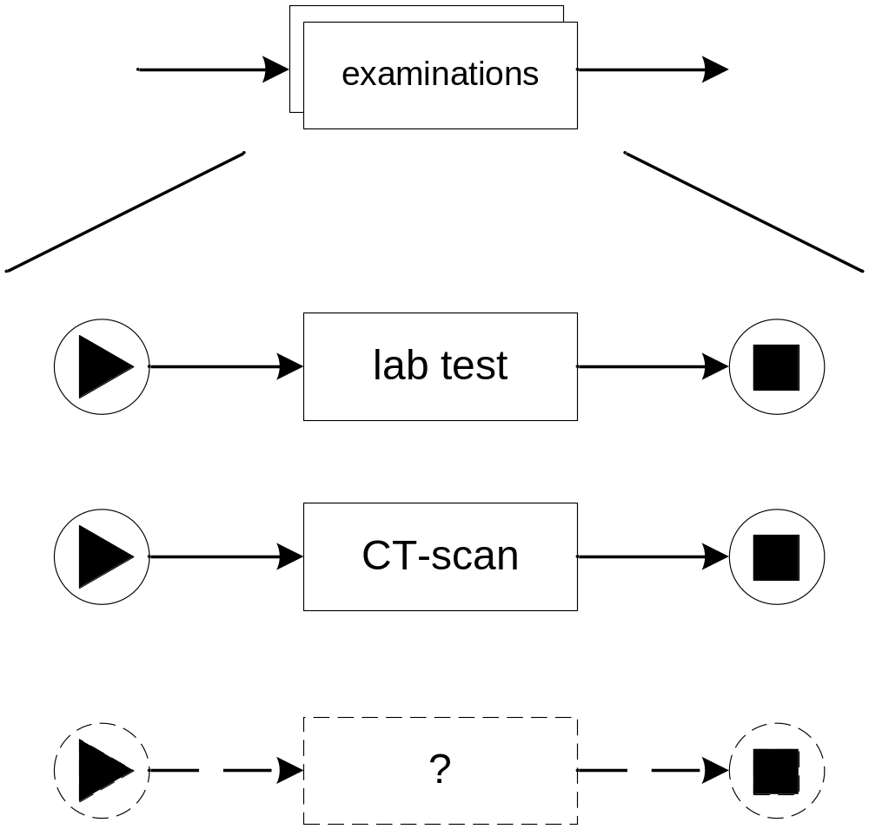
Gynecological Oncology
Selection of examinations
Selection of tests depends on:
actual condition of patient
outcome of earlier tests
quality of earlier tests
Selection of tests only becomes clear during course of process
Common test
Common test
But:
new tests
other tests needed

Slide 21
Gynecological Oncology
Kind of healthcare process:
elective
non-routine
complex care
Examinations:
can not be planned beforehand
step-by-step
multiple disciplines

Slide 22
Overview
Healthcare Processes
Gynecological Oncology
Realization (YAWL, FLOWer, ADEPT1, Declare)
Conclusions

Slide 23
Realization
YAWL
  230 tasks
  120 hour implementation time
  Non-trivial
  Perspectives: control-flow, resource, data
  Scenario
Implementation in FLOWer, ADEPT1, Declare

Slide 24
Realization (Control-flow perspective)
Examinations:
Worklet Service
repertoire of worklets
right worklet chosen at runtime
add worklets
30 hours required

Slide 25
Realization (Resource perspective)
Each task performed by a single person having a specific role
YAWL:
  participant (may have one or more roles)
  For each task, single role is specified
  Worklist handler of Resource Service
  5 hours required

Slide 26

Realization (Resource perspective)
Limitation:
  Each task performed at an arbitrary point in time when a participant becomes available
  All workitems presented via worklist
Healthcare domain:
Importance of appointments:
    Patients (with preferences)
    Staff meetings
    Equipment
    …
people are used to work in a
planned way
which is
not supported
by current workflow management systems

Slide 27
Realization (Resource perspective)
Calendar-based scheduling is required for workitem
Appointment between doctor and patient (e.g. at 10 ‘o clock)

Slide 28
Realization (Data perspective)
Routing purposes
Complex data types defined in XML schema
  (re)scheduling, canceling appointments
Automatic form generation
30 hours required

Slide 29
Realization (Scenario)
Needed:
MRI
CT
Preoperative screening
send pathology slides
Worklist after this step

Slide 30
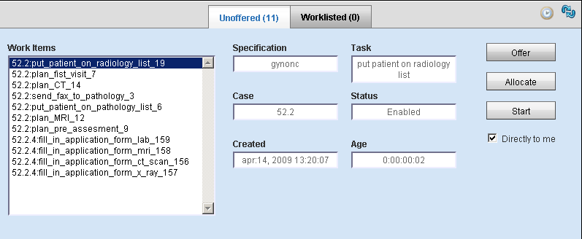
Realization (Scenario)

Slide 31
Realization (Scenario)
discuss status
decide about tests

Slide 32
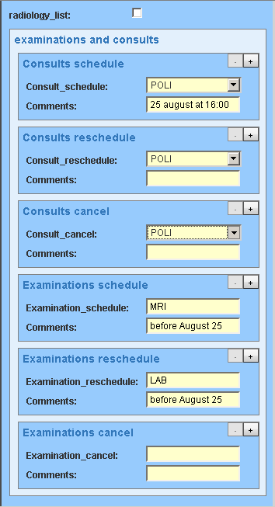
Realization (Scenario)
MRI
Lab test

Slide 33
Realization (Scenario)
Examinations:
Worklet Service
lab test
MRI

Slide 34
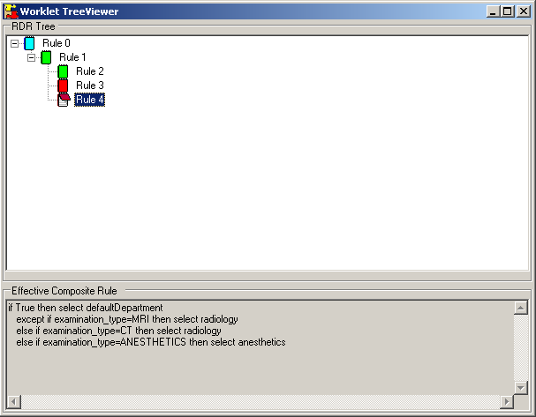
Realization (Scenario)
MRI
Lab test

Slide 35
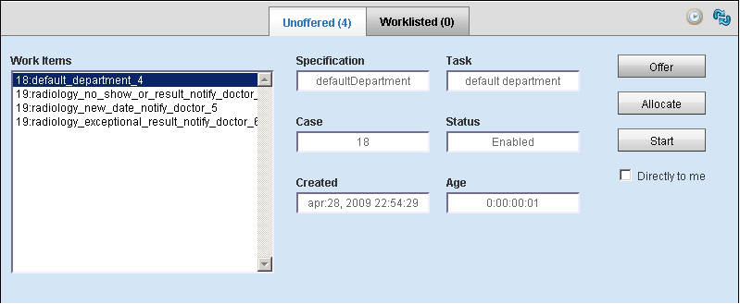

Realization (Scenario)
MRI
Lab test

Slide 36
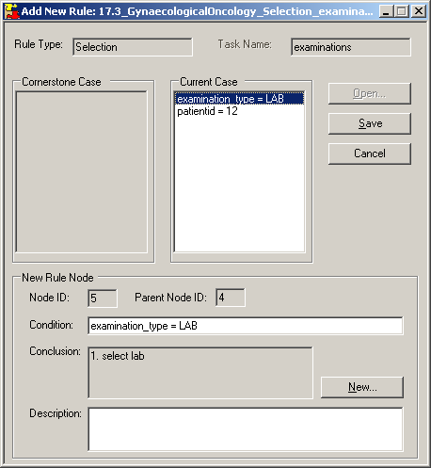
Realization (Scenario)
Replacement of lab worklet

Slide 37
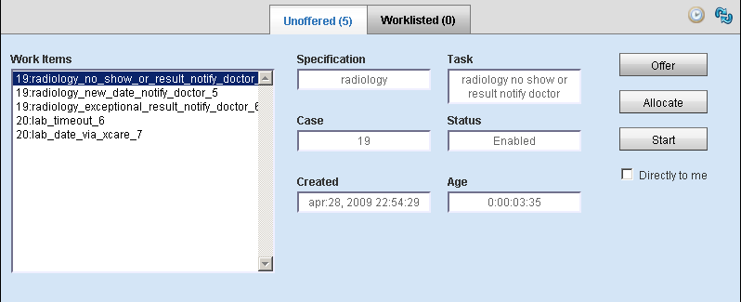
Realization (Scenario)
Lab test
MRI
Acceptance of workflow technology
in healthcare
Selecting right worklet
Replacement of less suitable worklet

Slide 38
Realization (FLOWer, ADEPT1, Declare)
FLOWer
Case handling
Deviation from existing process
  Skip, redo
  View/add/modify data elements

Slide 39
Realization (FLOWer, ADEPT1, Declare)
Can be skipped
Can be redone
Optimal support for
routine
processes

Slide 40
Realization (FLOWer, ADEPT1, Declare)
ADEPT1
Dynamic change
Process model for one case can be changed
  Insertion/deletion of steps

Slide 41
Realization (FLOWer, ADEPT1, Declare)
Insert
order drug
activity
Optimal support for
acute care
processes,
and processes with
high probability that
complications occur

Slide 42
Realization (FLOWer, ADEPT1, Declare)
Declare
Declarative process modeling language (ConDec)
  What should be done
  Constraints
  Dynamic change

Slide 43
Realization (FLOWer, ADEPT1, Declare)
Executed at least once, but in which order is open
Insert
order drug
activity
Optimal support for
routine
processes
Optimal support for
acute care
processes,
and processes with
high probability that
complications occur

Slide 44
Overview
Healthcare Processes
Gynecological Oncology
Realization (YAWL, FLOWer, ADEPT1, Declare)
Conclusions

Slide 45
Conclusions
YAWL
Implementation of gynecological oncology healthcare process
  Elective, non-routine healthcare process
  Complex care
Optimal support for required flexibility by Worklet Service
Limitations
  Lack of calendar-based scheduling support
  Interaction between processes

