Slide 1
Chapter 22
YAWL4Film
Chun Ouyang

Slide 2
Overview
Introduction
Film production process in practice
YAWL4Film
  Design
  Implementation
  Deployment
Pilot applications
Summary

Slide 3
Introduction
Background
  Project “Applying Business Process Management (BPM) to Screen Business”
  Supported by “Australian Research Council Centre of Excellence for Creative Industries and Innovation”
Collaboration
  BPM Group at Queensland University of Technology (QUT)
  Australian Film, Television and Radio School (AFTRS)

Slide 4
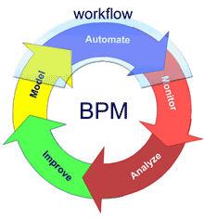

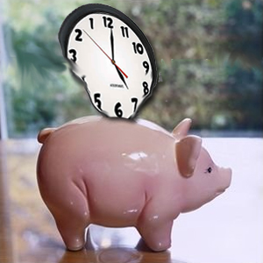
BPM and Screen Business
Business Process Management
Screen Business
Bringing process innovation
Development
Pre-production
Production
Learning new domain features
Post-production

Slide 5
Film Production Process in Practice
Production phase in screen business
Film production process
  Highly manual process (i.e. paper-based)
  Large amounts of heterogeneous data
  Many geographically distributed stakeholders
Daily shooting procedure
  Generation of call sheet and daily progress report (DPR)
Production documents
  Call sheet, DPR, etc.
Production roles
  Production manager (PM), production coordinator (PC), etc.

Slide 6
Daily Shooting Procedure
Daily Shooting Procedure
DPR Production
Continuity Log
(continuity)
Sound Sheets
(sound recordist)
Cast List
DPR
(PC, PM)
Camera Sheets
(camera assistant)
Crew List
2nd AD Report
(2nd AD)
Location List
Start a Day
Call Sheet Production
End a Day
Shooting Schedule Revisions
(1st AD)
Shooting Schedule (initial)
Call Sheet Final
(PC, PM)
Input from Pre-production
Call Sheet Drafts
(PC, PM)

Slide 7

Automating Film Production Process
Traditional process
  Paper-based, manual
  Time-consuming, tedious and error-prone
Goals & Benefits
  To optimize process execution
  To automate document processing and report generation
  To increase efficiency without sacrificing creativity & flexibility
  To reduce the cost of film production

Slide 8
YAWL4Film – Design & Implementation
YAWL4Film
  Application of YAWL to film production
  Customized user interface to support professional filmmaking
Film production process model
  Control-flow Definition
  Data perspective
  Resource perspective
Custom forms of film production documents

Slide 9
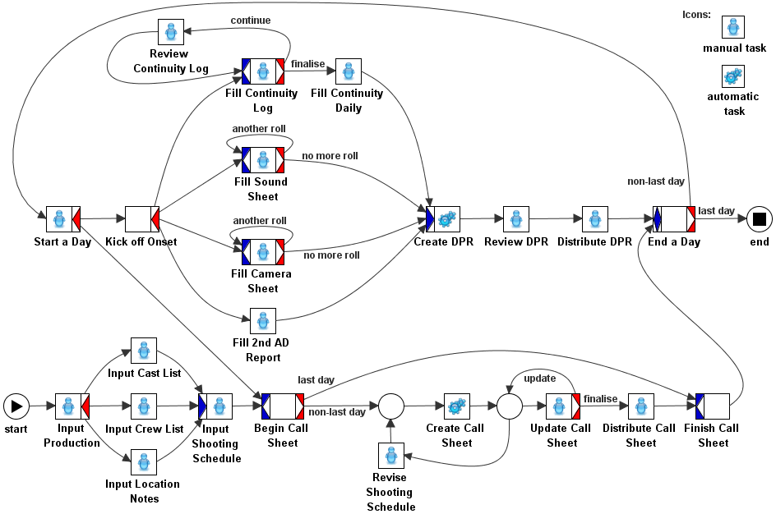
Film Production Control-flow

Slide 10
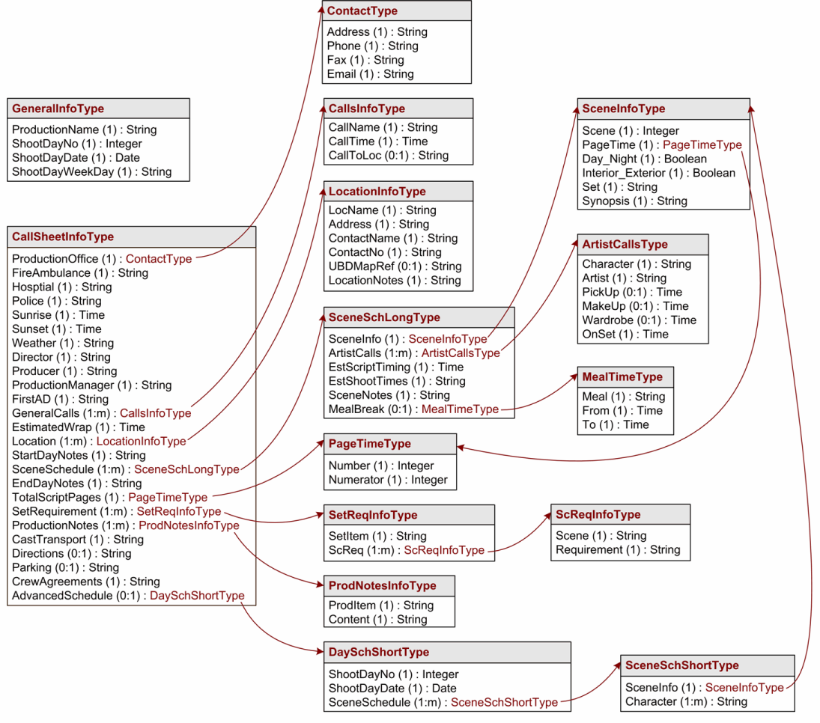
Film Production Data Structure
XML Schema
Example: data types for call sheet

Slide 11
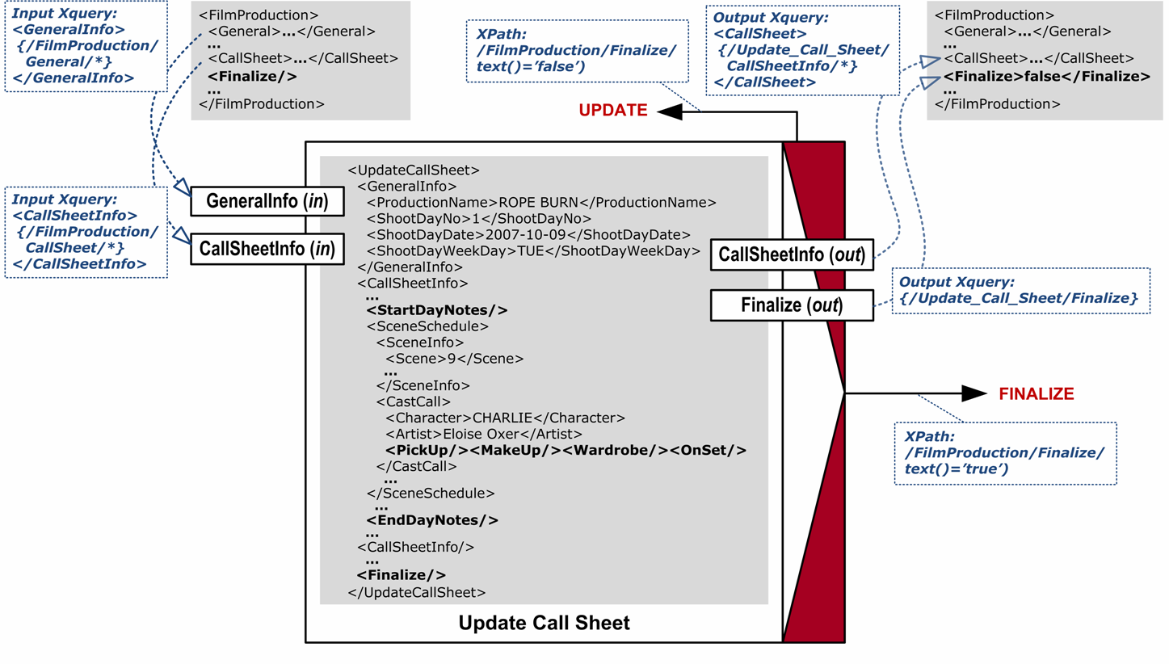
Film Production Data Mapping
XPath and XQuery
Example: Data mapping for task “Update Call Sheet”

Slide 12
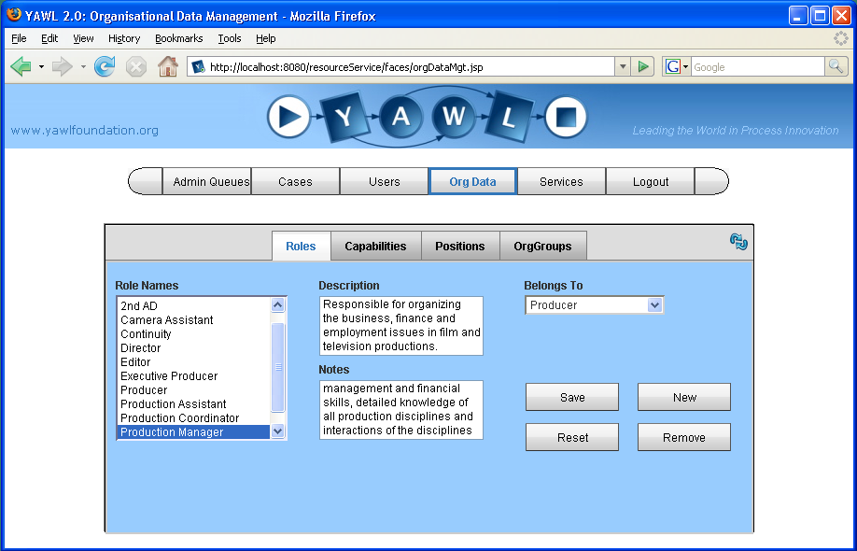
Film Production Organizational Data
A view of production roles stored in YAWL Org. Database

Slide 13
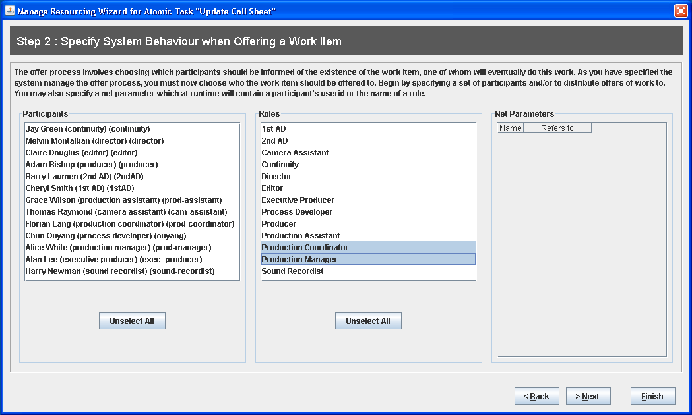
Film Production Task-Role Allocation
Example: task-role allocation for task “Update Call Sheet”

Slide 14
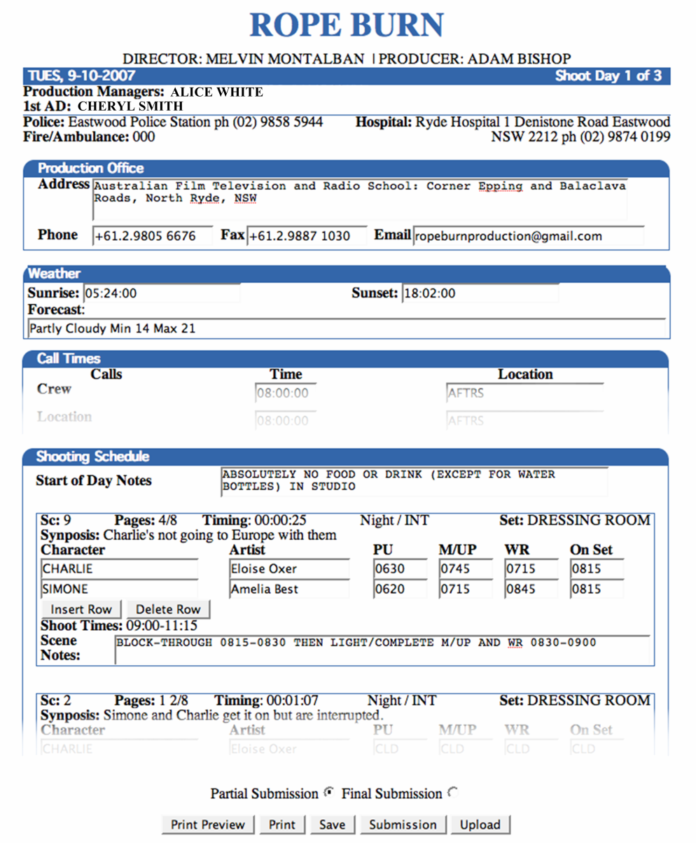
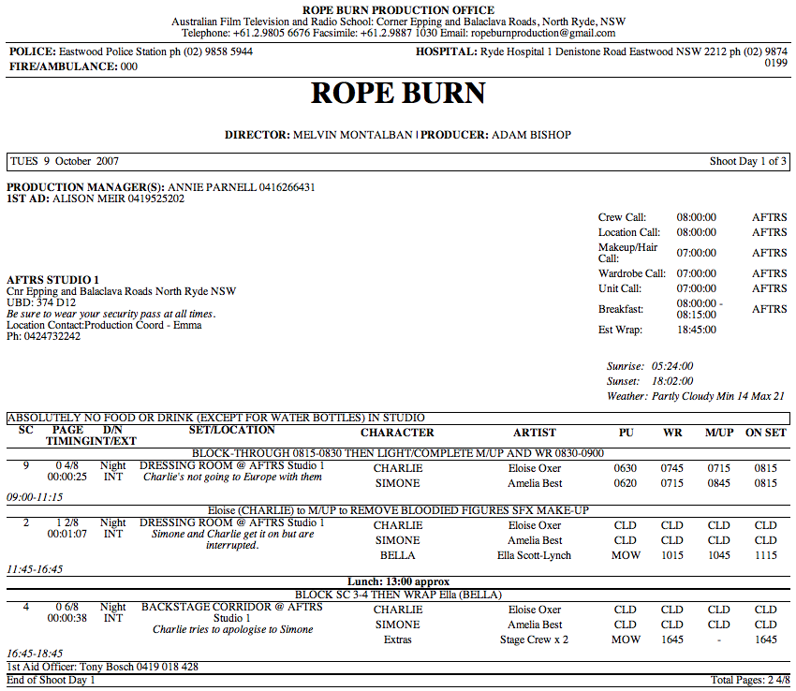
Film Production Custom Forms
A print-ready copy resembles the hard copy format used in practice
click

Slide 15
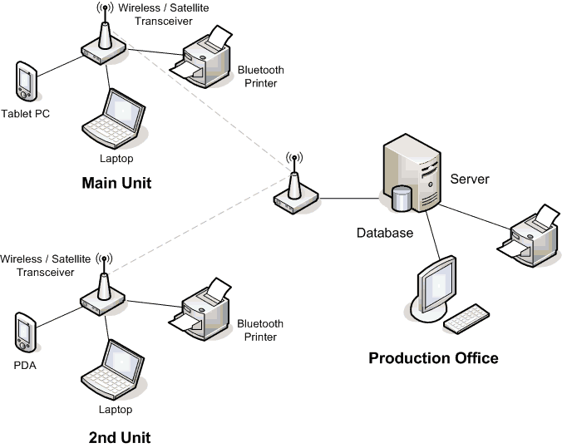
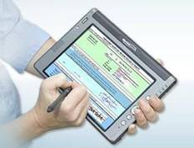

YAWL4Film Deployment
Scenario 1: Traditional set-up

Slide 16
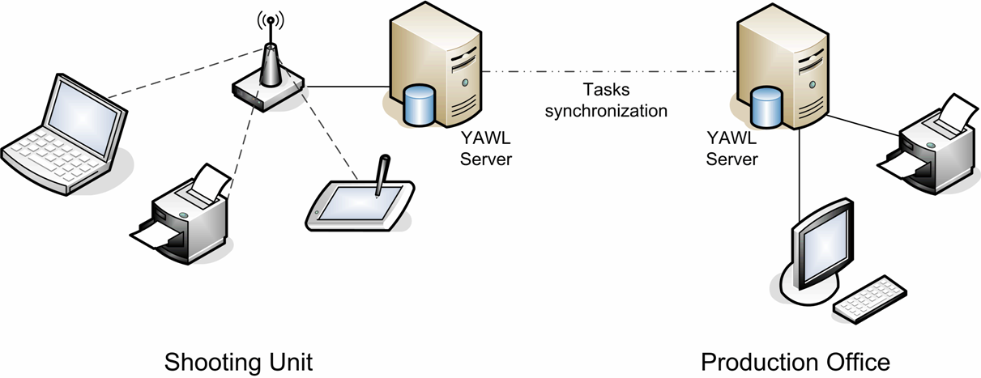
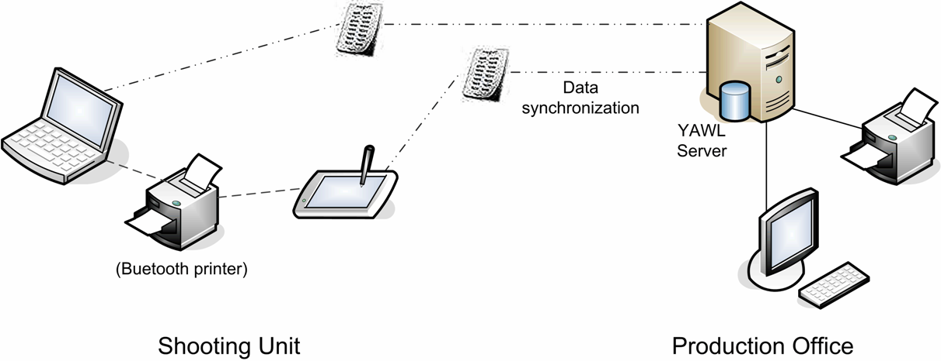
YAWL4Film Deployment – No Connectivity
Scenario 2: Task synchronization
Scenario 3: Data synchronization

Slide 17
Pilot Applications
YAWL4Film was successfully deployed on two film productions at the AFTRS in October 2007
  Project 1 “Rope Burn”: a three-day shoot in studio with 30 onset crew, 6 cast and 6 production office crew
  Project 2 “Family Man”: a three-day shoot on location and in studio with 35 crew, 5 cast and 4 production office crew
YAWL4Film shadowed the process of call sheet generation, DPR generation, and cast and crew database update for both productions
Feedback
  Client testimonials
  To extend YAWL4Film to support the pre-production phase

Slide 18
Summary
Development of YAWL4Film
  Generic YAWL system was extended with a number of additional modules tailored to the needs of film industry
Evaluation of YAWL4Film
  Positive feedback and comments from two pilot applications bode well for its deployment in an educational setting
  Potential for use in real-world film productions
Proof of concept for BPM and screen business
Further development
  Support for other phases in the screen business
  Deployment in the context of very large production projects

