Slide 1
Chapter 23
Epilogue
Wil van der Aalst
Michael Adams
Arthur ter Hofstede
Nick Russell

Slide 2
Overview
YAWL refers to both a language and a support environment
YAWL provides support for a broader range of processes than traditionally covered by workflow management systems
Its development was triggered by limitations in existing software
Lack of consensus about best approach to process analysis and enactment
Standardization efforts have failed (e.g. too much driven by vendor interests)

Slide 3
Overview (cont’d)
The Workflow Patterns initiative was driven by the lack of consensus and the inherent complexity of business processes
Process modeling requirements are captured through patterns in a language independent way
Other than control-flow patterns, many other pattern collections have been developed over the years (e.g. data, resource, exception handling, flexibility, service interaction)
Many approaches have been subjected to a patterns-based analysis
  Process modeling
  Proposed standards
  Workflow management systems (both commercial and open source)

Slide 4
Overview (cont’d)
A patterns-based analysis provides deep insight into the capabilities of an approach to process specification
  Many gaps were exposed
YAWL was developed to demonstrate that comprehensive patterns support is feasible by means of a simple yet powerful language
  Petri nets provided the starting point for the YAWL language
The limitations of Petri nets for workflow specification were overcome through the introduction of some dedicated new constructs
The resulting language was given a formal semantics to remove any ambiguity and to allow for verification support

Slide 5
Overview (cont’d)
YAWL is more than a pen-and-paper exercise
Open source support environment has been developed
  This environment has gradually extended over time and grew into a full-blown BPM solution
Substantial interest from both academia and business
System uses a service-oriented architecture
  Engine provides support for control-flow and data, other perspectives are supported through custom services (e.g. resources, exceptions)
YAWL, and associated systems such as ProM, provide a wide range of sophisticated analysis techniques
The book provides a comparison to a number of current BPM languages and tools and discusses two case studies (YAWL4Film and YAWL4Healthcare)

Slide 6
Positioning
BPM solution that can be used in practice
  Offers expected BPM functionality
  Expressive due to comprehensive patterns support
  Additional aspects can be supported by services (e.g. flexibility)
  Sophisticated analysis support
  Open source (easy to install, no software acquisition costs)
  Use of standard XML technology
  Well-defined interfaces
Influence on current tools and standards
  Aims to advance the maturity of other approaches
  End-users may develop a better understanding of BPM requirements

Slide 7
Analysis
Analysis is a differentiating factor among BPM offerings
Model-based analysis
  Verification (soundness)
Process mining
  Process conformance checking
  Process discovery
  Discovery of complete simulation models
  Support for short-term simulation based on current state
  “As BPM technology matures, more information will become available in the form of (executable) process models and event logs. This will make the analysis techniques supported by YAWL and related tools even more relevant.”

Slide 8
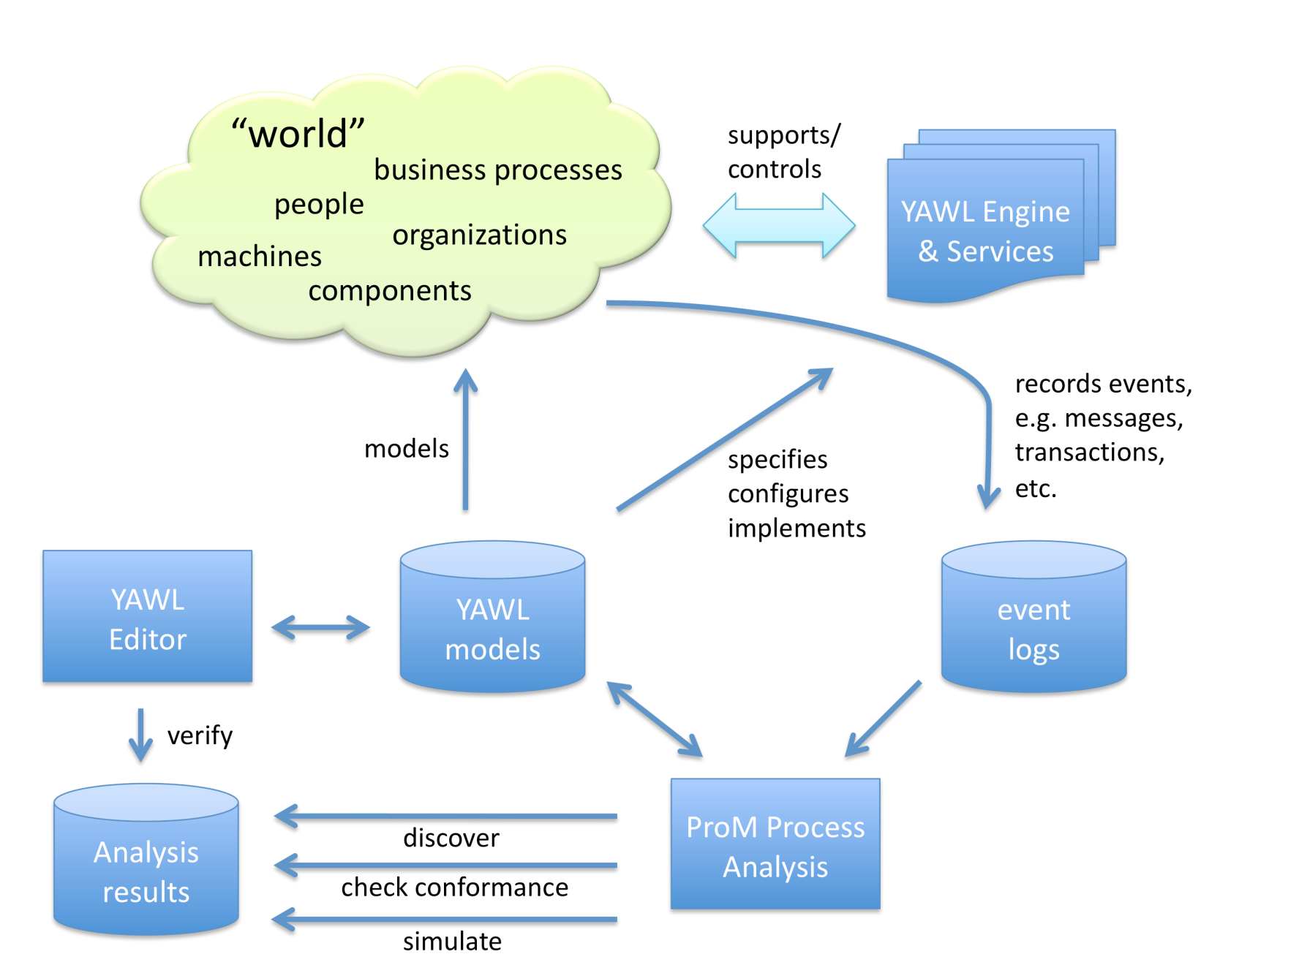
Overview of Analysis in the Context of YAWL

Slide 9
Next Steps
Developers of workflow technology
  Source of ideas
  Checklist for missing functionality
  How to deal with missing functionality
Software developers using workflow technology
  Easy to use to rapidly develop initial prototype (easy to install and use)
  Better understanding of BPM concepts
BPM researchers
  Experimentation platform for new ideas
Workflow consultants or analysts
  Overview of BPM state-of-the-art
  Concrete yet not too system-specific
  Basis for selection and evaluation of BPM technology
End users
  Easier to express requirements (assist with Business-IT gap)
  Easier to more rapidly develop first solution at low cost for feedback

