Slide 1

MP2 Unsupervised Single-Cell Analysis
Yaxin Tang
Yaxint2

Slide 2
Task 0 –Biology Primer
“This paper demonstrates an unsupervised learning approach to identify genes with significant differential expression across single-cell subpopulations induced by therapeutic treatment.”
- Arjun P. Athreya, Alan J. Gaglio,
Zbigniew T. Kalbarczyk, and Ravishankar K. Iyer
We have two group cells, one is baseline cells with no treatment with metformin, one is called metformin with treatment with metformin.
The goal is to identify a small group of differentially expressed genes across clusters.

Slide 3
1.1 Import both datasets into Pandas.
How many gene samples are present in each dataset? 1170 genes in each data set.
How many cells are present in each dataset? For baseline cell data, there are 169 cells in dataset. For metformin cell data, there are 177 cells in dataset.
How many genes are common in both datasets? There are 833 genes are common in both dataset.
Task 1 – Getting familiar with the dataset

Slide 4



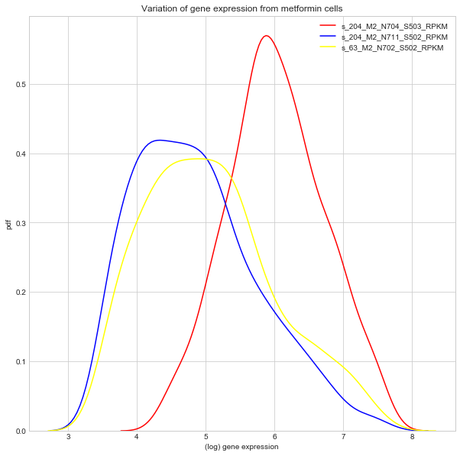
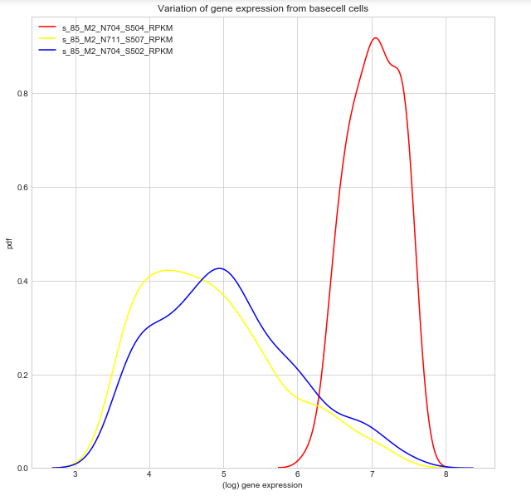

Task 1 – Getting familiar with the dataset
1.2. Plot the variation of gene expression across different genes for your assigned cells. You will have two plots - One for baseline cells and another for Metformin cells.
Clean data: we only choose the expression levels greater than 32 on the RPKM scale and exclude cells that has low sequencing coverage. So we limit RPKM values to (32, 2000) and plot in log scale.

Slide 5
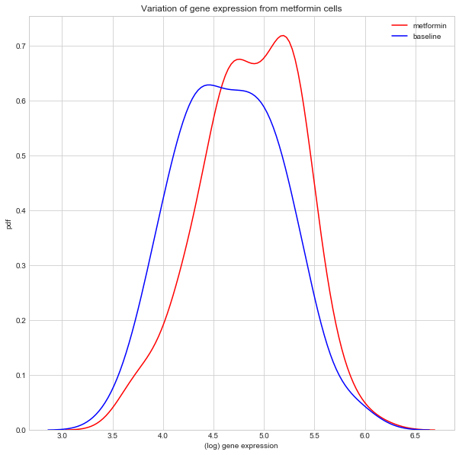
Task 1 – Getting familiar with the dataset
1.3 Plot the variation of gene expression across different cells for your assigned gene.
Clean data: we only choose the expression levels greater than 32 on the RPKM scale and exclude cells that has low sequencing coverage. So we limit RPKM values to (32, 2000) and plot in log scale. We also remove the column with ‘nan’

Slide 6
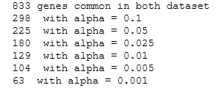
Task 1 – Getting familiar with the dataset
1.4 Perform the KS test on your Baseline and Metformin Variance distributions.
How many genes are differentially expressed at α=0.10,0.05,0.025,0.01,0.005

Slide 7
Task 2 - Clustering
We drop the first 5 columns of the original data set (e.g. GeneID, Coding Length) since we won’t need it. And then transpose to cells as row, and gene as column. Then apply GMM clustering algorithm to the data.
As requirement we use N =2 cluster for baseline cells and N=3 cluster for metformin cells.
Means in the ‘means_’ attribute is the mean parameters for each mixture component. So here it is the expected means of Gaussians for clusters.
Clusters for how many cells in each of the 5 clusters
Base cell : (0: 152), (1,17)
Metformin Cell: (0: 161),(1:11),(2:55)

Slide 8
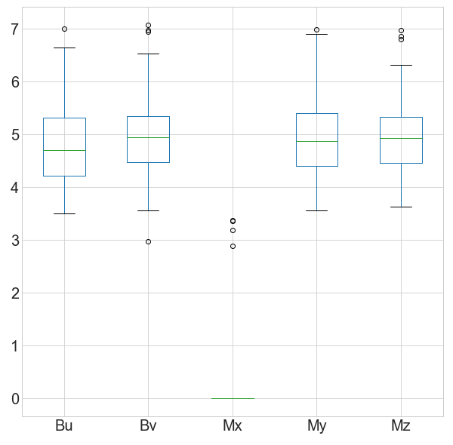
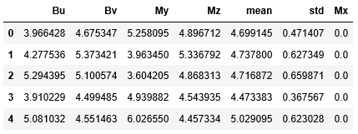

Task 2 - Clustering
I sort the clusters so that Bu always match the smaller size cluster.
Split the genes followed $\overline{Mx}<32<\overline{My}<\overline{Mz},\overline{Bu}<32<\overline{Bv}$, I for a new data frame by combining My, Mz, Bu and Bz, calculate the mean and std. Since Mx is 0.0, it will not give a correct mean if calculate it together. So we add Mx after I finish calculate the mean and std of other four data.
I use (log+1) apply to data, and (+1) to eliminate the consequence of log(0). So 1 stands for log(0)
Total 221 genes common in both dataset after split as above.

Slide 9
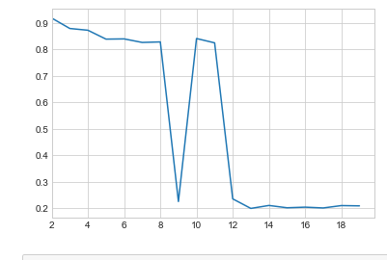
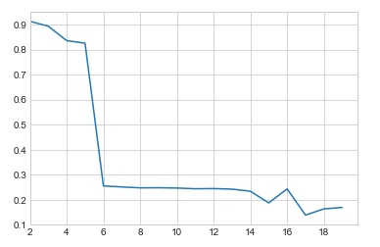
Task 2 - Clustering
2.14 Repeat previous 1-13 steps with k-means clustering in Step 3
We use silhouette analysis to find the best cluster numbers (the highest silhouette score)
Clearly we N=2
for both baseline
cells and metformin
Cells.

Slide 10

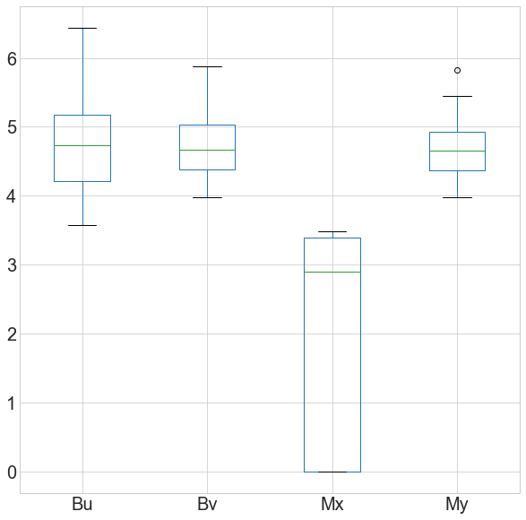
Baseline cell
Metformin cell
Task 2 - Clustering

Slide 11
Task 3 – Principal Component Analysis
Perform Principal Component Analysis on your datasets.
For task 3, I find the eigenvectors and eigenvalues of a covariance matrix from the transpose of the cells data set.
We reduce the dimension by choosing the “top 2” eigenvectors with the highest eigenvalues.

Slide 12
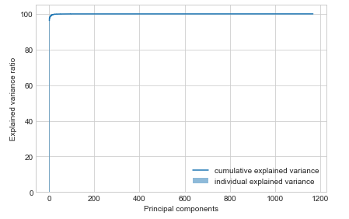
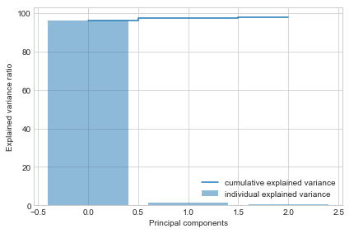
Task 3 – Principal Component Analysis
How many components did you use for your analysis?
2 components since 2 components covered about 98% of the data (Baseline Cell)

Slide 13
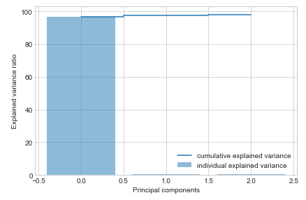
Task 3 – Principal Component Analysis
How many components did you use for your analysis?
2 components since 2 components covered about 98% of the data (Metformin Cell)

Slide 14
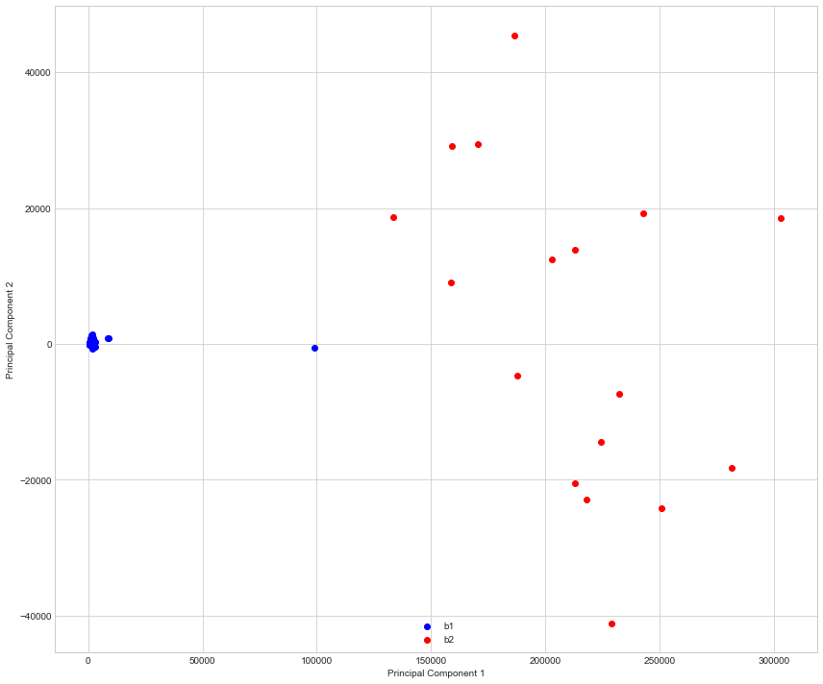
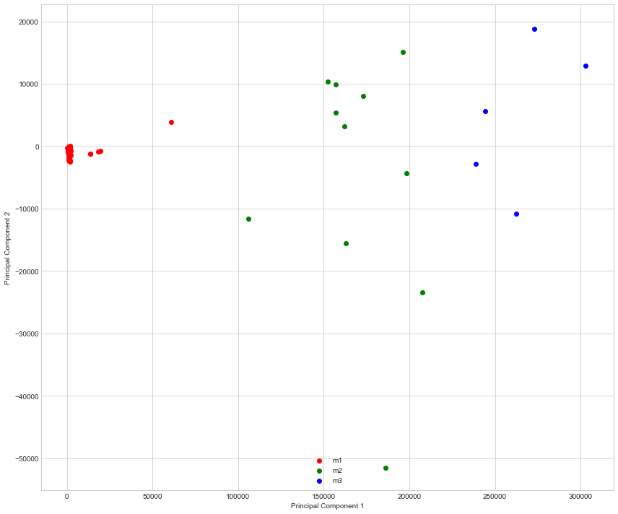
Task 3 – Principal Component Analysis
Projecting onto new feature space

Slide 15
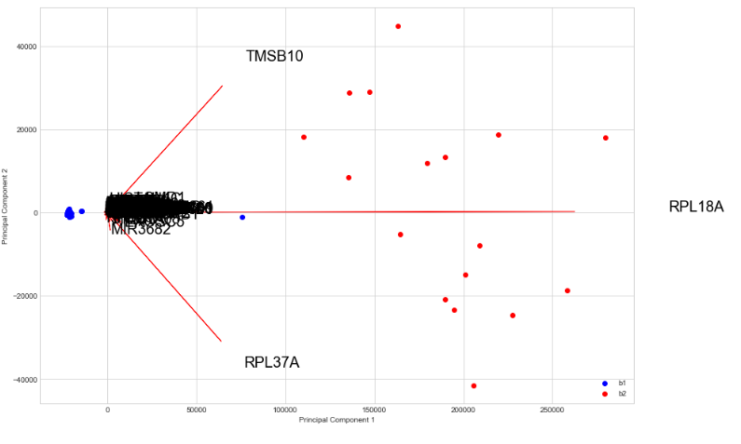
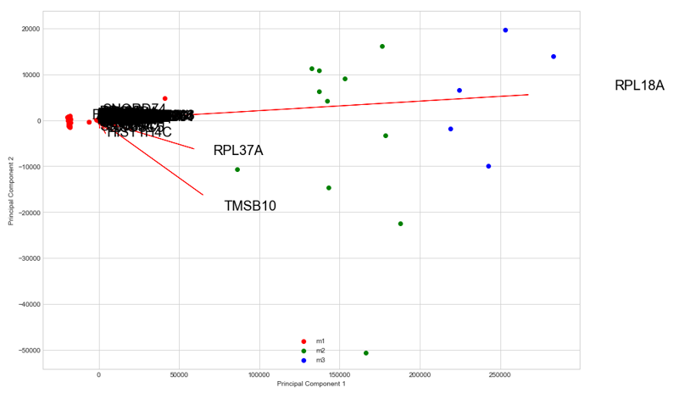
Task 3 – Principal Component Analysis
Projecting onto new feature space
I use genes ID instead of just values. We can clearly see that TMSB10, PRL18A and RPL37A have the longest line, they have the top three largest eigenvectors.

Slide 16
Thank you !

