Slide 1

Starting out with Visual Basic®
Seventh Edition
Chapter 4
Making Decisions
Copyright © 2017, 2014, 2011 Pearson Education, Inc. All Rights Reserved
Notes:
If this PowerPoint presentation contains mathematical equations, you may need to check that your computer has the following installed:
1) MathType Plugin
2) Math Player (free versions available)
3) NVDA Reader (free versions available)

Slide 2
Learning Objectives (1 of 2)
4.1 The Decision Structure
4.2 The If…Then Statement
4.3 The If…Then…Else Statement
4.4 The If…Then…ElseIf Statement
4.5 Nested If Statements
4.6 Logical Operators

Slide 3
Learning Objectives (2 of 2)
4.7 Comparing, Testing, and Working with Strings
4.8 The Select Case Statement
4.9 Introduction to Input Validation
4.10 Focus on G U I Design: Radio Buttons and Check Boxes
4.11 Focus on Program Design and Problem Solving: Building the Health Club Membership Fee Calculator Application

Slide 4
4.1 The Decision Structure

Slide 5
Order of Statement Execution
Thus far, our code has been executed sequentially in a sequence structure
To write meaningful programs we need multiple paths of execution
Some statements should be executed under certain circumstances in a decision structure
This chapter presents the means to execute statements conditionally
Next chapter presents the means to execute the same statements repeatedly

Slide 6
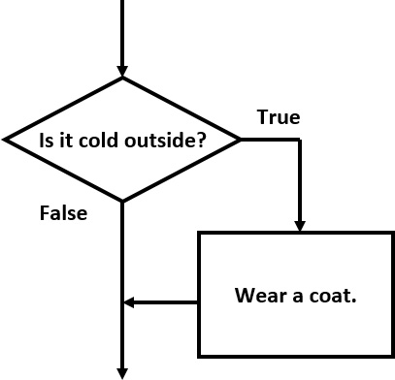
The Decision Structure
Flowchart of a typical decision structure
Evaluate the condition
Is it cold outside?
Execute or skip over some code
If yes, wear a coat

Slide 7
4.2 The If…Then Statement

Slide 8
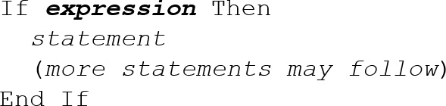
General Format (1 of 4)
If the expression is True, execute the statements between If…Then and End If
Otherwise, the statements are skipped

Slide 9
Relational Operators
Usually a condition is formed using a relational operator
A relational operator determines if a specific relationship exists between two values
> | Greater than
< | Less than
= | Equal to
<> | Not equal to
>= | Greater than or equal to
<= | Less than or equal to

Slide 10
Boolean Expressions
Relational operators are binary – meaning they use two operands, for example:
length > width | Is length greater than width?
size less than or equal to 10 | Is size less than or equal 10?
Relational operators are used in Boolean expressions which yield a True or False result

Slide 11
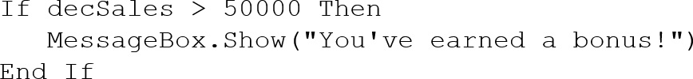
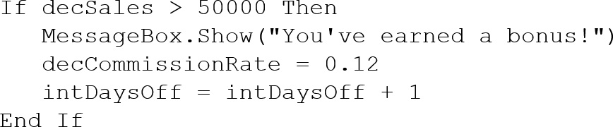
Putting It All Together
If…Then statement examples:

Slide 12
Rules to Remember
The If and the Then must be on the same line
Only a comment may follow the Then
The End If must be on a separate line
Only a comment may follow the End If
Tutorial 4-1 presents an application that uses the If…Then statement

Slide 13
Programming Style
The code between the If…Then and the End If is indented
Visual Basic does not require this.
It is a convention among programmers to aid in the readability of programs.
By default, the Visual Basic editor will automatically do this indentation as you enter your program.

Slide 14
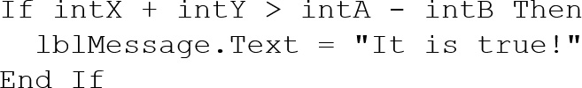
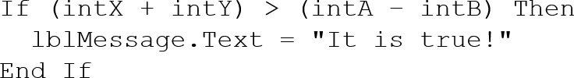
Using Relational Operators with Math Operators
Math operators are evaluated before relational operators
i n t X + i n t Y and i n t A − i n t B are evaluated first
Most programmers prefer to use parentheses to clarify the order of operations

Slide 15
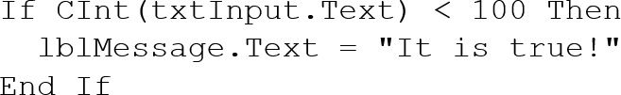
Using Function Calls with Relational Operators
Either or both relational operator operands may be function calls
The return value of the function call is compared to the value using the relational operator

Slide 16
Using Boolean Variables as Flags
A flag is a Boolean variable that signals when some condition exists in the program
Since a Boolean variable is either True or False, it can be used as the condition of an If…Then statement
Since a Boolean variable already evaluates to True or False, an = operator is not required

Slide 17
4.3 The If…Then…Else Statement

Slide 18
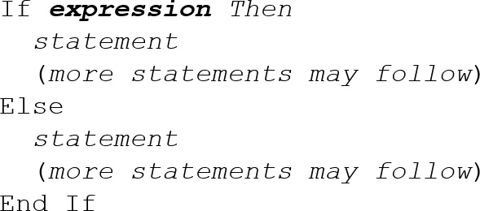
General Format (2 of 4)
If the expression is True
Execute the statements between If…Then and Else
If the expression is False
Execute the statements between Else and End If

Slide 19
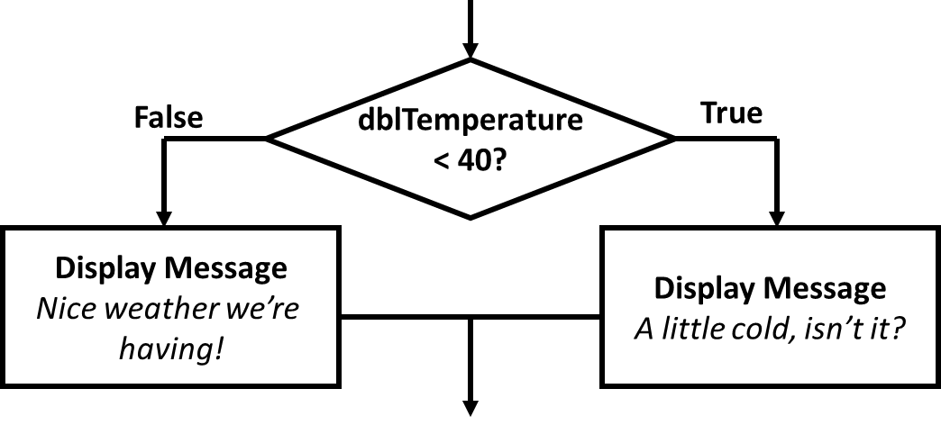
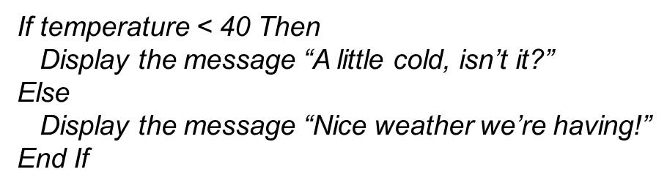
Flowchart and Pseudocode

Slide 20
Two Mutually Exclusive Choices
The If…Then…Else has two choices
The condition will either be True or False
So either the Then clause or Else clause will be executed
These are two mutually exclusive choices
Tutorial 4-2 contains an example of the If…Then…Else construct

Slide 21
4.4 The If…Then…ElseIf Statement

Slide 22
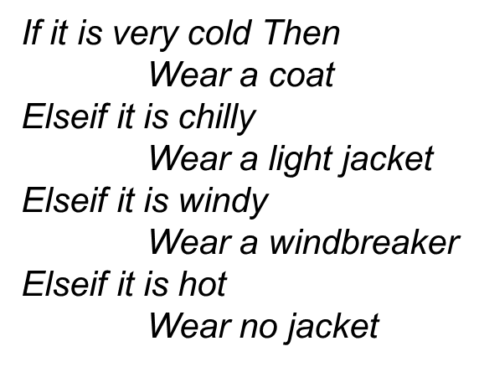
Multiple Possible Choices (1 of 2)
The If…Then…ElseIf statement allows for an entire series of possible choices
In pseudocode:

Slide 23
Multiple Possible Choices (2 of 2)
Each of the series of conditions in an If…Then…ElseIf is tested in sequence
When a condition is True, the remaining conditions are ignored
The order of the conditions is vital
Wrong order can result in wrong decision - called a logic error
What if it’s chilly and windy?
If windy is tested before chilly, you’d go out with a windbreaker when you need a jacket

Slide 24
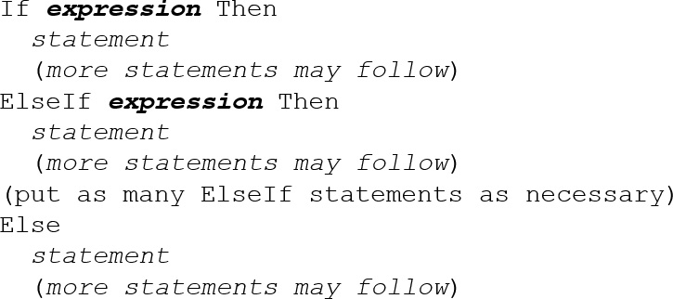
General Format (3 of 4)
This construction is like a chain of If...Then...Else statements
The Else part of one statement is linked to the If part of another

Slide 25
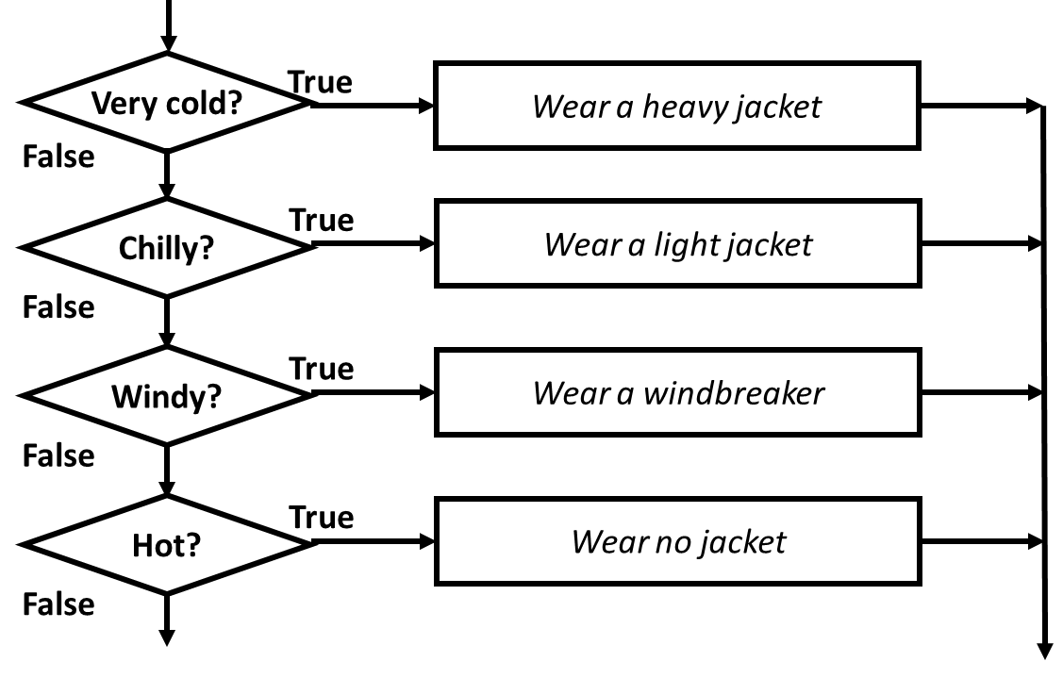
Flowchart

Slide 26
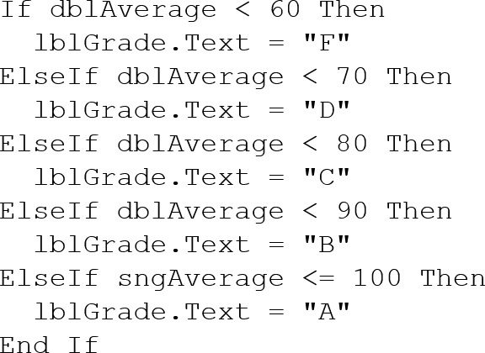
Example of ElseIf Usage
Does the order of these conditions matter?
What happens if we reverse the order?

Slide 27
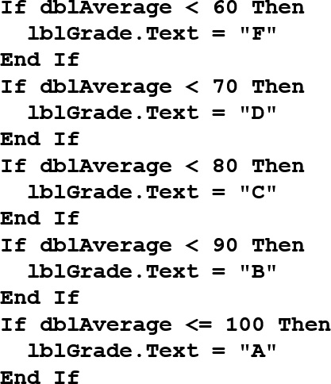
Using Only If…Then Statements
Does this code function correctly?
What is assigned to l b l Grade for a 65 average? 75?

Slide 28
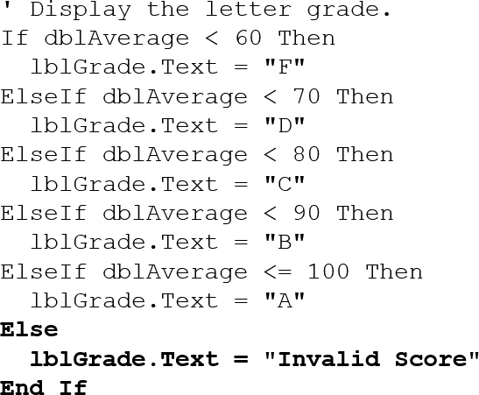
Using a Trailing Else
A sequence of ElseIf statements may end with a plain Else, called a trailing Else
If none of the conditions are True, the trailing Else statement(s) will be executed
The trailing Else catches any value that falls through the cracks

Slide 29
4.5 Nested If Statements

Slide 30
If Statements Within If Statements
Any type of statement may be used inside a set of Then, Else, or ElseIf statements of an If
This includes other If statements
If statements within If statements create a more complex decision structure called a Nested If

Slide 31
Nested If Example
Tutorial 4-4 examines an application that uses nested If Statements
In the application, the customer must meet one of the following qualifications:
Earn $30,000 per year or more and have worked in his or her current job for more than two years.
Have worked at his or her current job for more than five years.

Slide 32
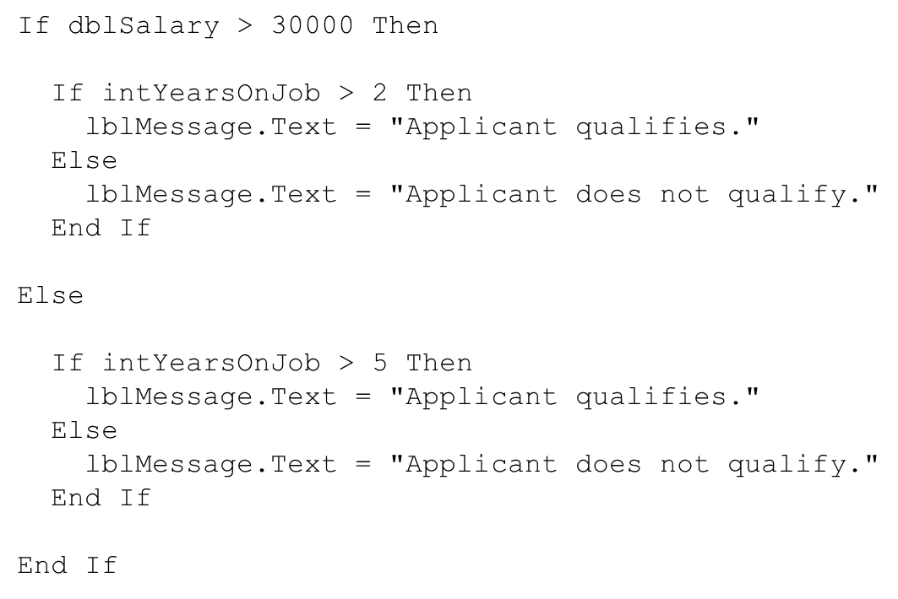
Examining the Nested If Statement

Slide 33
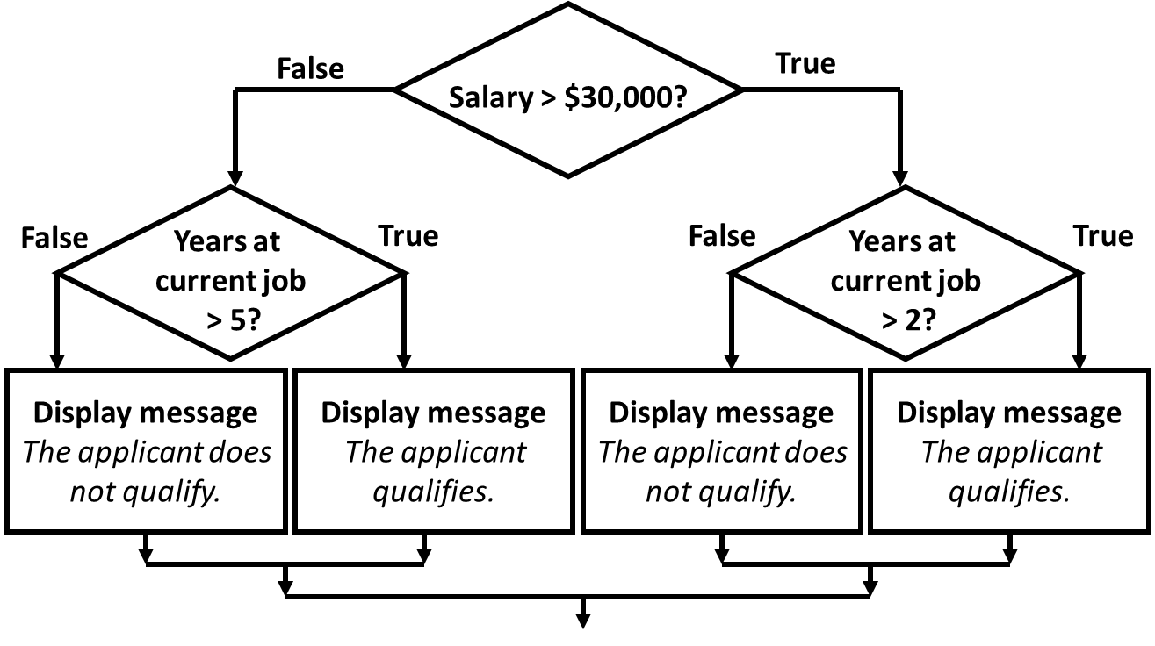
Flowchart of Nested If Statements

Slide 34
4.6 Logical Operators

Slide 35
Visual Basic Logical Operators
Visual Basic provides Logical operators that can combine multiple Boolean expressions into a compound expression
Operator | Effect
And | Combines two expressions into one. Both expressions must be true for the overall expression to be true.
Or | Combines two expressions into one. One or both expressions must be true for the overall expression to be true. It is only necessary for one to be true, and it does not matter which.
X or | Combines two expressions into one. One expression (not both) must be true for the overall expression to be true. If both expressions are true, or both expressions are false, the overall expression is false.
Not | Reverses the logical value of an expression: makes a true expression false and a false expression true.

Slide 36
The And Operator
The And operator combines two expressions into one
The following If statement uses the And operator:
Both expressions must be true for the overall expression to be true, as shown in the following truth table:
Expression 1 | Expression 2 | Expression 1 And Expression 2
True | False | False
False | True | False
False | False | False
True | True | True

Slide 37
Short-Circuit Evaluation with AndAlso (1 of 2)
When using the And operator, if the first expression is false, then the entire expression will be false
If there is no need to evaluate the second expression, it can be skipped using a method called short-circuit evaluation
In Visual Basic you use the AndAlso operator to achieve short-circuit evaluation

Slide 38
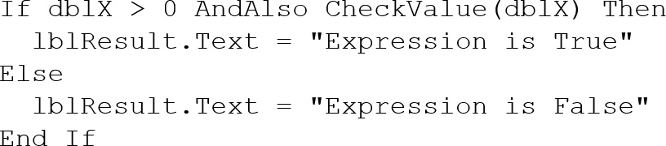
Short-Circuit Evaluation with AndAlso (2 of 2)
In the following example, assuming that d b l X is less than or equal to zero, CheckValue is not called and “Expression is False” is displayed:

Slide 39
The Or Operator
The Or operator combines two expressions into one
The following If statement uses the Or operator:
One or both expressions must be true for the overall expression to be true, as shown in the following truth table:
Expression 1 | Expression 2 | Expression 1 Or Expression 2
True | False | True
False | True | True
False | False | False
True | True | True

Slide 40
Short Circuit-Evaluation with OrElse (1 of 2)
When using the Or operator, if the first expression is true, then the entire expression will be true
If there is no need to evaluate the second expression, it can be skipped using short-circuit evaluation with the OrElse operator

Slide 41
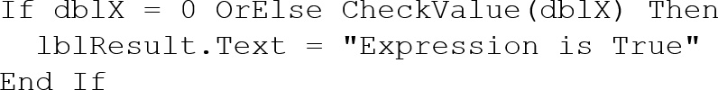
Short Circuit-Evaluation with OrElse (2 of 2)
In the following example, if d b l X is equal to zero, CheckValue is not called and “Expression is True” is displayed:

Slide 42

The X or Operator
The X or operator combines two expressions into one
X or stands for exclusive or
The following If statement uses the X or operator:
One but not both expressions must be true for the overall expression to be true, as shown in the following truth table:
Expression 1 | Expression 2 | Expression 1 X or Expression 2
True | False | True
False | True | True
False | False | False
True | True | False

Slide 43
The Not Operator
The Not operator takes a Boolean expression and reverses its logical value
The following If statement uses the Not operator:
If the expression is true, the Not operator returns False, and if the expression is false, it returns True, as shown in the following truth table:
Expression | Not Expression
True | False
False | True

Slide 44
Checking Numerical Ranges
The And operator is best for checking if a value is inside a range of numbers
The Or operator is best for checking if a value is outside a range of numbers

Slide 45
Precedence of Logical Operators (1 of 2)
Logical operators have an order of precedence just as arithmetic operators do
From highest to lowest precedence
Not
And
Or
X or
As with arithmetic operations, parentheses are often used to clarify order of operations

Slide 46
Precedence of Logical Operators (2 of 2)
For example, in the statement
x < 0 And y > 100 is evaluated first
If the And condition is true, we then evaluate
True Or z = 50
If the And condition is false, we then evaluate
False Or z = 50
If the Or condition is to be evaluated first, parentheses must be used

Slide 47
Math, Relational, & Logical Operators
Evaluate the following if: a=5, b=7, x=100, y=30
Evaluating the math operators leaves us with
Evaluating the relational operators leaves
If True And False
Evaluating the logical operators leaves
False
Parentheses make order of operations clear

Slide 48
4.7 Comparing, Testing, and Working with Strings

Slide 49
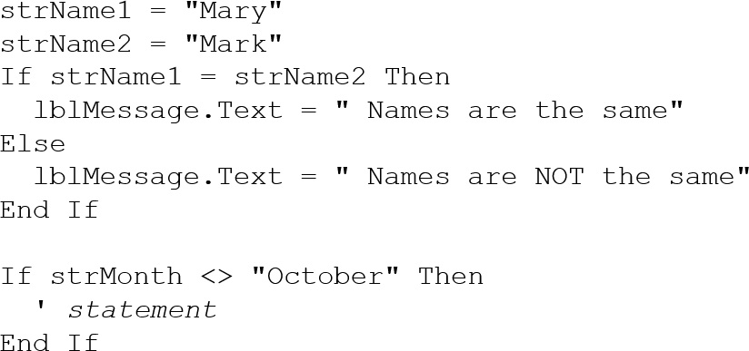
Strings Can Be Compared
Relational operators can be used to compare strings and string literals

Slide 50
How Are Strings Compared? (1 of 2)
Characters are stored as numeric values
Visual Basic uses Unicode
The Unicode numbering system represents:
All letters of the alphabet
Printable digits 0 through 9
Punctuation symbols and special characters
Letters (A,B,C) are arranged alphabetically
The numeric value of A is less than the numeric value of B

Slide 51
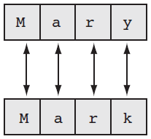
How Are Strings Compared? (2 of 2)
Characters of each string are compared one by one until a difference is found
Mary is greater than Mark because “y” has a Unicode value greater than “k”

Slide 52
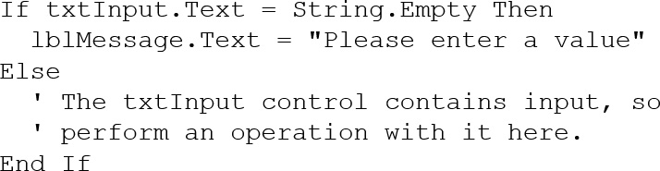
Testing for No Input
The predefined constant String.Empty represents an empty string, which is a string that contains no characters
Useful for determining whether the user has provided input for a required field before performing operations on that field

Slide 53
The ToUpper and ToLower Methods (1 of 2)
The ToUpper method can be applied to a string
Results in a string with lowercase letters converted to uppercase
The original string is not changed
General Format:
In the following example, s t r BigWord is assigned the string “HELLO” using the ToUpper method:

Slide 54
The ToUpper and ToLower Methods (2 of 2)
The ToLower method can be applied to a string
Results in a string with uppercase letters converted to lowercase
The original string is not changed
General Format:
In the following example, s t r LittleTown is assigned the string “new york” using the ToLower method:

Slide 55
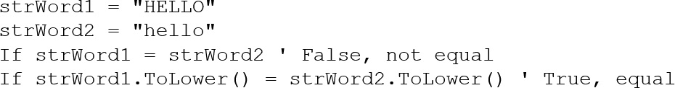
A Handy Use for ToUpper or ToLower
ToUpper or ToLower can be used to perform case insensitive comparisons of strings
1st comparison below is false
2nd comparison is true
ToLower converts both strings to lower case
Causes “hello” to be compared to “hello”
Tutorial 4-5 demonstrates how this is used

Slide 56
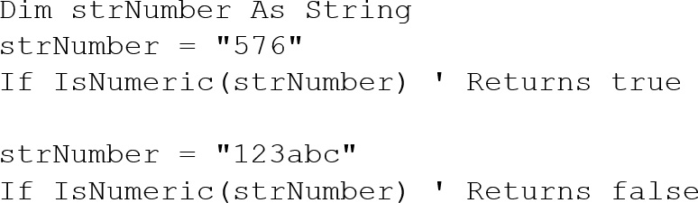
The Is Numeric Function
This function accepts a string as an argument and returns True if the string contains a number
Use Is Numeric function to determine if a given string contains numeric data

Slide 57

Determining the Length of a String
The Length property, a member of the String class, returns the number of characters in a string
In the following example, the i n t N u m C h a r s variable contains the value 6:
You can also determine the length of a control’s Text property, as shown in the following code:

Slide 58

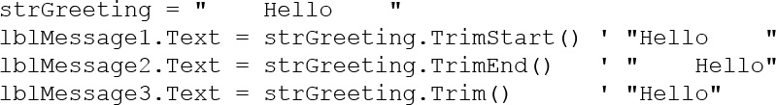
Optional Topic: Trimming Spaces from Strings
There are three methods that remove spaces from strings:
TrimStart - removes leading spaces
TrimEnd - removes trailing spaces
Trim - removes leading and trailing spaces
Here is the general format for each method:
An example with three leading and trailing spaces, using each method:

Slide 59
The Substring Method
The Substring method returns a portion of a string or a “string within a string” (a substring)
Each character position is numbered sequentially with the 1st character referred to as position zero
Returns the characters from the Start position to the end of the string
Returns the number of characters specified by Length beginning with the Start position

Slide 60


Substring Method Examples
The first example starts at the 8th (W) character in the string and continues to the end of the string:
The second example starts at the beginning (G) of the string and continues until it reaches the 7th (empty space) character of the string

Slide 61
Optional Topic: The IndexOf Method
The IndexOf method searches for a character or string within a string, it has three general formats:
Searches the entire string for SearchString
Starts at the character position Start and searches for SearchString from that point
Starts at the character position Start and searches Count characters for SearchString

Slide 62
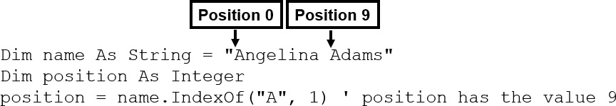
IndexOf Method Examples
The IndexOf method will return the starting position of the SearchString in the string being searched
Positions are numbered starting at 0 (for the first)
If SearchString is not found, a value of −1 is returned
Tutorial 4-6 provides an opportunity to work with several of the string methods

Slide 63
4.8 The Select Case Statement

Slide 64
The Select Case Statement
Similar to If…Then…ElseIf
Performs a series of tests
Conditionally executes the first true condition
Select Case is different in that:
A single test expression may be evaluated
The test expression is listed once
The possible values of the expression are then listed with their conditional statements
Case Else may be included and executed if none of the values match the expression

Slide 65
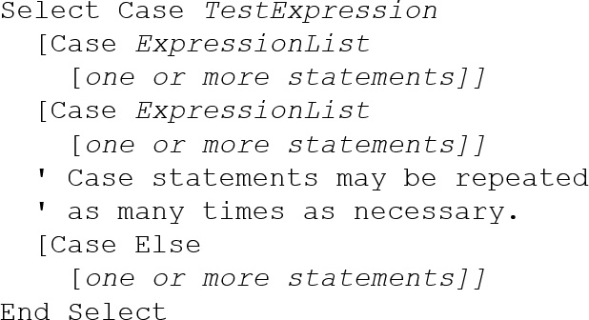
Select Case General Format

Slide 66
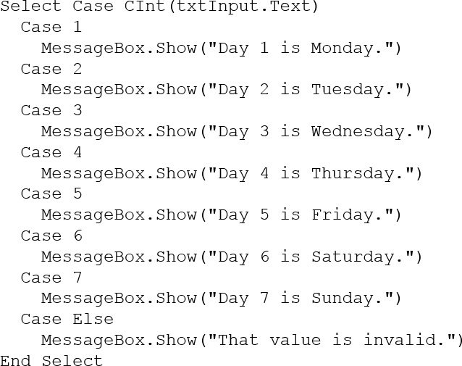
Select Case Statement Example

Slide 67
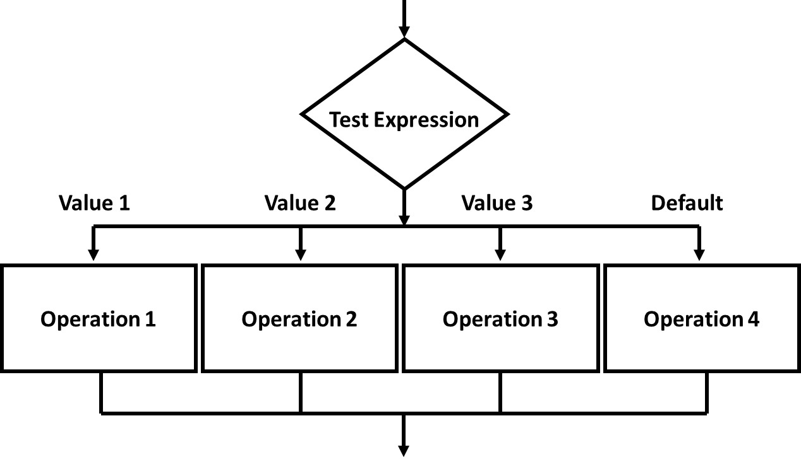
Select Case Flowchart Example

Slide 68
Select Case Pseudocode Example (1 of 2)
Select Case Input
Case 1
Display Message “Day 1 is Monday.”
Case 2
Display Message “Day 2 is Tuesday.”
Case 3
Display Message “Day 3 is Wednesday.”
Case 4
Display Message “Day 4 is Thursday.”
Case 5
Display Message “Day 5 is Friday.”

Slide 69
Select Case Pseudocode Example (2 of 2)
Case 6
Display Message “Day 6 is Saturday.”
Case 7
Display Message “Day 7 is Sunday.”
Case Else
Display Message “That value is invalid.”
End Select

Slide 70
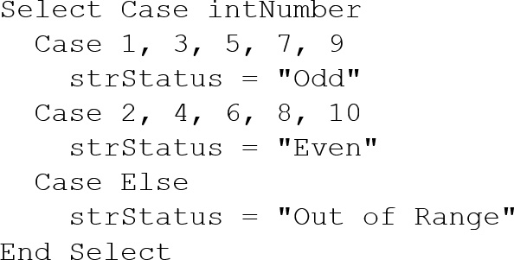
More About the Expression List: Multiple Expressions
The Case statement’s expression list can contain multiple expressions, separated by commas

Slide 71
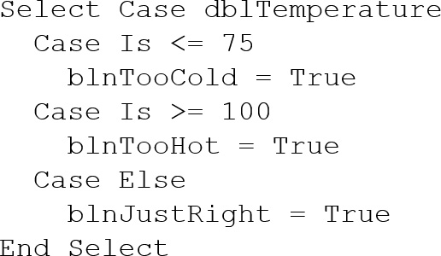
More About the Expression List: Relational Operators
You can use relational operators in the Case statement
The Is keyword represents the test expression in the relational comparison

Slide 72
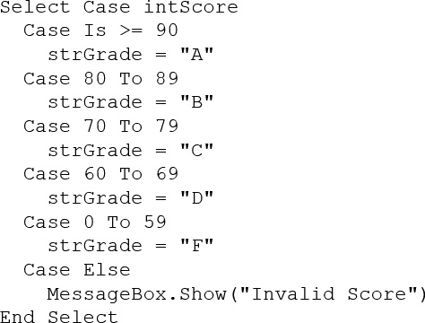
More About the Expression List: Ranges of Values
You can determine whether the test expression falls within a range of values
Requires the To keyword
Smaller number on the left
Larger number on the right
Numbers on each side are included in the range

Slide 73
4.9 Introduction to Input Validation

Slide 74
Validation Example
Output is only as good as the input
“Garbage in, garbage out”
Input validation is the process of inspecting user input to see that it meets certain rules
The TryParse method verifies that an input value is in a valid numeric or date format
Decision structures are often used to validate input

Slide 75
The TryParse Method
Converts an input value to another format
Verifies that input of integers, decimals, dates, etc., are entered in an acceptable format
Returns Boolean value indicating True if conversion successful
Returns False if unsuccessful
Each numeric variable type has a TryParse method
Date & Boolean types include the TryParse method as well

Slide 76
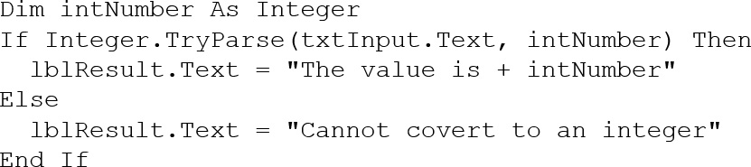
Verify Integer Entry with TryParse
Use Integer.TryParse method to convert value
t x t Input.Text contains numeric string to convert
I n t Number receives converted value
TryParse returns True if input is an integer
TryParse returns False if input is not an integer

Slide 77
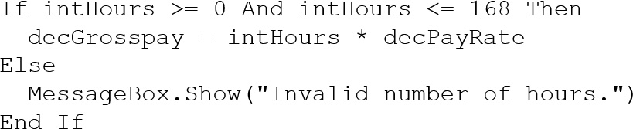

Checking Numeric Ranges
Sometimes you need to check numeric input values to make sure they fall within a range

Slide 78
4.10 Focus on G U I Design: Radio Buttons and Check Boxes

Slide 79
Radio Buttons
Used when only one of several possible options may be selected at one time
Car radio buttons select one station at a time
May be placed in a group box
Group box defines a set of radio buttons
Can select only one button within a group box
Those on a form but not inside a group box are considered members of the same group
Radio buttons have a Boolean Checked property and a CheckChanged event

Slide 80
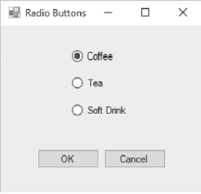
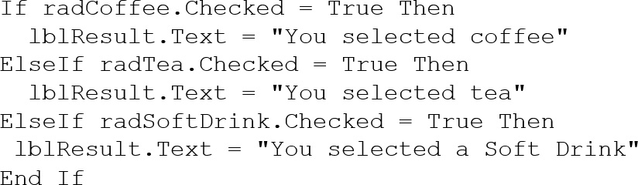
Checking Radio Buttons in Code

Slide 81
Check Boxes
Unlike radio buttons, can select many check boxes at one time
May also be placed in a group box
Not limited to one selection within a group box
Can select as many check boxes as you like within the same group box
Check boxes also have a Boolean Checked property and a CheckChanged event
Tutorial 4-9 provides radio button and check box examples

Slide 82
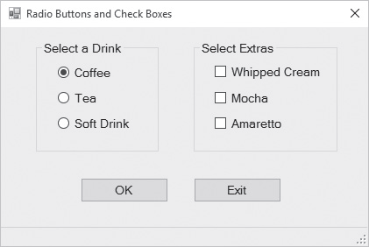
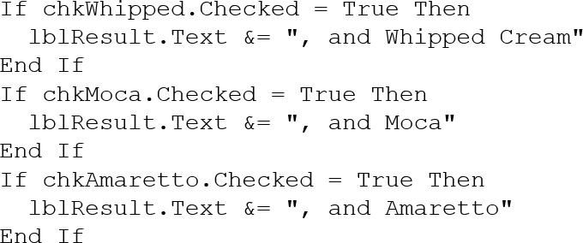
Checking Check Boxes in Code

Slide 83
4.11 Focus on Program Design and Problem Solving: Building the Health Club Membership Fee Calculator Application

Slide 84
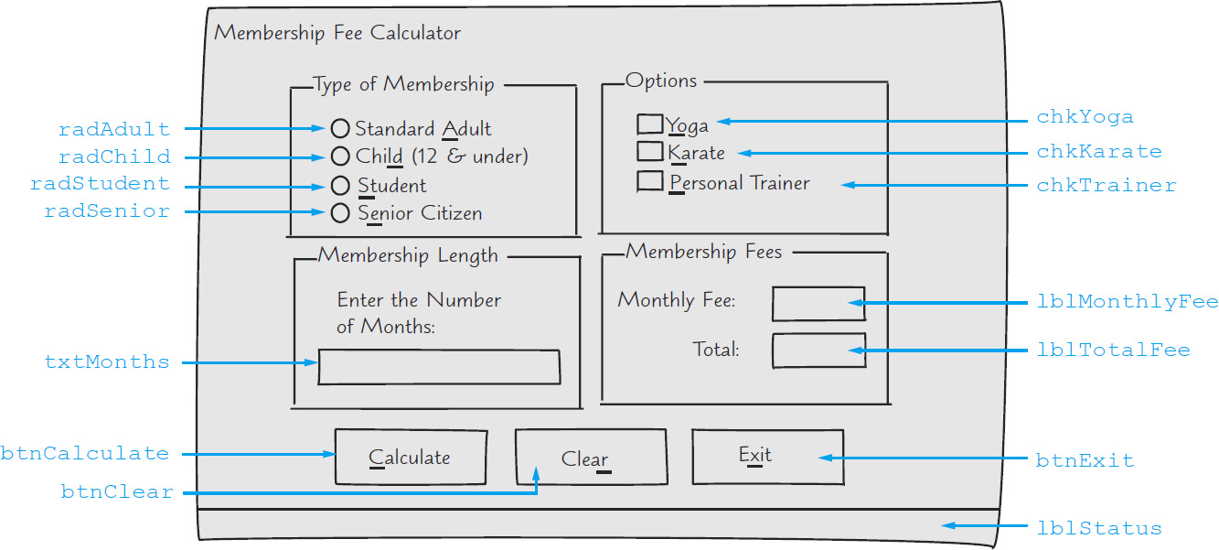
Health Club Membership Fee Calculator Form

Slide 85
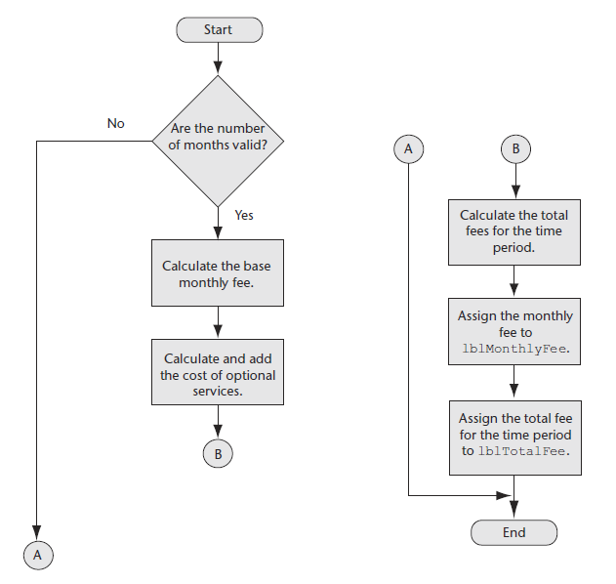
Flowchart for b t n Calculate_Click

Slide 86
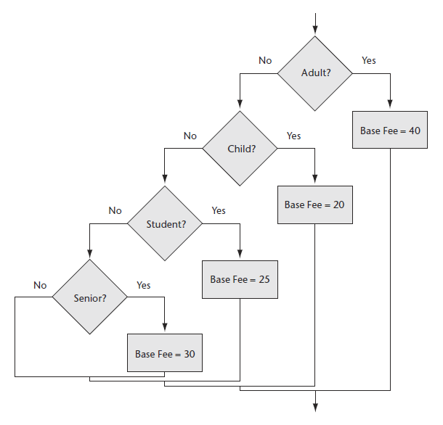
Base Monthly Fee Calculation Flowchart

Slide 87
Base Monthly Fee Calculation Pseudocode
If Member is an Adult Then
Monthly Base Fee = 40
ElseIf Member is a Child Then
Monthly Base Fee = 20
ElseIf Member is a Student Then
Monthly Base Fee = 25
ElseIf Member is a Senior Citizen Then
Monthly Base Fee = 30
End If

Slide 88
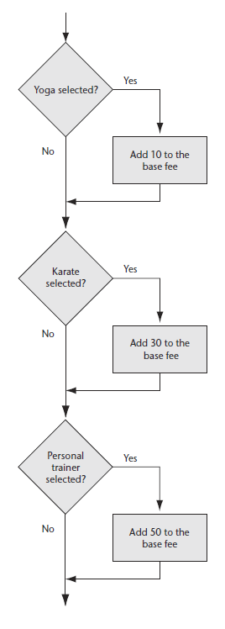
Calculate Optional Services Flowchart & Pseudocode
If Yoga is selected Then
Add 10 to the monthly base fee
End If
If Karate is selected Then
Add 30 to the monthly base fee
End If
If Personal Trainer is selected Then
Add 50 to the monthly base fee
End If

Slide 89
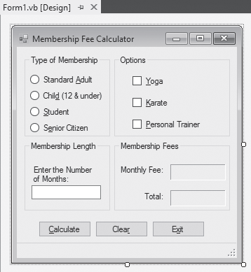
The Completed Membership Fee Calculator Form

Slide 90
Test Data for the Membership Fee Calculator
Type of Membership | Monthly Fee | Total
Standard adult with yoga, karate, and personal trainer for 6 months | $130.00 | $780.00
Child with karate for 3 months | $50.00 | $150.00
Student with yoga for 12 months | $35.00 | $420.00
Senior citizen with karate and personal trainer for 8 months | $110.00 | $880.00

Slide 91

Copyright

